Slide 1
Data Sharing Agreement
Focus now on CA Datasets only
Group consensus sought on a couple of key issues

Slide 2
Basics of agreement
Applies only to CA datasets posted on StreamNet and/or the proposed EPA node
Basic data sharing guidelines apply to all contributors and users
Two basic access levels;
    Level One; generally free access similar to StreamNet now
    Level Two; Access to specific data fields in DES restricted

Slide 3
Level one, consensus to choose either;
Free access without acknowledgement or sign in
Access requires either acknowledgement or sign in with password

Slide 4
Level Two; consensus needed on which (if any) data fields in each des need restriction
Request by some contributors to restrict data
Technically difficult or impossible to restrict some contributors data in a shared database
Propose going over DES data fields to develop consensus on specifically which data fields to be restricted (if any)
If restricted, need to decide; acknowledgement only, or password and ID?

Slide 5
If certain data fields are to be restricted at level two
Each agency or tribe will need to provide their own Data Sharing Agreement language.
The aggregated agreements would be combined into a “EULA” that users would have to agree to in order to access data
By accepting, the requester would acknowledge that they understand and agree to the terms and conditions specified by all of the data contributors.
Failure to acknowledge acceptance by clicking an “accept” or “agree” acknowledgement would cause the data to remain inaccessible. At that point the potential data user would be directed to a list of contacts for further discussion.
Notes:
EULA = end users license agreement

Slide 6
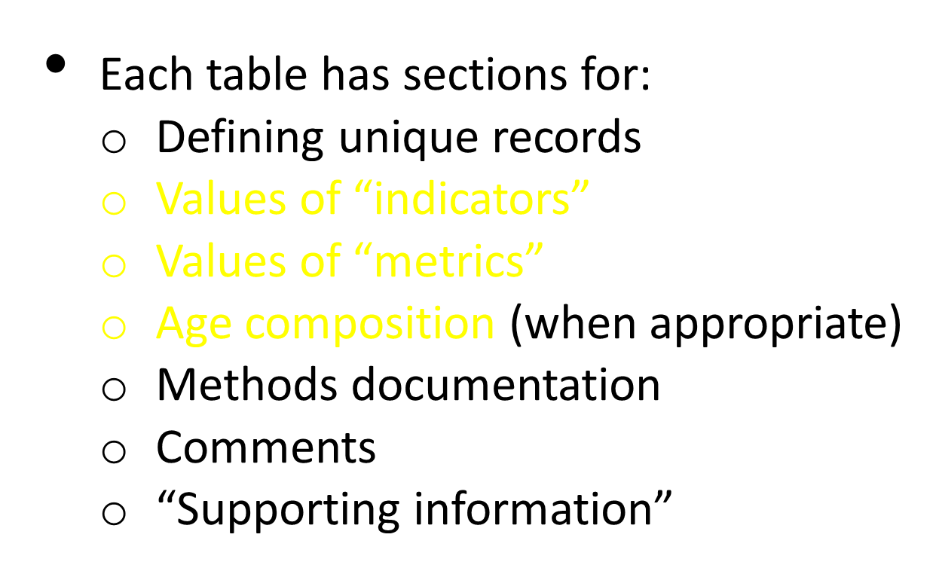
General layout of tables

Slide 7
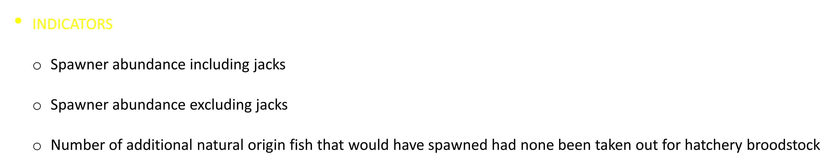
NOSA table

Slide 8
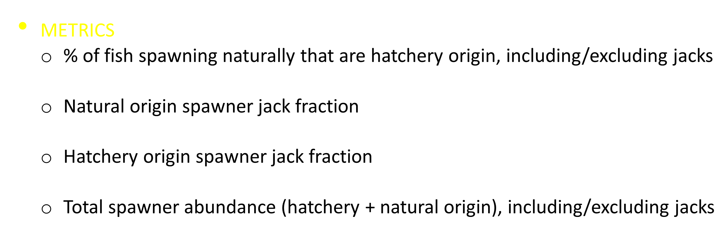
NOSA table

Slide 9
NOSA table
AGE COMPOSITION
  For natural origin fish only

Slide 10
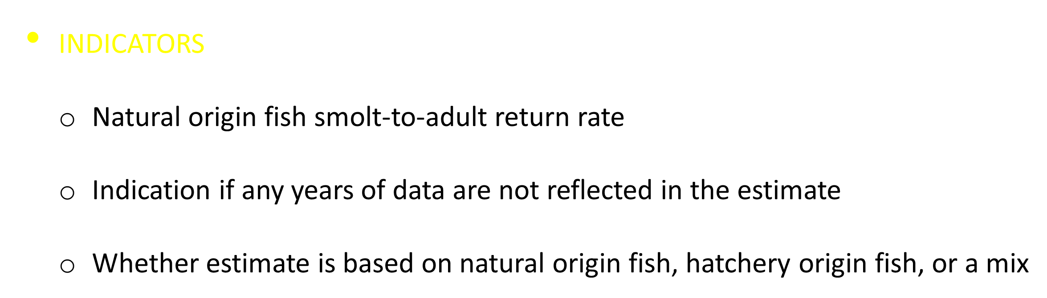
SAR table

Slide 11
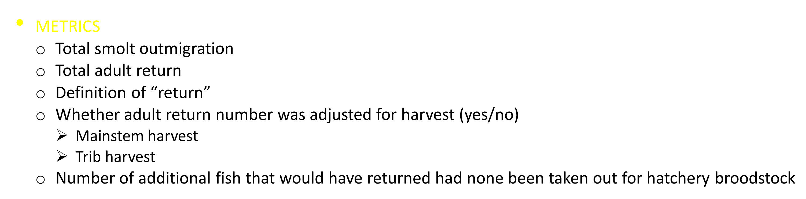
SAR table

Slide 12
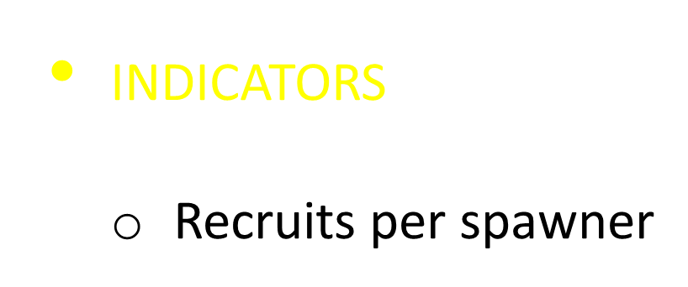
RperS table

Slide 13
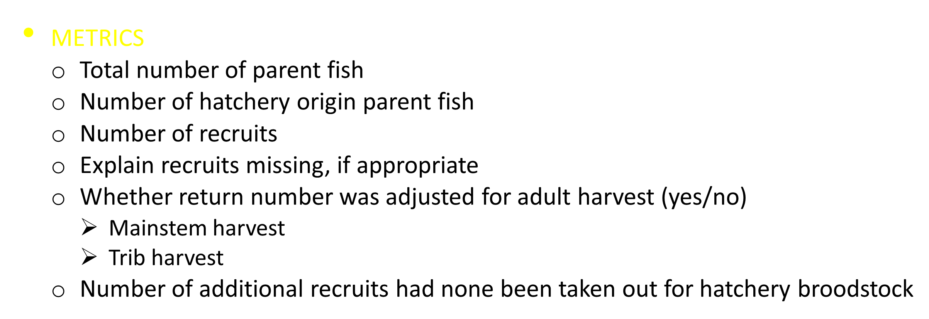
RperS table

Slide 14
RperS table
AGE COMPOSITION
  For juvenile recruits
    YOY
    Age 1, 2, 3, 4+
  For adult recruits
    Age 2 - 10, 11+

Slide 15
 | Input to DSA form (to be filled out by data contributor/creator/provider) | Output – what data requester sees on the website, or when clicks ‘Download’
Level 1: Open Access or Basic DSA with user acknowledgement | Anyone may download. No stipulations for required interaction with consumers are necessary. See StreamNet Data Use Policy | See StreamNet Data Use Policy. Users are free to use the data without consent of the data owner or Data users acknowledge policy and basic data sharing agreement by “clicking” before access
Level 2: Restricted DSA with user acknowledgement | Customized DSAs, with language provided in a file by the data contributor, is linked to access to specified data fields in each DES. Any contractual requirements imposed are the responsibility of the contributor to include in the DSA. If this option is chosen, data users would have to acknowledge agreement before accessing data. | Upon a request for access to certain restricted data fields in each DES, the data sharing agreement text for all agencies and tribes would be shown to the data user and would require agreement by the user before proceeding. If this option is chosen, and agreement was not forthcoming, the user would be directed to a list of contacts, and access to the data through the repository would be denied.

Slide 16
Caveats
Disclaimer for any liabilities;
No enforcement responsibility;
Enforceability issues in general;
Requirements imposed for data sharing by an agency or funding entity would be a contractual matter;
Other?

Slide 17
Next Steps
Conceptual Agreement?
Open access or acknowledgement for Level 1?
Proposed DES fields to be restricted?
Process to identify and decide
Agency/Tribe specific data access language

