Slide 1

State and Tribal Recommended Data Repositories
Notes:
Half-circle picture with accent arcs
(Basic)
To reproduce the shape effects on this slide, do the following:
On the Home tab, in the Slides group, click Layout, and then click Blank.
On the Home tab, in the Drawing group, click Shapes, and then under Basic Shapes, click Arc (third row, 12th option from the left). On the slide, drag to draw an arc.
Select the arc. Under Drawing Tools, on the Format tab, in the Size group, do the following:
In the Shape Height box, enter 7.5”.
In the Shape Width box, enter 7.5”.
Drag the right yellow diamond adjustment handle to the bottom of the slide to create a half-circle.
Under Drawing Tools, on the Format tab, in the bottom right corner of the Shape Styles group, click the Format Shape dialog box launcher. In the Format Shape dialog box, click Fill in the left pane. In the Fill pane, select Picture or texture fill, and then under Insert from, click File.
In the Insert Picture dialog box, select a picture, and then click Insert.
Also in the Format Shape dialog box, in the Fill pane, under Insert from, select Tile picture as texture.
Also in the Format Shape dialog box, click Line Color in the left pane, and then select No line in the Line Color pane.
Also in the Format Shape dialog box, click Shadow in the left pane, and then do the following in the Shadow pane:
Click the button next to Presets, and then under Inner click Inside Diagonal Top Right (first row, third option from the left).
In the Transparency box, enter 70%.
In the Blur box, enter 20 pt.
In the Distance box, enter 20 pt.
Drag the half-circle to the left until the two middle yellow adjustment diamonds are lined up with the left edge of the slide. On the Home tab, in the Drawing group, click Arrange, point to Align, and then do the following:
Click Align to Slide.
Click Align Middle.
Select the arc. On the Home tab, in the Clipboard group, click the arrow under Copy, and then click Duplicate.
Select the second arc. Under Drawing Tools, on the Format tab, in the Size group, do the following:
In the Shape Height box, enter 6.79”.
In the Shape Width box, enter 10.03”.
On the Home tab, in the bottom right corner of the Drawing group, click the Format Shape dialog box launcher. In the Format Picture dialog box, click Fill in the left pane, and then in the Fill pane, select No fill.
Also in the Format Shape dialog box, click Line Color in the left pane. In the Line Color pane, select Solid line and then do the following:
Click the button next to Color, and then under Theme Colors click White, Background 1 (first row, first option from the left).
In the Transparency box, enter 50%.
Also in the Format Shape dialog box, click Line Style in the left pane. In the Line Style pane, in the Width box, enter 1.5 pt.
Drag the second arc left on the slide until the two middle yellow adjustment diamonds are lined up with the left edge of the slide. On the Home tab, in the Drawing group, click Arrange, point to Align, and then do the following:
Click Align to Slide.
Click Align Middle.
Select the second arc. On the Home tab, in the Clipboard group, click the arrow under Copy, and then click Duplicate.
Select the third arc. Under Drawing Tools, on the Format tab, in the Size group, do the following:
In the Shape Height box, enter 6.86”.
In the Shape Width box, enter 9.98”.
On the Home tab, in the bottom right corner of the Drawing group, click the Format Shape dialog box launcher. In the Format Shape dialog box, click Line Color in the left pane, select Gradient line in the Line Color pane, and then do the following:
In the Type list, select Linear.
Click the button next to Direction, and then click Linear Down (first row, second option from the left).
Under Gradient stops, click Add gradient stop or Remove gradient stop until two stops appear in the slider.
Also under Gradient stops, customize the gradient stops that you added as follows:
Select the first stop in the slider, and then do the following:
In the Position box, enter 0%.
Click the button next to Color, and then under Theme Colors click Blue, Accent 1, Lighter 40% (fourth row, fifth option from the left).
In the Transparency box, enter 77%.
Select the second stop in the slider, and then do the following:
In the Position box, enter 100%.
Click the button next to Color, click More Colors, and then in the Colors dialog box, on the Custom tab, enter values for Red: 208, Green: 215, Blue: 222.
In the Format Shape dialog box, in the Line Style pane, in the Transparency box, enter 90%.
Also in the Format Shape dialog box, click Line Style in the left pane. In the Line Style pane, in the Width box, enter 4.25 pt.
On the Home tab, in the Drawing group, click Arrange, point to Align, and then do the following:
Click Align to Slide.
Click Align Left.
Drag the third arc left on the slide until the two middle yellow adjustment diamonds are lined up with the left edge of the slide. Drag the third arc vertically as needed to position it slightly above the second arc on the slide.
To reproduce the background on this slide, do the following:
Right-click the slide background area, and then click Format Background. In the Format Background dialog box, click Fill in the left pane, select Gradient fill in the Fill pane, and then do the following:
In the Type list, select Linear.
Click the button next to Direction, and then click Linear Up (second row, second option from the left).
In the Angle box, enter 270⁰.
Under Gradient stops, click Add gradient stop or Remove gradient stop until four stops appear in the slider
Also under Gradient stops, customize the gradient stops that you added as follows:
Select the first stop in the slider, and then do the following:
In the Position box, enter 0%.
Click the button next to Color, click More Colors, and then in the Colors dialog box, on the Custom tab, enter values for Red: 167, Green: 185, Blue: 197.
Select the second stop in the slider, and then do the following:
In the Position box, enter 30%.
Click the button next to Color, and then under Theme Colors click White, Background 1 (first row, first option from the left).
Select the third stop in the slider, and then do the following:
In the Position box, enter 70%.
Click the button next to Color, and then under Theme Colors click White, Background 1 (first row, first option from the left).
Select the fourth stop in the slider, and then do the following:
In the Position box, enter 100%.
Click the button next to Color, click More Colors, and then in the Colors dialog box, on the Custom tab, enter values for Red: 167, Green: 185, Blue: 197.

Slide 2
2013-14 Data Inventory Project
Attempted to identify specific secure data repositories
Information based on state/tribal work last year
1,275 WSEIDs identified for 2013
Attempted to match each with appropriate choice from the Monitoring Methods list of Environmental Information Repositories
Proposed updates to Repositories. Five StreamNet compilers assisted in the final review of this product

Slide 3
Notes:
Half-circle picture with accent arcs
(Basic)
To reproduce the shape effects on this slide, do the following:
On the Home tab, in the Slides group, click Layout, and then click Blank.
On the Home tab, in the Drawing group, click Shapes, and then under Basic Shapes, click Arc (third row, 12th option from the left). On the slide, drag to draw an arc.
Select the arc. Under Drawing Tools, on the Format tab, in the Size group, do the following:
In the Shape Height box, enter 7.5”.
In the Shape Width box, enter 7.5”.
Drag the right yellow diamond adjustment handle to the bottom of the slide to create a half-circle.
Under Drawing Tools, on the Format tab, in the bottom right corner of the Shape Styles group, click the Format Shape dialog box launcher. In the Format Shape dialog box, click Fill in the left pane. In the Fill pane, select Picture or texture fill, and then under Insert from, click File.
In the Insert Picture dialog box, select a picture, and then click Insert.
Also in the Format Shape dialog box, in the Fill pane, under Insert from, select Tile picture as texture.
Also in the Format Shape dialog box, click Line Color in the left pane, and then select No line in the Line Color pane.
Also in the Format Shape dialog box, click Shadow in the left pane, and then do the following in the Shadow pane:
Click the button next to Presets, and then under Inner click Inside Diagonal Top Right (first row, third option from the left).
In the Transparency box, enter 70%.
In the Blur box, enter 20 pt.
In the Distance box, enter 20 pt.
Drag the half-circle to the left until the two middle yellow adjustment diamonds are lined up with the left edge of the slide. On the Home tab, in the Drawing group, click Arrange, point to Align, and then do the following:
Click Align to Slide.
Click Align Middle.
Select the arc. On the Home tab, in the Clipboard group, click the arrow under Copy, and then click Duplicate.
Select the second arc. Under Drawing Tools, on the Format tab, in the Size group, do the following:
In the Shape Height box, enter 6.79”.
In the Shape Width box, enter 10.03”.
On the Home tab, in the bottom right corner of the Drawing group, click the Format Shape dialog box launcher. In the Format Picture dialog box, click Fill in the left pane, and then in the Fill pane, select No fill.
Also in the Format Shape dialog box, click Line Color in the left pane. In the Line Color pane, select Solid line and then do the following:
Click the button next to Color, and then under Theme Colors click White, Background 1 (first row, first option from the left).
In the Transparency box, enter 50%.
Also in the Format Shape dialog box, click Line Style in the left pane. In the Line Style pane, in the Width box, enter 1.5 pt.
Drag the second arc left on the slide until the two middle yellow adjustment diamonds are lined up with the left edge of the slide. On the Home tab, in the Drawing group, click Arrange, point to Align, and then do the following:
Click Align to Slide.
Click Align Middle.
Select the second arc. On the Home tab, in the Clipboard group, click the arrow under Copy, and then click Duplicate.
Select the third arc. Under Drawing Tools, on the Format tab, in the Size group, do the following:
In the Shape Height box, enter 6.86”.
In the Shape Width box, enter 9.98”.
On the Home tab, in the bottom right corner of the Drawing group, click the Format Shape dialog box launcher. In the Format Shape dialog box, click Line Color in the left pane, select Gradient line in the Line Color pane, and then do the following:
In the Type list, select Linear.
Click the button next to Direction, and then click Linear Down (first row, second option from the left).
Under Gradient stops, click Add gradient stop or Remove gradient stop until two stops appear in the slider.
Also under Gradient stops, customize the gradient stops that you added as follows:
Select the first stop in the slider, and then do the following:
In the Position box, enter 0%.
Click the button next to Color, and then under Theme Colors click Blue, Accent 1, Lighter 40% (fourth row, fifth option from the left).
In the Transparency box, enter 77%.
Select the second stop in the slider, and then do the following:
In the Position box, enter 100%.
Click the button next to Color, click More Colors, and then in the Colors dialog box, on the Custom tab, enter values for Red: 208, Green: 215, Blue: 222.
In the Format Shape dialog box, in the Line Style pane, in the Transparency box, enter 90%.
Also in the Format Shape dialog box, click Line Style in the left pane. In the Line Style pane, in the Width box, enter 4.25 pt.
On the Home tab, in the Drawing group, click Arrange, point to Align, and then do the following:
Click Align to Slide.
Click Align Left.
Drag the third arc left on the slide until the two middle yellow adjustment diamonds are lined up with the left edge of the slide. Drag the third arc vertically as needed to position it slightly above the second arc on the slide.
To reproduce the background on this slide, do the following:
Right-click the slide background area, and then click Format Background. In the Format Background dialog box, click Fill in the left pane, select Gradient fill in the Fill pane, and then do the following:
In the Type list, select Linear.
Click the button next to Direction, and then click Linear Up (second row, second option from the left).
In the Angle box, enter 270⁰.
Under Gradient stops, click Add gradient stop or Remove gradient stop until four stops appear in the slider
Also under Gradient stops, customize the gradient stops that you added as follows:
Select the first stop in the slider, and then do the following:
In the Position box, enter 0%.
Click the button next to Color, click More Colors, and then in the Colors dialog box, on the Custom tab, enter values for Red: 167, Green: 185, Blue: 197.
Select the second stop in the slider, and then do the following:
In the Position box, enter 30%.
Click the button next to Color, and then under Theme Colors click White, Background 1 (first row, first option from the left).
Select the third stop in the slider, and then do the following:
In the Position box, enter 70%.
Click the button next to Color, and then under Theme Colors click White, Background 1 (first row, first option from the left).
Select the fourth stop in the slider, and then do the following:
In the Position box, enter 100%.
Click the button next to Color, click More Colors, and then in the Colors dialog box, on the Custom tab, enter values for Red: 167, Green: 185, Blue: 197.

Slide 4
Framework for the Future?
Monitoring Metadata Exchange (MMX)elements for protocols and data repositories
StreamNet both a coordination and repository (data store, CA data, traditional data sets) role to advise biologists.
Use PNAMP list of Environmental Repositories
https://www.monitoringresources.org/Resources/DataRepository/Index
Develop list of recommended repositories by Metric/Indicator Fish Categories Subcategories and Focus https://www.monitoringmethods.org/Category/Details/6
PISCES & CBFISH contracts indicate data type which reference recommendations?

Slide 5
Location Data
MMX Standards to exchange data requires site location.
BPA contracts require Final location in Pisces (poor documentation currently)
NED Best Practices for Documenting Time and Location Data Document
BPA and Non-BPA project exchange of data to PNAMP Monitoring Explorer

Slide 6
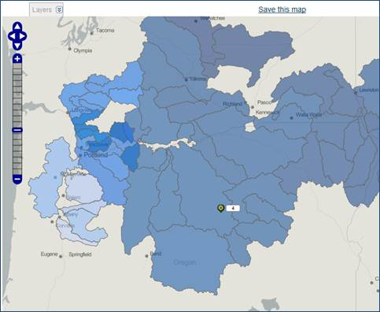
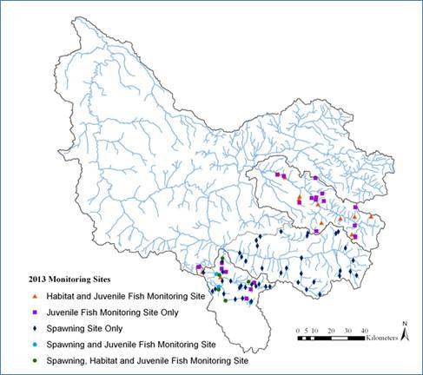
Pisces Contract vs. Sponsor Report
Pisces allows to type in lat and long or draw a point to upload of GIS information

Slide 7
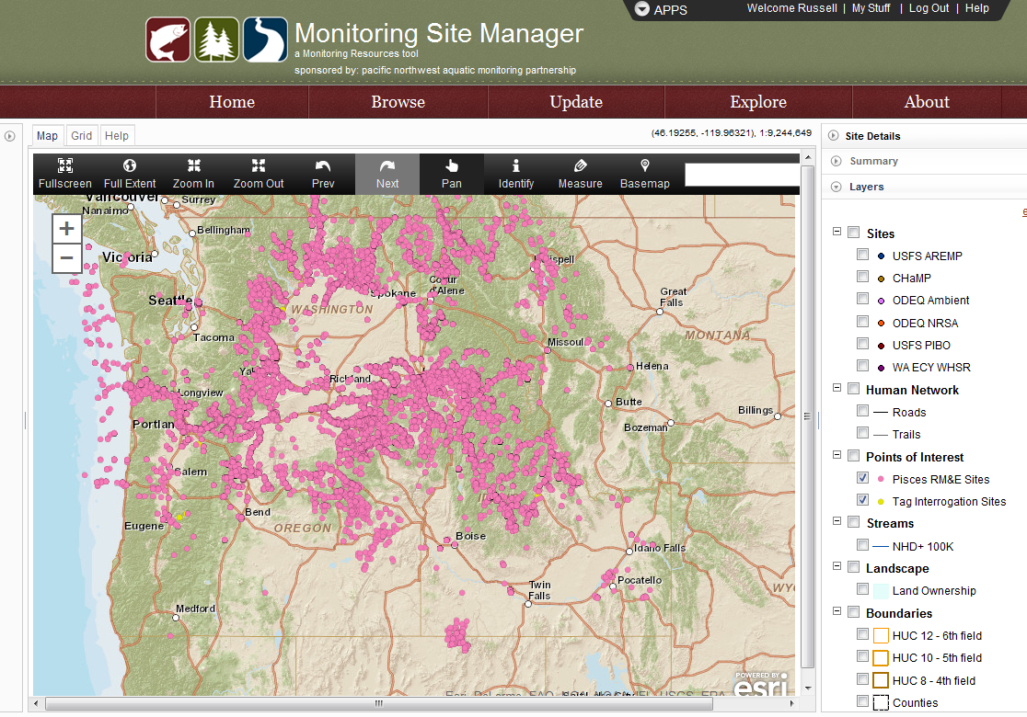
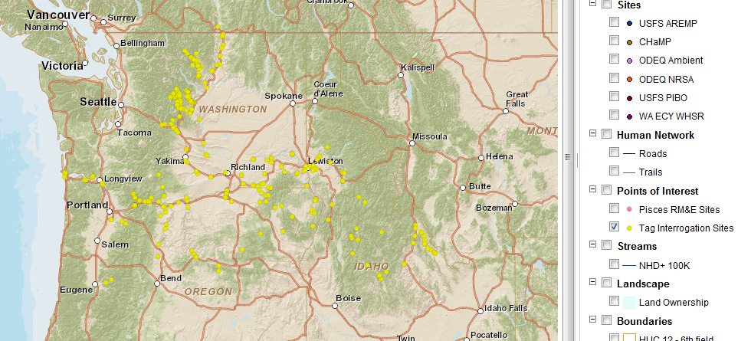
PNAMP Monitoring Explorer
PNAMP does not want to display BPA data, without disclaimer on the poor quality

Slide 8
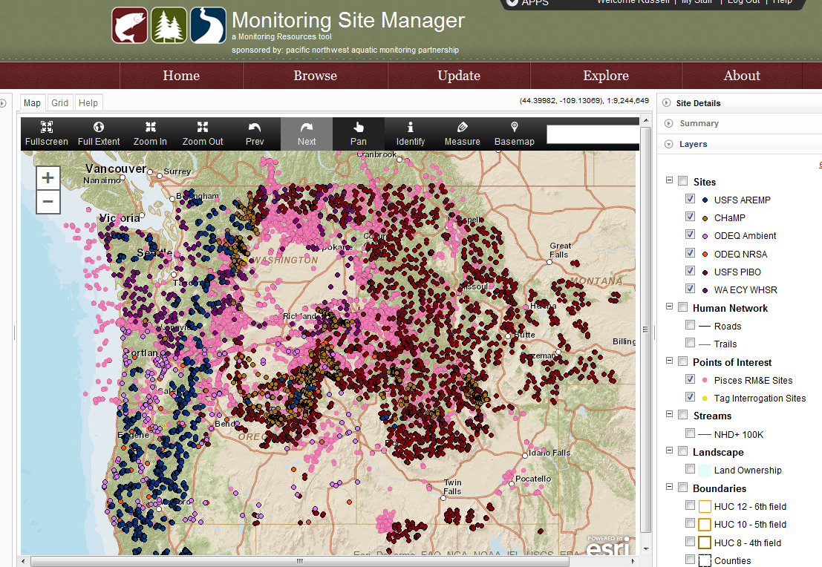
PNAMP Explorer In Development

Slide 9
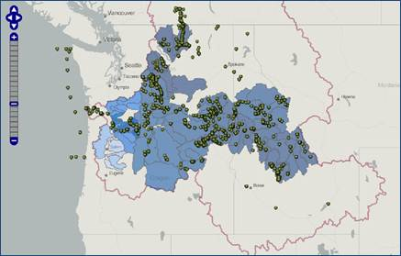
Example of Juvenile Abundance
Snorkel or Smolt Trap
Figure 3 Juvenile Abundance Monitoring Sites Some exceptions but most sponsor show 1-5 sites per population when we are paying for 20-50 sites per year per population. Depends on the Contract lead

Slide 10
Proposed Solutions
Use StreamNet and CRITFC Staff to support agency sponsors in documenting location data
PNAMP Site Manager to document monitoring program sites
  Points
  Lines
  Polygons
BPA sponsors provided multiple opportunities to use the PNAMP tools to meet contract requirements and have not had sponsor participation 2 of 20.
Consequences will be delay in contracts or suspension of funds to collect data. Same Consequences for failing to report or publish a protocol.

Slide 11
Discussion
Notes:
Half-circle picture with accent arcs
(Basic)
To reproduce the shape effects on this slide, do the following:
On the Home tab, in the Slides group, click Layout, and then click Blank.
On the Home tab, in the Drawing group, click Shapes, and then under Basic Shapes, click Arc (third row, 12th option from the left). On the slide, drag to draw an arc.
Select the arc. Under Drawing Tools, on the Format tab, in the Size group, do the following:
In the Shape Height box, enter 7.5”.
In the Shape Width box, enter 7.5”.
Drag the right yellow diamond adjustment handle to the bottom of the slide to create a half-circle.
Under Drawing Tools, on the Format tab, in the bottom right corner of the Shape Styles group, click the Format Shape dialog box launcher. In the Format Shape dialog box, click Fill in the left pane. In the Fill pane, select Picture or texture fill, and then under Insert from, click File.
In the Insert Picture dialog box, select a picture, and then click Insert.
Also in the Format Shape dialog box, in the Fill pane, under Insert from, select Tile picture as texture.
Also in the Format Shape dialog box, click Line Color in the left pane, and then select No line in the Line Color pane.
Also in the Format Shape dialog box, click Shadow in the left pane, and then do the following in the Shadow pane:
Click the button next to Presets, and then under Inner click Inside Diagonal Top Right (first row, third option from the left).
In the Transparency box, enter 70%.
In the Blur box, enter 20 pt.
In the Distance box, enter 20 pt.
Drag the half-circle to the left until the two middle yellow adjustment diamonds are lined up with the left edge of the slide. On the Home tab, in the Drawing group, click Arrange, point to Align, and then do the following:
Click Align to Slide.
Click Align Middle.
Select the arc. On the Home tab, in the Clipboard group, click the arrow under Copy, and then click Duplicate.
Select the second arc. Under Drawing Tools, on the Format tab, in the Size group, do the following:
In the Shape Height box, enter 6.79”.
In the Shape Width box, enter 10.03”.
On the Home tab, in the bottom right corner of the Drawing group, click the Format Shape dialog box launcher. In the Format Picture dialog box, click Fill in the left pane, and then in the Fill pane, select No fill.
Also in the Format Shape dialog box, click Line Color in the left pane. In the Line Color pane, select Solid line and then do the following:
Click the button next to Color, and then under Theme Colors click White, Background 1 (first row, first option from the left).
In the Transparency box, enter 50%.
Also in the Format Shape dialog box, click Line Style in the left pane. In the Line Style pane, in the Width box, enter 1.5 pt.
Drag the second arc left on the slide until the two middle yellow adjustment diamonds are lined up with the left edge of the slide. On the Home tab, in the Drawing group, click Arrange, point to Align, and then do the following:
Click Align to Slide.
Click Align Middle.
Select the second arc. On the Home tab, in the Clipboard group, click the arrow under Copy, and then click Duplicate.
Select the third arc. Under Drawing Tools, on the Format tab, in the Size group, do the following:
In the Shape Height box, enter 6.86”.
In the Shape Width box, enter 9.98”.
On the Home tab, in the bottom right corner of the Drawing group, click the Format Shape dialog box launcher. In the Format Shape dialog box, click Line Color in the left pane, select Gradient line in the Line Color pane, and then do the following:
In the Type list, select Linear.
Click the button next to Direction, and then click Linear Down (first row, second option from the left).
Under Gradient stops, click Add gradient stop or Remove gradient stop until two stops appear in the slider.
Also under Gradient stops, customize the gradient stops that you added as follows:
Select the first stop in the slider, and then do the following:
In the Position box, enter 0%.
Click the button next to Color, and then under Theme Colors click Blue, Accent 1, Lighter 40% (fourth row, fifth option from the left).
In the Transparency box, enter 77%.
Select the second stop in the slider, and then do the following:
In the Position box, enter 100%.
Click the button next to Color, click More Colors, and then in the Colors dialog box, on the Custom tab, enter values for Red: 208, Green: 215, Blue: 222.
In the Format Shape dialog box, in the Line Style pane, in the Transparency box, enter 90%.
Also in the Format Shape dialog box, click Line Style in the left pane. In the Line Style pane, in the Width box, enter 4.25 pt.
On the Home tab, in the Drawing group, click Arrange, point to Align, and then do the following:
Click Align to Slide.
Click Align Left.
Drag the third arc left on the slide until the two middle yellow adjustment diamonds are lined up with the left edge of the slide. Drag the third arc vertically as needed to position it slightly above the second arc on the slide.
To reproduce the background on this slide, do the following:
Right-click the slide background area, and then click Format Background. In the Format Background dialog box, click Fill in the left pane, select Gradient fill in the Fill pane, and then do the following:
In the Type list, select Linear.
Click the button next to Direction, and then click Linear Up (second row, second option from the left).
In the Angle box, enter 270⁰.
Under Gradient stops, click Add gradient stop or Remove gradient stop until four stops appear in the slider
Also under Gradient stops, customize the gradient stops that you added as follows:
Select the first stop in the slider, and then do the following:
In the Position box, enter 0%.
Click the button next to Color, click More Colors, and then in the Colors dialog box, on the Custom tab, enter values for Red: 167, Green: 185, Blue: 197.
Select the second stop in the slider, and then do the following:
In the Position box, enter 30%.
Click the button next to Color, and then under Theme Colors click White, Background 1 (first row, first option from the left).
Select the third stop in the slider, and then do the following:
In the Position box, enter 70%.
Click the button next to Color, and then under Theme Colors click White, Background 1 (first row, first option from the left).
Select the fourth stop in the slider, and then do the following:
In the Position box, enter 100%.
Click the button next to Color, click More Colors, and then in the Colors dialog box, on the Custom tab, enter values for Red: 167, Green: 185, Blue: 197.

