Slide 1
Fiscal Year 2016 Budget and Statement of Work
Preliminary Discussion
Recommendations/changes ?
Guidance to steering Committee by April 1?

Slide 2
Budget issues and discussion
2014 budget was $2,084, 576 – same as 2013
  (Permanent shift of $50,000 from PTAGIS)
Need to get Baseline budget proposals from all partners;
  Personnel costs ?
  Other expenses or savings?
  Early budget guidance from BPA?
Cost reductions at PSMFC last year to fund partner projects should be good for one more year. After that???
Executive Committee Discussion: BPA budget guidance, requests for additional funding, cost savings, or other adjustments as we built next budget and SOW?

Slide 4
FY 14 and 15 Budgets; Building the 2016 Request
(*15 & draft 16 PSMFC budgets include $17,920 for WDFW seasonal)
FY | PSMFC* | CCT | IDFG | MFWP | ODFW | USFWS | WDFW* | INDIRECT | TOTAL
2014 | $647,812 | $90,000 | $265,580 | $153,115 | $421,859 | $18,200 | $387,759 | $100,251 | $2,084,576
2015 | $544,386 | $90,001 | $301,638 | $168,877 | $474,461 | $18,200 | $402,961 | $84,052 | $2,084,576
2016 (Request) | $553,774 | ? | ? | ? | ? | ? | ? | (11.82% and 1.43%) | ?
Notes:
Original PSMFC: Wheaton (11.5), Kinney (11), Banach (11.5), Wilke (12), Roberts (1) $545,298
Reduced to $459,086 by shifting to other projects, also added WDFW Temp (Total 477,006)
ODFW: Cooney (11.22), Bowers (0.76), Craft (8.9), Chambers (11.3), Robinson (6.29) $442,508
Increased to $474,461 (NE Oregon Data Steward)
WDFW: Woodard (12), Lippert (10.6), Sikora (9.6), Groesbeck (9.6) $402,961
IDFG: Butterfield (7), Walsh (7), Harrington (11), Brown (11) $279,084
Increased to $301,638 (Snorkel survey seasonals)
MFWP: Anderson (208), Data Analyst, vacant (2,088), Data Analyst, vacant (2,088) $168,877
PSMFC Indirect $93,468
Reduced to $84,052
CCT: Arterburn (320), Trott (1,040) $90,000
USFWS: Pastor (1.79) $18,200
Total Budget Unchanged at $2,084,576

Slide 5
Steering Committee Recommendations ?
WDFW: BPA should fund a Data Steward position in Wenatchee. Est: $174,400 (116,200 annual)
WDFW: BPA should fund a Data Steward position in the Snake River Basin. Est: ($116,200 annual)
WDFW: Outfit fixed data collection sites such as adult and juvenile fish traps in the Lower Columbia, Upper Columbia, and Snake regions with waterproof, ruggedized tablets that interface with existing radio frequency identification (RFID) readers for PIT tag detection. Automate data transfer from these collectors to HQ systems of record and receiving customers like StreamNet and BPA via subscriptions cloud service base mobile application. Est: $60K-80K ($15-$20K annual)
Notes:
Deliverables include: further refinement of aggregator databases to meet the additional data collection needs in the Upper Columbia along with provide training and data management support to Upper Columbia biologists. Deliverables include working with Upper Columbia biologists to: 1) identify infrastructure needs for Traps, Weirs Surveys & Juvenile Migrant Exchange databases through standardization of data collection, protocols, and forms, 2) create standardized and customized database queries and summaries to facilitate analysis needed to estimate CA metrics and indicators, and 3) develop automated data transfer of adult and juvenile PIT tag insertions, and recoveries into PTAGIS.
Deliverables include further refinement of aggregator databases to meet the additional data collection needs in the Snake region along with provide training and data management support to Snake River biologists. Deliverables include working with Snake River biologists to: 1) identify infrastructure needs for Traps, Weirs Surveys & Juvenile Migrant Exchange databases through standardization of data collection, protocols, and forms, 2) create standardized and customized database queries and summaries to facilitate analysis needed to estimate CA metrics and indicators, and 3) develop automated data transfer of adult and juvenile PIT tag insertions and recoveries into PTAGIS.

Slide 6
Executive Committee Budget Discussion
BPA Budget Guidance?
Budget Concepts & issues for next contract?

Slide 7
Discuss Statement of Work For 2016
Last year focus was simplification of reporting
Reduced to 20 work elements from 38 in 2014
Tried to focus on priorities; (Coordinated Assessments, Secure Data Repositories, Support of data management staff & programs in states and tribes, Regional Coordination)
Today want to discuss any major changes for 2016

Slide 8
Streamnet program themes
Support data management personnel & systems in partner agencies and tribes
Provide a regional coordination forum for fish data management issues (i.e. CA)
  Work to identify the data management priorities of regional fish and wildlife managers
  Once priorities are established, work to develop efficient data flow
  Develop protocols for data sharing
Help to secure data in accessible data repositories, provide a repository where others unavailable
Decide what to do about historical datasets

Slide 9
“Traditional” StreamNet data ?
Long history of trends; redd counts, barriers, distribution, etc.
Updating of these largely stopped over last two years due to prioritization of CA
What should we do with long term datasets?
Traditional data are generally also available through links to state and tribal data systems, often partially supported by BPA thru StreamNet funding
Standardized Regional Data sets may be useful to maintain for regional analysis and comparison (i.e. long term fish trend datasets collected in the vicinity of habitat projects)
Suggestion: next proposed SOW include resumption of maintenance of “highest level of importance” traditional data, as determined by a poll of StreamNet Steering Committee members and other interested individuals and reported back to you

Slide 11
Recommendations ?
Support the development and deployment of emerging technologies in fisheries through sponsorship of workshops and through funding, purchasing, development, and testing of these technologies by partners
Seek out efficiencies and new sources of revenue. Where appropriate, recommend increases in traditional funding and support, as needed to complete established priorities
Ensure that data collected and managed using BPA funding is secured in approved repositories
Provide information to the public: StreamNet take on tasks more formally of maintaining back end databases for NPCC (Protected areas, facilities, dashboards, HLIs – automate and maintain data flow?)
Focus and prioritize the CA Project (To be discussed in detail later)
Evaluate and prioritize updating traditional StreamNet data sets to reflect an emphasis on those that add value to ongoing regional O&M efforts
Where traditional data is needed in support of regional priorities (i.e. resident fish data for NPCC indicators and dashboards), Support data management in agencies and tribes to automate and streamline data flow
Take on regional task of identifying and maintaining standard population names, codes, and geographic locations?

Slide 12
Steering Committee SOW Recommendations ?
(Input to date)
MFWP: Related to (Regional prioritization) Recommend BPA or the StreamNet Executive Committee clearly convey to agencies the importance of contributing to regional efforts. This will assist in gaining acceptance and buy-in from agency managers and biologists.
WDFW Budget Proposals:
Data Steward position in Wenatchee
Data Steward position in the Snake River Basin
Outfit fixed data collection sites with waterproof, ruggedized tablets that interface with existing radio frequency identification (RFID) readers for PIT tag detection. Automate data transfer from these collectors to HQ systems of record and receiving customers like StreamNet and BPA via subscriptions cloud service base mobile application
Notes:
Deliverables include: further refinement of aggregator databases to meet the additional data collection needs in the Upper Columbia along with provide training and data management support to Upper Columbia biologists. Deliverables include working with Upper Columbia biologists to: 1) identify infrastructure needs for Traps, Weirs Surveys & Juvenile Migrant Exchange databases through standardization of data collection, protocols, and forms, 2) create standardized and customized database queries and summaries to facilitate analysis needed to estimate CA metrics and indicators, and 3) develop automated data transfer of adult and juvenile PIT tag insertions, and recoveries into PTAGIS.
Deliverables include further refinement of aggregator databases to meet the additional data collection needs in the Snake region along with provide training and data management support to Snake River biologists. Deliverables include working with Snake River biologists to: 1) identify infrastructure needs for Traps, Weirs Surveys & Juvenile Migrant Exchange databases through standardization of data collection, protocols, and forms, 2) create standardized and customized database queries and summaries to facilitate analysis needed to estimate CA metrics and indicators, and 3) develop automated data transfer of adult and juvenile PIT tag insertions and recoveries into PTAGIS.

Slide 13
Executive Committee SOW Discussion
Concepts & issues for next Statement of WORK?

Slide 14
Background
Slides

Slide 16
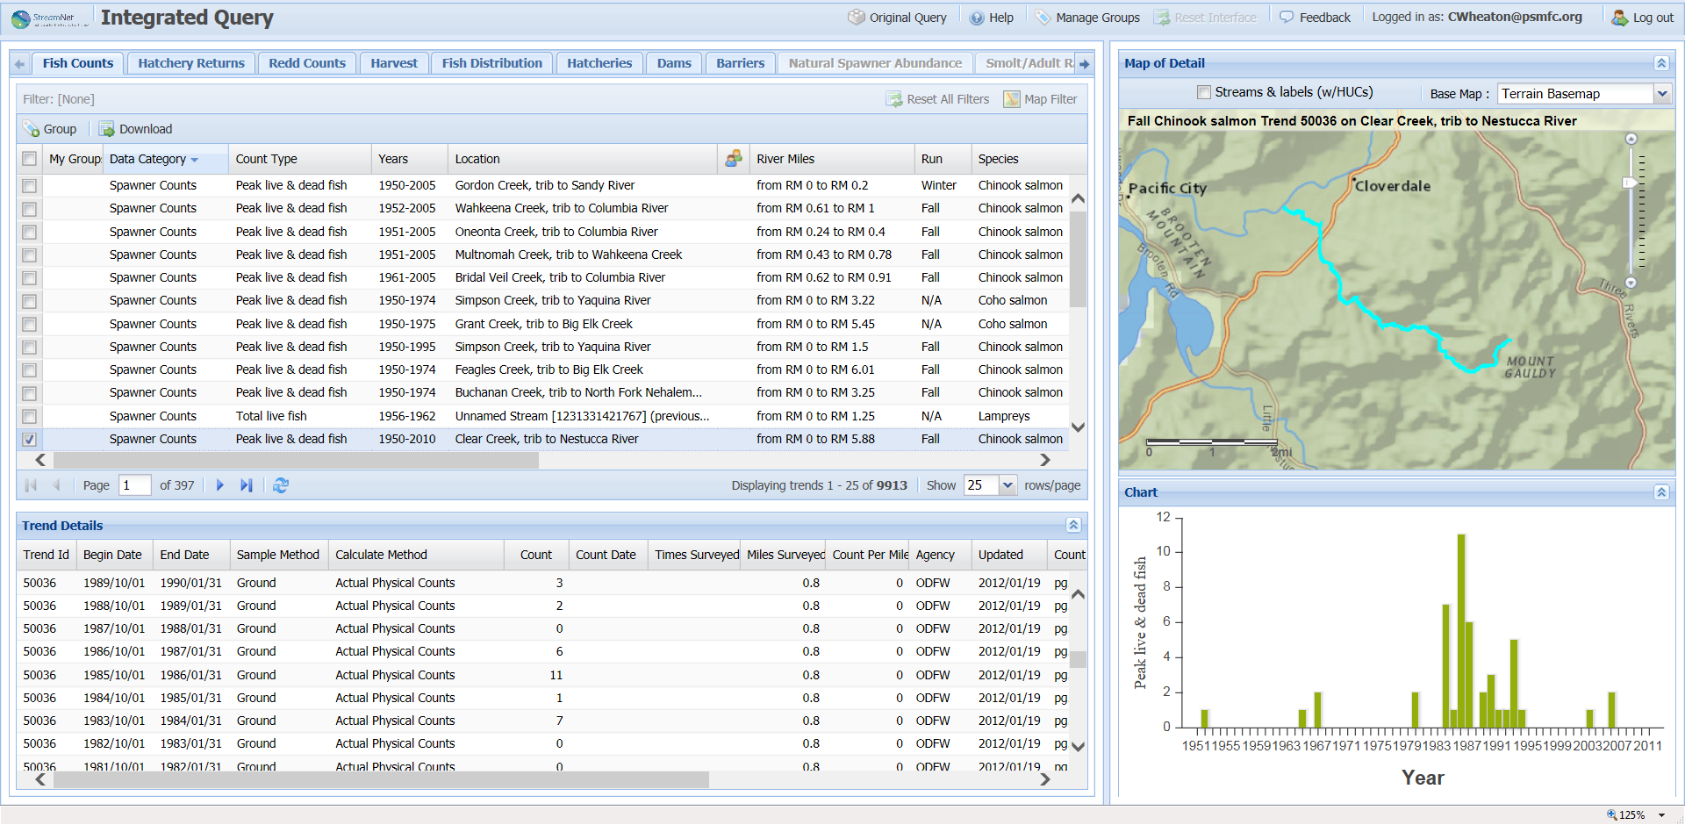

Slide 17
Current Recommendations
StreamNet should continue to seek out efficiencies and new sources of revenue in order to fund agency operations that support regional data management priorities (i.e. field data stewards that compile and provide CA data). Where appropriate, the StreamNet Executive committee should recommend increases in traditional funding and support, as needed to complete the priorities they have established.
WDFW: In order to facilitate Upper Columbia River Data Management, BPA should fund a Data Steward position in Wenatchee. Deliverables include: further refinement of aggregator databases to meet the additional data collection needs in the Upper Columbia along with provide training and data management support to Upper Columbia biologists. Deliverables include working with Upper Columbia biologists to: 1) identify infrastructure needs for Traps, Weirs Surveys & Juvenile Migrant Exchange databases through standardization of data collection, protocols, and forms, 2) create standardized and customized database queries and summaries to facilitate analysis needed to estimate CA metrics and indicators, and 3) develop automated data transfer of adult and juvenile PIT tag insertions, and recoveries into PTAGIS. Est: $174,400 (116,200 annual)
In order to facilitate Upper Columbia River Data Management, BPA should fund a Data Steward position in the Snake River Basin. Deliverables include further refinement of aggregator databases to meet the additional data collection needs in the Snake region along with provide training and data management support to Snake River biologists. Deliverables include working with Snake River biologists to: 1) identify infrastructure needs for Traps, Weirs Surveys & Juvenile Migrant Exchange databases through standardization of data collection, protocols, and forms, 2) create standardized and customized database queries and summaries to facilitate analysis needed to estimate CA metrics and indicators, and 3) develop automated data transfer of adult and juvenile PIT tag insertions and recoveries into PTAGIS. Est: $116,200 annual
Electronic Field Data Collection: The use of electronic data collection devices is likely to save time and money, reduce transcription errors, and allow for more efficient data transfer of biological and environmental data into WDFW databases. We propose outfit fixed data collection sites such as adult and juvenile fish traps in the Lower Columbia, Upper Columbia, and Snake regions with waterproof, ruggedized tablets that interface with existing radio frequency identification (RFID) readers for PIT tag detection. In addition, we propose to automate data transfer from these collectors to HQ systems of record and receiving customers like StreamNet and BPA via subscriptions cloud service base mobile application. Est: $60K-80K ($15-$20K annual)
The StreamNet Executive Committee should be used to focus and prioritize the CA Project. This should specifically include prioritizing selection of new high level indicators, taking into account regional data needs, such as NOAA status assessments and NPCC high level indicators and dashboards. Priorities should incorporate realistic assessments of available staff, and other agency priorities.
The StreamNet Executive Committee should also evaluate and prioritize updating traditional StreamNet data sets to reflect an emphasis on those that add value to ongoing regional O&M efforts. For example, updating geo-referenced surveys that take place in proximity to habitat restoration efforts. Support of agency GIS systems and maintenance of regional databases such as fish distribution, barriers, and hatchery information should be considered and prioritized within the StreamNet program.
StreamNet should provide accessible and useful displays of information at the regional scale, with special focus on the CA project. Improvements to the StreamNet website should include GIS-based, population level graphical presentation of the High level indicators as they are developed. StreamNet should also assist in supporting the efforts of others (NOAA, NPCC, etc.) who are engaged in similar efforts by focusing on automating and streamlining the flow of data for these efforts.
While focusing the CA project on high level indicators that support regionally significant monitoring efforts, clear direction and consensus should be used to guide agencies and tribes to submit data that support population level assessments. Where such data is lacking, care should be used to avoid cluttering the CA data sets with lower-level information simply because that is all that is available. The Executive Committee should provide direction on when such lower level or even higher level information is acceptable and beneficial to be incorporated into the CA database. The StreamNet Executive Committee should also periodically evaluate whether regional data collection and management efforts are aligned with the high level data needs identified by the users of CA data, and recommendations for funding and support provided to BPA, NPCC, NOAA, and others from a regional perspective.
Where data is needed in support of regional prioritization (i.e. resident fish data for NPCC indicators and dashboards), StreamNet should prioritize infrastructure and data management assistance needed to support such indicators. This will require advance planning in order to potentially shift resources or request additional support, as agencies are currently fully committed to ongoing efforts.
Related to 5 above. Recommend BPA or the StreamNet Executive Committee clearly convey to agencies the importance of contributing to regional efforts. This will assist in gaining acceptance and buy-in from agency managers and biologists.
CA methodologies for calculation of high level indicators should be fully documented.
StreamNet should continue to play a role in the development and deployment of emerging technologies in fisheries data collection through sponsorship of workshops and through funding the engagement of agency-embedded staff in purchasing, development and testing of these technologies, with the objective of making data collection and transfer more efficient and secure across the region.

