Slide 1
Updating Traditional StreamNet Data
Analysis of Queries and Survey Results
June 4, 2015

Slide 2
Attempted to Assess Usage and Interest in “Traditional” Data
Analysis of StreamNet Use by looking at old Query System and IQS
Survey Using Survey Monkey
Discussion with StreamNet Partners

Slide 3
Plans for Considering Updating some Traditional Data: Review with Steering Committee July 1
Request Adoption from Executive Committee July 8
+ More Consistent Approach to Data in to StreamNet from Across the Region
+ Expectations for Resuming Data Flow for Selected Data. Prioritize data that supports NPCC Indicators, provide building blocks for CA Indicators, etc.
+ Workload and Implementation Questions?
+ Build into Next SOW

Slide 4
Decline in StreamNet Website Data Usage: Relationship to Lack of Updated Data?

Slide 5
Original StreamNet Query System Requests for Data
Data Category | Queries | %
Fish Distribution | 48,187 | 30.80%
Adult Return-Est. of Spawning Populations | 21,196 | 13.60%
Adult Return-Redd Counts | 17,107 | 10.90%
Barrier | 13,596 | 8.70%
Adult Return-Spawner Counts | 8,932 | 5.70%
Harvest - Freshwater/Estuary | 8,547 | 5.50%
Dam/Weir Counts (Adult or Juvenile) | 8,057 | 5.20%
Hatchery - Returns | 6,980 | 4.50%
Protected Areas | 5,668 | 3.60%
Photographs | 5,059 | 3.20%
Facilities - Dams | 2,387 | 1.60%
Maps - View Prebuilt Maps | 2,261 | 1.50%
Facilities - Hatcheries | 2,103 | 1.50%
Habitat Restoration/Improvement Projects | 1,435 | 0.90%
Harvest - Marine Landings | 1,321 | 0.84%
Adult Return-Spawner/Recruit Estimates | 1,133 | 0.72%
A particular TrendID | 1,055 | 0.67%
Smolt Density Model Data | 958 | 0.61%
Reference | 352 | 0.23%
2010 to present Total | 156,334 | 100

Slide 6
Data Category | Available Data | Years | Observations
Adult Return-Est. of Spawning Populations | 3,503 Trends | 1901-2013 | 23,267
Adult Return-Redd Counts | 4,957 Trends | 1901-2014 | 46,649
Adult Return-Spawner Counts | 5,619 Trends | 1944-2014 | 35,579
Adult Return-Spawner/Recruit Estimates | 30 Trends | 1938-2006 | 1,116
Dam/Weir Counts (Adult or Juvenile) | 584 Trends | 1925-2014 | 14,718
Estimates of juvenile populations | 130 Trends | 1991-2012 | 485
Facilities - Barriers (potential) | 64,258 Barriers | n/a
Facilities - Dams | 7882 Dams | n/a
Facilities - Hatcheries | 537 Hatcheries | n/a
Fish Counts | 77 Trends | 1953-2012 | 549
Fish Distribution | 26,319 Streams | n/a | 63,621
Harvest - Freshwater/Estuary | 2,708 Trends | 1894-2012 | 41,493
Harvest - Marine Landings | 579 Trends | 1950-1996 | 7,198
Hatchery - Returns | 1,093 Trends | 1906-2013 | 10,371
Maps (pre-built) | 398 Maps | n/a
Photographs | 1,065 Photos | n/a
Protected Areas | 29,524 Records | n/a
StreamNet Data Snapshot May, 2015

Slide 8
Survey Open for a Little Over 1 Month
19 Total Respondents. 17 Gave Their Affiliation;
Private Consultant Confederated Tribes of the Warm Springs Reservation of Oregon
WDFW
NRC, ISAB, ISRP
ODFW
Montana Fish, Wildlife and Parks
BPA
NPCC
Montana Fish, Wildlife & Parks
Bonneville Power Administration
IDFG
Oregon Department of Fish and Wildlife
NPCC
ODFW
Colville Confederated Tribes
BPA
BPA

Slide 9
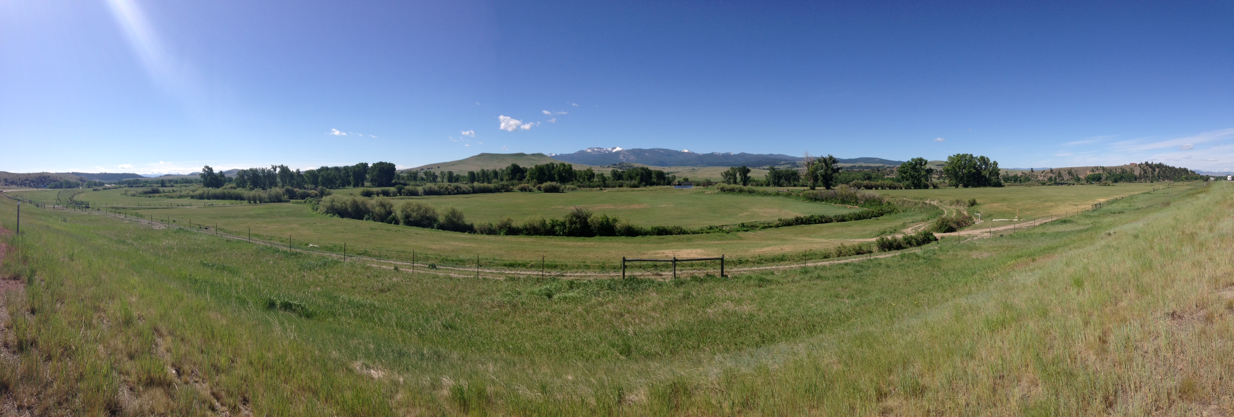
Why might focused updates to traditional
StreamNet data be relevant?
NPCC Dashboards & Indicators use over 1,500 StreamNet
  Trends
Long time series data sets – many in proximity to habitat
  projects or intensive monitoring work…

Slide 10
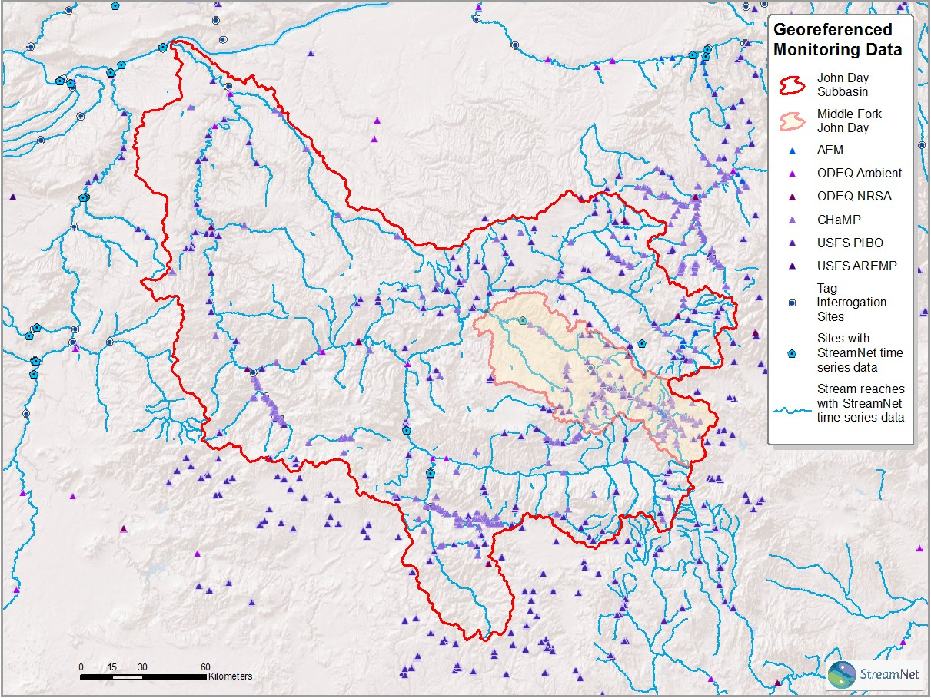

Slide 11
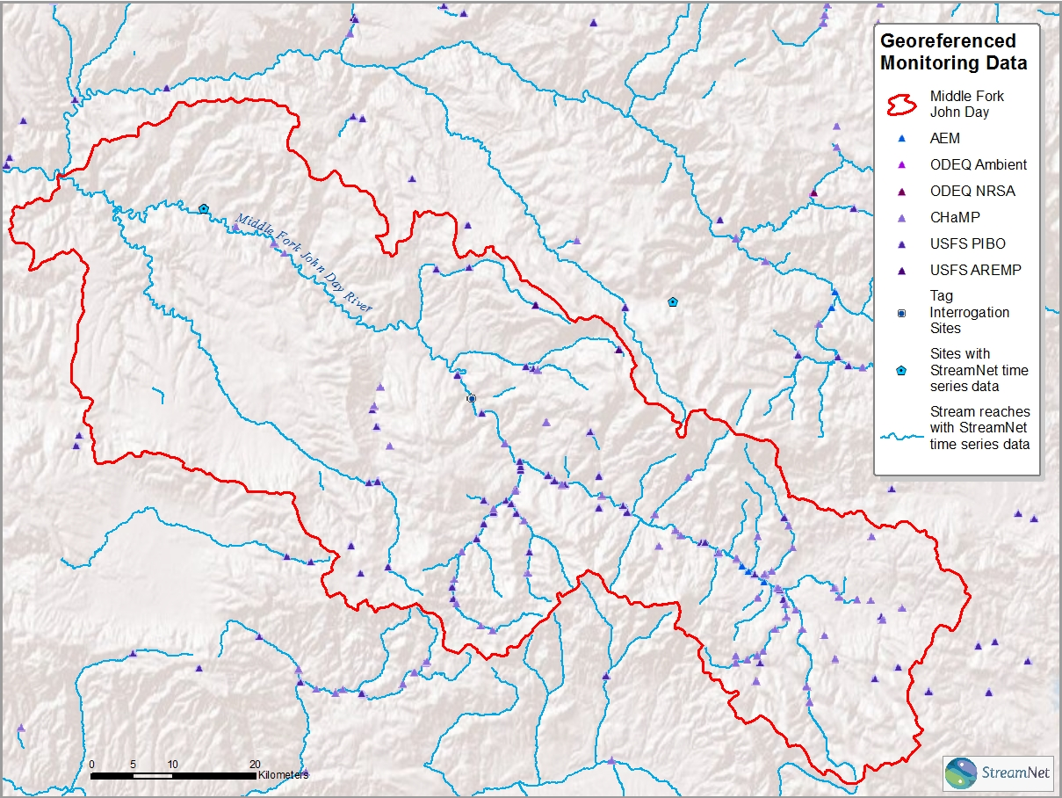
Notes:
Duplicate of prior slide but with tabular data dialogue and arrow that can be repositioned if desired. Point is to indicate that StreamNet has significant amounts of data catalogued for this area but the time series are not being updated.

Slide 12
The Winner is…
Adult Return, Estimates of Spawning Population
Six “Most Important” Answers
Highest Priority Score (3.67)

Slide 13
Availability of Data and Past Usage;
Adult Return, Estimates of Spawning Population
5 States/Tribes Reporting Comprehensive Data
Second Highest Original Query Searches (13.6%)
Already used in CA ?
Support for NPCC sub-basin
And population reporting?
Original StreamNet Query System Requests for Data
Data Category | Queries | %
Fish Distribution | 48,187 | 30.80%
Adult Return-Est. of Spawning Populations | 21,196 | 13.60%
Adult Return-Redd Counts | 17,107 | 10.90%
Barrier | 13,596 | 8.70%
Adult Return-Spawner Counts | 8,932 | 5.70%
Harvest - Freshwater/Estuary | 8,547 | 5.50%
Dam/Weir Counts (Adult or Juvenile) | 8,057 | 5.20%
Hatchery - Returns | 6,980 | 4.50%
Protected Areas | 5,668 | 3.60%
Photographs | 5,059 | 3.20%
Facilities - Dams | 2,387 | 1.60%
Maps - View Prebuilt Maps | 2,261 | 1.50%
Facilities - Hatcheries | 2,103 | 1.50%
Habitat Restoration/Improvement Projects | 1,435 | 0.90%
Harvest - Marine Landings | 1,321 | 0.84%
Adult Return-Spawner/Recruit Estimates | 1,133 | 0.72%
A particular TrendID | 1,055 | 0.67%
Smolt Density Model Data | 958 | 0.61%
Reference | 352 | 0.23%
2010 to present Total | 156,334 | 100

Slide 14
Coming in Second?
Fish Distribution
Four “Most Important” Answers
Third Highest Priority Score (4.72)

Slide 15
Availability of Data and Past Usage;
Fish Distribution
7 States/Tribes Reporting Comprehensive Data
Highest Original Query Searches (30.8%)
Original StreamNet Query System Requests for Data
Data Category | Queries | %
Fish Distribution | 48,187 | 30.80%
Adult Return-Est. of Spawning Populations | 21,196 | 13.60%
Adult Return-Redd Counts | 17,107 | 10.90%
Barrier | 13,596 | 8.70%
Adult Return-Spawner Counts | 8,932 | 5.70%
Harvest - Freshwater/Estuary | 8,547 | 5.50%
Dam/Weir Counts (Adult or Juvenile) | 8,057 | 5.20%
Hatchery - Returns | 6,980 | 4.50%
Protected Areas | 5,668 | 3.60%
Photographs | 5,059 | 3.20%
Facilities - Dams | 2,387 | 1.60%
Maps - View Prebuilt Maps | 2,261 | 1.50%
Facilities - Hatcheries | 2,103 | 1.50%
Habitat Restoration/Improvement Projects | 1,435 | 0.90%
Harvest - Marine Landings | 1,321 | 0.84%
Adult Return-Spawner/Recruit Estimates | 1,133 | 0.72%
A particular TrendID | 1,055 | 0.67%
Smolt Density Model Data | 958 | 0.61%
Reference | 352 | 0.23%
2010 to present Total | 156,334 | 100
Important baseline information for many purposes?

Slide 16
Fish distribution records all have a year value associated
Agency | Year | records
IDFG | 2011 | 554
IDFG | 2006 | 9
IDFG | 2005 | 62
IDFG | 2004 | 2227
IDFG | 2002 | 4876
IDFG | 2001 | 267
IDFG | 1999 | 72
MFWP | 2014 | 70
MFWP | 2013 | 404
MFWP | 2012 | 745
MFWP | 2011 | 866
MFWP | 2010 | 348
MFWP | 2009 | 2840
MFWP | 2008 | 293
MFWP | 2007 | 52
MFWP | 2006 | 95
MFWP | 2005 | 3705
MFWP | 2004 | 19
ODFW | 2012 | 603
ODFW | 2011 | 4841
Agency | Year | records
ODFW | 2010 | 716
ODFW | 2009 | 193
ODFW | 2008 | 30
ODFW | 2007 | 11
ODFW | 2006 | 32
ODFW | 2005 | 27
ODFW | 2004 | 76
ODFW | 2003 | 1292
ODFW | 2002 | 7502
ODFW | 2001 | 1442
ODFW | 2000 | 1724
ODFW | 1999 | 3654
ODFW | 1998 | 258
ODFW | 1996 | 310
PSMFC | 2007 | 1
PSMFC | 2005 | 5
PSMFC | 2004 | 1
WDFW | 2005 | 14139
WDFW | 2004 | 8703
WDFW | 2003 | 557

Slide 17
Third?
Adult Return –
Redd Counts
Two “Most Important” Answers (4th highest)
Second Highest Priority Score (4.44)

Slide 18
Availability of Data and Past Usage;
Adult Return –
Redd Counts
5 States/Tribes Reporting Comprehensive Data
Third Highest Original Query Searches (10.9%)
Original StreamNet Query System Requests for Data
Data Category | Queries | %
Fish Distribution | 48,187 | 30.80%
Adult Return-Est. of Spawning Populations | 21,196 | 13.60%
Adult Return-Redd Counts | 17,107 | 10.90%
Barrier | 13,596 | 8.70%
Adult Return-Spawner Counts | 8,932 | 5.70%
Harvest - Freshwater/Estuary | 8,547 | 5.50%
Dam/Weir Counts (Adult or Juvenile) | 8,057 | 5.20%
Hatchery - Returns | 6,980 | 4.50%
Protected Areas | 5,668 | 3.60%
Photographs | 5,059 | 3.20%
Facilities - Dams | 2,387 | 1.60%
Maps - View Prebuilt Maps | 2,261 | 1.50%
Facilities - Hatcheries | 2,103 | 1.50%
Habitat Restoration/Improvement Projects | 1,435 | 0.90%
Harvest - Marine Landings | 1,321 | 0.84%
Adult Return-Spawner/Recruit Estimates | 1,133 | 0.72%
A particular TrendID | 1,055 | 0.67%
Smolt Density Model Data | 958 | 0.61%
Reference | 352 | 0.23%
2010 to present Total | 156,334 | 100
Already used in CA?
Support NPCC sub-basin and population reporting?

Slide 19
Fourth?
Facilities/Dams/Barriers/Hatchery Returns?
“Facilities” has one “Most Important” Answer (5th highest - tie)
Not a High Priority Score (6.94)

Slide 20
Availability of Data and Past Usage; Facilities
Five States/Tribes Reported Comprehensive Data on Facilities
Four Reported Comprehensive Data on Hatchery Returns
Substantial Original Query Searches (Barriers – 8.7%; Hatchery Returns – 4.5%; Facilities – 3.1%)
Original StreamNet Query System Requests for Data
Data Category | Queries | %
Fish Distribution | 48,187 | 30.80%
Adult Return-Est. of Spawning Populations | 21,196 | 13.60%
Adult Return-Redd Counts | 17,107 | 10.90%
Barrier | 13,596 | 8.70%
Adult Return-Spawner Counts | 8,932 | 5.70%
Harvest - Freshwater/Estuary | 8,547 | 5.50%
Dam/Weir Counts (Adult or Juvenile) | 8,057 | 5.20%
Hatchery - Returns | 6,980 | 4.50%
Protected Areas | 5,668 | 3.60%
Photographs | 5,059 | 3.20%
Facilities - Dams | 2,387 | 1.60%
Maps - View Prebuilt Maps | 2,261 | 1.50%
Facilities - Hatcheries | 2,103 | 1.50%
Habitat Restoration/Improvement Projects | 1,435 | 0.90%
Harvest - Marine Landings | 1,321 | 0.84%
Adult Return-Spawner/Recruit Estimates | 1,133 | 0.72%
A particular TrendID | 1,055 | 0.67%
Smolt Density Model Data | 958 | 0.61%
Reference | 352 | 0.23%
2010 to present Total | 156,334 | 100
BPA Initiative and Data Need?
Needs Definitions and Priorities

Slide 21
Recommendation: SOW, budget, and expectations for FY 2016 should include resumption and updates of (in priority order);
1. Adult Return Data; Estimates of Spawning Populations (Particularly as they are part of data that support CA)
2. Periodic updates to maintain comprehensive fish distribution data and mapping capability
3. Adult Return Data; Redd Counts (Particularly as they are part of data that support CA)
4. Maintain the “facilities” dataset. Relatively simple for hatcheries, large dams. Barriers? Screens? Others?
5. Hatchery Return Information? (Also needed to support CA?) Available elsewhere?
Discuss workload and budget impacts, make sure we stay aligned with regional data needs (NPCC HLIs, etc.). What are realistic expectations for data updates?

Slide 22
Change Language in 2016 SOW to be consistent?
G: Compile high priority traditional StreamNet data
WDFW* will update high priority StreamNet data sets and exchange the data in DES format to the StreamNet database at PSMFC.
  * Suggest that WDFW, IDFG, CCT, ODFW, USFWS all have the same language
Also have CRITFC Milestone?
  CRITFC will provide accurate URL links to updated high priority data to ensure that documentation is accessible and correctly linked between StreamNet and the StreamNet library.

Slide 23


Slide 24
Others to Consider?
Adult Return – Spawner Counts?
Adult Return – Spawner – Recruit Estimates?
Others?

Slide 25
Fish Counts – Adult or Juvenile
Three “Most Important” Answers (3rd highest)
Fourth Highest Priority Score (4.89)
No States/Tribes Reported Comprehensive Data
Category without definition?

Slide 26
Other data types that you feel should be updated and maintained?
Separate estimates of adult returns by hatchery versus natural origin for each species and each region of the basin. An age-structured brood table is needed for each natural origin stock. High ranking
the above are all equally important to the Program. Would also be good to compile accessible environmental data to complement the fish data as that environmental data becomes more accessible . Might also be good to form a partnership with FPC to connect the data so have the same draft data available until the QA/QC data is available
Habitat @ #5; Protected Areas @ #6; wildlife distribution @#7
Resident fish population estimates (3) Genetic information (5)
Smolts out by stream reach/year, if not represented by one of the categories above. Should be number three or four in relationship to the list above. Is NOSA represented by one of the categories above? not clear, but that's a top priority too.
Quantity of High Quality habitat 3
Life Cycle Monitoring data 4
Fish out data from smolt traps, as well as fish density data integrated into the distribution by lifestage (Adult or juvenile) The standard hydrography such that all models may use the same features or link between DEM derived and 1:24k layers.

Slide 27
Notes:
“Other” answers;
Collecting and reporting can be done for many categories in the Columbia Basin only. Other funding and resources would need to be identified for outside the basin and to collected other data types within the state.
I think that we're already automatically transferring available data to StreamNet. Additional data streams would require additional funding

Slide 28
Regional processes where updates would be useful?
NOAA 5-year status review, WA State of the Salmon, NPCC-Annual report & Subbasin Dashboards
You should bring back all of the data tables reported in the Columbia River Fish Runs annual series that was terminated in the early 2000s.
NOAA 5 yr. status review, ESA listing decisions, funding decisions, fishery and hatchery management
5 Year Status Review, Action Agency Annual Reports to NOAA, Action Agency Three Year Comprehensive Evaluation and Implementation Plan documents, Action Agency Expert Panel Workshops
NPCC Dashboard and HLI reports
Yes - native trout assessments
The Objectives Process that NOAA and Council are just undertaking. BiOp progress reports. PSCRF reports to Congress.
USFWS Range Wide Assessments
I believe that NOAA is able to access data for 5 year reviews through current automatic reporting and our own databases.
3 year Expert Panel Limiting Factor assessments (Spatial distribution and abundance is important)
Asset mgmt. plans; wildlife mitigation; Protected Areas; HLIs/Dashboards; Monitoring Explorer

Slide 29
Discussion
Backlog would need to be addressed (2012-13 to present)
Staffing and workload in partner agencies
  CA Priority (Is the data requested available as CA building block information?)
  Is the right staff supported (i.e. GIS expertise)
Consistent data on high priorities from all partners?
Seek comprehensive data in fewer categories?

Slide 30
Are there any regional processes or data needs (i.e. like NOAA 5 year status reviews) that you are aware of where you think regularly updated traditional StreamNet data would be useful?
NOAA 5-year status review, WA State of the Salmon, NPCC-Annual report & Subbasin Dashboards
You should bring back all of the data tables reported in the Columbia River Fish Runs annual series that was terminated in the early 2000s.
NOAA 5 yr. status review, ESA listing decisions, funding decisions, fishery and hatchery management
NPCC Dashboard and HLI reports
5 Year Status Review, Action Agency Annual Reports to NOAA, Action Agency Three Year Comprehensive Evaluation and Implementation Plan documents, Action Agency Expert Panel Workshops
Yes - native trout assessments
The Objectives Process that NOAA and Council are just undertaking. BiOp progress reports. PSCRF reports to Congress.

Slide 31
Are there any regional processes or data needs (i.e. like NOAA 5 year status reviews) that you are aware of where you think regularly updated traditional StreamNet data would be useful? (Continued)
USFWS Range Wide Assessments
I believe that NOAA is able to access data for 5 year reviews through current automatic reporting and our own databases.
3 year Expert Panel Limiting Factor assessments (Spatial distribution and abundance is important)
Asset mgmt plans; wildlife mitigation; Protected Areas; HLIs/Dashboards; Monitoring Explorer

Slide 32
Are there any other thoughts or ideas about updating traditional StreamNet data that you would like to share with us?
There is information here that is duplicative of the direction of the last survey for CA indicators. Much of the traditional Stream Net data is focused on the wrong scale, which is why we moved to CA. Updating traditional data, that is not part of CA is a very low priority with the exception of fish distribution.
Traditional data sets are very important to keep up to date and it's unfortunate that they haven't been. States/Agencies will need more resources or will need to see significant benefit in order to make this a priority.
If not StreamNet, who/where will these traditional data sets be updated and accessed?
You should bring back all of the data tables reported in the Columbia River Fish Runs annual series that was terminated in the early 2000s. Keep updating all of the time series listed above. I had difficult time ranking the data series. They are all important and will be come more important in the future.
Coordinated Assessments very valuable. Hope to be able to show trends and relationship of fish trends to habitat restoration actions and hoping a comprehensive data base such as what StreamNet's creating will be able to support that at regional and watershed scale.

Slide 33
Respondent’s ranking of data categories as “Most Important”

