Slide 1
Fiscal Year 2016 Budget
Base budget Discussion
Incremental/inflation Guidance
Enhancements
Guidance from Bpa

Slide 2
Budget issues and discussion
2015 budget was $2,084, 576 – same as 2014
  (Permanent shift of $50,000 from PTAGIS)
Have $2,084,576 Baseline budget proposals for FY 2016 from all partners;
  Reduced spending $21,408 at PSMFC
  MFWP eliminated Data Entry Tech
  IDFG and WDFW reduced travel, leases, and/or supplies
  ODFW, CCT, and USFWS absorbed cost increases by reducing staffing and support to project
Staff cost reductions at PSMFC last year (-$101,000) to fund partner projects should be good for one more year (now -$117,000 from FY14). After that???

Slide 3
Direction on Budget from Executive Committee;
Each partner state and tribe should let Chris know by March 25th if they have serious structural costs that we need to talk about in the next budget (i.e. COLAs, unavoidable costs, etc.). We will try to accommodate but will need to build into existing program as per BPA guidance. Chris will submit budget by March 27th.
Each partner state or tribe should propose enhancements (like WDFW) that foster progress on priorities so that they may be considered if funds become available. Format should be fairly simple. Provide these requests by March 25th as well please. Prioritizing these requests in advance would be useful if money becomes available during the budget year; would then already know where the funds should be directed. Chris and Tom will work with Steering Committee to finalize “base budget” at current funding level and a prioritized list of possible enhancements at the April 1st Steering Committee meeting.

Slide 4
States & Tribes
Notes:
In FY 14 comparable figures were;
States and Tribes $1,336,513
Indirect $100,251
PSMFC $647,812
PSMFC down 19.3% in two years
IDFG up 24.7% in two years
MFWP up 0.7% in two years
ODFW up 12.5% in two years
WDFW up 5.9% in two years
CCT and USFWS level funded for last two years

Slide 5
FY 14 and 15 Budgets; Building the 2016 Request
(*15 & draft 16 PSMFC budgets include $17,920 for WDFW seasonal)
FY | PSMFC* | CCT | IDFG | MFWP | ODFW | USFWS | WDFW* | INDIRECT | TOTAL
2014 | $647,812 | $90,000 | $265,580 | $153,115 | $421,859 | $18,200 | $387,759 | $100,251 | $2,084,576
2015 | $544,386 | $90,001 | $301,638 | $168,877 | $474,461 | $18,200 | $402,961 | $84,052 | $2,084,576
2016 (Baseline Request) | $522,978 | $90,000 | $331,288 | $154,168 | $474,458 | $18,200 | $410,523 | $82,961 | $2,084,576
Notes:
Original PSMFC: Wheaton (11.5), Kinney (11), Banach (11.5), Wilke (12), Roberts (1) $545,298
Reduced to $459,086 by shifting to other projects, also added WDFW Temp (Total 477,006)
ODFW: Cooney (11.22), Bowers (0.76), Craft (8.9), Chambers (11.3), Robinson (6.29) $442,508
Increased to $474,461 (NE Oregon Data Steward)
WDFW: Woodard (12), Lippert (10.6), Sikora (9.6), Groesbeck (9.6) $402,961
IDFG: Butterfield (7), Walsh (7), Harrington (11), Brown (11) $279,084
Increased to $301,638 (Snorkel survey seasonals)
MFWP: Anderson (208), Data Analyst, vacant (2,088), Data Analyst, vacant (2,088) $168,877
PSMFC Indirect $93,468
Reduced to $84,052
CCT: Arterburn (320), Trott (1,040) $90,000
USFWS: Pastor (1.79) $18,200
Total Budget Unchanged at $2,084,576

Slide 6
Inflation/incremental cost increases - Prioritize
These proposals simply restore cuts made to budgets or provide inflation adjustments
the absence of which forces staff shifts to other programs in order to keep program level funded at $2,084,576)+
MFWP |  | $17,407 |  | Restores 700 hour Data Entry Tech position eliminated for budget savings
IDFG |  | $2,900 |  | Restores reduced travel cut for cost savings
WDFW |  | $3,000 |  | Restores vehicle lease expenses and supplies cut for cost savings
ODFW |  | $12,000 |  | Provides inflationary adjustment which reduces staff shifts to other programs
USFWS |  | $2,000 |  | Provides inflationary adjustment which reduces staff shifts to other programs
CCT |  | $3,000 |  | Provides inflationary adjustment which reduces staff shifts to other programs
PSMFC |  | $9,500 |  | Restores field devices, web services and reduced travel cut for cost savings
 |  | $49,807

Slide 7
StreamNet Program Enhancements
Items are not prioritized, except that within agencies they are in the agency priority order
WDFW:
$117,000 Data Steward position in Wenatchee
$117,000 Data Steward position in the Snake River Basin
$40,000 Outfit sites with waterproof, ruggedized tablets with readers for PIT tag detection. Automate data transfer from these collectors to HQ systems of record
USFWS:
$130,000 Geographer/data manager to represent the Service in technical fora and provide data management/data services/data for regionwide data management initiatives, such as the Coordinated Assessments

Slide 8
StreamNet Program Enhancements – Page 2
Items are not prioritized, except that within agencies they are in the agency priority order
ODFW:
$100,000 Additional data steward to focus on the new indicators for juvenile abundance and hatchery performance and assist with developing methods and metadata records and help input into databases.
$28,000 Add funding to cover 2 months of Data analyst and a small amount for participation of Program Leader in the CA project and StreamNet Executive Committee, including some travel.
$15,000 Additional GIS time for whole stream route maintenance in support of StreamNet.
PSMFC:
$50,000 Purchase, deploy, test, and make recommendations on the use of emerging technology devices in fisheries survey applications.

Slide 9
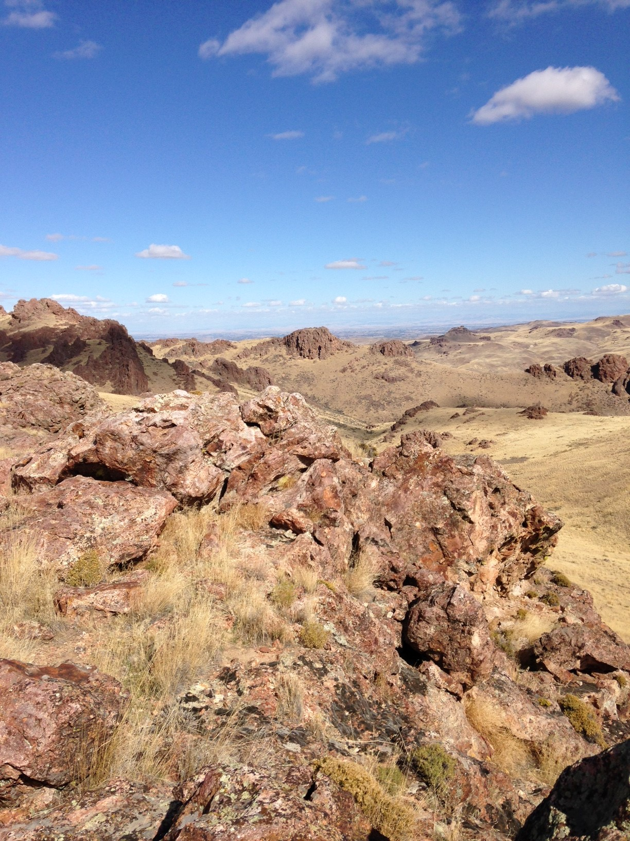
Bpa Budget guidance?
Discussion?

