Slide 1
StreamNet Steering Committee
July 21, 2016

Slide 2
Agenda
How are we doing in the final push to get NOSA and juvenile data for BPA priority populations?
  Partner updates
  Impacts to other priorities, issues, etc.
End of Year Spending and FY 2017 Budget
  Partner updates on any spending issues (+ or -)
  Opportunity to roll $50k in savings into next FY
  Sub-contract for Tribal Coordination
  Alternatives (device purchases, other?)
  End of Current EPA grant – spending & Close out
Discuss a possible EPA grant for Bull Trout -WDFW sponsor
  Identify interested parties (organizations & specific contacts)
  Brainstorm alternatives;
    Bull Trout Distribution updates
    Range-wide status assessment
    Other?
Adjourn

Slide 3
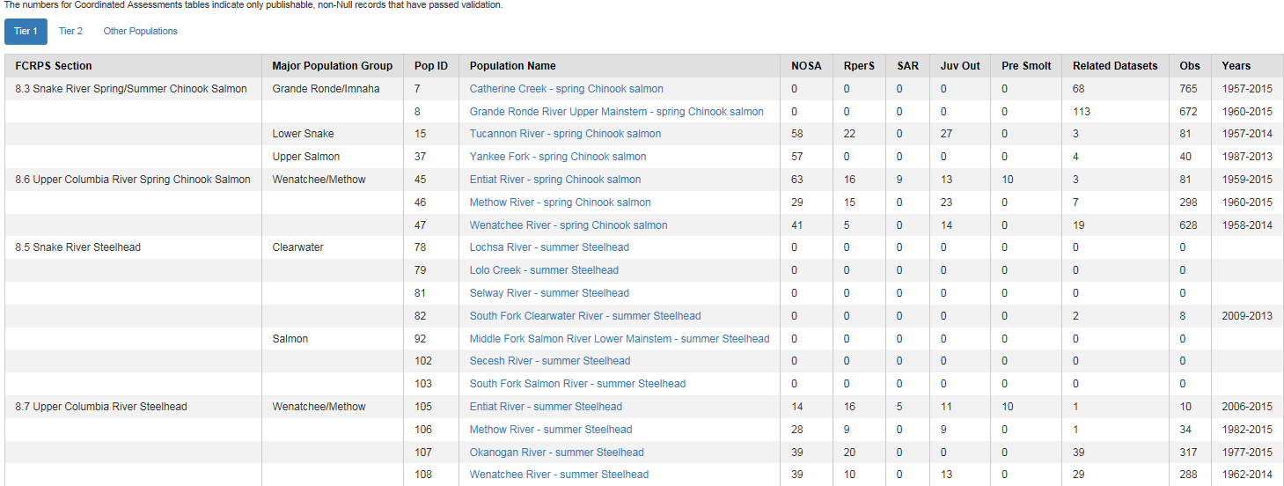
NOSA & Juvenile Data Update: Tier 1

Slide 4
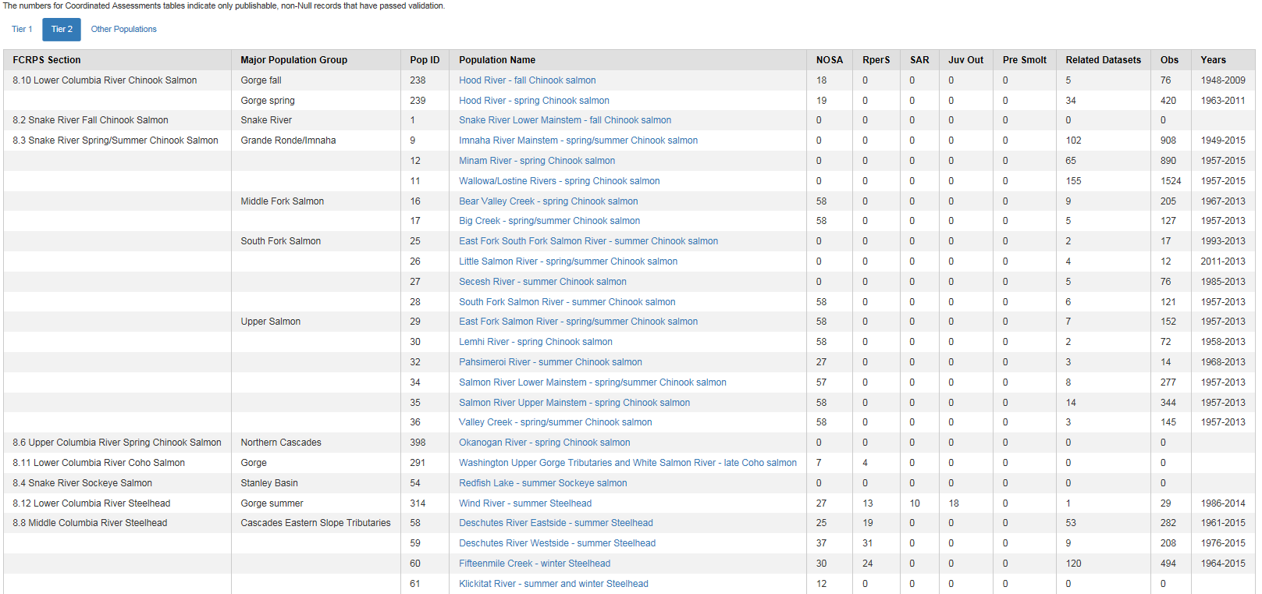
NOSA & Juvenile Data Update: Tier 2

Slide 5
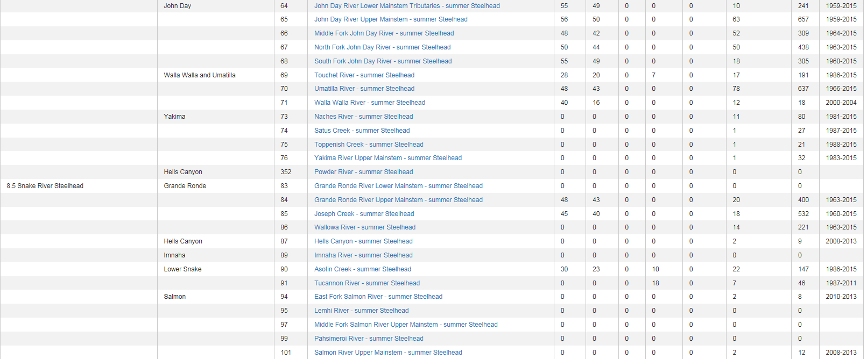
NOSA & Juvenile Data Update: Tier 2 (continued)

Slide 6
  *Partner updates
  *Impacts to other priorities
  * Other issues & discussion

Slide 7
End of Year Spending and FY 2017 Budget
  *Partner updates on any spending issues (+ or -)
  *Opportunity to roll $50k in savings into next FY
  *Sub-contract for Tribal Coordination
  *Alternatives (device purchases, other?)
  *End of Current EPA grant – spending & Close out

Slide 8
Suggested Response; Save +/- 50k, Use to;
Restore to 100% of FY 16 Levels; Eliminate cuts Needed to Balance;
This was the situation before restoration;
CCT for data compilation and submission | $90,000
IDFG for data compilation and submission | $331,288
MFWP for data compilation and submission | $168,877
ODFW for data compilation and submission | $474,458
USFWS for data compilation and submission | $78,248
WDFW for data compilation and submission | $470,530
$89,380 |  |  | 99.31%
$329,012 |  |  | 99.31%
$155,000 |  |  | 91.78%
$471,210 |  |  | 99.32%
$77,719 |  |  | 99.32%
$467,323 |  |  | 99.32%
 |  |  | 95.59% | PSMFC (staff, travel, meetings, supplies, web)

Slide 9
Also Propose a Tribal Coordination Subcontract, so the FY 17 Budget would have these “additions”;
CCT | $620
IDFG | $2,276
MFWP | $13,877
ODFW | $3,248
USFWS | $529
WDFW | $3,207
PSMFC | $2,000
Subtotal | $25,758
Subcontract for Iverson | $24,000
Total | $49,758
New FY 17 annual amount | $2,195,241

Slide 10
Do need to identify $50k in savings and agree that this is the right way to spend them
PSMFC should be able to save at least $40K, but are there any other know savings out there?
About 25% of year remaining,
But billing varies

Slide 11
Also have a standing request for additional devices (please update);
Oregon Replacement Desktop (high priority) $3,500
Idaho Replacement Tablets $3,500
Washington 2 Toughpads ($3500 each) $7,000
Oregon 2 Toughpads $7,000

Slide 12
Budget Decisions;
Save 50K this fiscal year and apply to next?
Where do savings come from?
If yes to savings;
Spend savings as proposed, or;
Buy additional devices, or;
Do both (if savings identified), or;
Do some combination?

Slide 13
Possible EPA grant for Bull Trout -WDFW sponsor
  Identify interested parties (organizations & specific contacts)
  Brainstorm alternatives;
    Bull Trout Distribution updates
    Range-wide status assessment
    Other?

Slide 14

Adjourn

