Slide 1
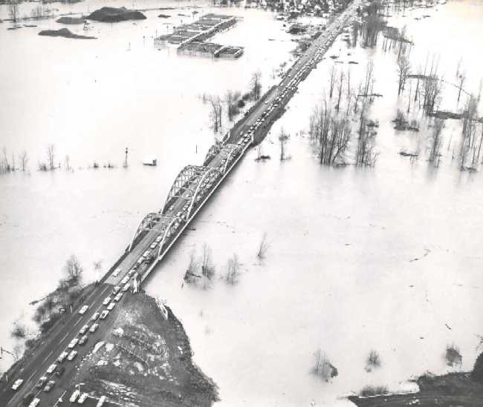
StreamNet Steering Committee
02/09/17 Budget Meeting
Prepare for StreamNet Executive Committee Budget Review 03/07/17
(Focus on Improving the presentation!)
Go Over CA Data Flow Survey Results
Quick Update on next Budget, Annual Reports, New SOW

Slide 2
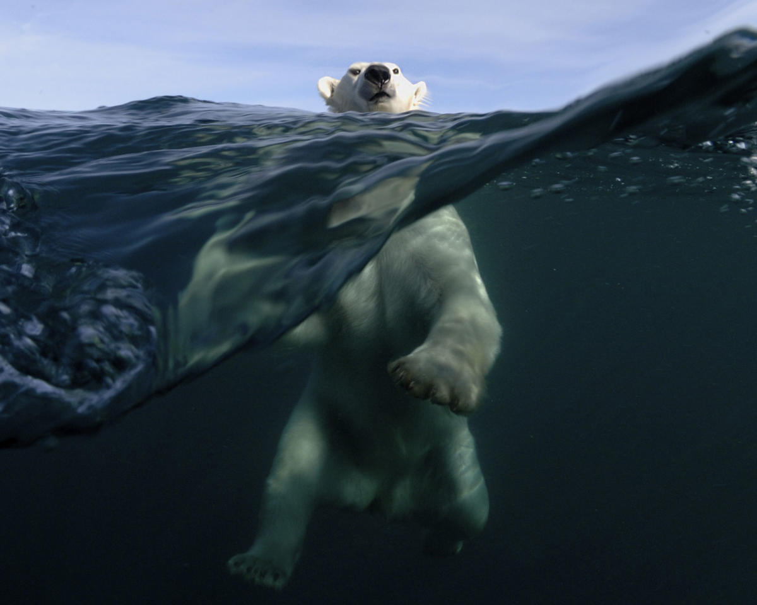
BPA Would Like a Budget Review ☺

Slide 3
 | Category % of Total | 71.1% | 17.8% | 7.2% | 1.7% | 1.4% | 0.8% | 0.1%
Agency% of Total |  | Total Personnel Expense | Indirect/ OverHead | Sub-Contracts | Rent | Travel | Supplies & Equip | Meetings & Training
26.5% | PSMFC | $441,141 | $87,299 | $24,000 | $24,500 | $1,850 | $2,050 | $1,000
4.1% | CCT | $15,952 | $4,815 | $68,382 | $0 | $852 | $0 | $0
15.1% | IDFG | $256,995 | $65,637 | $0 | $0 | $5,652 | $3,004 | $0
7.7% | MFWP | $80,279 | $16,312 | $65,568 | $0 | $4,380 | $2,088 | $250
21.6% | ODFW | $361,290 | $91,769 | $0 | $6,986 | $6,193 | $8,220 | $0
21.4% | WDFW | $346,959 | $106,371 | $0 | $5,136 | $10,220 | $1,844 | $0
3.6% | USFWS | $58,794 | $18,744 | $0 | $0 | $710 | $0 | $0
100.0% | Total | $1,561,410 | $390,947 | $157,950 | $36,622 | $29,857 | $17,206 | $1,250
 | Total FY Budget | $2,195,241
96% !
Notes:
Indirect rates are;
PSMFC 15%
CCT 5.4%
IDFG 19.8%
MFWP 9.7%
ODFW 19.3%
WDFW 22.6%
USFWS 23.9%
Average 17.8%

Slide 4
Agency % of Total Budget | Staffing | Months | FTE | % of FTE
26.9% | PSMFC | 43.2 | 3.6 | 22.8%
4.1% | CCT | 2.0 | 0.2 | 1.1%
15.0% | IDFG | 34.0 | 2.8 | 17.9%
7.7% | MFWP | 13.2 | 1.1 | 7.0%
21.5% | ODFW | 41.5 | 3.5 | 21.9%
3.5% | USFWS | 8.2 | 0.7 | 4.3%
21.3% | WDFW | 47.6 | 4.0 | 25.1%
100.0% | Totals | 189.7 | 15.8

Slide 5
Major Work Elements from SOW
Coordination, Management,
  Reporting 45.92%
Coordinated Assessments 27.34%
Enhancing Efficiency and Transfer
  Of Data 16.34%
Traditional Data 10.22%

Slide 6
StreamNet should provide accessible and useful displays of information at the regional scale, with special focus on the CA project
Focus the CA project on high level indicators that support regionally significant monitoring efforts, agencies and tribes should submit data that support population level assessments. Where such data are lacking, use lower level or even higher level information and incorporate that into the CA database.
Where data are needed in support of regional prioritization (i.e. resident fish data for NPCC indicators and dashboards), BPA and the StreamNet Executive Committee should clearly convey to agencies the importance of contributing to regional efforts.
CA methodologies for calculation of high level indicators should be fully documented.
The StreamNet Data Store should continue to serve a role as a secure environmental data repository.
StreamNet should continue to play a role in the development and deployment of emerging technologies in fisheries data collection through sponsorship of workshops
StreamNet partners should focus first on updating time series data for established trends (i.e., those already defined and mapped in the regional GIS) prior to making any effort to identify and map new stream survey reaches.
Fish Distribution as a StreamNet data category should be redefined as a GIS dataset that is exchanged (or compiled regionally) using GIS file formats.
                FY 2017 SOW Priorities

Slide 7
FY 2017 Priorities from ExComm
  Populating the existing natural origin indicators
  Survey partners to get information on predicted dataflow for the year, including information on “predicted” data, which shows where population level data is not/won’t be available
  Continue to work with CRITFC tribes to include them in data flow to the extent that resources allow them to do so.
  Bull trout workshop to identify players, discuss data needs, and identify future paths forward for regional data sharing for this species

Slide 8
Percentage of effort is being spent on CA; Estimate 75% CA, balance coordination, reporting, administration, traditional data, distribution, etc.
Tasks involved include database management and queries (Bill, Greg, Mike); DES development (Mike, Chris); Website programming, APIs, etc. (Greg, Mike, Bill); Data QA/QC (Bill, Mike); Coordination (Chris, Mike, Bill); Project Management (Chris)
Proportion of effort that is technical assistance to CA; Bill and Greg 85%; Mike; 75%
What does that assistance entail (in general categories); Programming, QA/QC, DES development, API development
What are the other major uses of StreamNet staff time; Coordination with other entities and projects (i.e. Council, NOAA, CRITFC, tribes); administration (budget, expenditures, reporting, etc.)

Slide 9
Months FTE
Time on Stream-net accordingly:
40 hours to prep for Excom meetings
40 hours to travel to Excom meetings
40 hours to participate in Excom meetings
80 hours to do busy work like this and respond to inquiries from stream-net staff
80 hours to coordinate with others in my agency related to stream-net activities
40 hours to oversee deliverables under CA
Sitka Tech contract (76% of budget):
1) 40 hours to prep for steering com meetings
40 hours to travel to Steering com meetings
40 hours to participate in Steering com meetings
80 hours to respond to inquiries from stream-net staff
80 hours to coordinate with others agencies related to stream-net activities
260 to compile and actually push CA data
320 hours To enhance and maintain tribal data systems
100+ hours to help push traditional data set as time allows

Slide 10
IDFG
Project Leader/IFWIS Mgr. (Butterfield | 5 | mo. | 33 | 2.75
Database Analyst, Sr. (Walsh) | 7 | mo.
Integration Systems Analyst, Sr. (Harrington) | 11 | mo.
Data Coordinator (Brown) | 10 | mo.
Quantify staff effort (money, time, or both?) tied to specific products (e.g., what percentage of effort is being spent on CA? Coordinated Assessments - 90% Traditional trend data - 10%
What are the tasks involved, and who spends how much time on them? Obtain data - Brown 2 mo., Harrington 8 mo., Walsh 5 mo. Manage data - Brown 2 mo. Analyze data - Brown 1 mo. Deliver data - Brown 1 mo., Harrington 1 mo., Walsh 0.5 mo. Training - Brown 1 mo., Harrington 1 mo., Walsh 0.5 mo., Butterfield 0.5 mo. Tech. Assist. - Brown 2 mo., Harrington 1 mo., Walsh 1 mo., Butterfield 0.5 mo. Coordination - Brown 1 mo, Butterfield 2 mo. Administration - Butterfield 2 mo.

Slide 11
IDFG continued
Proportion of effort considered technical assistance to CA? - 10%
What does that assistance entail (in general categories)? Application-use training Understanding indicators Understanding data exchange standards Locating hard-to-find data Custom analyses and reports
What are the other major uses of StreamNet staff time? Department requirements, such as meeting, administration, record keeping, training, etc. Assistance in data collection Coordination with other projects

Slide 12
Months FTE
MFWP
Data Analyst (Horton) |  |  | 12.0 | mo. | 13.2 | 1.1
Project Lead (Anderson) |  |  | 1.2 | mo.
Due to the program’s current focus on anadromous species, MT spends StreamNet time and dollars on critical traditional datasets like distribution, survey and inventory, genetics and native species assessments. Time and dollars are also spent on development and enhancement of our internal database systems and spatial data.
Since October 1, 2016 20% of the analyst time has been spent on the multi-state/agency YCT assessment. This includes data prep, meetings with each GMU, data edits/QC, GIS layer creation, submitting the data to StreamNet, developing a presentation and annual presentation. StreamNet staff do the most of this work, however there is assistance by non SN staff.
Data and GIS Layer maintenance, data editing/QC and data exchange: 20%
Hydrography updates – moving to 1:24k hydro: 18%
Map/data requests and staff support: 13%
Tool development like the distribution editor, have been developed with a mixture of StreamNet and non StreamNet funds

Slide 13
Months FTE
Quantify staff effort (money, time, or both?) tied to specific products (e.g., what percentage of effort is being spent on CA?
100% of time paid by BPA goes to specific StreamNet SOW products
~44% of time paid by BPA is spent on CA WE’s
Note: ODFW’s budget represents the template we intend to follow through the year. However, if staff are reassigned under other funding due to agency priorities, StreamNet funding is diverted to other staff (Bliesner, Firman, newly hired staff) as time and resources allow to focus on targeted StreamNet priorities (typically CA tasks).
What are the tasks involved, and who spends how much time on them?
40% Coordination, Management, Reporting
44% Coordinated Assessments
4% Enhancing Efficiency and Transfer Of Data
11% Traditional Data
* Bliesner & Firman perform these tasks as needed depending on available time and resources. See note above

Slide 14
ODFW
What proportion of effort is technical assistance to CA?
Q: What does this constitute – just helping others or everything associated with CA or something in between? The answer can be provided once we identify which WEs fall into this category.
What does that assistance entail (in general categories)?
The answer can developed once we identify which WEs fall into this category.
What are the other major uses of StreamNet staff time?
Department requirements, such as meeting, administration, record keeping, training, etc.
Coordination with other projects
Monitoring and participation in setting agency direction relate to data management, standards, compilation methods, etc.

Slide 15
Months FTE
Quantify staff effort (money, time, or both?) tied to specific products (e.g., what percentage of effort is being spent on CA?
What are the tasks involved, and who spends how much time on them?
What proportion of effort is technical assistance to CA?
What does that entail (in general categories)?
What are the other major uses of StreamNet staff time?

Slide 16
Months FTE
Quantify staff effort (money, time, or both?) tied to specific products (e.g., what percentage of effort is being spent on CA?
--~100%
What are the tasks involved, and who spends how much time on them?
Database Development:
  Lead, consult, and coordinate with other WDFW staff members across the Columbia Basin to advance legacy data storage systems.
  Verify regional dataset contents for accuracy and submit datasets to corporate database.
  Manage WDFW SQL CA database to incorporate the CA data (indicators, metrics and metadata) in DES format, and participate in management of the CA DES.

Slide 17
WDFW
  What are the tasks involved, and who spends how much time on them? (con’t)
  Lead, consult, and coordinate with other WDFW staff members across the Columbia Basin to advance legacy data storage systems that contain the supporting metrics and metadata necessary to populate the CA database with a focus on the following.
  SGSm – Spawning Ground Survey data
  JMS – Juvenile data
  SaSI – Adult Reporting
    SPi – New SaSI to contain and report CA HLI data
  Age and Scales – Data flow from SGSm to Age and Scales
Technical Assistance:
  Conduct information technology training sessions and develop training materials for field and technical staff.
  Work with biologists and research scientists to develop complex tools integral for data analysis and reporting.
  Will work with regional entities to contribute data management expertise toward development of activities within the scope of the Fish and Wildlife Program and serve as a data management resource to the FWP.
  Participate in field testing of data capture devices and creating data entry forms for the devices.

Slide 18
WDFW
What proportion of effort is technical assistance to CA?
100% (not sure I understand the distinction from the first Q)
What does that assistance entail (in general categories)?
See above itemized detail
What are the other major uses of StreamNet staff time?
Projects funded by other sources where StreamNet staff is needed for technical needs and expertise (2-3 Staff Mos.)
Sport and Commercial (Columbia Harvest) database:
  Oversee this database and the implementation of it to house sport harvest data and commercial harvest data on the mainstem Columbia River. Exchange the proofed data with ODFW monthly. Migration to MaRSS database
  Create E-data forms for data collection
  PIT Tag management
  Implement New technologies (e.g.Bluetooth PIT Tag readers, iForm – iPads
Regional Evaluation:
  Created and manages Access database to store Columbia River Regional Evaluation and alternative gear biological and PIT tag data.
  Leads in the designing of queries and output reports to summarize, manage, and report the collected data.

Slide 19
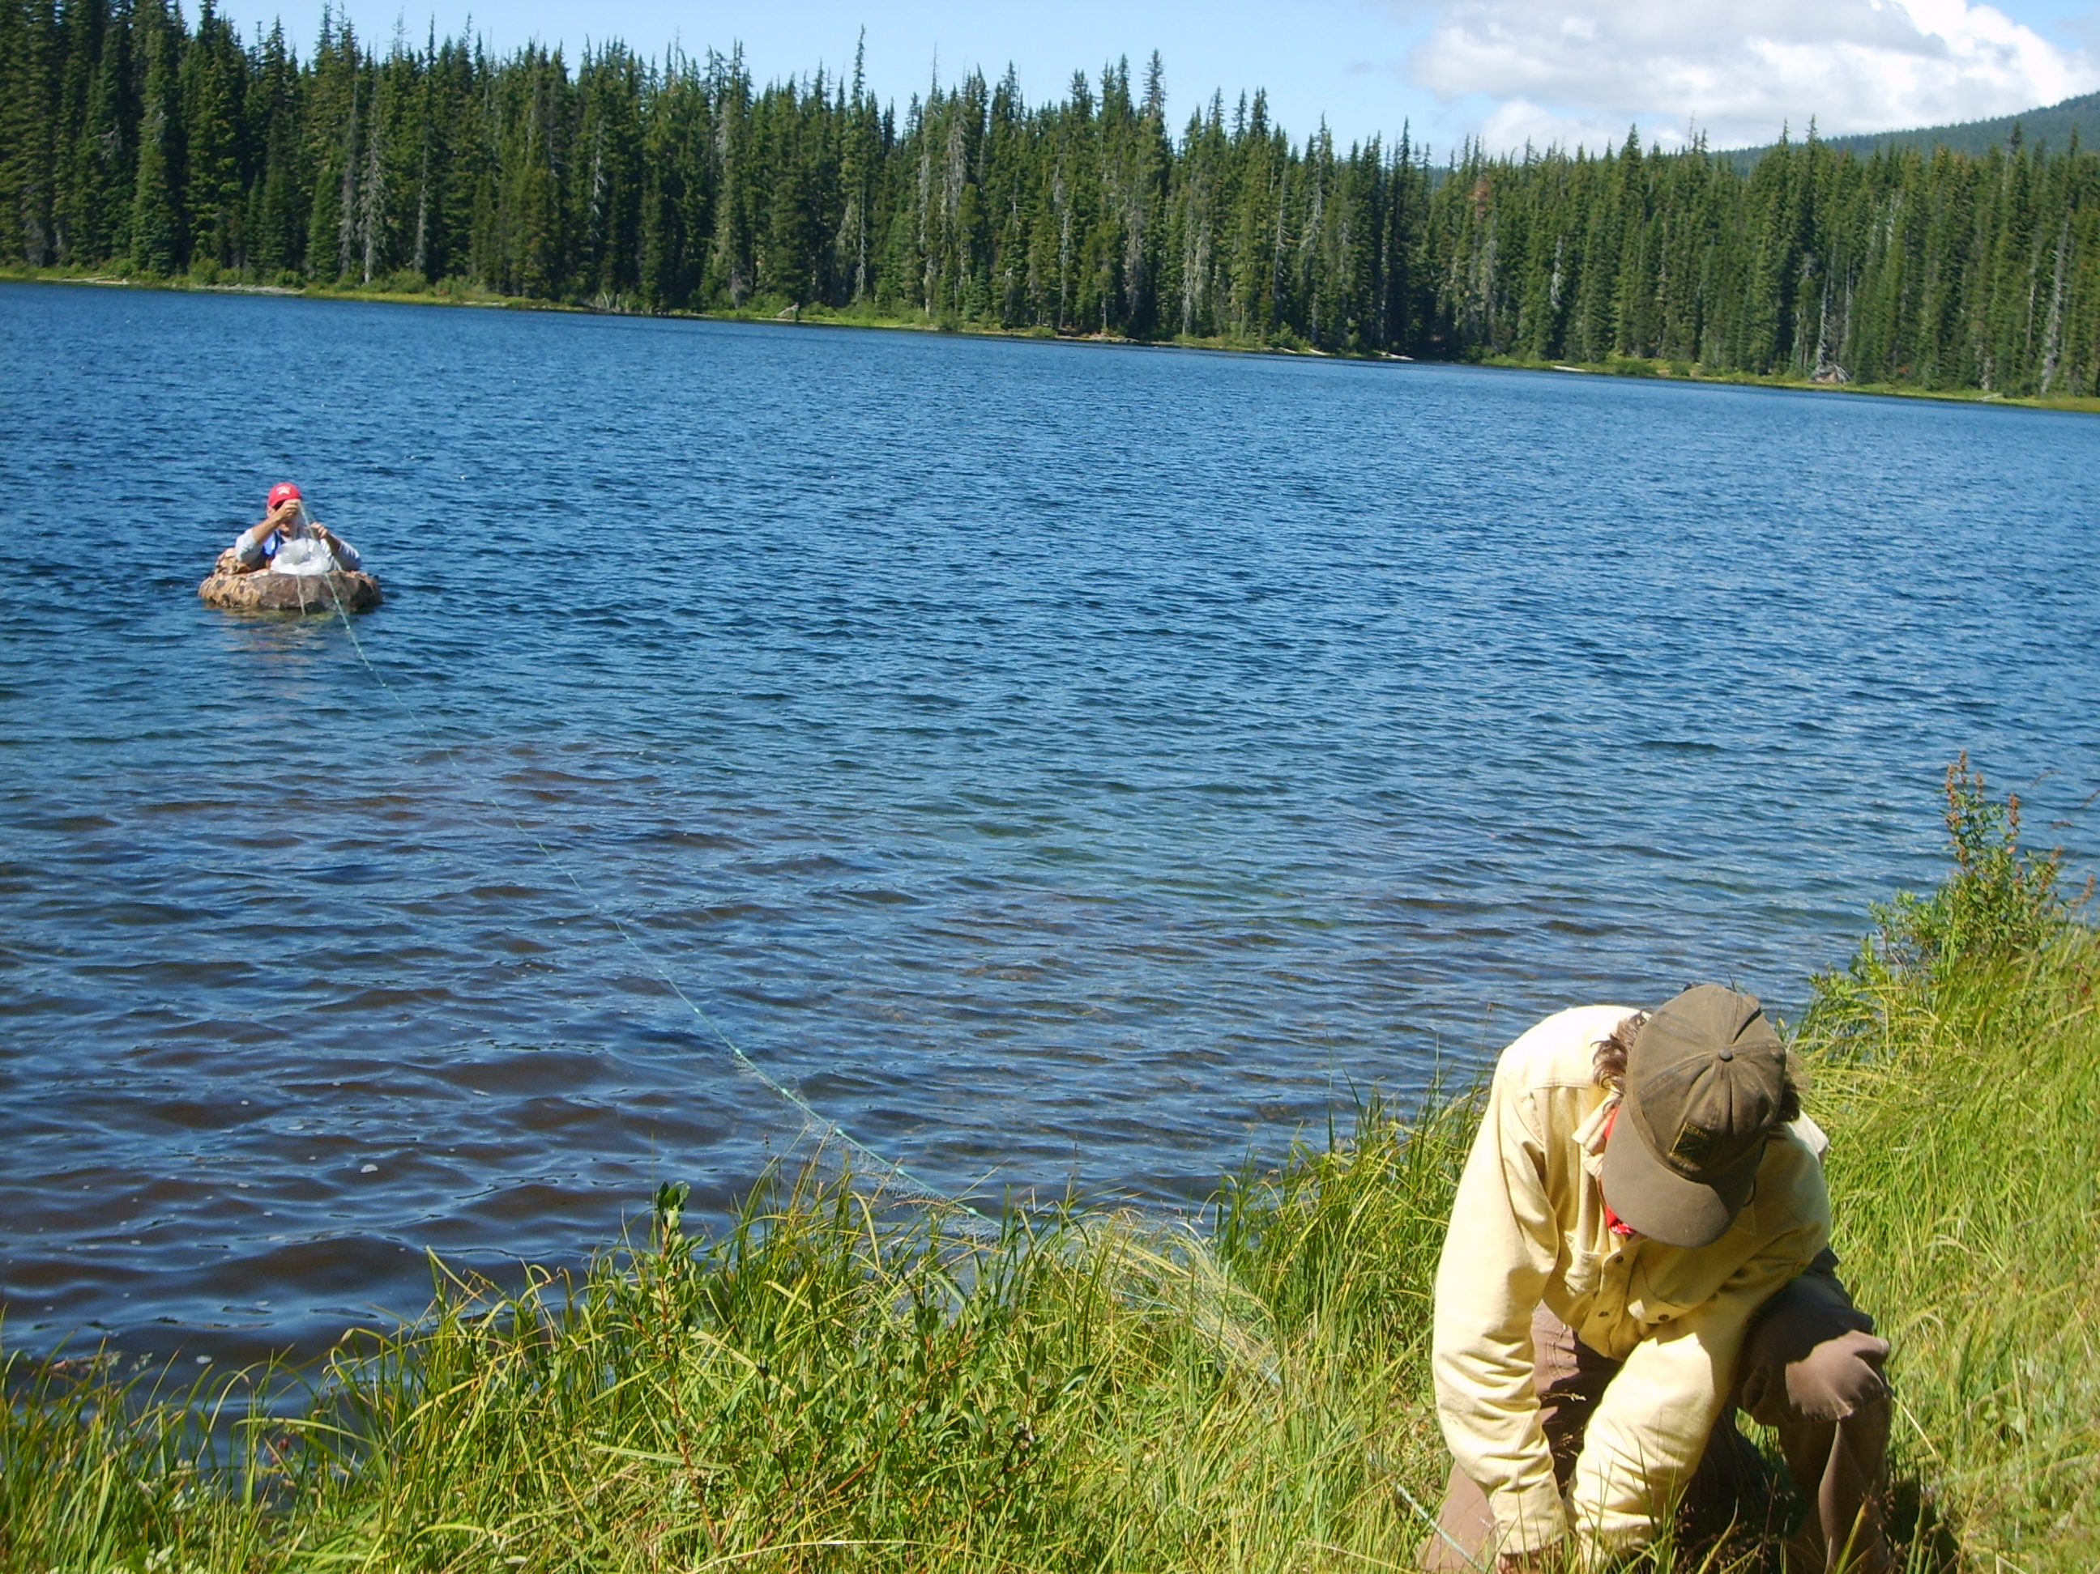
BPA Budget, Annual Reports, New SOW

Slide 20
New BPA Budget Format
Hours & Unit Costs, Benefit Reporting Changes
Will Require a Little Work to Prepare the Budget
Notes:
Two year budget ?
Timeline is that we will need budgets prepared in next month or so (last one was due 3/31/2016
New format requires hourly pay rates
BPA guidance?

Slide 21
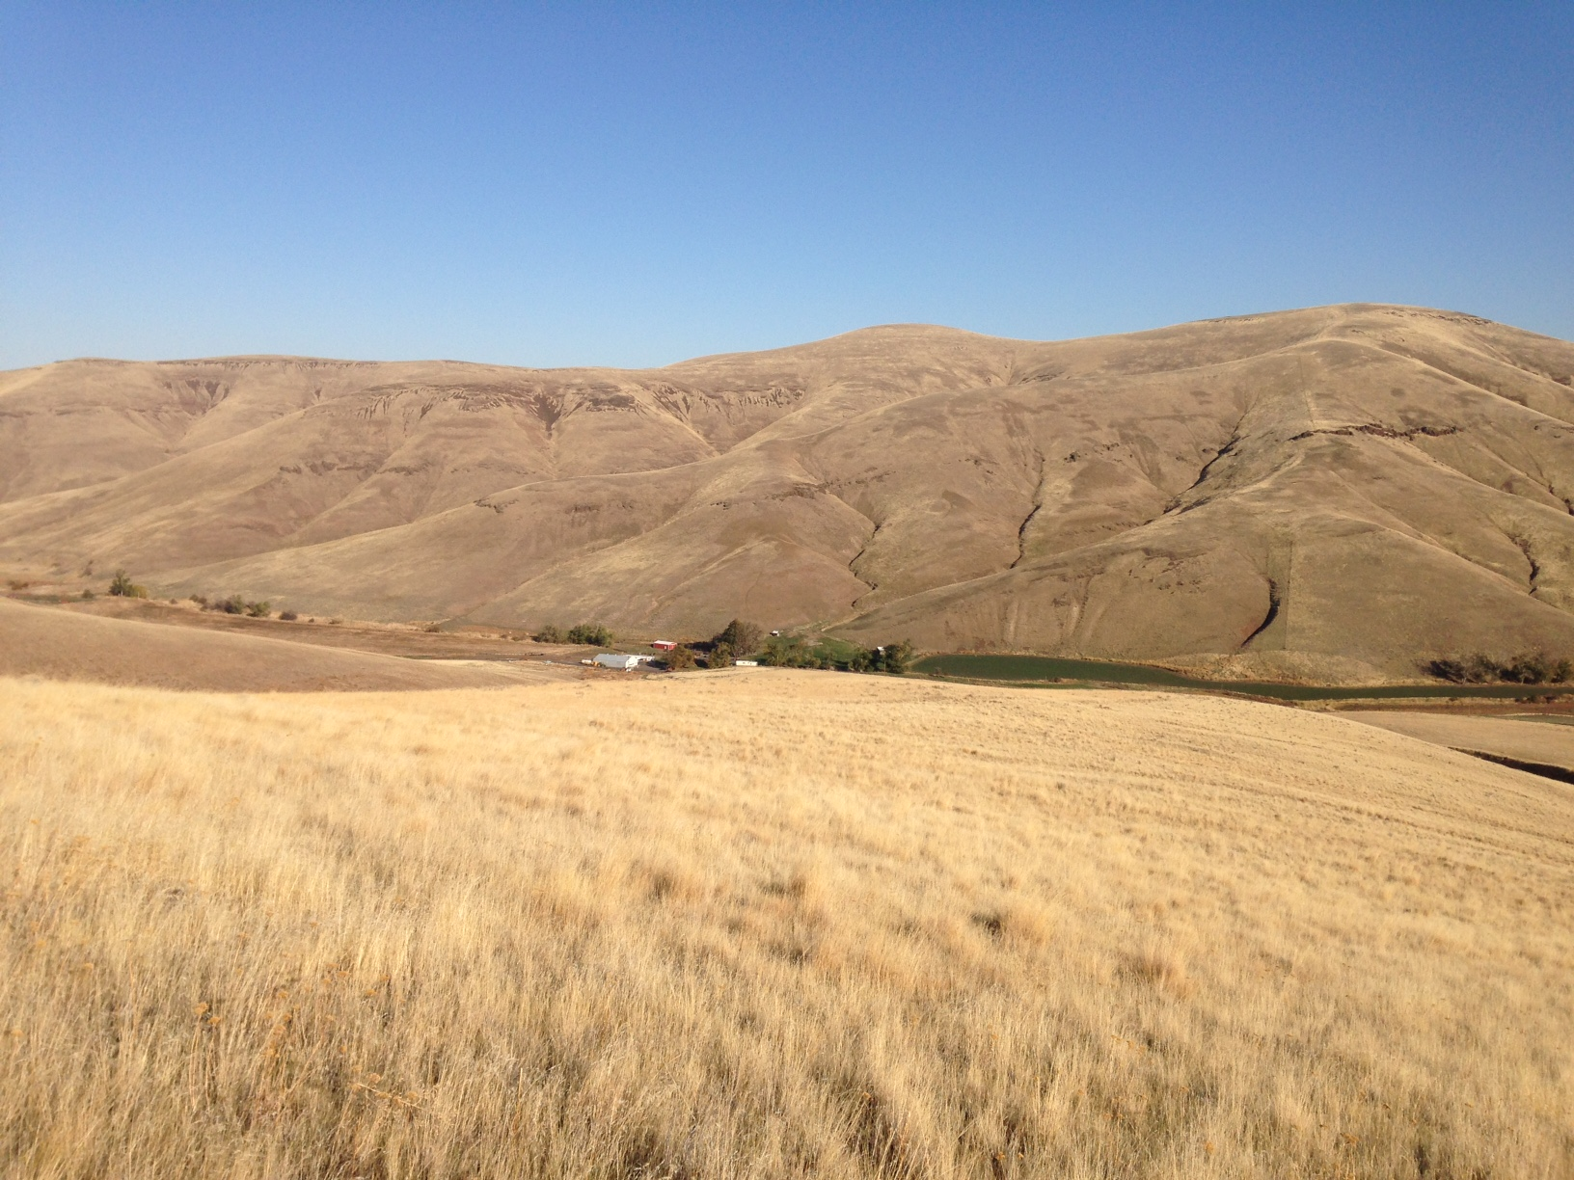
CA Data Flow
Final for FY 2016 and
Predictions for FY 2017

Slide 22
2016 CA Data Flow – Final for Annual Reports

Slide 23
Update on FY-2017 CA Data Predictions as of 20170208
Thank you everyone for all the hard work you have put into filling in this document. It is coming along nicely and it looks like all of you have entered data. We have done a sort and come up with a couple of TRT populations where no one has identified the population as being “theirs” – they are blank. We ignored extirpated populations and CRITFC superpops. There also are a few “?” pops – next slide – we would like to resolve these today if possible.
In the next week or so, it would be a big help if you could re-enter the google spreadsheet and check the current status, particularly for “your” populations and those in your states. Let us know if you see anything weird or wrong.

Slide 24
Update on FY-2017 C.A.Data Predictions as of 20170208
Remaining "Question" 17 Populations that are not marked "Extirpated"
Agency | PopulationName | Comments | SNPopID
 | Steelhead (Middle Columbia River DPS) Rock Creek - summer |  | 62
 | Steelhead (Upper Columbia River DPS) Crab Creek - summer |  | 104
CCT? | Salmon, Chinook (Upper Columbia River spring-run ESU) Okanogan River - spring |  | 345
CCT? | Salmon, Chinook (Upper Columbia River spring-run ESU--XN) Okanogan River - spring |  | 398
CRITFC | Salmon, Chinook (Snake River fall-run ESU) Snake River Lower Mainstem - fall |  | 1
CRITFC | Salmon, Chinook (Upper Columbia River spring-run ESU) Wenatchee River - spring |  | 47
CRITFC | Steelhead (Middle Columbia River DPS) Deschutes River Eastside - summer |  | 58
NPT? | Salmon, Chinook (Snake River spring/summer-run ESU) East Fork South Fork Salmon River - summer |  | 25
NPT? | Salmon, Chinook (Snake River spring/summer-run ESU) Lapwai/Big Canyon Creeks - unknown |  | 2
NPT? | Salmon, Chinook (Snake River spring/summer-run ESU) Lawyer Creek - unknown |  | 3
NPT? | Salmon, Chinook (Snake River spring/summer-run ESU) Lolo Creek - unknown |  | 39
NPT? | Salmon, Chinook (Snake River spring/summer-run ESU) Meadow Creek - unknown |  | 41
NPT? | Salmon, Chinook (Snake River spring/summer-run ESU) Secesh River - summer |  | 27
NPT? | Steelhead (Snake River Basin DPS) Imnaha River - summer | ODFW contributes a portion of related data to StreamNet. | 89
NPT? | Steelhead (Snake River Basin DPS) Lolo Creek - summer |  | 79
NPT? | Steelhead (Snake River Basin DPS) Secesh River - summer |  | 102
YNF? | Steelhead (Middle Columbia River DPS) Yakima River Upper Mainstem - summer |  | 76

Slide 25
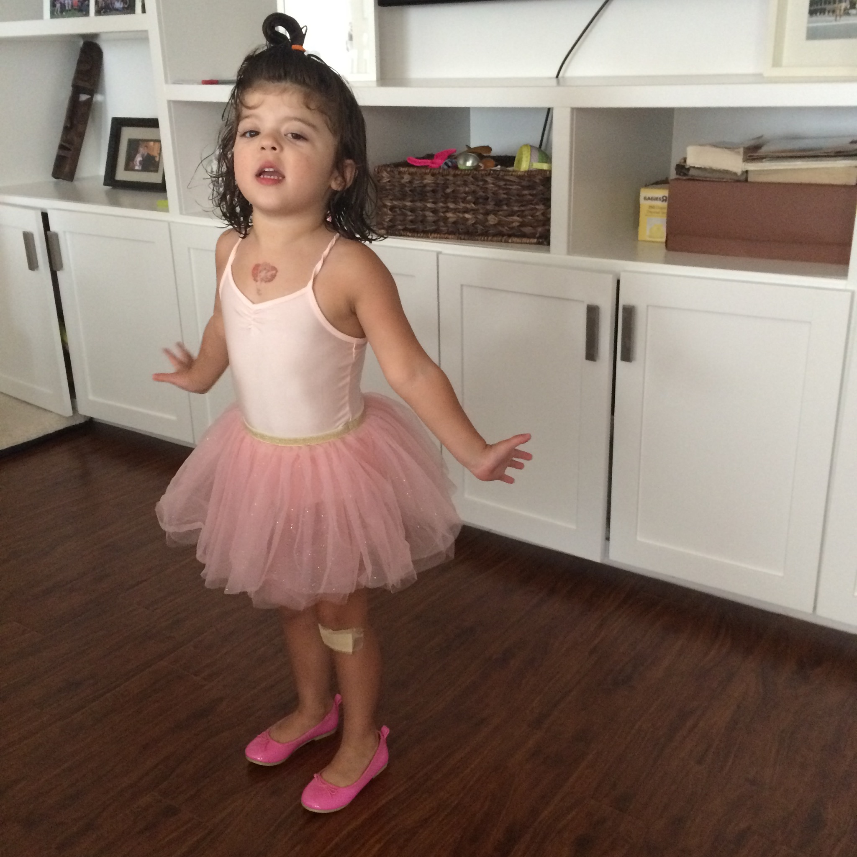
Results Preview!

Slide 27
Y = We can calculate this indicator and will be providing data in FY 2017.
X = It is not possible to calculate this indicator for this population.
N = Indicator calculation for this population is at least theoretically possible, however we will be unable to provide data in FY 2017.
<>= Blank in online Google Sheet or Agency entered with a “?”

Slide 28
Y = We can calculate this indicator and will be providing data in FY 2017.
X = It is not possible to calculate this indicator for this population.
N = Indicator calculation for this population is at least theoretically possible, however we will be unable to provide data in FY 2017.
<>= Blank in online Google Sheet or Agency entered with a “?”

Slide 29
Y = We can calculate this indicator and will be providing data in FY 2017.
X = It is not possible to calculate this indicator for this population.
N = Indicator calculation for this population is at least theoretically possible, however we will be unable to provide data in FY 2017.
<>= Blank in online Google Sheet or Agency entered with a “?”

Slide 30
Y = We can calculate this indicator and will be providing data in FY 2017.
X = It is not possible to calculate this indicator for this population.
N = Indicator calculation for this population is at least theoretically possible, however we will be unable to provide data in FY 2017.
<>= Blank in online Google Sheet or Agency entered with a “?”

Slide 31
Y = We can calculate this indicator and will be providing data in FY 2017.
X = It is not possible to calculate this indicator for this population.
N = Indicator calculation for this population is at least theoretically possible, however we will be unable to provide data in FY 2017.
<>= Blank in online Google Sheet or Agency entered with a “?”

Slide 32

EXTRA SLIDES

