Slide 1
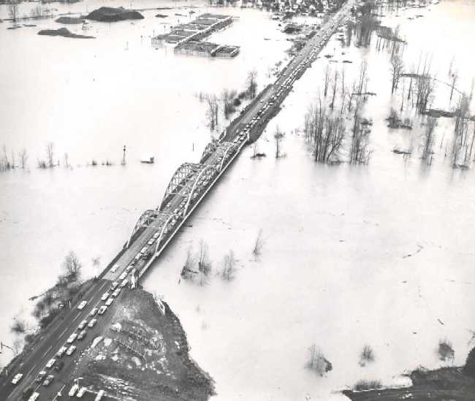
StreamNet Executive Committee
03/07/17 Meeting
Executive Committee Budget Review of CURRENT Budgets
FY 2017
Review of Draft NEXT Budget and New SOW
FY 2018 & 2019
Predicted CA Data Flow Survey Results & Discussion
Discuss CA Priorities – Hatchery Indicators, Resident Fish, etc.
Roundtable/Good of the Order

Slide 2

Lunch Order !

Slide 3

FY 2017 Budget Review

Slide 4
 | Category % of Total | 71.1% | 17.8% | 7.2% | 1.7% | 1.4% | 0.8% | 0.1%
 |  | Total Personnel Expense | Indirect/ OverHead | Sub-Contracts | Rent/ Utilities | Travel | Supplies & Equip | Meetings & Training
 | PSMFC | $441,141 | $87,299 | $24,000 | $24,500 | $1,850 | $2,050 | $1,000
 | CCT | $15,952 | $4,815 | $68,382 | $0 | $852 | $0 | $0
 | IDFG | $256,995 | $65,637 | $0 | $0 | $5,652 | $3,004 | $0
 | MFWP | $80,279 | $16,312 | $65,568 | $0 | $4,380 | $2,088 | $250
 | ODFW | $361,290 | $91,769 | $0 | $6,986 | $6,193 | $8,220 | $0
 | WDFW | $346,959 | $106,371 | $0 | $5,136 | $10,220 | $1,844 | $0
 | USFWS | $58,794 | $18,744 | $0 | $0 | $710 | $0 | $0
 | Total | $1,561,410 | $390,947 | $157,950 | $36,622 | $29,857 | $17,206 | $1,250
 | Total FY Budget | $2,195,241
96% !
Notes:
Indirect rates are;
PSMFC 15%
CCT 5.4%
IDFG 19.8%
MFWP 9.7%
ODFW 19.3%
WDFW 22.6%
USFWS 23.9%
Average 17.8%

Slide 5
Agency % of Total Budget | Staffing | Months | FTE | % of FTE
26.9% | PSMFC | 43.2 | 3.6 | 22.8%
4.1% | CCT | 2.0 | 0.2 | 1.1%
15.0% | IDFG | 34.0 | 2.8 | 17.9%
7.7% | MFWP | 13.2 | 1.1 | 7.0%
21.5% | ODFW | 41.5 | 3.5 | 21.9%
3.5% | USFWS | 8.2 | 0.7 | 4.3%
21.3% | WDFW | 47.6 | 4.0 | 25.1%
100.0% | Totals | 189.7 | 15.8
Notes:
Average cost is $98,823 per FTE (salaries and benefits)

Slide 6
Major Work Elements from SOW
Coordination, Management,
  Reporting 45.92%
Coordinated Assessments 27.34%
Enhancing Efficiency and Transfer
  Of Data 16.34%
Traditional Data 10.22%
BPA StreamNet funding is used by most partners as an integral part of a broader data management infrastructure. These systems have high level regional benefits beyond what is funded by BPA. CA work connects to the Council’s needs to report on status and trend of species as well as informing progress towards objectives per the 2014 Program. < Next Slide >

Slide 7


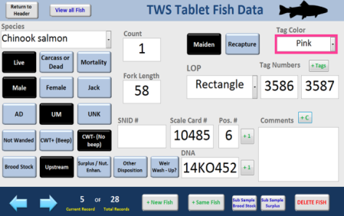
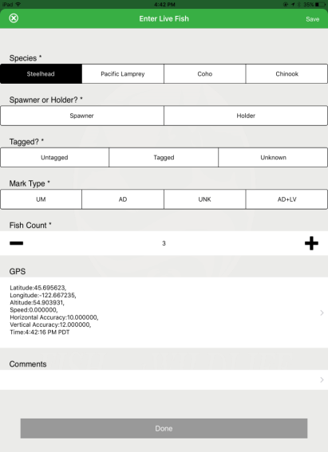
WDFW - Electronic Data Capture – EDC
Panasonic Toughpads - Initial BPA purchase of 5 Panasonic Toughpads in 2014 has grown to 34 total Toughpads for Columbia River projects (16 BPA, 18 other funding sources). These units are used at fixed site locations (Adult and Juvenile traps & weirs)
iPads – Due to the success of incorporating EDC, 42 iPads using iForm software to create custom sampling forms have been implemented for use in redd surveys and is expanding to all projects where applicable
EDC is possible because of standardized DB structure in JMX, TWS, & SGS.
ODFW - Created and shared applications to read CA data from Access, load into SQL & extract data out of SQL and deliver to PSMFC via the SN API

Slide 8
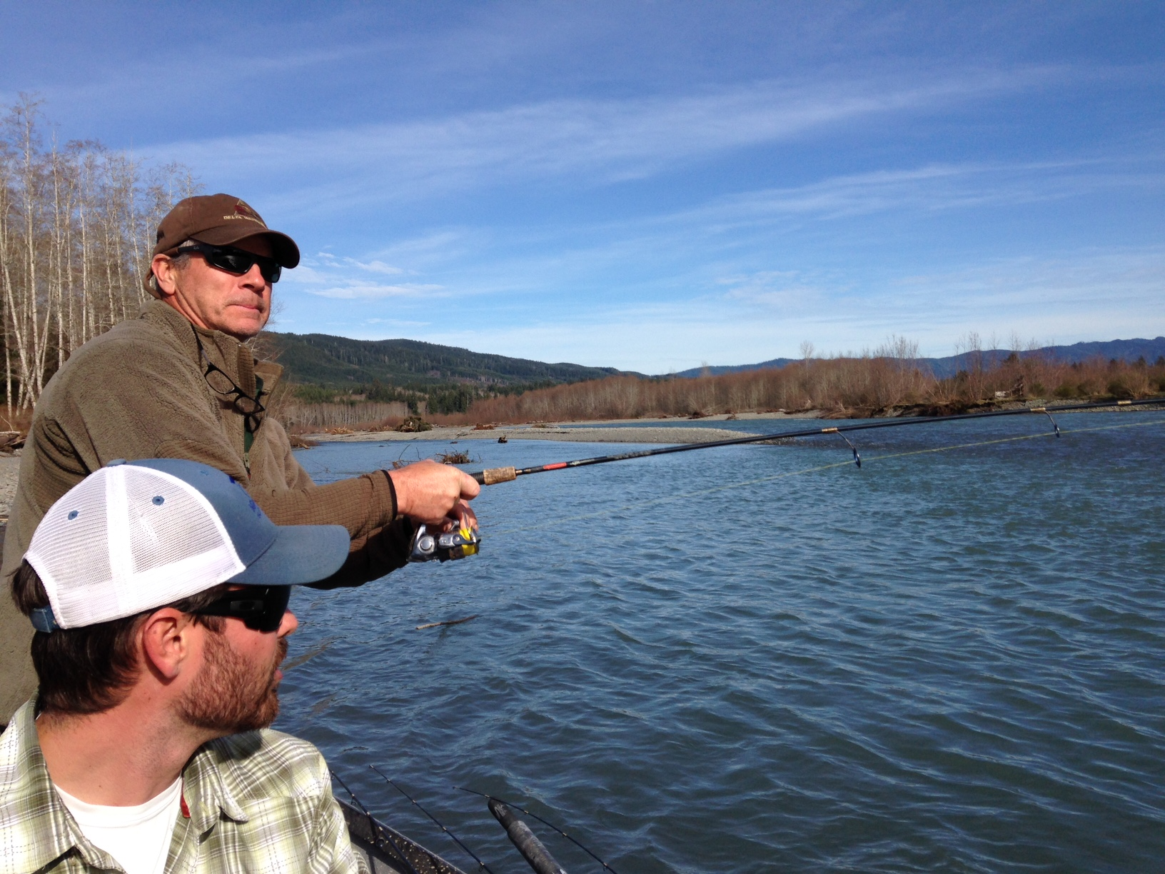
Each Partner will review existing FY 2017 Budget
Please note that flexibility from the budget templates provided (i.e. the specific staff listed, number of months, etc. in each agency) is often needed to address in-year issues, changes, shortfalls, cost increases, etc.
Review of Subcontract Budgets

Slide 9
Budget includes a $24,000 contract with Tom Iverson to coordinate tribal participation in the Coordinated Assessments Project
25% Coordination, Management, Reporting
55% Coordinated Assessments
15% Enhancing Efficiency and Transfer Of Data
5% Traditional Data
Tasks involved include database management and queries (Bill, Greg, Mike); DES development (Mike, Chris); Website programming, APIs, etc. (Greg, Mike, Bill); Data QA/QC (Bill, Mike); Coordination (Chris, Mike, Bill); Project Management (Chris). Staff provide technical assistance including; Programming, QA/QC, DES development, API development. Coordination with other entities and projects (i.e. Council, NOAA, CRITFC, tribes) and administration (budget, expenditures, reporting, etc.) are major work elements
Have reduced PSMFC BPA funding from $748,062 in 2014 to $581,840 in FY 17

Slide 10
Months FTE
Time on StreamNet accordingly:
40 hours to prep for Excom meetings
40 hours to travel to Excom meetings
40 hours to participate in Excom meetings
80 hours to respond to inquiries from StreamNet staff
80 hours to coordinate with others in my agency related to StreamNet activities
40 hours to oversee deliverables under CA
Sitka Tech contract (76% of budget):
1) 40 hours to prep for Steering com meetings
40 hours to travel to Steering com meetings
40 hours to participate in Steering com meetings
80 hours to respond to inquiries from stream-net staff
80 hours to coordinate with others agencies related to StreamNet activities
260 to compile and actually push CA data
320 hours To enhance and maintain tribal data systems
100+ hours to help push traditional data set as time allows

Slide 11
IDFG |  |  | Months | FTE
Project Leader/IFWIS Mgr (Butterfield) | 5 | mo. | 33 | 2.75
Database Analyst, Sr. (Walsh) | 7 | mo.
Integration Systems Analyst, Sr. (Harrington) | 11 | mo.
Data Coordinator (Brown) | 10 | mo.
Staff effort tied to specific products:
Coordinated Assessments - 80%, Technical Assistance - 10%, Traditional trend data - 10%
Staff effort tied to general tasks:
Obtain data - 50% (includes tool development), Manage data - 25%, Deliver data - 5%, Technical Assistance - 10%, Coordination - 5%, Administration - 5%
Proportion of effort considered technical assistance to CA = 10%
Technical assistance to CA includes:
Training, Explaining data exchange standards, Custom analyses and reports
Other uses of StreamNet staff time include:
IDFG requirements, such as meetings, administration, record keeping, etc., Assistance in data collection, Coordination with other projects

Slide 12
MFWP
Data Analyst (Horton) |  |  | 12.0 | mo. | 13.2 | 1.1
Project Lead (Anderson) |  |  | 1.2 | mo.
Sub Contract |  |  | $68,000
Months FTE
A subcontract for application development includes enhancing internal database systems to incorporate additional fisheries data categories, reporting/data analysis, and the development of the a public facing web portal for fisheries data that will replace the obsolete MFISH and Fishing Guide applications.
MT spends 100% of it’s StreamNet resources on resident species.
20 % Coordination, management & reporting
10 % Coordinated assessments**
15 % Enhancing efficiency and transfer of data
55 % Traditional data
**In 2017, resources will be used identifying Bull trout objectives, reporting needs and facilitating data sharing across the region.

Slide 13
ODFW | Months | 41.5 mths | 3.5 FTE
Project Manager (Cooney) | 11.1
GIS Coordinator (Bowers) | 0.8
ODFW Data Steward (Craft) | 11.6
Software Devel./Database Manager (Robinson) | 6.0
StreamNet Data Steward (Chambers) | 12.0
Staff effort tied to specific products:
40% Coordination, Management, Reporting
44% Coordinated Assessments
4% Enhancing Efficiency and Transfer Of Data
11% Traditional Data
Staff effort tied to general tasks:
Obtain data - 37% (includes tool development), Manage data - 12%, Deliver data - 11%, Technical Assistance - 4%, Program Coordination – 24%, Administration - 13%
Other points of note:
ODFW Data Steward increased to 12 months using PSMFC cost savings, increasing CA data flow & documentation from the Middle & Upper Columbia
Manager works across product categories
Extensive additional agency staff time for entire process
Staff funded by StreamNet may shift with work needs
Realized in-year savings shift to staff enhance data flow processes

Slide 14
USFWS | Months | FTE
Regional Data Manager (Threloff) | 5.2 | 0.44
USFWS’s Region 1 Regional Data Manager salary. Work will primarily focus on exploring, designing, and implementing alternatives and strategies that aggregate, standardize, store, and report USFWS fish hatchery data in the USFWS’s Region 1 area.
What are the tasks involved, and who spends how much time on them?
60% Coordination, Management, Reporting
10% Coordinated Assessments
20% Enhancing Efficiency and Transfer Of Data
10% Traditional Data

Slide 15
5.5% Coordination, Management, Reporting
58.1% Coordinated Assessments
26.4% Enhancing Efficiency and Transfer Of Data
10% Traditional Data
100% of time paid by BPA goes to specific StreamNet SOW products. WDFW used increased funding provided from PSMFC cost savings to hire an East side data steward, which directly contributed to CA data flow from the Upper Columbia.
BPA funded StreamNet staff are responsible for database development and management, providing technical assistance to biologists, research scientists and upper management, application development, and integrate new technology into the data flow of Columbia Basin projects to improve overall efficiency.

Slide 16
EXAMPLE: WDFW StreamNet Funded Staff and Tasks
 | NOSA | RperS | SAR | Juv. | TWS/SGS | Application Development | Admin | Total
Data Manager (Woodard) | 2 | 2 | 0.5 | 2 | 2 | 1.5 | 2 | 12
Data Manager (Lippert) | 5 | 0.5 | 0.5 |  | 2 | 3.1 |  | 11.1
Location Data Manager (Sikora) | 3 |  |  | 1 | 2.6 | 3 |  | 9.6
Data Manager (Groesbeck) | 3 | 0.5 | 0.5 |  | 2 | 3 | 0.6 | 9.6
East Side CA Data Manager (Schonning) | 1.3 |  |  | 2 |  | 2 |  | 5.3
Database Development, Application Development, and providing technical assistance have produced the following deliverables
  NOSA = 64 Columbia River WDFW populations are being reported on and exchanged
  RperS = 26 populations of the 64 reported NOSA populations are able to report RperS
  SAR = 3 populations of the 64 reported NOSA populations are reporting SAR data
  Juvenile Outmigrants = 19 populations estimates and have been reported
  Presmolt Abundance = 1 population reported
CA dependent on WDFW DB-JMX, SGS, TWS, SCoRE
CA DES- increased metrics & metadata with net loss in BPA project funding due to increased COLA, Bio class salary (10%) , & overhead
Only way for WDFW to deliver CA and BPA project data is through increased efficiency in field collection, DB management & analysis

Slide 17
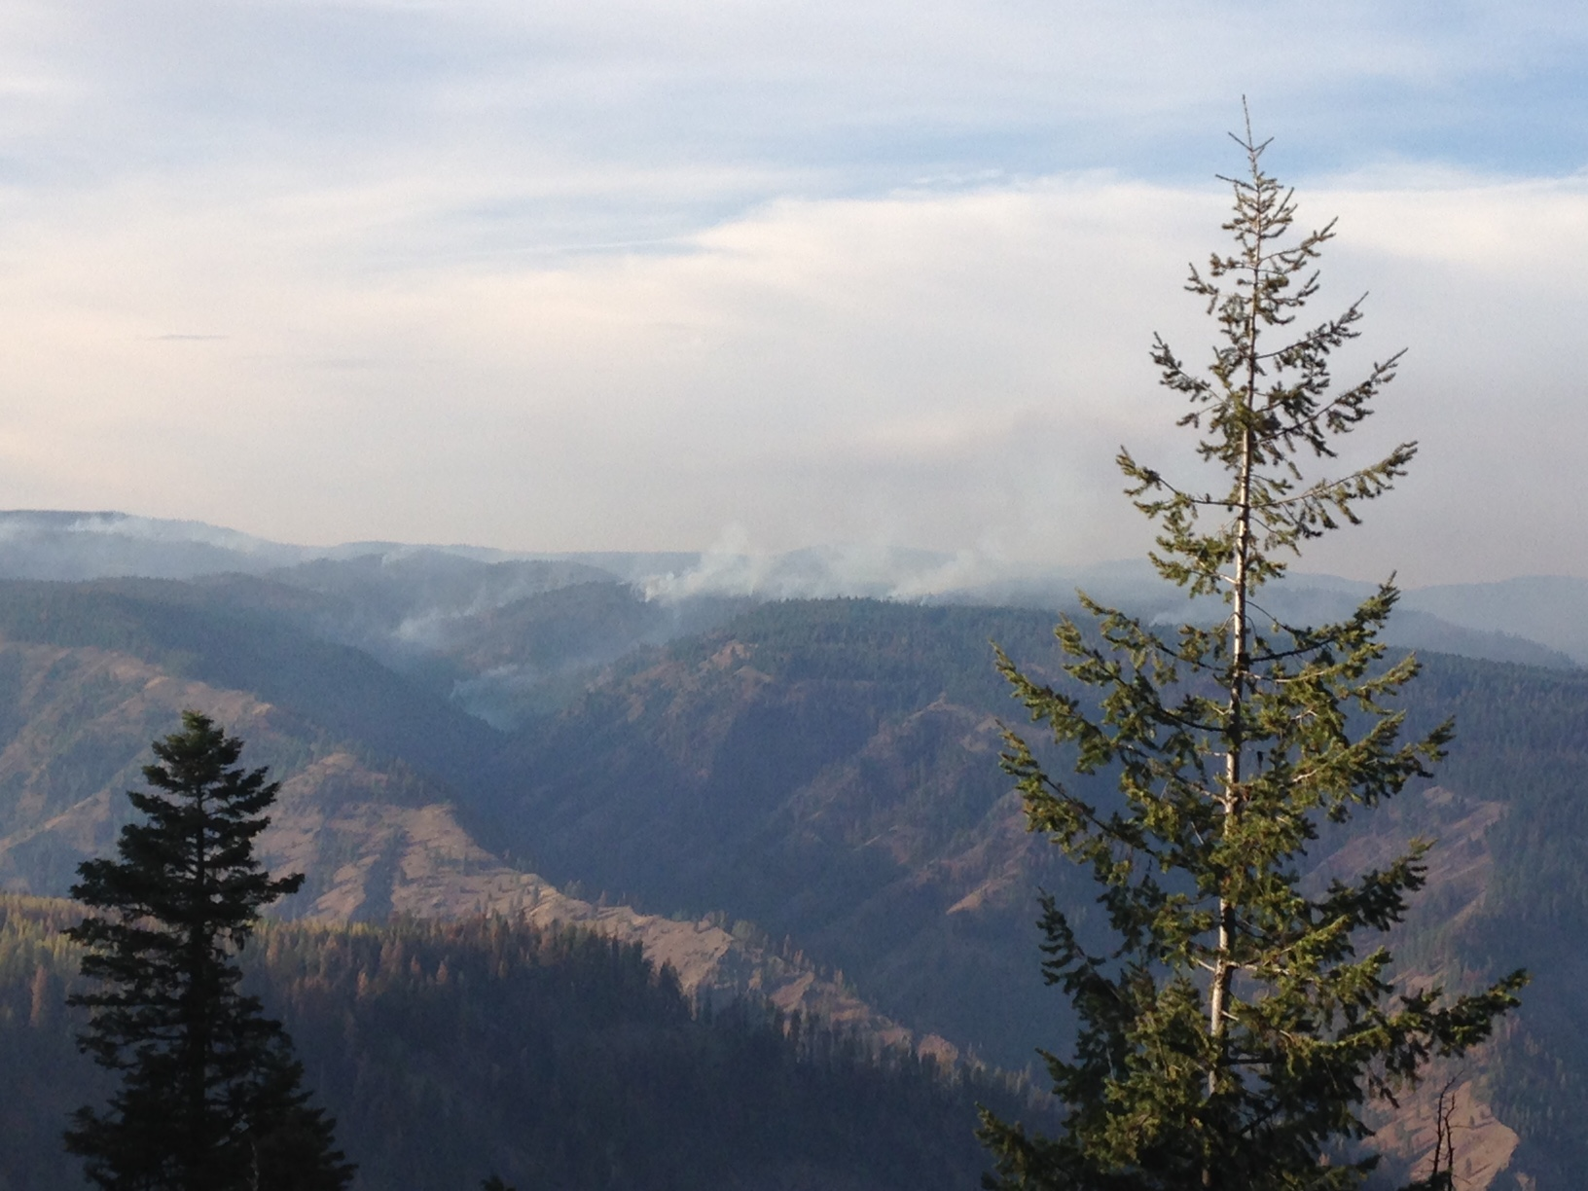
Discussion

Slide 18
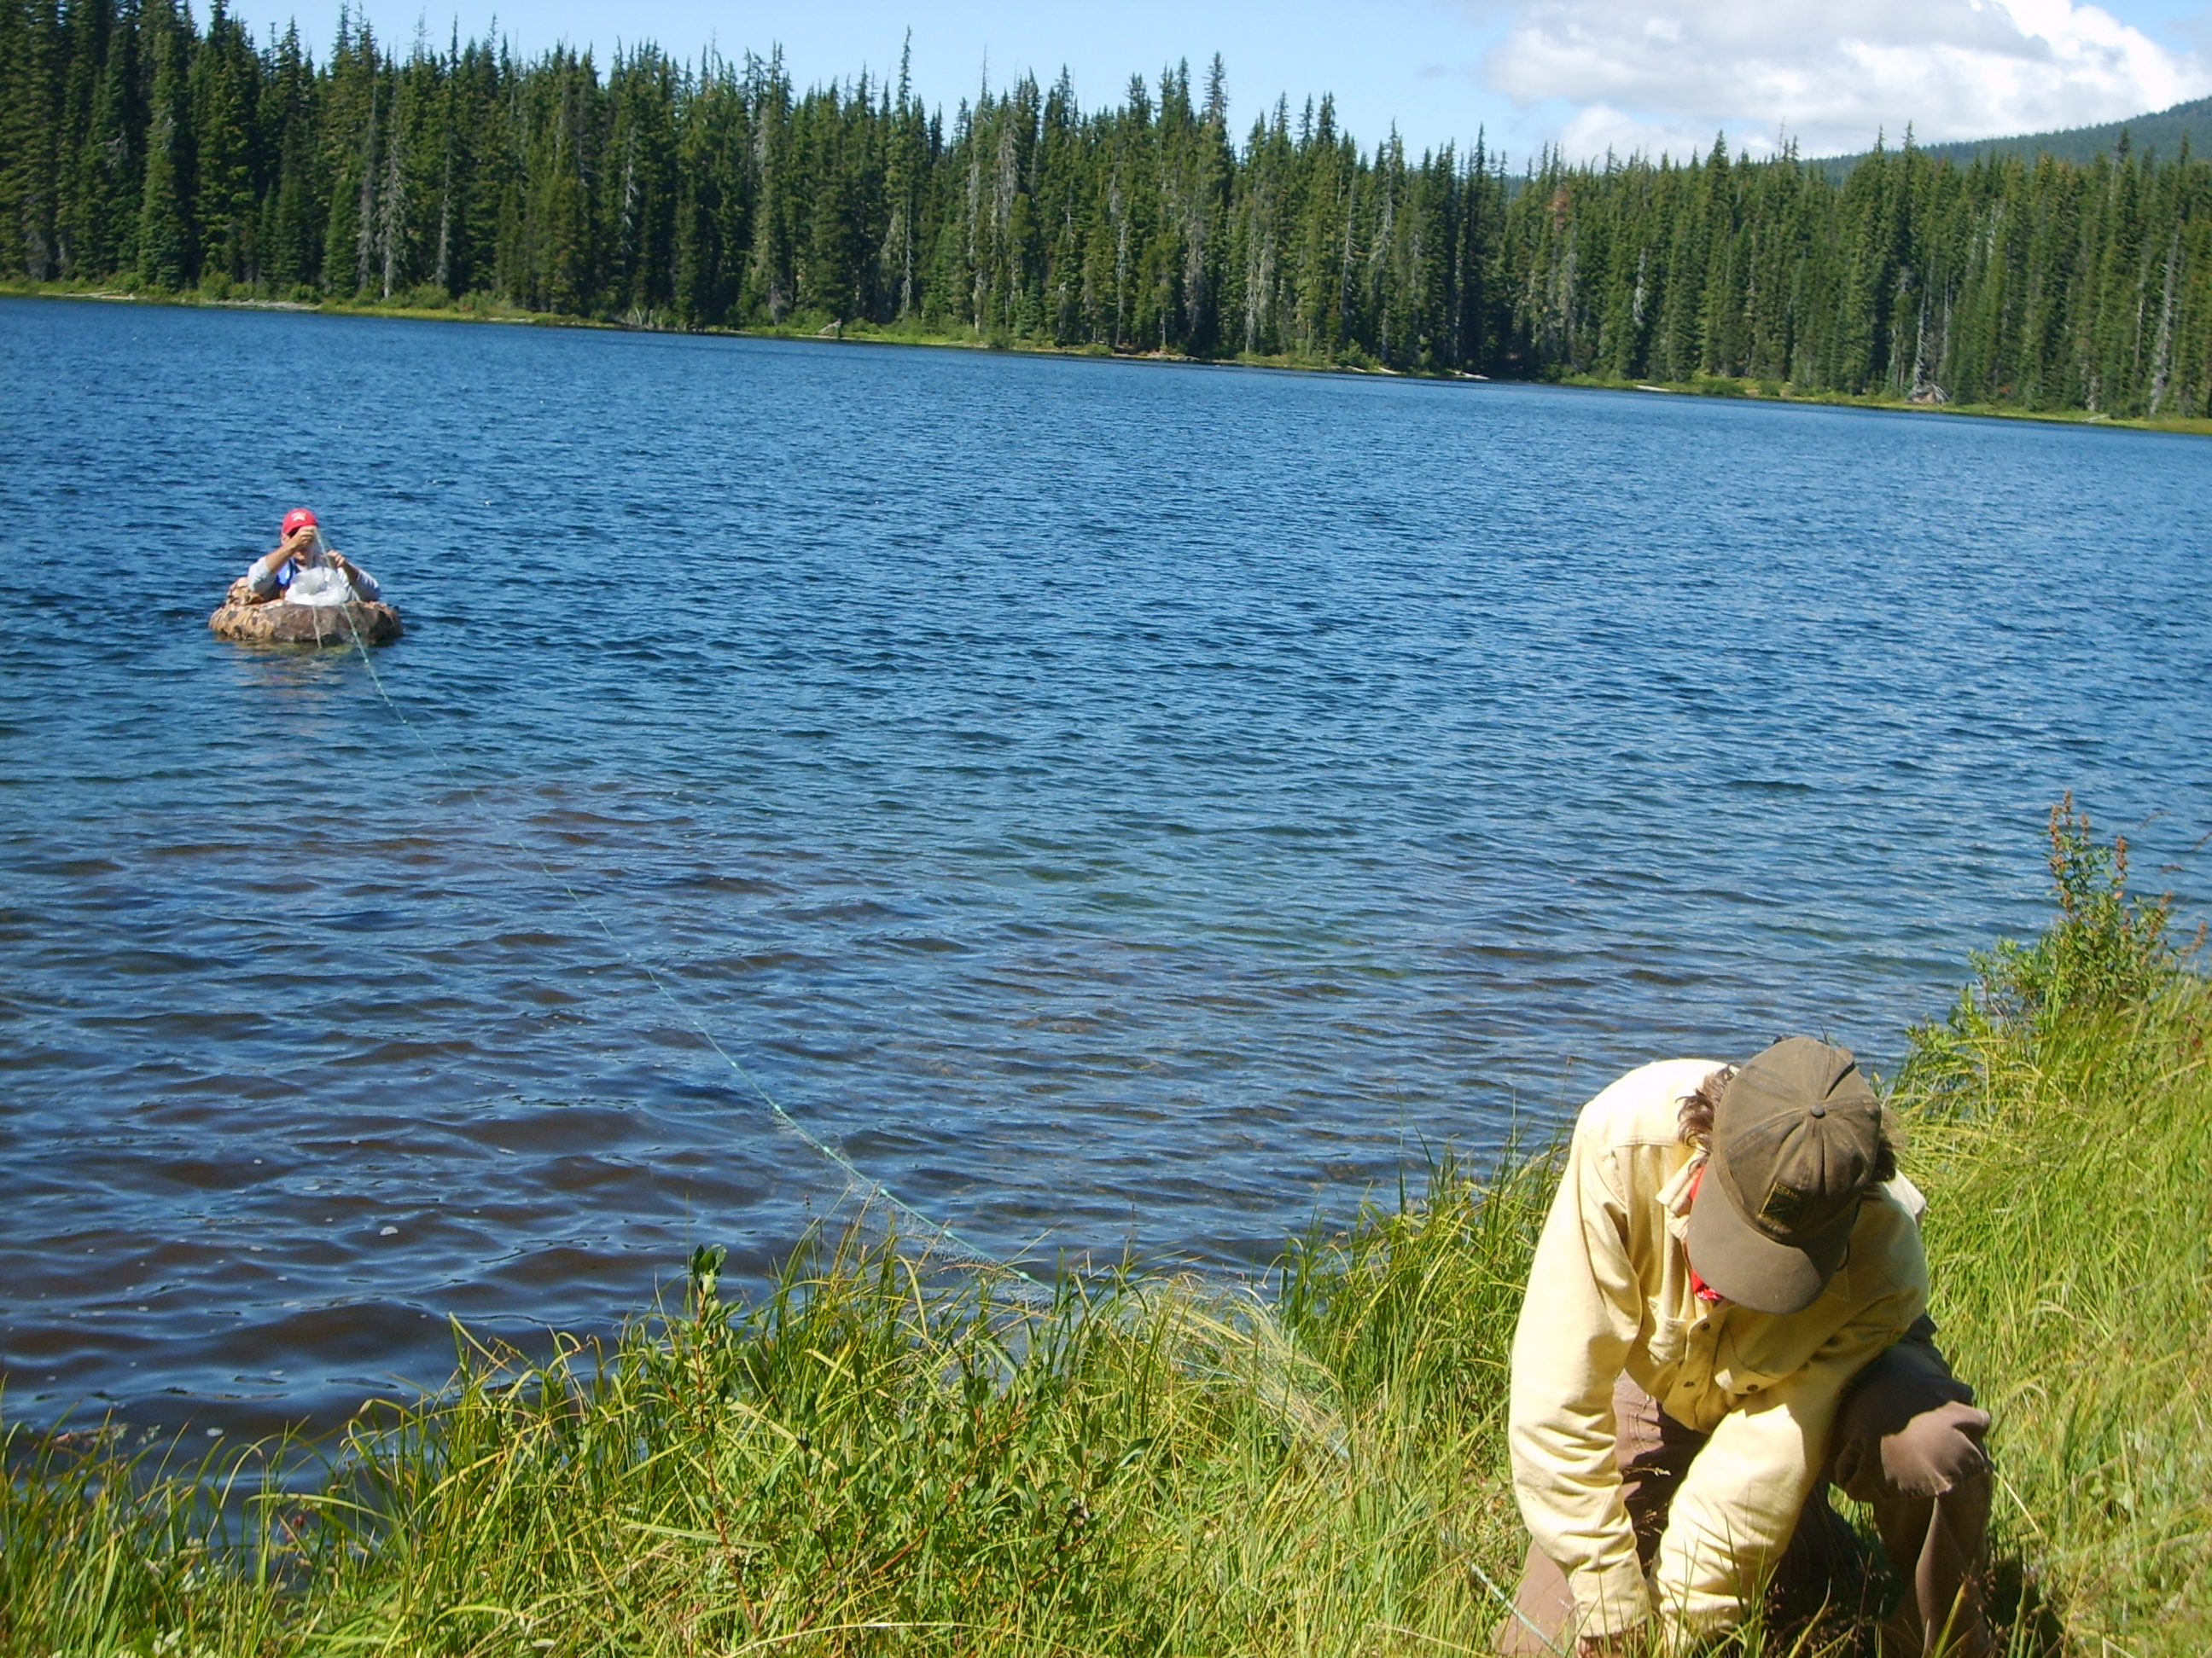
FY 2018 & 2019 Budgets and New SOW

Slide 19
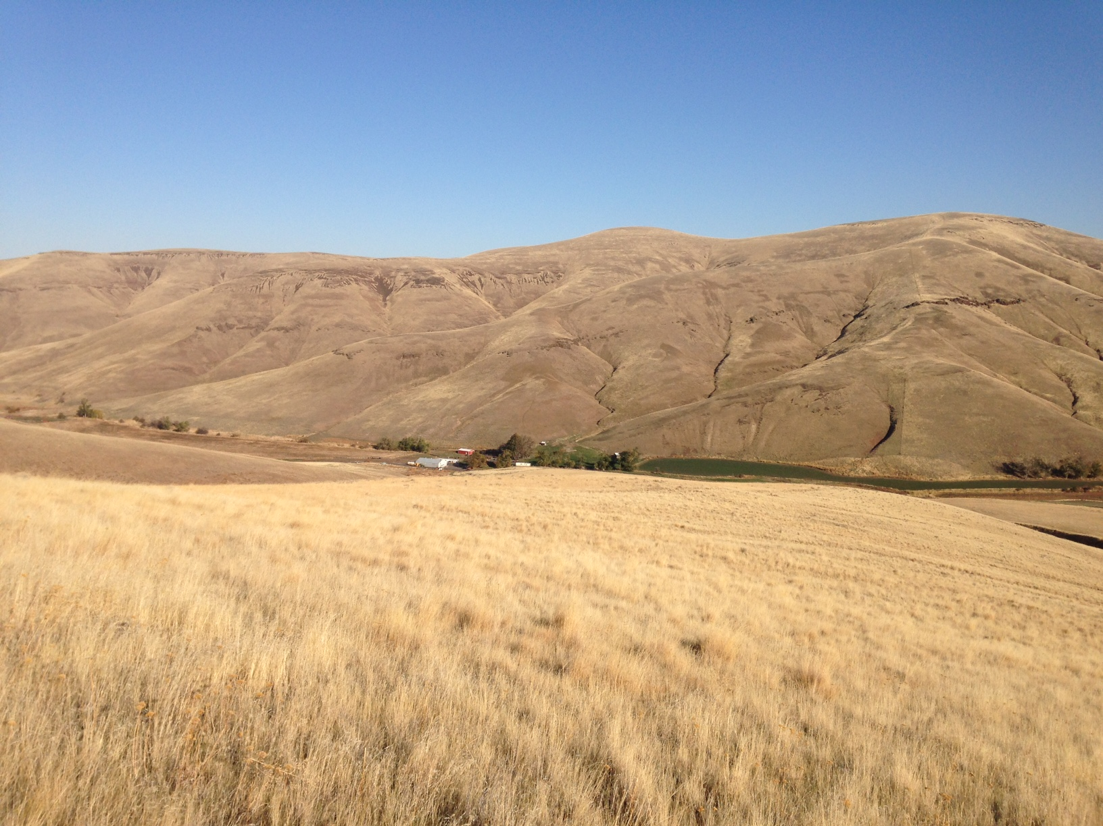
Two Year Budget & SOW Background
Two year contract proposed: BPA budget guidance of $2,145,483 for FY 2018.
Requests total $2,297,824. Budget shortfall in FY 2018 (Requests vs. baseline)
of $152k
Assuming level funding of $2,145,483 in FY 19, FY 2019 Requests total $2,257,373
Budget shortfall in year 2 of $112k
(PSMFC reduces staff from 4 FTE to 3 FTE)
Simplify 18 – 19 SOW? Reduce/eliminate WE’s? What do we prioritize?
Current 5 Year Plan for CA:
FY 18 Maintain data flow for existing indicators
Finalize and adopt hatchery indicators, populate with data,
review hatchery Data flow vs. regional need
Begin development of lamprey, sturgeon, bull trout indicators
FY 19 Maintain data flow for existing indicators
Finalize and adopt lamprey, sturgeon, and bull trout indicators, populate with data,
Review Data flow vs. regional need
Begin review of resident trout

Slide 20
Update with final requests
 | FY 2014 | FY 2015 * | FY 2016* |  | FY 2017* |  | FY 2018* |  | % FY 18 change from FY 14
CCT | $90,000 | $90,002 | $90,000 |  | $90,000 |  | $97,986 |  | 8.87%
IDFG | $265,580 | $301,638 | $331,288 |  | $331,288 |  | $338,275 |  | 27.37%
MFWP | $153,115 | $168,877 | $168,877 |  | $168,877 |  | $170,565 |  | 11.40%
ODFW | $421,859 | $474,461 | $474,458 |  | $474,458 |  | $499,214 |  | 18.34%
USFWS | $18,200 | $18,200 | $78,248 |  | $78,248 |  | $89,423 |  | 391.33%
WDFW | $387,759 | $402,961 | $470,530 |  | $470,530 |  | $490,512 |  | 26.50%
PSMFC | $748,062 | $628,437 | $595,649 |  | $581,840 |  | $611,850 |  | -18.21%
 | $2,084,575 | $2,084,576 | $2,209,050 |  | $2,195,241 |  | $2,297,824 |  | 10.23%
* FY 15, switched PSMFC GIS staff to indirect, savings of $119,625,
increased funds to IDFG, MFWP, ODFW, WDFW
* FY 15, saved $38,856 and used in FY 2016 via contract extension
* FY 16 USFWS budget increased by $60,048 as per BPA-USFWS Agreement
* FY 16 added $20,100 for USACE contract (defunct)
* FY 16 Savings of $49,109 from PSMFC to WDFW for east side data steward
* FY 16 saved $49,758 and used in FY 17 via contract extension
* FY 16 ODFW overspent $2,500; IDFG overspent $2,762; MFWP saved $32,107 & PSMFC saved $51,565
* FY 17 PSMFC savings via cutting almost all travel, equipment, switching Wheaton to 3/4 time on StreamNet
FY 18 Base budget is $2,145,483 as per BPA 2/14/17

Slide 21
Comparison $50k cut applied to 2017 budgets vs. 6.63% cut applied to 18 requests
 | FY 2017* | FY 2018* Request
CCT | $90,000 | $97,986
IDFG | $331,288 | $338,275
MFWP | $168,877 | $170,565
ODFW | $474,458 | $499,214
USFWS | $78,248 | $89,423
WDFW | $470,530 | $490,512
PSMFC | $581,840 | $611,850
 | $2,195,241 | $2,297,824
 | Equal % Cut to FY 18 Request | $49,758 Dollar Cut to FY 17 Budgets
CCT | $91,490 | $87,960
IDFG | $315,848 | $323,779
MFWP | $159,257 | $165,049
ODFW | $466,118 | $463,704
USFWS | $83,494 | $76,474
WDFW | $457,992 | $459,865
PSMFC | $571,286 | $568,652
 | $2,145,484 | $2,145,483
$152k over

Slide 22
2019 budget requests
 | FY 2018* | FY 2019
CCT | $97,986 | $97,986
IDFG | $338,275 | $348,338
MFWP | $170,565 | $172,371
ODFW | $499,214 | $508,763
USFWS | $89,423 | $89,423
WDFW | $490,512 | $493,637
PSMFC | $611,850 | $546,854
 | $2,297,824 | $2,257,373
Note: For PSMFC, Klamath Project currently ends 8/31/2018 and Wheaton returns to full time StreamNet
that date. PSMFC Plan envisions reducing PSMFC FTE from 4 to 3 Oct. 1, 2018 (projected retirement)

Slide 23
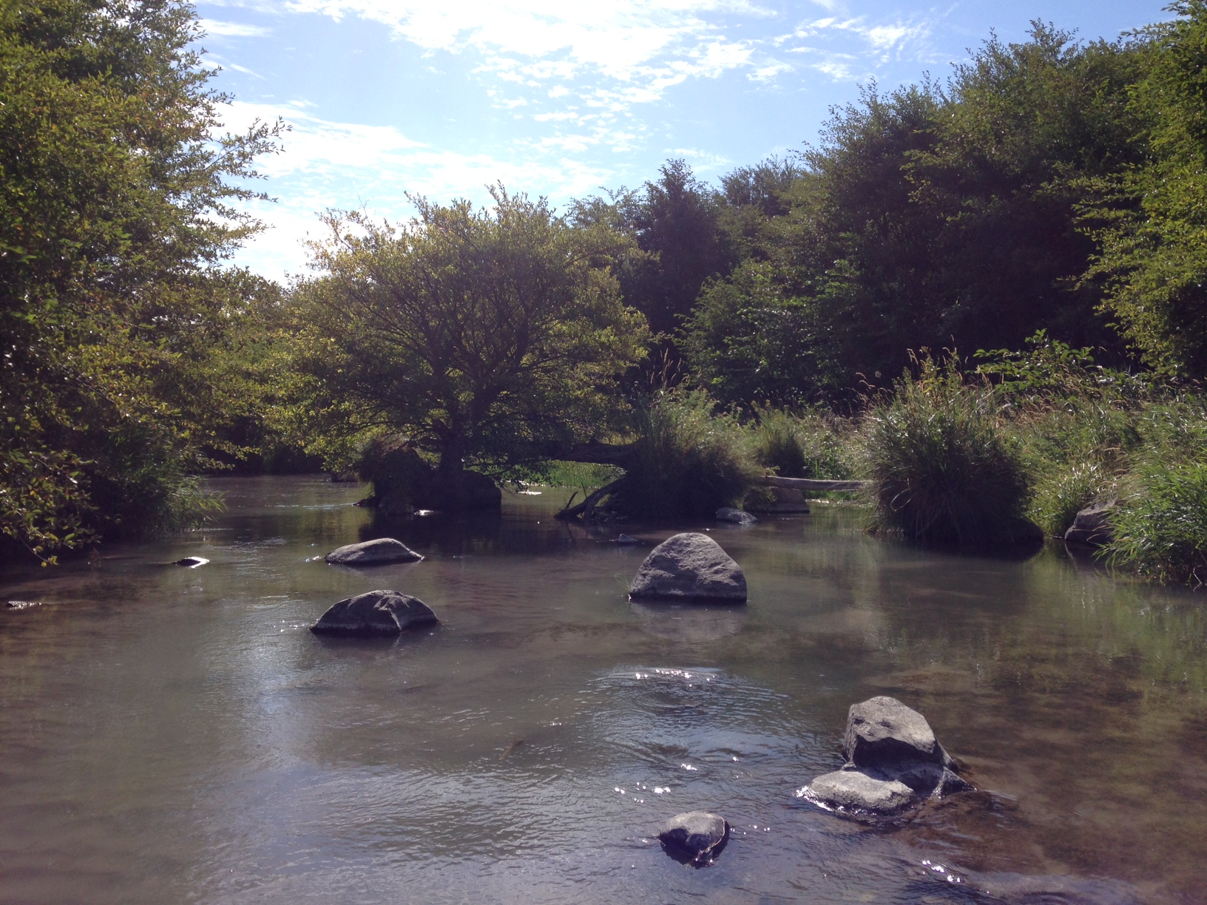
Decision –
FY 18 Request is $152,341 over BPA Guidance
Any flexibility from Bonneville?
Any opportunities for other funding of project?
If we need to balance these particular numbers, what is EXCOMM guidance on how to do so?
What are the impacts of final decision?
Timeline for decision making?
Simplification of SOW still a goal?
PSMFC proposes to reduce staff to 3 FTE in FY 19 – would reduce costs +/- $78k. Lessens problem in year 2

Slide 24
CA Data Flow
Final for FY 2016 and
Predictions for FY 2017
Reporting on TRT populations only
Numbers of TRT populations differ year to year;
Total of 213 in 2016
Total of 201 in 2017
Changes due to NOAA population revisions
Slightly different criteria in surveys
(i.e. extirpated in or out?)
In the 2017 survey on data flow, reporting on
Extant TRT populations only

Slide 25
Fiscal Year 2016 All Publishable* Coordinated Assessments as of March 2, 2017
High Level Indicator | Reporting Agency (may include data from others) | All Populations Reported (includes partial & multiple popfit) | Years of Valid data | Total HLIs Reported | TRT Populations Reported | TRT Pop. Years with HLIs | % of all 201 TRT Populations
Natural Origin Spawner Abundance | ODFW | 72 | 2,048 | 2,374 | 45 | 1,517 | 22.4%
 | IDFG | 24 | 1,162 | 2,173 | 19 | 965 | 9.5%
 | WDFW | 64 | 1,825 | 795 | 52 | 795 | 25.9%
 | CCT | 1 | 11 | 11 | 1 | 11 | 0.5%
 | All Agencies | 155 | 5,046 | 5,353 | 125 | 3,288 | 62.2%
Recruits per Spawner | ODFW | 42 | 1,642 | 1,559 | 21 | 1,202 | 10.4%
 | IDFG | 18 | 931 | 820 | 18 | 820 | 9.0%
 | WDFW | 26 | 272 | 271 | 26 | 271 | 12.9%
 | CCT | 1 | 2 | 2 | 1 | 2 | 0.5%
 | All Agencies | 86 | 2,847 | 2,652 | 65 | 2,295 | 32.3%
Smolt to Adult Ratios | CRITFC | 25 | 366 | 362 | 4 | 33 | 2.0%
 | ODFW | 4 | 62 | 56 | 4 | 56 | 2.0%
 | WDFW | 3 | 24 | 24 | 3 | 24 | 1.5%
 | CCT | 1 | 7 | 7 | 1 | 7 | 0.5%
 | All Agencies | 33 | 459 | 449 | 12 | 120 | 6.0%
Juvenile Outmigrants | WDFW | 19 | 277 | 270 | 18 | 245 | 9.0%
 | IDFG | 8 | 134 | 130 | 8 | 130 | 4.0%
 | ODFW | 5 | 91 | 84 | 5 | 84 | 2.5%
 | CCT | 1 | 9 | 9 | 1 | 9 | 0.5%
 | All Agencies | 33 | 511 | 493 | 32 | 468 | 15.9%
Presmolt Abundance | ODFW | 4 | 73 | 58 | 4 | 58 | 2.0%
 | WDFW | 2 | 20 | 20 | 2 | 20 | 1.0%
 | All Agencies | 6 | 93 | 78 | 6 | 78 | 3.0%
All HLIs | All Agencies | 313 | 8,956 | 9,025 | 240 | 6,249

Slide 26

Fiscal Year 2017
Coordinated Assessments
Predicted Data Flow
as of February 23, 2017

Slide 27

Asked states and tribes to qualitatively evaluate CA data flow for all extant TRT populations in the Columbia basin and report as follows;
We can calculate this indicator and will be providing data in FY 2017 = YES
Indicator calculation for this population is at least theoretically possible,
however, we will be unable to provide data in FY 2017 = NO
It is not possible to calculate this indicator for this population = X

Slide 28
FY17 Predicted Coordinated Assessments Data Flow
Natural Origin Spawner Abundance |  |  |  |  | Recruits per Spawner |  |  |  |  | Smolt to Adult Ratios
Agency | Yes | No | X | Total | Agency | Yes | No | X | Total | Agency | Yes | No | X | Total
WDFW | 61 |  | 21 | 82 | WDFW | 25 | 6 | 51 | 82 | WDFW | 1 | 12 | 69 | 82
ODFW | 33 | 19 | 9 | 61 | ODFW | 19 | 25 | 17 | 61 | ODFW | 6 | 5 | 50 | 61
IDFG | 29 | 10 | 4 | 43 | IDFG | 18 | 21 | 4 | 43 | IDFG | 1 | 37 | 5 | 43
YNF |  | 2 | 3 | 5 | YNF |  |  | 5 | 5 | YNF |  |  | 5 | 5
NPT |  | 7 | 1 | 8 | NPT |  | 4 | 4 | 8 | NPT |  | 4 | 4 | 8
CCT | 1 |  | 1 | 1 | CCT | 1 |  | 1 | 2 | CCT | 1 |  | 1 | 2
Total | 124 | 38 | 39 | 201 | Total | 63 | 56 | 82 | 201 | Total | 9 | 58 | 134 | 201
% | 62 | 19 | 19 | 100 | % | 31 | 28 | 41 | 100 | % | 5 | 29 | 66 | 100
201 TRT Populations in the Interior Columbia and Willamette/Lower Columbia Recovery Domains
excluding SuperPopulations and extinct/extirpated populations.
Yes = We can calculate this indicator and will be providing data in FY 2017.
No = Indicator calculation for this population is at least theoretically possible,
however, we will be unable to provide data in FY 2017.
X = It is not possible to calculate this indicator for this population.

Slide 29
FY17 Predicted Coordinated Assessments Data Flow
Natural Origin Spawner Abundance |  |  |  |  | Recruits per Spawner |  |  |  |  | Smolt to Adult Ratios
Agency | Yes | No | X | Total | Agency | Yes | No | X | Total | Agency | Yes | No | X | Total
WDFW | 61 |  | 21 | 82 | WDFW | 25 | 6 | 51 | 82 | WDFW | 1 | 12 | 69 | 82
ODFW | 33 | 19 | 9 | 61 | ODFW | 19 | 25 | 17 | 61 | ODFW | 6 | 5 | 50 | 61
IDFG | 29 | 10 | 4 | 43 | IDFG | 18 | 21 | 4 | 43 | IDFG | 1 | 37 | 5 | 43
YNF |  | 2 | 3 | 5 | YNF |  |  | 5 | 5 | YNF |  |  | 5 | 5
NPT |  | 7 | 1 | 8 | NPT |  | 4 | 4 | 8 | NPT |  | 4 | 4 | 8
CCT | 1 |  | 1 | 1 | CCT | 1 |  | 1 | 2 | CCT | 1 |  | 1 | 2
Total | 124 | 38 | 39 | 201 | Total | 63 | 56 | 82 | 201 | Total | 9 | 58 | 134 | 201
% | 62 | 19 | 19 | 100 | % | 31 | 28 | 41 | 100 | % | 5 | 29 | 66 | 100
Juvenile Outmigrants |  |  |  |  | Presmolt Abundance |  |  |  |  | Related Data
Agency | Yes | No | X | Total | Agency | Yes | No | X | Total | Agency | Yes | No | X | Total
WDFW | 20 | 1 | 61 | 82 | WDFW | 2 | 2 | 78 | 82 | WDFW | 53 | 12 | 17 | 82
ODFW | 6 | 5 | 50 | 61 | ODFW | 4 |  | 57 | 61 | ODFW | 37 | 14 | 10 | 61
IDFG | 6 | 34 | 3 | 43 | IDFG |  | 38 | 5 | 43 | IDFG | 25 | 16 | 2 | 43
YNF |  |  | 5 | 5 | YNF |  |  | 5 | 5 | YNF |  | 2 | 3 | 5
NPT |  | 7 | 1 | 8 | NPT |  |  | 8 | 8 | NPT |  | 6 | 2 | 8
CCT | 1 |  | 1 | 2 | CCT | 1 |  | 1 | 2 | CCT | 1 |  | 1 | 2
Total | 33 | 47 | 121 | 201 | Total | 7 | 40 | 154 | 201 | Total | 116 | 50 | 35 | 201
% | 17 | 23 | 60 | 100 | % | 3 | 20 | 77 | 100 | % | 58 | 25 | 17 | 100
201 TRT Populations in the Interior Columbia and Willamette/Lower Columbia Recovery Domains
excluding SuperPopulations and extinct/extirpated populations.

Slide 31
Agency FY17 Predicted NOSA
 | Y | X | N | Total
Total | 124 | 38 | 39 | 201
% | 62 | 19 | 19 | 100
Y = We can calculate this indicator and will be providing data in FY 2017.
X = It is not possible to calculate this indicator for this population.
N = Indicator calculation for this population is at least theoretically possible, however we will be unable to provide data in FY 2017.
NOSA

Slide 32
Agency FY17 Predicted RperS
 | Y | X | N | Total
Total | 63 | 56 | 82 | 201
% | 31 | 28 | 41 | 100
Y = We can calculate this indicator and will be providing data in FY 2017.
X = It is not possible to calculate this indicator for this population.
N = Indicator calculation for this population is at least theoretically possible, however we will be unable to provide data in FY 2017.
RperS

Slide 33
Agency FY17 Predicted SAR
 | Y | X | N | Total
Total | 9 | 58 | 134 | 201
% | 5 | 29 | 66 | 100
Y = We can calculate this indicator and will be providing data in FY 2017.
X = It is not possible to calculate this indicator for this population.
N = Indicator calculation for this population is at least theoretically possible, however we will be unable to provide data in FY 2017.
SAR

Slide 34
Agency FY17 Predicted JuvenileOutMigrants
 | Y | X | N | Total
Total | 33 | 47 | 121 | 201
% | 17 | 23 | 60 | 100
Y = We can calculate this indicator and will be providing data in FY 2017.
X = It is not possible to calculate this indicator for this population.
N = Indicator calculation for this population is at least theoretically possible, however we will be unable to provide data in FY 2017.

Slide 35
Agency FY17 Predicted Presmolt Abundance
 | Y | X | N | Total
Total | 7 | 40 | 154 | 201
% | 3 | 20 | 77 | 100
Y = We can calculate this indicator and will be providing data in FY 2017.
X = It is not possible to calculate this indicator for this population.
N = Indicator calculation for this population is at least theoretically possible, however we will be unable to provide data in FY 2017.

Slide 36
Discussion

Slide 37
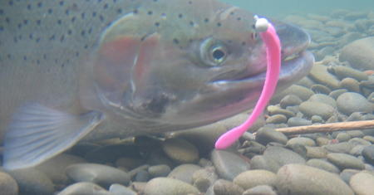
CA Priorities – Hatchery Indicators, Resident Fish, etc.
November ExComm Meeting:
Make populating the existing natural origin indicators the priority for FY 2016. Include discussions with FPC & CRITFC about sharing and displaying SARs for superpopulations. Continue to work with CRITFC tribes to include them in data flow to the extent that resources allow them to do so
NPCC, StreamNet, and MFWP convene a Bull trout workshop to identify players, discuss data needs, and identify future paths forward for regional data sharing for this species
Finalize DES for hatchery indicators and begin to populate but have not identified a management/ leadership “pull” for this information (wanted by Council, useful for ESA lawsuits in terms of straying, release sizes, rearing strategies, etc.)

Slide 38
Discuss Bull Trout Meeting – Missoula, Montana April 12th – In Conjunction with NPCC Meeting
Sponsored by NPCC, StreamNet, MFWP
NPCC program goal – identify existing (year 2000-current) goals and objectives for bull trout (species/core populations/ management units/ habitat)
- What data is available and is there any benefit to sharing regionally?
- What are current reporting needs at different scales and could their be a benefit from facilitated data sharing (e.g., local entity, across jurisdiction and regional such as recovery status updates.
Invitees: Federal, State and Tribal fish biologists and managers involved in reporting on species and interested in improving reporting on status and progress

Slide 39
Good of the Order/Roundtable

Slide 40
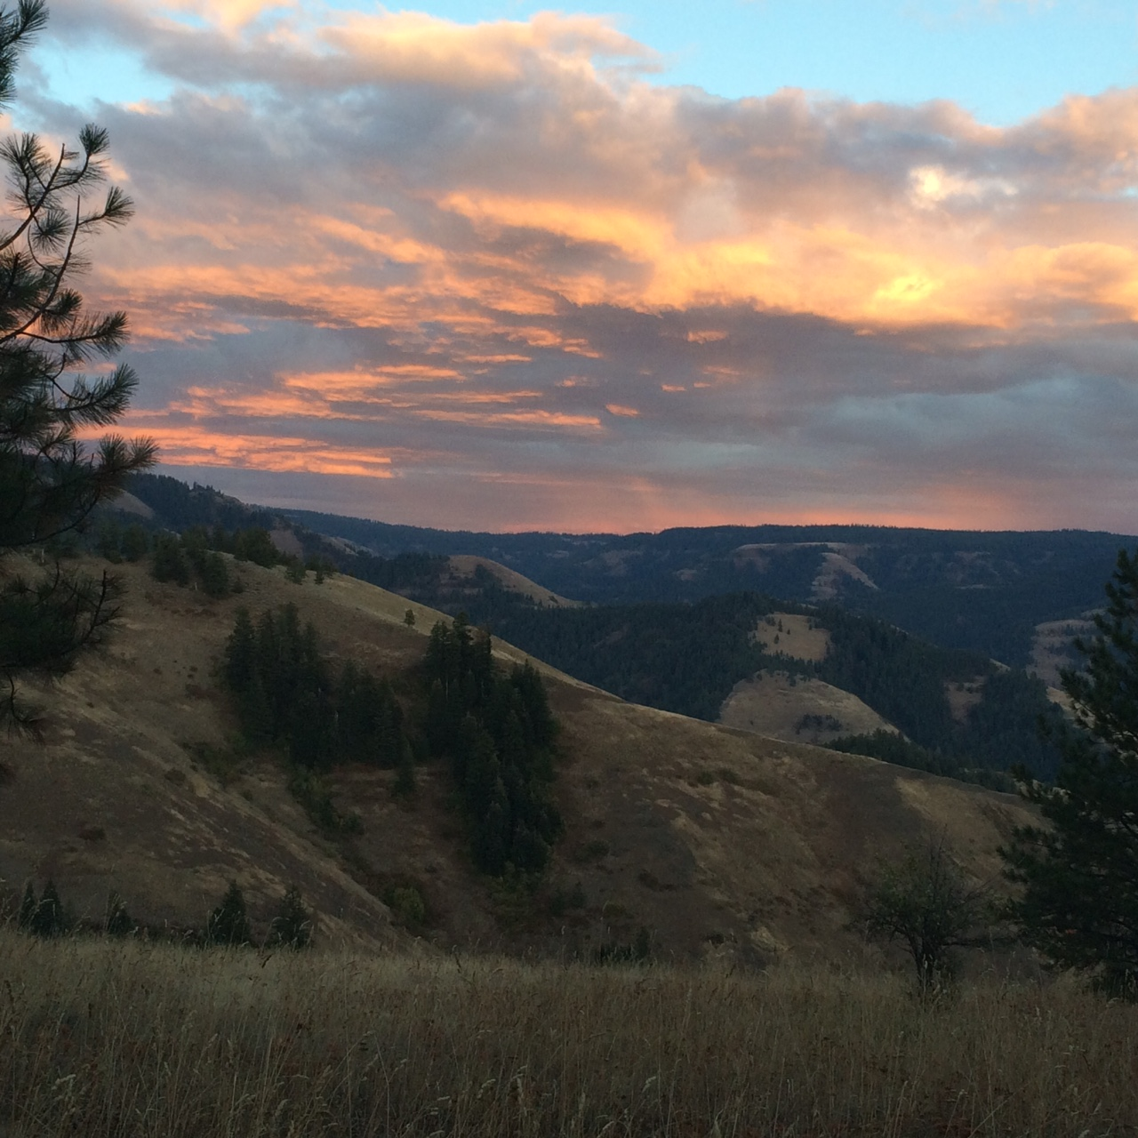
Adjourn

Slide 41
Extra Slides

Slide 42
Definitions (Work Elements from SOW)
Coordination, Management, Reporting Coordinate with a wide range of entities to assure data flow, improve data sharing, promote data standards, and encourage widespread adoption of modern information technology to improve fish and wildlife management and recovery programs. Highest priority for coordination activities will be for entities participating in the Fish and Wildlife Program (BPA, NPCC, PNAMP, Federal Caucus, FWP project sponsors, etc.) and the agencies and tribes in the StreamNet program. Ensure that StreamNet is aligned with the data management needs and regional priorities established in the NPCC F&W program, recovery plans for listed species, and the participating agencies and tribes. Produce BiOp, annual, and quarterly reports as required by contract.
Coordinated Assessments Leadership of the Coordinated Assessments project, including serving as technical lead, serving on committees, leading the DES Development Team, establishing and maintaining a 5 Year Plan, and coordinating with the agencies that provide and use the CA data, as prioritized by the Executive Committee. Manage the existing Coordinated Assessments Data Exchange Standard (DES) for indicators and metrics. Continue development of regional data exchange standards. Lead the process of implementation of DES’s and databases for indicators for the next 5 years and expand the DES and CA databases to include additional metrics as they are adopted by the StreamNet Executive Committee. Obtain the available CA indicator and supporting metrics, convert them into the DES format, and exchange them with the CA database at PSFMC StreamNet. Host a database on the StreamNet website and/or by supporting access portals on NPCC or other regional fisheries management sites.
Enhancing Efficiency and Transfer Of Data Assist agencies in development of database systems and data management for CA and traditional data, with focus on data collected as part of the regional fish and wildlife program. Work with interested parties to coordinate ongoing regional review of field electronic data capture devices in fisheries settings. Maintain the infrastructure necessary for acquiring, managing and disseminating regionally standardized and georeferenced data, including system administration, databases, website pages, query systems, web services, and various data related applications. Maintain access to existing and historic data sets.
Traditional Data Update selected high priority traditional Trend datasets and integrate them into query system.

Slide 43
If 6.63% cut applied to 2018 requests across the board
 | 6.6% Cut | FY 2018 Cut Budget Allocations
CCT | $6,496 | $91,490
IDFG | $22,427 | $315,848
MFWP | $11,308 | $159,257
ODFW | $33,097 | $466,118
USFWS | $5,928 | $83,494
WDFW | $32,520 | $457,992
PSMFC | $40,564 | $571,286
 | $152,339 | $2,145,484
 | FY 2017* | FY 2018*
CCT | $90,000 | $97,986
IDFG | $331,288 | $338,275
MFWP | $168,877 | $170,565
ODFW | $474,458 | $499,214
USFWS | $78,248 | $89,423
WDFW | $470,530 | $490,512
PSMFC | $581,840 | $611,850
 | $2,195,241 | $2,297,824

Slide 44
If $50k cut applied to 2017 budgets by percentage across the board
 | % of 2017 budget | Amount Cut | FY 18 Allocation
CCT | 4.1% | $2,040 | $87,960
IDFG | 15.1% | $7,509 | $323,779
MFWP | 7.7% | $3,828 | $165,049
ODFW | 21.6% | $10,754 | $463,704
USFWS | 3.6% | $1,774 | $76,474
WDFW | 21.4% | $10,665 | $459,865
PSMFC | 26.5% | $13,188 | $568,652
 | 100.0% |  | $2,145,483
 | FY 2017*
CCT | $90,000
IDFG | $331,288
MFWP | $168,877
ODFW | $474,458
USFWS | $78,248
WDFW | $470,530
PSMFC | $581,840
 | $2,195,241

Slide 47
Nancy ideas:
I agree that what you highlighted as important aspects to communicate, and these will resonate with the Council:
- clearly articulating how the budget supports CA (data delivery, supporting meetings etc)
- how this CA work connects to the Council’s broader information needs to report on status and trend of species as well as informing progress towards objectives per the 2014 Program .
- explain limitation of the restricted/reduced budget such as how the upcoming tasks for hatchery indicators, bull trout & other fish population indicators may be affected by the current budget and expected out-years. Also how it may impact the ability to respond to Council request for information and support.
- I think it is good to convey what can and cannot be done with expected budget.
- Also would be critical to illustrate (even roughly) the cost-share leveraged such as data received that isn’t paid by Bonneville.

Slide 48
Populations used in FY2017 Predicted Data Flow Summary March 2, 2017
TRT or Not | NMFS PopStatus | NMFS Listing Status | # of Popula-tions | CAX has NOSA | CAX has RperS | CAX has SAR | CAX has JuvOut | CAX has PreSmolts | SN has Related Data | StreamNet FY17 Data Predictions
TRT | Extant | Endangered | 4 | 179 | 65 | 15 | 75 | 10 | 29 | 4
TRT | Extant | Threatened | 182 | 4,271 | 2,489 | 113 | 383 | 83 | 1,901 | 182
TRT | Extirpated | Endangered | 10
TRT | Extirpated | Threatened | 50 |  |  |  |  |  |  | 1
TRT | Functionally Extirpated | Endangered | 1
TRT | Functionally Extirpated | Threatened | 17 | 14 |  |  | 30 |  | 52 | 13
TRT | Reintroduced - 10(j) Designation | Threatened | 2 |  |  |  |  |  |  | 1
Non-TRT |  |  | 8 | 36 |  | 24
Non-TRT |  | Endangered | 2 |  |  | 25
Non-TRT |  | Not listed | 5
Non-TRT |  | Not Warrant | 2 |  |  | 26
Non-TRT |  | Threatened | 16 |  |  | 258
Non-TRT | Extant |  | 6 | 122
Non-TRT | Extant | Threatened | 1 |  |  |  | 25
 |  |  | 306 |  |  |  |  |  |  | 201
Non-extant populations with predicted or annotated data are highlighted with colors and are explained on the next slide.

Slide 49
All populations above are TRT populations that Threatened and have a Status of:
Extirpated
Functionally Extirpated
Reintroduced – 10(j) Designation

