Slide 1
Welcome to the StreamNet Executive Committee Meeting
September 20, 2017

Slide 2

9:30 AM Budget Updates – last month adjustments – Next FY Budgets All
Please come prepared to discuss your situation
9:45 AM CA Data flow in 2017 How are we doing? End of year priorities All
Please come prepared to discuss your situation
10:00 AM FPC data sharing and Hatchery data Update Mike
11:00 AM Partner Updates All
11:45 Lunch – On our own
1:00 PM CA/StreamNet Priorities for new FY and review of 5 year work plan All
Potential Modifications to the DES/New Indicators
(Juvenile Outmigrants & NOSA)
QA/QC discussion
Possible Pilot Project? High Priority Project Data into CAX as “Related Data”?
3:00 PM Tribal Data Project and Coordination with CAX (getting tribal data into CAX) Denise Kelsey
3:30 PM Discussion of a proposed PNAMP Workshop Jen
PNAMP has offered to facilitate a methods review workshop focused on protocols and methods used to derive NOSA for steelhead. Jen is seeking feedback on interest, scope and timing of such a workshop (assuming sufficient interest).
4:00 PM Adjourn
Agenda
StreamNet Steering Committee Meeting
September 7, 2017

Slide 3
End of FY 2017 & FY 2018 Budgets
FY 2017 Remaining Balances – As of 09/15/17;
FY 18 Budgets, Total: $2,085,033 (Cut $450 training)
  CCT $28,425
  IDFG $84,733
  MFWP $67,797
  ODFW $165,801
  USFWS $0
  WDFW $101,335
  PSMFC $39,847
CCT $87,960
IDFG $323,771
MFWP $165,049
ODFW $463,704
USFWS $0
WDFW $459,865
PSMFC $584,683

Slide 4
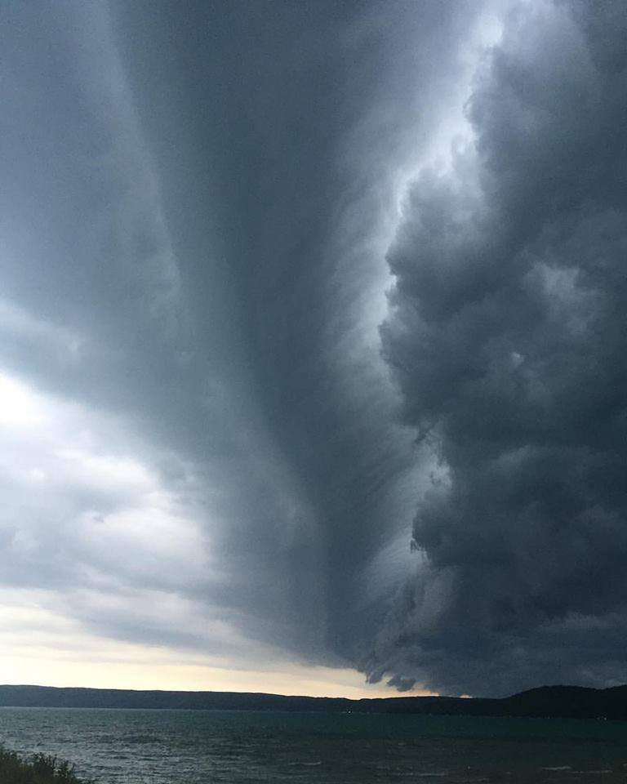
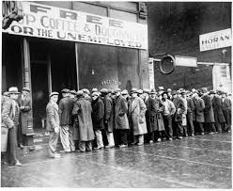

End of FY 17 Issues;
Emergency Budget Issues -
  WDFW identified $52,984 in shortfalls
  Due to increased indirect rate. ODFW
  offered $27,000 in savings, and subcontract
  amendments are in the works to move funds
  to help WDFW. Overall contract will not
  be exceeded
Opportunities for using any savings -
  PSMFC will purchase $4,541 of computer
  replacements for ODFW out of savings

Slide 5

Publishable Coordinated Assessments Data Since the End of 2016 as of September 17, 2017
Number of Populations at end of 2016 and Additional HLIs Reported since 2016
Indicator | End of 2016 Reported Populations / HLIs | ODFW End of 2016 Populations / Additional HLIs | IDFG^{Ӿ} End of 2016 Populations / Additional HLIs | WDFW^{Ӿ} End of 2016 Populations / Additional HLIs | CCT End of 2016 Populations / / Additional HLIs
Natural Origin Spawner Abundance | 155 / 3,885 | 72 / 65 | 24 / 33 | 64 / 57 (2 new Populations w/ 164 HLIs) | 1 / 1
Recruits per Spawner | 86/ 2,652 | 42 / 0 | 18 / 17 | 27 / 10 (1 new Population with 11 HLIs) | 1 / 0
Smolt to Adult Ratio | 33 / 449 | 4 / 0 | 0 / 0 | 3 / 0 | 1 / 0
Juvenile Abundance | 32 / 484 | 5 / 0 | 8 / 0 (2 new Populations with 16 HLIs) | 19 / 22 (1 new Population with 1 HLI) | 1 / 0
Presmolt Abundance | 6 / 78 | 4 / 0 | 0 / 0 | 2 / 0 | 1/ 0 (1 new Population with 5 HLIs)
^{Ӿ}IDFG includes estimates coordinated with ISEMP, NPT or SBT. ^{Ӿ}WDFW includes estimates by USFWS. Includes TRT, non-TRT Populations and SuperPopulations. CRITFC SARs not shown.
Note: Some numbers don’t add up across Indicators Reported due to portions of Populations shared by agencies or multiple RperSTypes reported per Population, etc.

Slide 6
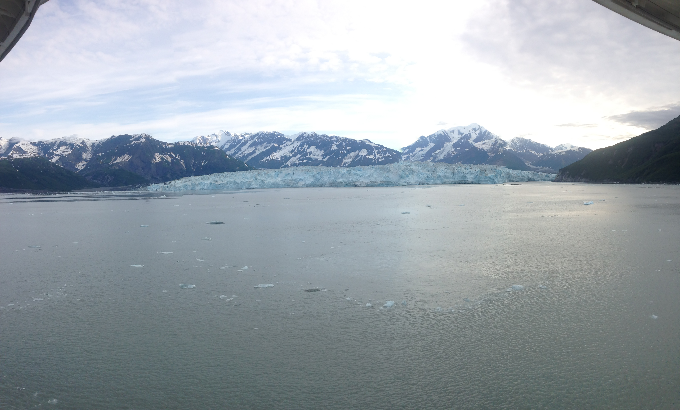
Update on Fish Passage Center Data Sharing and Hatchery Data Update Mike Banach
November 4, 2016

Slide 7
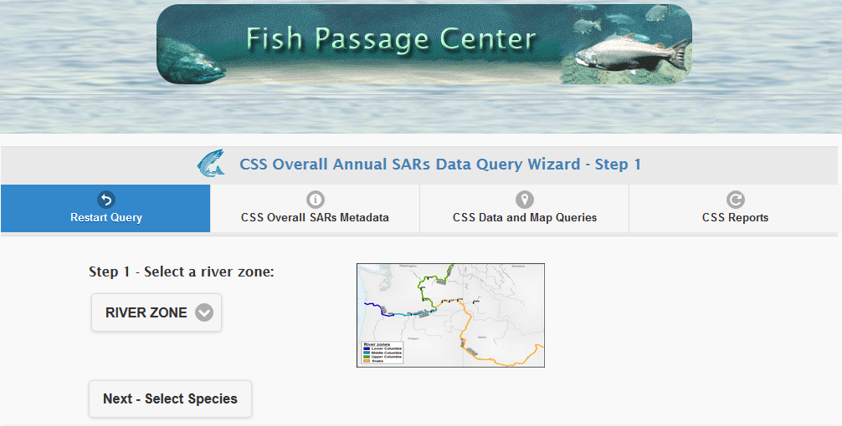
Capturing FPC SARs

Slide 8
The Process:

Slide 9
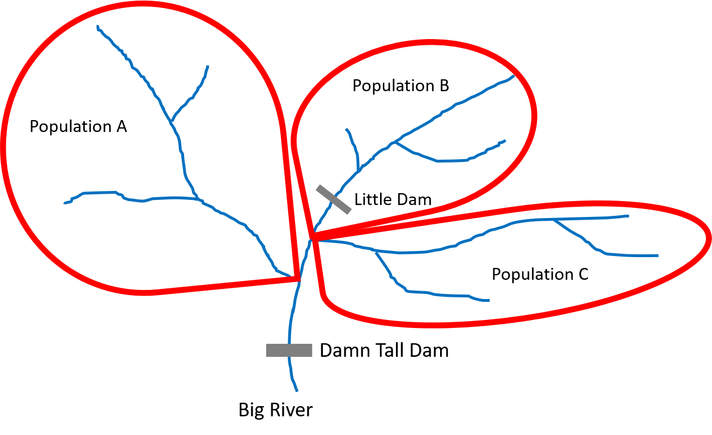
I need mappings from you ...
... then PSMFC runs this once a year
and you don’t worry about it.

Slide 10
I sent you an email 8/25/17. Once you map FPC groups to CA populations / superpopulations then all the pieces are in place.
I took an initial shot at
this to get the ball rolling.

Slide 11
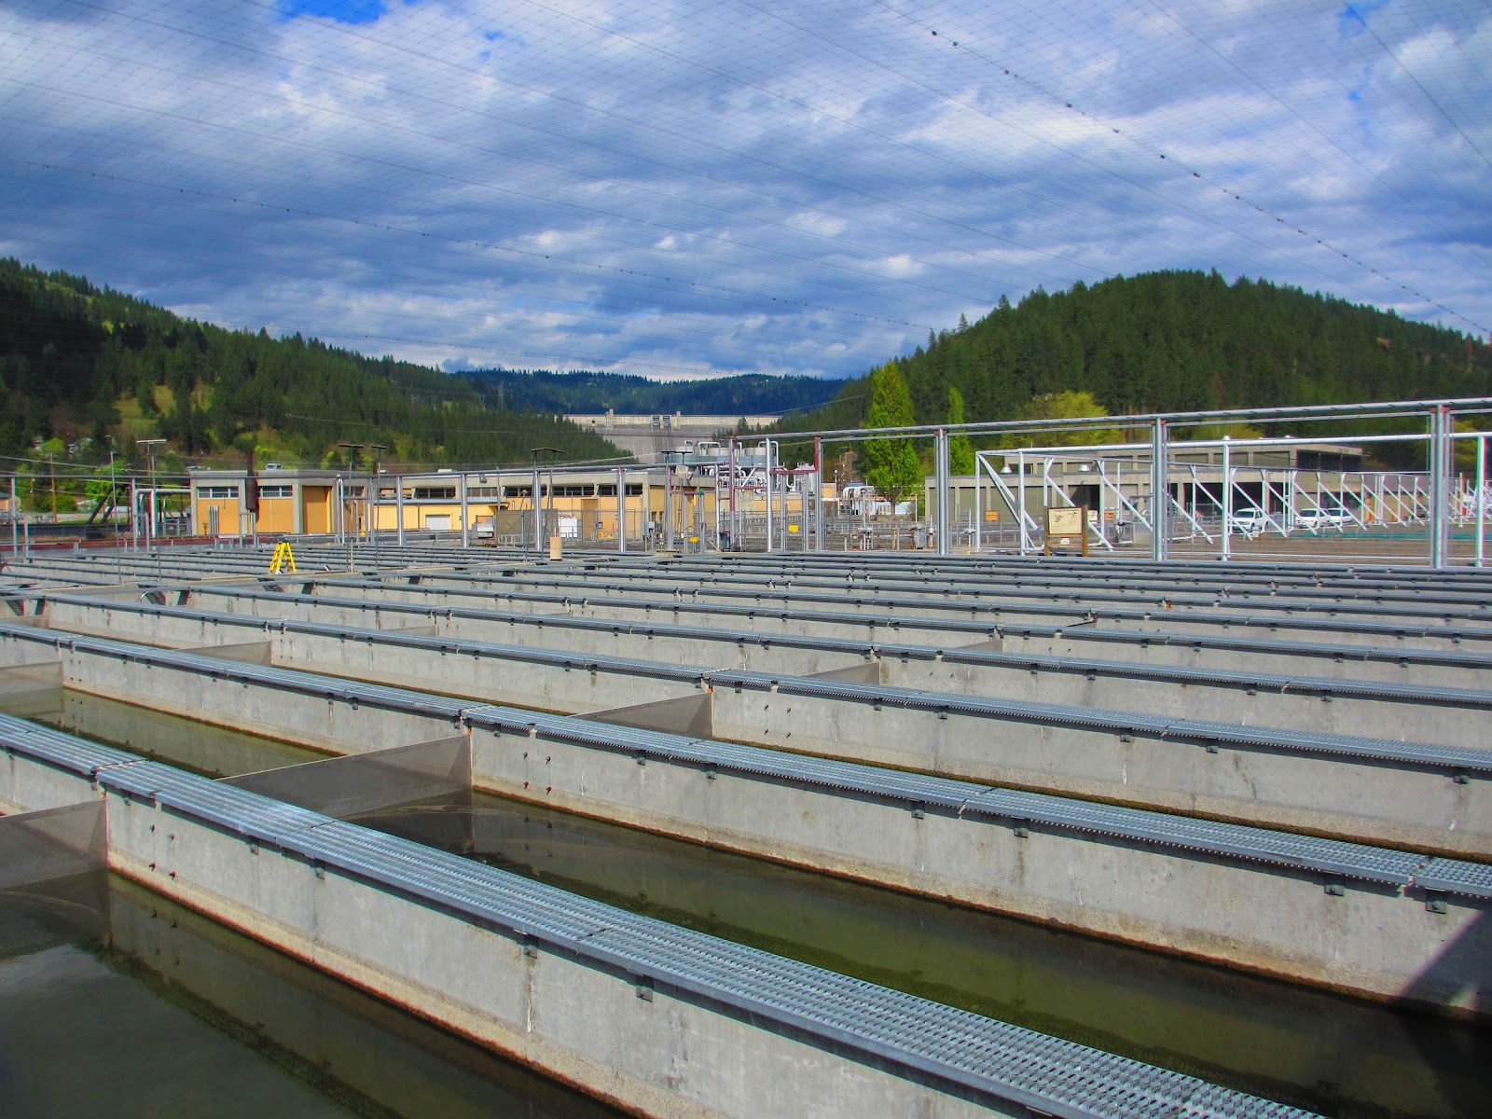
Hatchery Data

Slide 12
June 14, 2017 CA hatchery indicators conference call
Possible indicators to examine:
Juvenile releases (date, location, release type, fish size, maybe marks)
Adult returns by location. (with / without jacks)
SAR (by broodstock; start with data from FPC)
R/S (lowest priority; difficult)

Slide 13
June 14, 2017 CA hatchery indicators conference call
Next Steps –
Mike will mark up a draft DES with this information and send it out for review.
States and USFWS will review DES and get comments back to Mike.
Once we are comfortable with initial draft, will look for sample data sharing from states and USFWS, use initial sharing as test case and modify DES as we share and learn.

Slide 14
We need sample data sets so we can see what exists
and make suggestions for the DES.

Slide 15
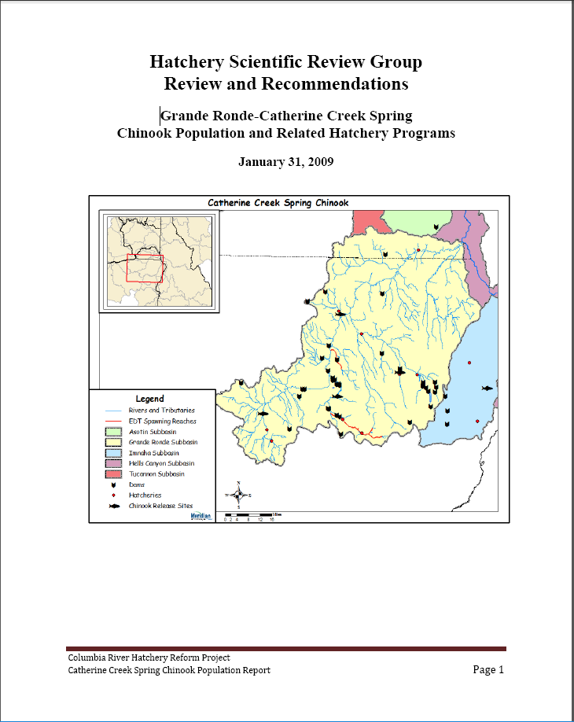
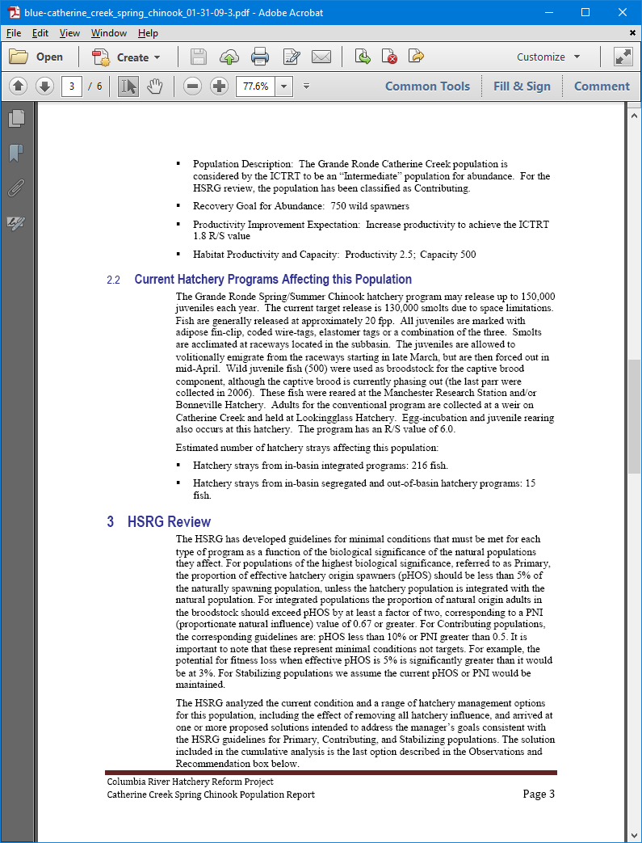
An example: HSRG report for Grande Ronde / Catherine Creek
Next
slide

Slide 16
An example: HSRG report for Grande Ronde / Catherine Creek
Does the scale of information available match the scale of interest?

Slide 17

Please Sir, some example data sets for the poor?

Slide 18
Example data sets: USFWS

Slide 19
Example data sets: IDFG
Indicator | Sockeye | Chinook | Steelhead | Comments
Juvenile releases (date, location, release type, fish size, maybe marks): | Yes, from database | Yes, from database | Yes, from database | We have a release database for all programs operated by IDFG and HNFH. The FPC also has our release info (offhand, not sure how far back).
Adult returns by location (with / without jacks) | Yes, from XLS | Yes, from XLS/FINS | Yes, from XLS/FINS | Yes, we have spreadsheets with this data for Sthd and Chinook.
SAR (by broodstock; start with data from FPC) | Yes, from XLS | Yes, from XLS | Yes, from XLS | Does FPC have hatchery SARs for CH and SH? FPC will have SARs based on PIT tag release/returns. We have SARs based on traditional run reconstruction for steelhead and chinook (harvest+ hatchery returns + spawning ground etc.)
R/S (lowest priority; difficult; but if anyone has data, please let us see what you have) | Yes, from XLS | ???? | ???? | Yes, we have this data for steelhead and chinook but will need some time to clean this up before we submit.

Slide 20
Example data sets: ODFW

Slide 21
Example data sets: WDFW
Received North Toutle Hatchery Chinook Program Data 9/12/2017
ESA Status: This population is listed as threatened and is part of the Lower Columbia Chinook ESU.
Population Description: This stock is one of 23 fall Chinook stocks in the ESU and is designated as a Stabilizing population (LCSR&SP 2004). Historically, this was a large tule fall Chinook population. There is significant history of hatchery transfers from other lower Columbia subbasins. The primary historical spawning areas of the North Fork and mainstem Toutle remain impacted by the eruption of Mt. St. Helens.

Slide 22
Example data sets: NPT
Our data aligns with the DES for the hatchery indicators. As far as scale is concerned we report our hatchery data by release group/site. So it may be possible to have multiple records for one population as is the instance with Fall Chinook in the Snake River main stem.
Please let me know if you have any questions.
Ryan Santo

Slide 23

FIN
fin

Slide 24

Partner Updates
Notes:
Discussed one fish – two fish visualization tools. Everyone appreciates the perspective they give on data. Question was discussed – why not make them available to everyone permanently by asking that they be built into the CAX data viewer? Would require discussion and possible contract change with Brian Mashoff.
I bring up the idea of tools being built at the data interface level at Exec Comm meeting, so that everyone can access it and improve quality control through integration with the database

Slide 25

Coordinated Assessment/StreamNet Priorities Discussion
From the Existing CA 5 Year Plan Year 3 (Oct, 2017 – Sep, 2018);
Maintain, update, and automate existing data flow. Maintain automated flow of all Natural Origin Indicators with data
Finalize DES for hatchery indicators, begin to populate with data
Begin development of new indicators, conduct review of data on lamprey, sturgeon, and bull trout
Conduct performance review of hatchery data flow and data needs
Notes:
Faded background picture
(Basic)
To reproduce the background effects on this slide, do the following:
On the Home tab, in the Slides group, click Layout and then click Blank.
Right-click the slide and click Format Background.
In the Format Background dialog box, click Fill in the left pane. In the Fill pane, select Picture or texture fill, and then under Insert from, click File.
In the Insert Picture dialog box, select a picture, and then click Insert.
Also in the Format Background dialog box, in the Fill pane, in the Transparency box, enter 85%.

Slide 26
Coordinated Assessment 5 Year Plan Discussion Draft – Suggested Changes for the Executive Committee
Year 2 - (2016-17)
  Maintain or establish automated flow of existing Natural Origin indicators. Work on priority populations as established by Executive Committee
  Implement “ground-up” hatchery indicator exercise
  Bull trout discussion and meeting with biologists
  Implement data sharing with FPC
Year 3 - (2017-18)
  Maintain automated flow of existing indicators, especially for priority pops. Obtain more data and share data with tribes if possible
  Maintain FPC data sharing. Implement hatchery data sharing if initial exercise is productive
  Examine pilot project for getting priority data from certain BPA-funded projects into CAX as “related data” for populations
  Delay review of data on lamprey, sturgeon, and bull trout, and discuss data availability and relationship to regional data needs until FY 2019

Slide 27
Coordinated Assessment Existing 5 Year Plan
Year 5 - (2019-20)
  Maintain automated flow of all adopted indicators.
  Implement recommendations of performance reviews in data collection efforts
  Finalize and adopt resident trout indicators, begin to populate with data
  Conduct review of CA project and evaluate next 5 years for possible new plan. Include assessment of regional data needs
  Begin development of next indicators, ensure alignment with data needs
Year 4 - (2018-19)
  Maintain automated flow of existing indicator data. Implement recommendations of performance reviews in data collection efforts
  Finalize and adopt lamprey, sturgeon, and bull trout indicators, begin to populate with data
  Conduct review of data on resident trout, to assess and discuss data availability and relationship to regional data needs
  Begin development of resident trout indicators, ensure alignment with data needs
Propose changes now?

Slide 28
Coordinated Assessment Possible Edits to Existing 5 Year Plan
Year 5 - (2019-20)
  Maintain automated flow of all adopted indicators.
  Implement recommendations of performance reviews in data collection efforts
  Finalize and adopt lamprey, sturgeon, and/or bull trout resident trout indicators, begin to populate with data
  Conduct review of CA project and update/ develop a new plan for next 5 years. Include assessment of regional data needs
  Begin development of next indicators, ensure alignment with data needs
Year 4 - (2018-19)
  Maintain automated flow of existing indicator data. Implement recommendations of performance reviews in data collection efforts
  Finalize DES lamprey, sturgeon, and bull trout for a limited number of high priority hatchery indicators, begin to populate with data
  If supported by region’s priorities and does not detract from highest priority items, conduct review of lamprey, sturgeon, and bull trout resident trout, to assess and discuss data availability and relationship to regional data needs
  Begin development of resident trout indicators, ensure alignment with data needs
Suggested changes for the Exec Committee
Notes:
Briefing on the Upper and Mid-Columbia sturgeon activities.
Upper Columbia: Jason McLellan, Colville Confederated Tribes with representatives from Spokane Tribe of Indians and Washington Department of Fish and Wildlife.
Mid-Columbia: Representatives from the Yakama Nation, Washington Department of Fish and Wildlife and the Mid-Columbia PUDs.
Jason McLellan noted at NPCC meeting 9/13 that they had a sturgeon data management system in the upper basin (above Grand Coulee) and were looking to possibly expand that to the whole basin

Slide 29
Draft Priority List for FY 18:
HLIs for 18 Tier 1 Populations
HLIs for 51 Tier 2 Populations
HLIs for other populations
Maintain facilities dataset/fish distribution
Related data pilot project for high priority populations?
Fully Implement FPC data sharing
Hatchery Datasets and DES Development
NPCC dashboard trends
Other (New Indicators? Bull trout?, etc.)
Move up list from 7 ?→

Slide 30
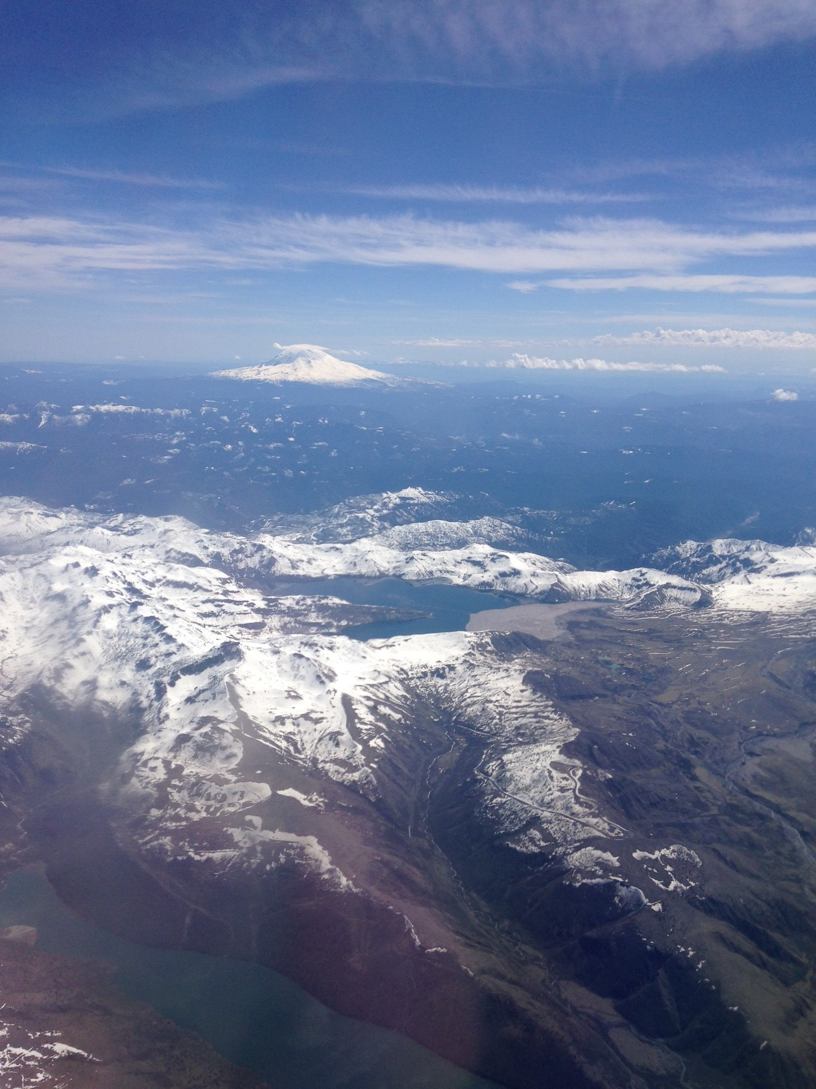
Related data pilot project for high priority populations?
Notes:
Faded background picture
(Basic)
To reproduce the background effects on this slide, do the following:
On the Home tab, in the Slides group, click Layout and then click Blank.
Right-click the slide and click Format Background.
In the Format Background dialog box, click Fill in the left pane. In the Fill pane, select Picture or texture fill, and then under Insert from, click File.
In the Insert Picture dialog box, select a picture, and then click Insert.
Also in the Format Background dialog box, in the Fill pane, in the Transparency box, enter 85%.

Slide 31
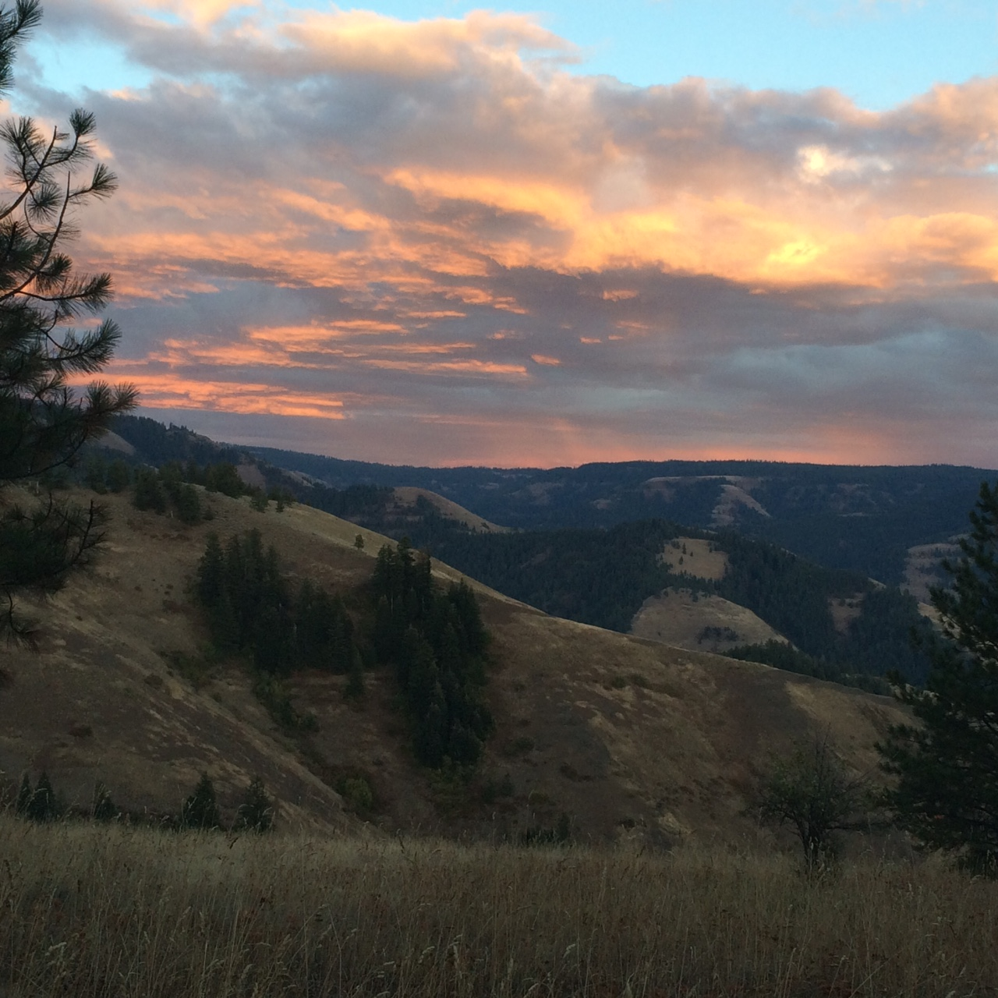
November 4, 2016
BPA Identify StreamNet partner projects that appear to have data, but that data not accessible (pilot – start small scale)
StreamNet partners contact their internal agency contract manager – determine issues with data availability
If the problem is technical or communication, offer assistance to get data into CAX or as “related data” in display
StreamNet staff NOT contract enforcement personnel – do not impart a “must comply” message during the pilot
Report back on pilot project and decide where to go from here.

Slide 32
November 4, 2016
Upload project data here if
It is available. Add link to
Data Store if data is un-
Structured.

Slide 33
Potential New Indicators and
QA/QC Discussion
Notes:
Faded background picture
(Basic)
To reproduce the background effects on this slide, do the following:
On the Home tab, in the Slides group, click Layout and then click Blank.
Right-click the slide and click Format Background.
In the Format Background dialog box, click Fill in the left pane. In the Fill pane, select Picture or texture fill, and then under Insert from, click File.
In the Insert Picture dialog box, select a picture, and then click Insert.
Also in the Format Background dialog box, in the Fill pane, in the Transparency box, enter 85%.

Slide 34
November 4, 2016
Tribal Data Project and Coordination with CAX (getting tribal data into CAX)
Denise Kelsey

Slide 35
November 4, 2016
Proposed PNAMP Workshop
Jen Bayer
PNAMP has offered to facilitate a methods review workshop focused on protocols and methods used to derive NOSA for steelhead. Jen is seeking feedback on interest, scope and timing of such a workshop (assuming sufficient interest)

Slide 36
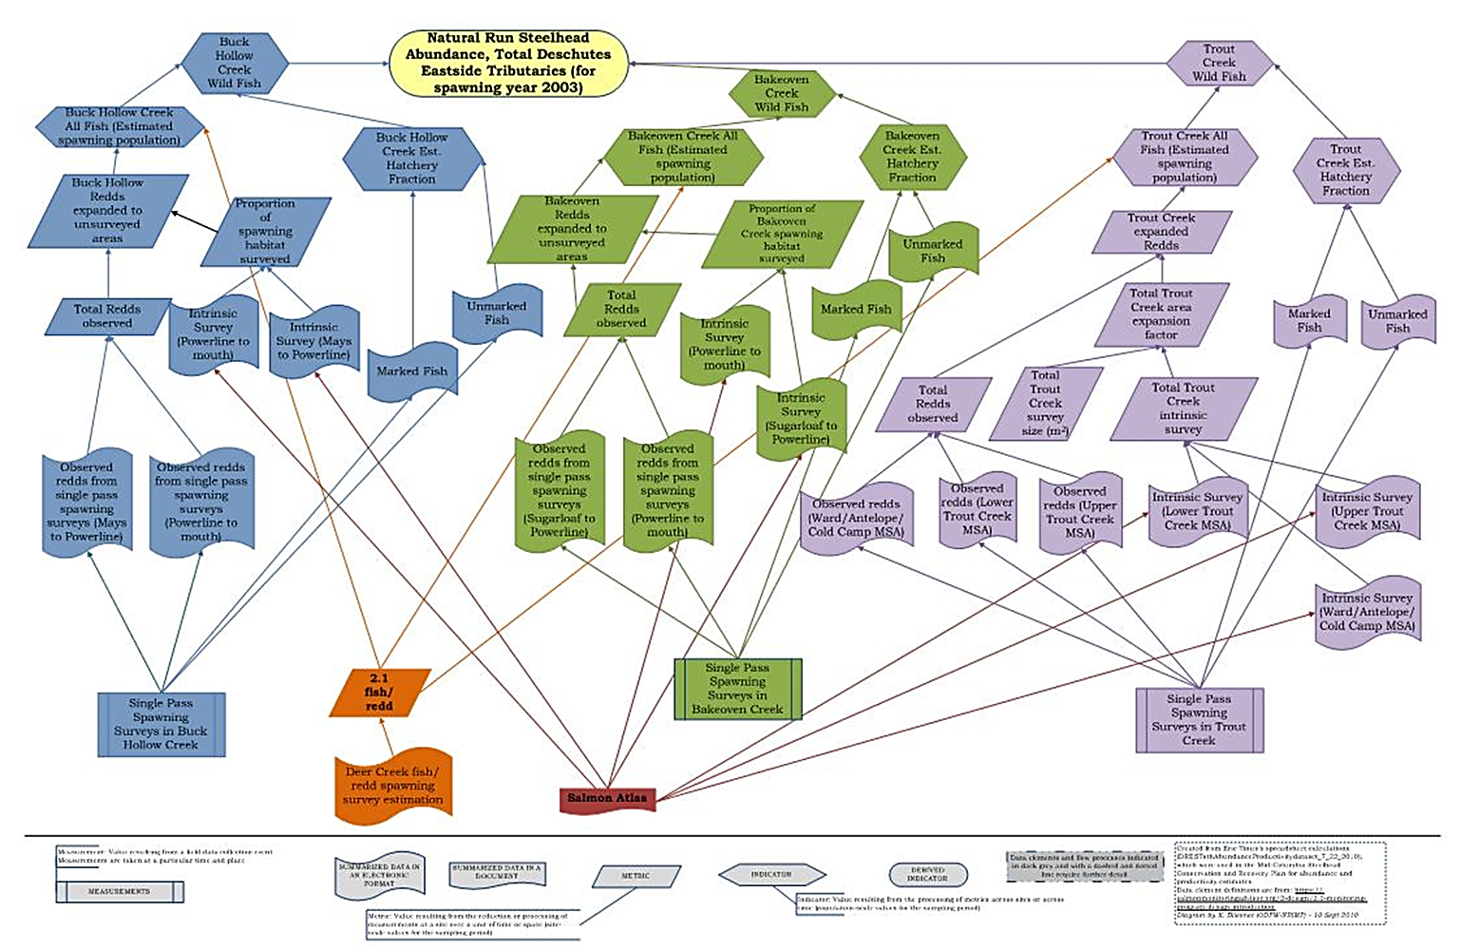
NOSA Documentation

Slide 37
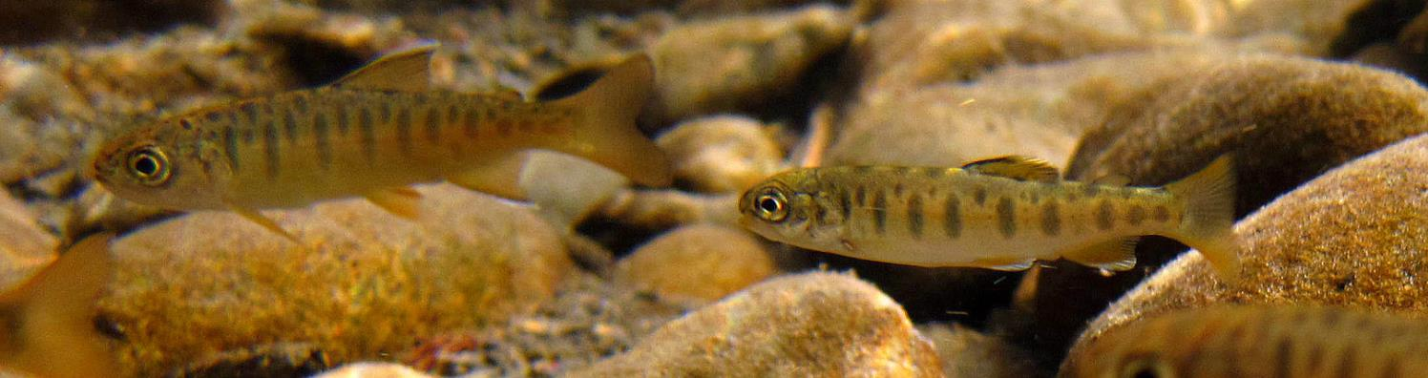

Documentation of NOSA Protocols in MonitoringResources.org
Some project sponsors are affected by contract changes; project sponsors with similar needs are welcome to join
  Seeking to update documentation before contract changes occur to support continuity
  See handout for scope

Slide 38
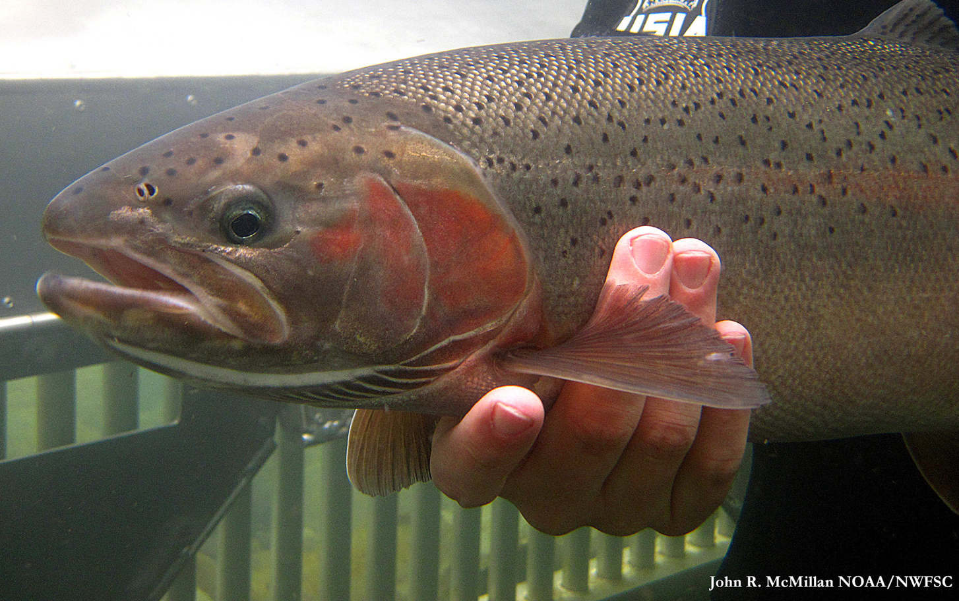

  Proposed Discussion of NOSA Steelhead Protocols
Scope: NOSA for Steelhead only?
Participants
Timeline
Location

Slide 39
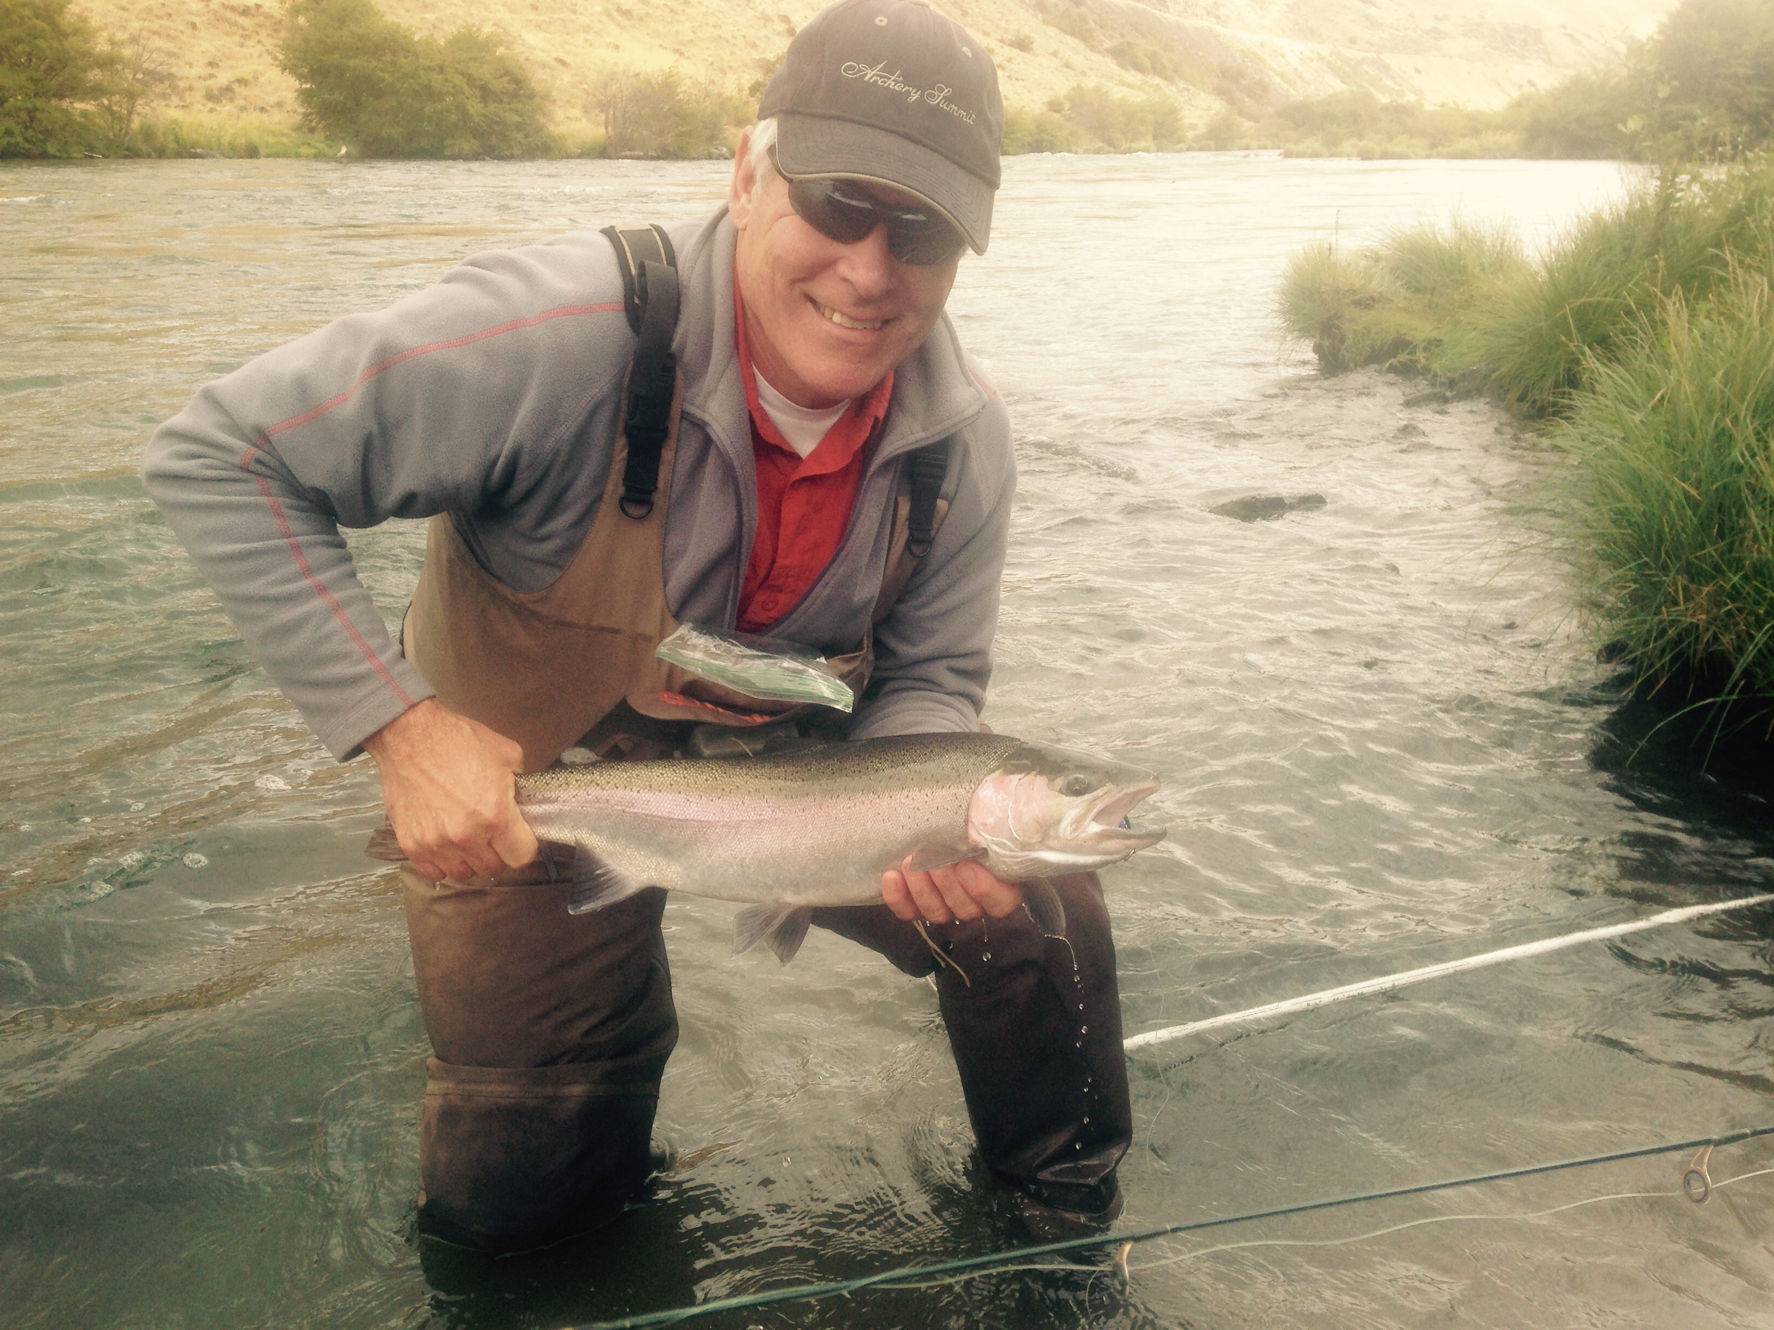
Adjourn

Slide 40
Extra Slides

Slide 41
Data Store: Data Sets by Fiscal Year (all years)
Fiscal Year | Total data sets | BPA-funded
2016 | 10 | 6
2015 | 12 | 6
2014 | 6 | 4
2013 | 9 | 8
2012 | 5 | 3
2011 | 13 | 7
2010 | 7 | 3
2009 | 4 | 2
2008 | 6 | 4
2007 | 7 | 5
2006 | 6 | 3
2005 | 26 | 8
TOTAL | 111 | 59
9 new data sets so far in 2017, all BPA funded, 1 NOAA, 3 SWCD, 2 IDFG, 1 USFWS, 2 USGS

Slide 42
Data Store: Last 5 Fiscal Years by Agency
 | Fiscal Year
Agency | 2012 | 2013 | 2014 | 2015 | 2016 | TOTAL
Columbia River Estuary Study Taskforce |  | 1 |  |  |  | 1
IDFG |  |  |  | 4 |  | 4
MFW&P | 2 | 1 | 2 | 6 | 3 | 14
Nez Perce S&W Cons. Dist. | 1 | 1 | 1 |  | 1 | 4
NPT |  | 1 |  | 1 |  | 2
PNNL |  |  |  | 1 |  | 1
SBT | 2 | 3 | 3 |  | 1 | 9
StreamNet |  | 1 |  |  |  | 1
USFWS |  | 1 |  |  | 1 | 2
USGS |  |  |  |  | 2 | 2
YIN |  |  |  |  | 1 | 1
TOTAL | 5 | 9 | 6 | 12 | 9 | 41

Slide 43
Question / Issue: relationship to natural populations.
Do we define hatchery indicators in relation to the natural populations they affect?
If so, how?
And which natural pop(s)
for each hatchery group?
Are we interested in hatchery indicators per se, or only their effects on / interactions with natural populations?

Slide 44
Question / Issue: relationship to natural populations.
Do we define hatchery indicators in relation to the natural populations they affect?
If so, how?
And which natural pop(s)
for each hatchery group?
Are we interested in hatchery indicators per se, or only their effects on / interactions with natural populations?

Slide 45
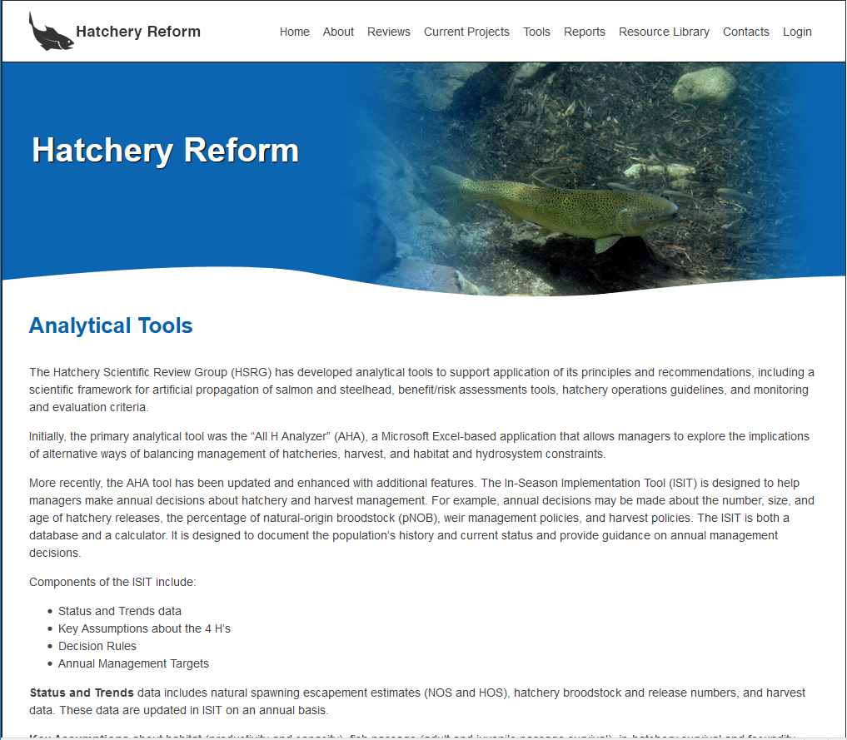
Another example of
where hatchery indicator
data could be useful.

Slide 46
Coordinated Assessments Data Since the End of 2016 as of September 6, 2017
Number of Populations at end of 2016 & More Current Years of HLIs Reported since 2016
Indicator | End of 2016 Reported Populations / HLIs | ODFW End of 2016 Populations / More Recent HLIs | IDFG^{Ӿ} End of 2016 Populations / More Recent HLIs | WDFW^{Ӿ} End of 2016 Populations / More Recent HLIs | CCT End of 2016 Populations / / More Recent HLIs
Natural Origin Spawner Abundance | 155 / 4,548 | 72 / 59 | 24 / 33 | 64 / 22 (2 new Populations w/ 164 HLIs) | 1 / 1
Recruits per Spawner | 86/ 2,295 | 42 / 0 | 18 / 17 | 27 / 10 (1 new Population with 11 HLIs) | 1 / 0
Smolt to Adult Ratio | 33 / 120 | 4 / 0 | 0 / 0 | 3 / 0 | 1 / 0
Juvenile Abundance | 32 / 484 | 5 / 0 | 8 / 0 (2 new Populations with 16 HLIs) | 19 / 21 (1 new Population with 1 HLI) | 1 / 0
Presmolt Abundance | 6 / 78 | 4 / 0 | 0 / 0 | 2 / 0 | 1/ 0 (1 new Population with 5 HLIs)
^{Ӿ}IDFG includes estimates coordinated with ISEMP, NPT or SBT. ^{Ӿ}WDFW includes estimates by USFWS. Includes TRT, non-TRT Populations and SuperPopulations.
Note: Some numbers don’t add up across Indicators Reported due to portions of Populations shared by agencies or multiple RperSTypes reported per Population, etc.

Slide 47
Hypothetical Example
ODFW Project 1992-026-04 - Grande Ronde Early Life History of Spring Chinook and Steelhead
Identified as having juvenile outmigrant data for these populations but data is not in CAX
BPA has difficulty accessing data in a useful format and requests StreamNet assistance in obtaining
Data
ODFW StreamNet-funded staff asked to help access data, determine if data is structured to fit an
Existing StreamNet DES (CAX or “Trend”)

