Slide 1
StreamNet Executive Committee Meeting
June 14, 2018

Slide 2
Agenda
  Plans and Adjustments for Next Year’s Budgets: BPA Guidance
  Current Year Budget Update
  Progress on our Priorities this Year - Partner Updates
  Setting CA/StreamNet Priorities for Next Fiscal Year
  Council F&W Amendment Process
  CRITFC Library Update and Discussion
  Tribal ITMD Project Update and Discussion
  Roundtable Discussion

Slide 3
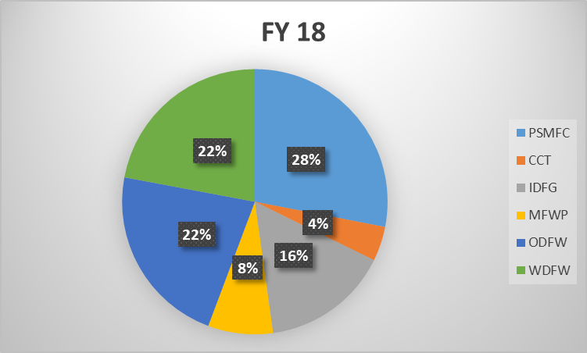
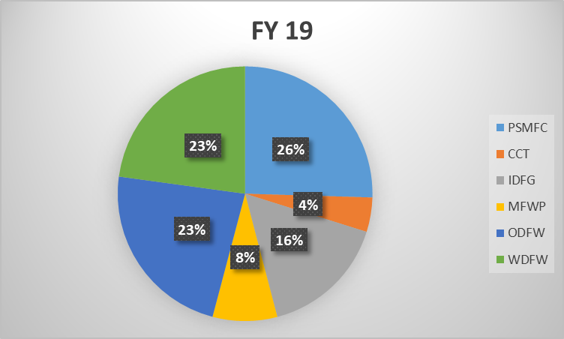
Plans and Adjustments for Next FY;
BPA Guidance?

Slide 4
BPA Budget Discussion FY 19 Adjustments?
Bonneville Cost Savings Overview
Data management and RM&E Issues
StreamNet and CA Project Discussion
Budget adjustments?

Slide 5
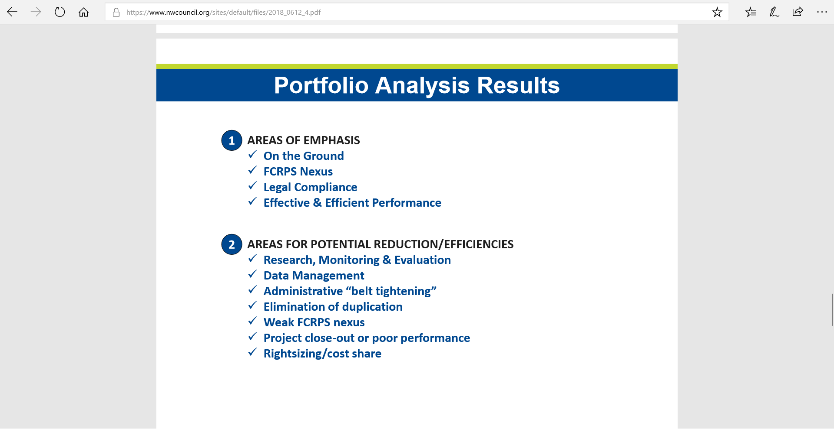

Slide 6
Current Fiscal Year (10/17 – 9/18)
Budget update
  Two year budget – can we roll savings into next year?
  Budget savings anticipated?
  Budget shortfall issues to address?
        (See Next Slide)

Slide 7
Last Year's Savings |  | Spent to date (w/o fees) | Balance | Percent of Funds Remaining | Percent of Billing Year Remaining
$2,092 | CCT | $12,153 | $75,807 | 86.2% | 100.0%
$12,008 | IDFG | $126,885 | $196,886 | 60.8% | 50.0%
$14,154 | MFWP | $83,534 | $81,516 | 49.4% | 42.0%
$1 | ODFW | $204,698 | $259,006 | 55.9% | 42.0%
$2,627 | PSMFC | $309,552 | $190,207 | 38.1% | 37.0%
$0 | WDFW | $252,613 | $207,252 | 45.1% | 42.0%

Slide 8
Progress on current ca priorities
  1) HLIs for 18 Tier 1 Populations;
  2) HLIs for 51 Tier 2 Populations (Including Implementing FPC data sharing for these Tier 1&2 populations);
  3) HLIs for other populations (Including Implementing FPC data sharing for these populations);
  4) Maintain facilities dataset/fish distribution;
  5) Related data pilot project for high priority populations;
  6) Hatchery Datasets and DES Development;
  7) NPCC dashboard trends

Slide 9
Published^{1o} Coordinated Assessments Records 2017 Results and Predictions for 2018
High Level Indicator | Agency | 2017 Populations Reported² | 2017 Records From All Populations | 2018 Predictions: Populations |  | 2018 Predictions: Related Data | 2018 Predictions: BPA Priority Populations
Natural Origin Spawner Abundance (NOSA) | All | 164 | 5,418 | 167 |  |  | 50
Presmolt Abundance | All | 7 | 132 | 7 |  |  | 6
Juvenile Outmigrants | All | 52 | 900 | 61 |  |  | 42
Smolt to Adult Return Rate (SAR) | All | 35 | 774 | 111 |  |  | 63
Recruits per Spawner (R/S) | All | 88 | 3,095 | 103 |  |  | 43
All | All | 346 Includes duplicates | 10,319 | 449 includes duplicates |  | 1,705 | 204 includes duplicates
¹ "Published" is defined as the data available to all on the CA query system (CAX).
² For 2017 a record for a superpopulation was counted only once, for that superpopulation; component populations were not included in the counts. For 2018 the number of populations and records reflects populations, not superpopulations.
³ The 213 "TRT populations" are those in the Columbia Basin not listed as extirpated.

Slide 10
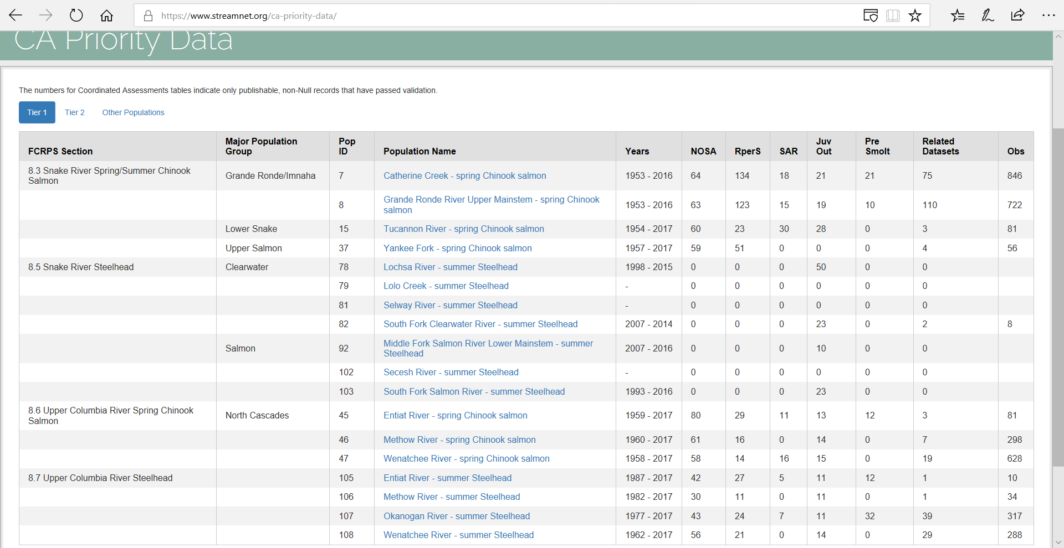

Slide 11
Setting priorities for Coordinated Assessments project for next year
What constitutes successful performance for this project?
Set priorities and measurable outcomes for the next year
New Indicators? Other major changes to DES?
Hatchery Indicator(s) for BPA funded programs (Adult-equivalents to mouth of river)?
Current 5 Year Plan language;
    Maintain automated flow of existing indicator data.
    Finalize DES for a limited number of high priority hatchery indicators, begin to populate with data
    If supported by region’s priorities and does not detract from highest priority items, conduct review of lamprey, sturgeon, and bull trout, to assess and discuss data availability and relationship to regional data needs

Slide 12
Data Management and the Council F&W Program
Amendment Process Overview – Patty O’Toole
Make a recommendation directly from the StreamNet Executive Committee?
Incorporate data management into individual state and tribal recommendations?

Slide 13
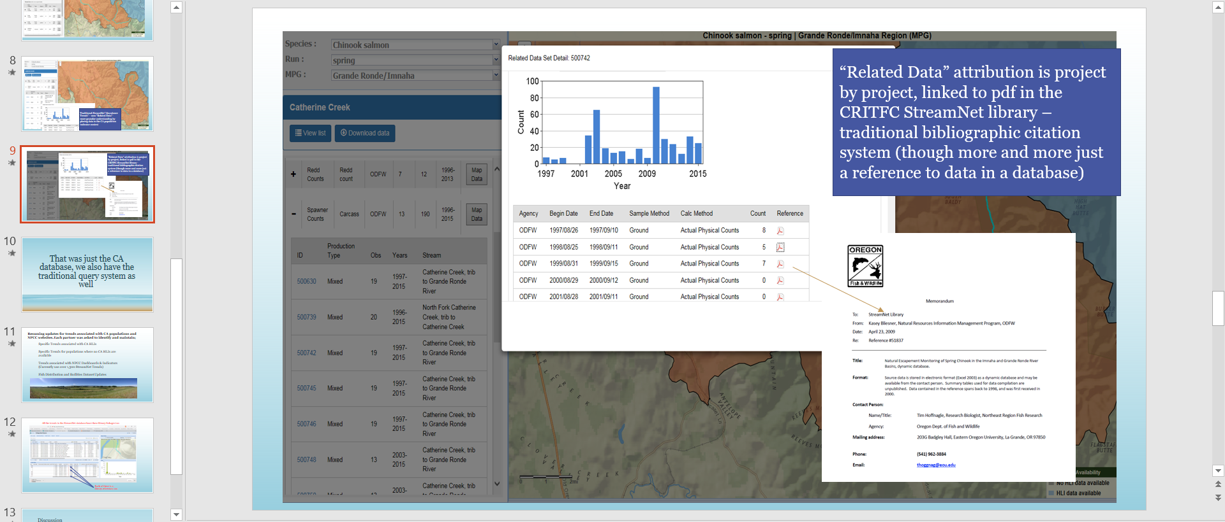
CRITFC - StreamNet library Update and Discussion – Zach Penny

Slide 14
CRITFC – Tribal ITMD Project Update – Zach Penny

Slide 15
Roundtable discussion

Slide 16
Extra Slides

Slide 17
Published¹ Coordinated Assessments Records 2017 Results and Predictions for 2018
High Level Indicator | Agency | 2017 Populations Reported² | 2017 Records From All Populations | 2018 Predictions: Populations | 2018 Predictions: Records | 2018 Predictions: Related Data | 2018 Predictions: BPA Priority Populations | General Comments
Natural Origin Spawner Abundance (NOSA) | CCT | 1 | 12 | 1 | 1 | 4 | 0 | Plan to get related data for redd counts, carcass counts, snorkel surveys, and spawning escapement
 | IDFG | 24 | 1,164 | 25 | 1,165 | 96 | 25 | add sockeye
 | ODFW | 72 | 2,189 | 78 | 250 |  | 14 | Added 4 new Willamette spring Chinook populations and 3 new Coastal coho populations. If time/resources allows, 3 new John Day spring Chinook populations might be added. No updates likely for 4 summer steelhead populations (Deschutes east, Deschutes west, Fifteenmile and Joseph Creek). BPA priority populations in Column J are for Priority 1 and 2.
 | WDFW | 67 | 2,053 | 63 | 60 | 281 | 11 | Related trends are under evaluation and revision due to transfer to CRITFIC and other tribal fisheries agencies. Related trends will be updated after review is finished. Have already sent 9 pops with 10 records for NOSA data
 | All | 164 | 5,418 | 167 | 1,476 | 381 | 50
Presmolt Abundance | CCT | 1 | 31 | 1 | 9 |  | 0
 | IDFG | 0 | 0 | 0 | 0 | 0 | 0
 | ODFW | 4 | 81 | 4 | 4 |  | 4 | No new populations anticipated. BPA priority populations in Column J are for Priority 1 and 2.
 | WDFW | 2 | 20 | 2 | 2 |  | 2 | Data are USFW, Entiat, reported by consulting Co. Last Monitoring for smolts will be done in 2018 for steelhead and spring chinook by TerrAqua.
 | All | 7 | 132 | 7 | 15 | 0 | 6

Slide 18
Published¹ Coordinated Assessments Records 2017 Results and Predictions for 2018
High Level Indicator | Agency | 2017 Populations Reported² | 2017 Records From All Populations | 2018 Predictions: Populations | 2018 Predictions: Records | 2018 Predictions: Related Data | 2018 Predictions: BPA Priority Populations | General Comments
Juvenile Outmigrants | CCT | 1 | 9 | 1 | 1 |  | 0
 | IDFG | 21 | 472 | 22 | 473 | 0 | 21 | add sockeye
 | ODFW | 5 | 100 | 18 | 225 |  | 10 | Added 7 new Coastal coho populations (PopFit = Portion) and 1 new Lower Columbia steelhead population. Anticipate adding Fifteenmile, Umatilla, Upper John Day, MF John Day and SF John Day summer steelhead. BPA priority populations in Column J are for Priority 1 and 2.
 | WDFW | 25 | 319 | 20 | 20 | 0 | 11
 | All | 52 | 900 | 61 | 719 | 0 | 42
Smolt to Adult Return Rate (SAR) | CCT | 1 | 7 | 1 | 1 |  | 0
 | IDFG | 0 | 0 | 0 | 0 | 0 | 0 | (See PFMC-FPC web service)
 | ODFW | 5 | 80 | 15 | 240 |  | 7 | Added 7 new Coastal coho populations (PopFit = Portion) and 1 new Lower Columbia steelhead population. Anticipate adding Fifteenmile and Umatilla summer steelhead. BPA priority populations in Column J are for Priority 1 and 2.
 | PSMFC | 26 | 663 | 89 | 152 | 0 | 51 | 88 SARs are anticipated for the 51 priority populations.
 | WDFW | 3 | 24 | 6 | 17 | 0 | 5 | Have already sent 1 pop with 12 records for SAR data
 | All | 35 | 774 | 111 | 410 | 0 | 63

Slide 19
Published¹ Coordinated Assessments Records 2017 Results and Predictions for 2018
High Level Indicator | Agency | 2017 Populations Reported² | 2017 Records From All Populations | 2018 Predictions: Populations | 2018 Predictions: Records | 2018 Predictions: Related Data | 2018 Predictions: BPA Priority Populations | General Comments
Recruits per Spawner (R/S) | CCT | 1 | 2 | 1 | 5 |  | 0
 | IDFG | 18 | 1,001 | 19 | 1,002 | 96 | 19 | add sockeye
 | ODFW | 42 | 1,799 | 52 | 286 |  | 14 | Added 14 new Coastal coho populations for adult and juvenile RperS (PopFit = Portion). No updates likely for 4 summer steelhead populations (Deschutes east, Deschutes west, Fifteenmile and Joseph Creek). BPA priority populations in Column J are for Priority 1 and 2.
 | WDFW | 27 | 293 | 31 | 31 | 0 | 10
 | All | 88 | 3,095 | 103 | 1,324 | 96 | 43
All HLIs | All | 346 | 10,319 | 449 | 3,944 | 477 | 204
Related Data | CCT |  |  |  | 4 | 4
 | IDFG | 24 | 119 | 25 | 120 | 96
 | ODFW |  |  |  | 1,300 |  |  | ODFW related data = ~705 different trends updated or added, which equates to ~1,300 EscData records updated or added since 10/1/2017. Data deliverables apply to recovery populations, NPCC dashboard trends and updates related to coordination with StreamNet on the traditional API. Trend categories included = Redd counts, spawner counts, fish counts, dam/weir counts, fish abundance and spawner abundance estimates. John Day spring Chinook trends might be added/updated if time/resources are available.
 | WDFW |  |  |  | 281 | 281
 | All | 24 | 119 | 25 | 1,705 | 381
¹ "Published" is defined as the data available to all on the CA query system (CAX).
² For 2017 a record for a superpopulation was counted only once, for that superpopulation; component populations were not included in the counts. For 2018 the number of populations and records reflects populations, not superpopulations.
³ The 213 "TRT populations" are those in the Columbia Basin not listed as extirpated.
4 Note "Related Data" totals do not sum as not all entities could predict by indicator.

Slide 20
BPA Tier 1 Populations
Catherine Creek - spring Chinook salmon
Grande Ronde River Upper Mainstem - spring Chinook salmon
Tucannon River - spring Chinook salmon
Yankee Fork - spring Chinook salmon
Lochsa River - summer Steelhead
Lolo Creek - summer Steelhead
Selway River - summer Steelhead
South Fork Clearwater River - summer Steelhead
Middle Fork Salmon River Lower Mainstem - summer Steelhead
Secesh River - summer Steelhead
South Fork Salmon River - summer Steelhead
Entiat River - spring Chinook salmon
Methow River - spring Chinook salmon
Wenatchee River - spring Chinook salmon
Entiat River - summer Steelhead
Methow River - summer Steelhead
Okanogan River - summer Steelhead
Wenatchee River - summer Steelhead

Slide 21
BPA Tier 2 Populations
Okanogan River - spring Chinook salmon - reintroduced
Snake River Lower Mainstem - fall Chinook salmon
Imnaha River Mainstem - spring/summer Chinook salmon
Wallowa/Lostine Rivers - spring Chinook salmon
Minam River - spring Chinook salmon
Bear Valley Creek - spring Chinook salmon
Big Creek - spring/summer Chinook salmon
East Fork South Fork Salmon River - summer Chinook salmon
Little Salmon River - spring/summer Chinook salmon
Secesh River - summer Chinook salmon
South Fork Salmon River - summer Chinook salmon
East Fork Salmon River - spring/summer Chinook salmon
Lemhi River - spring Chinook salmon
Pahsimeroi River - summer Chinook salmon
Salmon River Lower Mainstem - spring/summer Chinook salmon
Salmon River Upper Mainstem - spring Chinook salmon
Valley Creek - spring/summer Chinook salmon
Redfish Lake - summer Sockeye salmon
Grande Ronde River Lower Mainstem - summer Steelhead
Grande Ronde River Upper Mainstem - summer Steelhead
Joseph Creek - summer Steelhead
Wallowa River - summer Steelhead
Hells Canyon - summer Steelhead
Imnaha River - summer Steelhead
Asotin Creek - summer Steelhead
Tucannon River - summer Steelhead
East Fork Salmon River - summer Steelhead
Lemhi River - summer Steelhead
Middle Fork Salmon River Upper Mainstem - summer Steelhead
Pahsimeroi River - summer Steelhead
Salmon River Upper Mainstem - summer Steelhead
Deschutes River Eastside - summer Steelhead
Deschutes River Westside - summer Steelhead
Fifteenmile Creek - winter Steelhead
Klickitat River - summer and winter Steelhead
John Day River Lower Mainstem Tributaries - summer Steelhead
John Day River Upper Mainstem - summer Steelhead
Middle Fork John Day River - summer Steelhead
North Fork John Day River - summer Steelhead
South Fork John Day River - summer Steelhead
Touchet River - summer Steelhead
Umatilla River - summer Steelhead
Walla Walla River - summer Steelhead
Naches River - summer Steelhead
Satus Creek - summer Steelhead
Toppenish Creek - summer Steelhead
Yakima River Upper Mainstem - summer Steelhead
Hood River - fall Chinook salmon
Hood River - spring Chinook salmon
Washington Upper Gorge Tributaries and White Salmon River - late Coho salmon
Wind River - summer Steelhead

Slide 22
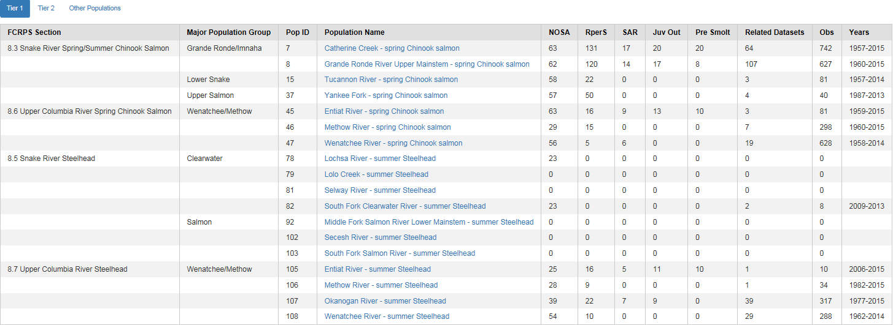
BPA Priority 1 Populations

Slide 23
Published Coordinated Assessments Data Snapshot Date June 13, 2018 |  |  |  |  |  |  | In Last 163 Days (since Jan. 1, 2018)
CA HLI table | Agency | Populations | Records Validated | Records w/HLIs | Records w/o HLIs | Last Modified | New | Validated | HLIs Changed*
NOSA | ODFW | 78 | 2,271 | 2,222 | 49 | May 30 2018 | 118 | 143 | 27
 | WDFW | 67 | 2,088 | 1,029 | 1,059 | May 29 2018 | 25 | 509 | 492
 | IDFG | 24 | 1,165 | 1,090 | 75 | Jan 11 2018 |  | 1 | 1
 | CCT | 1 | 12 | 12 |  | Jul 18 2017
 | All Agencies | 164 | 5,536 | 4,353 | 1,183 | May 30 2018 | 143 | 653 | 520
RperS | ODFW | 42 | 2,031 | 1,958 | 73 | May 18 2018 | 232 | 232
 | IDFG | 18 | 1,001 | 890 | 111 | Dec 19 2017
 | WDFW | 27 | 316 | 315 | 1 | May 25 2018 | 23 | 170 | 156
 | CCT | 1 | 2 | 2 |  | Dec 19 2017
 | All Agencies | 87 | 3,350 | 3,165 | 185 | May 25 2018 | 255 | 402 | 156
SAR | PSMFC | 26 | 663 | 663 |  | Dec 11 2017
 | ODFW | 12 | 204 | 195 | 9 | May 18 2018 | 124 | 124
 | WDFW | 4 | 58 | 58 |  | Jun 8 2018 | 34 | 53 | 19
 | CCT | 1 | 7 | 7 |  | Dec 19 2017
 | All Agencies | 43 | 932 | 923 | 9 | Jun 8 2018 | 158 | 177 | 19
Juvenile Outmigrants | IDFG | 21 | 472 | 462 | 10 | Dec 19 2017
 | WDFW | 25 | 327 | 315 | 12 | Jun 5 2018 | 8 | 208 | 201
 | ODFW | 12 | 232 | 222 | 10 | May 18 2018 | 132 | 132
 | CCT | 1 | 9 | 9 |  | Dec 19 2017
 | All Agencies | 59 | 1,040 | 1,008 | 32 | Jun 5 2018 | 140 | 340 | 201
Presmolt Abundance | ODFW | 4 | 81 | 65 | 16 | Oct 19 2017
 | CCT | 1 | 31 | 31 |  | Sep 18 2017
 | WDFW | 2 | 24 | 24 |  | Jun 6 2018 | 4 | 20 | 3
 | All Agencies | 7 | 136 | 120 | 16 | Jun 6 2018 | 4 | 20 | 3
All Tables | All Agencies | 360 | 10,994 | 9,569 | 1,425 | Jun 8 2018 | 700 | 1,592 | 899
“New” = New records loaded, based on primary key. “Validated” = records with a ValidationDate within the period noted; these can include new, updated & re-validated records.
*“HLIs Changed” is the number of existing records that have had their High Level Indicator value(s) changed; these are flagged with a date in the field named HLI_LastUpdated.
The sum of Populations may be less than the total of all agencies due to shared populations.

