Slide 1
StreamNet Executive Committee
June 20, 2019

Slide 3
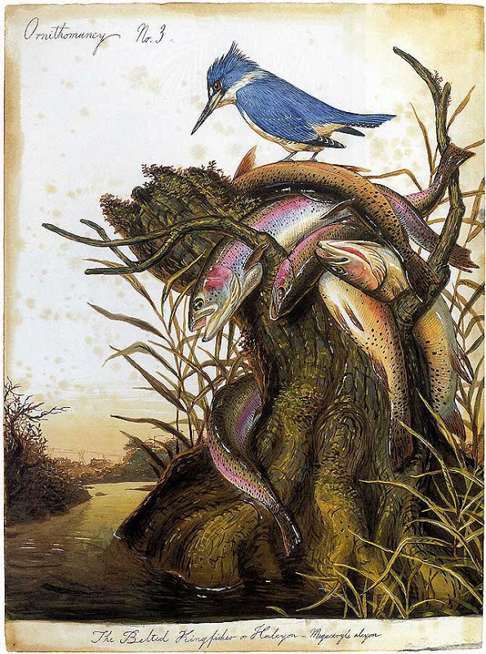
NOAA Update
Greg Sieglitz
Walton Ford

Slide 4
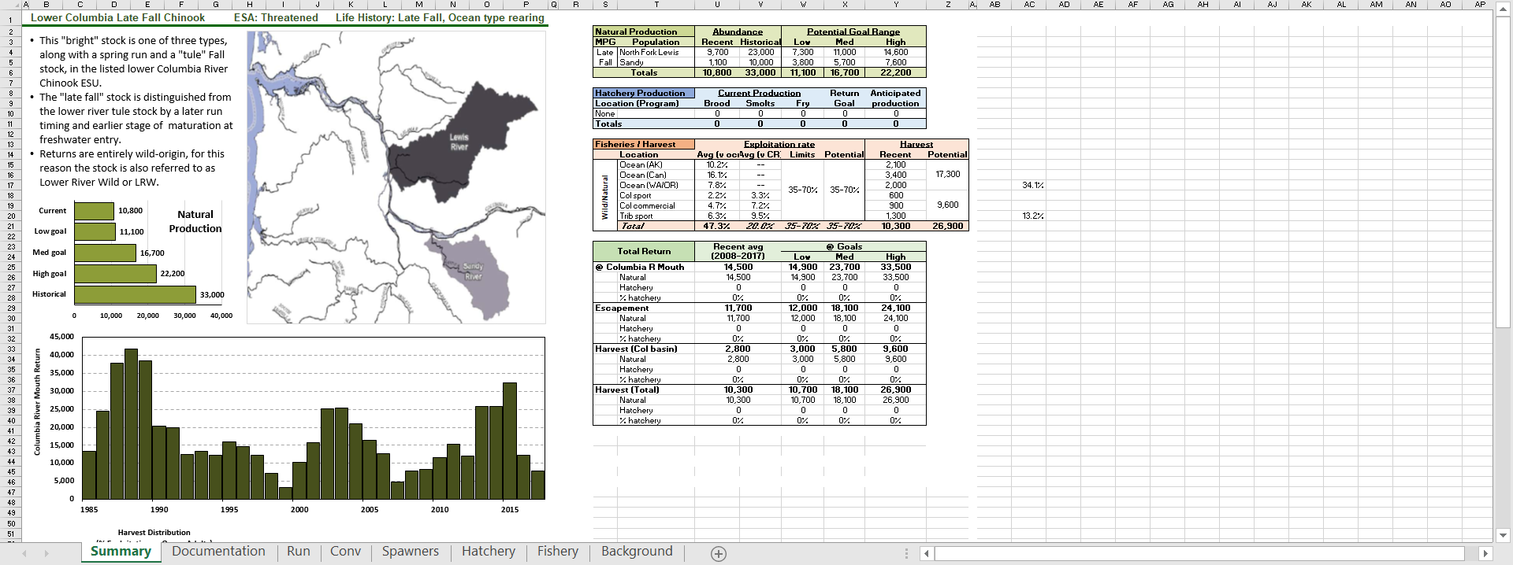
Columbia Basin Partnership Spreadsheets

Slide 5
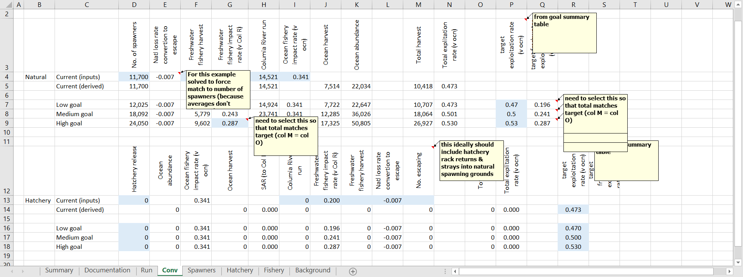
One Example -

Slide 6

NPCC F&W Program Addendum
Tony Grover

Slide 7
Coordinated Assessments
New 5 Year Plan Oct. 2019 – September, 2024

Slide 8

Current CA Priority
HLIs for Salmon & Steelhead Populations;
NOSA
RperS
SAR
Juvenile Outmigrants
PreSmolt Abundance
Further Prioritized by;
HLIs for 18 Tier 1 Populations
HLIs for 51 Tier 2 Populations
HLIs for other populations
Walton Ford

Slide 9
What do we change in new 5 year plan?
Previous 5 Year Plan was very ambitious – move on to new data categories (hatcheries, native fish, etc.) after initial effort
Experience – Current HLI effort not easily automatable, remains labor intensive
Focus has been on maximizing quantity of data for existing HLIs, particularly for priority populations
Level/decreased funding has limited expansion, as has lack of clear and apparent demand for data for these other species/data categories

Slide 10
HLIs for 18 Tier 1 and 51 Tier 2 Salmon & Steelhead Populations?
NOSA
RperS
SAR
Juvenile Outmigrants
PreSmolt Abundance
Do we change Indicators?
Do we change Populations?
Do we add any new Data Categories or Efforts?

Slide 11
Long Term - level funding, can we still provide the same effort? If not, what is a lower priority - what can be dropped?
Short Term +/- $100k in additional one-time funding – How to Utilize?
New indicators (If adopted) – Does something need to be dropped to make room for new effort? And -
Does this mean new reporting of existing data?
Or;
Does this mean changes in monitoring efforts?

Slide 12

Additional CA 5 Year Plan Discussion –
Workshops?
Governance ?
Other issues?
Walton Ford

Slide 13
Suggested Approach for Next Five Years
Maintain effort for existing HLIs
Maintain current populations priorities
Respond to policy direction as it is forthcoming;
    NPCC F&W Program Amendments
    Columbia Partnership
    Federal BiOps, EIS, etc.
Schedule Workshop if Policy Direction Implementation Merits Review
Continue to work with Tribes via coordination with Tribal ITMD Project
Fine tune effort through DES refinement, process improvement, efficiencies, as possible
Review and revise annually with Executive Committee Direction

Slide 14

Discussion

Slide 15
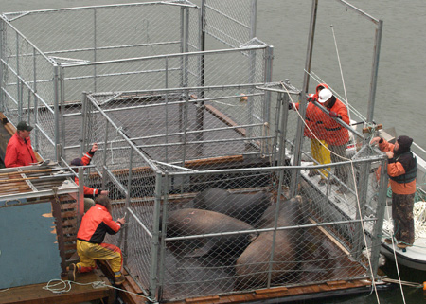
New Budgets and Statement of Work
BPA Budget Guidance
Jeff Lane and Jody Lando
Photo courtesy ODFW

Slide 16
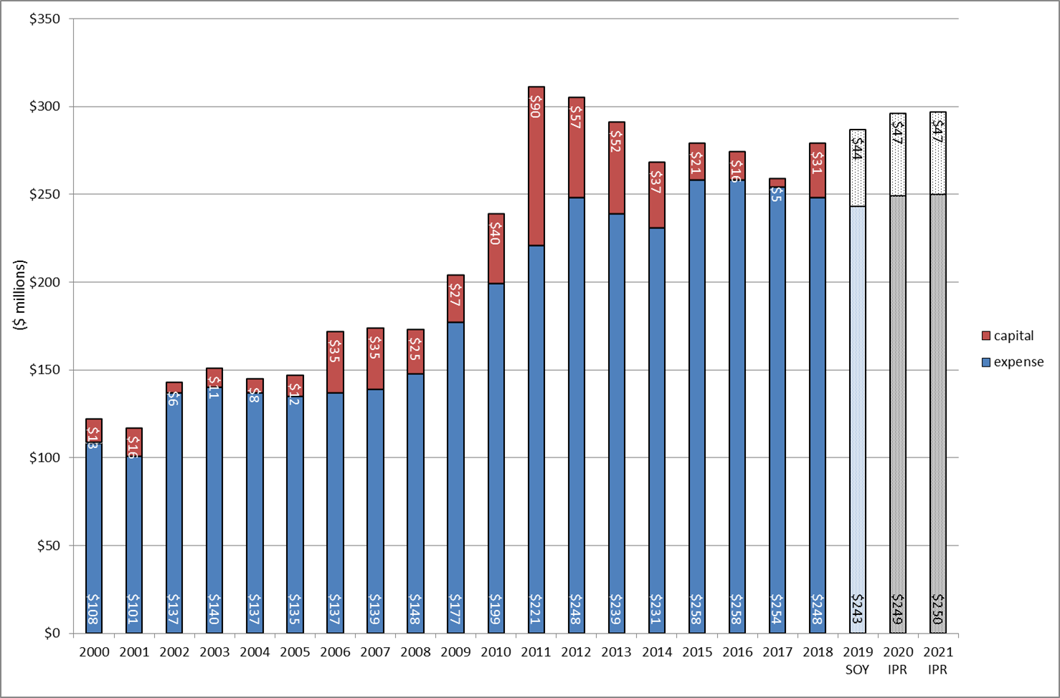

Slide 17
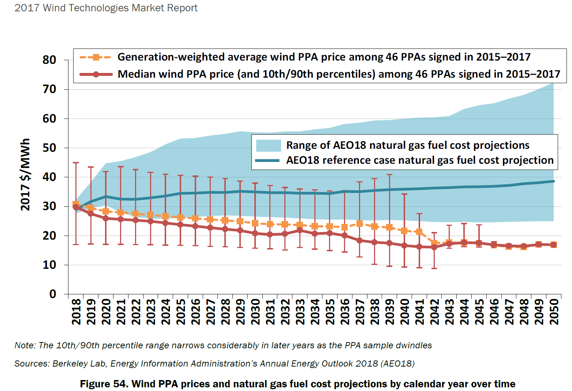
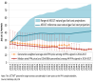





Non-Hydro resources will become increasingly competitive in the PNW.
Natural gas prices are currently projected to remain low for the foreseeable future, increasing slightly as electric power production and exports increase demand.
Wholesale market prices will be suppressed by the combination of low natural gas prices and an increase in renewable generation (utility-scale and behind-the-meter).
Renewables market penetration will create new opportunities and requirements for the provision of new power products that optimize generator flexibility.
In the long-term, changes in markets, rates, technology, and load behavior may reduce real-time market volatility and capacity shortfalls (e.g. increased generation capability of renewables, increased functionality of building-level energy management, etc.).
By 2028, competitively priced utility-scale wind and solar could displace some FCRPS-generated power.
Utility-scale wind is becoming more competitive as its cost lowers and its performance improves.
Wind PPA prices and natural gas fuel cost projections
by calendar year over time
Image/Data Source: [Insert Citation]

Slide 18
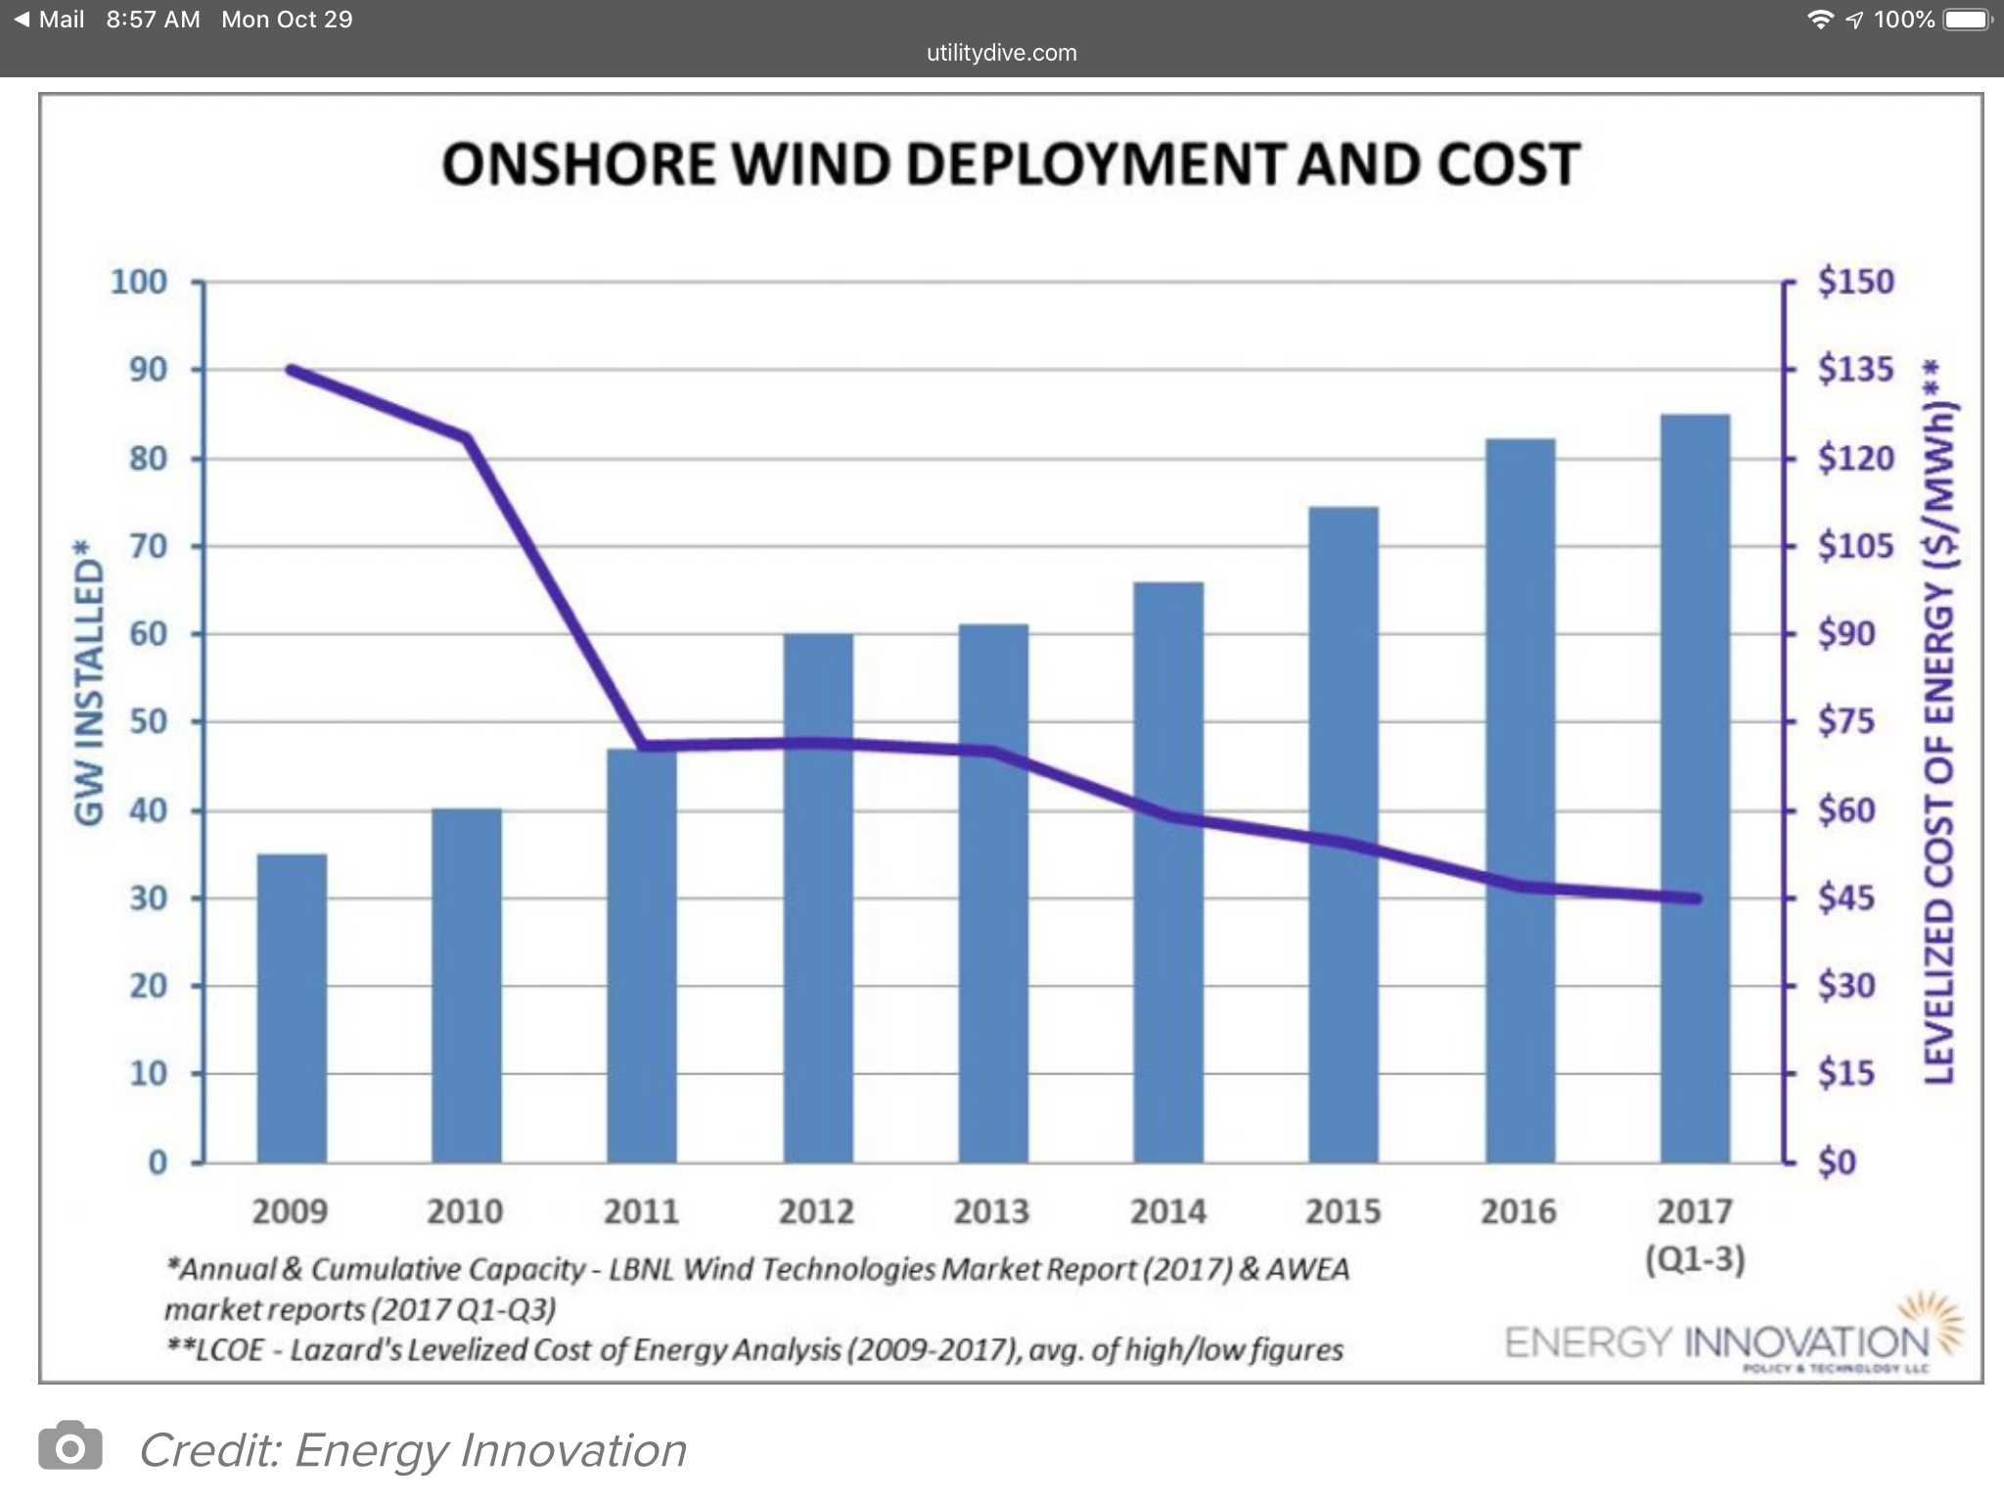
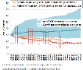
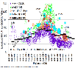







U.S. Onshore Wind Deployment and Cost (2009 – 2017)
Image/Data Source: Michael O’Boyle and Silvio Maracci, “Wind and solar costs continue to drop below fossil fuels. What barriers remain for a low-carbon grid?” Utility Dive, Mar. 21, 2018, https://www.utilitydive.com/news/wind-and-solar-costs-continue-to-drop-below-fossil-fuels-what-barriers-rem/519671/ (last accessed on Jan. 27, 2019).

Slide 19
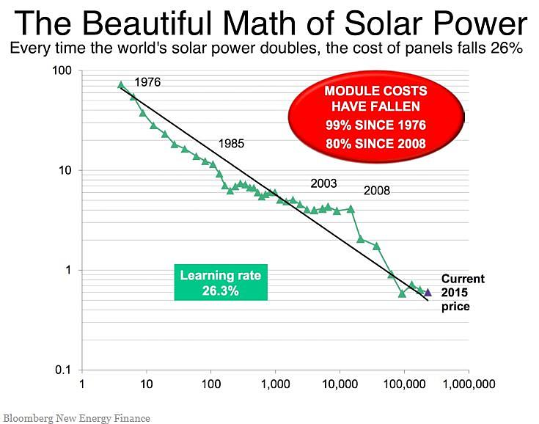

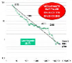

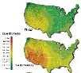

Every time the world’s solar power doubles,
the cost of panels falls 26 percent.
Image/Data Source: Tom Randall, “The world nears peak fossil fuels for electricity: Coal and gas will begin their terminal decline in less than a decade, according to a new BNEF analysis,” Bloomberg, June 12, 2016, http://www.bloomberg.com/news/articles/2016-06-13/we-ve-almost-reached-peak-fossil-fuels-for-electricity (last accessed on 6-27-16).

Slide 20

BPA Priorities for StreamNet ExCom
June 20, 2019
Jody Lando

Slide 21
2019 – a year of transitions
Budget reductions and project prioritization
2019 CRSO BiOp with 2021 in development
Strategic planning initiatives
Flex Spill
BPA executive, management and staff changes: Scott Armentrout, Crystal Ball and Jody Lando
What remains essential to our collective success – coordination, collaboration and prioritization

Slide 22
BPA Priorities - 2020
Centralized data access (with links to primary repositories)
Timely, accessible data
Standardized indicators
Collaboration with regional F&W managers to advance data management needs

Slide 23
Coordinated Assessments 5-yr plan BPA recommendations
  Clarify CA scope and intent
  Refine implementation tracking and reporting
  Continue to update priority populations
  Explore the potential for additional metrics / indicators
  Expand data usability

Slide 24
Coordinated Assessments 5-yr plan BPA recommendations
  Clarify CA scope and intent
    Adopt definition, finalize purpose statement, roles and responsibilities
  Implementation tracking and reporting
  Priority populations and metrics/indicators
  Continue to increase data usability

Slide 25
Coordinated Assessments 5-yr plan BPA recommendations
  Clarify CA scope and intent
    Adopt definition, finalize purpose statement, roles and responsibilities
  Implementation tracking and reporting
    PSMFC lead CAX documentation for VSP and fish out data (with partners i.e. CRITFC)
    PSMFC to maintain a web-based inventory by population of data providers and reporting status
    Sponsors are responsible for complete data sets and QA/QC
  Priority populations and metrics/indicators
  Continue to increase data usability

Slide 26
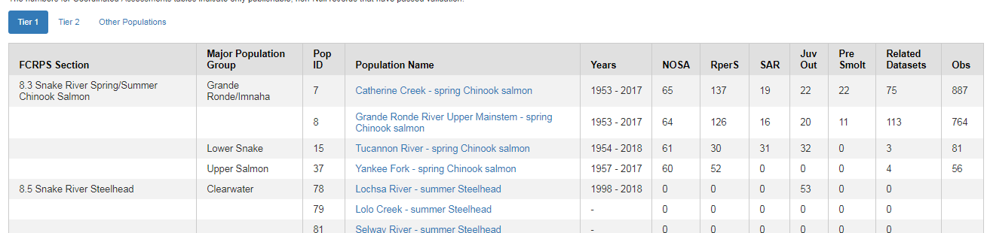
CA Reporting website summary is good but needs improvement and replication in StreamNet Update
https://www.streamnet.org/ca-priority-data/
Years need to be relevant to the indicator
Notes:
Resolution to be address by StreamNet SC

Slide 27
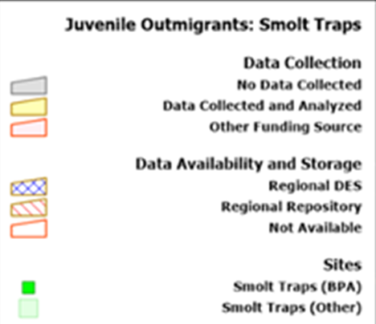
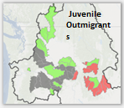
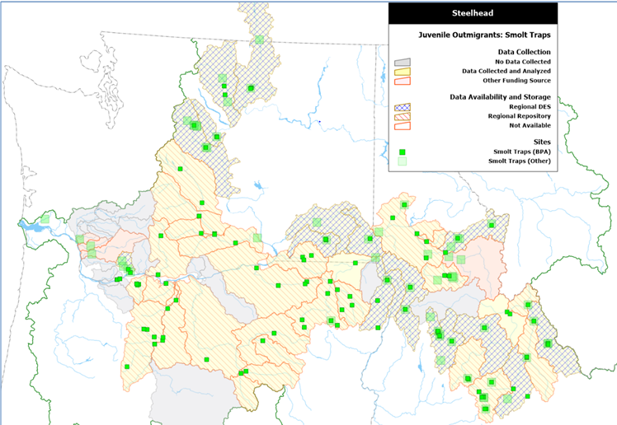
Implementation Tracking & Reporting
Indicator Type | Population or Subbasin for habitat data | Species | Representation Notes: | Org/s publishing data | Years of Data published | Missing Years | Comments: reason for missing the data | Data system team | Data System of Record
NOSA | Klickitat River | Steelhead | Portion | YKFP | 2005-2017 | 1 | Analysis processing time for 2018. Unknown for CA report | M. Steg-Geltner | YKFP, STAR Report
Current Format
Proposed Concept Format

Slide 28
Coordinated Assessments 5-yr plan BPA recommendations…continued
  Clarify CA scope and intent
  Implementation tracking and reporting
  Priority populations and metrics/indicators
  Continue to increase data usability

Slide 29
Priority populations
Timeliness: Based on data record length and availability:
Goal - data records published within 1-2 year of analysis
Prioritize data records with 5+ years of unpublished data (active monitoring)
Species focus:
Tier 1. ESA-listed CR Chinook, chum, steelhead, sockeye, and bull trout upstream from Bonneville Dam. CR chum in the Gorge MPG and bull trout.
  ESA Listed Interior Columbia Low Risk Populations, BPA Funded Hatcheries
  ESA Listed Interior Columbia Moderate Risk Populations, non BPA Hatcheries
Tier 2. Non-listed Interior Columbia populations associated with BPA-funded hatchery programs.
Tier 3. Other Columbia River Salmonid Populations or Species
  ESA population- not listed in this strategy (Lower Columbia, Willamette and non Columbia for reference application)
Notes:
BPA Funded Hatchery – Okanagan Sp Chinook (Colville)

Slide 30
Metric / Indicator priorities
Juvenile out-migrant abundance (CA)
Natural-origin spawner abundance (CA)
Recruits per spawner and out-migrants per adult (CA)
Adult escapements (Weir/Dam)
Rotary screw trap data
Adult distribution and abundance (spawner surveys)
Juvenile density and distribution (snorkel and electrofishing surveys)
PIT-array operations
Genetics
Temperature monitoring
Flow monitoring
Notes:
Redd, outmigrant and weir data is provided to StreamNet
Blue font are data that StreamNet compiles into SN database
Related datasets that agencies collected, but not part of CAX and StreamNet. Not needed at this time

Slide 31
Coordinated Assessments 5-year plan – recommendations…continued
  CA definition and purpose
  Implementation tracking and reporting
  Priority populations and metrics/indicators
  Continue to increase data usability
    Required attributes/fields
      Not just the minimum for system exchange
      Related attributes by data provider
    QA/QC processes
    Protocol method documentation

Slide 32
Recommendations for
StreamNet ExCom
$100k additional funds
  PSMFC to spearhead information tracking with CRITFC
  Refinements to CA Reporting website summary
  Manage GIS data for non-listed populations provided by BPA
Phase 2 pilot
  Populations with “No Data” submitted
  Complete age data for NOSA and juvenile data
Notes:
Data Endorsement – continue co-manager endorsement of “Best Value” i.e. “TRT Method” as an agency endorsement. Only done for NOSA. Can we do this for other indicators?

Slide 33
Recommendations for
StreamNet ExCom
DES Priorities
  Data Completeness and QA/QC
  New Indicators
    StreamNet DDT discussion in 2020
  Adjust DES for Weirs, Smolts and Redds
    Moving forward StreamNet should require population reference and methods where available (similar to CA)
Continue to identify opportunities for increased efficiency
Notes:
Data Completeness and QA/QC:
Blank Values: What is required for systems vs what is required if you actually produce a value.
Age, Alpha…
Protocol/Method publication to describe full DES
New Indicators
StreamNet DDT discussion in 2020
StreamNet SC discussion
Classes : E.g. NOSA: Escapement or Spawners
Carrying Capacity (DES Development Team (DDT) )
Potential Separation of Age data into separate DES
Adjust DES for Weirs, Smolts and Redds -
to include population reference and methods if available

Slide 34
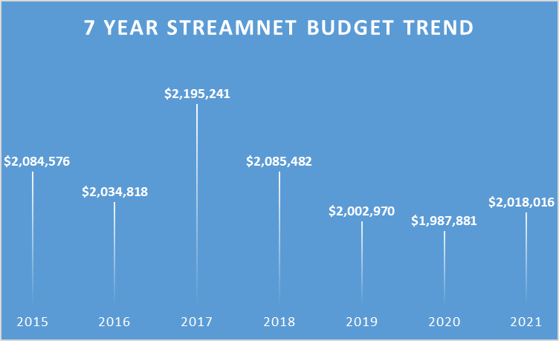
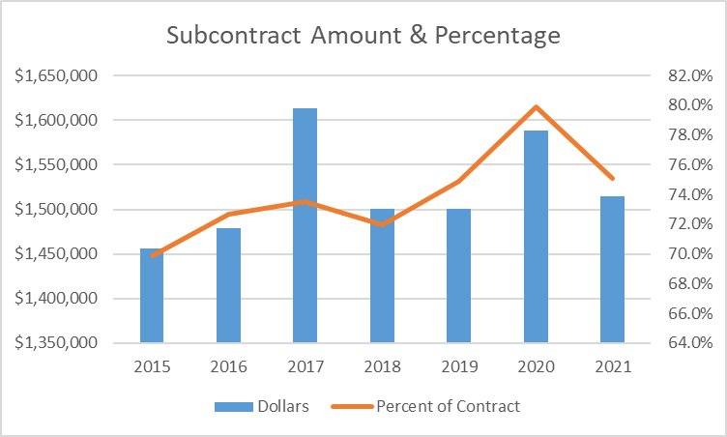
Note: $4,005,940 for 2020 & 2021
Cost savings in 20 yields small increase in 21
Note: $100k in one time funding in 2020
Yields increase in contracts

Slide 35
Budgets
Any problems or issues?
Current FY Snapshot (6/5/19)

Slide 36
Small “inflation increase” in Year 2 (From savings in year 1)
FY 2020
FY 2021
 | Increase
CCT | $836 | $88,796
IDFG | $3,076 | $326,846
MFWP | $1,568 | $166,617
ODFW | $4,405 | $468,109
WDFW | $4,369 | $464,234
CCT | $87,960
IDFG | $323,771
MFWP | $165,049
ODFW | $463,704
WDFW | $459,865

Slide 37
(Probable) PSMFC funding of $100,000 to StreamNet from NOAA IJ allocation – treat as one time
NOAA funds applied to funding some StreamNet staff time (Supports transfer of CA data to NOAA SPS)
Will allow increased BPA funding of subcontracts +/- $100,000 to existing partners, (and potentially others) for period Sep. 1, 2019 – Aug 31, 2020
No net effect on BPA funding – just less to PSMFC, more to subcontracts for one year
Allocation Process – should support BPA and NOAA Priorities
Decision – Ideas ???

Slide 38

PROJECT IDEAS
Yakama Data Sharing $21,500
ODFW
WDFW Snake R. Data Steward $43,261
IDFG
CCT – PSMFC Develop NOSA
Graphics for CR Objectives

Slide 39
ISRP Review Items;
1. Quantitative objectives & timelines – needed to provide a measure of program performance
“if useful, the ISRP would be pleased to review these objectives…followed by a review of them in the 2019 annual report”
2. Request funds from BPA to archive habitat restoration photographs (Note: CBFish currently allow folks to upload photos at either the project or contract level. They are stored on the Documents tab. Users can run a report to find all available photos. 158 exist today. This is a feature designed into the system early on, but apparently not used very much)

Slide 40
ISRP Direction – SOW - Quantify objectives and specify timelines
D. CA data – compile data
Establish quantitative objectives for obtaining CA data annually. Obtain CA indicator data and supporting metrics as directed by the priorities established annually by the StreamNet Executive Committee in the annual work plan,
Deliverable Specification: ______________CA indicators and metrics are obtained, updated, converted to the DES format, and exchanged with the CA database in fiscal year 2020.
G Compile high priority traditional StreamNet data
Description: As directed by the Executive Committee, standardize selected data types, specifically to include trends that are used by the NPCC to inform the Council Fish and Wildlife program.
Deliverable Specification: _____________high priority data sets are updated and maintained in fiscal year 2020. Data is compiled for selected metrics. As directed by the Executive Committee other fish metric data may be established via a CA-like process (is there such direction in 2020?). Managers will be surveyed to determine the availability of such fish metric data to detail the availability, type, and location of data.

Slide 41

Reporting – Moving from “predictive” to retrospective reporting (also quantitative goals & objectives in sow)
Walton Ford

Slide 42
Annual Data Updates:
From "Prediction" to
"Annual Report"
For StreamNet Executive Committee meeting
June 20, 2019
Mike Banach of PSMFC/StreamNet presenting

Slide 43
Summary:
For 2016-2018 we provided annual predictions of CA data delivery.
2018 "predictions" were largely based on data already provided.
We propose to no longer do "predictions".
  Actual data provided in the past is better predictor of future data delivery.
  Actual data provided is more efficient use of our time.
    Only 61/2086 predictions changed 2017 to 2018. Fewer still likely to change in the future.
Will be data already delivered, as of some specific date each year.
Will compare 2019 to 2018; specify what data are extra / missing.
Will not include yes/no/never designations done in previous years.
Will include maps of 2019 populations with data.

Slide 44
Prior years' procedure
StreamNet partners, plus NPT and YN, asked to ID CRB populations which they expected to add data in calendar year 2018.
  For each population X indicator, asked to specify:
    "Yes"
    "Don't have the resources"
    "Not possible"
Doing this first year was a lot of effort
2018 was less effort, but results not surprising
We summarized in two ways:
  All populations
  Only the 69 Tier-I / Tier-II populations

Slide 45
Proposed new procedure
We will not do predictions. Rather, we will report on what actually has been added to the database.
We intend to reduce work load on all the SN partners.
Many of the people we asked for information in previous years are not funded by BPA or StreamNet. We won't contact them.
We will create similar tables and graphs and maps as done in 2018.
  New proposed reporting approach shown on next slides.
  We will continue to report both "all populations" and "priority populations".

Slide 46
Asked states and tribes to qualitatively evaluate CA data additions for all extant populations in the Columbia basin and report as follows:
WILL NOT BE DONE IN 2019
Yes = We will provide data in calendar year 2018.
No = Indicator calculation for this population is at least theoretically
possible; however, we will be unable to provide data in 2018.
X = It is not possible to calculate this indicator for this population.

Slide 47
2019 Coordinated Assessments Data Additions (template)
2019 PROPOSED TABLE
Abundance estimates &
indexes of abundance
Natural Origin Spawner Abundance |  |  | Juvenile Outmigrants |  |  | Presmolt Abundance
Agency | All pops | Priority pops | Agency | All pops | Priority pops | Agency | All pops | Priority pops
All | 138 of 255 | 38 of 69 | All | 40 of 255 | 40 of 69 | All | 7 of 255 | 7 of 69
% | 54 | 55 | % | 16 | 58 | % | 3 | 10
Related Data
Agency | All pops | Priority pops
All | 200 of 255 | 65 of 69
% | 78 | 94
Rates & proportions
Smolt to Adult Return Rate |  |  | Recruits per Spawner |  |  | PNI
Agency | All pops | Priority pops | Agency | All pops | Priority pops | Agency | All pops | Priority pops
All | 13 of 255 | 10 of 69 | All | 17 of 255 | 14 of 69 | All | 3 of 255 | 2 of 69
% | 5 | 14 | % | 7 | 20 | % | 1 | 3
225 populations including component populations of superpopulations.
69 Tier I + Tier II priority populations including component populations of superpopulations.
Excludes extirpated populations and superpopulations.
Table 1a. 2019 coordinated assessments data additions for all populations and priority populations.

Slide 48
CONTINUE IN 2019, BUT MODIFY:
end of 2018 actual and end of 2019 actual
Current Year Compared To Previous Year
Abundance estimates &
indexes of abundance
SARs from FPC and done by PSMFC not included.
Rates & proportions
End of 2018 actual End of 2019 actual
End of 2019 actual End of 2018 x
Figure 1a. 2018 predicted coordinated assessments data additions for all populations compared to actual existing data as of 12/31/2017.

Slide 49

Maps of 2018 Predictions by Data Type:
BPA Priority Populations
Wim Delvoye

Slide 50
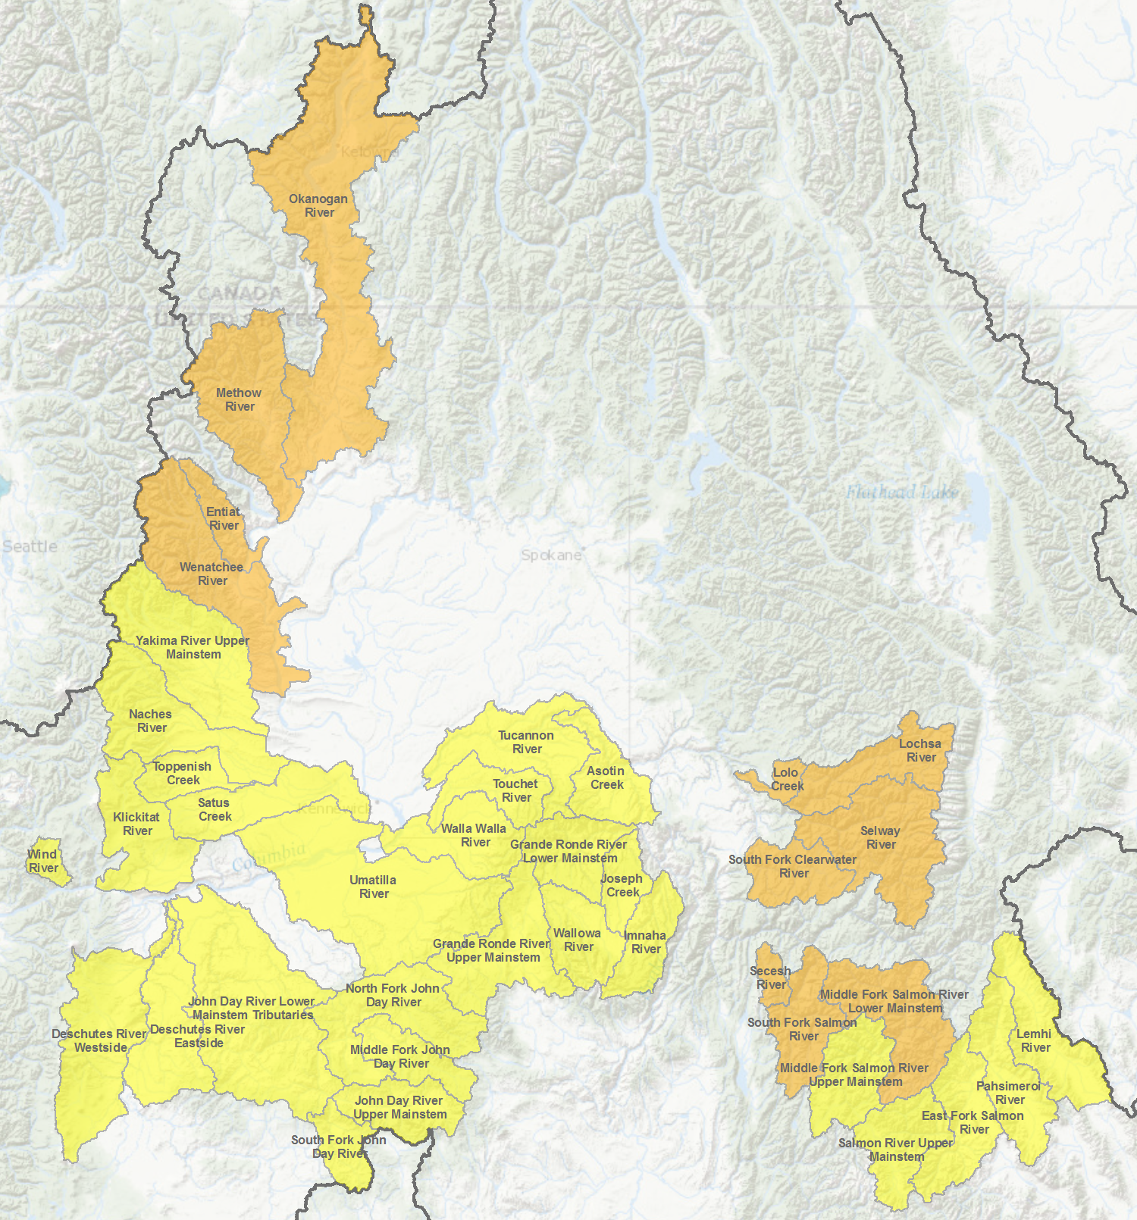

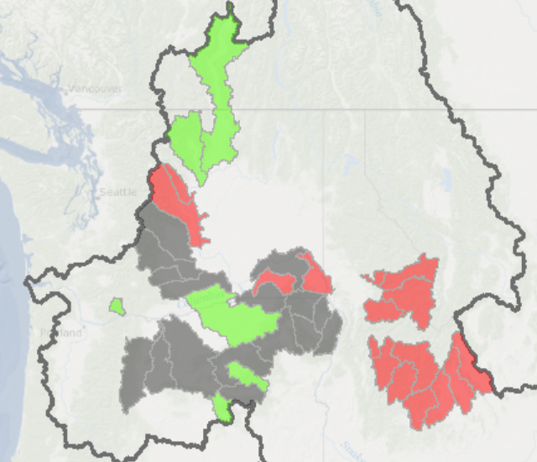
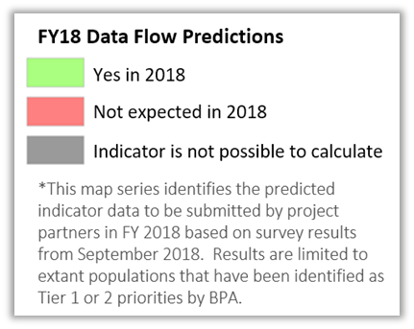
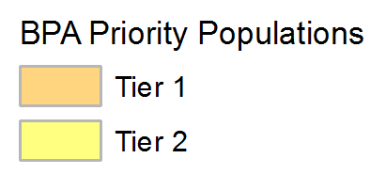
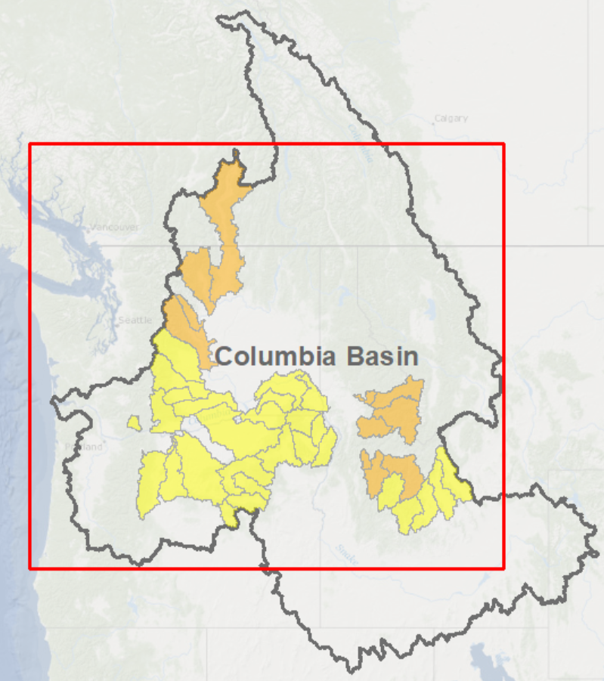
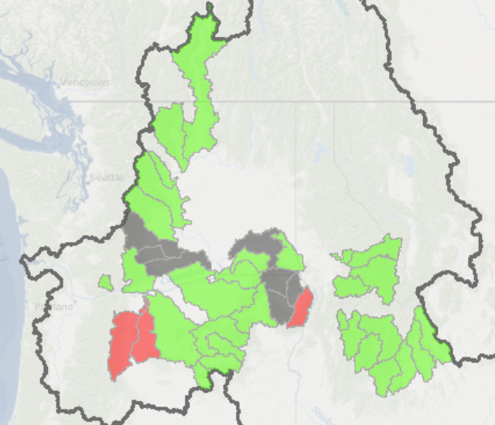
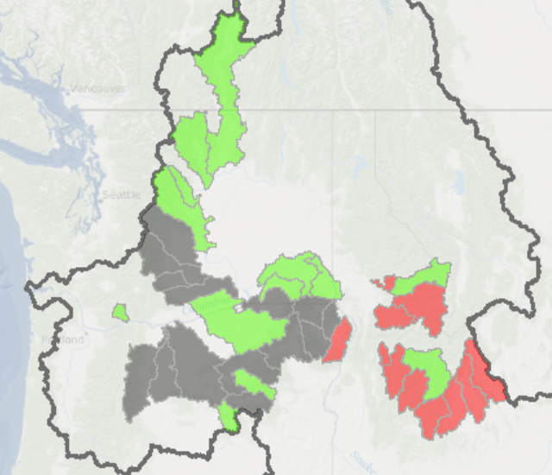
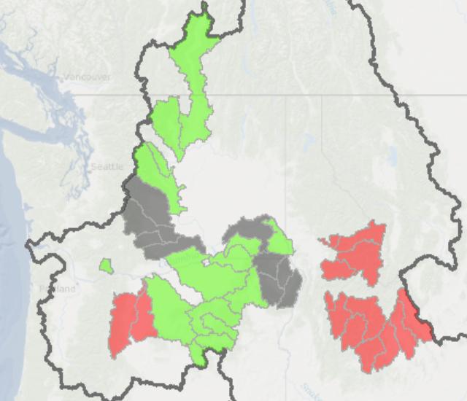
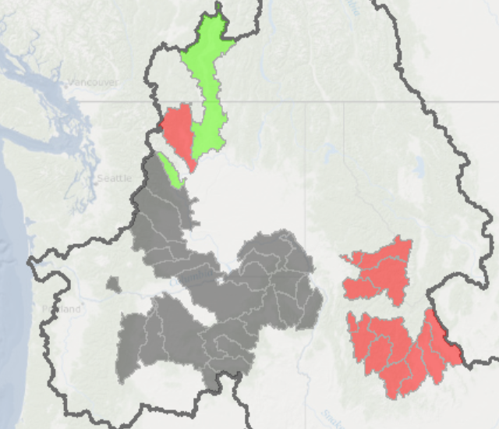
CONTINUE IN 2019
Summer Steelhead
Coordinated Assessments
Columbia River Basin
Smolt to Adult Ratio
Natural Origin Spawner Abundance
Juvenile
Outmigrants
Recruits per Spawner
Presmolt Abundance
Notes:
Notes:
CA Partners were asked to provide information on the populations they planned to submit data for in FY18. Responses (Yes/No/Not possible) were combined by Mike Banach into a single table maintained by PSMFC. Note that in cases where multiple partners responded for a single population the values were combined to record the final answer for each indicator. Super population based responses were attributed to the component populations as well. The final table (CoordinatedAssessments.dbo.FY18Predictions_ForMapping) was used by Van Hare to create the series of map graphics used in this presentation. Van’s working project folder is saved in the GIS file system as project #368.

Slide 51
Buy-in and direction
We are looking for buy-in on this approach.
  Any concerns or comments?
If approved, what date should this be done each year?
  Data submittals from StreamNet partners used to be infrequent, large data dumps would come at end of the fiscal year.
  With API, data submittal is nearly continuous. There is no off season.
  End of fiscal year? End of calendar year? Other?

Slide 52

“StreamNet” Library Discussion
Zach Penney
Flick Ford

Slide 53

Roundtable

Slide 54

Adjourn

Slide 55
Extra slides

Slide 56
PSMFC Priority List for FY 19:
Maintain automated flow of data to existing indicators, including retaining focus on BPA priority populations
Maintain facilities dataset/fish distribution
Convene DES team(s) to review and update DES’s for existing indicators
Update a more narrow and clearly defined set of related data records
Retain involvement in hatchery indicator discussions but take no action pending leadership decisions on specific indicators needed (assist NPCC in hatchery data capture efforts)
Prepare a report for BPA on Tier 1 & 2 data we have in CAX, including why we don’t have all the data they would like to see for them. Another part of the report is what would help get more data in those instances where they are available theoretically but not actually done yet.

