Slide 1
StreamNet Steering Committee Meeting
October 29, 2019

Slide 2
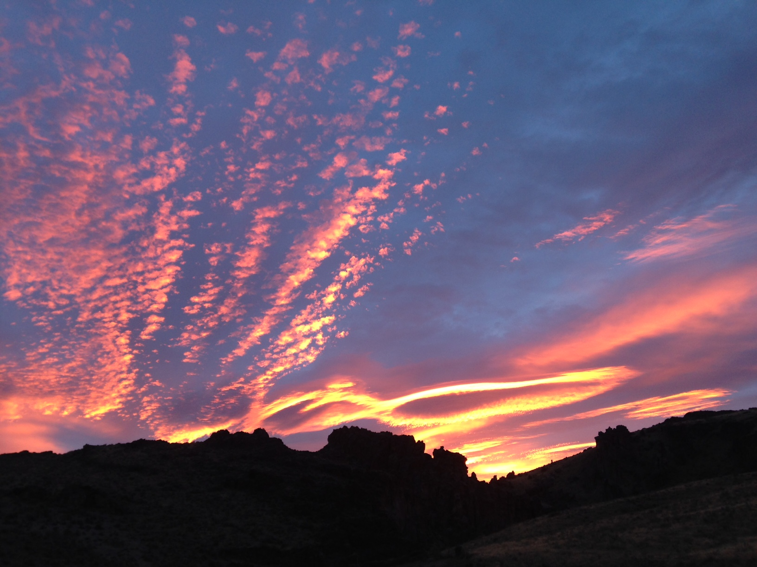
Agenda
9:00 AM New Budgets, Subcontracts, and SOW All
10:00 AM EPA Exchange Grant Application? Brodie
Possible CA Proposal Discussion
10:15 AM Break
10:30 AM Implementing the CA 5 Year Plan All
Filling in “missing data” gaps?
            Initiating the Juvenile Density – Carrying Capacity Discussion
Noon Lunch – On our own
1:15 PM DES Update/Discussion Mike
1:45 PM Priorities – Briefing Discussion with New Program Manager All
2:15 PM NPCC 2020 Program Addendum Nancy
2:45 PM Roundtable Discussion All
3:45 PM Adjourn

Slide 3
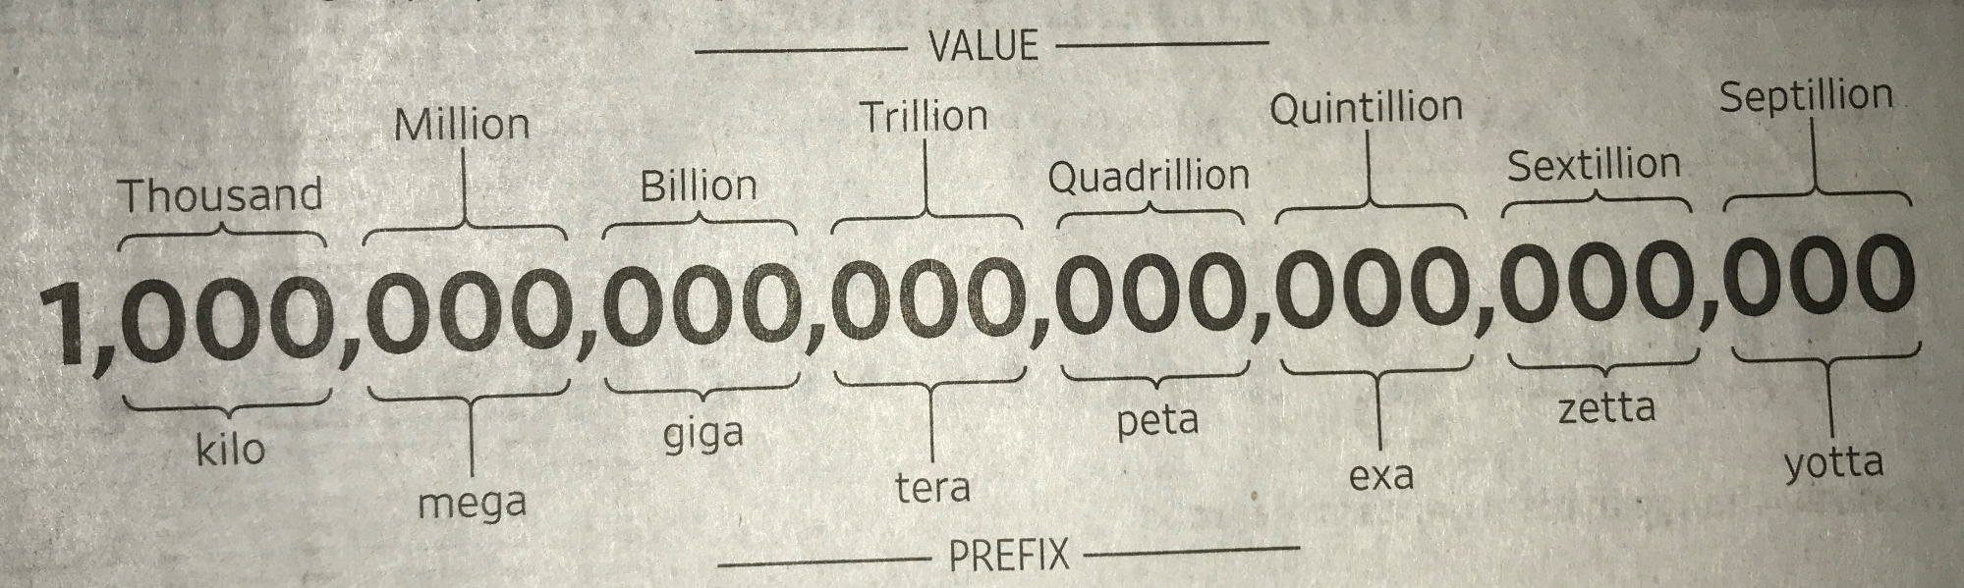
Next Budget (10/19 – 9/21)
  Overview and Update
  Pending Issues ?
      New Subcontracts
      Portfolio Management?
Credit: Wall
Street Journal
Remember – Cost Share Input Needed!

Slide 4
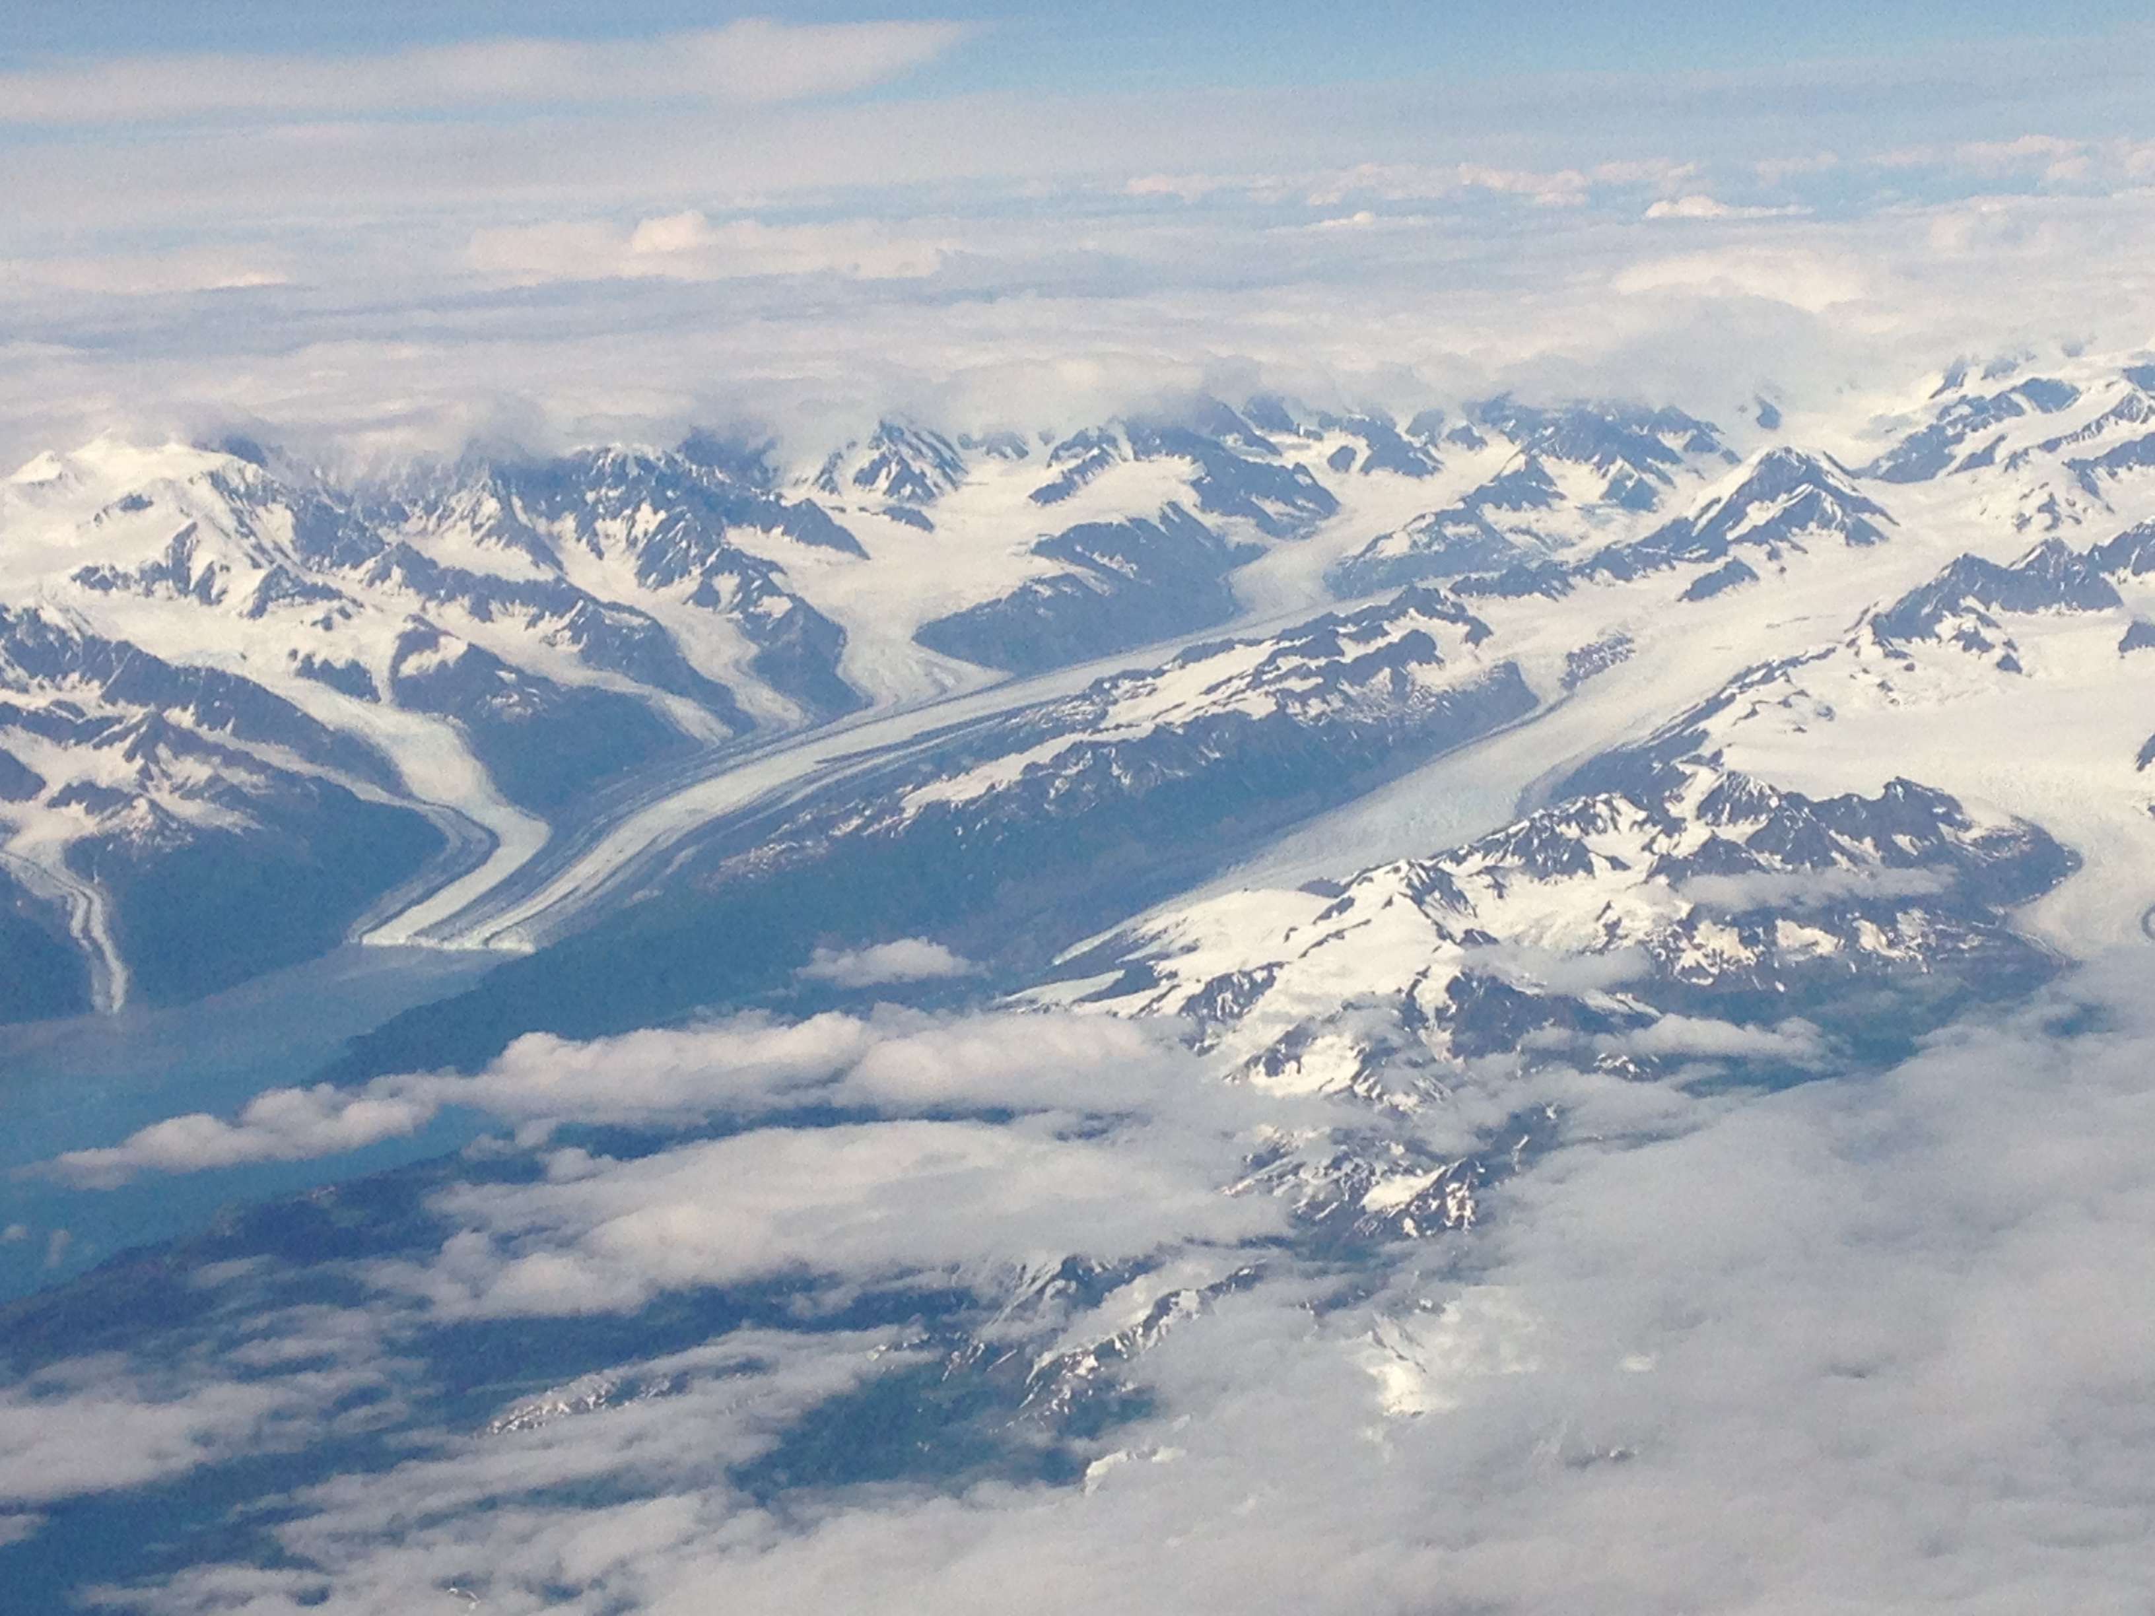
Notes:
Faded background picture
(Basic)
To reproduce the background effects on this slide, do the following:
On the Home tab, in the Slides group, click Layout and then click Blank.
Right-click the slide and click Format Background.
In the Format Background dialog box, click Fill in the left pane. In the Fill pane, select Picture or texture fill, and then under Insert from, click File.
In the Insert Picture dialog box, select a picture, and then click Insert.
Also in the Format Background dialog box, in the Fill pane, in the Transparency box, enter 85%.

Slide 5
EPA Exchange Grant Application
Possible CA Proposal?
Notes:
Faded background picture
(Basic)
To reproduce the background effects on this slide, do the following:
On the Home tab, in the Slides group, click Layout and then click Blank.
Right-click the slide and click Format Background.
In the Format Background dialog box, click Fill in the left pane. In the Fill pane, select Picture or texture fill, and then under Insert from, click File.
In the Insert Picture dialog box, select a picture, and then click Insert.
Also in the Format Background dialog box, in the Fill pane, in the Transparency box, enter 85%.

Slide 6
Implementing the CA 5 Year Plan
Filling in “Missing Data” Gaps
Initiating the Juvenile Density
– Carrying Capacity Discussion
Other Issues?
Notes:
Faded background picture
(Basic)
To reproduce the background effects on this slide, do the following:
On the Home tab, in the Slides group, click Layout and then click Blank.
Right-click the slide and click Format Background.
In the Format Background dialog box, click Fill in the left pane. In the Fill pane, select Picture or texture fill, and then under Insert from, click File.
In the Insert Picture dialog box, select a picture, and then click Insert.
Also in the Format Background dialog box, in the Fill pane, in the Transparency box, enter 85%.

Slide 7
Current CA priorities
  1) HLIs for 18 Tier 1 Populations;
  2) HLIs for 51 Tier 2 Populations;
  3) HLIs for other populations;
  4) Maintain facilities dataset/fish distribution;
  5) Related data for NPCC dashboard trends (and others);
  6) Discuss potential “carrying capacity” indicator;
  7) Align and adjust as priorities set by NOAA, BPA, NPCC
CA 5 Year plan (8/1/2019)

Slide 8
DES Update/Discussion
Mike

Slide 9
Two DESs
StreamNet
Coordinated Assessments

Slide 10
Two DESs
StreamNet
  Next version not yet formally proposed for adoption.
Coordinated Assessments
  Next version proposed, ODFW had objection.

Slide 11
StreamNet DES
Change approved for next version:
  NEW: For redd counts, ProdID field for redd counts was changed to
    "production type(s) of the fish that created the redds".
  OLD:
    "... all redd counts are assumed to be natural stocks, even if some ... hatchery origin."
    Existing data didn't match. DES changed to reflect reality.

Slide 12
StreamNet DES
Change approved for next version:
  Boolean fields such as NullFlag changed to text "Yes" or "No".
    This matches the approach used in the CA tables
      Better consistency among all our tables.

Slide 13
StreamNet DES
Change approved for next version:
  FishDist table is being replaced by spatial data submissions.
    SN DES will still contain the data needs and standards for the spatial data.

Slide 14
StreamNet DES
Change approved for next version:
  SourceURL field added to Reference table.
    Tells where original electronic copy can be obtained.

Slide 15
Two DESs
StreamNet
Coordinated Assessments

Slide 16
CA DES
Changes approved for next version:
  Fields now required: PopFit; BestValue
    Already adopted in the data validation rules.

Slide 17
CA DES
Changes approved for next version:
  Values that in the real world are whole numbers should be captured as such.
    Already adopted in the data validation rules.

Slide 18
CA DES
Changes approved for next version:
  For species without jacks, will use "IJ" fields for values, not "EJ" fields.
    Inconsistent among tables in current DES, and causing confusion among biologists providing data.

Slide 19
CA DES
Changes approved for next version:
  "OtherDataSources" now cannot include main organization.
    Already adopted in the data validation rules.

Slide 20
CA DES
Changes approved for next version:
  TRTmethod removed from R/S table.
    Ain't no such animal.

Slide 21
CA DES
Change proposed but not approved:
  Escapement proposal:
    NOSADefinition field added to the NOSA table.
      Indicates whether the record is (1) actual estimate of the number of spawners or (2) escapement estimate.
      The concept was agreed to, but ODFW did not agree to the exact implementation I chose.
      Only ODFW and Colville Tribes have responded.

Slide 22
Two DESs
StreamNet
Coordinated Assessments

Slide 23
BOTH DESs --
A suite of standard time stamps fields
Changes approved, currently being implemented in all tables:
  DES field in all CA and SN tables. Added as necessary.
    UpdDate
      Meaning changed to "date/time record was created or updated at source agency".
  Other time stamp, non-DES fields. Added as necessary. Set by triggers:
    SNLoad – When first added to the central database.
    ValidationDate – When last validated by the API.
    LastUpdated – When a DATA field was last updated.
      Taken out of DES; meaning changed.
    LastModifiedOn – When a DATA or METADATA field was last updated.
    Data set version: Time stamps of downloaded data sets.

Slide 24
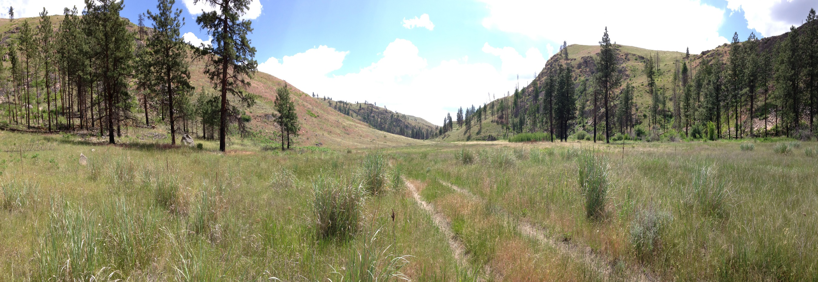
Priorities and Briefing with Nancy
Notes:
Photo: Hux

Slide 25
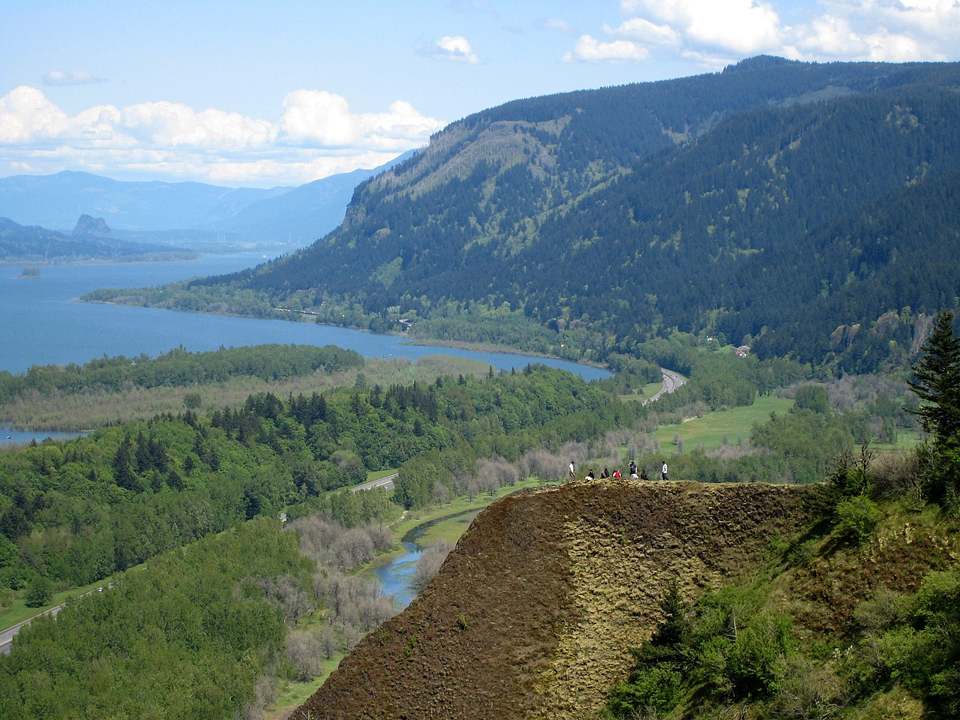
Columbia River Basin Fish and Wildlife Program
2020 Program Addendum
Nancy Leonard
Program Performance Manager
Photo by Hux taken from Crown Point
Notes:
Photo: Hux

Slide 26
Partner Updates
Notes:
Faded background picture
(Basic)
To reproduce the background effects on this slide, do the following:
On the Home tab, in the Slides group, click Layout and then click Blank.
Right-click the slide and click Format Background.
In the Format Background dialog box, click Fill in the left pane. In the Fill pane, select Picture or texture fill, and then under Insert from, click File.
In the Insert Picture dialog box, select a picture, and then click Insert.
Also in the Format Background dialog box, in the Fill pane, in the Transparency box, enter 85%.

Slide 27
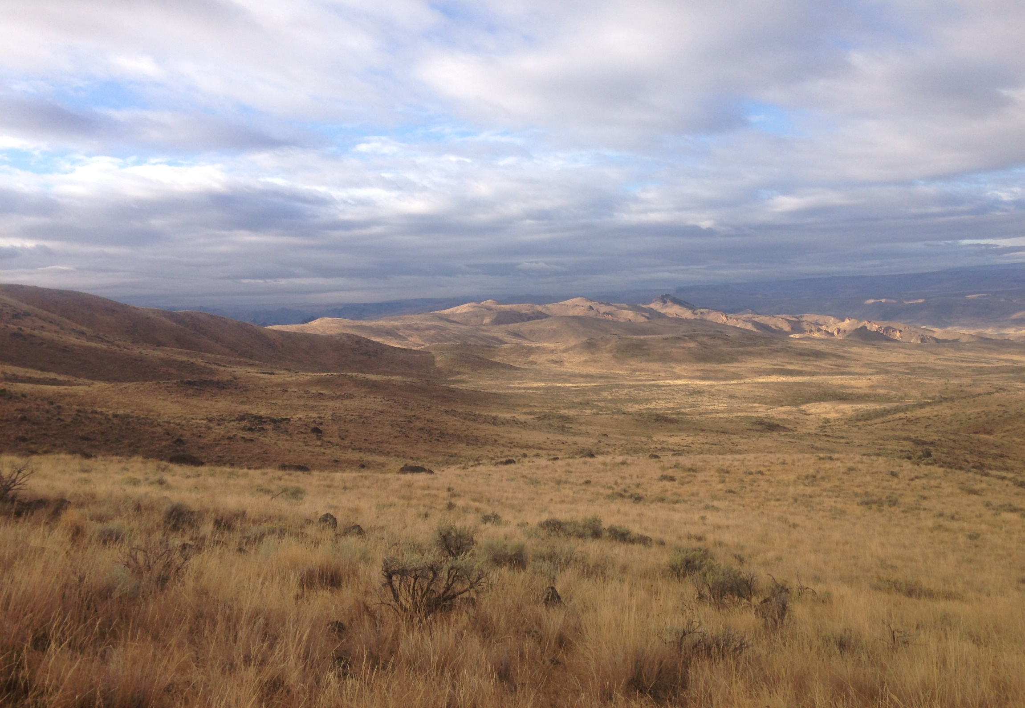
Adjourn

