Slide 1










StreamNet
Executive Committee
September 2, 2020
9:30 am – 3:30pm (PT)
StreamNet Executive Members
Columbia River Inter-Tribal Fish Commission
Idaho Department of Fish and Game
Montana Fish, Wildlife & Parks
Oregon Department of Fish and Wildlife
The Confederated Tribes of the Colville Reservation
US Fish and Wildlife Service
Washington Department of
Fish and Wildlife
StreamNet is funded by:
In support of:
A fisheries data project of:
Bonneville Power Administration
Northwest Power and Conservation Council
Pacific States Marine Fisheries Commission

Slide 2
Welcome and Introductions
Executive Committee members and presenters
  You are invited to join using your web-camera to facilitate discussions.
Other participants
  After the introductions you are kindly requested to mute your audio and turn off your web-camera.
  If you have questions please send these via the chat box.

Slide 3
Agenda
(times are approximate)
Time (PT) | Item | Lead/Presenter
9:30 | Welcome and introductions | All
10:00 | NPCC 2020 Program Addendum | Patty O’Toole, Leslie Bach
10:30 | Stretch break
10:40 | NOAA’s FCRPS BiOP and Willamette BiOP | Greg Sieglitz
11:10 | Member 5-min updates | Executive Committee members or their Steering Committee rep.
Noon | Break for lunch
1:00 pm | Coordinated Assessment Partnership | Nancy, Brodie Cox, Jen Bayer, Tom Iverson
2:00 pm | Projects coordinating with and supporting StreamNet | Nancy, Zach Penney, Denise Kelsey, Tami Wilkerson, Jen Bayer
2:40pm | Stretch break
2:50pm | StreamNet Program | Nancy, Mike Banach, Greg Wilke
3:20pm | Next ExCom meeting | All
3:30 pm | Adjourn

Slide 4
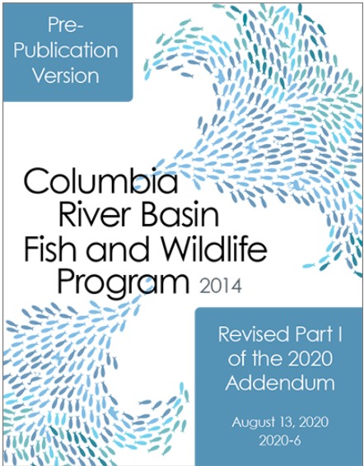
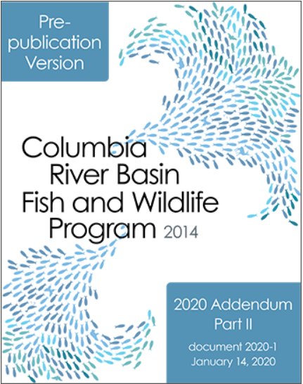
NPCC 2020 Program Addendum
Patty O’Toole, Fish and Wildlife Division Director
Leslie Bach, Senior Program Manager
https://www.nwcouncil.org/reports/2020-6
https://www.nwcouncil.org/reports/2020-1

Slide 5

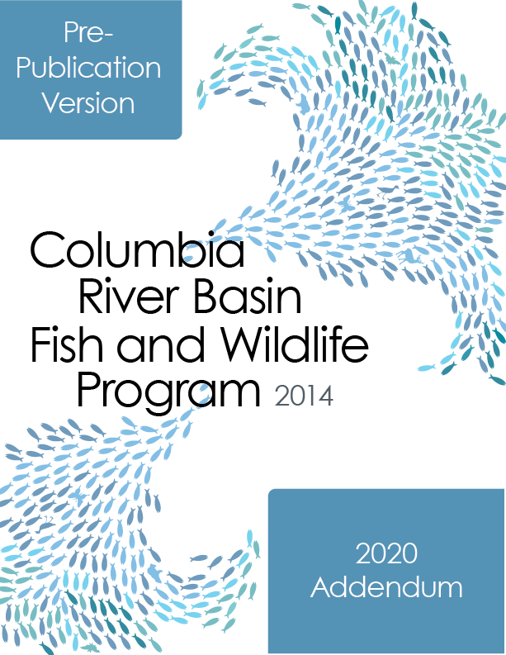
Columbia River Basin Fish and Wildlife Program
Northwest Power and Conservation Council

Slide 6
2020 Fish and Wildlife Addendum
Part I: Program Performance and Adaptive Management
Part II: Program Implementation

Slide 7
Part I: Goals, Objectives and Indicators
Goals and Objectives:
  Salmon and steelhead: returns, SARs, survival standards
  Sturgeon: abundance, distribution, diversity, productivity
  Lamprey: abundance, passage
  Resident salmonids: self-sustaining populations, habitat (miles and acres)
  Wildlife: acres and HUs
  Ecological objectives: flow, habitat, water quality
  Communication, coordination objectives

Slide 8
Part I: Goals, Objectives and Indicators
Strategy Performance Indicators:
  Habitat: acres, miles, etc.
  Non-native, invasive species, predator management: numbers, counts, etc.
  Water quality: temp, TDG
  Flow and passage: seasonal flows, travel times, reservoir elevations
  Native fish and hatchery fish indicators: production, abundance, counts
  Blocked areas: habitat, passage
  Resident fish: habitat, patch size, status and trend
  Public engagement: communications, publications

Slide 9
Part I: Assessing, Monitoring and Reporting
To assess the program, the following activities must continue to be adequately supported:
  Public access to project implementation information, e.g. improve the delivery of information that the Council uses to assess and report on program performance
  Public access through centralized databases of compiled and analyzed data required for reporting on program goals, objectives, strategy performance indicators.
  Maintenance of historical and current program data and products in a structured manner that facilitates public access in a searchable format (e.g. through libraries and databases).

Slide 10
Part I: Assessing, Monitoring and Reporting
Fish and Wildlife Program projects that we look to for support in assessing Program performance:
  StreamNet
  Pacific Northwest Aquatic Monitoring Program
  Columbia Basin Fish and Wildlife Library
  CRITFC Inter-Tribal Monitoring Data
  Intermountain Province/ Pend Oreille Subbasin data management project
  Data Access in Real Time
  Fish Passage Center

Slide 11
Back at 10:35

Slide 12
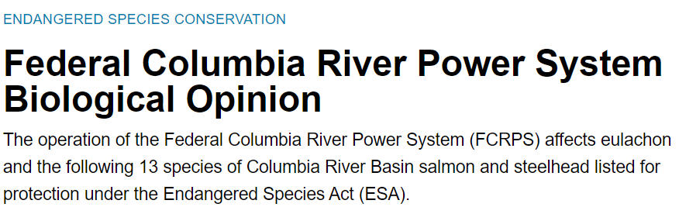
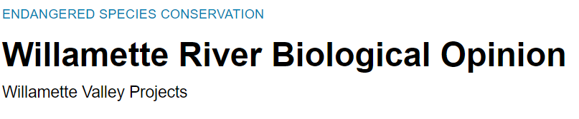
NOAA’s FCRPS BiOP and Willamette BiOP
Greg Sieglitz
NOAA National Marine Fisheries Service

Slide 13
Executive Committee Members’ Updates
WDFW (Dan Rawding)
USFWS (Doug Threloff, John Netto)
ODFW (Tom Stahl)
NOAA (Greg Sieglitz)
MTFWP (Don Skarr)
IDFG (Lance Hebdon)
CRITFC (Zach Penney)
Colville Tribes (John Arterburn)
BPA (Jody Lando, Rodrigo George)
NPCC (Patty O’Toole)

Slide 14

Lunch Break
Meeting resumes at 1pm pacific time
Image from https://medinachamber.com/events/2020/4/9/virtuallunchbreak

Slide 15

Coordinated Assessments Partnership (CAP) providing access to standardized indicators for regional assessments and policy/decision-makers
The Coordinated Assessments Partnership (CAP)
Is a collaborative process to share PNW fish data
provides access to standardized data
Informs reporting and decision-making
Collaborative effort funded by: BPA, EPA Exchange Network Grants, NOAA-F, states and tribes.
Partners: BPA, Colville Tribes, CRITFC, IDFG, ODFW, MFWP, NPT, NOAA-F, NPCC, CTUIR, CTWSR, WDFW, Shoshone-Bannock Tribes, YN, PSMFC
Co-sponsored: PNAMP (#2004-002-00) and StreamNet (#1988-108-04)
CAP Core Team
Nancy Leonard, StreamNet
Jen Bayer, PNAMP
Brodie Cox, WDFW
Mari Williams, PSMFC/NOAA-F
Denise Kelsey, CRITFC
Russell Scranton, BPA
Matt Schwartz, BPA
Tom Iverson, CAP support

Slide 16
Decision and Implementation Process Guiding Data Flow through CAP prioritizing work to flow data for regional assessments and policy/decision-makers
StreamNet Executive Committee
StreamNet Steering Committee
Teams (DES Team and StreamNet Technical Team)
Decisions on data flow priorities for 5-year Coordinated Assessments Partnership (CAP) workplan
Implements data flow from state and tribal data systems to the regional CAX data system by PSMFC, state, and tribal data managers
Data stewards and programmers coordinate development and implementation of the data exchange standards to flow data to the regional CAX data system
Fish Monitoring Workgroup
CAP Core Team
Fish Monitoring Workgroup
Identification of data needs (metrics, indicators) by FW managers to address priorities set by Executive Committee
Supports
Notes:
*CAP: Coordinated Assessments Partnership

Slide 17
From Start to Finish: Processes and Groups Informing and Using CAP Data
for regional assessments and reporting through the Coordinated Assessments Partnership
Regional Information Needs
CAP 5-year Workplan
CAX Regional Data System
Regional partners consume data from CAX
Regional decision-making and reporting processes informed
StreamNet Executive Committee
NOAA
ESA
NOAA SPS Data System and staff compilation
ESA 5-yr status review
Existing processes using existing projects and infrastructures to have FW managers, data managers, data stewards, and programmers:
implement Executive Committee data flow priorities,
identify available and appropriate data, and
make accessible standardized data
NPCC
2014 FW Program, 2020 Addendum
NPCC
Program Tracker
(NPCC and Fish Data Product Tech Services)
NPCC
FW Program objective and indicators review
BPA F&W Program/ ESA BiOp Mitigation
BPA Data Visualization and QA/QC & onefishtwofish tool
ESA: EIS, BA and CRSO BiOp and HGMP reports, LCM Tools

Slide 18
From Start to Finish: Processes and Groups Informing and Using CAP Data
for regional assessments and reporting through the Coordinated Assessments Partnership
Regional Information Needs
CAP 5-year Workplan
CAX Regional Data System
Regional partners consume data from CAX
Regional decision-making and reporting processes informed
StreamNet Executive Committee
NOAA
ESA
NOAA SPS Data System and staff compilation
ESA 5-yr status review
Tribal, federal, state fish and wildlife managers engage in Fish Monitoring Workgroup (PNAMP) confirm data needed; data collection and analysis.
State and Tribal Data Managers and Data Stewards manage data identified by FW Managers
Teams of data stewards and programmers composed of federal. state and tribal staff develop standard process to share data from agencies/tribes data system to regional CAX and StreamNet data systems
NPCC
2014 FW Program, 2020 Addendum
NPCC
Program Tracker
(NPCC and Fish Data Product Tech Services)
NPCC
FW Program objective and indicators review
BPA F&W Program/ ESA BiOp Mitigation
BPA Data Visualization and QA/QC & onefishtwofish tool
ESA: EIS, BA and CRSO BiOp and HGMP reports, LCM Tools

Slide 19
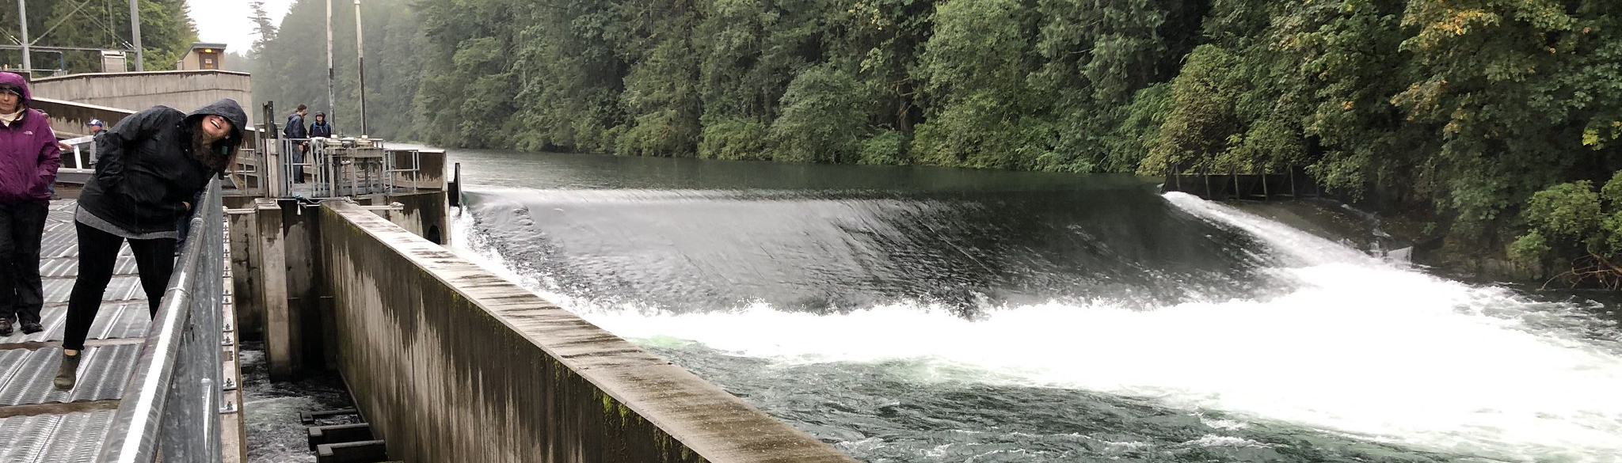
CAP HLI Data Status
Minto Facility, North Santiam, Oregon
August 3, 2020 data snapshot from CAX data system
Notes:
https://www.flickr.com/photos/150461980@N05/

Slide 20
CAP – Sum of Populations per HLI Category
(data as of August 3, 2020)
 | Sum of Populations* with estimates reported in CAX by HLI category⁺
HLI Category | Columbia River Basin (min-max yr range) | Priority Populations subset of CR Basin (min-max yr range) | Oregon Coast (min-max yr range) | Puget Sound (min-max yr)
Natural Origin Spawner Abundance (NOSA) | 172 (1938 – 2019) | 66 (1949-2019) | 56 (1994-2019) | 32 (1954-2019)
Presmolt Abundance | 8 (1993-2018) | 8 (1993-2018) | 0 | 0
Juvenile Outmigrants | 69 (1978-2019) | 42 (1987-2019) | 7 (1997-2017) | 0
Smolt to Adult Return Rate (SAR) | 99 (1985-2017) | 58 (1985-2017) | 7 (1997-2016) | 0
Recruits per Spawner (R/S) | 66 (1949-2017) | 39 (1949-2017) | 21 (1994-2015) | 0
Proportionate Natural Influence (PNI) | 5 (1985-2019) | 4 (1985-2019) | 0 | 0
No HLIs currently reported in CAX | 34 | 1 | 0 | 25
Abundance estimates &
indexes of abundance
Rates & proportions
The number of populations (pops) that have at least 1 HLIs reported in the CAX (includes component populations of superpopulations)
Columbia River Basin: 193 of 227 pops (includes 69 priority pops)
Oregon Coast: 56 of 56 populations
Puget Sound: 32 of 57 populations
Excludes extirpated populations and superpopulations
*Components of superpopulations are included within the pops
+ A population can be associated with more than one HLI
Notes:
There are 227 CRB populations, not 225.
33 is the number reported for CRB populations with no HLI data.
Subtracting 33 from 227, we should have 194 populations with at least one HLI. But I see only 193.
Exploring the data, what I found is, for some reason, PopID=398 (reintroduced Okanogan spring Chinook) are not reported for the "all CRB populations" group. That population has no data of any kind -- not even trends. It did show up as "no data" in the priority populations group, so something is inconsistent in my query logic. I will have to review my queries so it runs correctly next time.
Bottom line: this means 227 CRB populations, 34 of them with no HLI data.
193 CRB populations with HLI data
- 34 CRB populations with no HLI data
-----
227 Total CRB populations

Slide 21
CAP – Details for Superpopulations*
(data as of August 3, 2020)
 | Count of Populations with HLI data only submitted in CAX as part of a Superpopulation
HLI Category | Columbia River Basin | Priority Populations subset of Columbia River Basin | Oregon Coast | Puget Sound
Natural Origin Spawner Abundance (NOSA) | 1 | 1 | 35 | 0
Presmolt Abundance | 0 | 0 | 0 | 0
Juvenile Outmigrants | 4 | 0 | 0 | 0
Smolt to Adult Return Rate (SAR) | 75 | 41 | 0 | 0
Recruits per Spawner (R/S) | 0 | 0 | 0 | 0
Proportionate Natural Influence (PNI) | 0 | 0 | 0 | 0
Abundance estimates &
indexes of abundance
Rates & proportions
*Superpopulations or composed of more than one population.
The table shows the count of populations for which HLI data are only provided as part of a superpopulation (no separate population scale HLI is provided).

Slide 22
CAP – Total Records by Data Source per HLI Category
(data as of August 3, 2020, submitting entity may differ from source entity)
 | Colville Tribes | IDFG | NPT* | ODFW | USFWS | WDFW | YN | FPC | Others* | SBT | CTWSR | CTUIR
Count of data records HLI Category |  |  |  |  |  |  |  |  |  | pending
Natural Origin Spawner Abundance (NOSA) | 14 | 1196 | 389 | 2478 |  | 3539 | 165
Presmolt Abundance | 49 |  |  | 89 |  |  |  |  | 24
Juvenile Outmigrants | 12 | 750 | 157 | 316 |  | 383 |  |  | 31
Smolt to Adult Return Rate (SAR) | 10 |  |  | 264 | 16 | 46 |  | 955
Recruits per Spawner (R/S) | 10 | 984 |  | 2258 |  | 309
Proportionate Natural Influence (PNI) | 15 |  |  |  |  | 149
Count of unique populations and superpopulations (# of populations with HLI trend data only) | 1 | 38 (7) | 47 | 79 (7) | 2 (3) | 102 (17) | 6 | 29 | 5
During 2020 three new populations were added in CAX: Grays/Chinook, Elochoman/Skamokawa, and Mill/Abernathy/Germany populations.
*NPT started submitted HLI data to CAX in 2020. The “Others” entity group include Biomark, PSMFC, and Terraqua
Notes:
35 populations have an HLI category with more than 1 entity their own data record.
Total data records consist of individual lines of data within the CAX datasystem

Slide 23
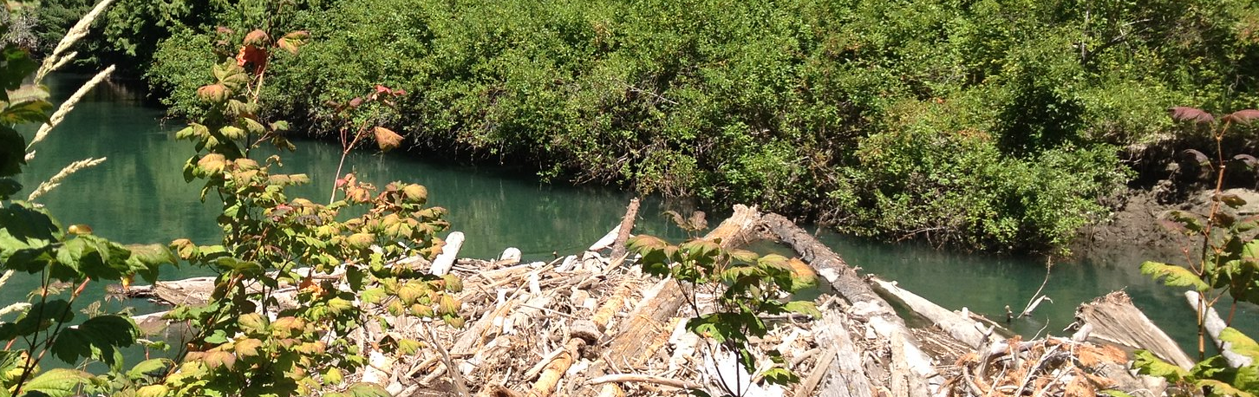
HCAX 2020 EPA Exchange Network Grant
Status update
White River, WA logjam project
Notes:
https://www.flickr.com/photos/150461980@N05/

Slide 24
CAP and EPA Exchange Network Grant - Pacific Northwest HCAX
Project goal: provide access to Pacific Northwest EPA Region 10 salmonid hatchery information for regional decision-making through the Hatchery Coordinated Assessments Exchange (Pacific Northwest HCAX)
Grant funding: $399,998
Project Partners:
Administration
Washington State RCO & GSRO
Goal 1 – Organize project governance and establish agreements for sub-award recipients
Policy/Process Facilitation
PNAMP
Goal 2 –Confirm and Facilitate Participation by New Members
Goal 5 – Disseminate Results of Project
Technical Facilitation
PSMFC-StreamNet
Goal 3 – Develop new data exchange standard (DES), templates, and processes
.Goal 4 – Review and Finalize XML Schema and Publish Design
Development and Participation
Goals 1-5
Colville Tribes & subcontractor Sitka Technology,
Washington Fish and Wildlife,
PSMFC – StreamNet & subcontractors ODFW & IDFG.

Slide 25
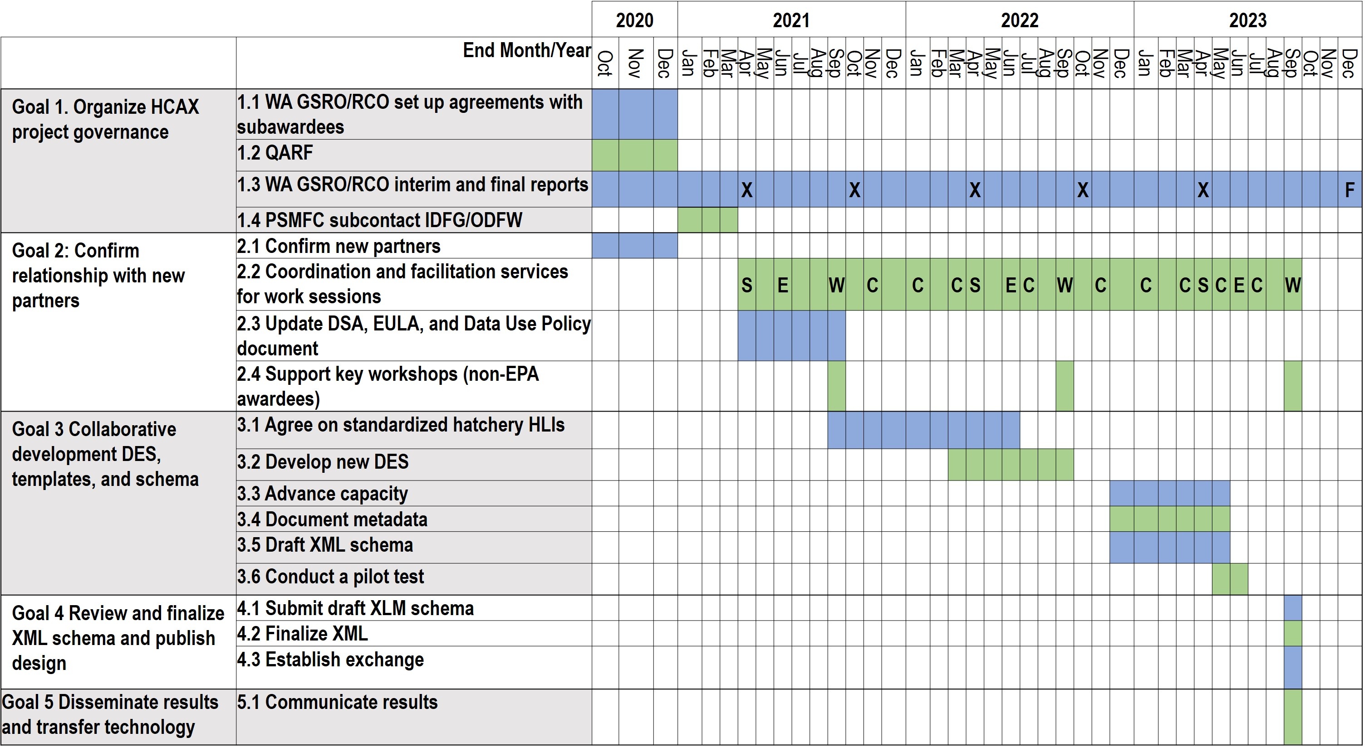
CAP and EPA Exchange Network Grant - Pacific Northwest HCAX
Project Implementation:
Legend
S
StreamNet Steering Committee
StreamNet Executive Committee
Workshop
Workgroup conference calls
EPA interim report
EPA final report
E
W
C
X
F

Slide 26
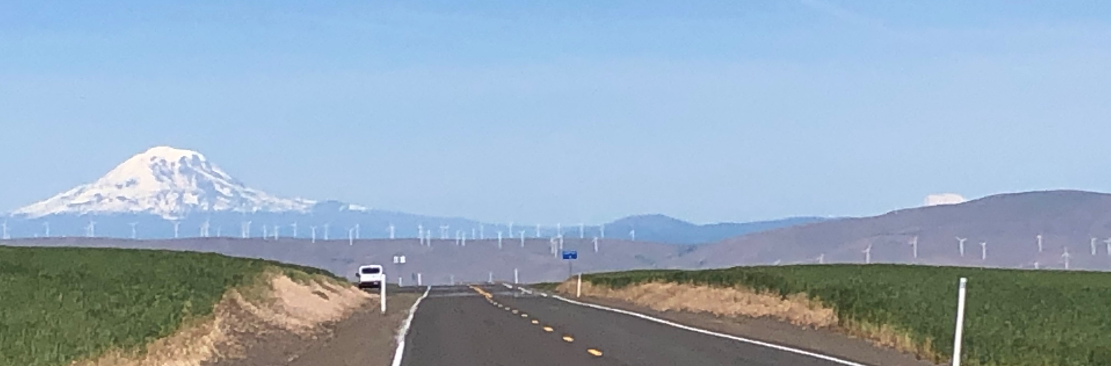
Five-Year Plan for Coordinated Assessments Partnership
Summary of edits in August 14 , 2020 version
Discussion of any additional changes for 2021
Road to John Day, OR
Notes:
https://www.flickr.com/photos/150461980@N05/

Slide 27
CAP – revised 5-year workplan
Summary of updates
Name Change: Added ‘Partnership’ to end of Coordinated Assessments and updated abbreviation to CAP
Section - Introduction: Expanded the background text to align with the CAP Core Team updates to the 2020 CAP Workgroup Roles and Responsibilities document
Section - Vision: Tightened up the vision statement, removing the descriptive process content that is now captured in the Implementation Approach section.
Section - Existing CAP HLIs : Added PNI under the Natural Origin side of the table (new change, not in emailed version)
Section - 5-Year Work Goals and Target
  Renamed the ‘Annual CA workflow’ section to the ‘5-year Work Goals and Target’ to better fit the reorganized content
  Reorganized to remove redundancies, now have a list for the entire 5-year period instead of repeating for each individual year
  Changed the formatting to highlight the groups tasked with various items
  CA Distribution List to be named “CAP Outreach Forum”
  Updated the ‘Carrying Capacity’ and ‘White Sturgeon’ scoping exercise steps to reflect revised status and role of Fish Monitoring Workgroup
  Added the CAP newsletter task (described for ExCom discussion in next slide)

Slide 28
Discussion - Executive Committee member input on CAP newsletter task
CAP – revised 5-year workplan’s Newsletter Task
new Electronic Newsletter
Audience: broad CAP Outreach Forum group
Frequency: twice a year
First newsletter: November 2020
Convey CAP and partner activities
  What is CAP
  Who is involved
  CAX Data updates
  Improvements to data sharing (DES) or new fields / data categories
  Partner spotlight
  Survey newsletter recipients for feedback on content in first newsletter
Other?
Develop Logo
Establish a consistent brand for use in newsletter, workshops, presentations, and outreach
Elements to consider including
  Geographic range
  Diversity of partners
  Scope of data types
Other?

Slide 29
CAP – revised 5-year workplan
Section - Implementation Approach
  Changed section name from ‘Workgroup Roles and Responsibilities’ to ‘Implementation Approach’
  Added process description at the start of the section, incorporating additional text from the 2020 CAP Workgroup Roles and Responsibilities doc.
  Updated names, added description of FMWG, and updated group descriptions to align with the 2020 CAP Workgroup Roles and Responsibilities doc.
  Name change: “CA Distribution List” to “CAP Outreach Forum”
  Added a figure to illustrate the relationship among the groups.
Additional additions/edits to consider for the CAP 5-year workplan
Section 5-Year Work Goals and Target:
Should we list USFWS along with BPA, NOAA, NPCC task related communication of data priorities?
Should we update the hatchery indicator item to include the HCAX project steps?
Other additions/deletions?

Slide 30
CAP and the PNAMP Fish Monitoring Workgroup
Provides a venue for discussion of topics related to CAP and StreamNet implementation
Members: subject matter experts (e.g. fisheries biologists, program managers) to address specific tasks or topics
Facilitator: USGS-PNAMP staff
Leader(s): TBD
https://www.pnamp.org/project/fish-monitoring-work-group
Some Suggested Topics
Recommendations from 2019 Smolt Workshop
Out-migrant observation metrics & indicators
Hatchery CAP indicators
Population boundaries: shared GIS layers for StreamNet and CAP, CBfish, NPCC dashboards, MonitoringResources.org
Carrying capacity: population level or reach-based
Juvenile density and distribution (snorkel surveys and electro-fishing)
Updates to spawner survey data exchanges & GIS for survey transects and redd sites (e.g., StreamNet “Trend” locations)
Notes:
Collaboratively Discuss and Address New Fish Data Needs In the Pacific Northwest Leveraging Existing Data Management Process and Projects
Note: These steps are not strictly sequential; interactions/discussions/feedback from previous steps are likely.

Slide 31
Collaboratively Discuss and Address New Fish Data Needs In the Pacific Northwest Leveraging Existing Data Management Process and Projects
Note: These steps are not strictly sequential; interactions/discussions/feedback from previous steps are likely.
A data need is identified
(e.g. BOR, BPA, NOAA, NPCC, USFWS)
Pose topic to PNAMP
fish monitoring workgroup (FMWG)
Solution modified/ maintained over time
FMWG: 1) Firm up/clarify proposed need. 2) Determine if one-time task or ongoing need.
Availability of time and funding will inform what can be achieved
Last step of process
Solution implemented by data management project (FPC, PTAGIS, StreamNet, FINS, ITMD, DART, etc.)
FMWG: Engage data experts. Discuss feasibility, and possible existing data project best suited
On-going need
One-time need
Engage appropriate data management group/forum (CAP, StreamNet ExCom, LSRCP etc)
FMWG recommends an approach not involving data management projects
Last step of process
Notes:
Note that the CAP address regional needs and may address needs from different partners with reporting and decision-needs involving more than one jurisdiction/entity, such as NPCC, BPA, NOAA, and USFWS

Slide 32
Collaboratively Discuss and Address New Fish Data Needs In the Pacific Northwest Leveraging Existing Data Management Process and Projects
Additional out migrant observations are needed for population estimation
Identify and invite biologists from tribes & states to clarify what information is needed
Solution modified/ maintained over time
FMWG: clarify exactly what information (e.g. condition/weight data) is needed and is this a 1-time ask or ongoing need
Last step of process
Solution implemented by data management project (FPC, PTAGIS, StreamNet, FINS, ITMD, DART, etc.)
FMWG asks StreamNet SC: does an existing data project work? If not, what else is feasible?
On-going need
One-time need
Engage appropriate data management group/forum (CAP, StreamNet ExCom, LSRCP etc)
FMWG recommends an approach not involving data management projects
Notes:
This is an example of how we plan to address a specific data need.
Biologists are asked to clarify what data are needed to answer the more general “information request” and if this is a one time ask or something that will be repeated
Consult SN SC – is there a data system that holds these data? A system that COULD hold these data?
Follow processes for
1 time ask
Repeated ask means we should consider how to institutionalize processes to make this efficient
NEXT STEPS for FMWG
Work group kickoff October 2020
Seeking 2-3 work group leaders

Slide 33
Projects coordinating with and supporting StreamNet
CRITFC ITMD
CBF&W Library
PNAMP
StreamNet
Nancy Leonard, StreamNet, #1988-108-04
Zach Penney and Denise Kelsey, CRITFC ITMD, #2008-507-00
Tami Wilkerson, Columbia Basin Fish & Wildlife Library, #2008-505-00
Jen Bayer, PNAMP #2004-002-00

Slide 34
Sharing Expertise to Provide Quality Data Managed by Data Stewards to efficiently provide quality data in support of regional assessments and reporting
CRITFC ITMD
CBF&W Library
PNAMP
StreamNet
FW Manager expertise to identify best data and indicators to share
Data Managers and Stewards
develop efficient data sharing approach
Documentation of data details (metadata)
for proper use of data
Data Sharing Capacity
is built and maintained within FW agencies and tribes
Data access tools and support
public understanding and wise decision making
Public access to documents and reports
that contain contextual supporting information for data
StreamNet Program, CRITFC ITMD, CBF&W Library, and PNAMP
Connecting Expertise for Successful Data Collection, Management, and Sharing

Slide 35




Collaboration among StreamNet, CRITFC, and PNAMP (BPA Funded Projects) to efficiently provide quality data in support of regional assessments and reporting
CRITFC ITMD
CBF&W Library
PNAMP
StreamNet
FW Manager expertise
Data Managers and Stewards
Documentation of data details (metadata)
Data Sharing Capacity
Data access tools and support
Public access to documents and reports
Fish Monitoring Work Group
Monitoring Resources.org
CRITFC ITMD #2008-507-00
(member tribes)
StreamNet #1988-108-00
Committee, Teams, Data Stewards
(4 states, Colville Tribes, and other tribes)
Columbia Basin
Fish & Wildlife Library
#2008-505-00
PNAMP #2004-002-00
StreamNet Program
1988-108-00
Executive Committee, Steering Committee, Technical/DES Teams, CAP Core Team
StreamNet Local Fish Data (trends/related data), fish distribution map, CAX, Data Store, etc.
5-year Status Review
Reporting on Program Goals, Objectives and Indicators
Contract Compliance
SPS Data system
Program Tracker Tool
BA, EIS, BiOp Reports
Life Cycle Models
Fish Data Products Technical Services (#2013-001-00)
BPA Decision Support Tools and Technical Reports

Slide 36
CRITFC Inter-Tribal Monitoring Data Project (ITMD)
#2008-507-00
CRITFC ITMD
CBF&W Library
PNAMP
StreamNet
Members: Data managers, data stewards, systems administrators, and programmers from
CRITFC,
Nez Perce Tribe,
Confederated Tribes of the Umatilla Indian Reservation,
Confederated Tribes and Bands of the Yakama Nation, and
Confederated Tribes of Warm Springs Reservation of Oregon.
Coordinator: Project Lead or other Tribal or CRITFC staff assigned the role.
Additional Information: https://www.critfc.org/tribal-data-network-workshop-documents/

Slide 37
CRITFC Inter-Tribal Monitoring Data Project (ITMD)
#2008-507-00
CRITFC ITMD
CBF&W Library
PNAMP
StreamNet
Coordinating with StreamNet
Initiated ITMD-SN staff Interactions and create as needed check-ins via ITMD meetings,
Continue exploring tribal capacity building opportunities by coordinating between CRITFC ITMD staff and SN staff,
Looking at possible future engagement of SN SC members with ITMD Data Stewards and/or Tribal Data Managers.

Slide 38
Columbia Basin Fish & Wildlife Library
CRITFC ITMD
CBF&W Library
PNAMP
StreamNet
A program of the Columbia River Inter-Tribal Fish Commission
Library Program Lead/Librarian: Tami Wilkerson
Additional Information: https://www.streamnetlibrary.org/
The Columbia Basin Fish & Wildlife Library provides access to current and historic information on the Columbia River Basin to inform scientific, policy, and cultural research.

Slide 39
Pacific Northwest Aquatic Monitoring Partnership (PNAMP)
#2004-002-00
Jen Bayer
PNAMP Coordinator, USGS
CRITFC ITMD
CBF&W Library
PNAMP
StreamNet

Slide 40
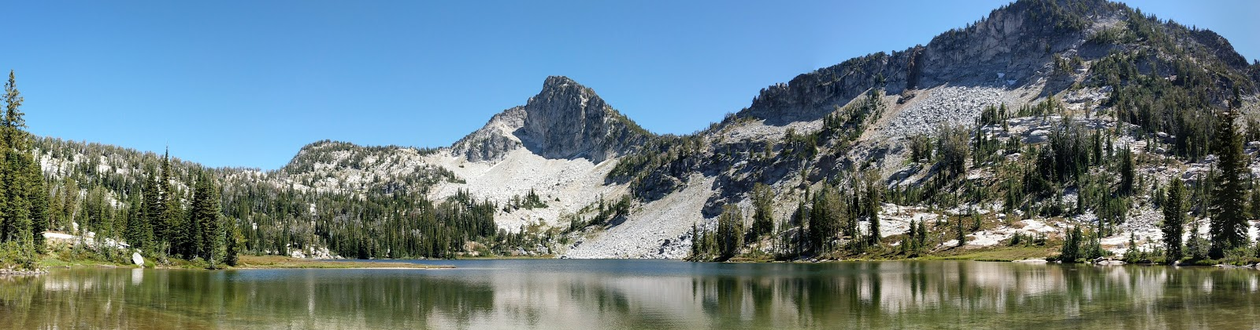
Pacific Northwest Aquatic Monitoring Partnership
#2004-002-00
Mission
The Pacific Northwest Aquatic Monitoring Partnership (PNAMP) provides a forum and functions to enhance the capacity of multiple entities to collaborate to produce an effective and comprehensive network of aquatic monitoring programs in the Pacific Northwest based on sound science designed to inform public policy and resource management decisions.
Unique Role in the Pacific Northwest
Align and integrate how we monitor, collect, and analyze data
  Facilitate collaboration and coordination on data collection efforts
  Sustain support for better documentation
  Plan and sustain data sharing infrastructure

Slide 41



















PNAMP Partners are State, Tribal and Federal Entities
Since 2004,
PNAMP has seen
in-kind participation from 1163 individuals representing more than 224 organizations and direct funding from
10 entities.

Slide 42
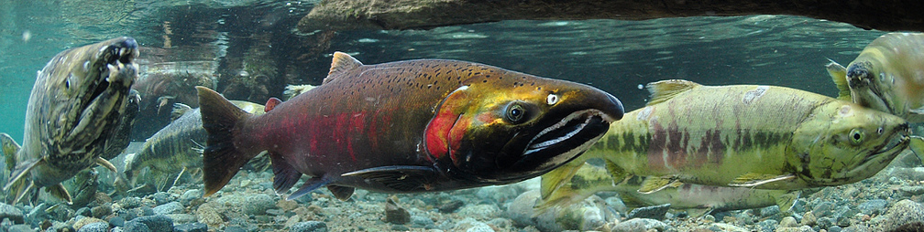
PNAMP 2020-21 Focus
Fish Monitoring Work Group
CAP & Hatchery CAX (HCAX)
Emerging Technology Information Sessions
MonitoringResources.org Project Sponsor Support
Instream Habitat Metric Data Integration
Photo credit: BLM

Slide 43

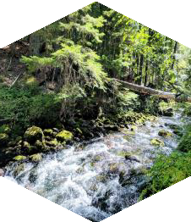


Emerging Technologies Information Sessions
October 2020 – February 2021
October 2020 – February 2021
Join us for the ETIS Webinar Series!
Schedule Overview
October 2020: Unmanned Aerial Vehicles (UAVs) November 2020: eDNA
January 2021: Fish Monitoring and Assessment February 2021: Data Management
October 2020: Aerial Monitoring of Aquatic Systems
Tuesday, Oct 6, 1:00-2:30pm Pacific
Richie Carmichael (Biomark) : Drone Assisted Stream Habitat (DASH) Protocol: Establishing consistency and compatibility between UAS monitoring programs
Sarah Hoffmann (Biomark) : Machine learning applications for conservation
Tuesday, Oct 13, 1:00-2:30pm Pacific
Kain Kutz (USFS) : Mapping Riparian Habitat and Geomorphology Monitoring Applications within the United States Forest Service (USFS) using Unmanned Aerial Systems (UAS) Acquired Imagery
Lauren Burns (CRITFC) : Integrating unmanned aerial vehicles into habitat monitoring methods
Tuesday, Oct 20, 1:00-2:30pm Pacific
Mischa Hey (Quantum Spatial) : Characterizing Riverine Fish Habitat with Bathymetric LiDAR
Phil Roni (Cramer Fish Sciences) : Review of remote sensing and emerging technologies for use in evaluating floodplain and riparian projects

Slide 44




Working Together to secure investments, reduce redundancies, and meet FAIR principles
PiscesWeb (cbfish.org)
proposals
contracts/SOW
annual reports
project management
MonitoringResources.org
study plans
sample designs
protocols
methods
monitoring metadata
Information exchange
StreamNet
local trends
CAX
archived data
Project sponsors
datasets, HLIs
reference materials
CBF&W Library
reports
gray literature
books
access to peer journals

Slide 45
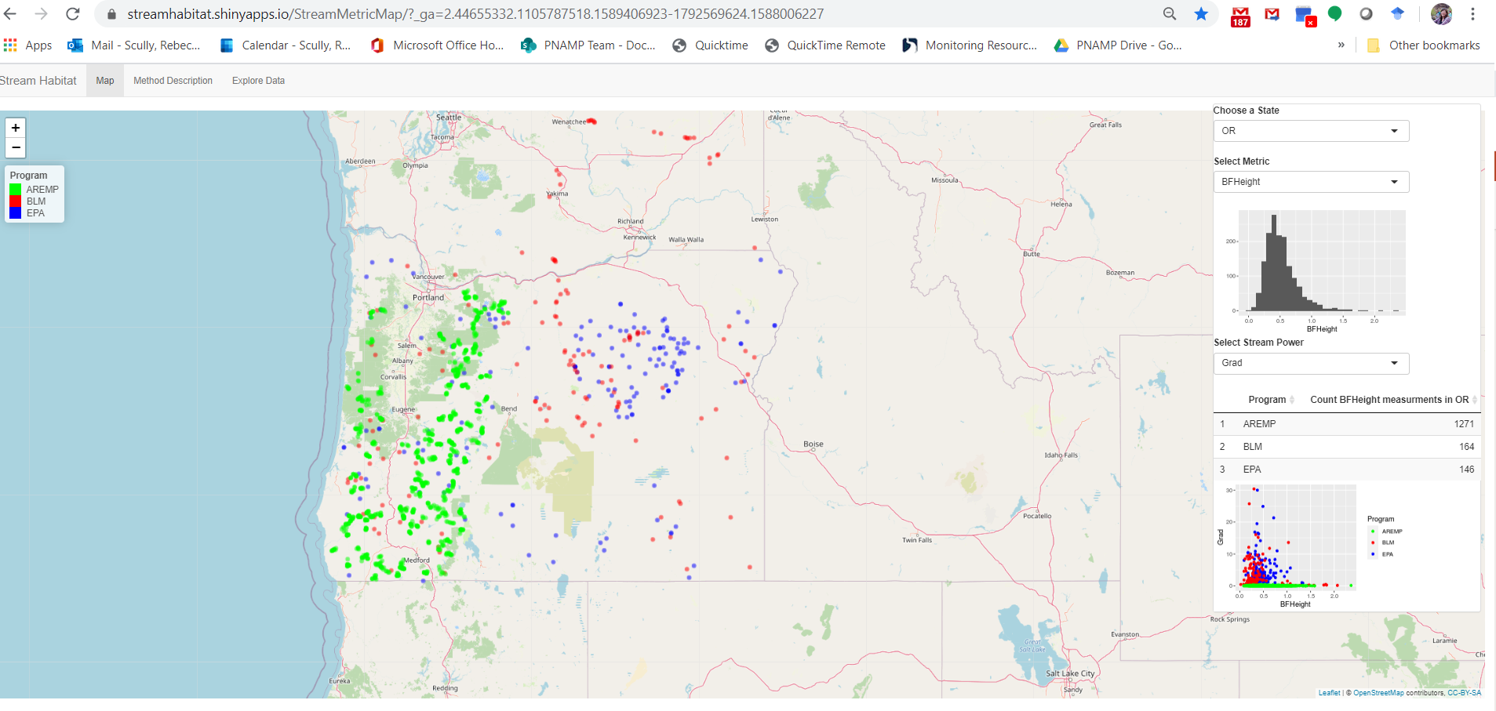
Habitat Metric Integration Project
BLM Assessment, Inventory, and Monitoring Program (AIM)
EPA National Aquatic Resources Survey (NARS)
USFS Aquatic and Riparian Effectiveness Monitoring Program (AREMP)
USFS Pacfish/Infish Biological Opinion Effectiveness Monitoring Program (PIBO-EM)
U.S. Geological Survey Core Science Systems Mission Area

Slide 46
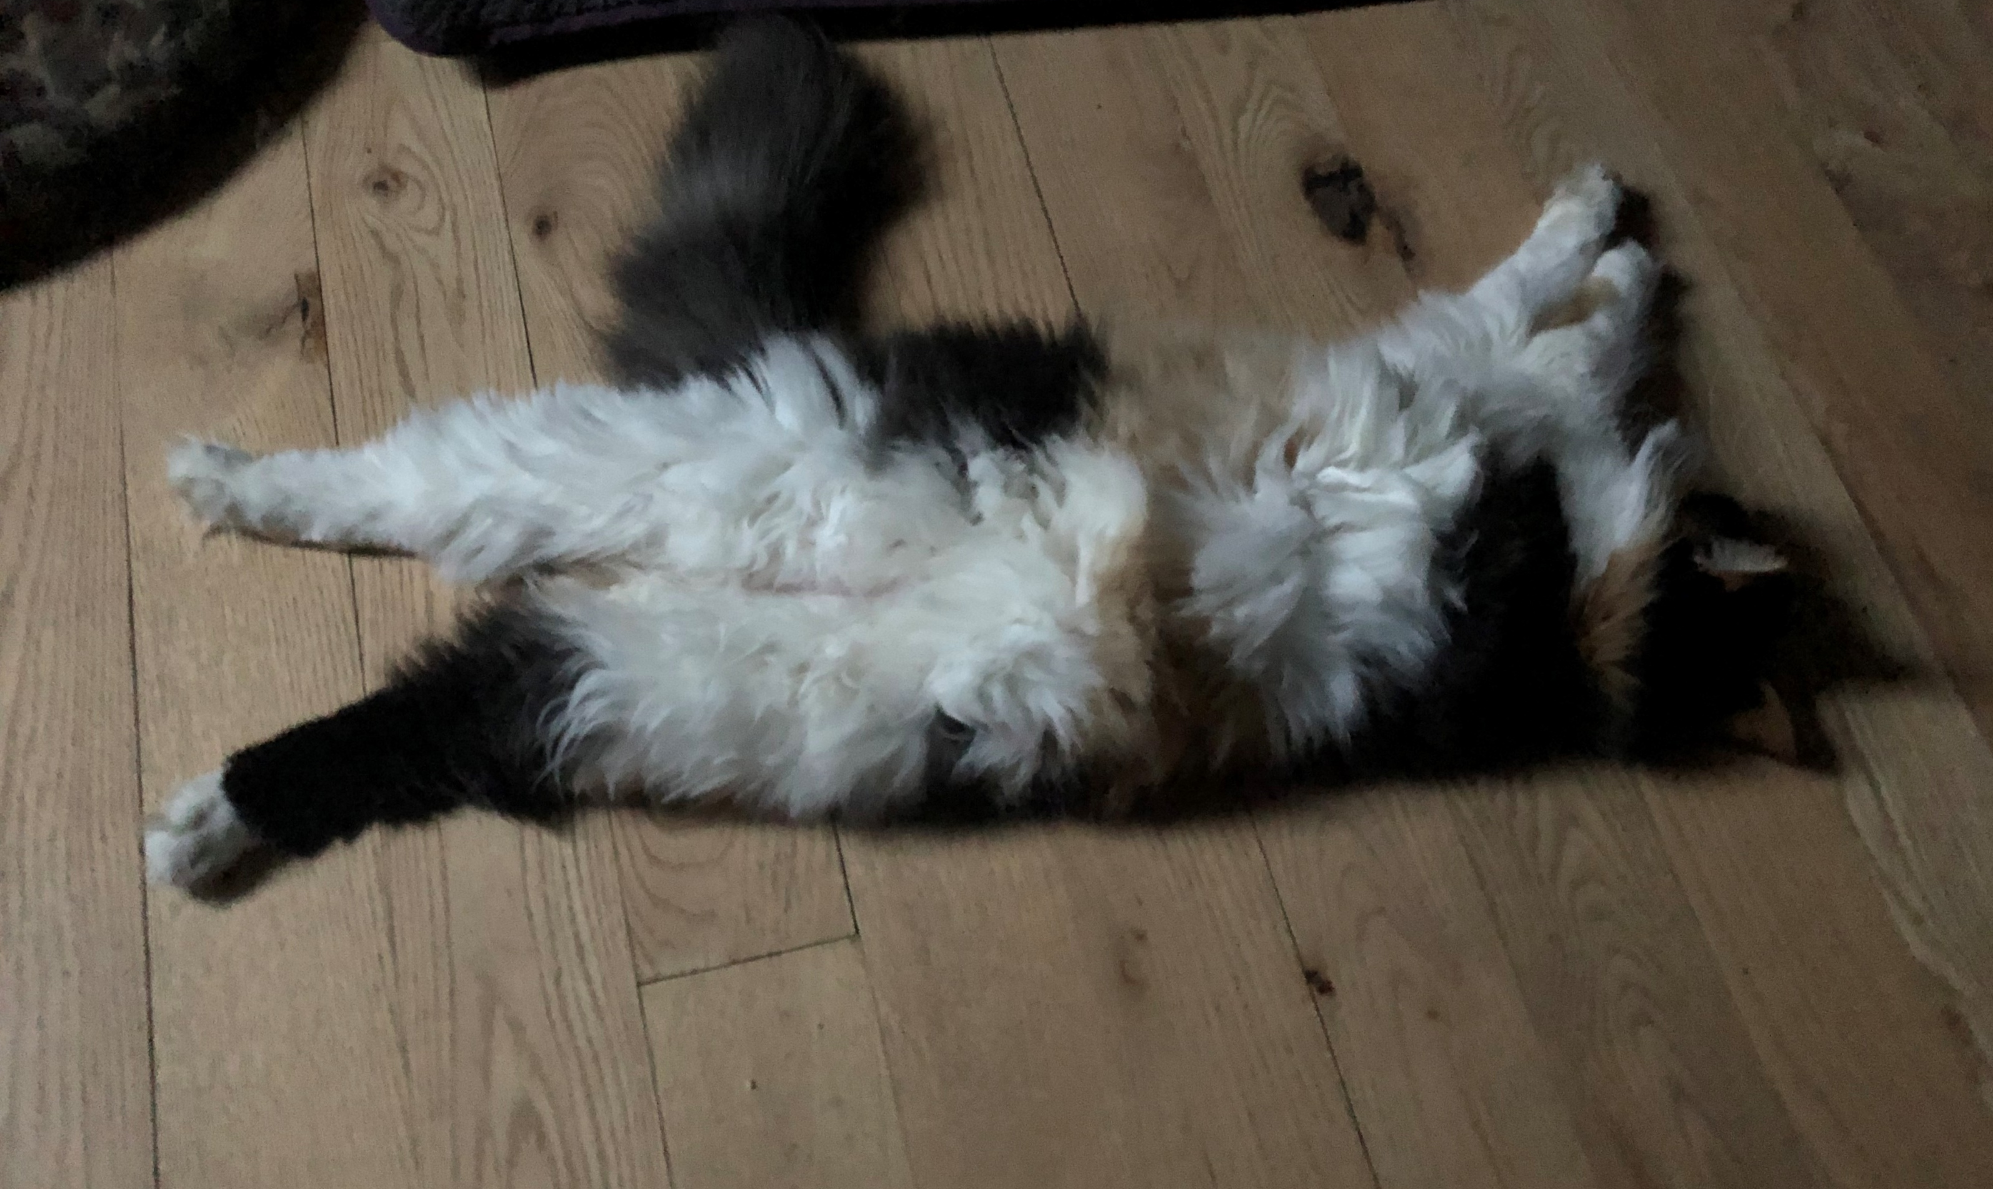
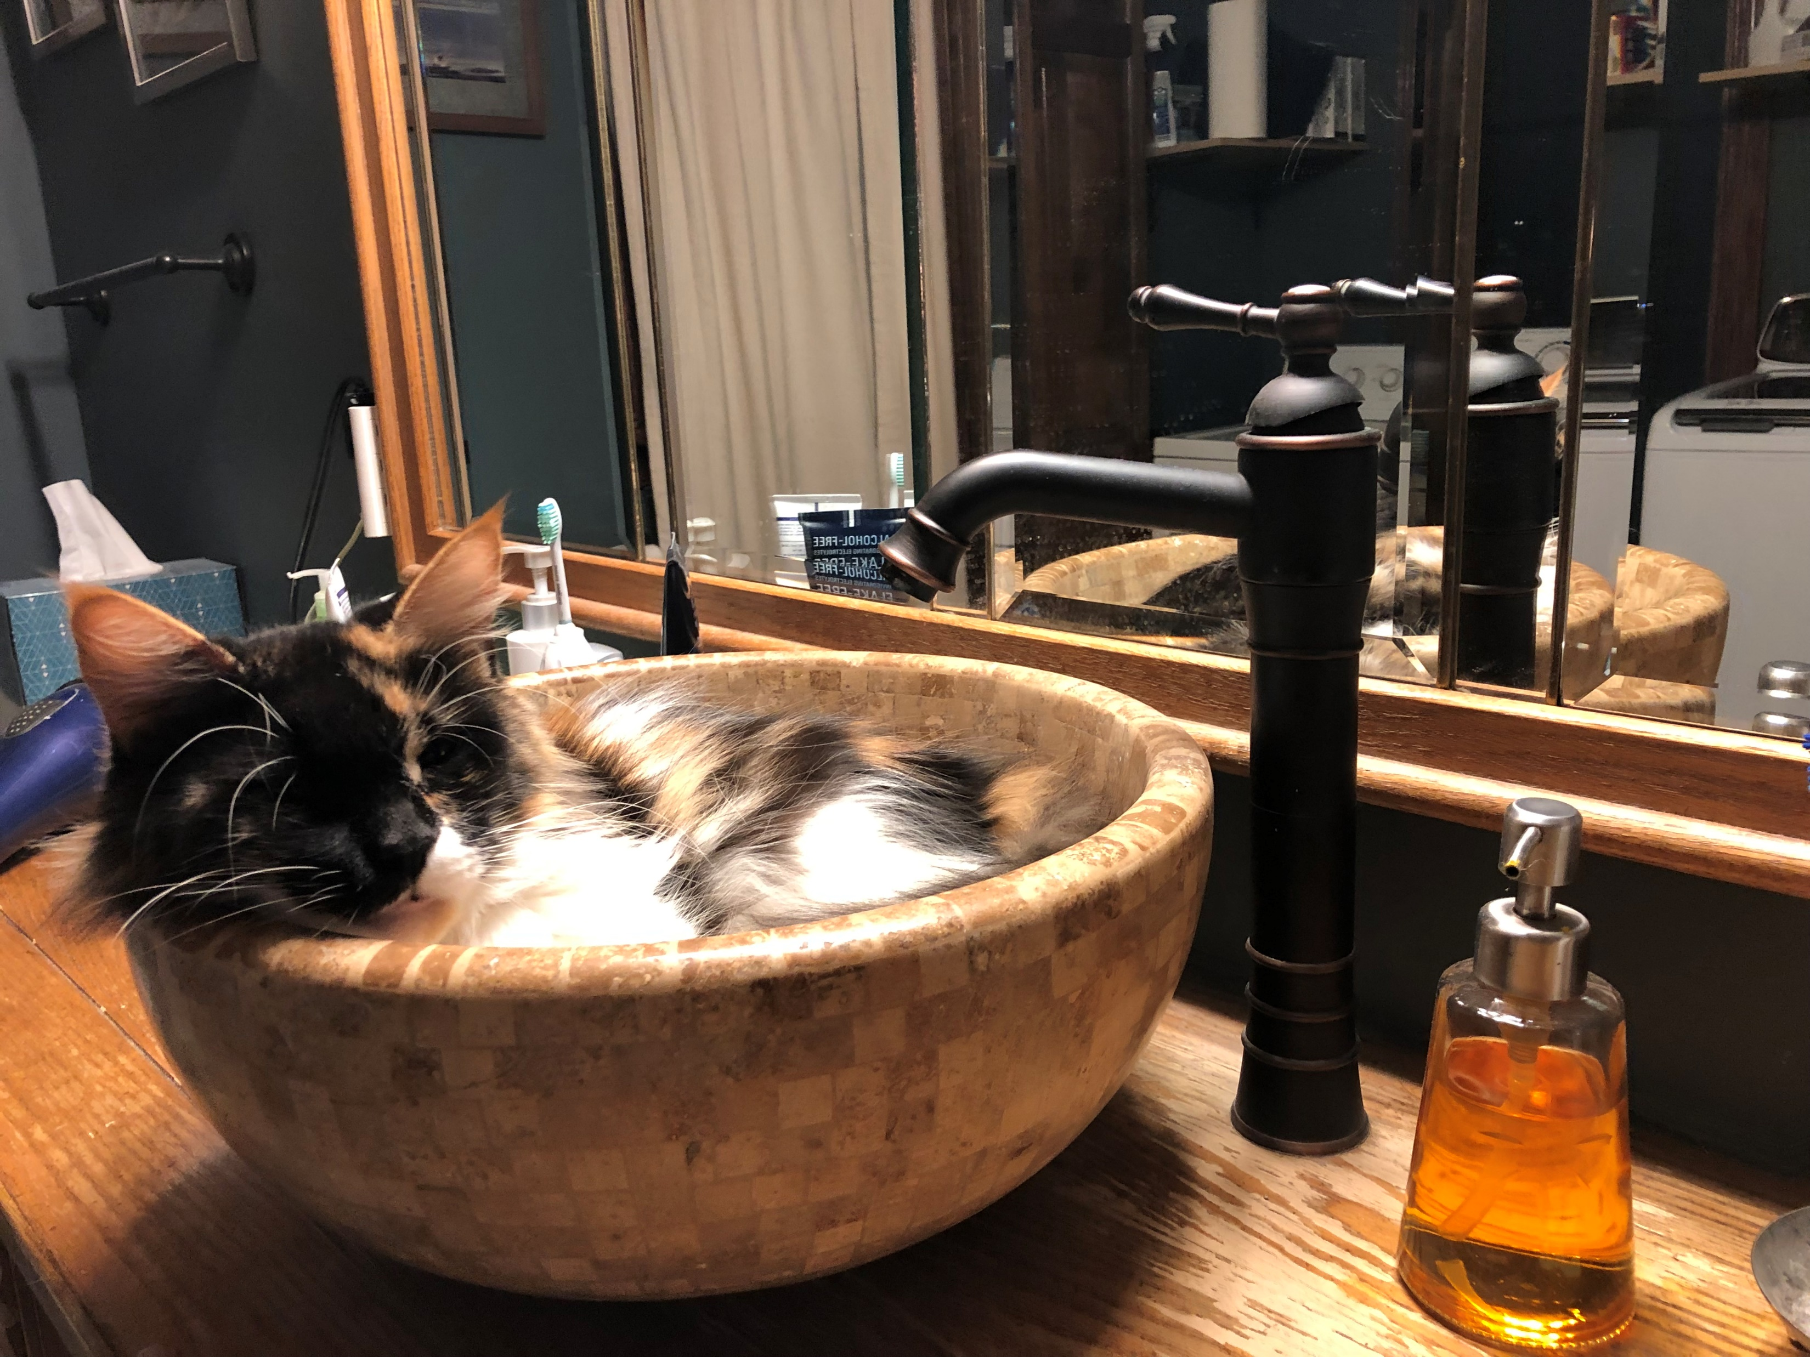
Stretch Break
Back at 2:50pm Pacific Time

Slide 47

StreamNet
#1988-108-00
Nancy Leonard, StreamNet Program Manager
Greg Wilke, StreamNet Programmer
Mike Banach, StreamNet Fishery Biologist and Database Administrator
Van Hare, PSMFC GIS Manager
Mission Statement
Coordinate and support efforts of state, tribal and federal agencies to collect, manage, and share fish and aquatic habitat information in the Pacific Northwest, with an emphasis on the Columbia River Basin (Basin), to support public understanding and wise decision making.

Slide 48
Decision and Implementation Process Guiding StreamNet prioritizing work to flow data for regional assessments and policy/decision-makers
StreamNet Executive Committee
StreamNet Steering Committee
Teams
(DES Development Team & StreamNet Technical Team)
Submit to BPA annual work elements for tasks related to communication, support, tools and data flow to data systems, including StreamNet Local Fish (trends) data system, CAX, Data Store, and other needs of committee members and partners
Data stewards and programmers develop and implement the data exchange standards to flow data to the StreamNet data systems
Informs and approves the StreamNet Strategic Plan and the 5-year Coordinated Assessments Partnership workplan
CAP Core Team
Fish Monitoring Workgroup
Identification of data (metrics, indicators) by FW managers to address priorities set by Executive Committee
Supports coordination among partners

Slide 49
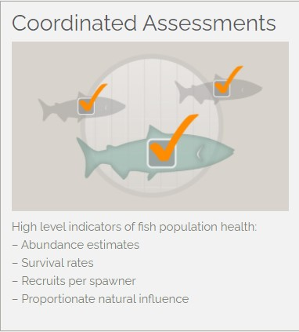
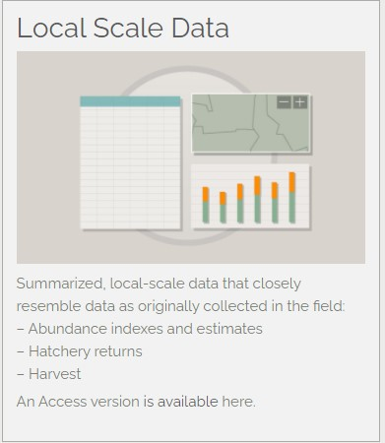
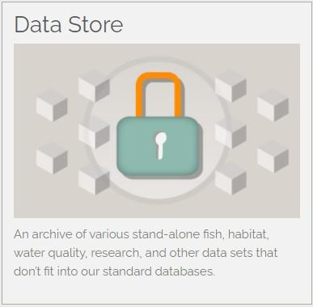
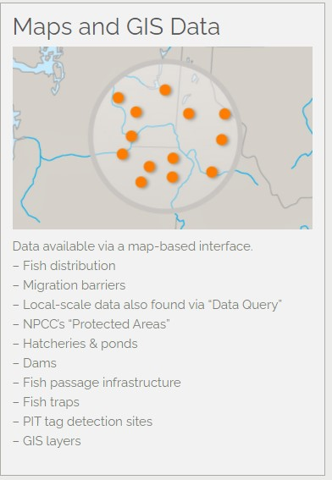
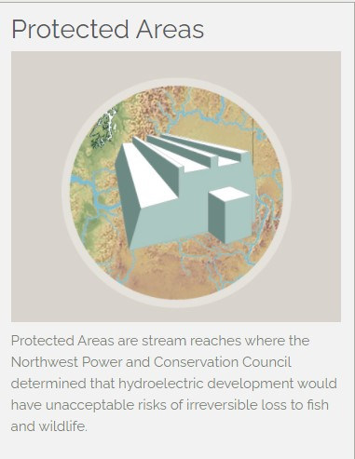
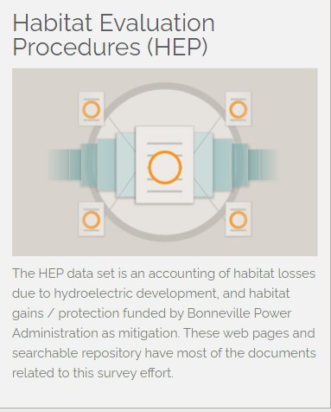
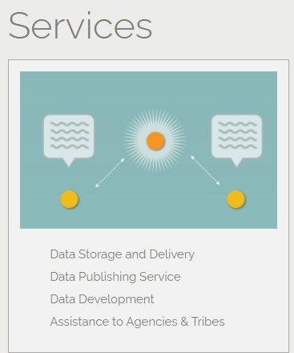
StreamNet Program and PSMFC GIS Data Systems and Tools

Slide 50
User Groups Frequenting StreamNet Website
(Jan – Dec 2019)
Data Accessed/Submitted
6,968
times users accessed data in 2019 from StreamNet queries (local trends and CAX)
425,710
count of when API was used to submit/use data to StreamNet in 2019
Notes:
17 group

Slide 51
User Groups Downloading StreamNet’s GIS Data Sets
(Jan-Dec 2019)
745
StreamNet GIS data sets were downloaded by these 8 user groups
Notes:
8 groups

Slide 52
StreamNet Local Fish Trend Data Status
(August 3, 2020 snapshot)
Data Category | Available Data* | Years | Records
Redd counts | 4,940 Trends | 1901 - 2019 | 53,662
Fish counts | 438 Trends | 1956 - 2019 | 2,275
Spawner counts | 5,135 Trends | 1944 - 2019 | 39,061
Spawning population estimates | 3,170 Trends | 1901 - 2019 | 22,025
Dam / weir counts | 506 Trends | 1926 - 2019 | 14,094
Fish abundance estimates | 128 Trends | 1976 - 2018 | 530
Hatchery returns | 1,084 Trends | 1906 - 2019 | 10,361
Freshwater harvest | 2,708 Trends | 1894 - 2015 | 45,661
Protected areas | 32,997 Records | n/a | n/a
*Data sets from Columbia River Basin and other areas of MT, ID, WA, and OR
- Fish Species include resident and anadromous fish, including 36 NPCC FW Program focal species

Slide 53
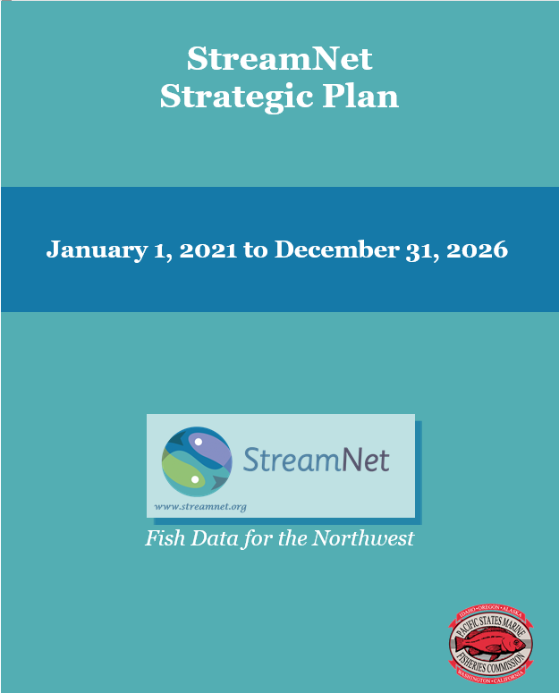
StreamNet revised Strategic Plan 2021-2026
Summary of updates
  Reformatted into a standard strategic plan format, incorporated relevant content from
    2015 Strategic Plan
    Current BPA statement of work (SOW) developed with Steering Committee
    2019 annual project report to BPA produced with Steering Committee
    updated/added content as needed with input from Steering Committee members.
  Aligned content overlapping with CAP 5-Year Work Plan and the 2020 Roles and Responsibilities document
  Developed new figures to illustrate data flow and relationship among groups
Any additions/deletions?

Slide 54
StreamNet FY2021 Baseline Budget
FY21 baseline budget: $2,159,766
$142,513 increase
Supports PSMFC staff funding 2.92 FTE StreamNet staff, 3-months PSMFC GIS staff, and subcontracts
FY 21 Percent baseline budget allocation
excluding indirect fees, and state specific adjustments from roll-over or portfolio mgmt. contributions:
CCT 4%
MFWP 8%
IDFG 15%
PSMFC 22%
WDFW 22%
ODFW 23%
Other subcontracts 5%
FY20-21 Statement of Work
details in CBFish for the 2018-2019 SOW and 2019 Annual Project Report to BPA
$2,159,989
2019 Annual Project Report to BPA: https://www.cbfish.org/Document.mvc/Viewer/P172069
Notes:
2019 Annual Project Report to BPA: https://www.cbfish.org/Document.mvc/Viewer/P172069

Slide 55
Highlights of FY21 activities – PSMFC StreamNet
Data
Maintain automated flow of data
Maintain GIS data layers, web map services and related mapping applications: fish population boundaries, trend survey locations, generalized fish distribution and fish facilities (weirs, hatcheries, traps, and fish data collection infrastructure)
Support use of GIS web map services by BPA funded data systems (e.g., monitoringresources.org)
Refresh query tools, data communication tools for target audiences, and website. Currently:
  Seeking input on pilot: refresh of Local Fish Trend (related data) query tool
  Initiated: Data Store query and data submittal tool
Connect and leverage relevant content from other data systems (e.g., CBFish.org, MR.org, CBF&W Library)
Groups
Convene DES Development team and StreamNet Technical team to update DESs and improve data flow and quality
Engage and support Fish Monitoring Workgroup working with FW Managers to improve/add HLIs
PSMFC-StreamNet staff and PNAMP co-organizing Emerging Technology Information Session (ETIS) webinar
Continue coordinating with CRITFC ITMD, PNAMP, and CBF&W Library
EPA Exchange Network Grant
Implement tasks related to new hatchery HLIs (HCAX) funded through the EPA Exchange Network Grant (pending)
PSMFC StreamNet/GIS Staff Support
Continue to provide technical assistance to public users and partners
Support data sharing capacity of partners (e.g. SBT subcontract)

Slide 56
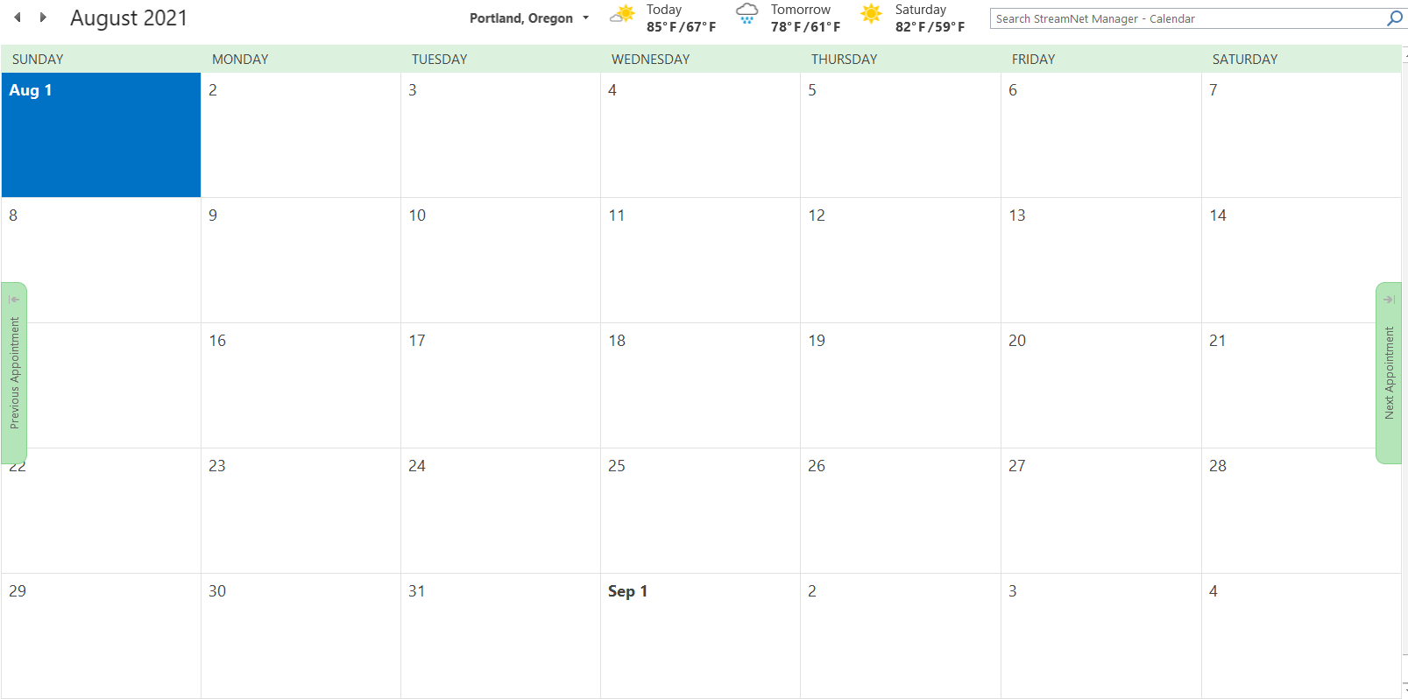
2021 StreamNet Executive Committee Meeting
August 2021
AFS 2021 annual meeting
PSMFC 2021 annual meeting

Slide 57
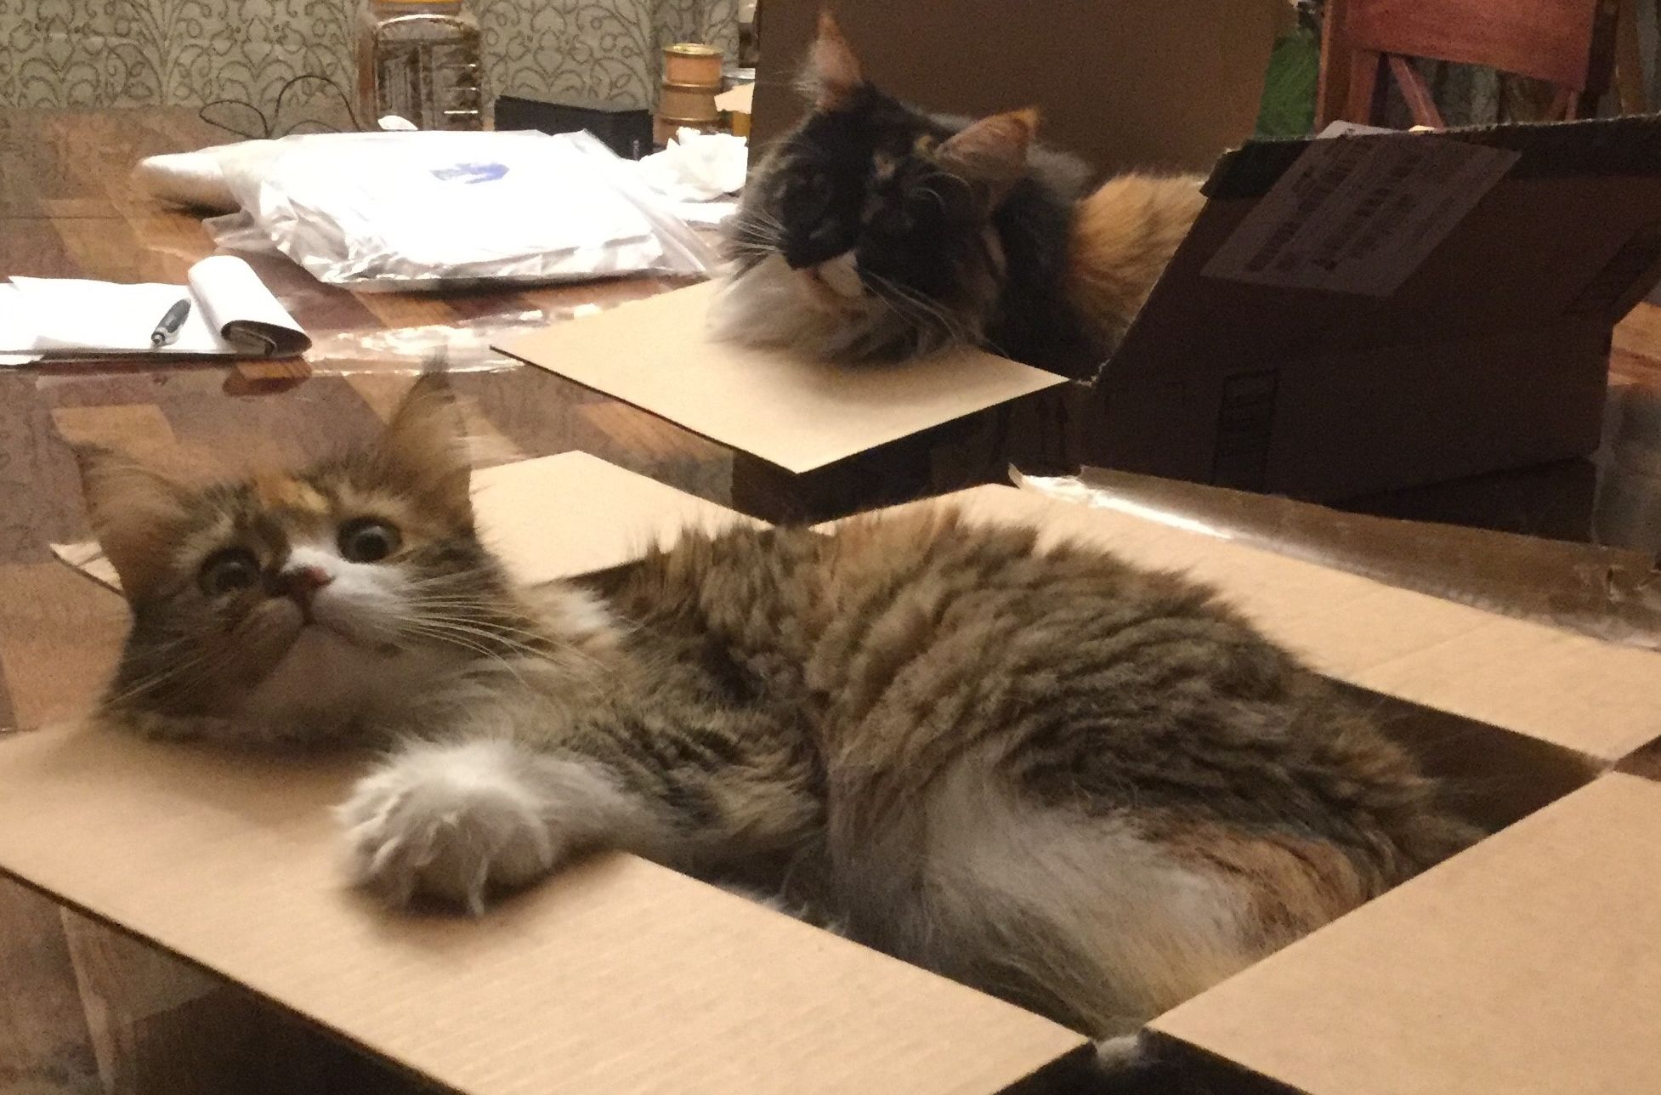
Adjourn

