Slide 1
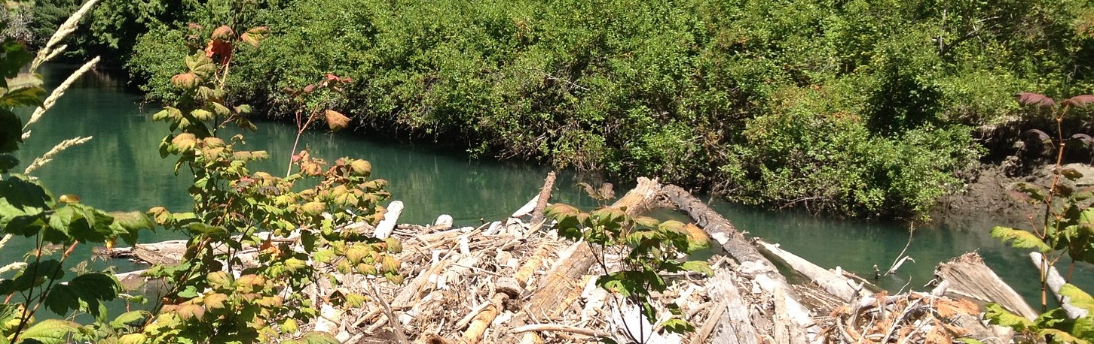
StreamNet Steering Committee Meeting
Tuesday, October 27, 2020
9:30 AM – 2:00 PM (PDT)
Please join my meeting from your computer, tablet or smartphone. https://global.gotomeeting.com/join/822759093
You can also dial in using your phone.
United States: +1 (872) 240-3311 ; Access Code: 822-759-093
White River, WA logjam project
Notes:
https://www.flickr.com/photos/150461980@N05/

Slide 2
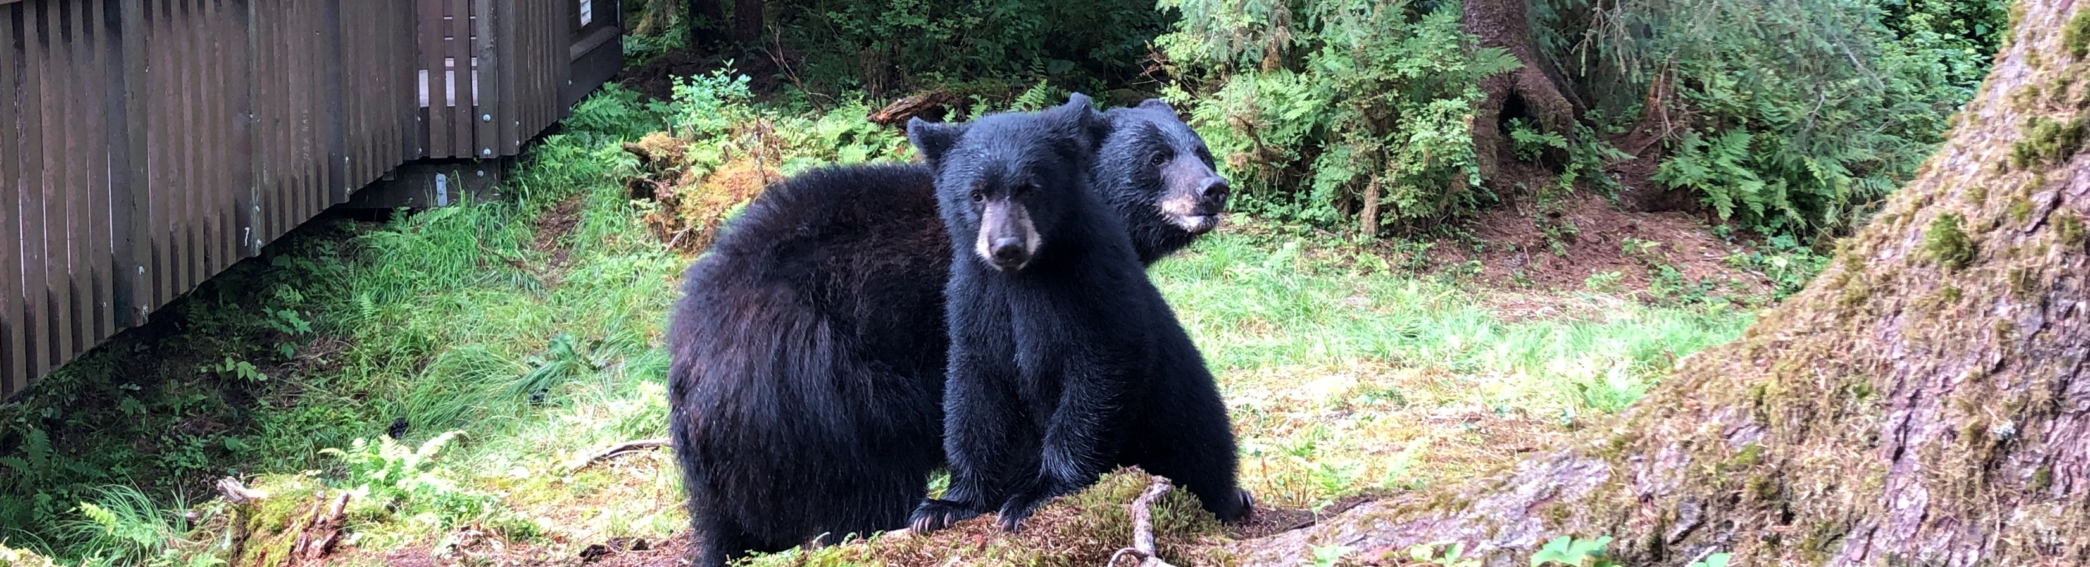
Anan Wildlife Observatory Site, USFS, Wrangell, Alaska
Welcome and Introductions
  Please leave your web-camera on for the meeting duration to facilitate discussions.

Slide 3
Agenda
(times are approximate)
Time | Agenda Item
9:30 am | Welcome and introductions (All)
9:45 am | Steering Committee Member Updates (All, 5-minute verbal updates)
10:30 am | PSMFC StreamNet staff updates
11:30 am | Update on IJ funding to improve access to Coordinated Assessments Partnership (CAP) Salmon and Steelhead data for NOAA (Nancy, Jen)
Noon | Lunch Break – 30 minutes (video and audio will remain on for informal discussion)
12:30 pm | CAP Newsletter template and logo (Nancy, Jen)
1:00 pm | EPA Exchange Network Grant for Hatchery Indicators HCAX update and next steps (Brodie Cox, Jen, Nancy)
1:15 pm | BPA reports (Nancy)
1:30 pm | Schedule 2021 late Feb/March SN Steering Committee meeting (All)
2:00 PM | Adjourn

Slide 4
Steering Committee Member Updates
(Follow random order shown below, verbal updates)
Entity (random order) | Steering Committee member
WDFW | Brodie Cox
PNAMP | Jen Bayer
MFWP | Dawn Anderson
NPCC | Mark Fritsch
Colville Tribes | George Batten
USFWS | Doug Threloff
ODFW | April Brenden-Locke, Mathew Oeder
BPA | Tom Pansky, Russell Scranton, Matt Schwartz
IDFG | Angie Schmidt, Evan Brown
CRITFC | Denise Kelsey (ITMD), Tami Wilkerson (CBF&W Library)
NOAA-Fisheries | Mari Williams
StreamNet (PSMFC) | Nancy Leonard

Slide 5
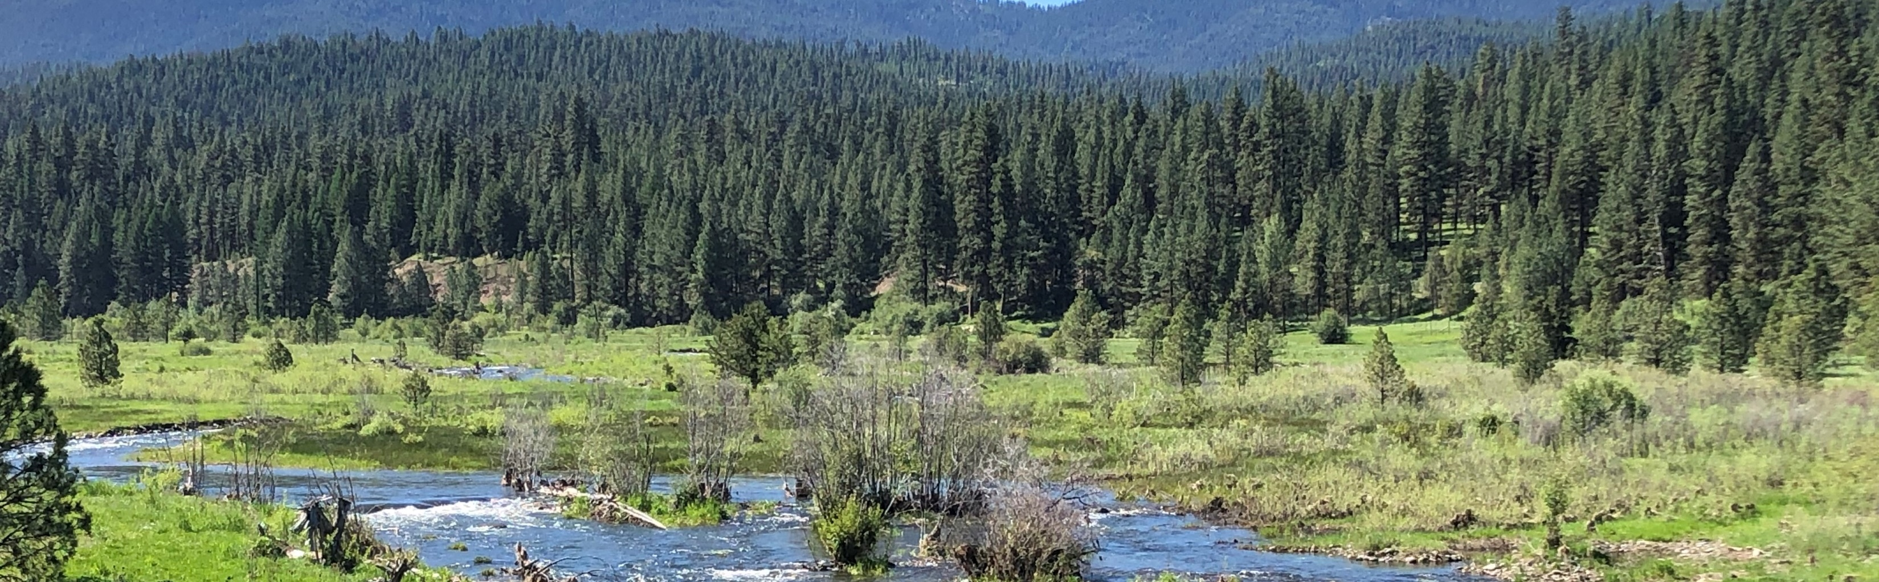
PSMFC StreamNet staff updates

Slide 6
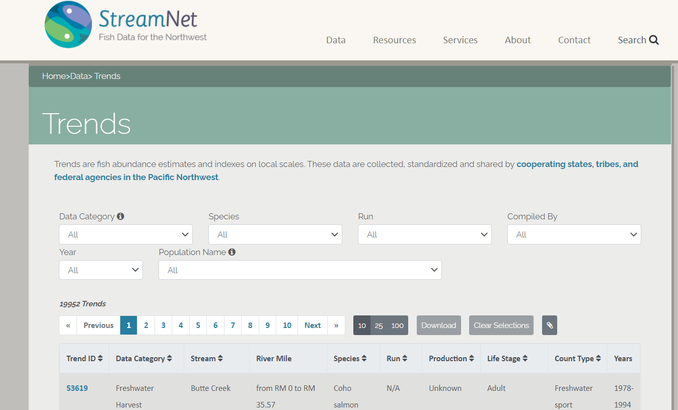
Update on Tabular Queries – Greg Wilke

Slide 7
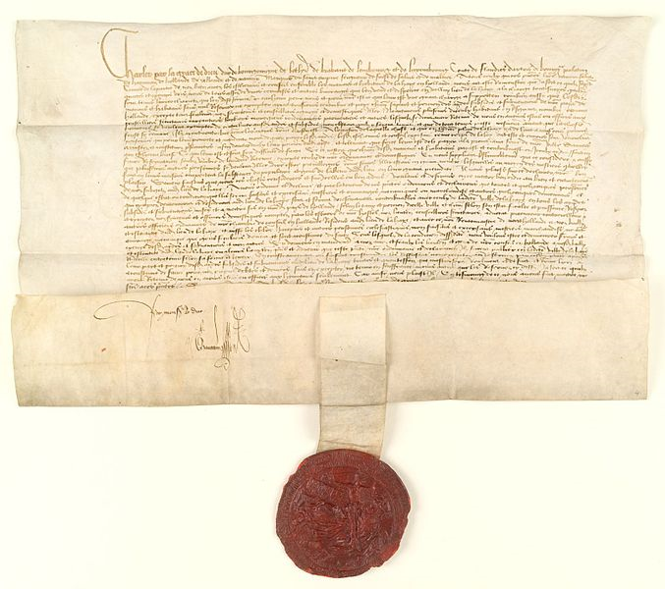
Update on Draft DES Development Team Charters
– Mike Banach

Slide 8
Draft DES Team Charters
Revised Data Exchange Standards (DES) Development/Revision Procedures
Existing teams
  Coordinated Assessments Partnership DES Development Team (CAP DDT)
  StreamNet DES Development Team
    Made of StreamNet Tech Committee & Steering Committee members, as needed
Current active participants. Include StreamNet funded and non-funded organizations
  CAP DDT
  BPA, NMFS, PSMFC, USGS
  IDFG, ODFW, WDFW
  CCT, NPT
Draft Charter for each team (documents under development)
  Team Membership – Clarify roles and responsibilities for current members and potential future members
  Operating Guidelines – Describe functions and processes used
  DES versions – Clarify and improve development and adoption processes for new and revised DESs
  Missing / incorrect validation rules – Improve notification of updates; specify schedule
  StreamNet DDT
  PSMFC, USFWS
  IDFG, MFWP, ODFW, WDFW
  CCT

Slide 9
Draft DES Team Charters
Revised Data Exchange Standards (DES) Development/Revision Procedures
Team Membership
  A Chair (PSMFC SN Biologist)
  1 or 2 “primary representatives” from each member organization
  “Observers” from each member organization
  A Cochair, selected from the primary reps. Serves for about 1 year.
  Leaders of ad hoc work groups. Work group leaders selected by the primary reps.
Operating Guidelines
  Each DDT meets at least twice per year to discuss status, progress, difficulties. Other topics as proposed.
  Chair and Cochair create agenda, synthesize input via email / phone to minimize number of meetings
  Primary reps discuss issues at meetings. Ad hoc work groups created for specific needs.
  Full DDT or a work group may request input from SN ExCom, PNAMP FMWG, etc.
  Chair and Cochair update draft DES based on DDT / work group proposals / deliberations / decisions
  In general, the DES Development/Revision Procedures will be followed
  Decisions made by 75% vote of primary reps. Attempt to accommodate others.

Slide 10
Draft DES Team Charters
Revised Data Exchange Standards (DES) Development/Revision Procedures
DES document versions processes
  New data structures and business (validation) rules take effect on the effective date
  Effective date no earlier than 2 months after approval by DDT
  2 month lead provides time for DBAs and programmers. Also to communicate changes to participating organizations not funded by StreamNet.
Missing or incorrect validation rules
  Non-critical validation rule error
    Fixed quarterly, with at least 1 month notice (no surprises)
    Quarterly schedule provides predictability to participating organizations not funded by StreamNet
  Critical validation rule error – Prevent data submission or result in useless data
    Communicate to all data providers immediately (no surprises)
    Problem will be fixed as soon as possible / immediately
    Data providers notified once issue is fixed

Slide 11
Draft DES Team Charters
Revised Data Exchange Standards (DES) Development/Revision Procedures
General DES addition / revision process
  Still under development
  Updating the 2003 version to clarify relationship with Executive Committee and PNAMP FMWG and align with draft Charter operating guidelines
  Adoption requires supermajority rather than consensus. 75%? Higher?

Slide 12
Update on Fish Monitoring Work Group (FMWG)
– Jen Bayer, Russell Scranton, Mike Banach, Nancy Leonard
FMWG and CAP’s Data Needs
A data need is identified
Pose topic to PNAMP
fish monitoring workgroup (FMWG)
Last step of process
Solution modified / maintained by StreamNet teams
FMWG: 1) Firm up/clarify proposed need.
Solution implemented by StreamNet teams
FMWG: Engage topic/data experts.
On-going need
One-time need
StreamNet committees and teams engaged
FMWG recommends an approach
Last step of process

Slide 13
CAP and the PNAMP Fish Monitoring Work Group
Provides a venue for discussion of topics related to CAP and StreamNet implementation
Members: subject matter experts (e.g. fisheries biologists, program managers) to address specific tasks or topics
Facilitator: USGS-PNAMP staff
Leader(s): Marika Dobos and Russell Scranton
StreamNet Staff: Mike Banach, Nancy Leonard
https://www.pnamp.org/project/fish-monitoring-work-group
Some Suggested Topics
Out-migrant observation metrics & indicators
Hatchery CAP indicators
Population boundaries: shared GIS layers for StreamNet and CAP, CBfish, NPCC dashboards, MonitoringResources.org
Carrying capacity: population level or reach-based
Juvenile density and distribution (snorkel surveys and electro-fishing)
Updates to spawner survey data exchanges & GIS for survey transects and redd sites (e.g., StreamNet “Trend” locations)

Slide 14
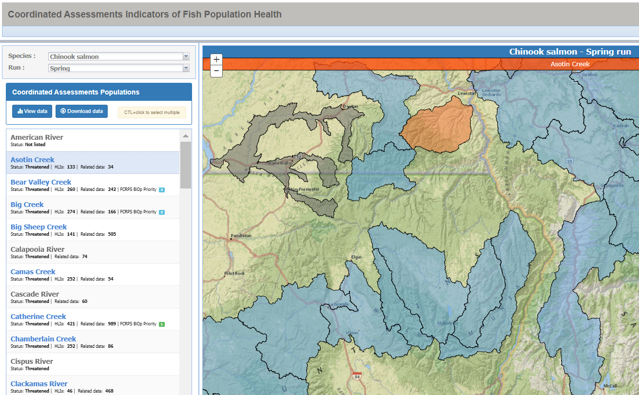
Update on IJ funding to improve data access for NOAA
- Nancy, Jen

Slide 15
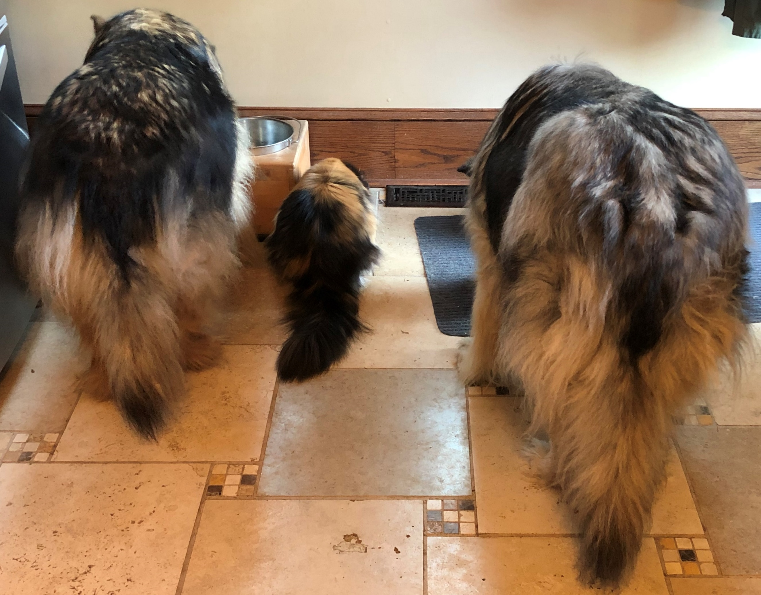
Lunch Break – 30 minutes
(video and audio will remain on for informal discussion)
Feeding Station

Slide 16
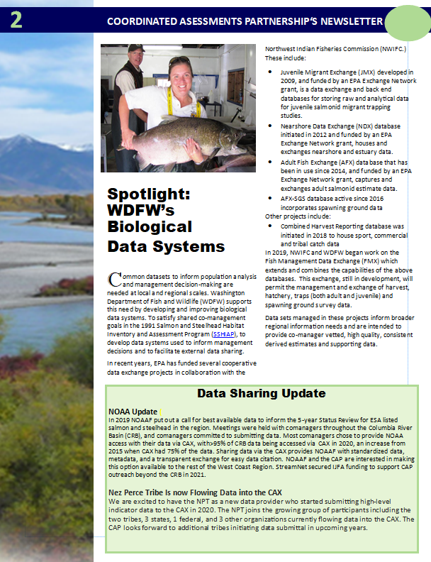
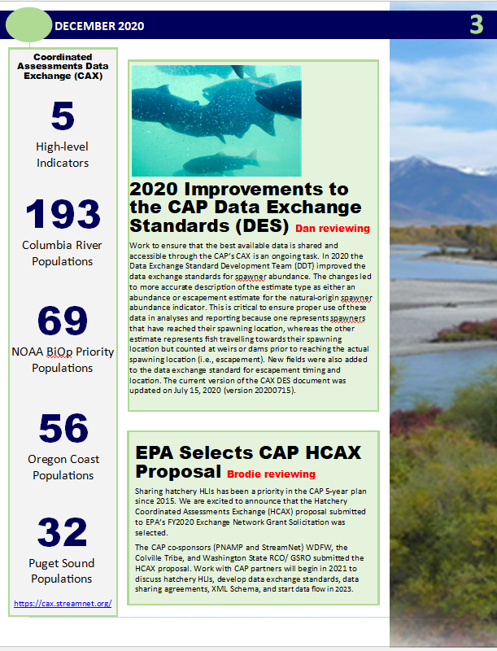
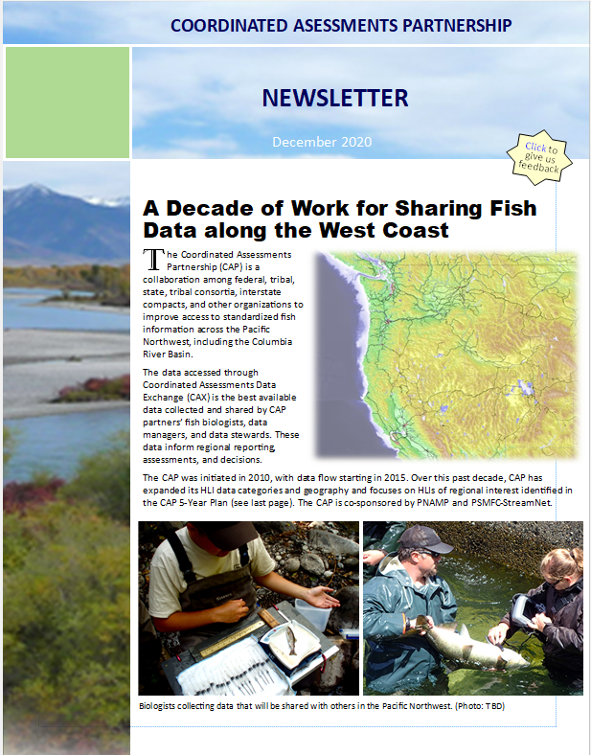
CAP Newsletter template and logo
- Nancy, Jen, and CAP Core Team members
Newsletter

Slide 17
CAP Newsletter
Confirm CAP logo
Confirm newsletter template and content
Confirm CAP participant logos to include
  Who is who (roles/responsibilities)
Post Steering Committee meeting: finalize images, text, logos
  Do you have rights to photos that you can share?

Slide 18



Selected New CAP Logo

Slide 19

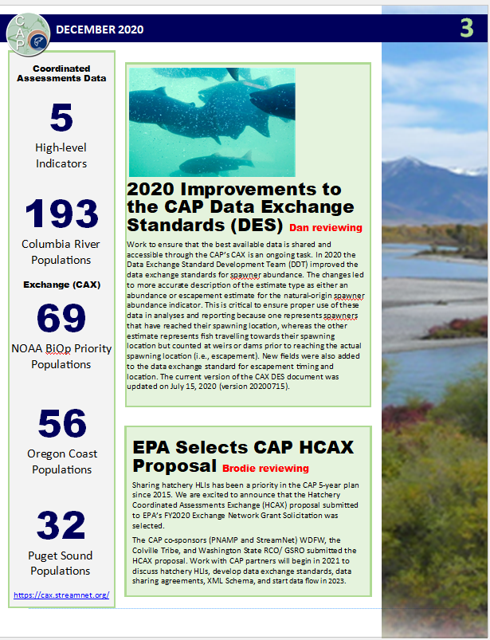
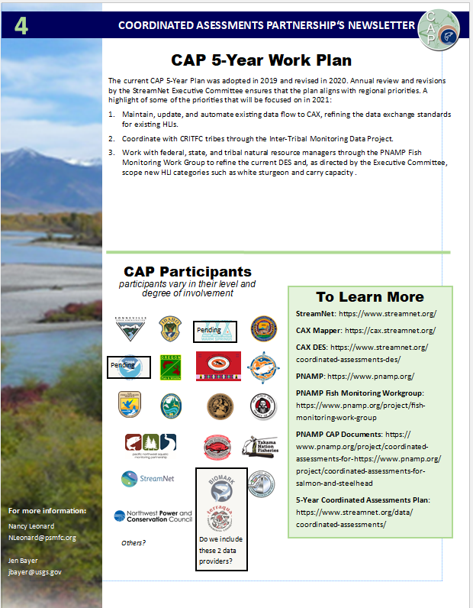
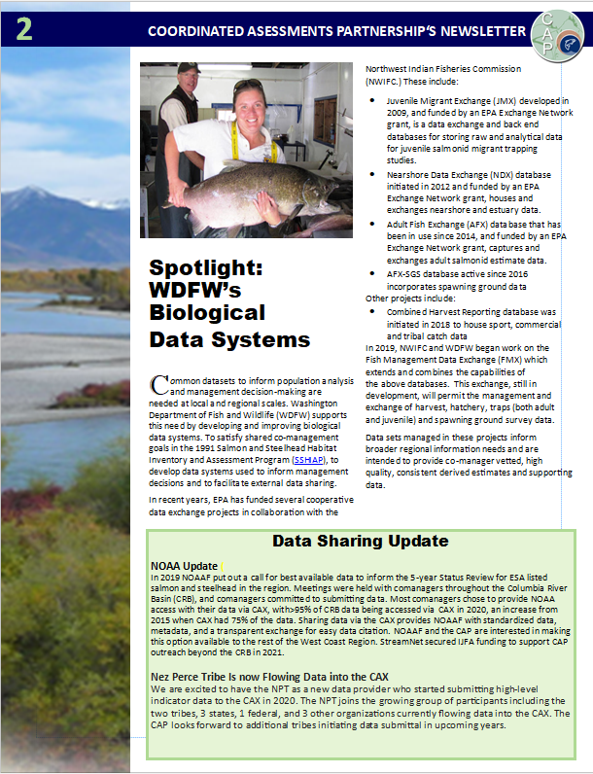
Share your Thoughts on the Newsletter
4 pages with fixed spaces for text and images
Twice a year
  First issue released November 2020
    Includes link to survey for input on first issue
  Second issue released prior to HCAX workshop (April / May 2020)
Emailed to CAP Outreach Forum and posted on StreamNet website
Logos shown on next slide

Slide 20
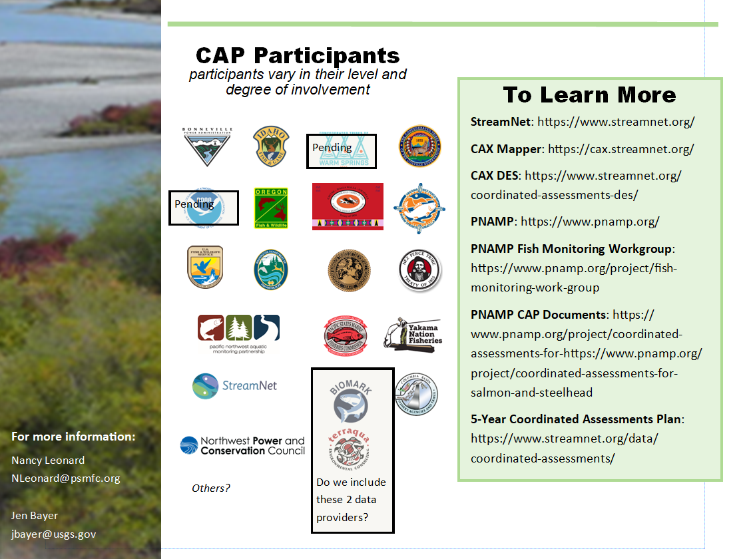
Share your thoughts on the Participant logos on page 4
Others?

Slide 21
Share your Input on Draft Survey Questions about the Newsletter
How relevant do you find the information in the newsletter?
  Select one answer ranging from ‘very relevant’ to ‘not relevant”
Please rate your satisfaction with the following attributes of this newsletter:
  Answer matrix allow selection of satisfaction with these 5 items: Length , Content, Layout , Images, Color
How often would you like to receive a new version of this newsletter?
  Select one answer ranging “once/yr; twice/yr; quarterly; other”
What can we do to improve the newsletter?
  [text box]
If you are interested in providing content for this newsletter please include your contact information below and general topic area:
  [text box for name, email, affiliation, topic]

Slide 22
Newsletter exercise revealed further need to clarify
More work needed to effectively communicate with new partners/participants such as:
  CAP definitions for who are and what is expected from Partners, Contributors, Participants
CAP Core Team will draft and share these and other items needed for communication with new partners/participants for your input once available.

Slide 23
Update HCAX 2020 EPA Exchange Network Grant
- Brodie, Jen, Nancy
White River, WA logjam project
Notes:
https://www.flickr.com/photos/150461980@N05/

Slide 24
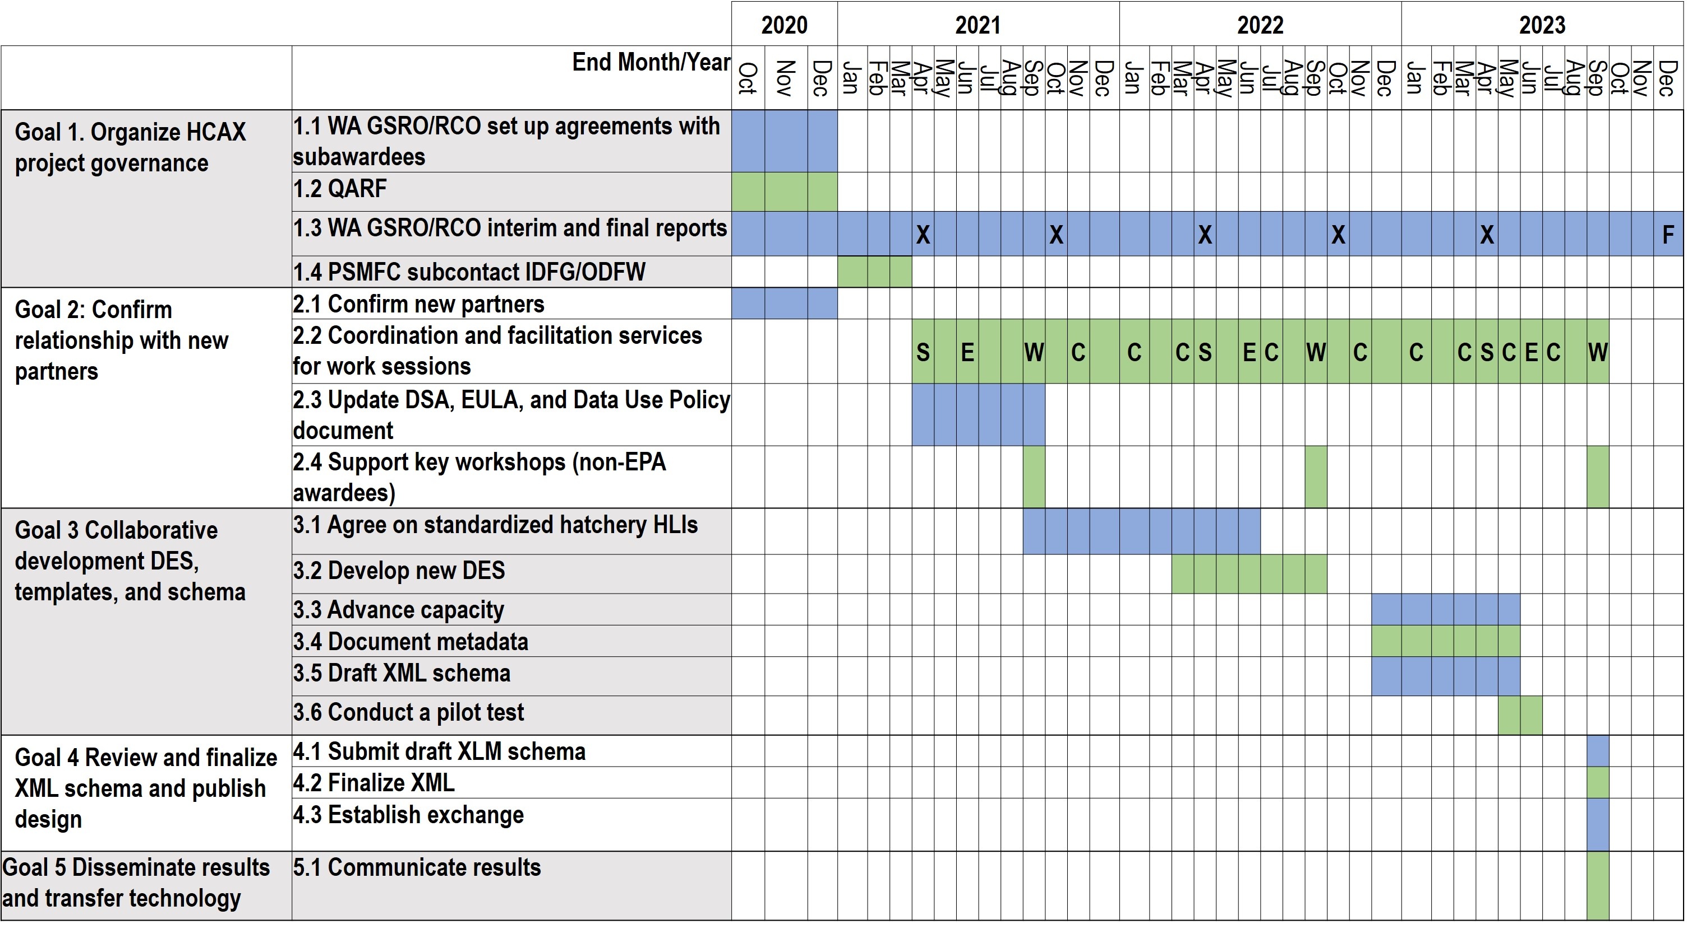
CAP and EPA Exchange Network Grant - Pacific Northwest HCAX
Project goal: provide access salmonid hatchery information through Coordinated Assessments Partnership
Project Partners: WA RCO/GSRO (grant adm.), PNAMP (facilitation), StreamNet (technical), CCT/ODFW/IDFG/WDFW (development and participation)
Legend
S
StreamNet Steering Committee
StreamNet Executive Committee
Workshop
Workgroup conference calls
EPA interim report
EPA final report
E
W
C
X
F

Slide 25
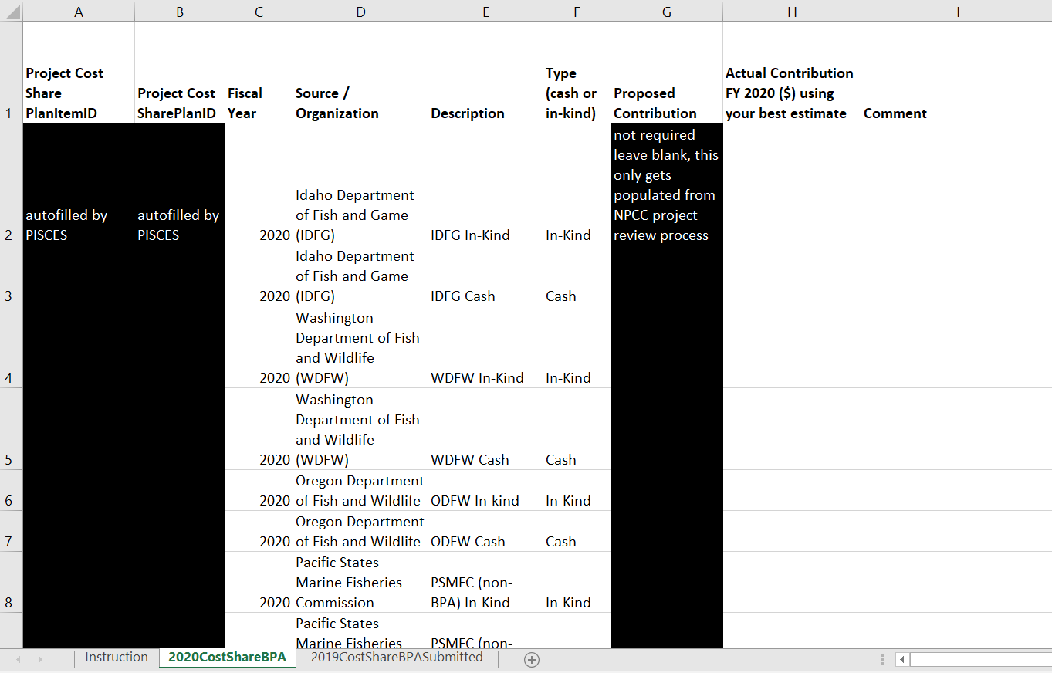
Upcoming 2 reports due to BPA (Nancy)
Cost Share Report send to Nancy by November 12th
  Nancy will send excel file to CCT, WDFW, IDFG, ODFW today (Oct 27th)after this meeting
    3 excel tabs: instructions/definitions, 2020 cost share, and 2019 cost share reported
  Nancy will submit to BPA November 15th
Cost Share Report send to Nancy by November 12th
  Nancy will send excel file to CCT, WDFW, IDFG, ODFW today (Oct 27th)after this meeting
    3 excel tabs: instructions/definitions, 2020 cost share, and 2019 cost share reported
  Nancy will submit to BPA November 15th
Annual Report
  Nancy will
    update the web-form with questions that align with report submitted last year
    Send link in January for CCT, WDFW, IDFG, ODFW, MFWP to complete by early February.
  Goal is to have draft report ready prior to our 2021 Steering Committee meeting
  Report due to BPA on April 4th

Slide 26
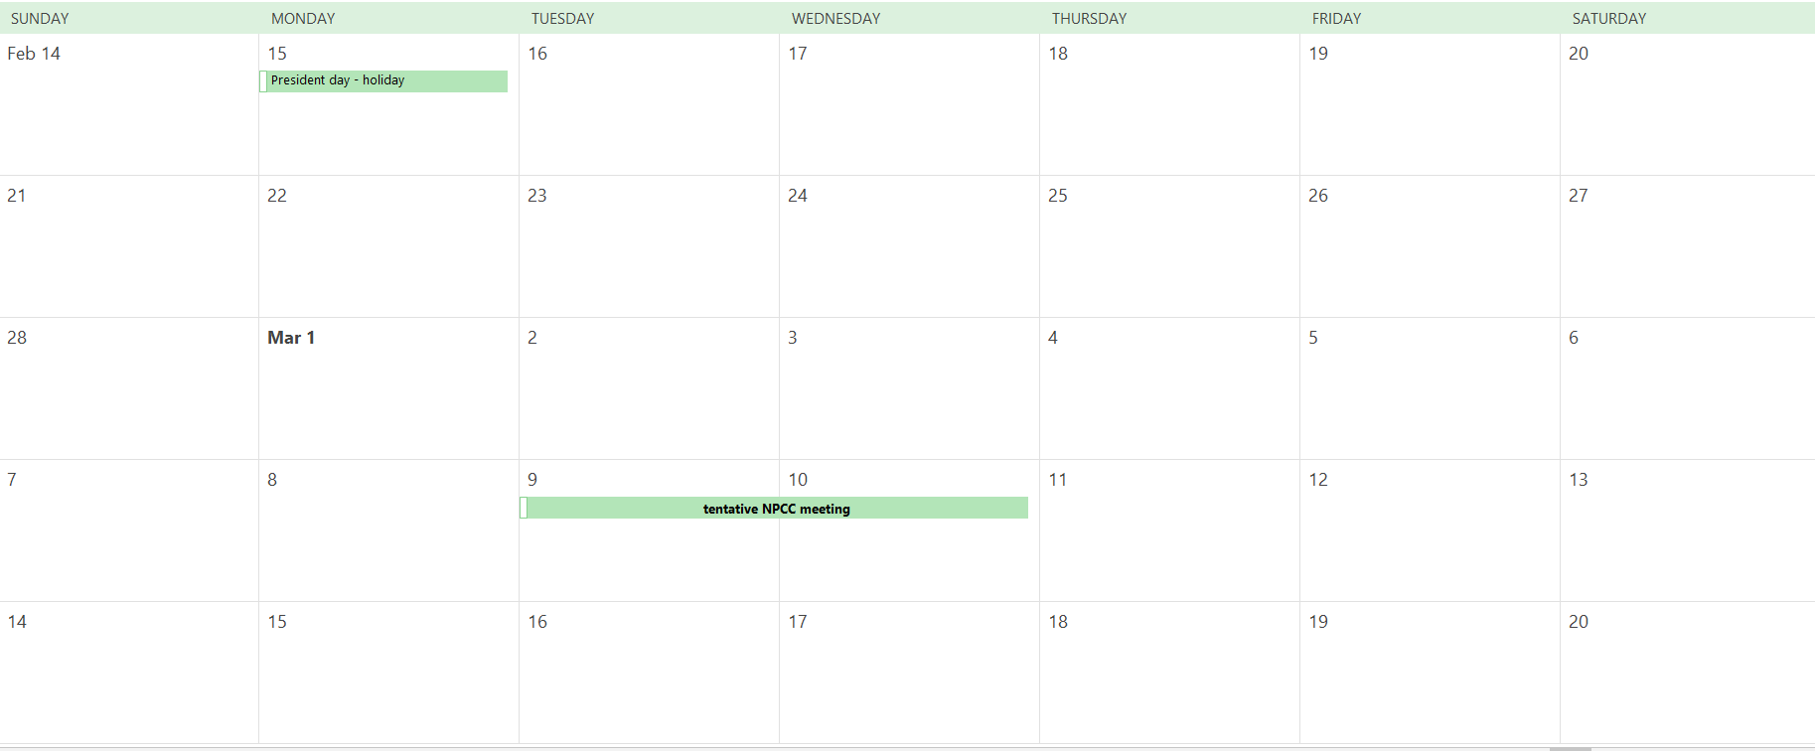
2021 StreamNet Steering Committee Meeting
(identify dates to avoid for doodle pool)

Slide 27
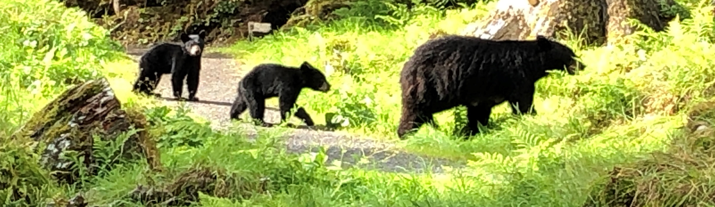
Adjourned
Anan Wildlife Observatory Site, USFS, Wrangell, Alaska

