Slide 1
Bull Trout Workshop
2014 Council’s Program Objectives Task and Discussing Data Opportunities
Missoula Montana
April 12, 2017
Remote Participation:
https://global.gotomeeting.com/join/892904389
Conference call: 800-356-8278, code 186685

Slide 2
Review Agenda
Time | Item
1:00 (MST) | Introductions (phone and in-person).
1:10 | Overview of workshop purpose and agenda.
1:20 | 2014 Council Program Objectives Task.
2:00 | Bull trout existing data and reporting needs. Council Program reporting; Discuss your needs
3:15 | Discuss opportunities and interest to share data. StreamNet data sharing example; Discuss your needs
3:45 | Next Steps
4:00 | Adjourn

Slide 3

Goals and Objectives Task

Slide 4
2014 Council Program Task
Refining Program Goals and Objectives
Purpose: inform and improve program goals, objectives and reporting indicators to convey
  status of focal species
  progress
Approach: step wise consisting of 4 broad groups
  Adult salmon and steelhead
  Other anadromous and resident fish
  Ecosystem function, habitat, and hydrosystem
  Public engagement

Slide 5
Group | Compilation Status | Not initiated | Initiated | Completed
1 | Adult Salmon and Steelhead |  | Discussions about hatchery origin facilitated by StreamNet-CA effort | Natural Origin https://www.nwcouncil.org/fw/program/maps/
2 | Bull Trout |  | March 2017
 | Cutthroat Trout | X
 | Kokanee | X
 | Lamprey | X
 | White Sturgeon | X
 | Eulachon | X
 | Other focal species | X
3 | Ecosystem Function / habitat / Hydrosystem | Partially | PNAMP RHIP 2016 (Aquatic habitat) https://www.pnamp.org/project/3149
4 | Public Engagement | x

Slide 6
2014 Council Program Task
Refining Program Goals and Objectives
Process: working with others survey, collect, and identify goals & objectives.
  Review existing sources:
    All existing Columbia River Basin documents
    2014 Council Program recommendations.
  Compile: as appropriate, objectives that
    can be informed by existing monitoring and other available data;
    consist of numbers, numerical ranges, densities', trends direction, or other measurement types;
    are specific, measureable, attainable, relevant, time-bound, and based on explicit scientific rationale;
    Does not preclude qualitative objectives

Slide 7
Bull Trout
Preliminary Document Review and Compilation
Searched
  Publications from 1991 to 2017
  Text that ‘sounds’ like a target for decisions related to Bull Trout habitat, recovery, management, etc.

Slide 8
Bull Trout
Preliminary Document Review and Compilation
Searched
Identified 179 documents that may have goals and objective-like text, authored by:
ACOE | Blackfoot Challenge | IDFG | NMFS
BLM | Clark Fork Coalition | LCFRB | NPCC
BPA | Coeur d’Alene Tribe | MFWP | ODFW
BOR | Hood River Watershed | USFWS | SPT
CBFWA | Powder Basin Watershed Council | USFS | PUD Chelan
CSKT | YN Subbasin FW Planning Board | UCSRB | PUD Douglas
NPT | MT Bull Trout Scientific Grp | WA GSRO | YN
WDFW | MT Bull Trout Rest^{n} Team | SBT

Slide 9
Bull Trout
Preliminary Document Review and Compilation
Searched
Identified 179 documents
Document Type:
  Subbasin plans, recovery plans, restoration plan, Biological Opinion, Oregon Native Fish Status Report, Master Plan, Action Plan, etc

Slide 10
Bull Trout
Preliminary Document Review and Compilation
Searched
Identified 179 documents
Document Type
Variables
Goal | Objective | Abundance
Recovery Goal | Task/action | Abundance criteria
Return Goal | Conservation objective | Abundance objective
Recovery Criteria | Productivity objective | Abundance target
Criteria | Productivity criteria | Strategy
Spatial structure/ diversity criteria | Spatial structure/ diversity objective | Vision

Slide 11
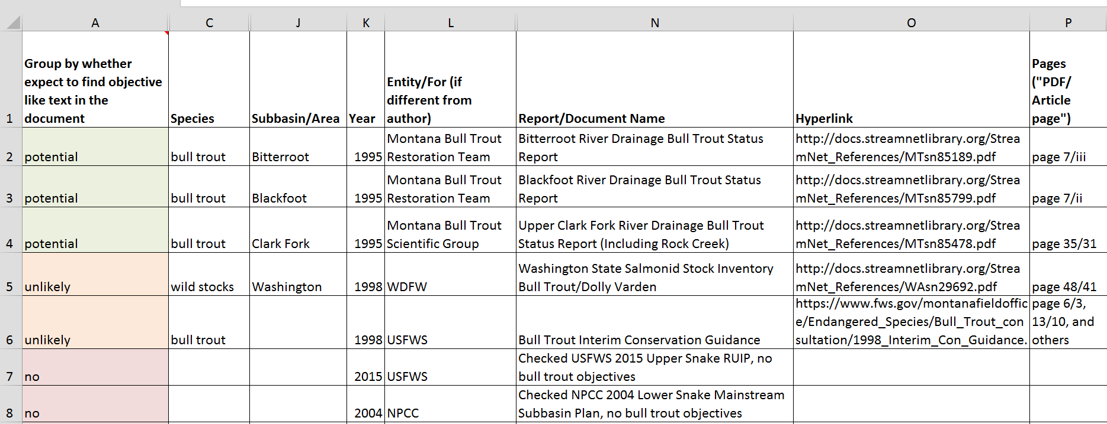
Bull Trout
Preliminary Document Review and Compilation
Searched
Identified 179 documents
Document Type
Variables
154 of 179 documents will be reviewed in-depth
  101 documents promising to have desired text
  53 documents unlikely to have desired text but will review
  25 document excluded since no text-matching criteria

Slide 12
Bull Trout - Sample Extraction
Variable | Statement | Entity
Vision | Washington lower Columbia …bull trout are recovered to healthy, harvestable levels that will sustain productive … fisheries … | LCFRB 2010
Objective | Maintain and/or restore viable populations of bull trout within the three major population groups in the Blackfoot Subbasin | Blackfoot Challenge 2014
Abundance Target | Abundance target of 1,000 adults, distributed in the West Fork, its tributaries, and mainstem Klickitat River | YN, WDFW 2008
Criteria | (within 15-25 yrs) abundance of Upper Columbia bull trout will increase and maintain a 12-year geometric mean of 4,144-5,402 spawners … (Wenatchee 1,612-2,257; Entiat 298-417; Methow 1,234-1,728) | UCSRB 2007
Objective (aka Recovery Goal in Subbasin Plan) | Conserve genetically diverse populations of bull trout populations within the Malheur Recovery Unit. This can best be achieved by ensuring connectivity between the North Fork Malheur River and the Upper Malheur River. | USFWS 2002
Notes:
Chapter 14, Malheur Recovery Unit, Oregon
Malheur River Subbasin Assessment and Management Plan For Fish and Wildlife
Mitigation Recovery Plan for the Coterminous United States Population of Bull Trout
Draft Malheur Subbasin Summary
Blackfoot River Watershed Restoration Plan
A Water Quality Addendum to the Blackfoot Subbasin Plan Chapter K,
North Fork Lewis Subbasin in Washington Lower Columbia Salmon Recovery and Fish & Wildlife Subbasin Plan
Upper Willamette Basin Bull Trout Action Plan 2010
Bitterroot Subbasin Plan for Fish and Wildlife Conservation: Executive Summary
Blackfoot Subbasin Plan
Klickitat River Anadromous Fisheries Master Plan
Upper Columbia Spring Chinook Salmon and Steelhead Recovery Plan
John Day Subbasin Revised Draft Plan 2005
Oregon Native Fish Status Report Volume II Assessment Methods & Population Results
Yakima Subbasin Salmon Recovery Plan
Asotin Subbasin Plan
BItterroot Subbasin Management Plan for Fish and Wildlife Conservation
Boise, Payette, and Weiser Subbasins Management Plan
2014 Program recommendations
The U.S.Fish and Wildlife Service's Biological Opinion assesses impacts of Federal Columbia River Power System Operations on Kootenai River white sturgeon and bull trout, both threatened species protected under the Endangered Species Act.

Slide 13
We Need your Assistance
By June 30th
Provide documents missed that we should review
  Include web-link or document
Identify documents superseded by newer documents
  Indicate the documents and their relationship
Suggest change to publication year range
  Should we go further back in time?
Draft document list: https://nwcouncil.box.com/s/fj82izyn3evoi8lf72pyq2x3v89o3hfg

Slide 14
Next Steps
April-November 2017 Council staff with QW Consulting will
  Revise list of documents and extract objective-like text
  Explore organizational approaches
Fall 2017 – Early 2018
  Revisit objectives and organization structure with you
Prior to April 2018
  Demo mapping tool reviewed and revised with your input
    Example Salmon and Steelhead objectives mapping tool https://www.nwcouncil.org/fw/program/maps/
Mid 2018
    Finalize online map and query tool
Ongoing
    Content will be revised as needed by Council staff with co-manager oversight

Slide 15
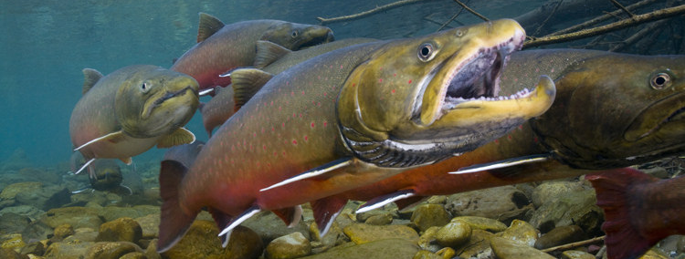
Questions?

Slide 16
Bull Trout Existing data and reporting needs
Council Program’s needs
Your reporting needs

Slide 17
Council Program’s
Bull Trout Info and Reporting Needs
Tracking the status of the basin’s fish and wildlife species
https://www.nwcouncil.org/fw/program/2014-12/program/parttwo_introduction/v_tracking_status_of_resources/
  To provide context for Program funded work
  Status and trend displayed on Dashboards, Fish Information Site, and HLI site
Use Program indicators to report progress towards Program goals and objectives (program, subbasin, and other scales)

Slide 18


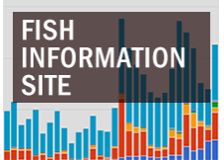
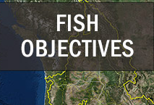
Council’s Program
Bull Trout Info and Reporting Needs

Slide 19
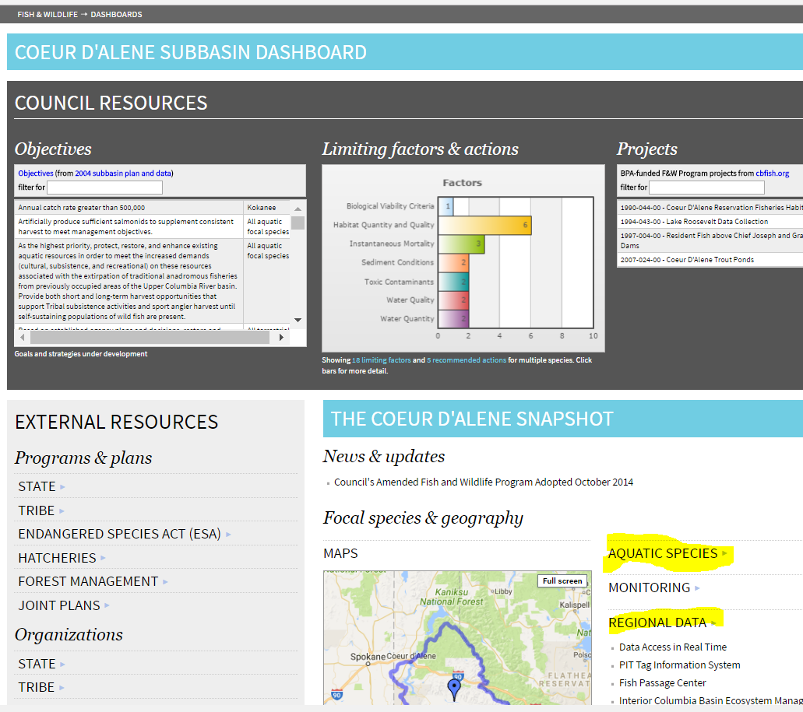
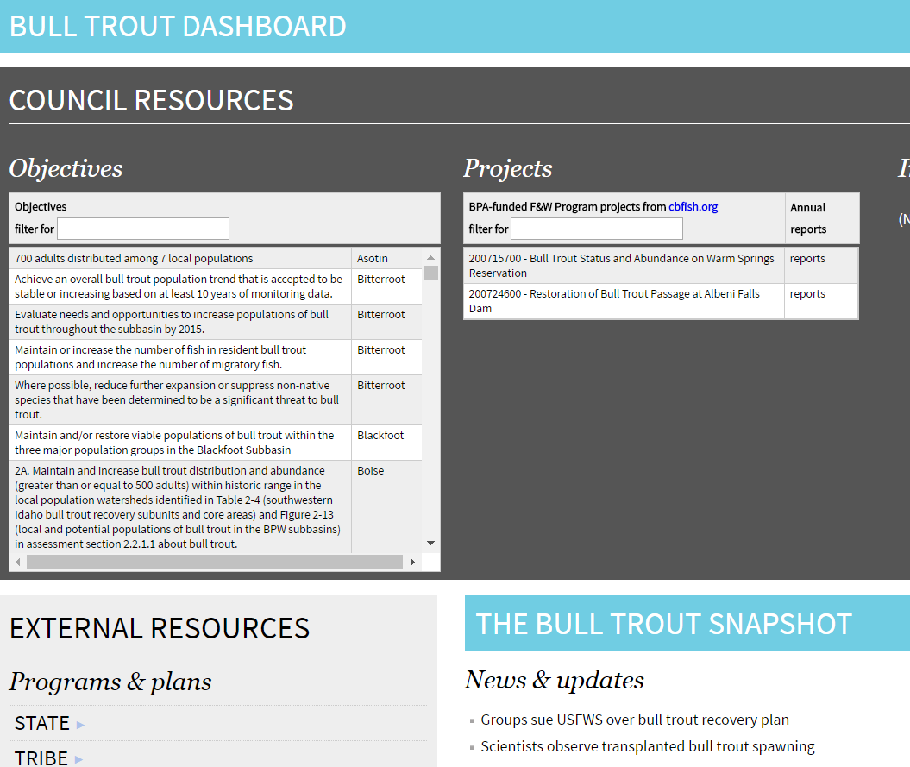
Council’s Program
Bull Trout Reporting Needs
https://www.nwcouncil.org/ext/dashboard/

Slide 20
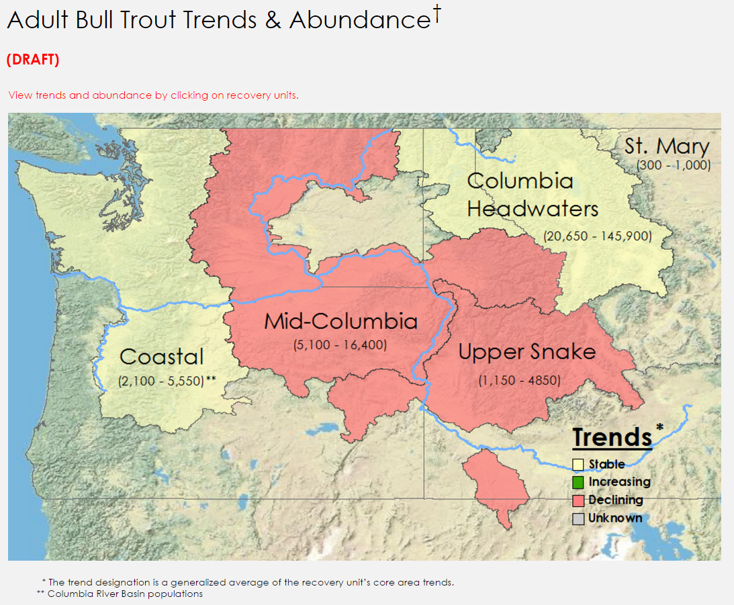
Council’s Program
Bull Trout Reporting Needs
https://www.nwcouncil.org/ext/hli/index.php

Slide 21
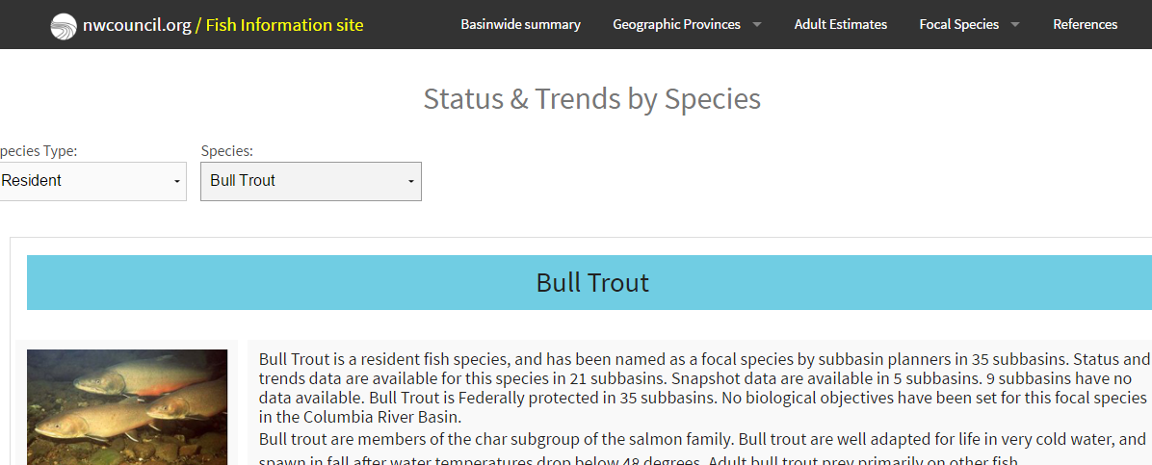
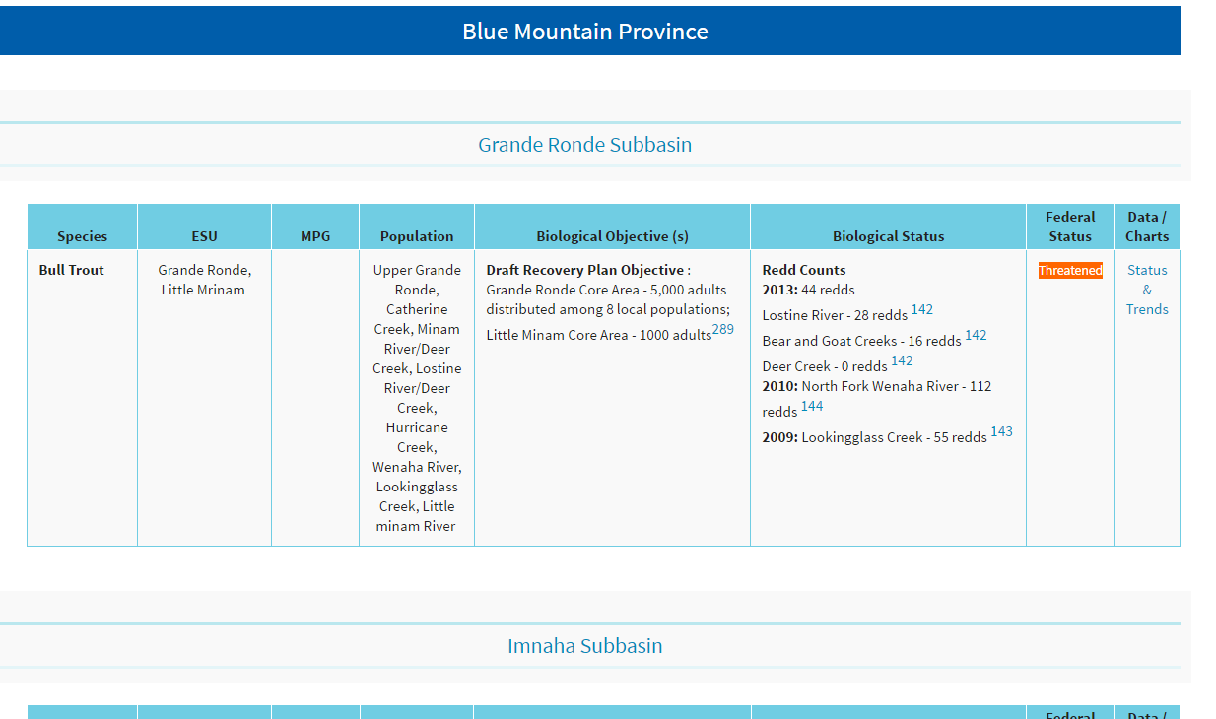
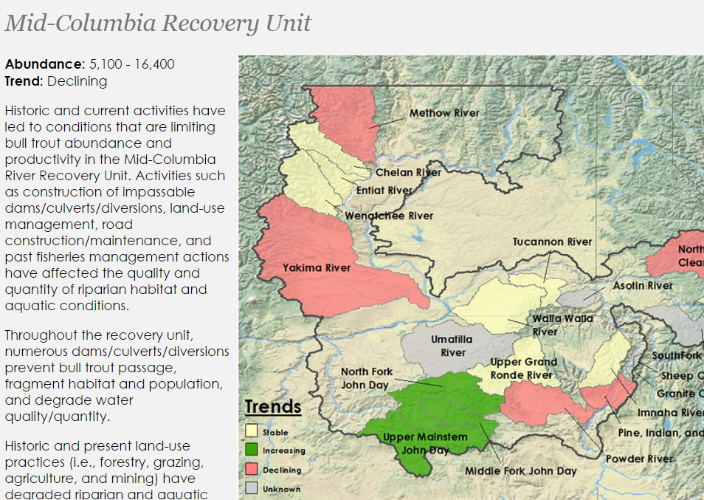
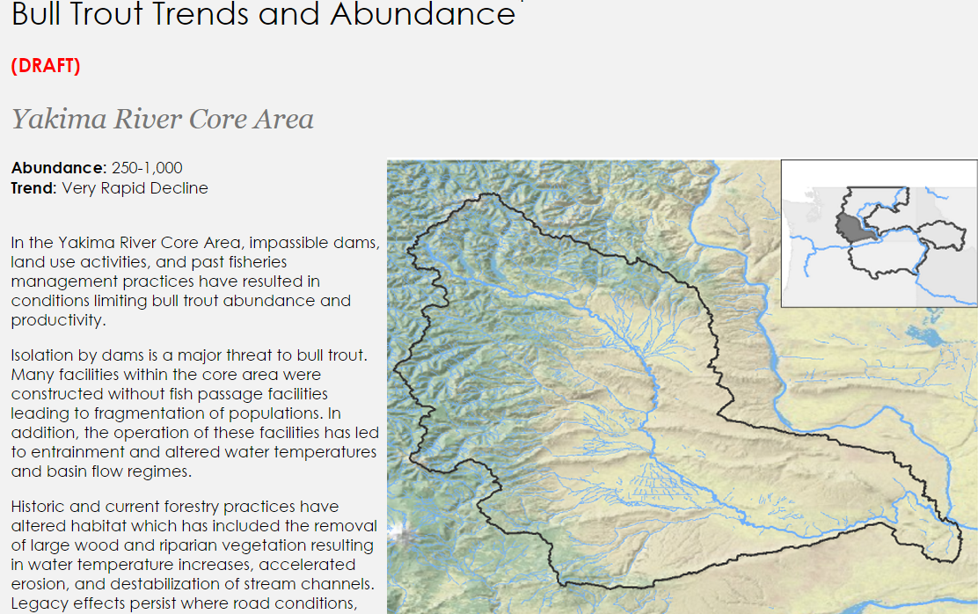
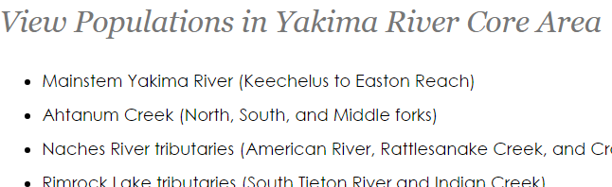
https://rs.nwcouncil.org/fs_StatusTrends.cfm?mnu=fs&species=10&sptype=Resident

Slide 22

Your Bull Trout
Existing data and reporting needs
Input from participants about
organization’s current and outstanding reporting needs
5-min per organization
databases, tools, web-reporting, etc.

Slide 23
sharing data
Example from StreamNet (CA)

Slide 24
Bull Trout Data Sharing
Example Approach from Coordinated Assessments Project
April 12, 2017
Missoula, Montana

Slide 25
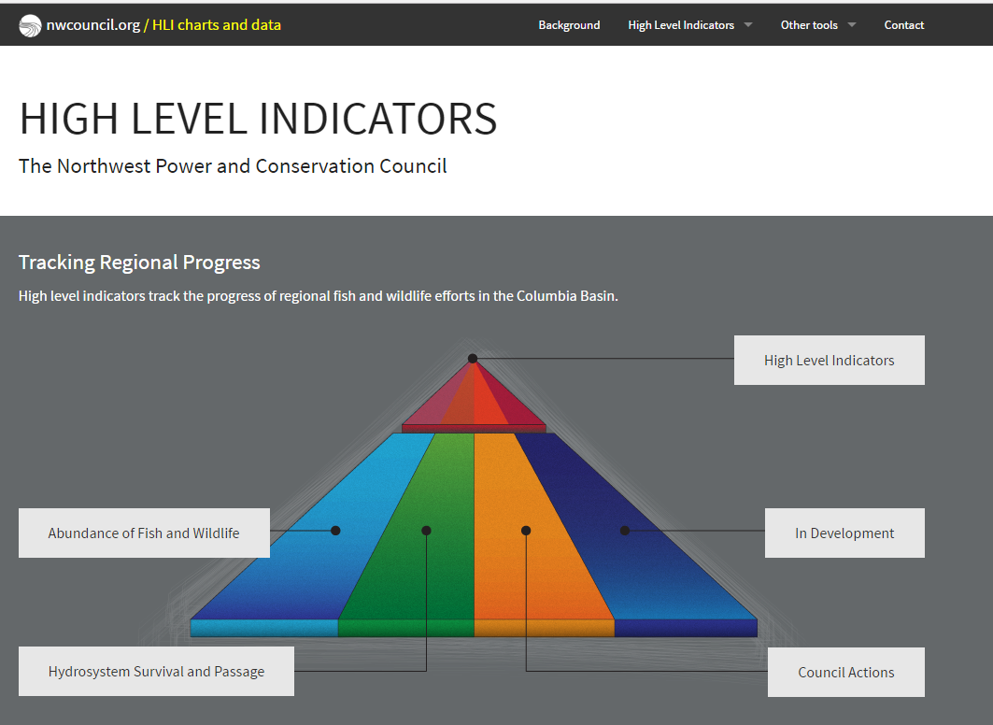
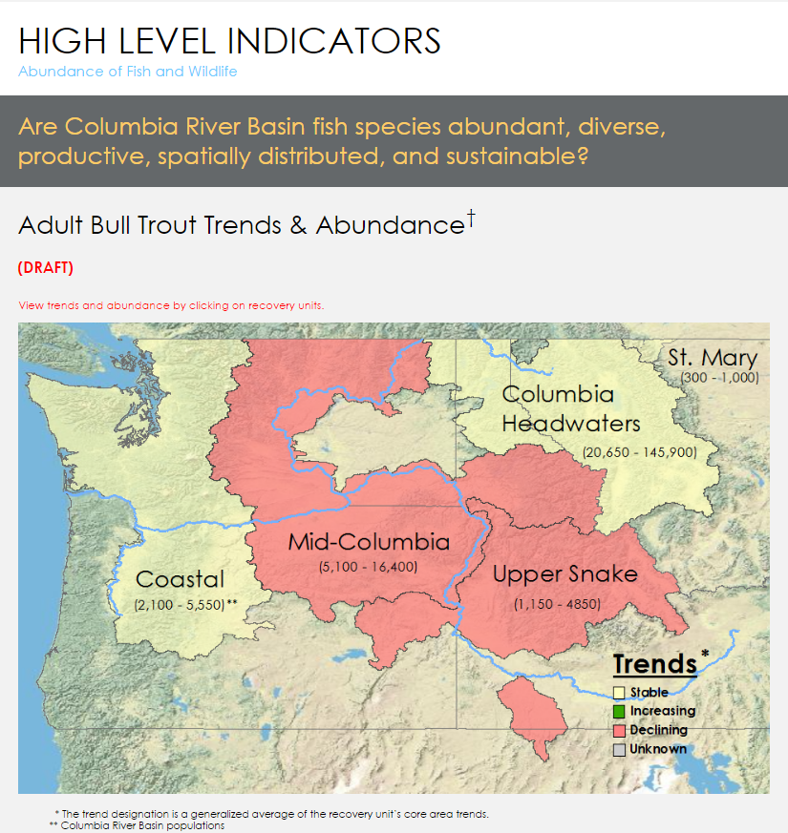
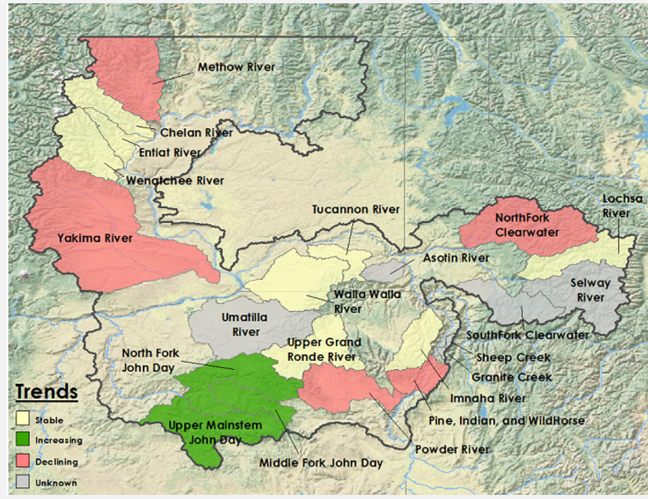

What is the value of coordinated data sharing?
To inform;
  cross-jurisdictional management assessments
  recovery progress
  regional reporting requests (e.g. Council’s Bull Trout HLI and supporting graphics)

Slide 26
Coordinated Assessments – Historical Perspective
Coordinated Assessments Project started in 2010 with the goal of improving the timeliness, reliability and transparency of the Salmon and Steelhead data necessary for regional assessments and management decisions
At that time the project identified specific actions and activities for sharing Viable Salmonid Population (VSP) indicators in the Columbia River Basin. Important to note that sharing data was for a common goal: to provide data to NOAA for their 5 year status review
In 2015 – we started sharing data on first five VSP indicators;
  Natural Origin Spawner Abundance
  Recruits per Spawner
  Smolt to Adult Ratio
  Juvenile Abundance: Outmigrants
  Presmolt Abundance

Slide 27
CA Focus: Getting Data for listed Salmon & Steelhead Populations for NOAA Status Reviews
BPA also requested assistance from StreamNet and the region’s fish managers to maximize data flow for certain populations identified as priorities by BPA for BiOp reporting in 2016. Continued interest from Bonneville in getting as much data as possible for these populations – remains a CA focus
If Data is not available at the population level, we work with the data providers to obtain the best available data for these populations into the database
Managing Data Exchange Standards (DES) and adopting changes thru a DES team approach
Hatchery Indicators, Bull Trout, other species as per a 5 year plan
A downloadable database not easy for the public and policy folks to access. Working on more user friendly displays of information, often map based

Slide 28

2016 Data Flow – all Populations
 | All Coordinated Assessments Populations |  | 200 TRT Populations
High Level Indicator | Reported with HLIs | Years with HLIs | Reported with HLIs | Years with HLIs | % of TRT Populations w/HLIs Submitted
Natural Origin Spawner Abundance | 155 | 3,908 | 112 | 3,290 | 56%
Recruits per Spawner | 86 | 2,652 | 65 | 2,295 | 33%
Smolt to Adult Ratios | 33 | 449 | 12 | 120 | 6%
Juvenile Outmigrants | 33 | 476 | 32 | 451 | 16%
Presmolt Abundance | 6 | 78 | 6 | 78 | 3%
All HLIs | 313 | 7,563 | 227 | 6,234
200 TRT Populations are in 'Interior Columbia' & 'Willamette/Lower Columbia' Recovery Domains, and exclude extirpated populations. March 30, 2017
*Publishable records are validated and have Publish=‘Yes’.

Slide 29
Lessons from Coordinated Assessments (CA)
Investment of time worth it if staff is repeatedly tasked with data requests
Investment in data structure and database management eases access
Standardizes data sets and avoids “conflicting” information
Focuses managers on information and resource gaps when available data is all shared in one place
Reduced time needed to provide data for NOAA ESA 5-yr status review
Facilitates action agency BiOp reporting needs, e.g. Bonneville need for data on BiOP populations
Provides data for Council indicators

Slide 30
CA Project Work Teams and Work Flow
CA Core Team
StreamNet Executive Committee
Coordinated Assessments
Work Group (CAWG)
StreamNet Steering
Committee
DES Development
Team (DDT)
StreamNet Technical
Team

Slide 31
“Core Team” - 4 or 5 key individuals that work to keep the project moving. Needs to be
a job function to get this done
“Executive Committee” - Policy/decision makers at agencies, tribes, etc. with
management responsibility (and/or funding). Need to recognize that data sharing
is useful, worth the effort, and helps agency mission and function
“DES Development Team” – the biologists/managers that know and analyze the data. Need
to recognize that data sharing makes their lives easier
“Steering Committee” – the data management staff in agencies/tribes that load and QC the
data. Need the technical ability and support to build and manage the agency database so that
it also shares data without the “sharing” becoming a major additional workload
“Coordinated Work Group” – periodic group meetings/workshops where everyone comes
together to work on the project

Slide 32
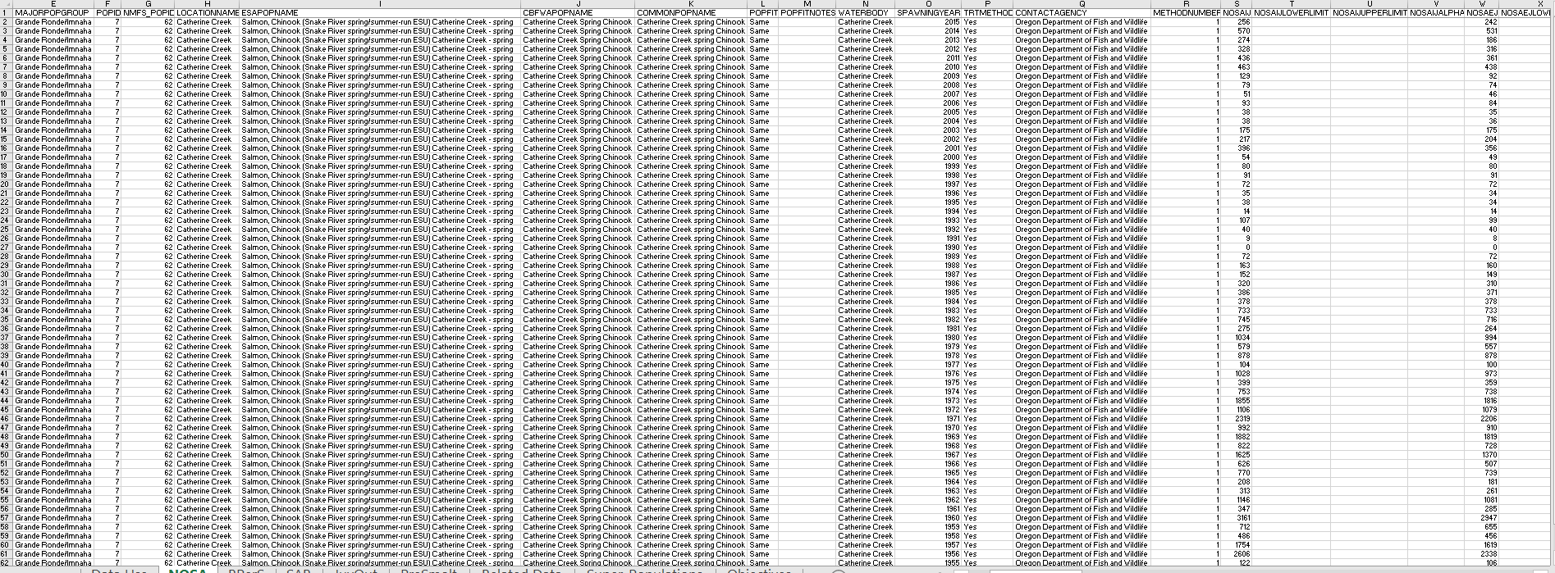
Just in case you think this is a really exciting topic – our
Downloadable Database…

Slide 33
“Traditional” website use is fairly stable, but automated sharing and consumption of data increasing rapidly

Slide 34
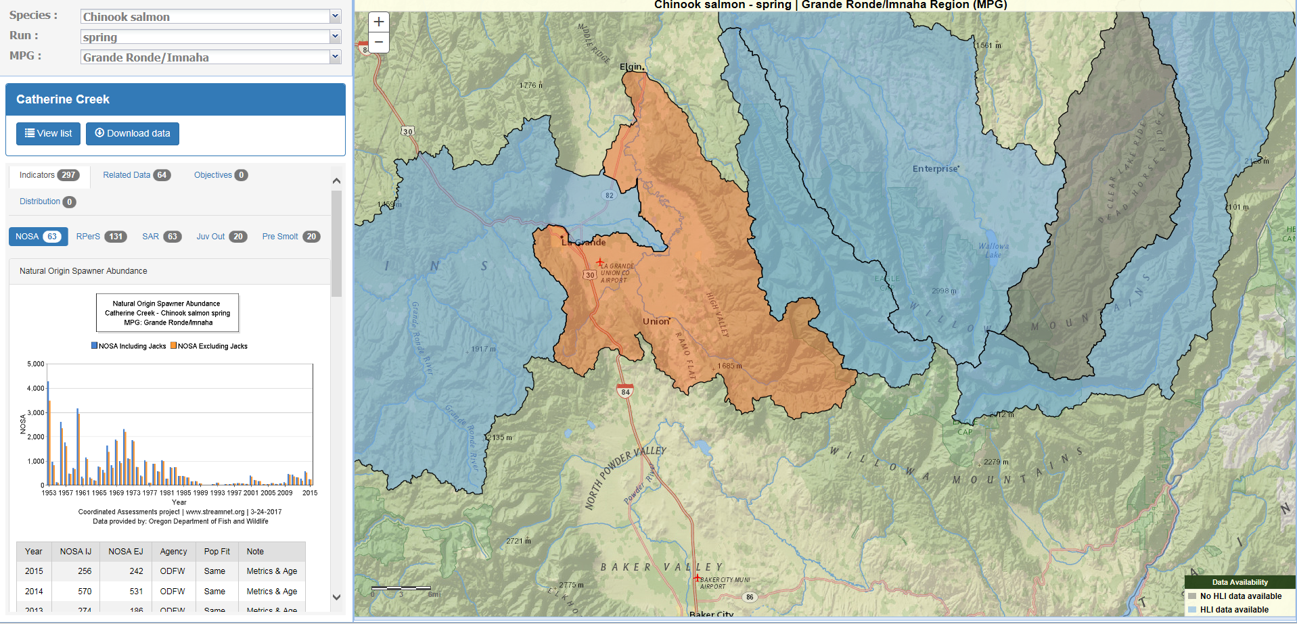
Will share Council Objectives here
Data/Graph is captured and exported to Council Objectives website

Slide 35
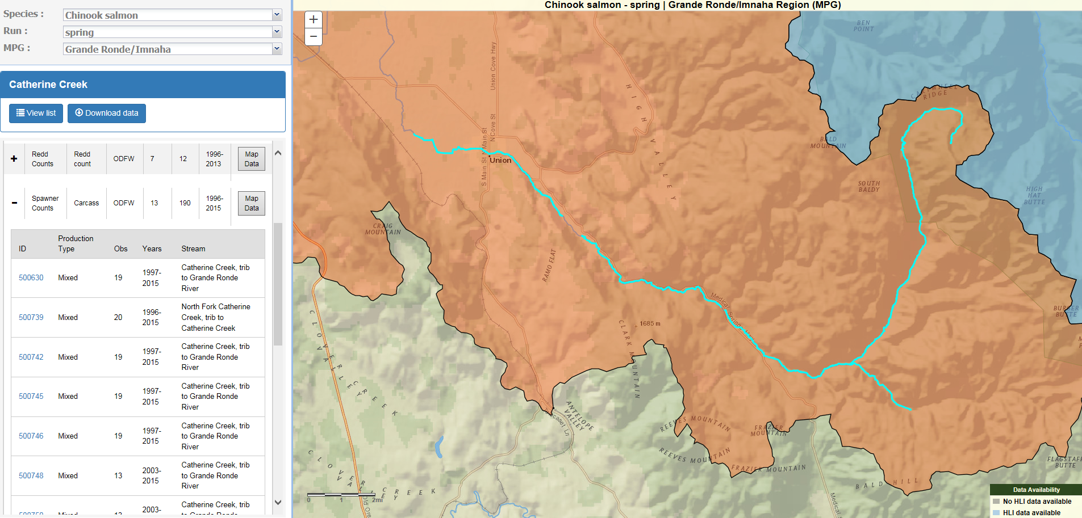
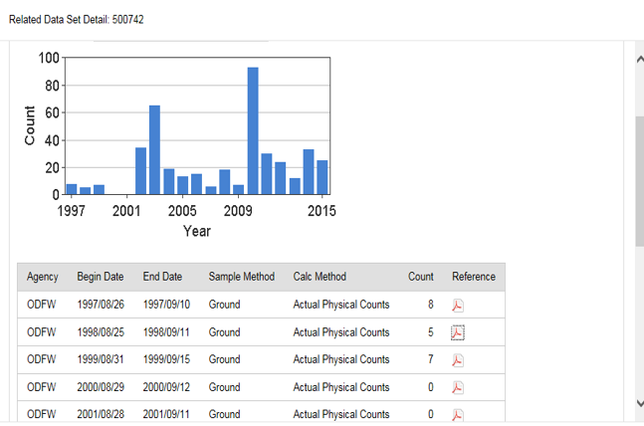
Traditional StreamNet “Abundance Trends” – now “Related Data” more granular understanding by placing data in the CA population indicator context

Slide 36
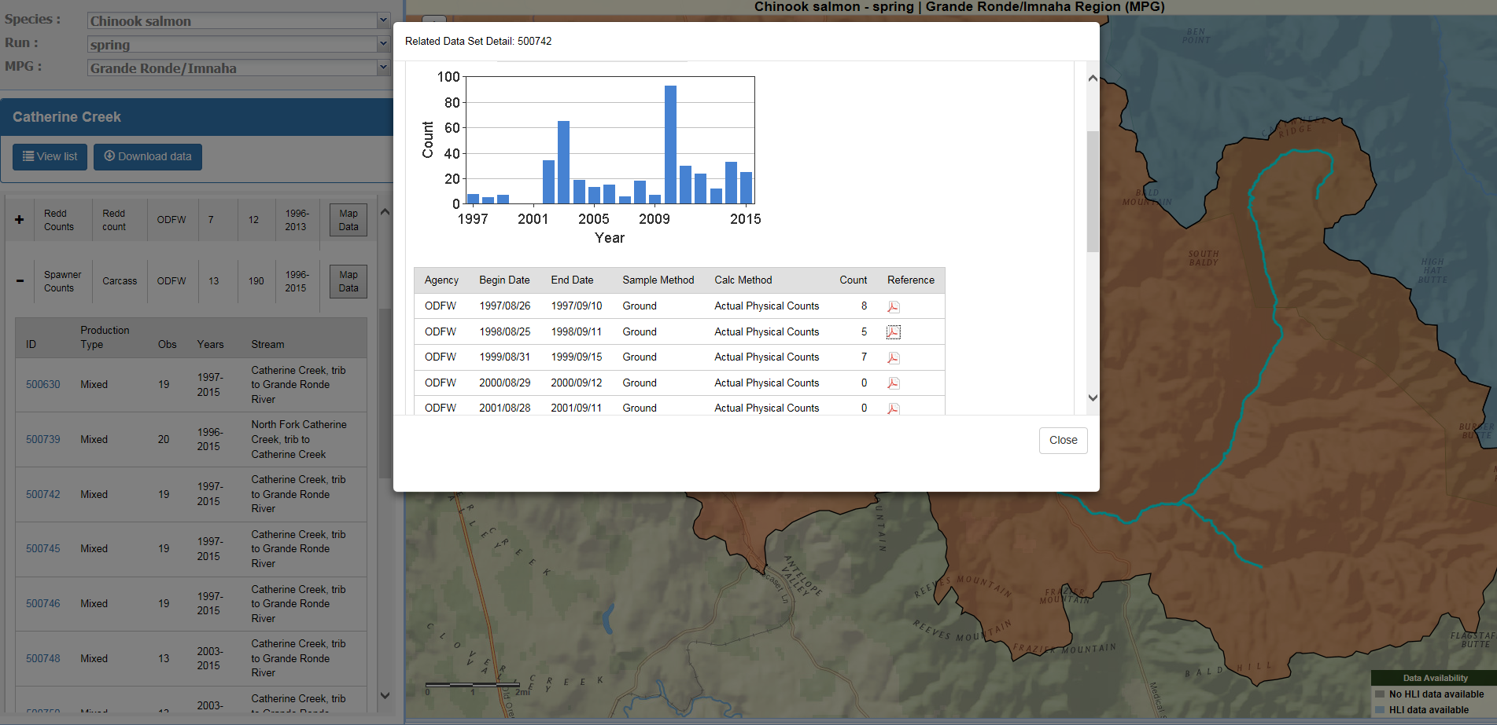
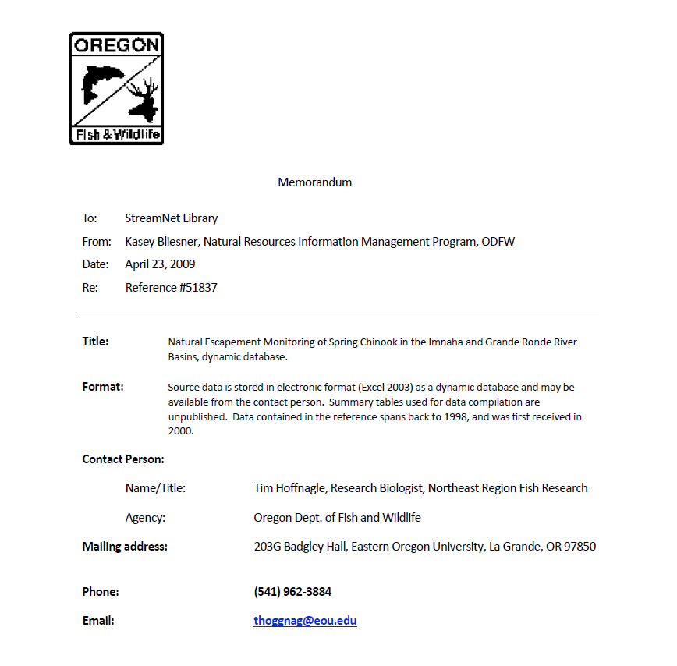
“Related Data” attribution is project by project, linked to pdf in StreamNet library – traditional bibliographic citation system (though more and more just a reference to data in a database)

Slide 37
Bottom Line
It takes a lot of coordination to get data reported in the same way across agency and state boundaries
There needs to be a data need “pull” to incentivize working across organizational boundaries. If each organization’s data needs are already met internally – why do extra work?
There needs to be structured data that is similar across Geographic and agency boundaries
Key participants are the biologists/data experts in each organization that collect data – they need to work together on the DES team to agree on the data exchange standards if this is going to work
It can be difficult to “automate” calculation of indicators, due to changing conditions and high level of analysis that goes into estimating parameters at the population scale

Slide 38
Why are we here ?/ What’s next?
The CA Five Year Plan:
Focus on data for Natural origin salmon & steelhead indicators
Hatchery data
bull trout – Missoula workshop with NPCC
Lamprey, sturgeon, Resident trout
For Bull Trout, we want to Explore interest
Determine if Data needs support continued discussion
Make sure Bull trout fisheries managers lead any discussion

Slide 39
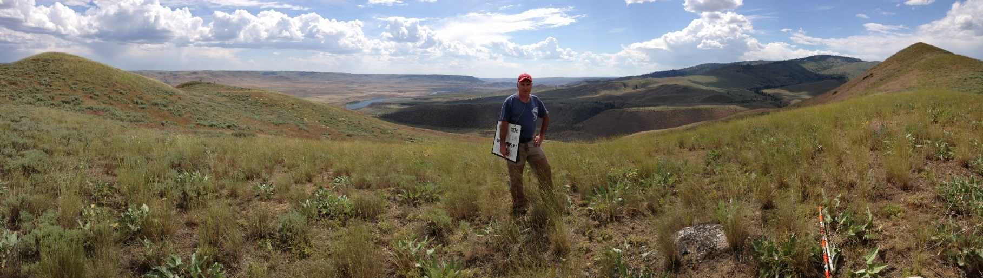
Questions?

Slide 40
Discussion
Opportunities and interest to share data
All participants – open discussion

Slide 41


Slide 42
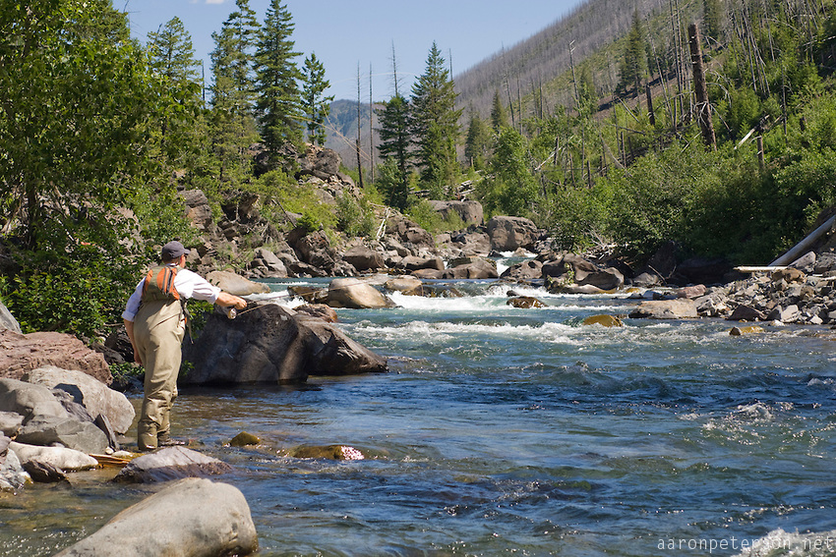
Adjourn

