Slide 1



Products of Key Management Question 1
Current Conditions and Limiting Factors
CHaMP and ISEMP State of the Science Workshop
Portland, Oregon – February 25th and 26th, 2014
Presenter:
Nick Bouwes
Collaborators:
CHaMP and ISEMP Coordination Team

Slide 2
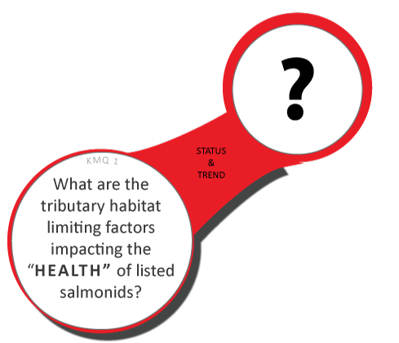
KMQ 1: Summary Products
Condition/
Limiting Factors
Maps
Notes:
Chris gave a quick overview of the framework of how we are tying the collection of data to key management questions, and products that are expected to help inform those products. Now we are going to dive into the a little more detail how we make these links, and I will be starting with a brief description of how and what we producing in KMQ1- or what is the current condition and limiting factors of fish and their habitat

Slide 3
Work Flow
Improve on
fish-habitat
relationships
Collect data
(habitat
and if possible fish)
Describe components of fish habitat
Translate habitat to fish response
Extrapolate across the watershed
Evaluate population level response
DATA→ METRICS→ INDICATORS→ SUMMARY PRODUCTS
Notes:
This is reminder of the general work flow for many of the products we are going to present. Without getting into the details, I will quickly outline how we go from data collection to population level response. This parallels Chris description of the data life-cycle where we move from raw data, to metrics, indicators to summary products

Slide 4
Work Flow
Improve on
fish-habitat
relationships
Collect data
(habitat
and if possible fish)
Describe components of fish habitat
Translate habitat to fish response
Extrapolate across the watershed
Evaluate population level response
Restoration
Notes:
As we will discuss later, we also have to link the effects of restoration on fish habitat to fish responses.

Slide 5
Work Flow
BRT
SEM
CHaMP
Hydraulic Model
RBT
GUT
NREI
HSI
HQI
GRTS
Network Models
Life Cycle Models
DATA→ METRICS→ INDICATORS→ SUMMARY PRODUCTS
Notes:
Here are examples of tools already developed to address these steps in the work flow, where we are creating. For example, we have developed hydraulic models, river batheymeytry tool kit, geomorphic unit toolkit to automate extration of data from the DEM to metrics. We are using various statistical tool such boosted regression trees and SEMs to evaluate factors describing fish abundance, growth and survival. We use NREI, HSI, Hqmodels to summarize metrics to more derived metrics. And methods to roll this up to watershed and population

Slide 6
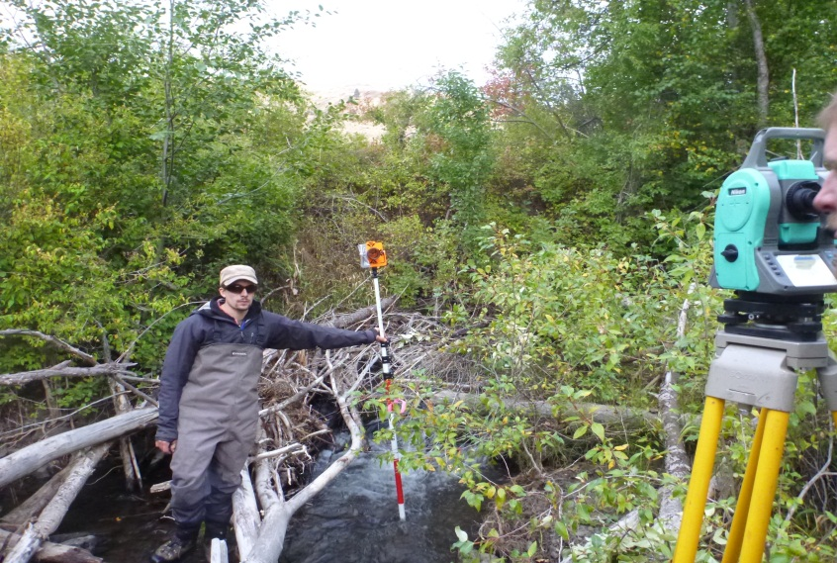
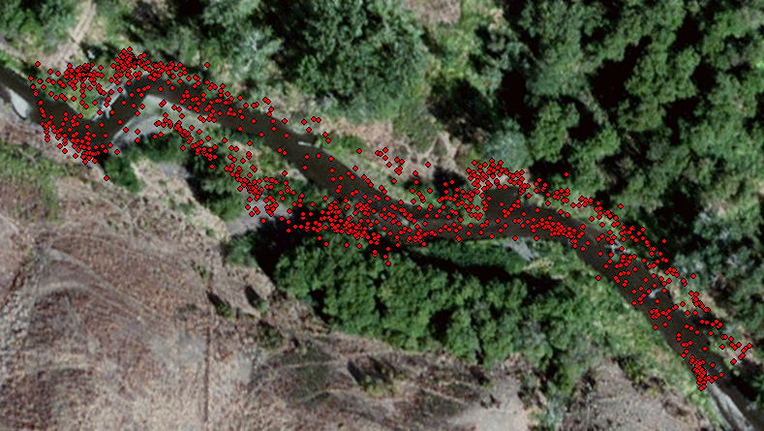
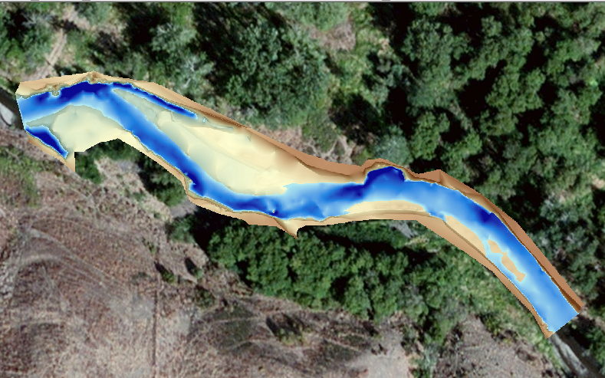
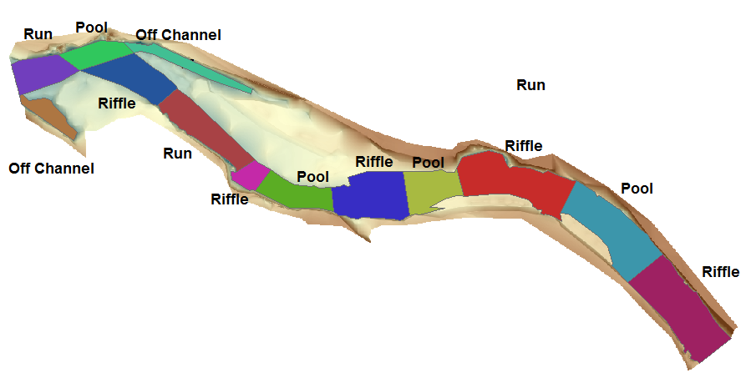
Collect data: CHaMP Habitat Survey
Notes:
So I will go through some of these steps in CHaMP is where we get the majority of our reach level information. As many of you are aware, we describe the reach planform with a total station, which is represented a DEM, delinate channel units, and collect both reach and channel unit attributes like LWD, substrate, cover, bugs, temperature, and riparian structure

Slide 7
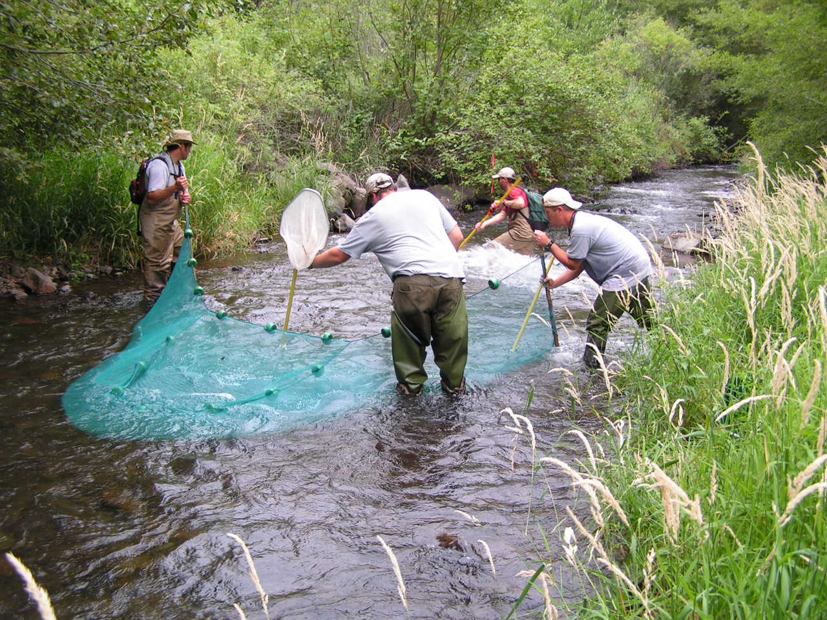
Collect data: CHaMP Habitat Survey
Collect data: Fish Survey
Notes:
In several locations we have paired our habitat surveys with fish surveys.

Slide 8
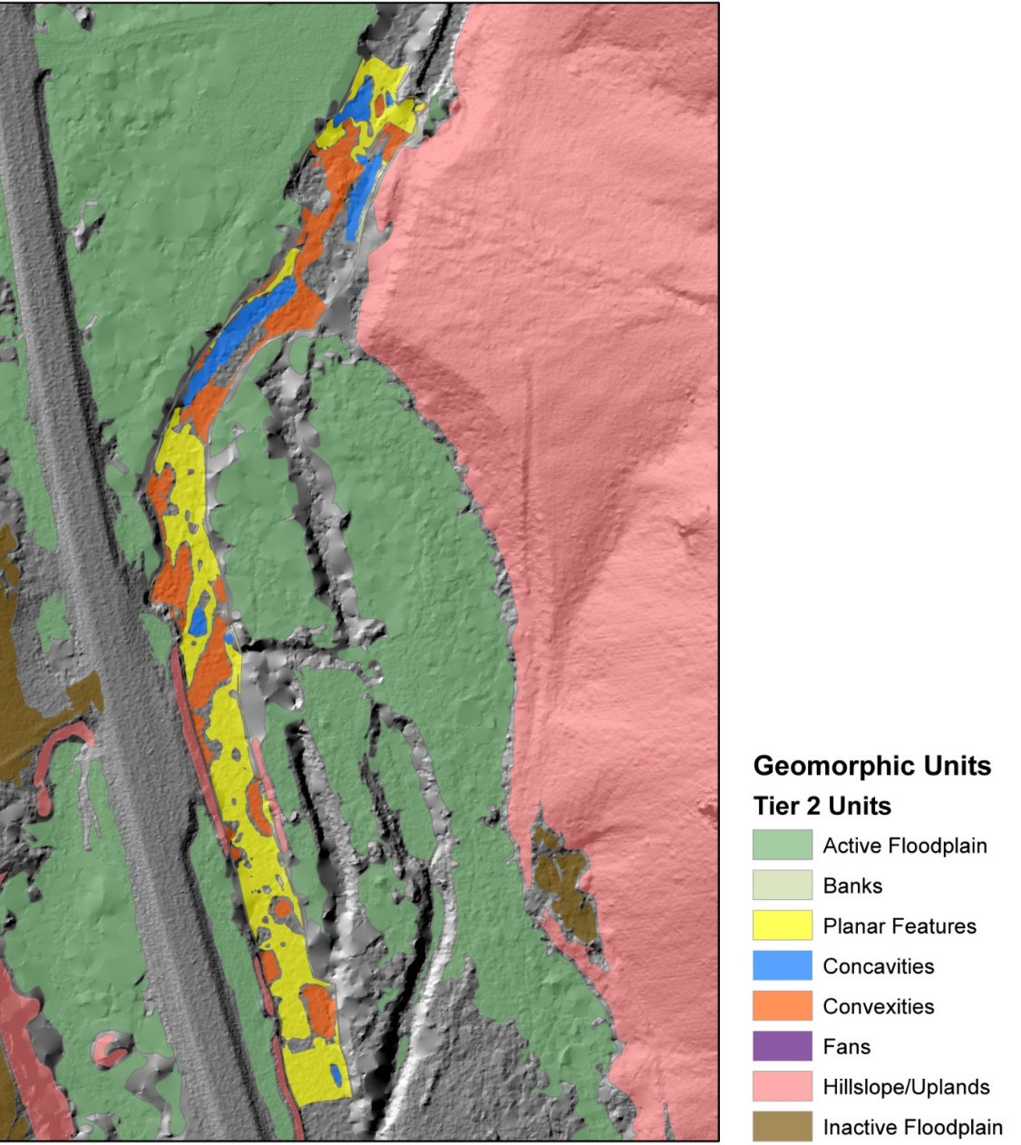
Components of Fish Habitat
e.g.
Channel Units
Depths
Velocity
Substrate
Structure/Cover
Notes:
When then turn this data into characteristics important fish- metrics. Here is an example of a CHaMP DEM seamlessly stitched into available LIDAR derived DEM. We have developed tools that delineate channel units such as pools a riffles in an automated fashion directly from DEM.

Slide 9
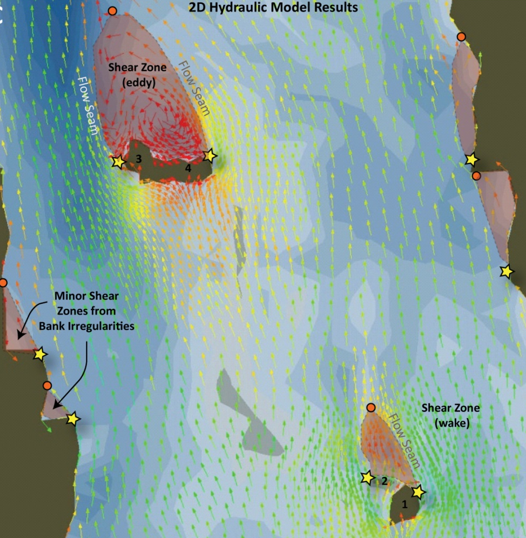
Components of Fish Habitat
e.g. Depths
Velocity
Channel Units
Substrate
Structure/Cover
Notes:
Or we might produce depths and velocities using a hydraulic model based on CHaMP collected data that is now operational.

Slide 10
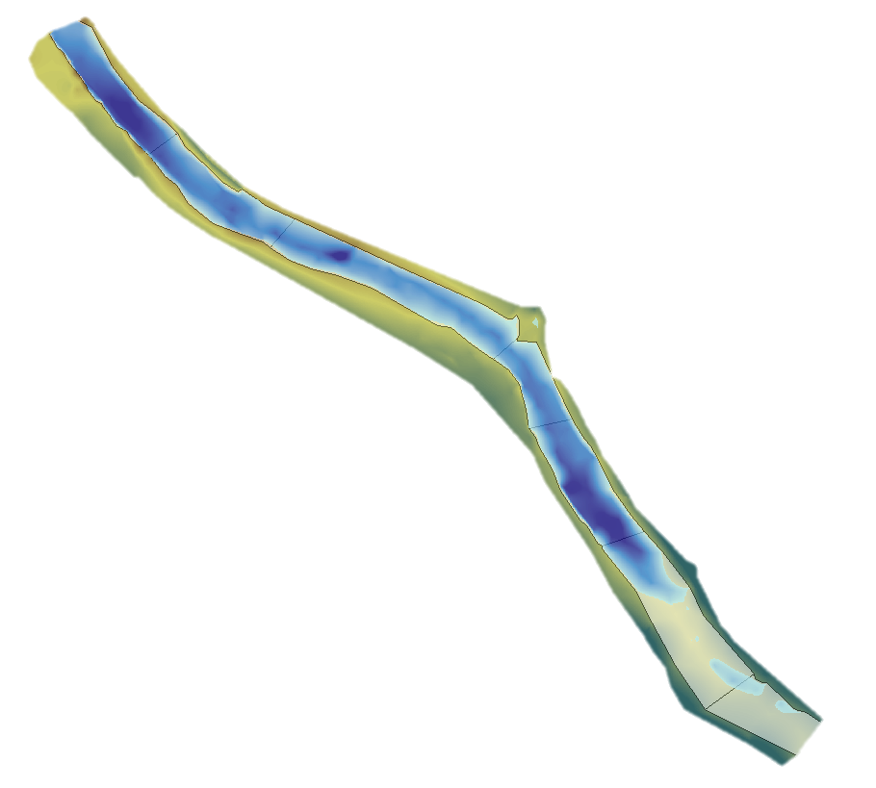
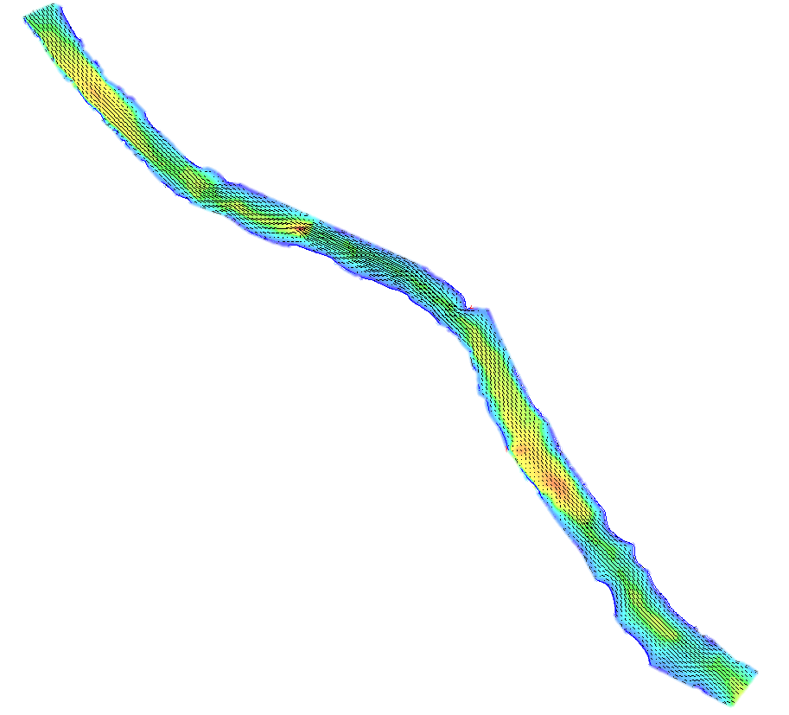
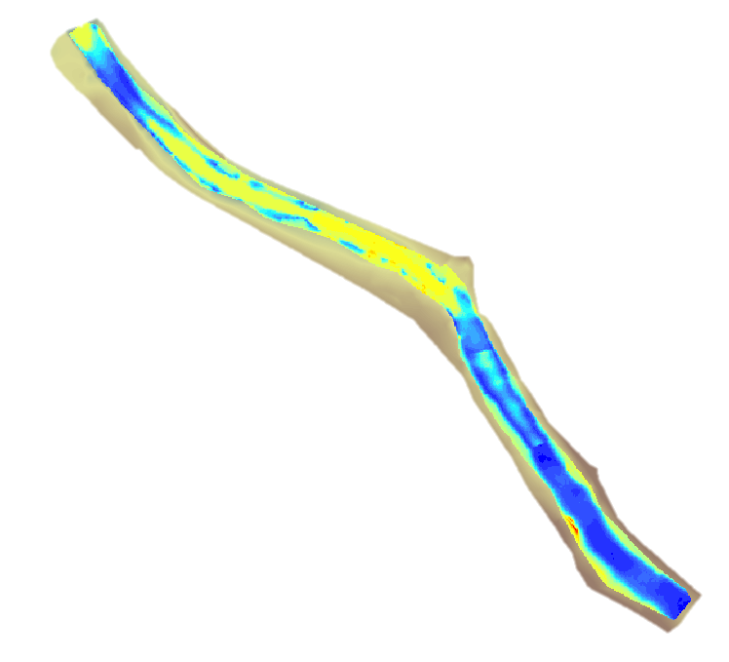
Translate habitat to fish
Water depth
Water Velocity
Spawner Habitat Suitability
Estimate of Carrying Capacity
= redd
Notes:
We use these metrics as inputs into a model and translate habitat to fish. This is an example of a commonly used HSI model to estimate carrying capacity of redds in a reach. But we have multiple approaches to this.

Slide 11
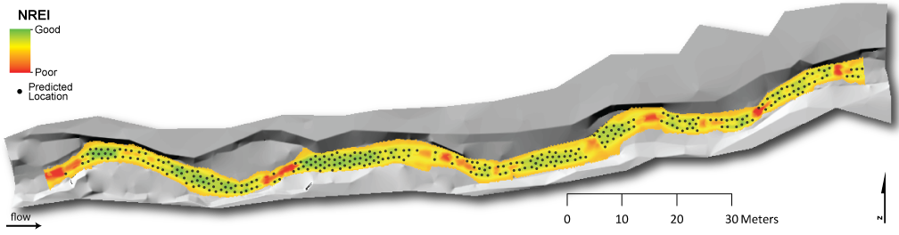
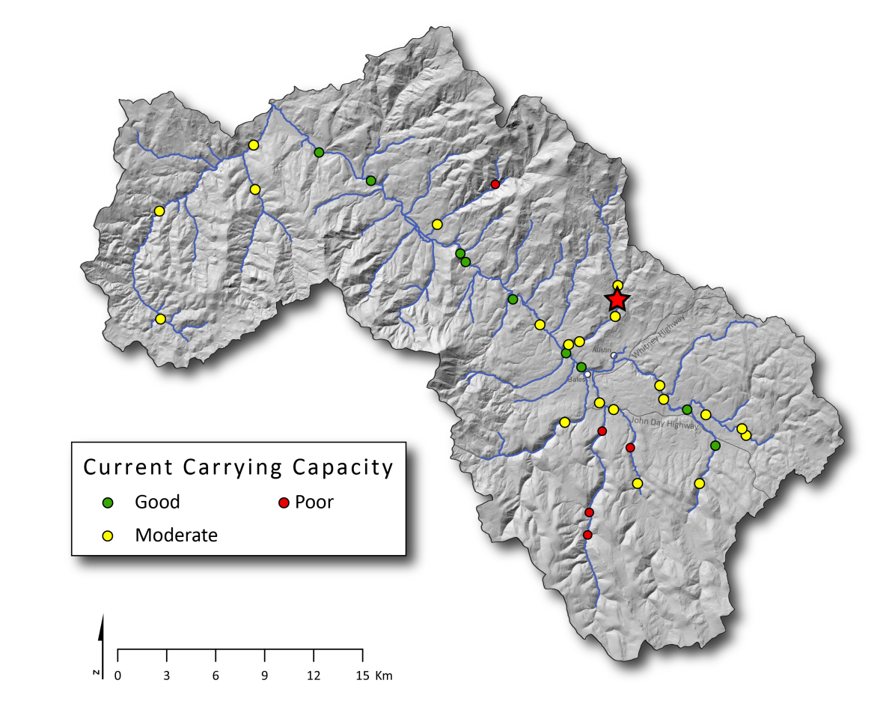
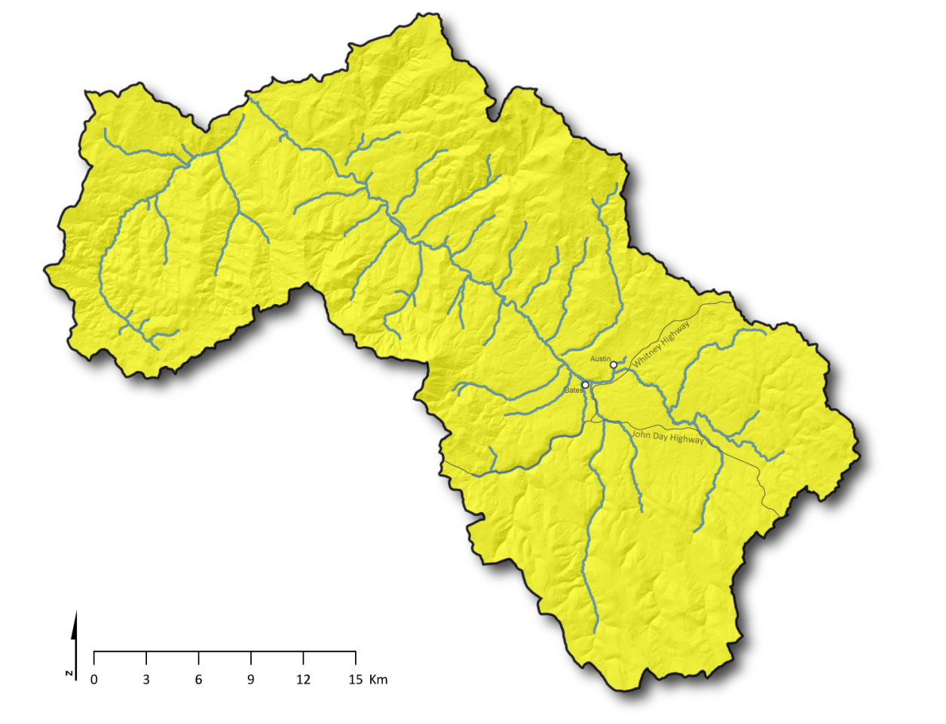
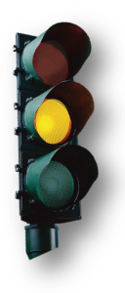
Carrying Capacity
Notes:
We then need to summarize each site across the landscape. This is another example of estimating carrying capacity of reach, where the dots are locations that can support a fish, we now have a model that can do this for steelhead par, and we can summarize this across the site, and all sites within a watershed, to a watersheds summary about habitat condition of carrying capacity

Slide 12

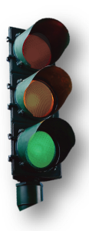
How do we go from sites to
a population summary product?

Slide 13
CHaMP survey design (GRTS)

Slide 14
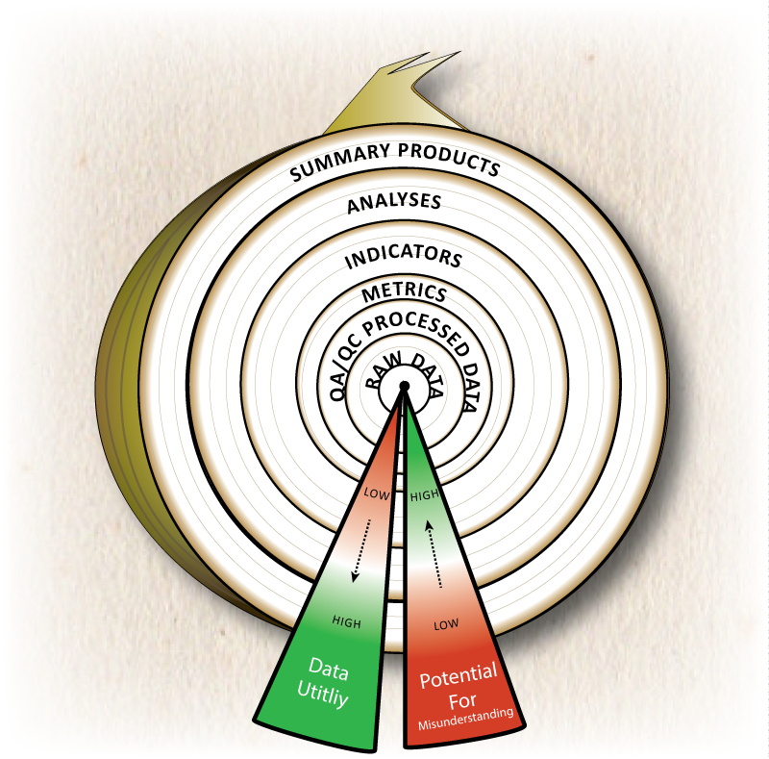
Survey design matters
Averaged with appropriate weights
Averaged without appropriate weights
Notes:
How we average sites across the watershed matters.

Slide 15
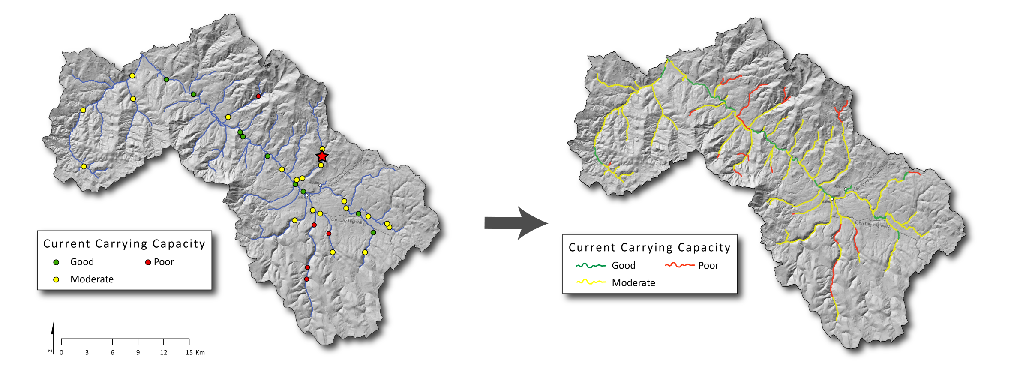
Extrapolate over the whole network:
Continuous models
Notes:
So how do we go from points to the whole watershed?

Slide 16
Why Continuous Models?
Spatially explicitly - where are:
  Impairments/limiting factors
  Conservation areas
  Highest restoration potential

Slide 17
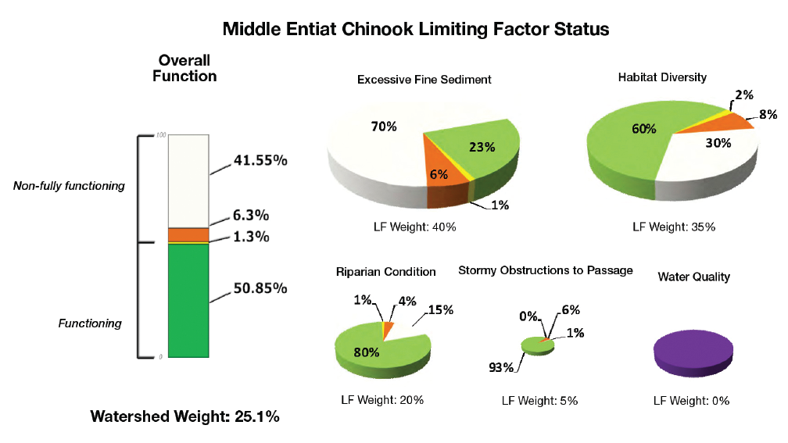

Slide 18
Why Continuous Models?
Spatially explicitly
Processed based- can help understand:
  why reaches are the way the are
  what are the restoration opportunities
  how they can be restored
May more realistically capture variability in streams
Can help improve sampling designs
Can incorporate other sources of data

Slide 19
Why Continuous Models?
Spatially explicitly
Processed based- can help understand:
May more realistically capture variability in streams
Can help improve sampling designs
  Under or over represented habitat types
Can incorporate other sources data

Slide 20
Why Continuous Models?
Spatially explicitly
Processed based- can help understand:
May more realistically capture variability in streams
Can help improve sampling designs
Can incorporate other sources data
  Other monitoring programs (e.g. Aquatic Inventories PIBO)
  GIS
  Remote Sensing

Slide 21
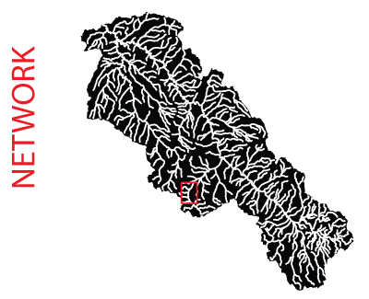
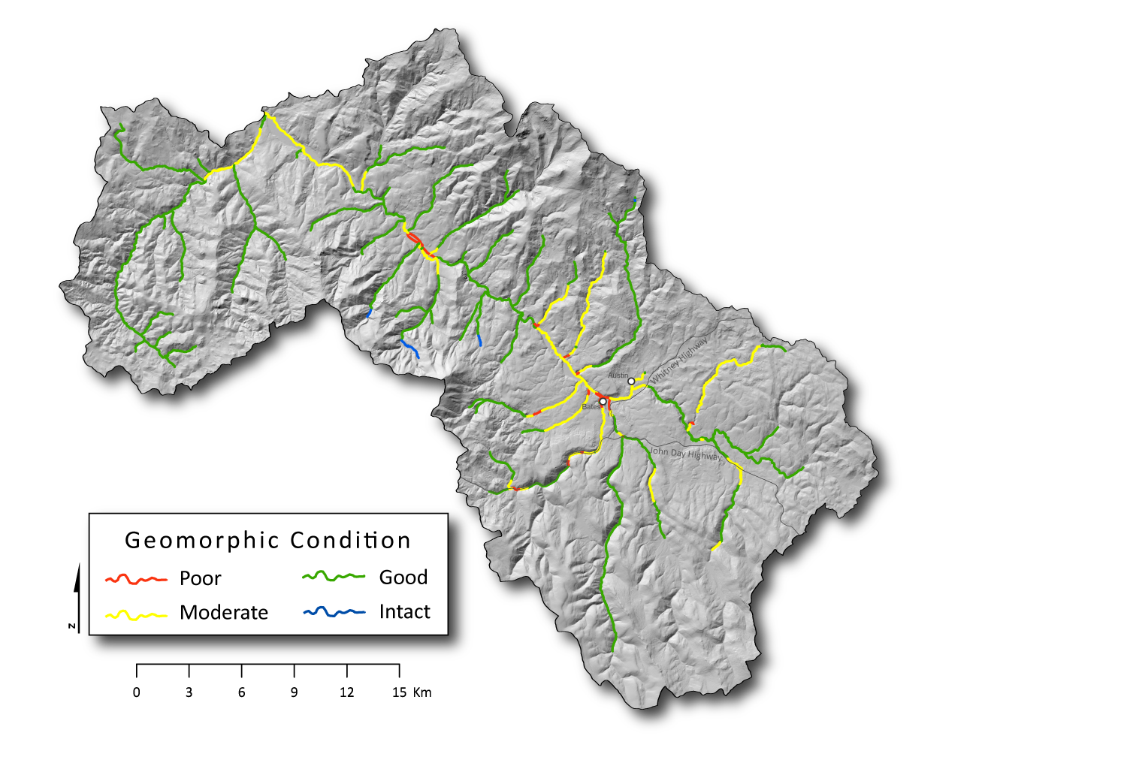
Geomorphic Condition
(River Styles)

Slide 22
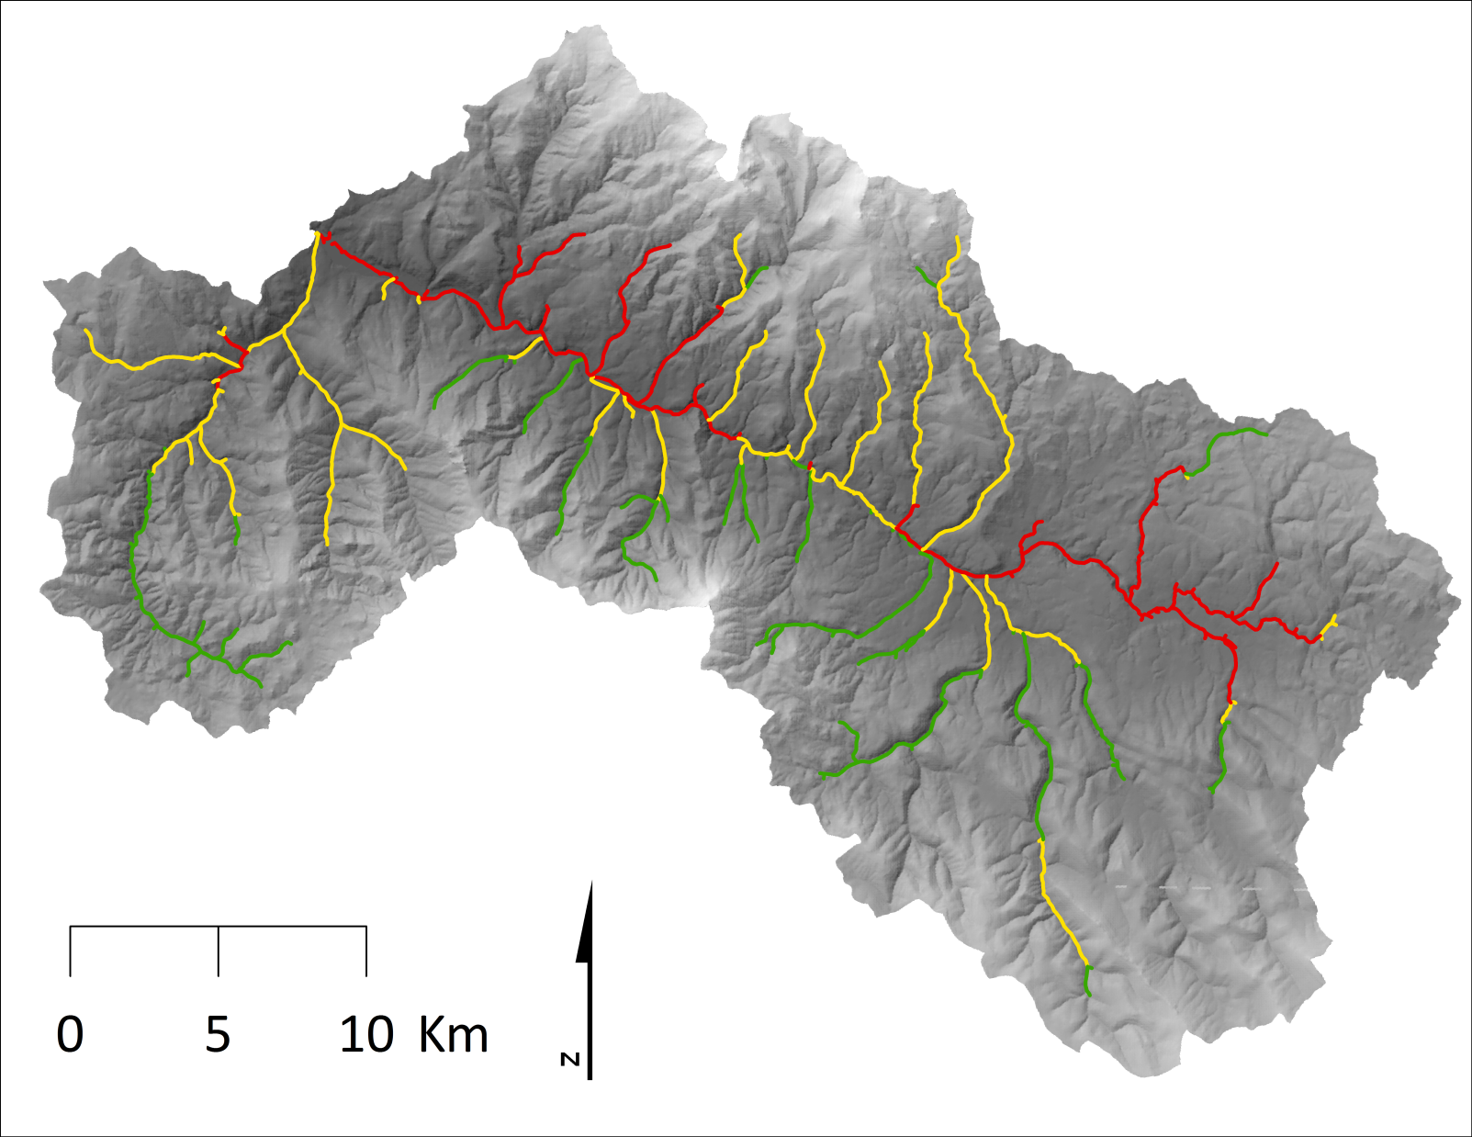
Temperature Condition
(Modis Model)

Slide 23
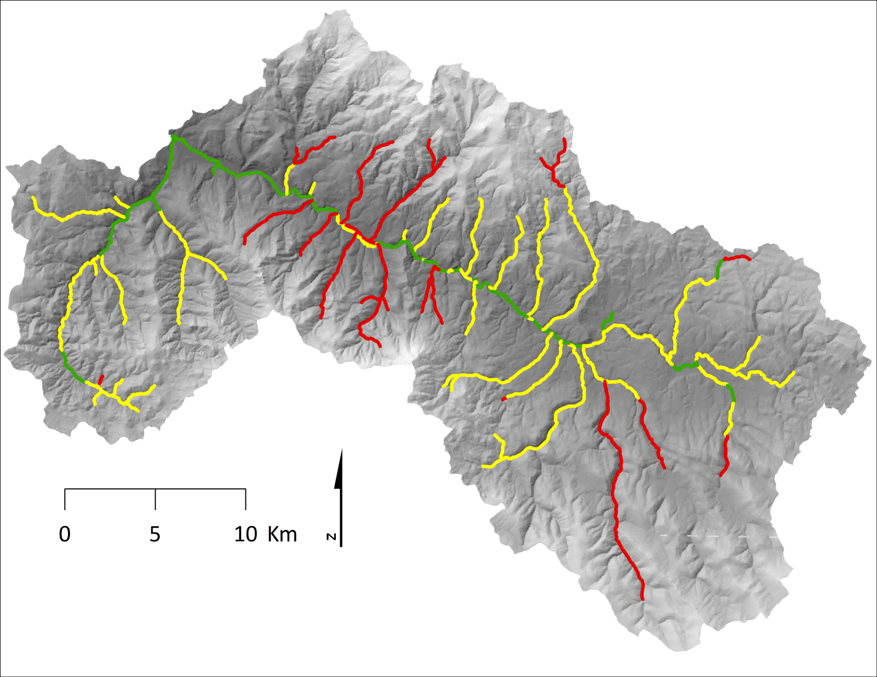
Stream Productivity

Slide 24
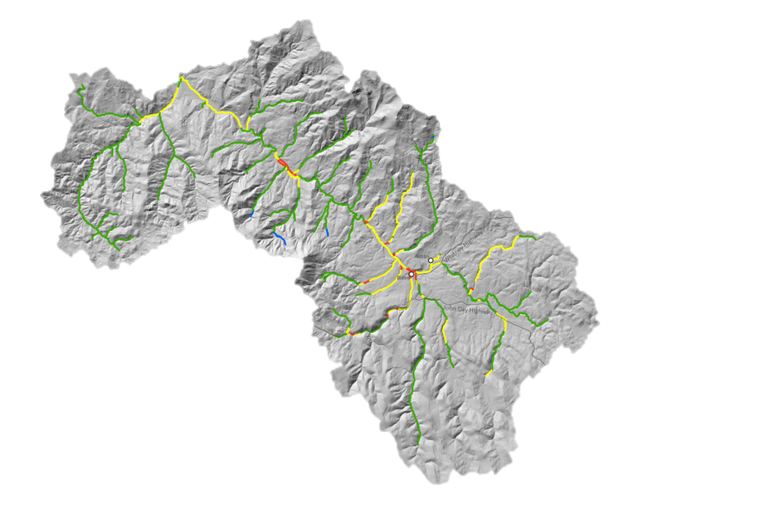
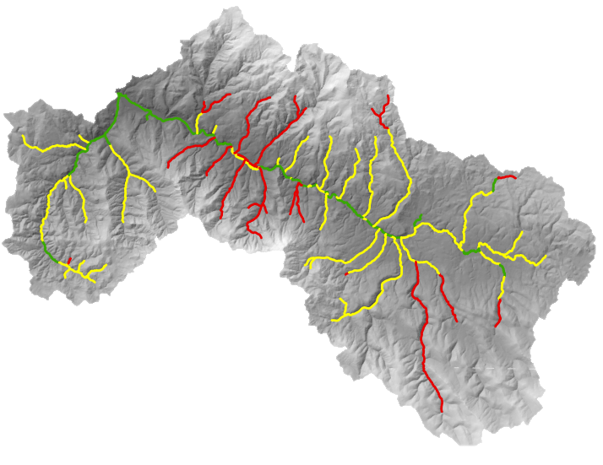

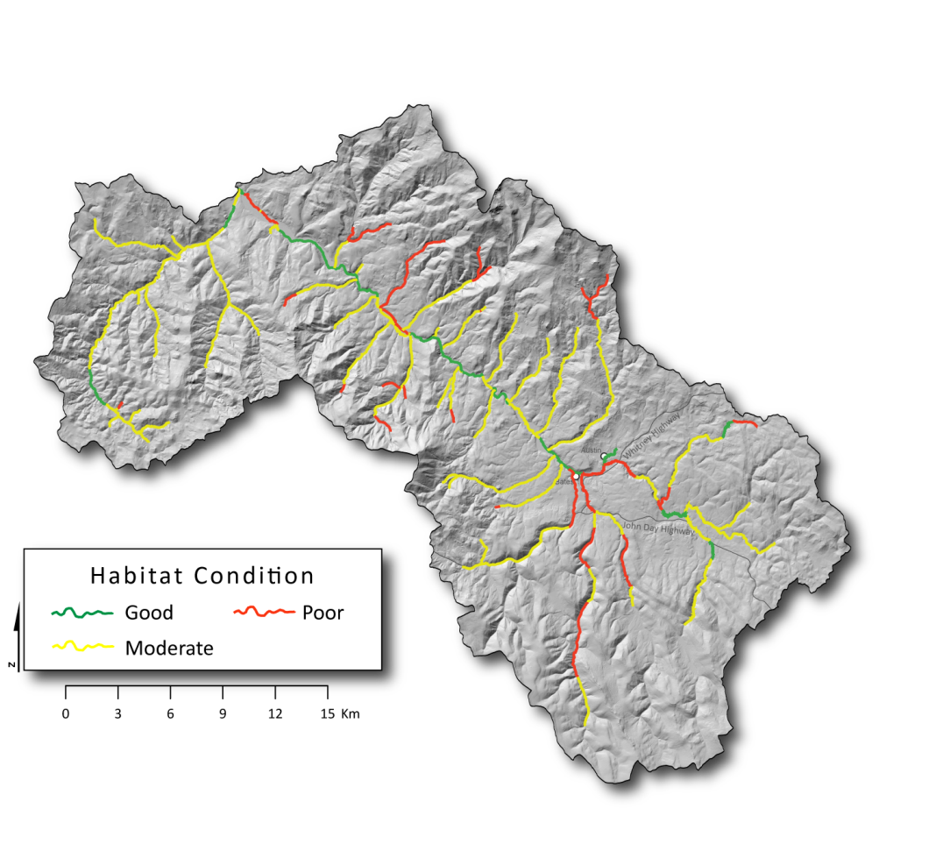
Habitat Condition
Habitat Quantity
Peripheral & Transitional Habitats
Channel Structure & Form
Sediment Conditions Food
Temperature Physical Habitat Stream Productivity

Slide 25

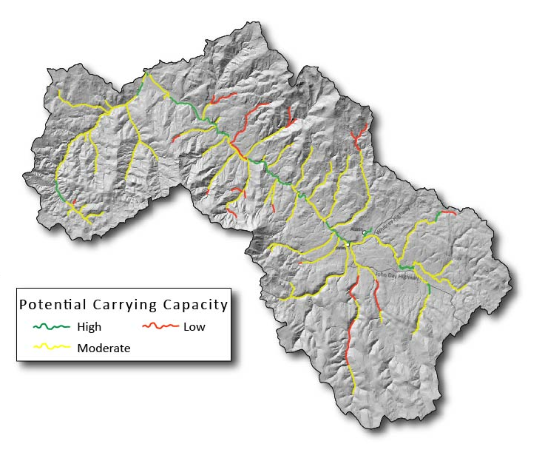
Current Carrying Capacity
Current

Slide 26
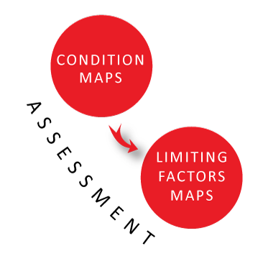
KMQ 1: Limiting Factors
Notes:
Condition is what it is,
Limiting factors is what is wrong

