Slide 1
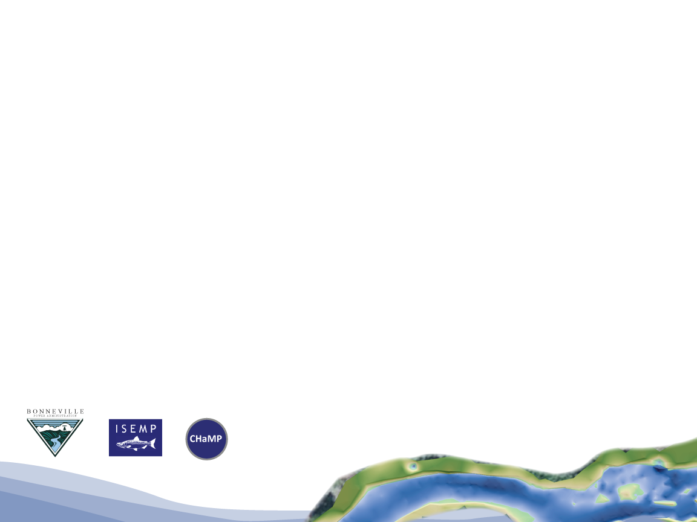
KMQ 3 – Tools and Products
CHaMP and ISEMP State of the Science Workshop
Portland, Oregon – February 25th and 26th, 2014
Presenter:
Chris Beasley
Collaborators:
ISEMP and CHaMP Team

Slide 2
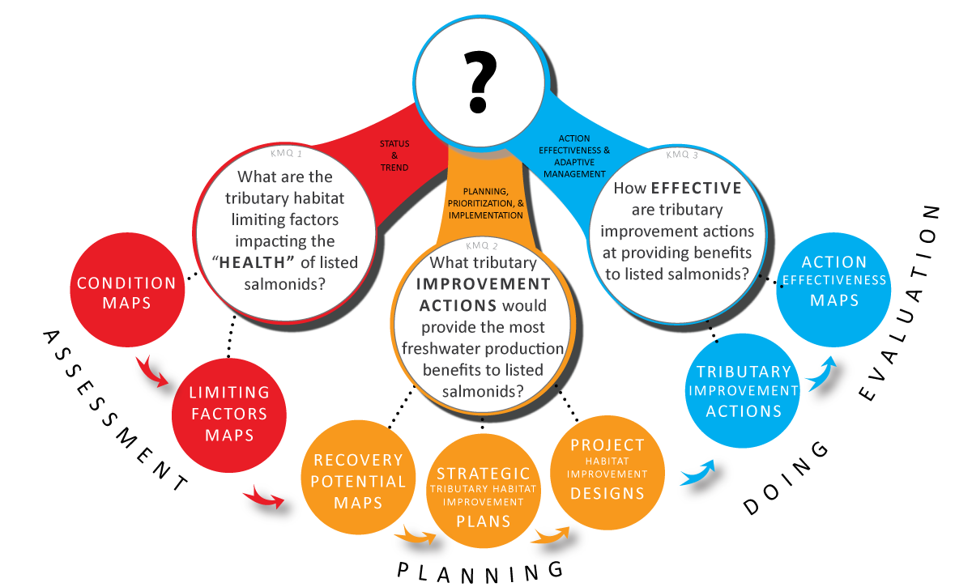
KMQ 3: Action Effectiveness

Slide 3
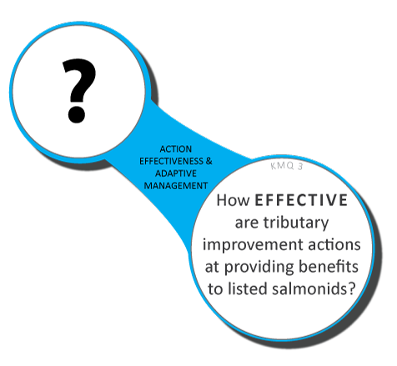
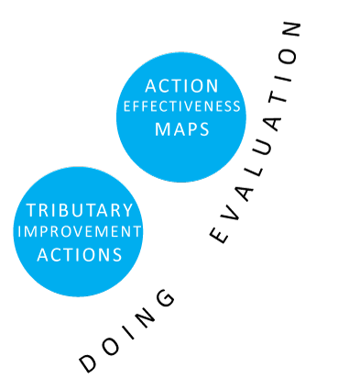

KMQ 3:
Summary Products
BPA already delivering through cbfish.org (Taurus)
Notes:
Did the plan get implemented? Chances are the realities of the real world will throw in some road blocks to the best intentions. An accurate description of what, where and when action were implemented is essential to linking restoration to the observed changes. It is surprising how often this is not done.
Second, we will have to evaluate if, what will then be, the current population condition has improved relative to our past condition. We also have to link this to actions that have been implemented.

Slide 4

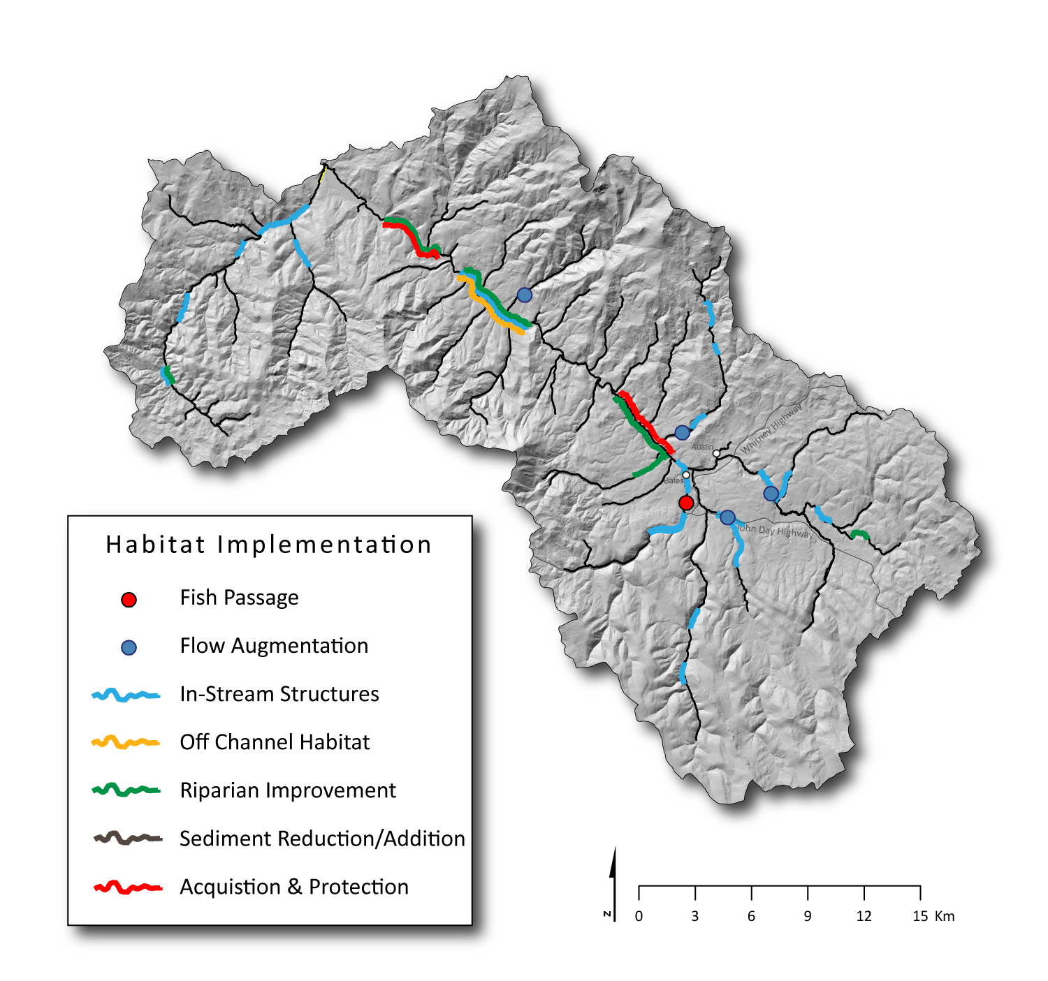
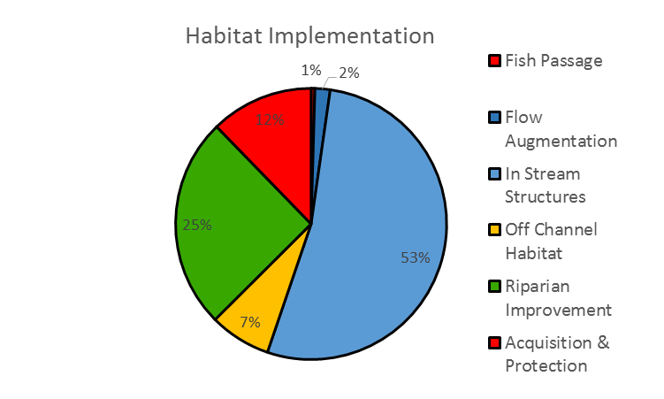
Taurus/CBFish.org

Slide 5
KMQ 3
ISEMP/CHAMP/AEM specifically designed to provide assessments
IMWs provide results
Tools to estimate outcomes
Summary products
Notes:
Did the plan get implemented? Chances are the realities of the real world will throw in some road blocks to the best intentions. An accurate description of what, where and when action were implemented is essential to linking restoration to the observed changes. It is surprising how often this is not done.
Second, we will have to evaluate if, what will then be, the current population condition has improved relative to our past condition. We also have to link this to actions that have been implemented.

Slide 6
Types of Effectiveness M&E
Habitat action effectiveness – physical change.
Biological action effectiveness – fish response.

Slide 7
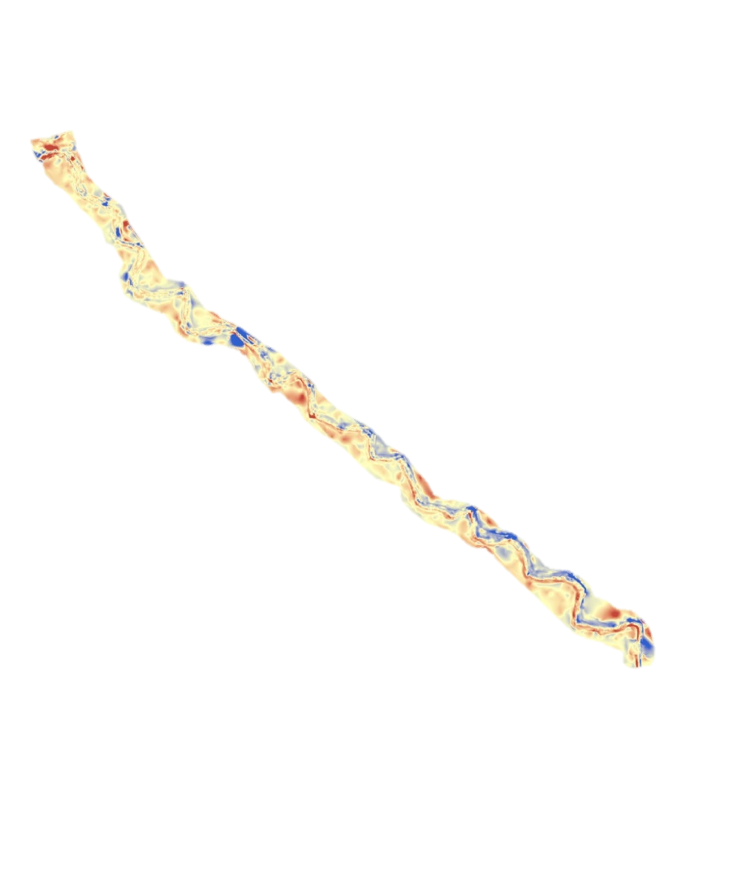
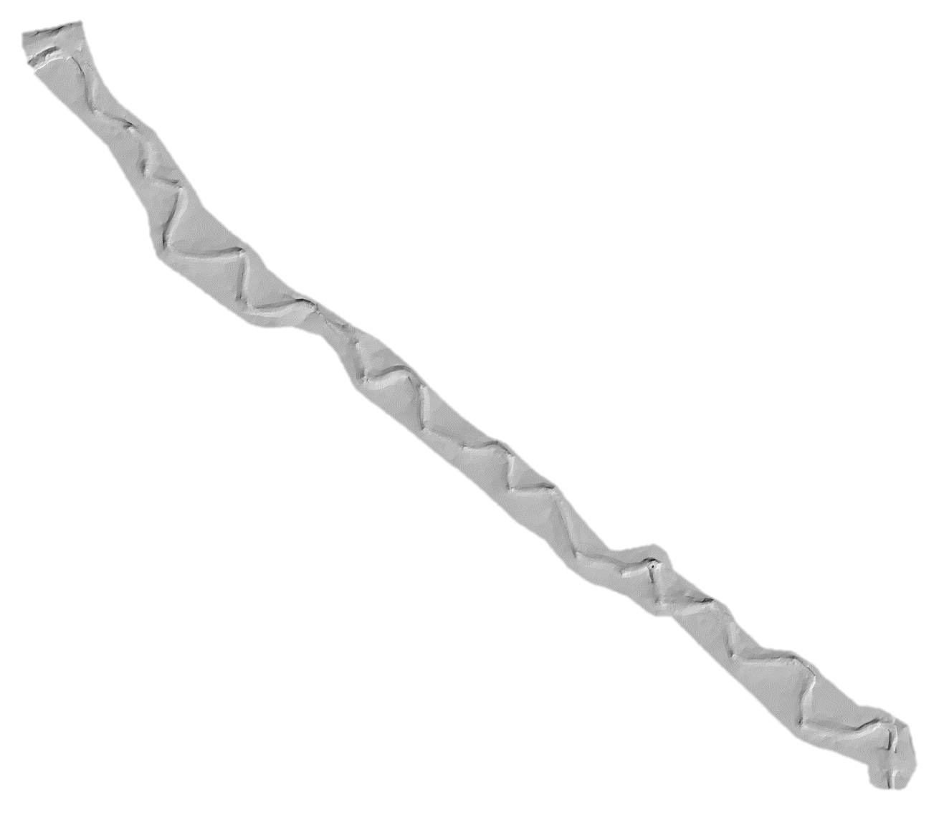

Little Springs Channel Restoration
2012 Habitat Survey
Pool Frequency | 3.51
Pool Average Residual Depth | 0.54
Fish Cover Composition Total | 3
2013 Habitat Survey
Pool Frequency | 3.84
Pool Average Residual Depth | 0.46
Fish Cover Composition Total | 23
Lemhi Subbasin
DEM of Difference
Volume of Erosion | 16.77
Volume of Deposition | 46.07
Notes:
This example shows that the “burn-in” of a channel realignment project in Little Springs Creek.

Slide 8
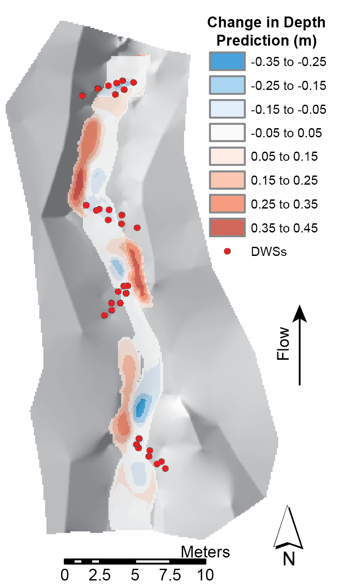
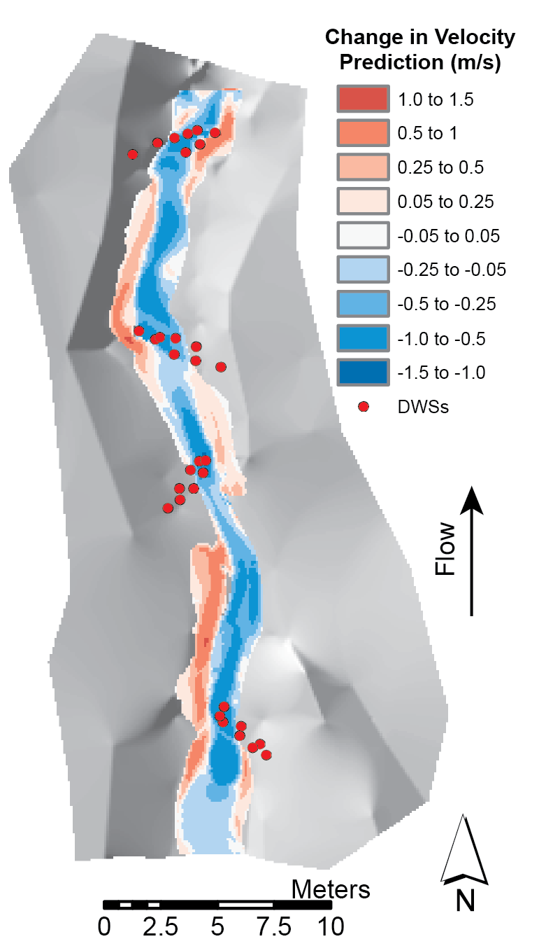
Predicted Changes in Depth and Velocity Following Restoration
Notes:
Post Assisted Log Structure

Slide 9
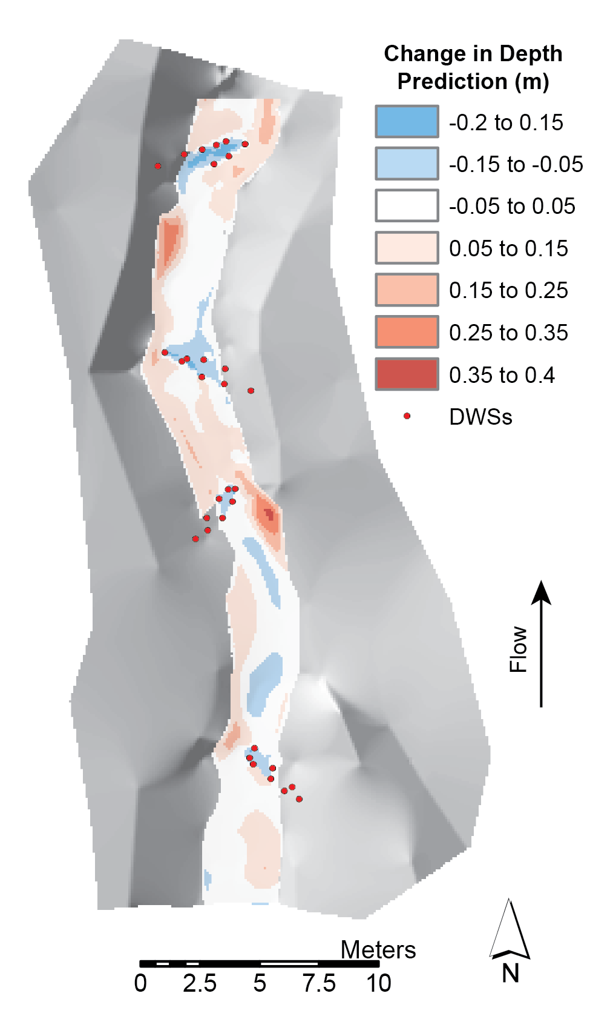
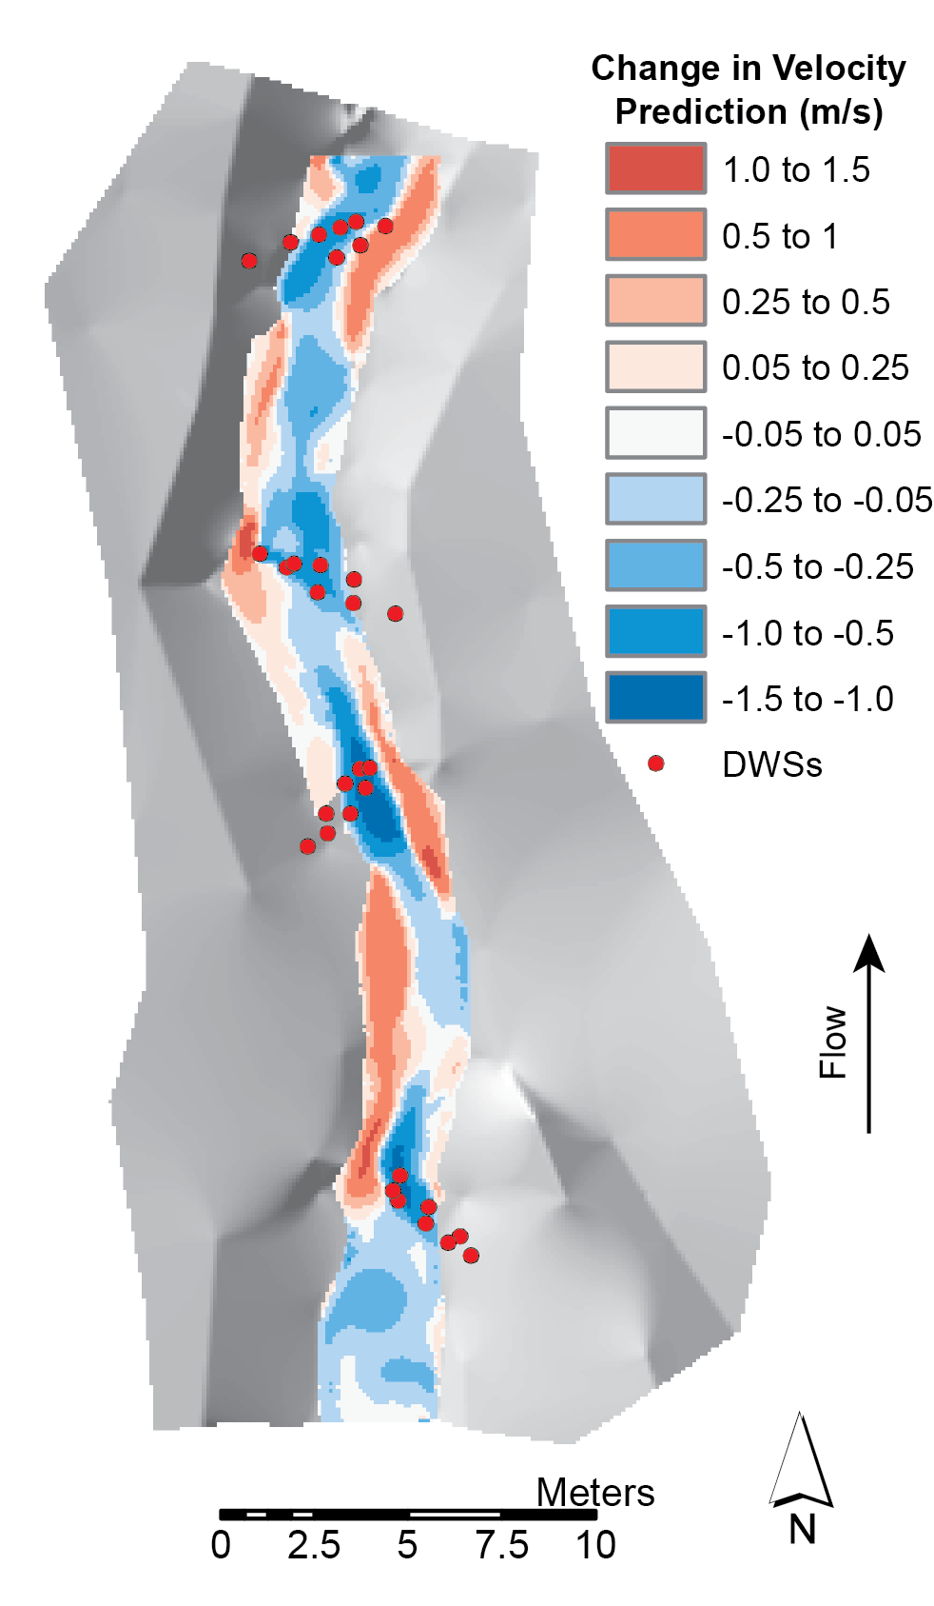
Observed Changes in Depth and Velocity Following Restoration
Notes:
Less than one year – low flow conditions.

Slide 10
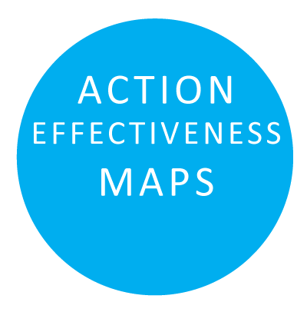
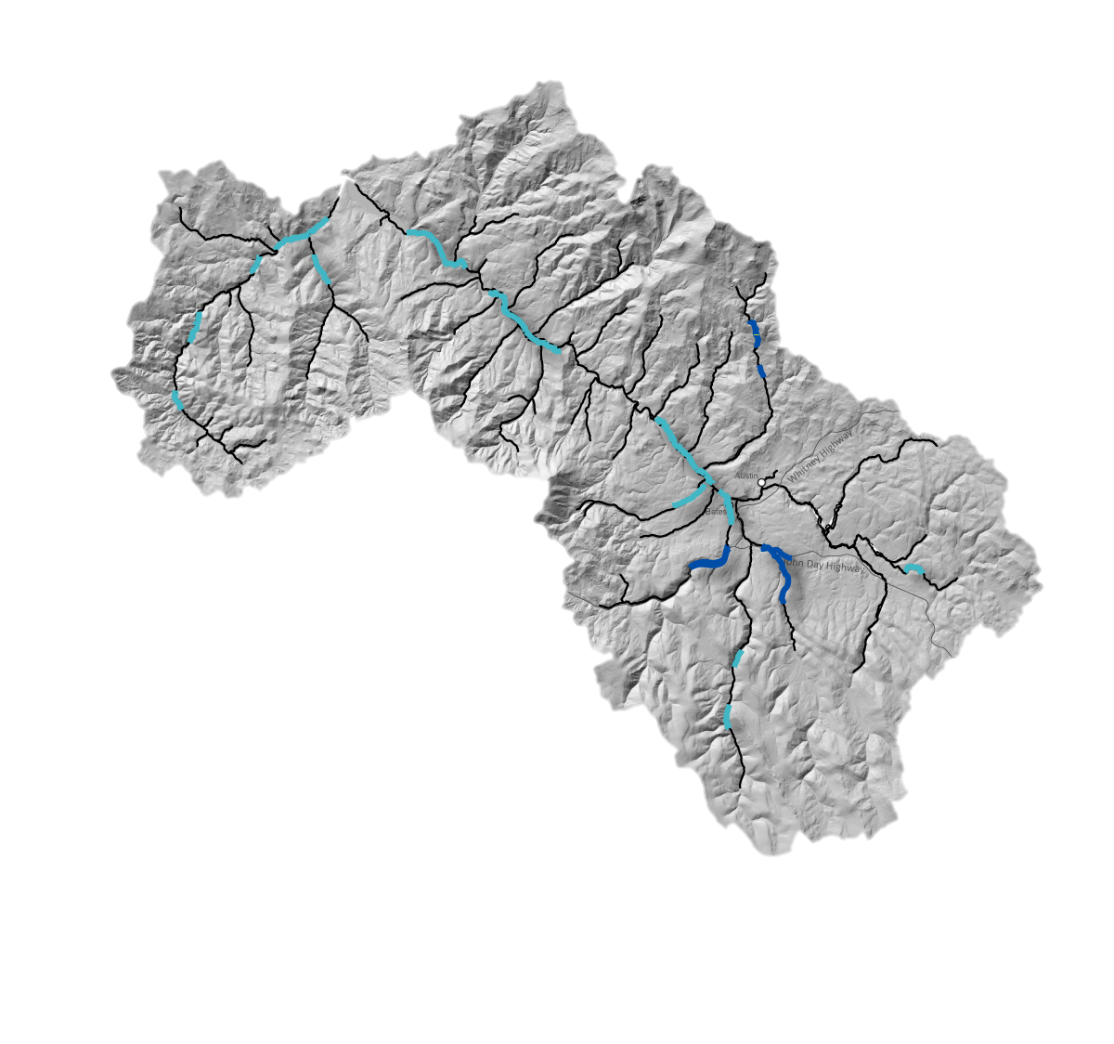
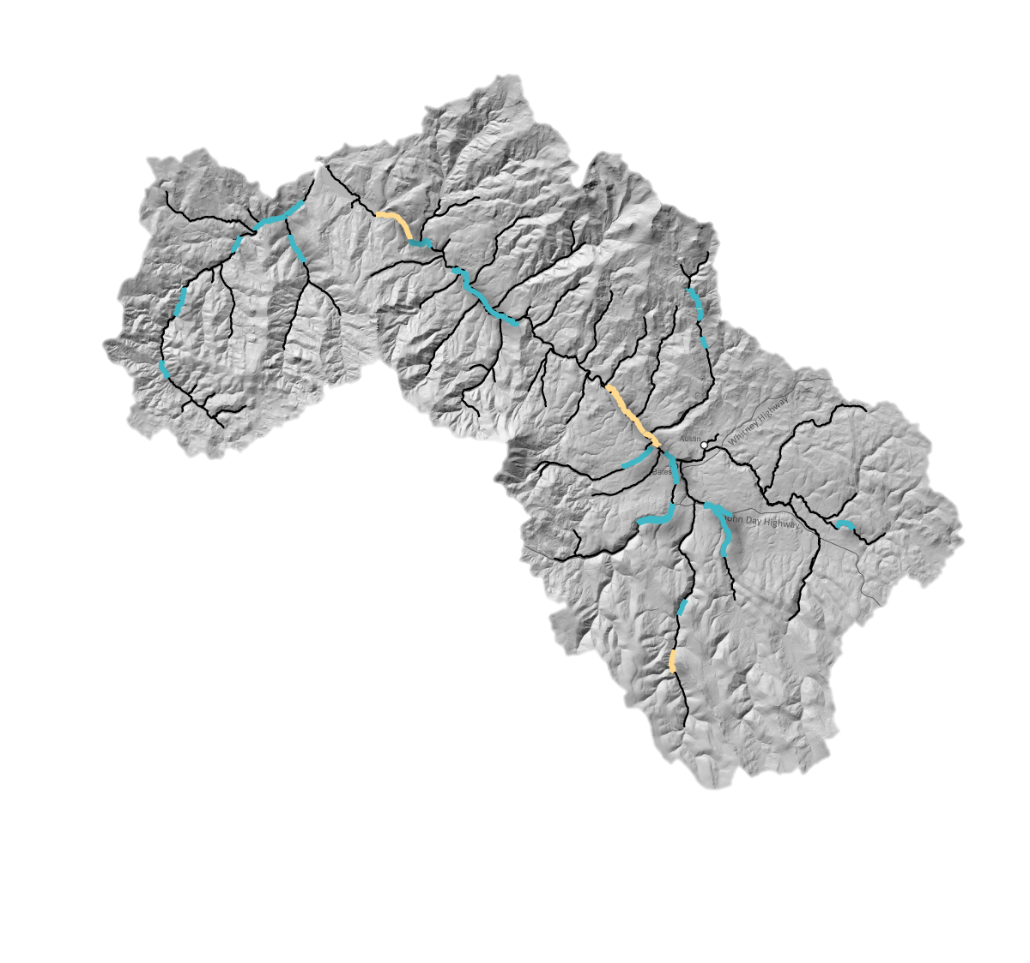
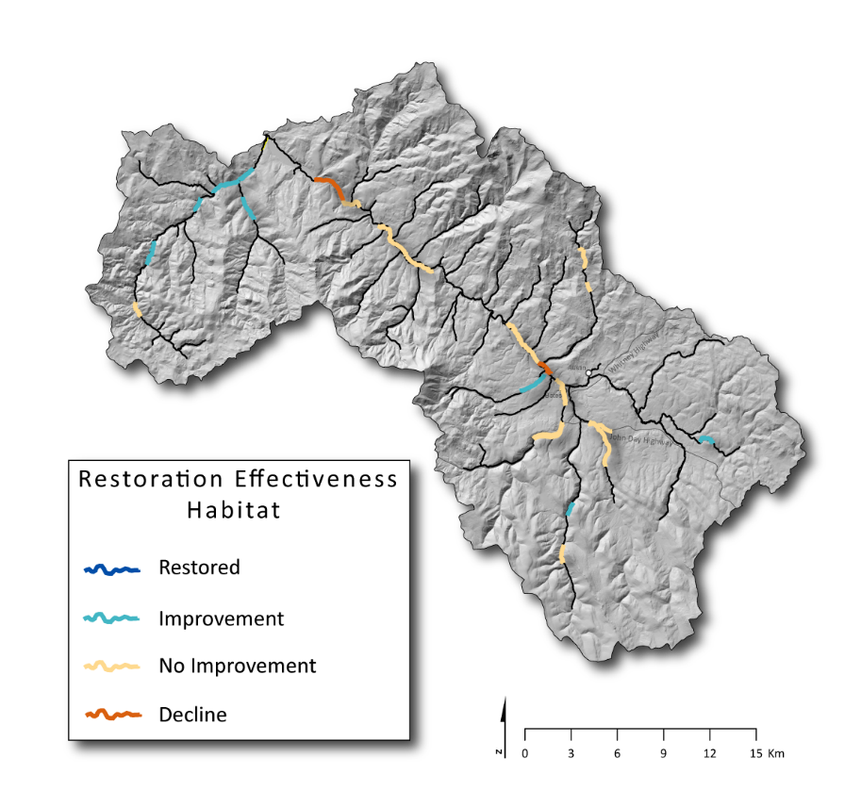
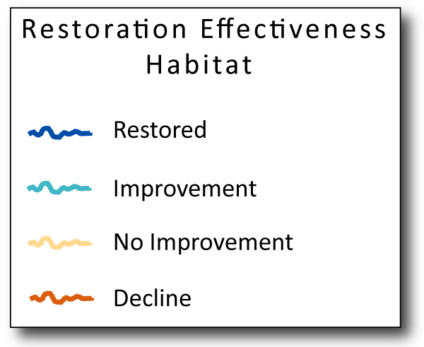
Restoration Effectiveness: Habitat Through Time
+20 Years
+10 Years
+5 Years
Relatively Quick Responses
Scope for Adaptive Management

Slide 11
Types of Effectiveness M&E
Habitat action effectiveness – physical change.
Biological action effectiveness – fish response.

Slide 12
Little Springs Channel Restoration
O. mykiss Abundance
Year | Estimate
2011 | 110
2012 | 436
2013 | 1,297
Chinook Survival
Year | Estimate
2012 | 29%
2013 | 80%
Lemhi Subbasin
Notes:
This example shows that the “burn-in” of a channel realignment project in Little Springs Creek.

Slide 13
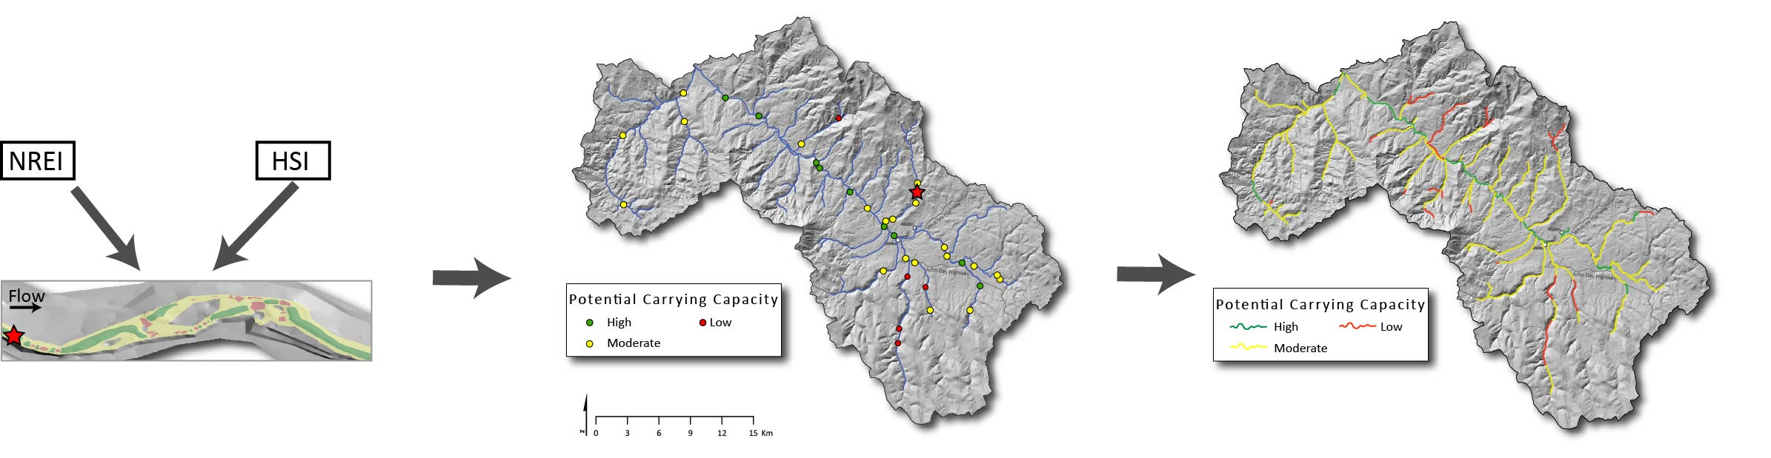
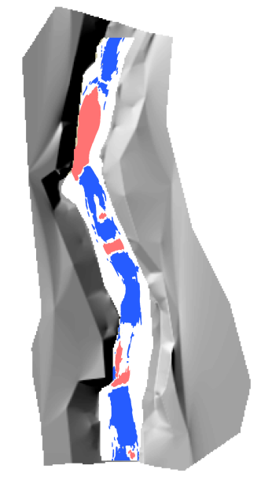
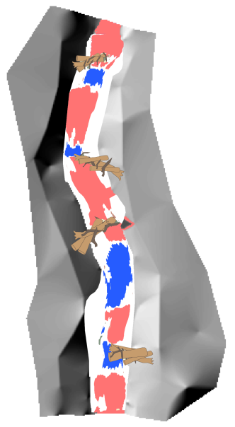
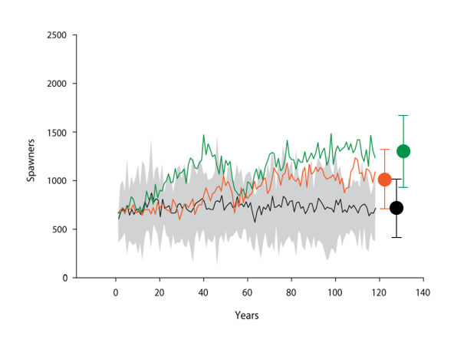
Management planning MFJD
Using a model within in a sampling design to aggregate actions spatially and predict population outcomes.

Slide 14
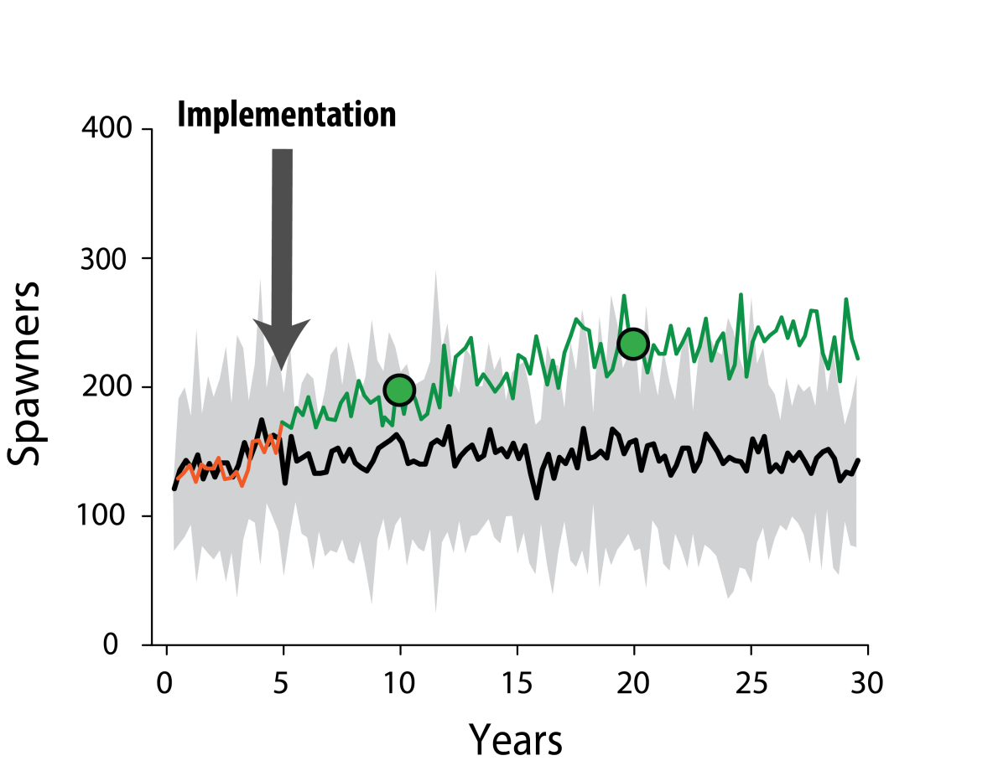
Life Cycle Model
Using LCM in a sampling design to aggregate actions spatially and predict outcomes.
Notes:
This is possible as these relationships are based on mechanistic understandings

Slide 15
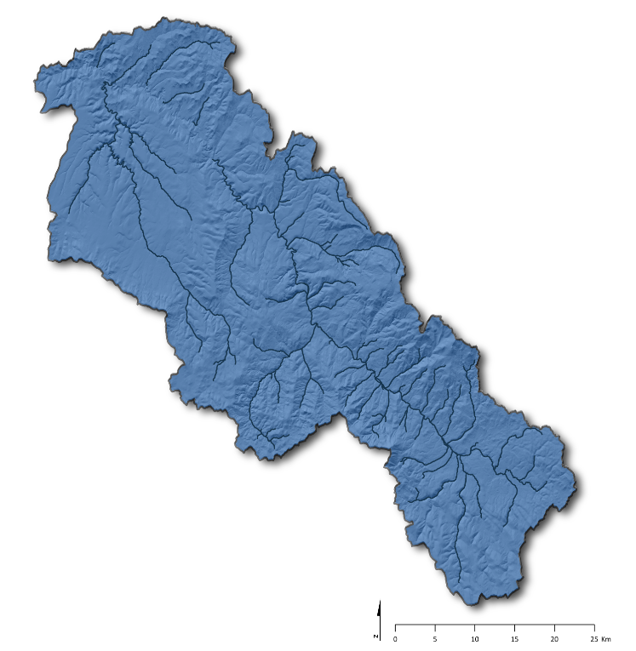

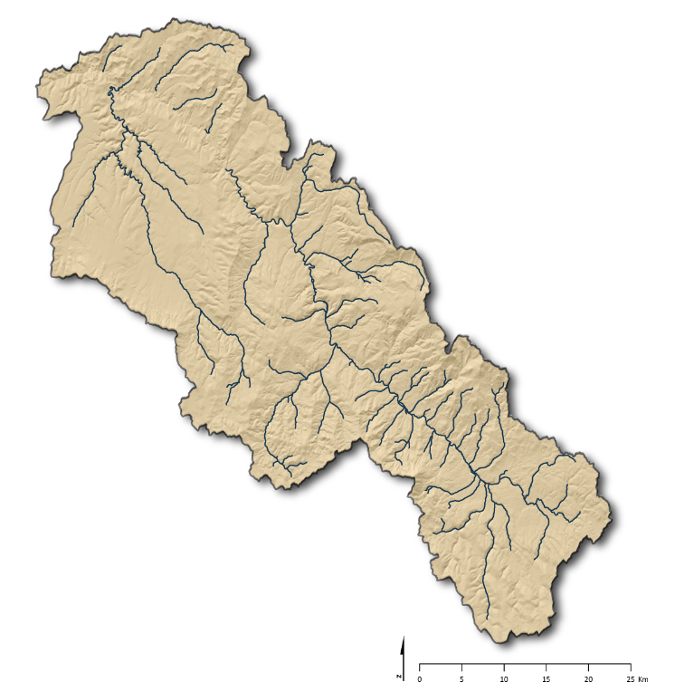
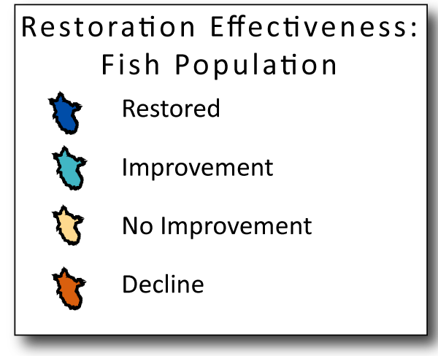
Restoration Effectiveness: Fish Population Through Time
+20 Years
+10 Years
+5 Years
Response tied to restoration efforts
Relatively Slow Responses

Slide 16
Next Up – Bridge Creek
Limiting Factor
Plan
Implement
Evaluation
Export

Slide 17


Lesson learned from the Bridge Creek Intensively Monitored Watershed Study
CHaMP and ISEMP State of the Science Workshop
Portland, Oregon – February 25th and 26th, 2014
Presenter:
Nick Bouwes
Collaborators:
Nick Weber - Eco Logical Research, Inc.,
Joe Wheaton - Watershed Sciences, USU
Chris Jordan, Michael Pollock, NOAA
Carol Volk- South Fork Research, Inc.

Slide 18
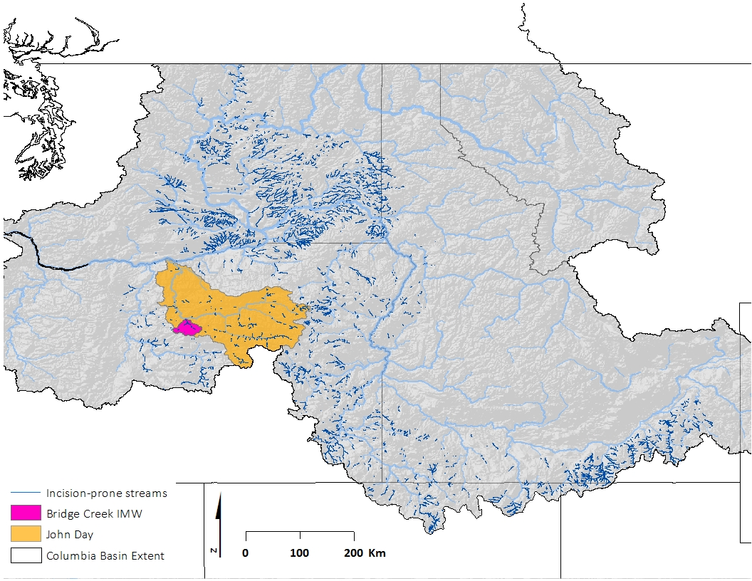
Channel incision is a common degraded state of streams in the CRB
15,131 km of streams
potentially incised
Notes:
Channel incision is
This is not a an isolated incident as in Bridge Creek, but is a rather common story across the range of salmon and steelhead in the CRB. This a first cut at the extent of the potential of channel incision in the CRB.

Slide 19
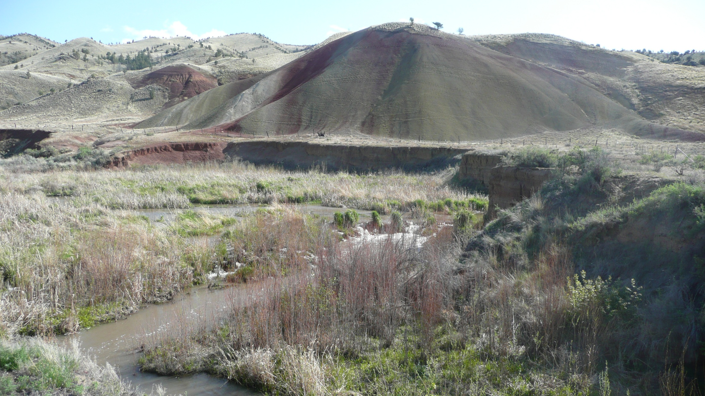
Notes:
Bridge Creek is tributary to the lower JD, that has the potential to be a highly productive stream for listed steelhead. But intensive grazing and agriculture along with the perfect storm of climatic conditions, lead to an incising of the stream over the past 100 yrs.

Slide 20
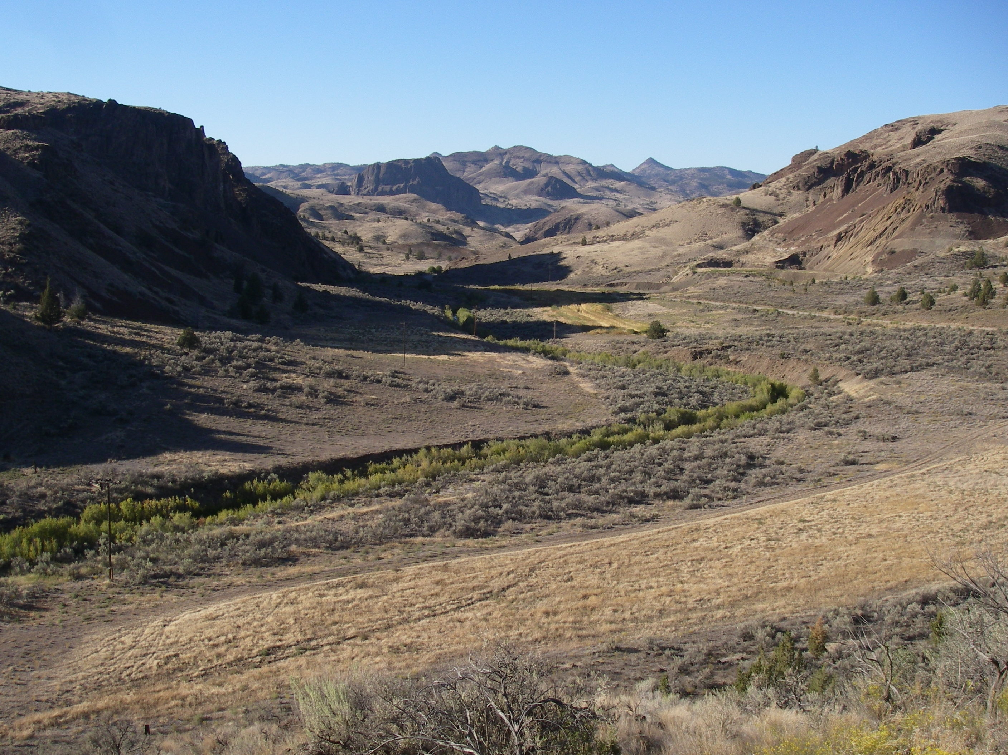
Notes:
This is a common site in Bridge Creek, which used to be a steep trench, plane bed stream with little riparian vegetation except a thin strip of willow,

Slide 21

Mean Annual Flood Height
Post Depth
60–90 cm
Notes:
So give them structure and there shall be stable dams

Slide 22
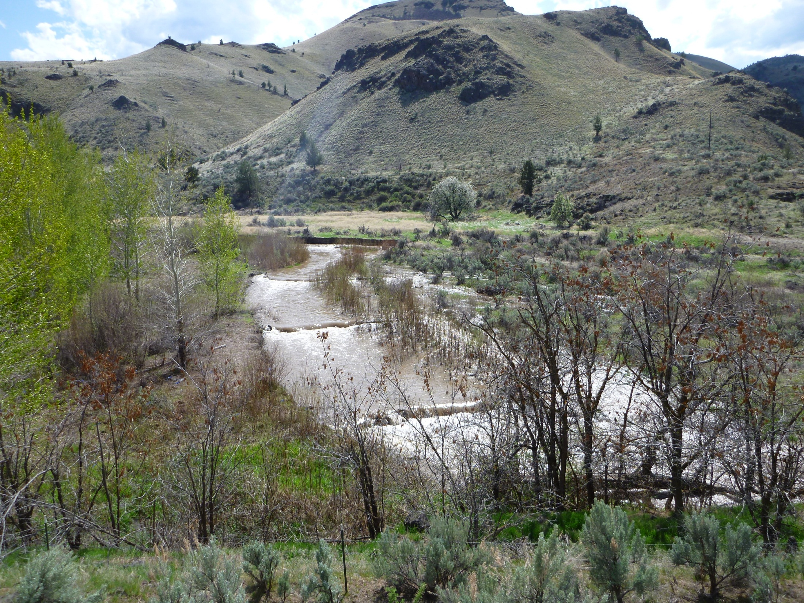
Notes:
We have put in about 140 structure, to cover 4 – approximately 1 km long treatment reaches
Beavers have occupied about 1/3 structures.

Slide 23
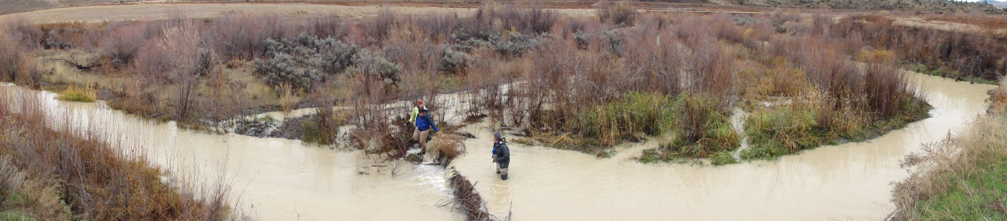
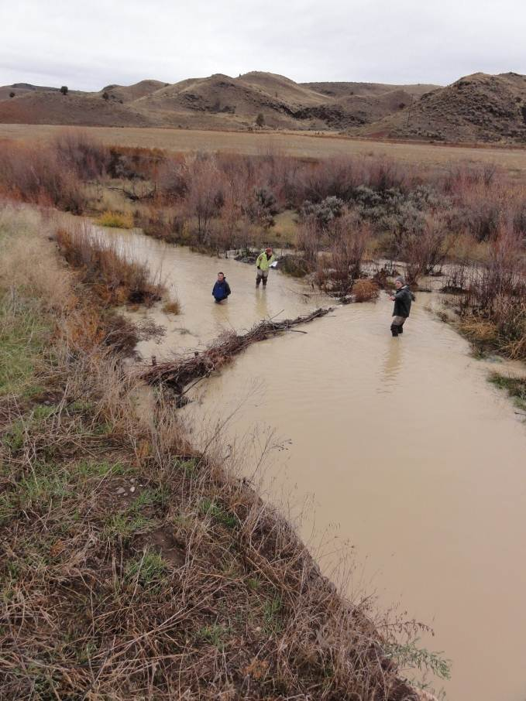
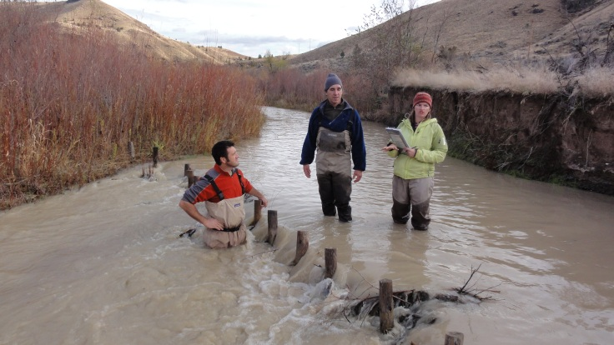
Will steelhead respond to this restoration?
Notes:
This restoration has resulted in dramtic changes much quicker than we anticipated. This is the fall following the summer we installed the structures

Slide 24
Abundance

Slide 25
Survival

Slide 26
Conclusions
Habitat Changes
Increase in deeper pools
Increased ground water storage
Aggradation
Frequent inundation of the floodplain
Habitat complexity
  Topography
  Velocity
  Substrate
  Temperatures

Slide 27
Conclusions
Habitat Changes
Increase in population abundance
Increase in survival (at multiple scales)
Decrease in growth (because of increased densities)
Increase in steelhead production
Continued fish passage

Slide 28
But is Bridge Creek a boutique restoration approach?

Slide 29
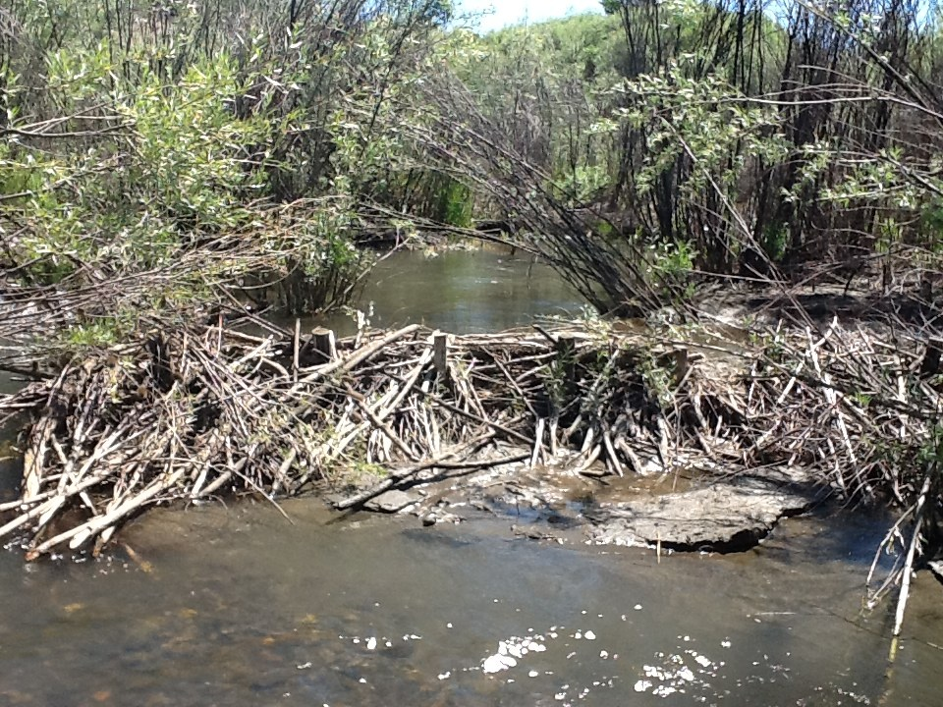
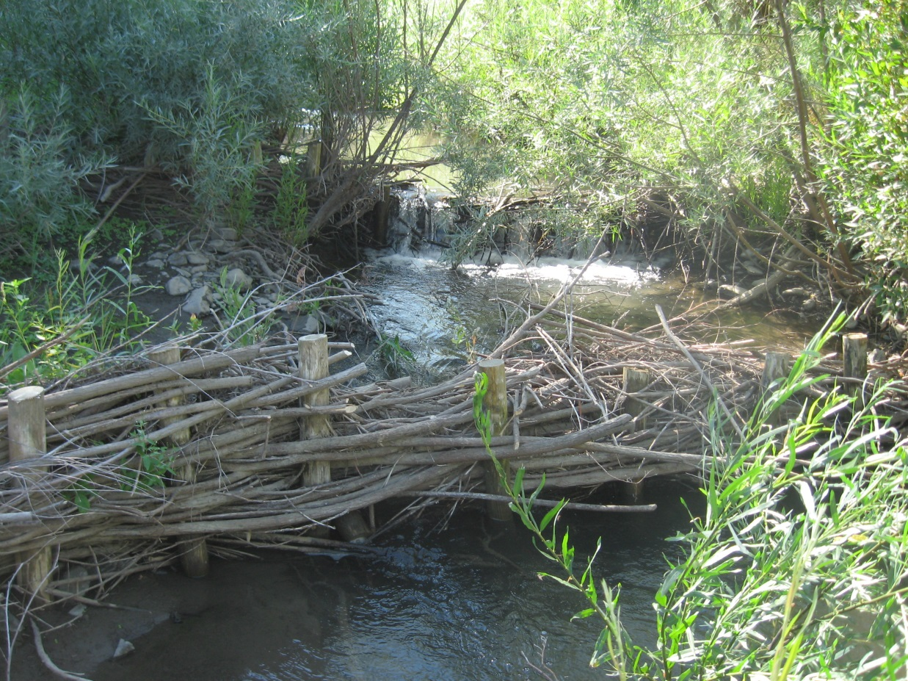
Beaver Dams
Beaver Dam Analogs
Notes:
So, what we have come up with during this process is a couple different flavors of this restoration approach
- The first, is just simple post lines, which gives beavers a starting point to work with
- The second is to just reinforce existing beaver dams so that they persist longer
- and the third is to put in posts and actually have our technicians weave willows through the posts
- This creates a pond behind the structure giving beavers more security and we think more likely to be in the area and use our structures

Slide 30
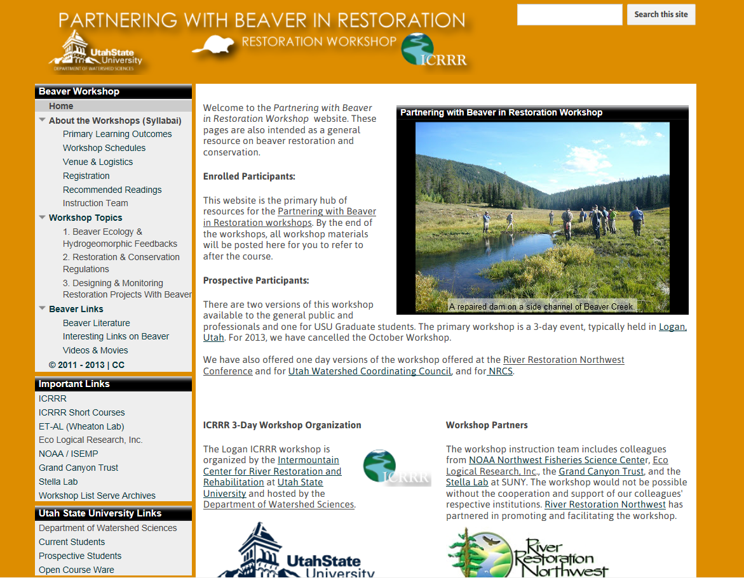

Slide 31
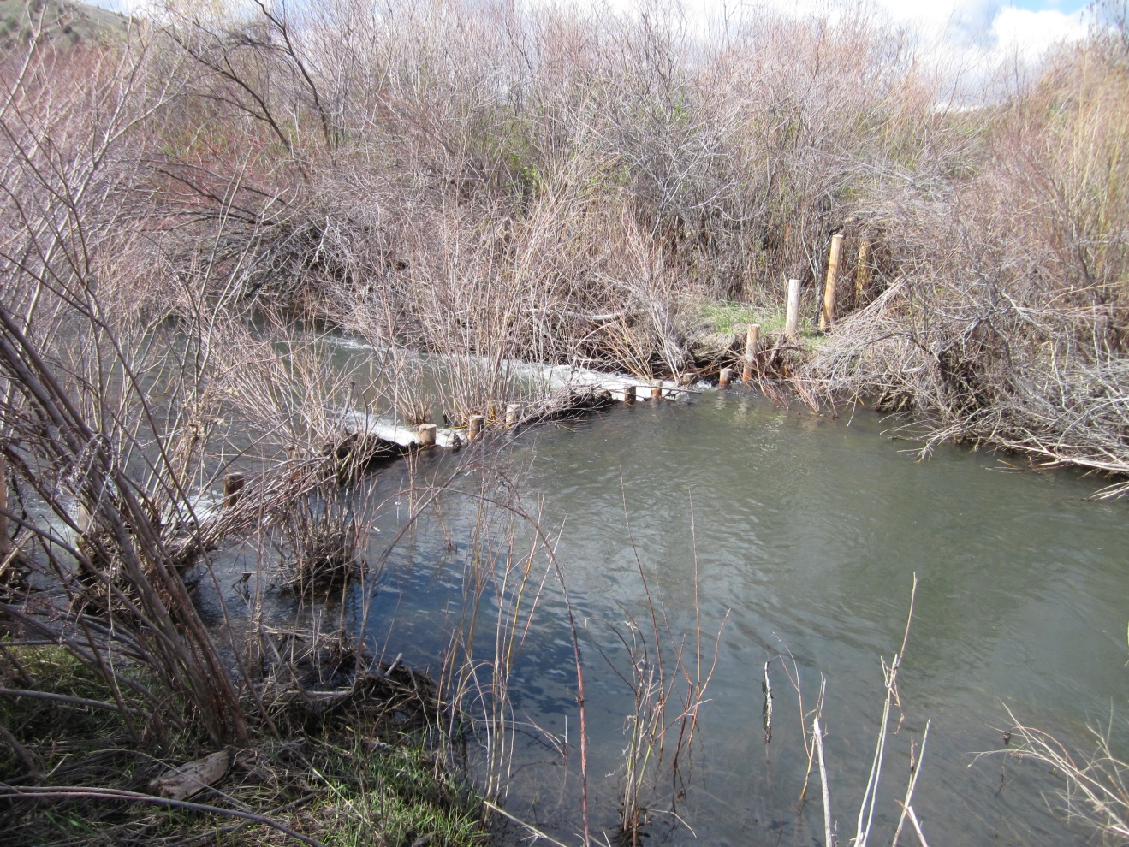
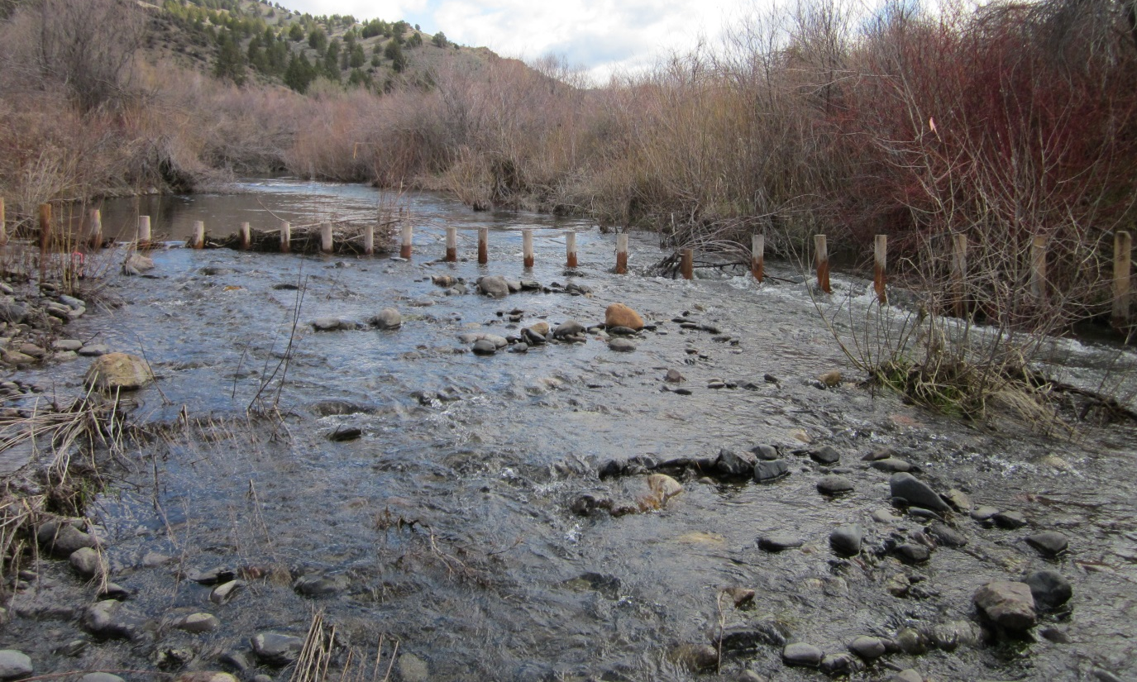
Oregon Department
of Fish and Wildlife
Confederated Tribes
of the Warm Springs
Beech Creek Restoration

Slide 32
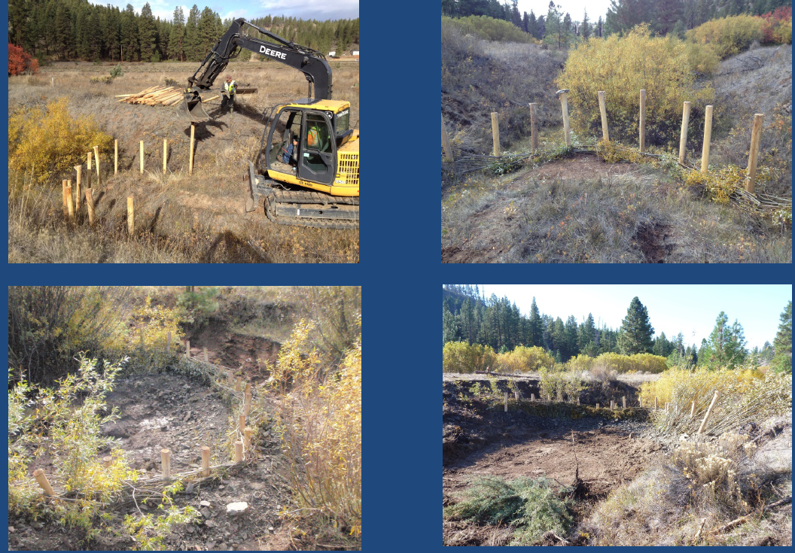
Confederated Tribes of the Warm Springs
Quartz Creek

Slide 33
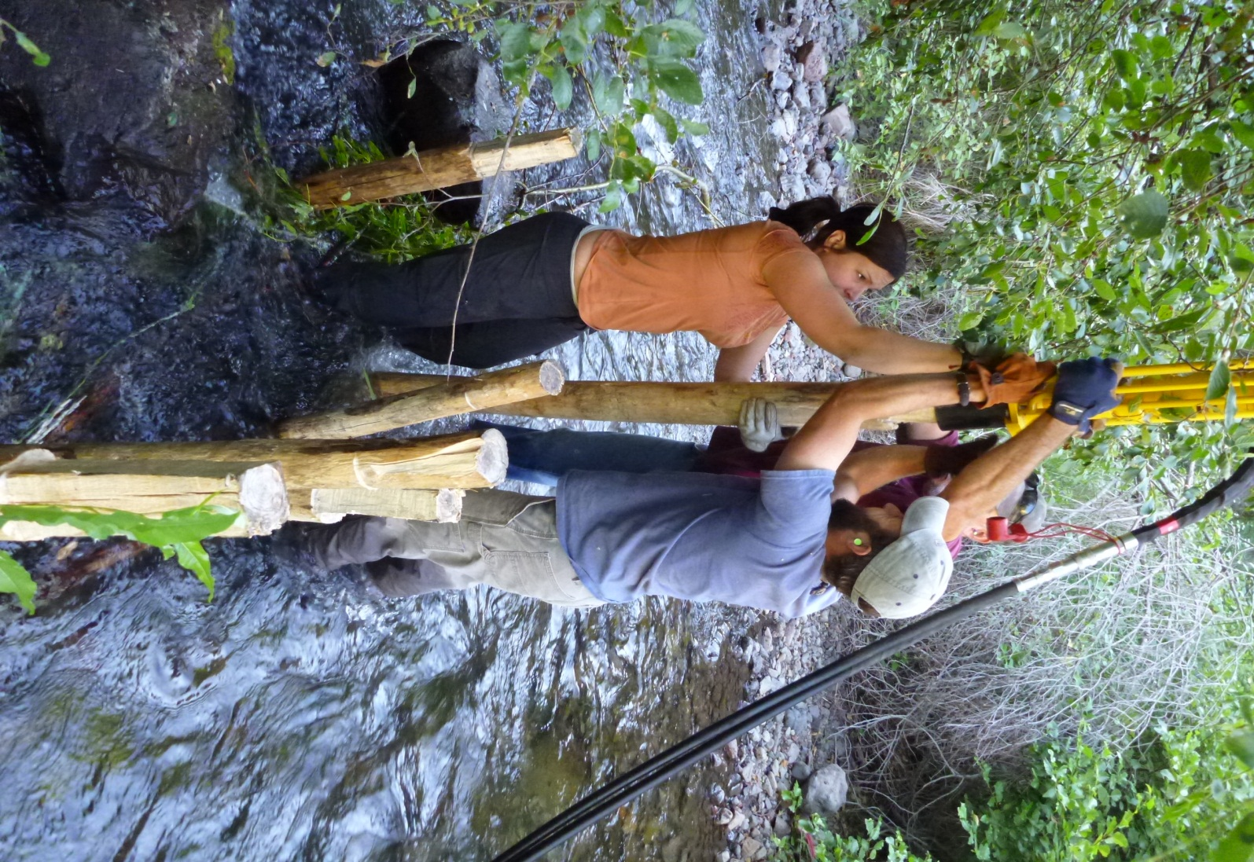
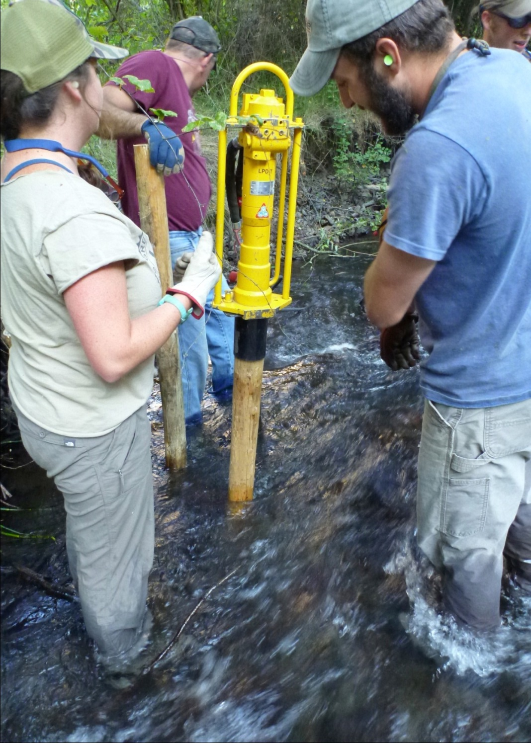
Notes:
Using the same approach as described in Asotin, we used a hydraulic post ponder to drive wooden post into the stream bed

Slide 34
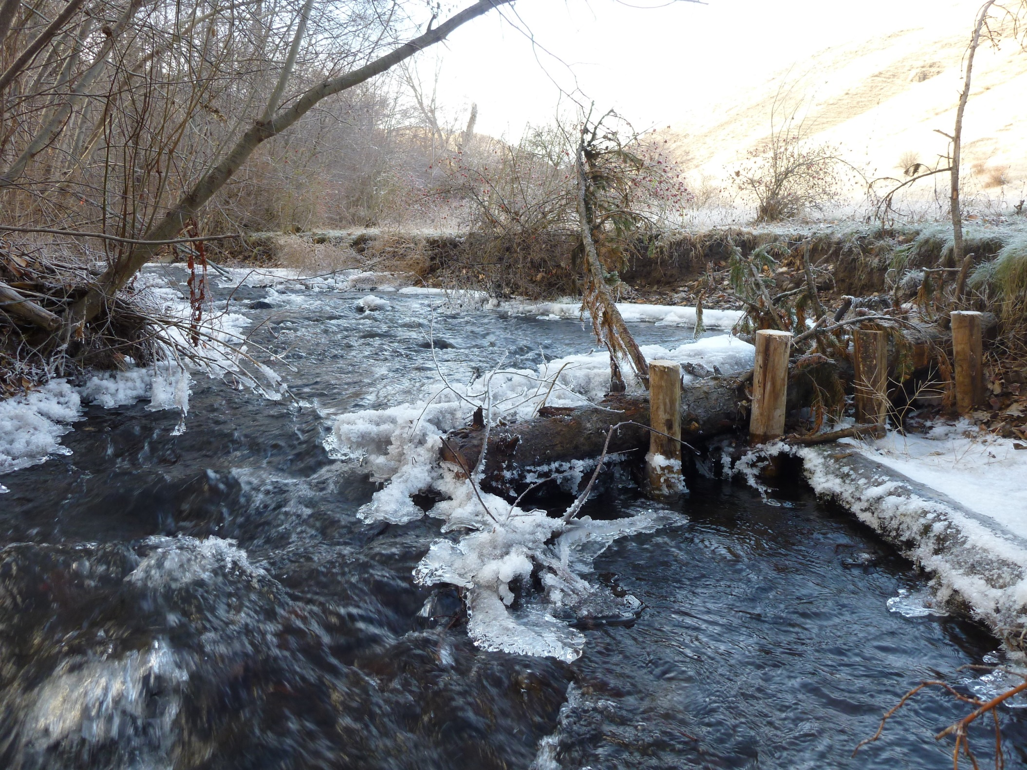

Slide 35
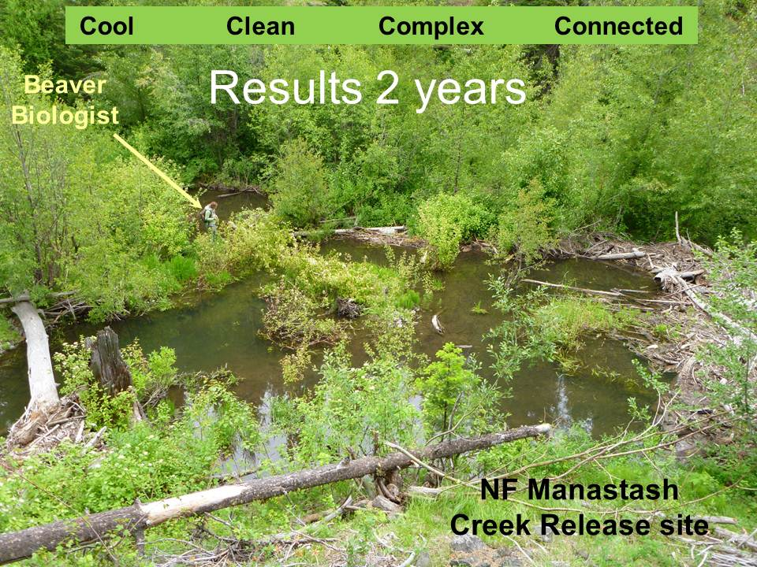

Beaver as an Ecosystem Engineer
- not just in incised streams
Courtesy of
William R. Meyer

Slide 36
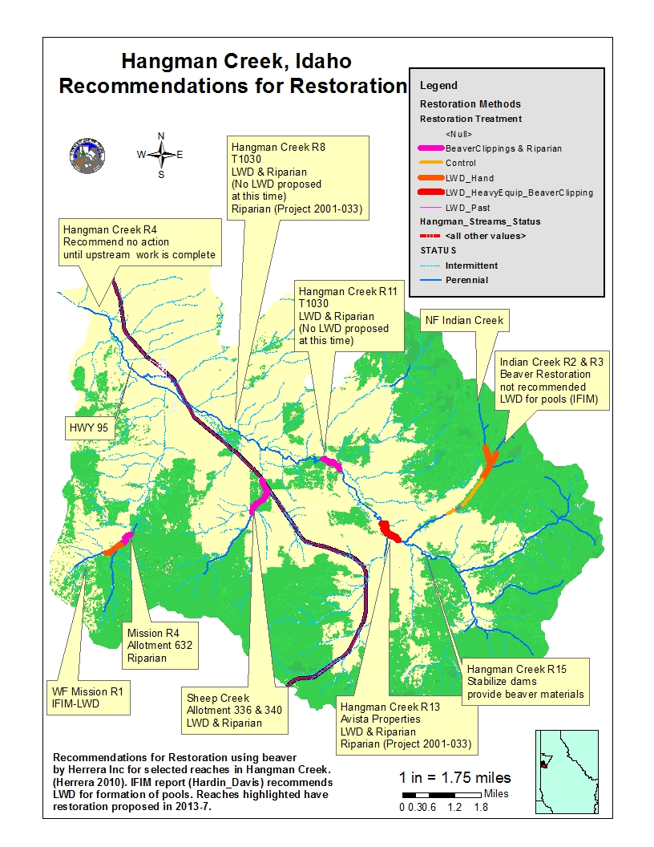

Slide 37
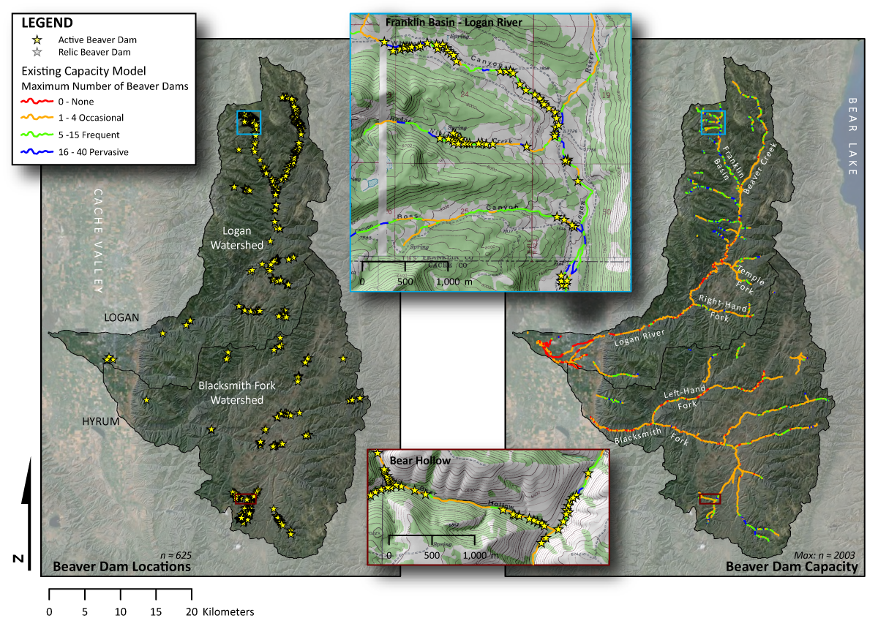
Beaver Restoration Assessment Tool - BRAT

Slide 38
Beaver as a restoration tool
USFS-NOAA Aquatic Resources Biological Opinion
  Accepted management practice
Utah Beaver Management Plan
New Mexico Legislation
  to direct NWDGF to use beaver in restoration
National Riparian Service Team (BLM, NRCS,…)

Slide 39
Agencies Leveraging Results of Bridge Creek to Develop Restoration Using Beaver
UDWR
BLM
NRCS
USFS
CWTS
Coeur d‘Alene Tribe
ODFW
WGF
IDFG

