Slide 1


Integrating ODFW’s Aquatic Inventories Project HabRate Model with CHaMP
CHaMP and ISEMP State of the Science Workshop
Portland, Oregon – February 25th and 26th, 2014
Presenter:
Ted Sedell
Collaborators:
Chris Horn & Rich Carmichael

Slide 2
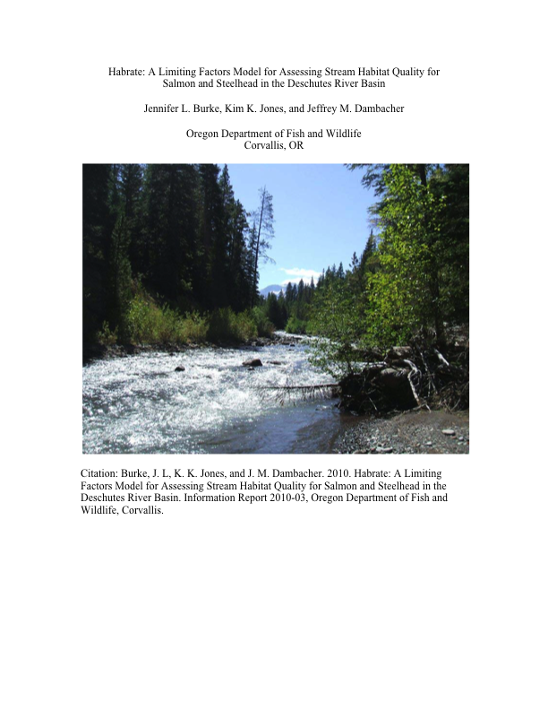

Slide 3
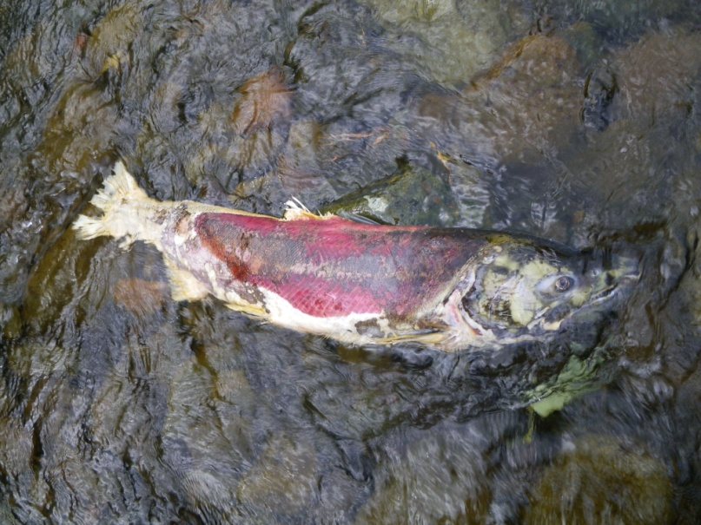
ODFW Aquatic Inventory’s HabRate Model
Attributes used in HabRate for Chinook salmon life history stages come from shared metrics to both AQI and CHaMP
Substrate (fines, gravel, cobble, boulders)
Cover (undercut, large wood, boulders)
Gradient
Channel morphology
Interstices (substrate interstitial space)
Pool area and residual pool depth
Pool complexity (scour pool depth, large wood)

Slide 4
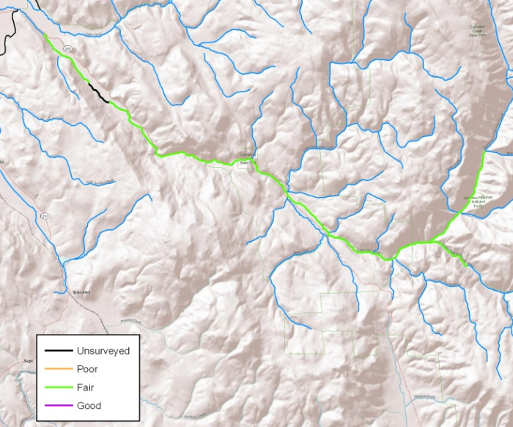
Aquatic Inventories Habitat Surveys
Catherine Creek HabRate Model
CH Summer Rearing
Notes:
We used a model (HabRate; Burke et al. 2010) to integrate habitat attributes as a method to assess overall habitat quality relative to freshwater life stages of Chinook and steelhead. We described the habitat quality for 1) spawning, egg survival, and emergence, 2) summer rearing, and 3) winter rearing. HabRate incorporates the habitat attributes collected in Catherine Creek. We collected information on stream substrate (fine sediment, gravel, and cobble), habitat unit type (scour, beaver, and off channel pools), cover (large wood, undercut banks), and channel morphology (secondary channels, gradient). The model combined attributes using logic equations, and provides a overall rating of habitat quality in a stepwise fashion. The ratings can be used as an additional tool to consider limiting factors for salmonid productivity in the system. Our assessment does not include water quality or quantity, although those factors can be added to the model for consideration. Model output ranks physical habitat quality from 1 to 3: poor, fair, and good.
The HabRate model is applied to other major streams and rivers within the Grande Ronde River basin (Minam & Little Minam Rivers and the Upper Grande Ronde River). Model is also being validated with the collection of fish data from all life history stages and from fine-scale habitat surveys (CHaMP).

Slide 5
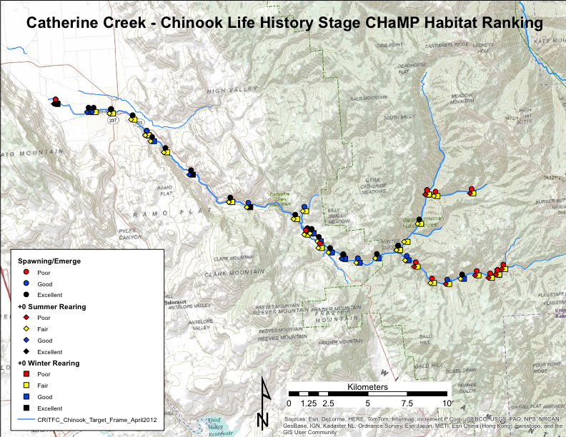

Slide 6
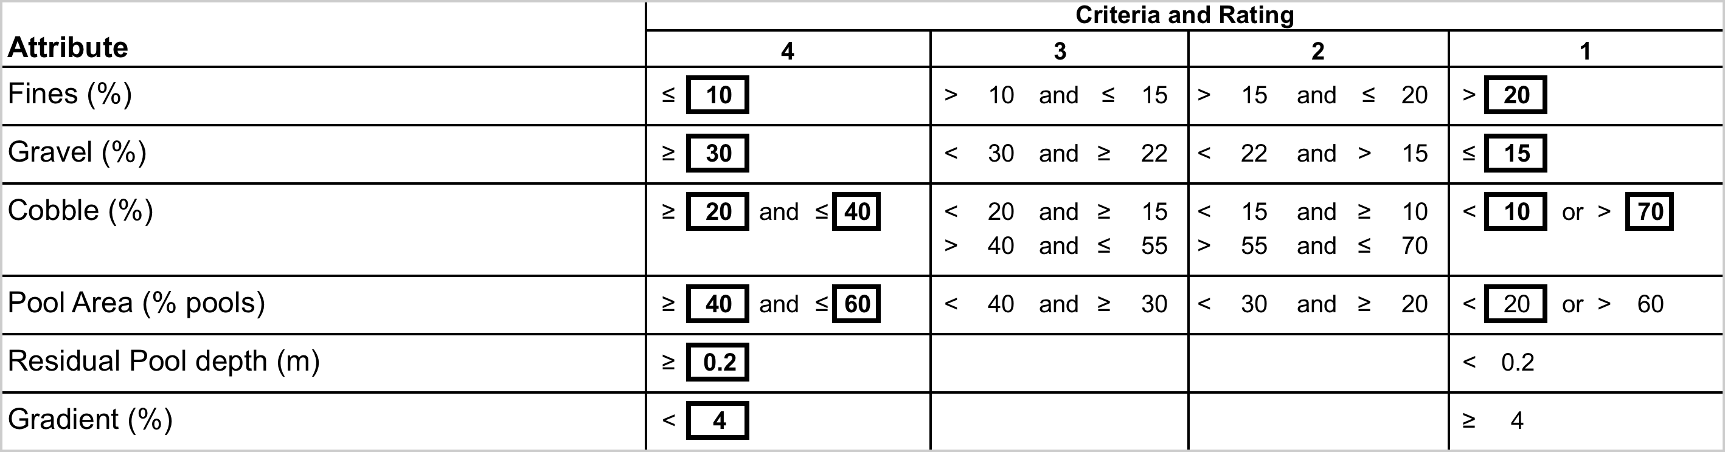
ATTRIBUTES
Chinook Spawning-egg incubation-emergence
Criteria and attributes are based on literature from field research and are important for survival.

Slide 7
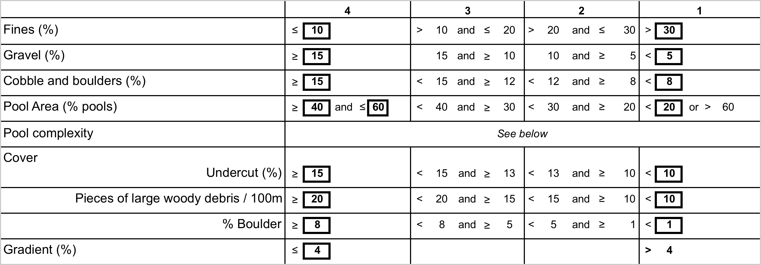
Chinook Summer Rearing
Protocol challenges:
LWD – no method is exactly the same
Boulders – percent vs. #/100m
Pools – Max depth vs. residual depth

Slide 8
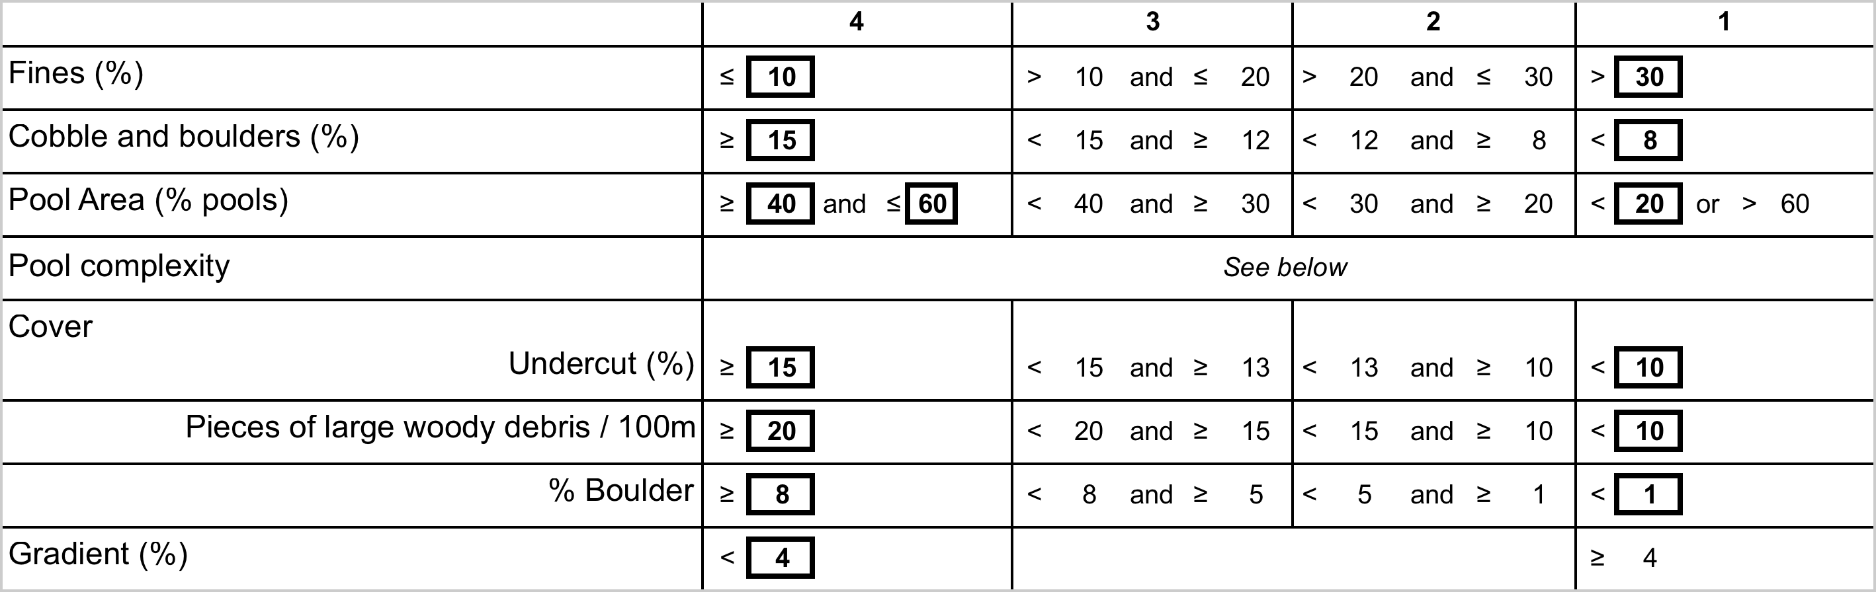
Chinook Overwinter Rearing
The scaled range and minimum value rating methodology was preferred to mean values so as not to obscure potentially detrimental attributes, and to identify limiting factors.

Slide 9
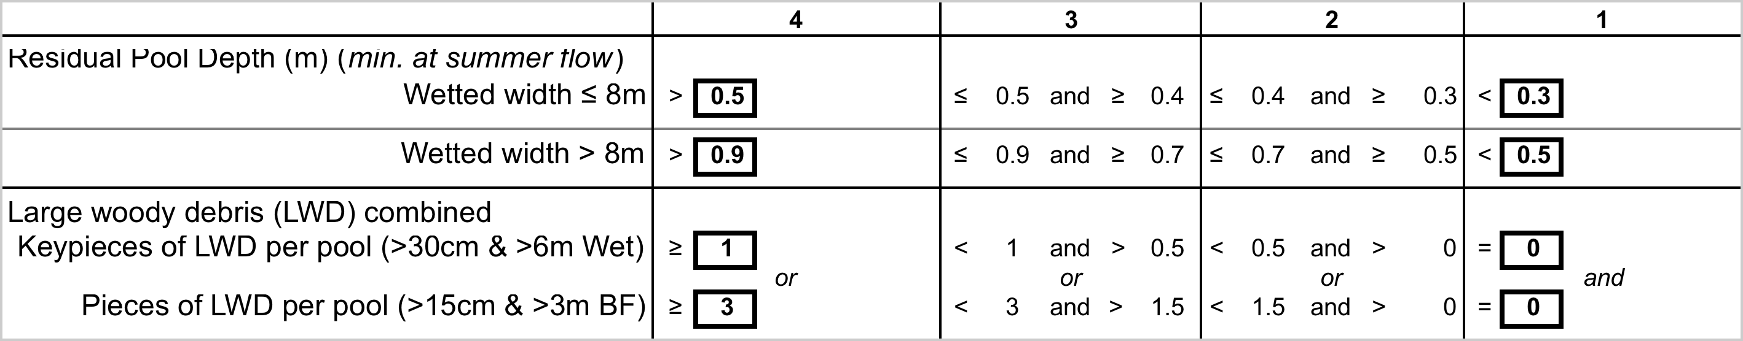
Pool Complexity
Attributes and rankings are weighted

Slide 10
CCC3 / Catherine Creek: Chinook Parr Summer Rearing HabRatings, 2011 - 2013
_ Legend _
= Excellent
= Good
= Fair
= Poor

Slide 11
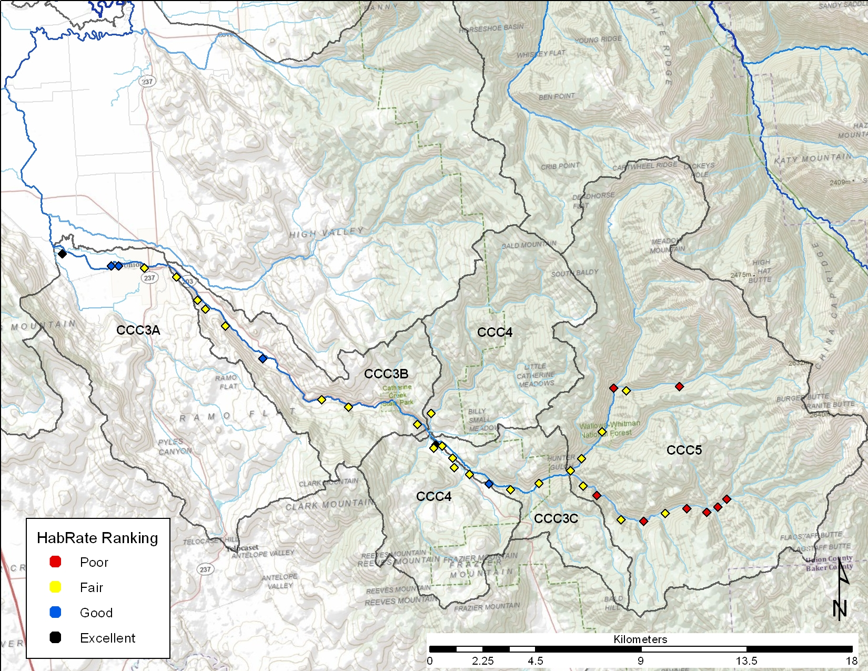
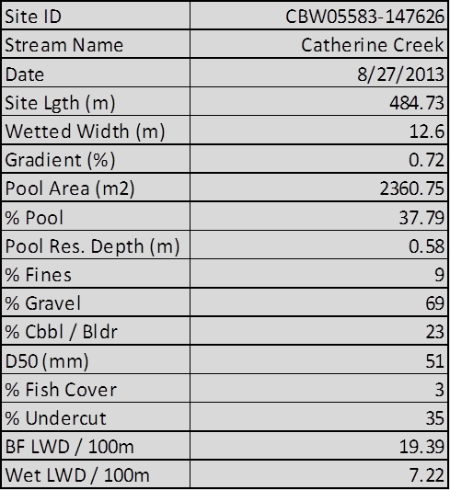
Key CHaMP site-level metrics used in HabRate Calculations
Summer Rearing Chinook 0+

Slide 12
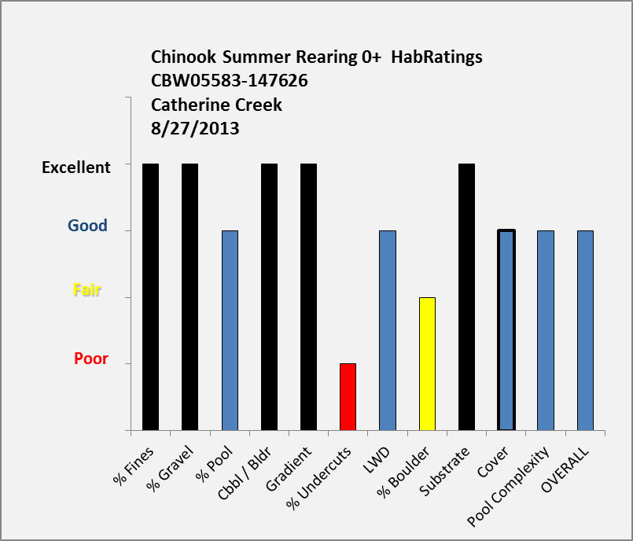
Component HabRatings that roll up to overall rating
Summer Rearing Chinook 0+

Slide 13
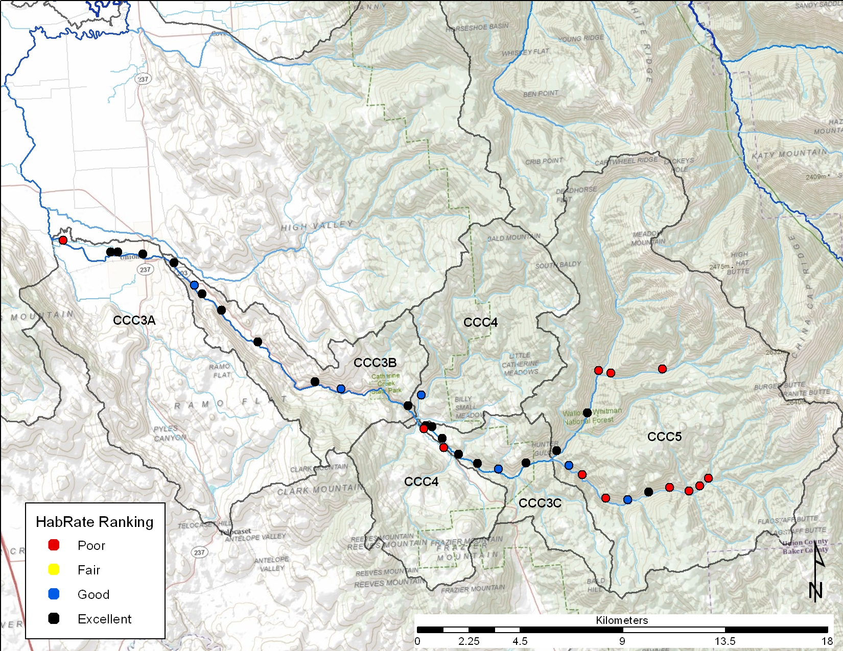
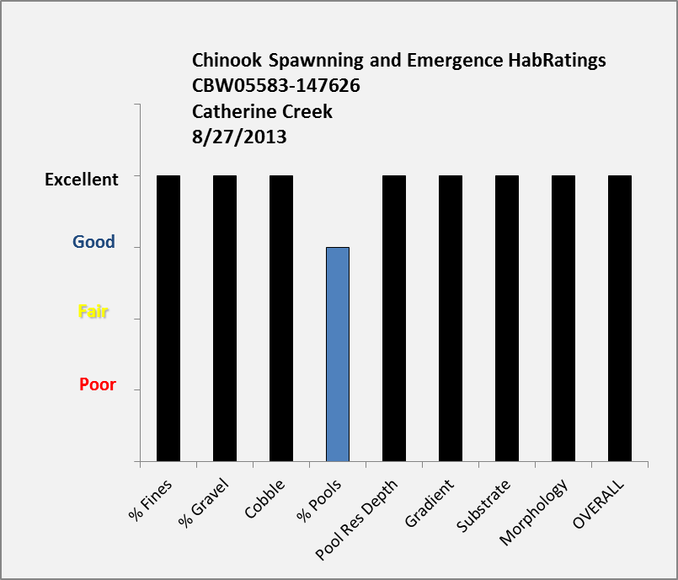
Component HabRatings that roll up to overall rating
Chinook Spawning and Emergence

Slide 14
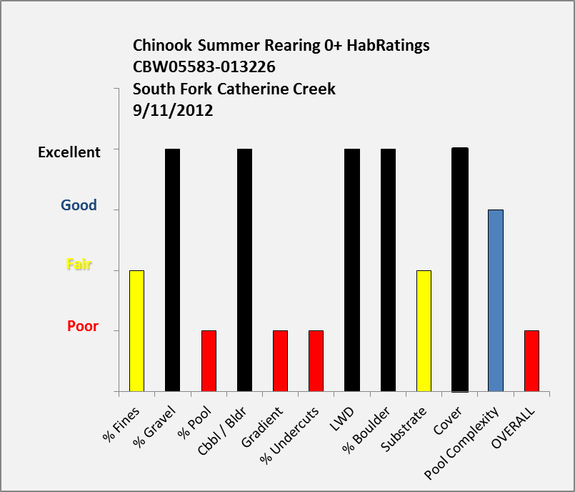
Component HabRatings that roll up to overall poor rating
Summer Rearing Chinook 0+

Slide 15
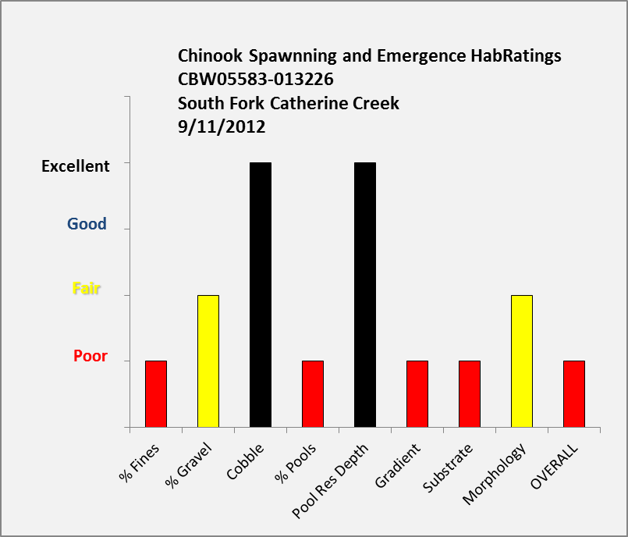
Component HabRatings that roll up to overall poor rating
Chinook Spawning and Emergence

Slide 16
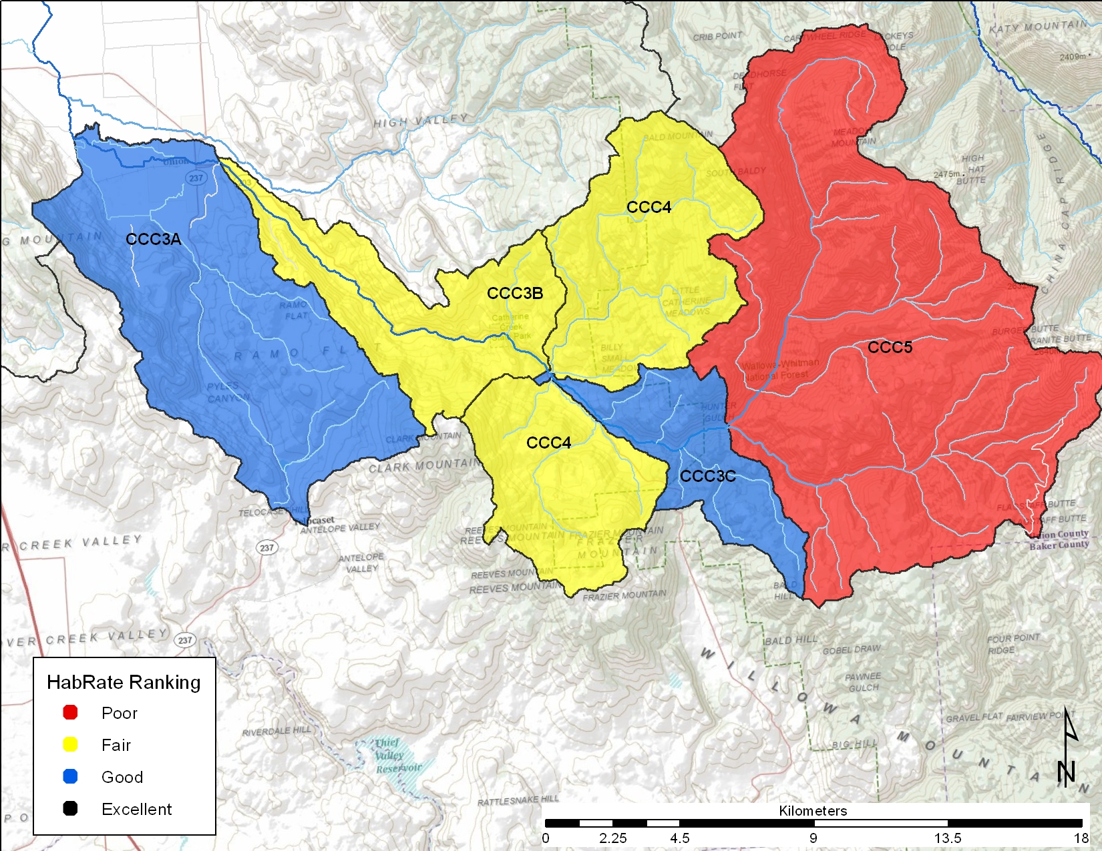
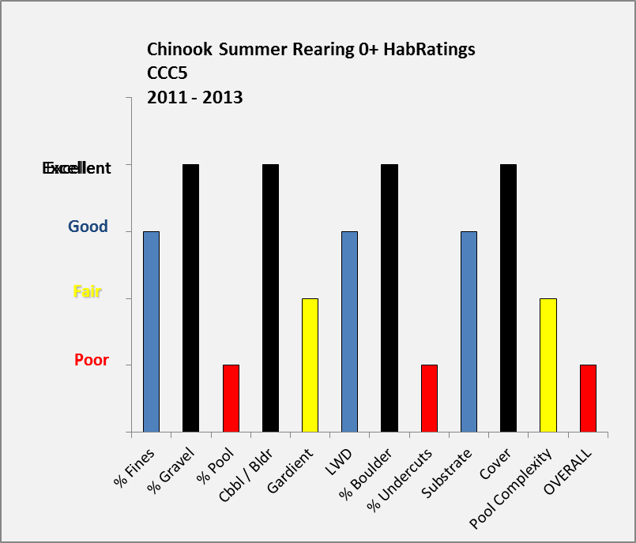
Component HabRatings averaged across Assessment Unit CCC5
Summer Rearing Chinook 0+

Slide 17
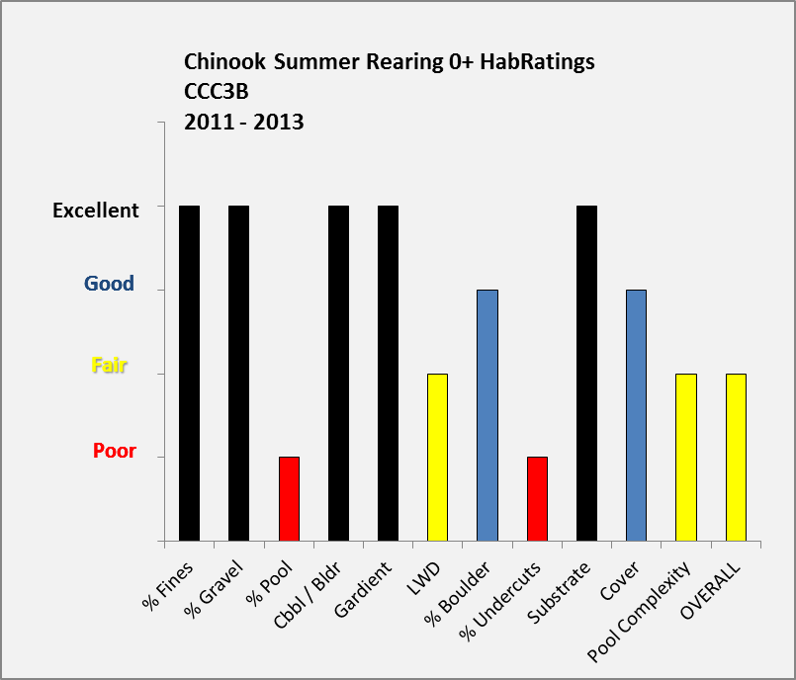
Component HabRatings averaged across Assessment Unit CCC3B
Summer Rearing Chinook 0+

Slide 18
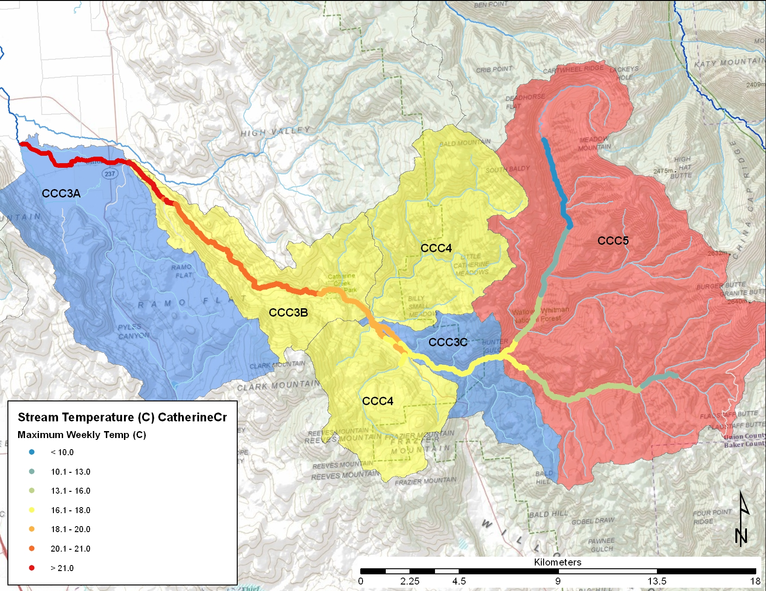
Peak stream temperatures and chinook summer rearing HabRatings

Slide 19
Next Steps
Expand HabRate to include adult migration and holding
Incorporate temperature and flow
Extrapolate to the stream network
Incorporate into the ATLAS and Expert Panel Process

