Slide 1

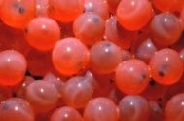
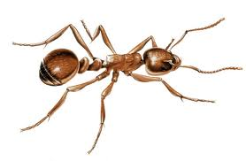
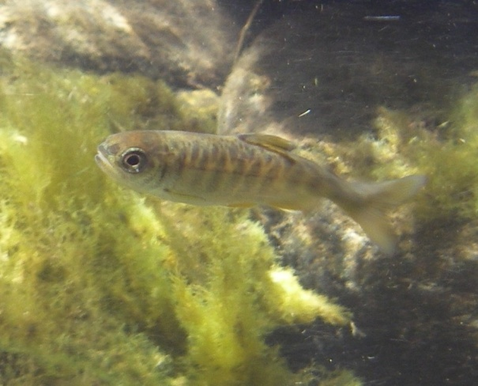
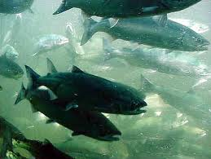
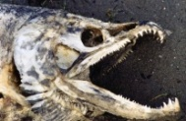
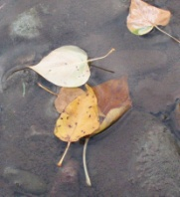
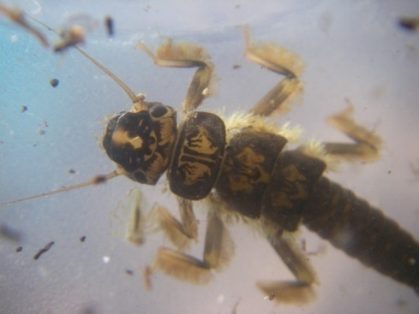
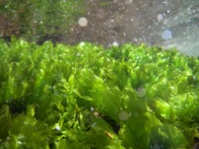

Modeling the Food Web Response to Restoration in the Methow River Using CHaMP Data
Ryan Bellmore (USGS), Michael Newsom (BOR), Alex Fremier (WSU), Pat Connolly (USGS)
Nutrients
Riparian Conditions
Physical Conditions

Slide 2
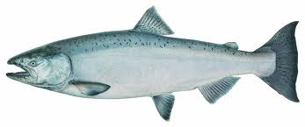
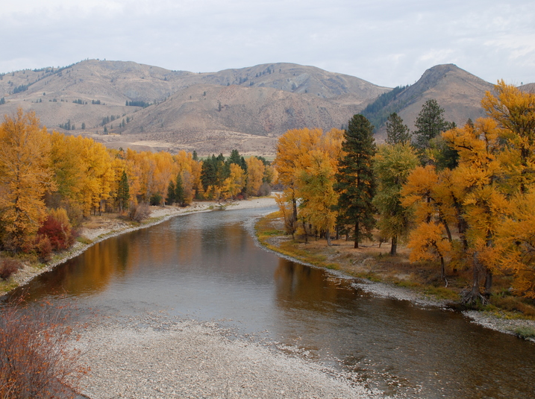
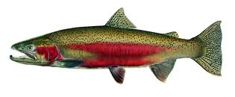
The Methow River
How do we recovery ESA listed Spring Chinook
salmon and summer steelhead?

Slide 3
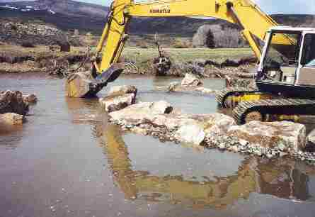
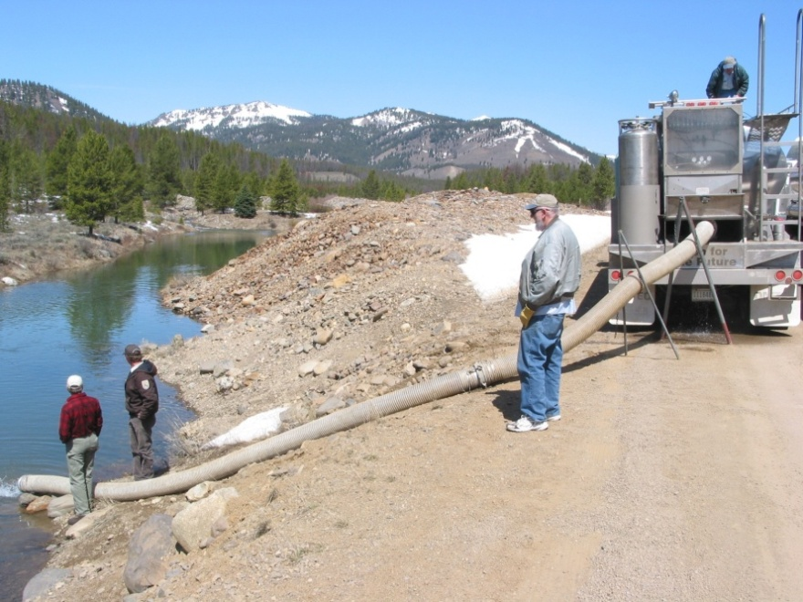
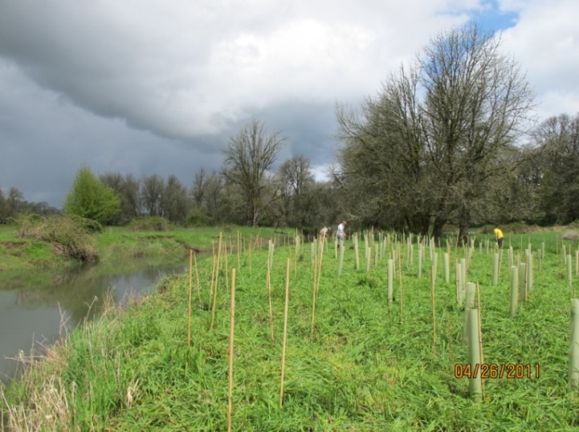
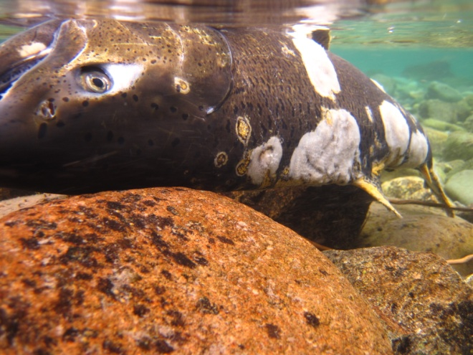
The Methow River
Problem: Which restoration strategy do we use?
Habitat Restoration
Hatchery Supplementation
There is a need for objective and defensible tools to prioritize and guide restoration efforts.
Riparian Restoration
Nutrient Augmentation
Notes:
Several salmon recovery strategies are currently being applied or considered in the Methow, including: habitat restoration, riparian restoration or recovery, hatchery supplementation, and even nutrient augmentation. The problem is, we don’t necessarily know which of these approaches or combination of approaches to use. In other words, we need objective and defensible tools to prioritize and guide restoration efforts.

Slide 4
Modeling as a tool
To address this problem in the Methow. . .
Constructed a mechanism-based dynamic food web model, termed the “Aquatic Trophic Productivity” model
Model is being used to explore how alternative restoration strategies might influence food webs, and the capacity for stream habitat to sustain fish populations.
Notes:
To address this problem, or need, in the Methow River, we have constructed a mechanism-based simulation model termed the “Aquatic Trophic Productivity” model, which we are using to explore how restoration strategies might influence food webs, and the capacity of freshwaters to sustain fish populations.

Slide 5
The Trophic Productivity Model
What is the Trophic Productivity Model?
It is a dynamic food web model, whereby fish production is explicitly tied to transfers of organic matter between different components of a simplified river food web.
Mechanistically links food web dynamics to in-stream physical habitat and riparian conditions
Simulates how the biomass of aquatic organisms changes through time
Can be used to predict fish carrying capacity
Notes:
what is the Trophic Productivity Model?
It is a dynamic food web model, whereby fish production is explicitly tied to transfers of organic matter between different components of a simplified river food web.
This model mechanistically links food web dynamics to in-stream physical habitat and riparian conditions,
which allows us to simulate how the biomass of different aquatic organisms, such as fish, invertebrates and periphyton change through time,
And, ultimately, to predict fish carrying capacity.

Slide 6
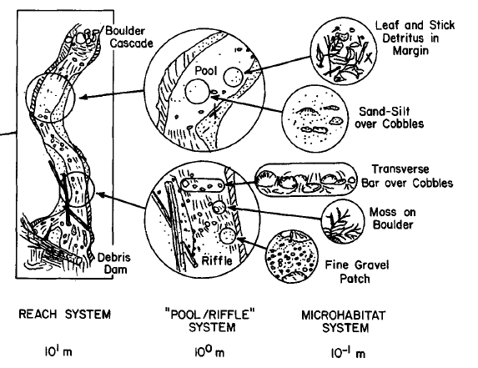
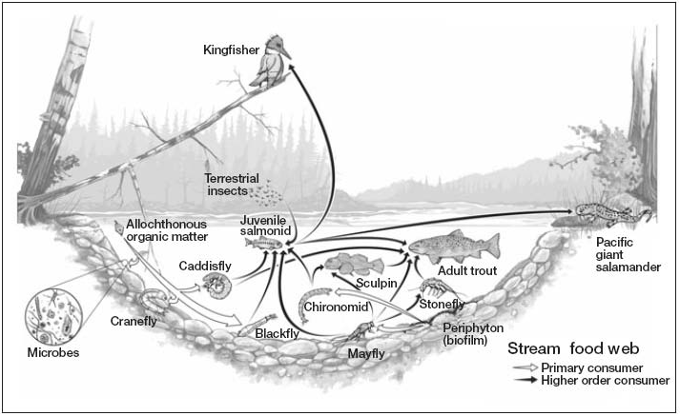
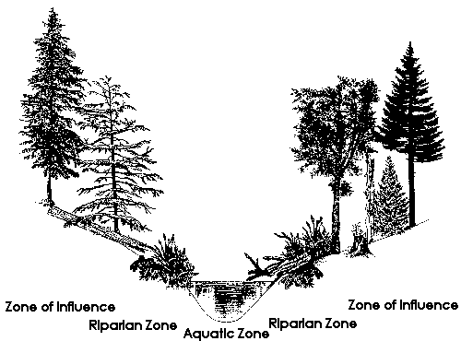
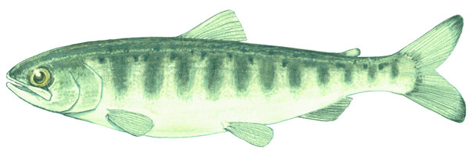
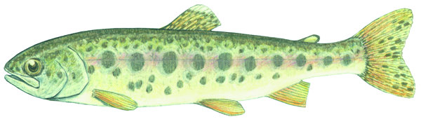
The Trophic Productivity Model
Physical Habitat
Food Web Dynamics
Riparian Condition
CARRYING CAPACITY
Notes:
So basically, the model takes CHaMP style information on physical habitat and riparian condition, makes predictions about food web dynamics given those initial conditions, and then based on the outcome of those dynamics, estimates fish carrying capacity.

Slide 7



The Trophic Productivity Model
Physical Habitat
Food Web Dynamics
Riparian Condition
CARRYING CAPACITY
Notes:
Once this is done, we can then use our model to SIMULATE how this capacity might change with alternative salmon recovery strategies.

Slide 8
Model Structure
FRESHWATER SYSTEM
Notes:
I don’t have time to go through all the details of the model, but will illustrate the general structure of the model with some simple diagrams.
The backbone of the model contains four different stocks of material: Fish, Aquatic Invertebrates, In-Stream Primary Producers or periphyton, and Terrestrial Derived Detritus, such as leaf litter.
In the model, energy flows from the bottom up, from periphyton and terrestrial detritus, to aquatic invertebrates, and from aquatic invertebrates to fish. However, there are also arrows pointing in the opposite direction, which illustrate that fish and invertebrates can exhibit top-down control on their resources.
Together these fours stocks and associated consumer-resource interactions represents the key components of the modeled freshwater system.

Slide 9
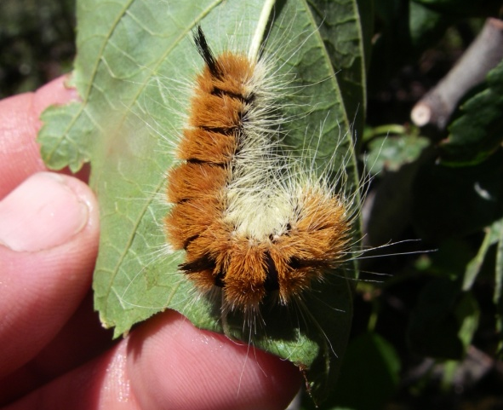


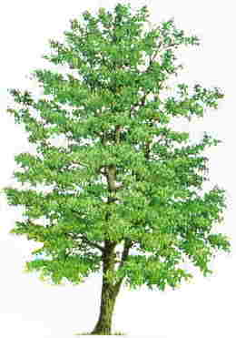

Model Structure
FRESHWATER SYSTEM
NUTRIENTS
Notes:
Connected into this system we have: sunlight and nutrients, necessary for in-stream primary production; riparian vegetation which not only provides terrestrial derived organic matter, but also shades the stream, and contributes to the input of terrestrial invertebrates, which are directly consumed by fish.
We have also included the multiple pathways by which salmon influence freshwater food web dynamics. In our model live salmon spawners contribute nutrients to the system via excretion. Upon death, the carcasses of these spawners also leach nutrients into the system, and are directly consumed by both aquatic invertebrates and fish. In addition to carcasses, we also represent the direct consumption of salmon eggs by fish, which become available when redds are superimposed upon one-another. We also assume that salmon increase the amount of terrestrial invertebrates entering the system.
During the process of spawning or redd building, salmon also scour the stream bed, removing or mobilizing periphyton and invertebrates.

Slide 10

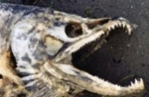

Model Structure
FRESHWATER SYSTEM
NUTRIENTS
CHAMP
DATA
Riparian Conditions
Physical Conditions
Notes:
Finally, the strength of all of the connections and energy flows depicted here are mediated by environmental or physical conditions of the stream and the adjacent riparian zone, most of which we are obtaining from CHaMP surveys.

Slide 11
Model Structure
FRESHWATER SYSTEM
WATER
TEMPERATURE
NUTRIENTS
Notes:
For example, water temperature collected at CHaMP sites is directly incorporated into our model because it influences the growth, respiration, and consumption of stream organisms.

Slide 12
Model Structure
FRESHWATER SYSTEM
AIR
TEMPERATURE
NUTRIENTS
Notes:
CHaMP air temperature data, influences the magnitude of terrestrial invertebrate inputs in our model

Slide 13
Model Structure
FRESHWATER SYSTEM
RIPARIAN
VEGETATION
NUTRIENTS
Notes:
CHaMP riparian surveys are used to estimate inputs of leaf litter, as well as terrestrial invertebrates.

Slide 14
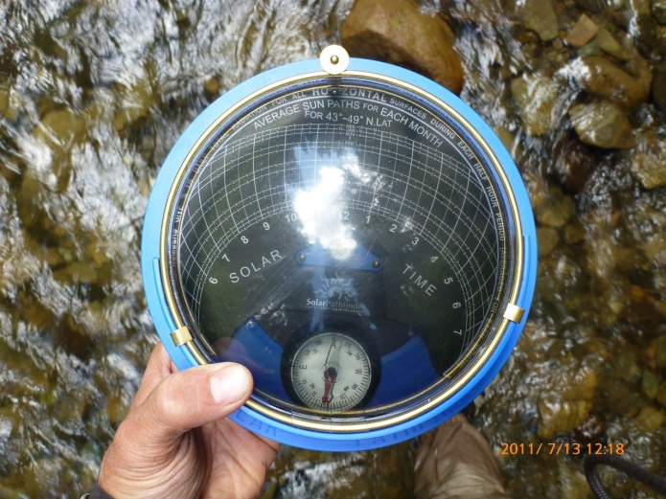
Model Structure
FRESHWATER SYSTEM
SOLAR
RADIATION
NUTRIENTS
Notes:
Similarly, stream shading measurements are used to calculate inputs of solar radiation.

Slide 15
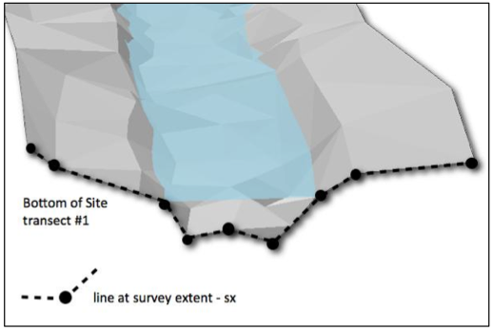
Model Structure
FRESHWATER SYSTEM
CHANNEL
MORPHOLOGY
&
HYDRAULICS
NUTRIENTS
Notes:
CHaMP transect and total station surveys provide key channel morphology and hydraulic information, such as stream gradient, depth, width, water velocity and shear stress, which effect food web dynamics via multiple pathways in our model

Slide 16
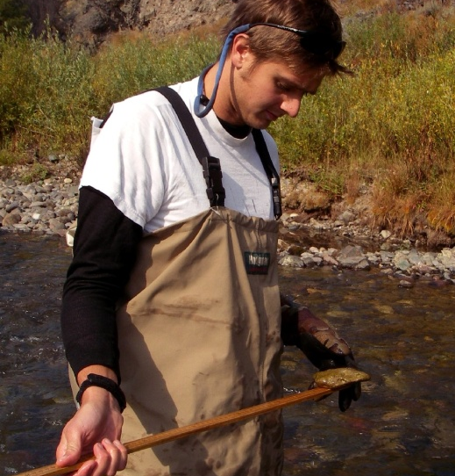
Model Structure
FRESHWATER SYSTEM
SUBSTRATE
SIZE
NUTRIENTS
Notes:
Finally, information on substrate size from CHaMP surveys effect the probability of bed scour and associated mortality of benthic organisms in our model, as well as the amount of suitable spawning habitat for adult salmon.

Slide 17
Model Inputs
FRESHWATER SYSTEM
Additional Inputs
Flow regime
Water turbidity
Nutrient concentrations (NO3, NH4, SRP)
Salmon spawner densities
NUTRIENTS
Notes:
I should note that there are a few other inputs to the model that are not part of CHaMP, including: discharge or flow regimes, water turbidity, nutrient concentrations and salmon spawner densities.

Slide 18
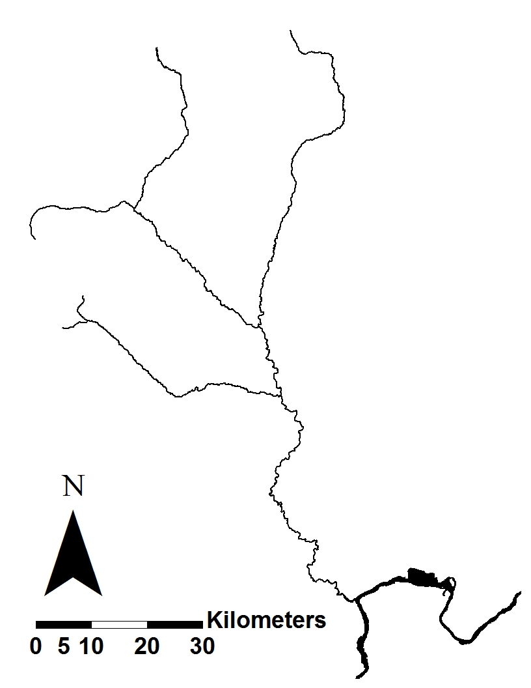
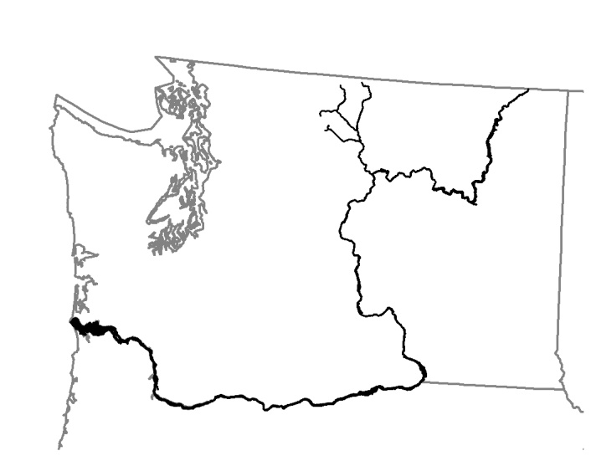
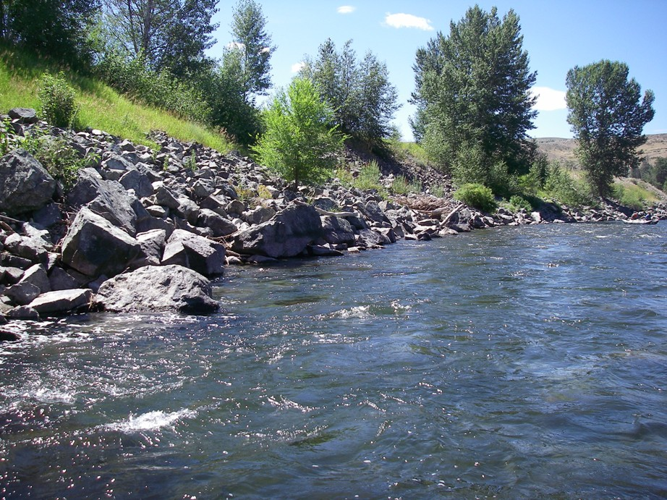
Model Test: Methow River
Methow River
Columbia River
Notes:
For the purposes of the talk today, I’m going to very quickly present an example application of the model to a floodplain segment of the Methow River, circled here in Red, which is the location of on-going salmon recovery efforts.
We also have CHaMP site located in this section, shown as the purple dot, which we have used to help parameterize the model.

Slide 19


Model Test: Methow River
Simulations:
No Treatment – Background Conditions
Riparian Restoration
Salmon Carcass Addition
Habitat Restoration (floodplain restoration)
Notes:
I’m going to present the result of four different simulations for this river segment.
A no treatment scenario, or a simulation of background conditions.
Followed by three treatment simulations
-A riparian restoration treatment
-A carcass addition treatment
-And a habitat or floodplain restoration treatment

Slide 20
(Bellmore
et al. 2013)
(Bellmore
et al. 2013)
Range: 1 – 18
g AFDM m⁻²
(Bellmore et al. 2012)
Range: 0.7 – 33
g AFDM m⁻²
(Bellmore et al. 2012)
Notes:
Here are the modeled results for fish, invertebrates, periphyton, and in-stream terrestrial litter for the background, no treatment condition. These figures show the simulated biomass for each of these items, for an each day of the calendar year, January 1 through January 1
We have also averaged these daily values to calculate the average annual biomass for each stock of material. So for fish this value represents an estimate of capacity, in terms of biomass, for this river segment.
By the way, these modeled values for fish and invertebrates correspond very well to empirical measured biomass values estimated as part of a previous study within this river segment. We did not measure periphyton and terrestrial detritus as part of this previous study. However, our modeled values ARE within the range of values that we have measured in similar river basins.

Slide 21
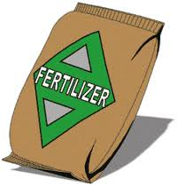
Model Test: Methow River
Simulations:
2. Riparian Restoration
  Increase percent of channel with overhanging vegetation from 5% to 10%
      Raises riparian leaf litter and invertebrate inputs
      Reduces light availability
Notes:
For the riparian vegetation simulation we are increasing the amount of vegetation overhanging the stream bank from 5% to 10%, which obviously raises leaf litter as well as terrestrial invertebrate inputs to the stream. However, it also reduced light availability by increasing stream shading.

Slide 22
17%
Notes:
Comparing the results of this treatment to the background condition, we find that we do indeed increase in-stream terrestrial detritus, which translates into a little bit greater invertebrate biomass, as well as fish biomass, which represents a XX% increase.

Slide 23
Model Test: Methow River
Simulations:
3. Salmon Carcass Addition
  10,000 carcasses added to segment
  0.01 carcasses / meter²
Notes:
So now, lets add salmon carcasses to the stream. Lets say we add 10,000 carcasses to the stream during the post spawn period. This sounds like a lot of carcasses, but because our modeled reach is so large, this only translates into 0.01 carcasses per meter square.

Slide 24
17%
37%
Notes:
In this scenarios we can see that we don’t really change periphyton or detritus biomass, but invertebrate and fish biomass increases, mainly due to the direct consumption of salmon carcass material. For fish, this represents a XX% increase.

Slide 25
Model Test: Methow River
Simulations:
4. Habitat Restoration (floodplain restoration)
  increase bankfull width (20%)
  decrease bankfull depth (20%)
  increase total floodplain width (50%)
  decrease stream gradient (20%)
Notes:
In our final treatment simulation we are exploring the potential impact of habitat restoration, or a relatively large scale floodplain restoration treatment. In this simulation, we increase the bankfull width of the channel by approximately 20%, decrease the bankfull depth of the channel by 20%, increase the width of the floodplain surface adjacent to the channel by 50%, and finally decrease channel gradient by 20%.

Slide 26
37%
50%
17%
Notes:
In this scenario we see that, habitat restoration increases periphyton biomass, particularly during the summer months when the demand for food by stream consumers is high, which translates into greater invertebrate biomass, and greater fish biomass. And overall we see that given the treatments and magnitude of those treatments that we have applied to the model, habitat restoration is predicted to have the greatest impact on fish carrying capacity.

Slide 27
Summary
The “Trophic Productivity Model” is a simplified food web model that mechanistically links trophic dynamics to CHaMP style physical habitat, and riparian data.
Used to explore the potential outcomes of alternative restoration strategies:
  Nutrient/salmon carcass augmentation
  Habitat restoration
  Riparian planting
  hatchery supplementation
  Invasive species
Notes:
To summarize: The “Trophic Productivity Model” is a simplified food web model that mechanistically links trophic dynamics to physical habitat, riparian conditions, and marine derived nutrients.
This model can be used to explore the potential outcomes of alternative management or restoration strategies:
Here we illustrate that it can be used to explore the response to nutrient additions, salmon carcass additions and habitat restoration. But it could also be used to explore the responses of several other restoration or salmon recovery strategies, such as riparian planting, and hatchery supplementation.

Slide 28
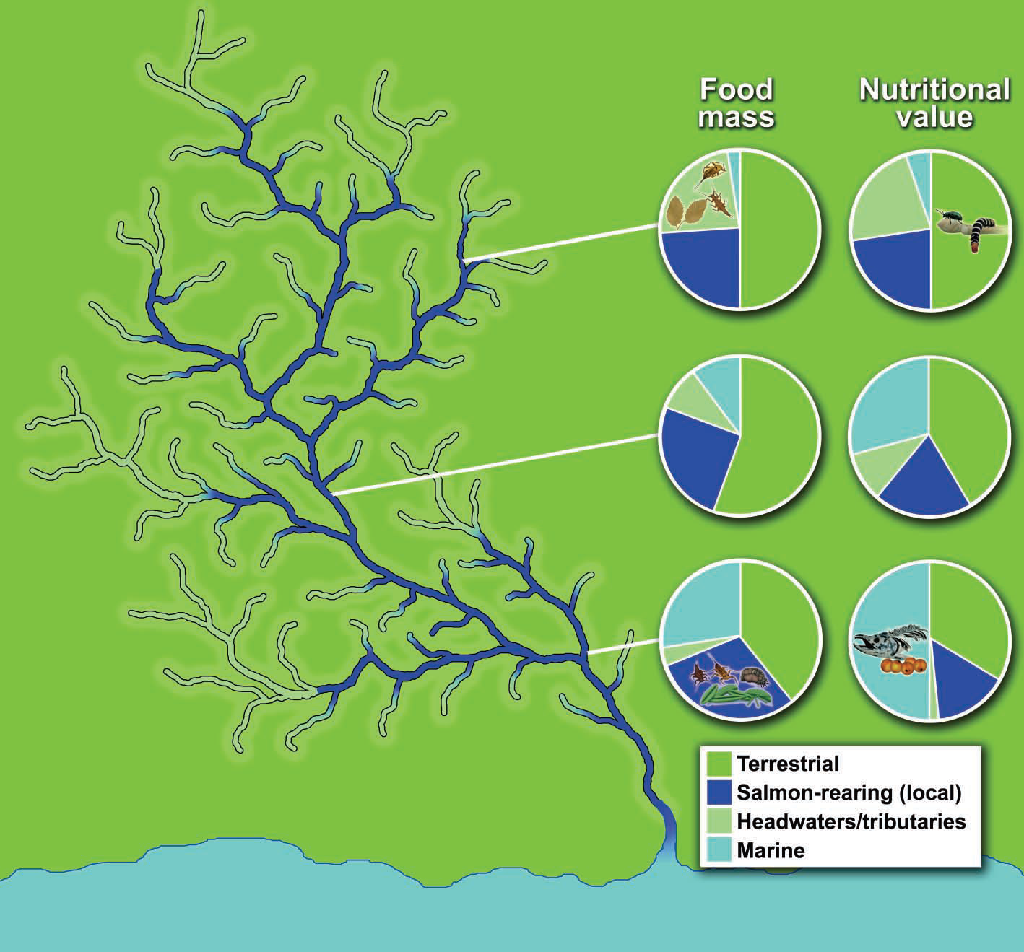
Spatially Explicit Capacity Estimates
(Wipfli and Baxter 2010)
Notes:
My final point that I wanted to make is that we often have great spatially explicit information on all kinds of features in river networks, such as geology, channel morphology, vegetation and temperature.
Well, Perhaps it is time we start thinking about understanding and mapping stream productivity, or stream food production in a spatially explicit fashion, as well. Cause fish, just like you and I, need both food and habitat. Although ideally we would just have models developed that predict food production based on physical features of the environments, we can’t build, calibrate or validate these models without first actually having empirical measurements of food production itself.

Slide 29
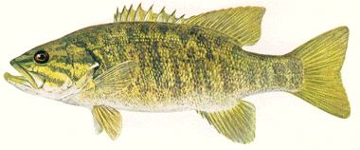
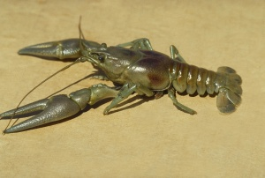
Notes:
The general structure of our model could also be easily be modified to explore the effects of invasive species on trophic dynamics, and/or the interaction of multiple invasive species.

