Slide 1
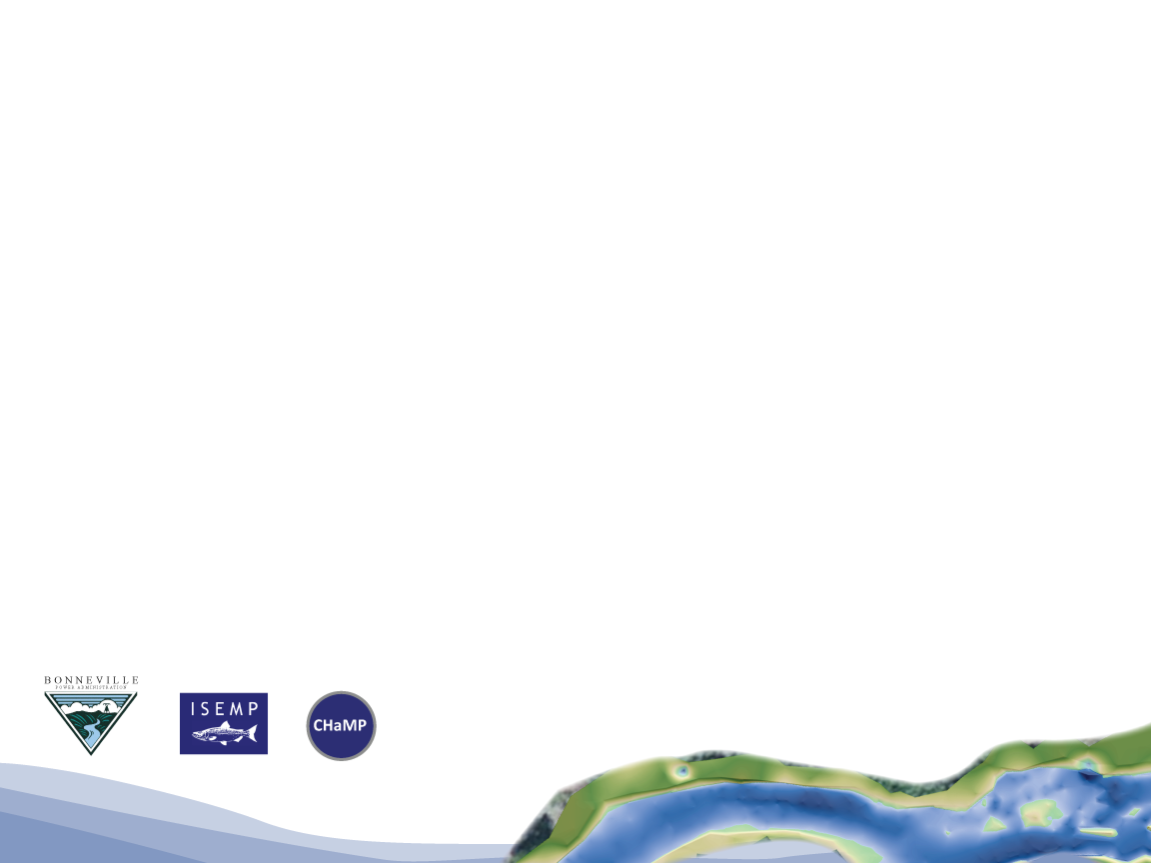



River Styles Framework
Adapting River Styles Framework to Support Regional Tributary Habitat Salmonid Management Needs
CHaMP and ISEMP State of the Science Workshop
Portland, Oregon – February 25th and 26th, 2014
Presenter:
Joe Wheaton
Collaborators:
Gary O’Brien, Gary Brierley, Kirstie Fryirs, Sara Bangen and Nick Bouwes

Slide 2
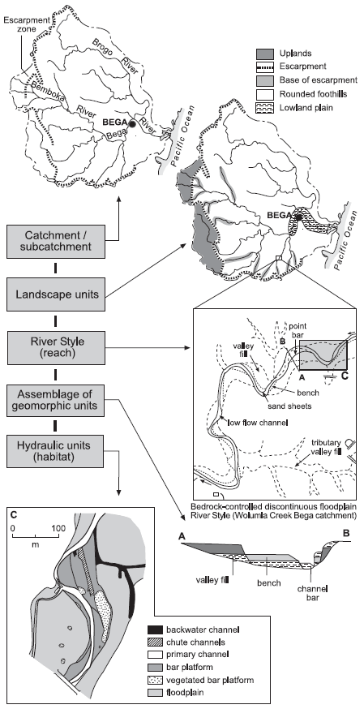
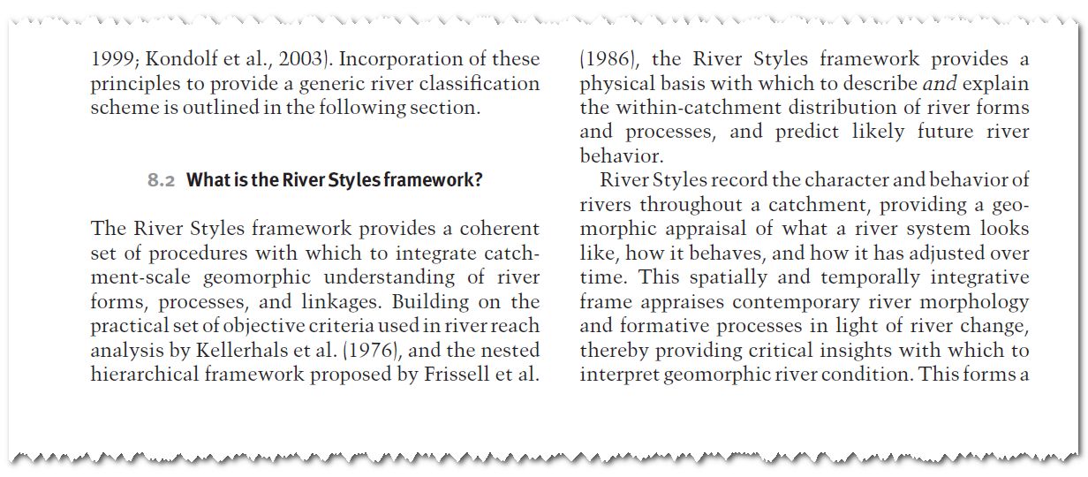
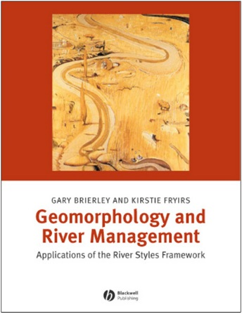
What is/are River Styles?
Not a classification scheme
A flexible framework for understanding rivers targeted at River Management

Slide 3
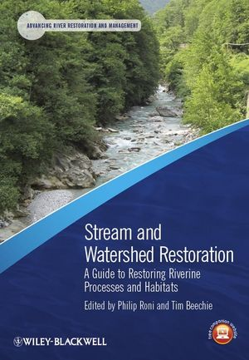
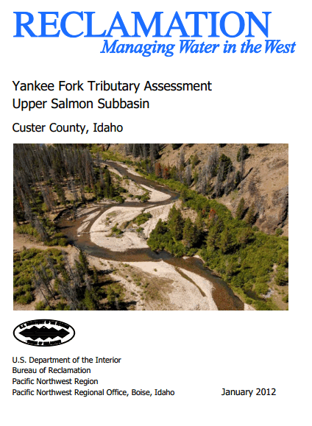
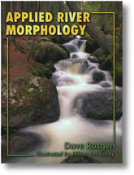
Why River Styles?
Most-thorough and comprehensive approach to using geomorphology to inform river management
Like Others… very process based…
We are working on cross-walking to other existing efforts
Adapting… not reinventing wheel

Slide 4
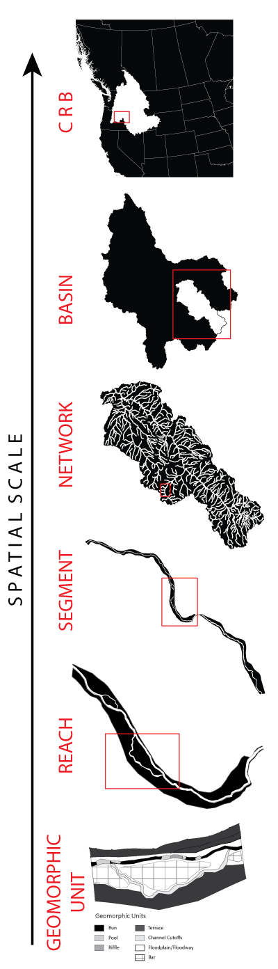
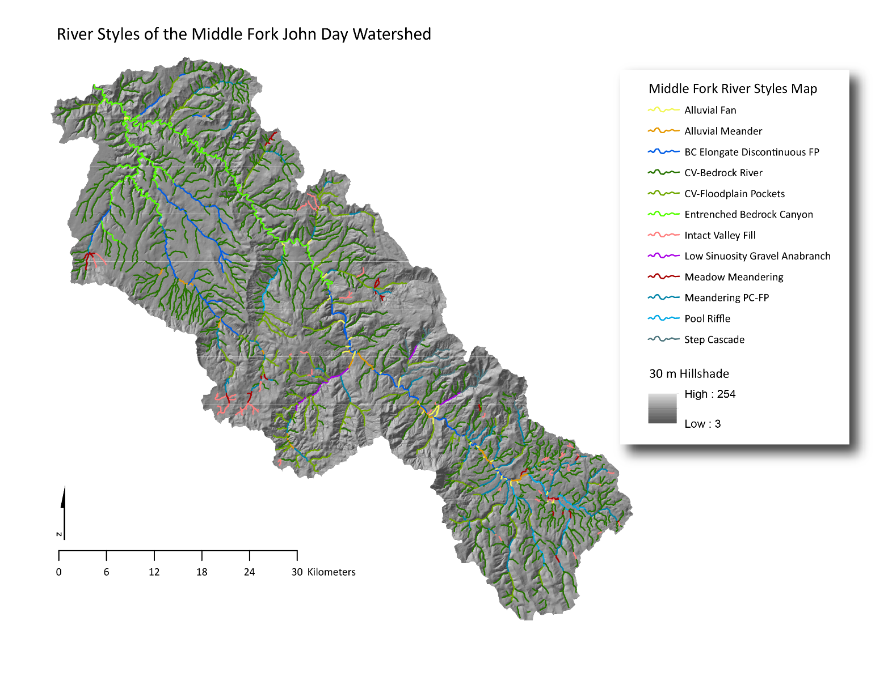
With River Styles, There is some Classification….

Slide 5
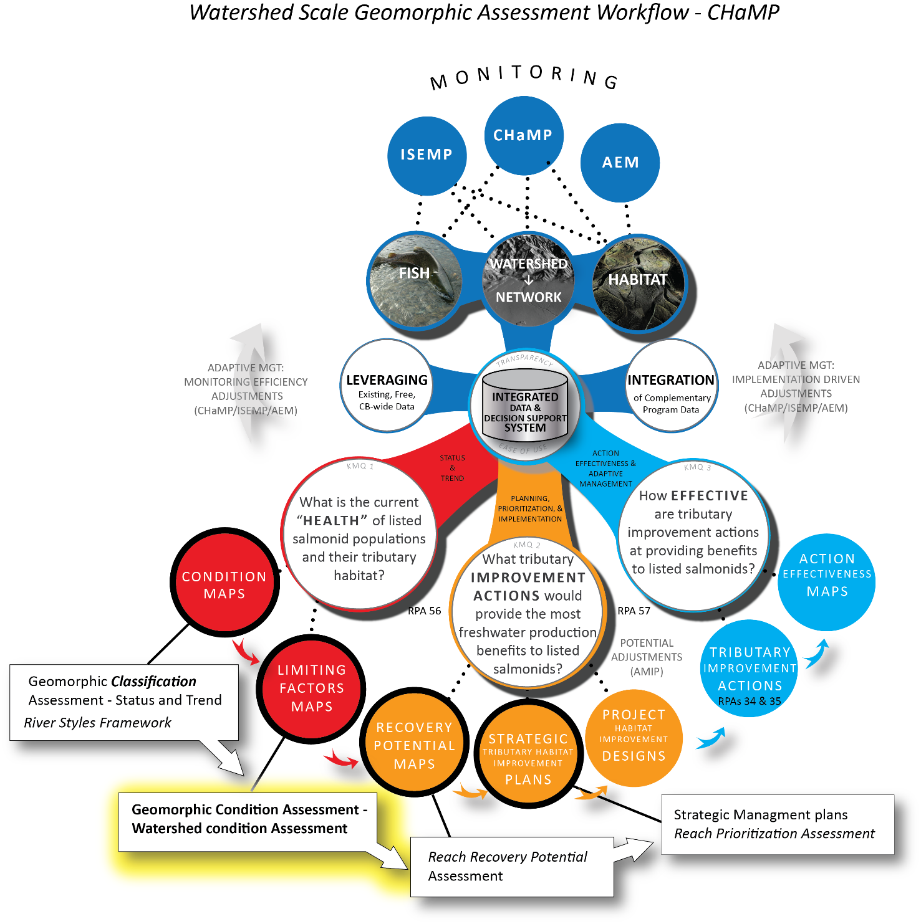
Geomorphic Condition assessment is a key step to developing Strategic Tributary Habitat improvement plans

Slide 6
Geomorphic Condition of CHaMP Streams..
…is defined as “the expected behavior of a stream reach flowing in its particular valley setting, given contemporary boundary conditions and owing to limiting factors and pressures in the watershed…”
…is a gauge of healthy function for individual reaches of the same River Style, compared to a best “Reference Condition” in the study watershed.
…Is needed to assess the quality of existing habitat, predict the recovery potential of impacted streams, and determine future management actions.
…is determined for every reach of every River Style in the watershed.

Slide 7
Steps for creating Geomorphic Condition Maps using River Styles
Determine sensitivity of reaches through capacity for adjustment assessment (which are prone to degradation?)
Evolutionary Diagrams show reach history and pathways for adjustment (how do they get there?)
Compare reaches to a “Reference Condition” in the watershed (What’s the baseline for comparison?)
Evaluate each reach in context of the reference condition, as Intact, good, fair, or poor (how they are ranked)
Analyze spatial distribution of conditions across the watershed (Map it!)

Slide 8
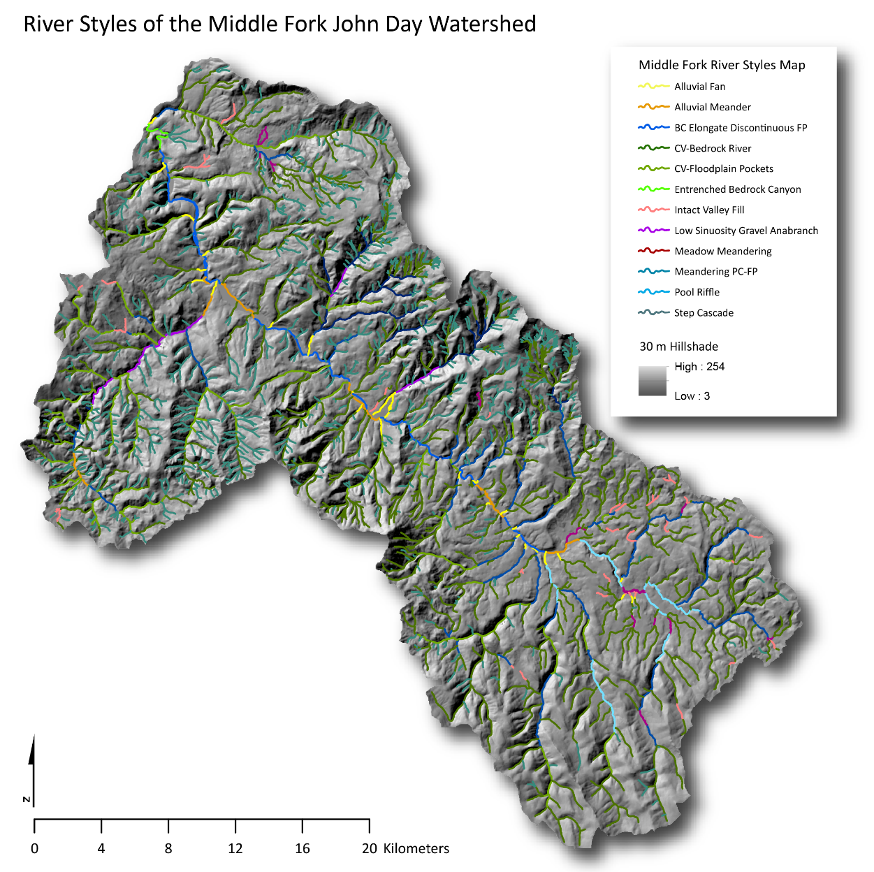
Start with: Geomorphic Classification of watershed using River Styles

Slide 9
1. Capacity for each stream to adjust its bed and floodplain..
River Style | Channel Attributes | Channel Planform |  | Bed Character | Capacity for Adjustment
Confined Valley settings
Steep Headwaters |  |  |  |  | Low
Steep Ephemeral Hillslope |  |  |  |  | Low
Confined Valley Bedrock River (intermittent) |  |  |  |  | Low
Step Cascade |  |  |  |  | Low
Confined Valley with Floodplain Pockets |  |  |  |  | Low
Entrenched Bedrock Canyon |  |  |  |  | Low
Unconfined Valley Settings
Intact Valley Fill |  |  |  |  | Moderate
Alluvial Meandering |  |  |  |  | High
Meadow Meandering |  |  |  |  | High
Partly Confined Valley Settings
Low Sinuosity Gravel Anabranch |  |  |  |  | Moderate
Bedrock-Controlled Elongate Floodplain |  |  |  |  | Low
Pool Riffle |  |  |  |  | Moderate
Meandering Planform Controlled Floodplain |  |  |  |  | Moderate
 | Minimal or no adjustment potential
 | Localized adjustment potential
 | Significant adjustment potential
Some river types can adjust significantly more than others….

Slide 10
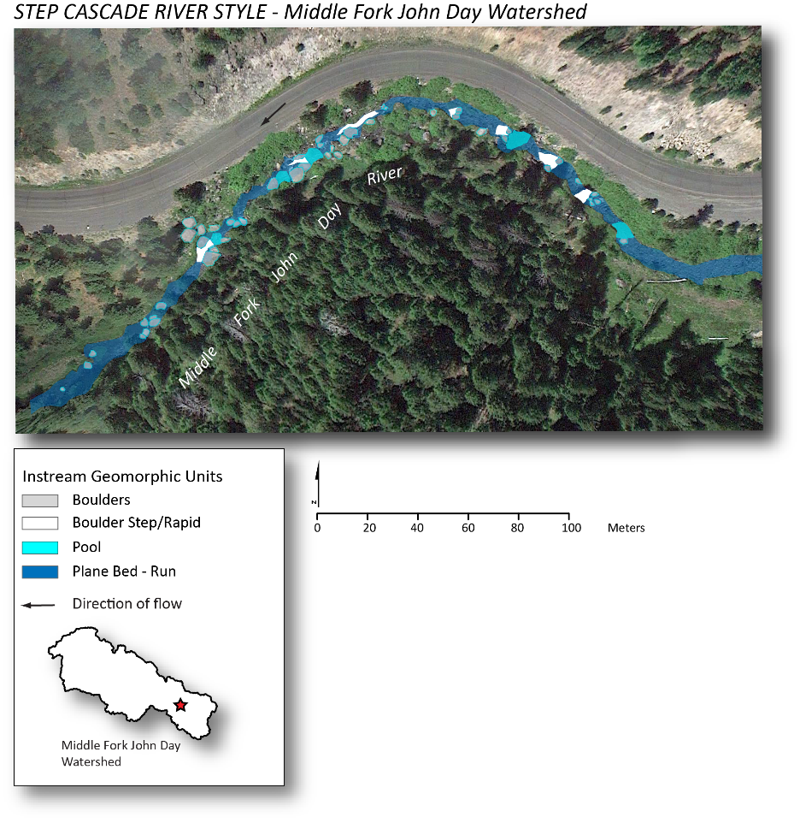
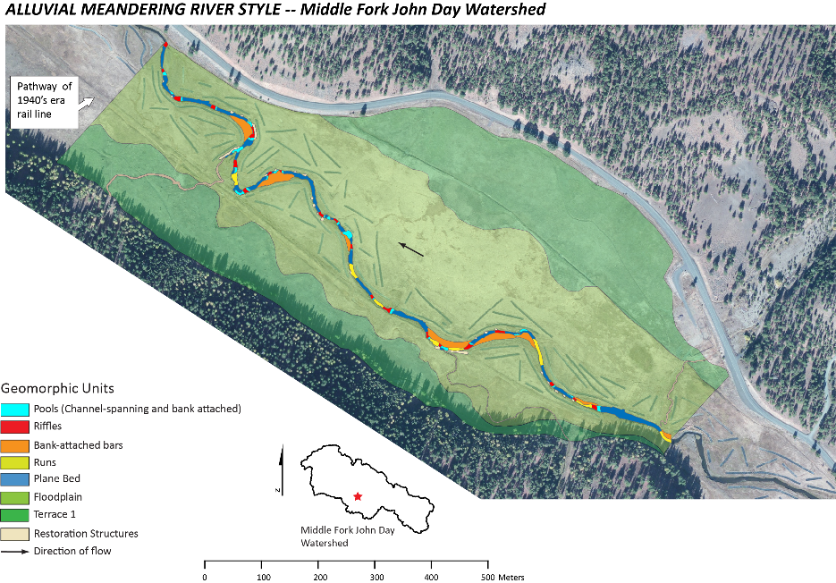
Reach sensitivity to disturbance effects is dictated by Adjustment Capacity..
confined valley
no floodplain
Coarse cobble-boulder bed
resistant to
disturbance
fine-grained floodplain,
unconfined valley,
meandering planform
gravel-cobble substrate
sensitive to disturbance

Slide 11
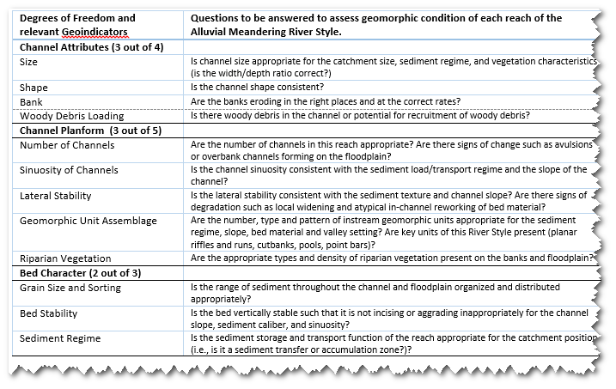
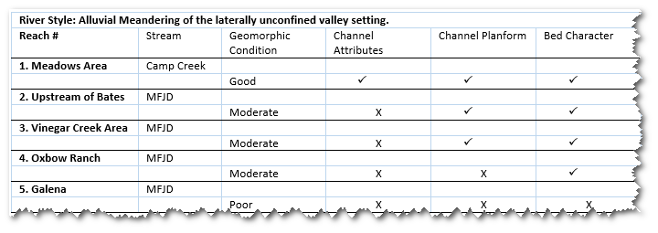
Relevant “Geo-indicators” measure the
Geomorphic Condition of reaches…
…and enable them to be categorized—key step of a Condition Assessment….

Slide 12
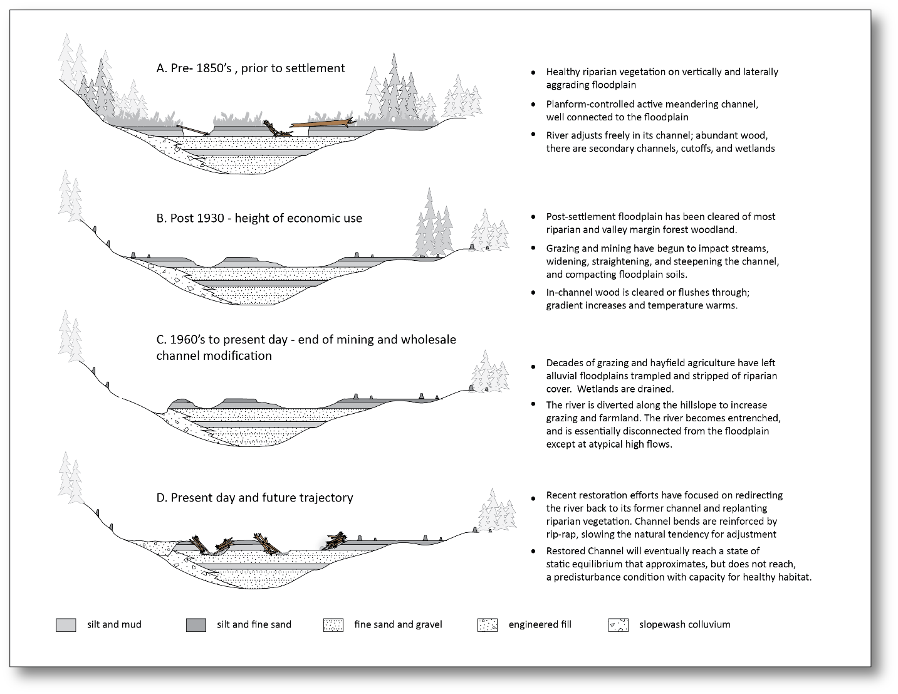
2. Evolution diagrams depict reach history, and pathways of adjustment for each River Style…
Alluvial Meandering
River Style,
Middle Fork
John Day River

Slide 13
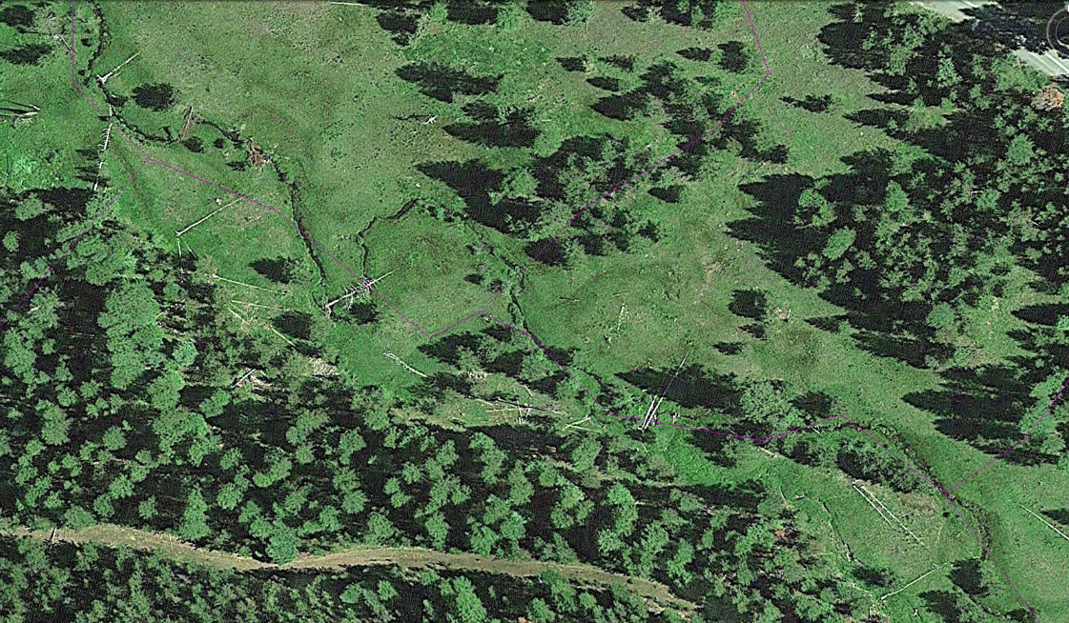
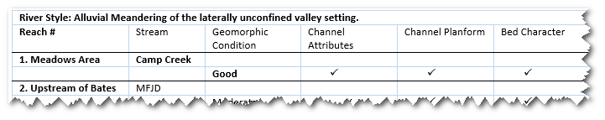
3. Reference condition: the most intact reach of each River Style found in the Watershed

Slide 14
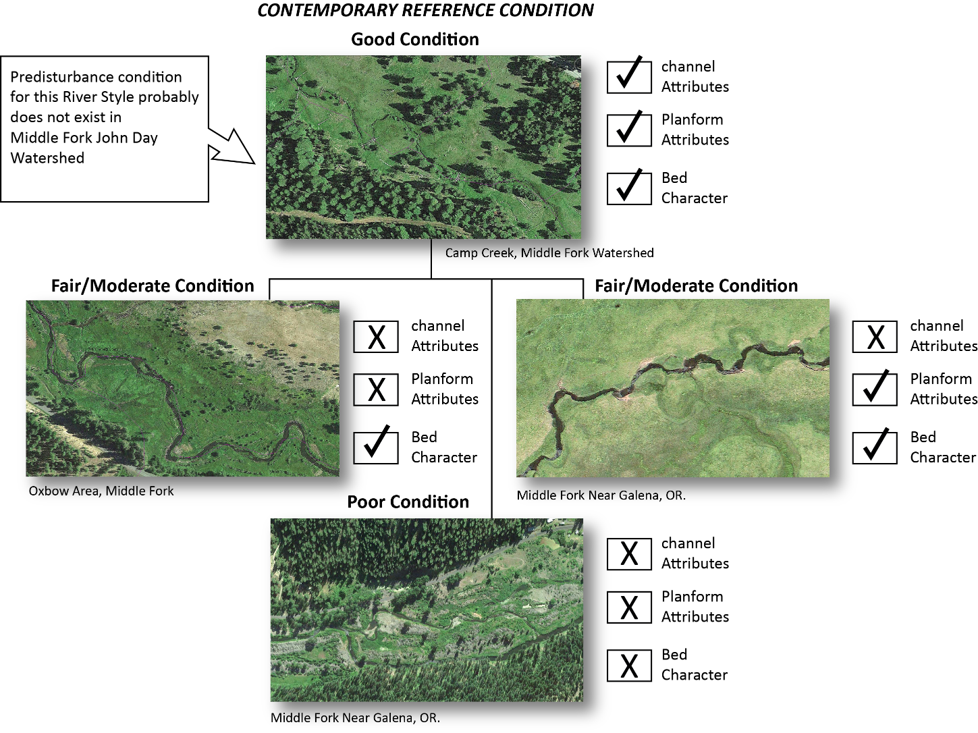
4. Each reach is evaluated in context of the reference condition..and ranked

Slide 15
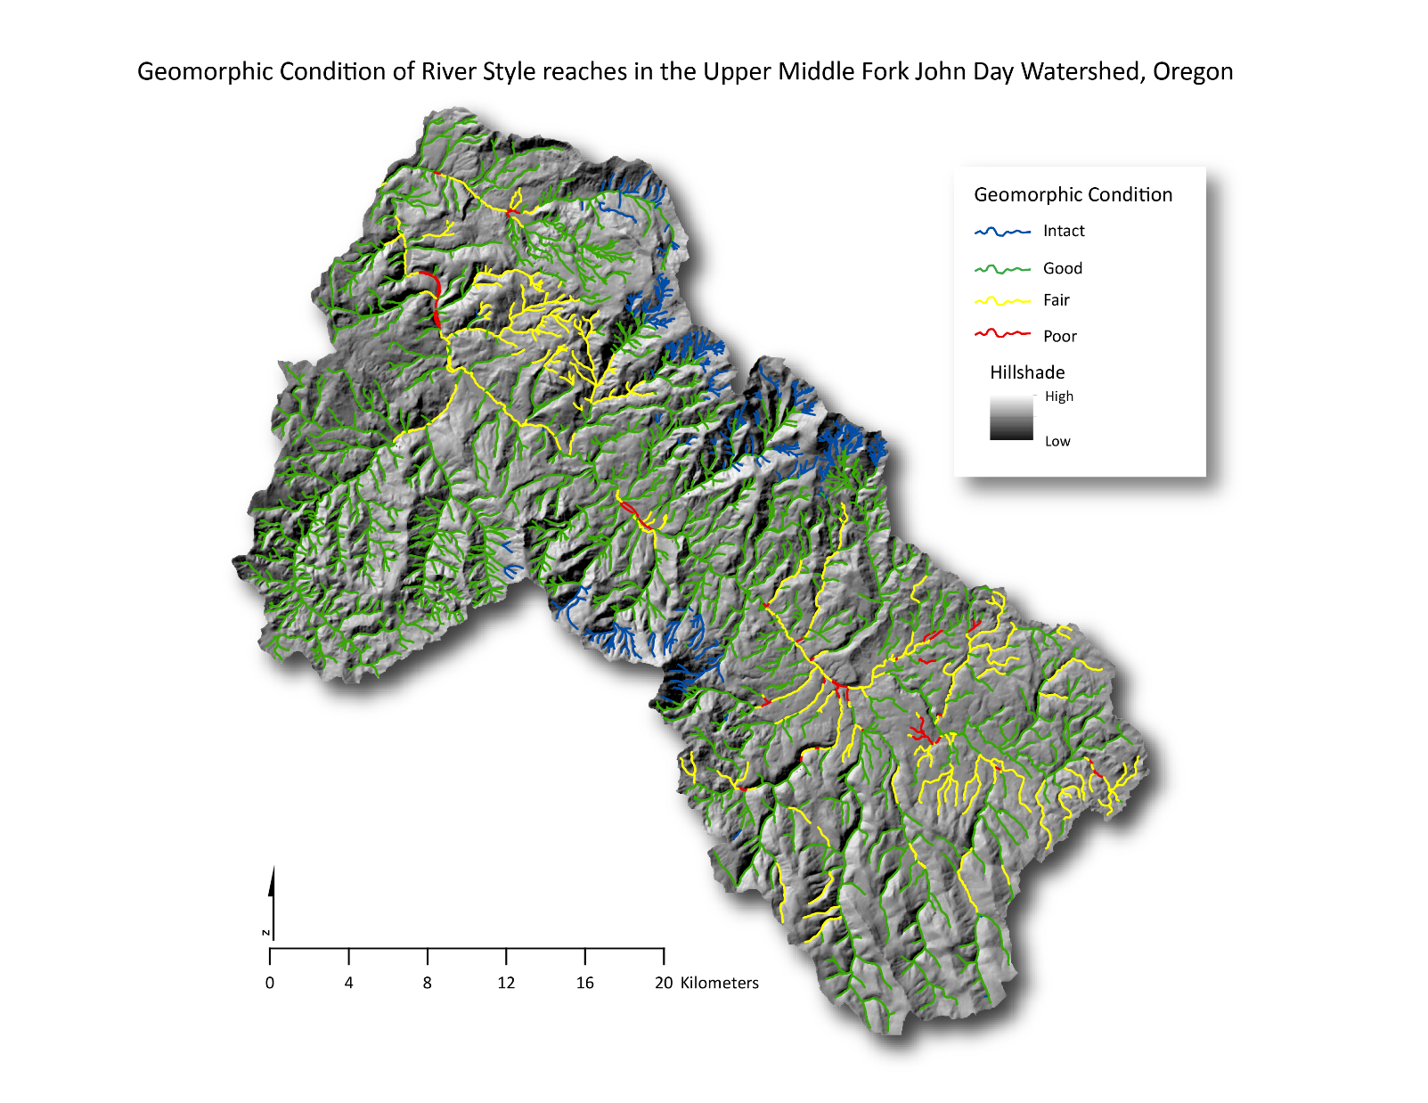
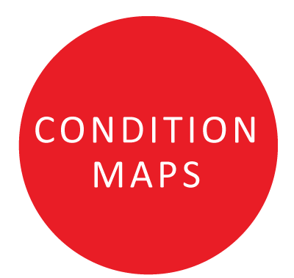
5. Geomorphic Condition of streams, by River Style reach, Middle Fork John Day Watershed
The geomorphic condition of adjoining reaches tends to reflect the overall limiting factors and pressures in the watershed, except where reach sensitivity differs in different River Styles and/or spatially focused land use practices have occurred.
In the Middle Fork John Day Watershed, downstream patterns of River Styles tend to reflect similar valley settings, and therefore, sensitivity to disturbances…
Areas of fair to poor condition:
Intense mining disrupted the channel and floodplain;
Recent, widespread clearcut logging and road building changed sediment balance and bed characteristics in channel;
Floodplain clearing and grazing, and channel diversion have fundamentally changed the form and function of sensitive reaches of the Middle Fork John Day River
Intact and Good condition reaches
Clearcut operations in the past, but recovering;
Widespread but sparse grazing;
Little change to sediment balance or channel attributes since 1940’s;
Pressures removed from lower watersheds; upper watersheds nearly intact

Slide 16
Geomorphic Condition assessments set the stage for…
Assessment and creation of Geomorphic Recovery Potential Maps
Using the suite of geomorphic assessment products for development of Strategic Watershed Management Plans

Slide 17
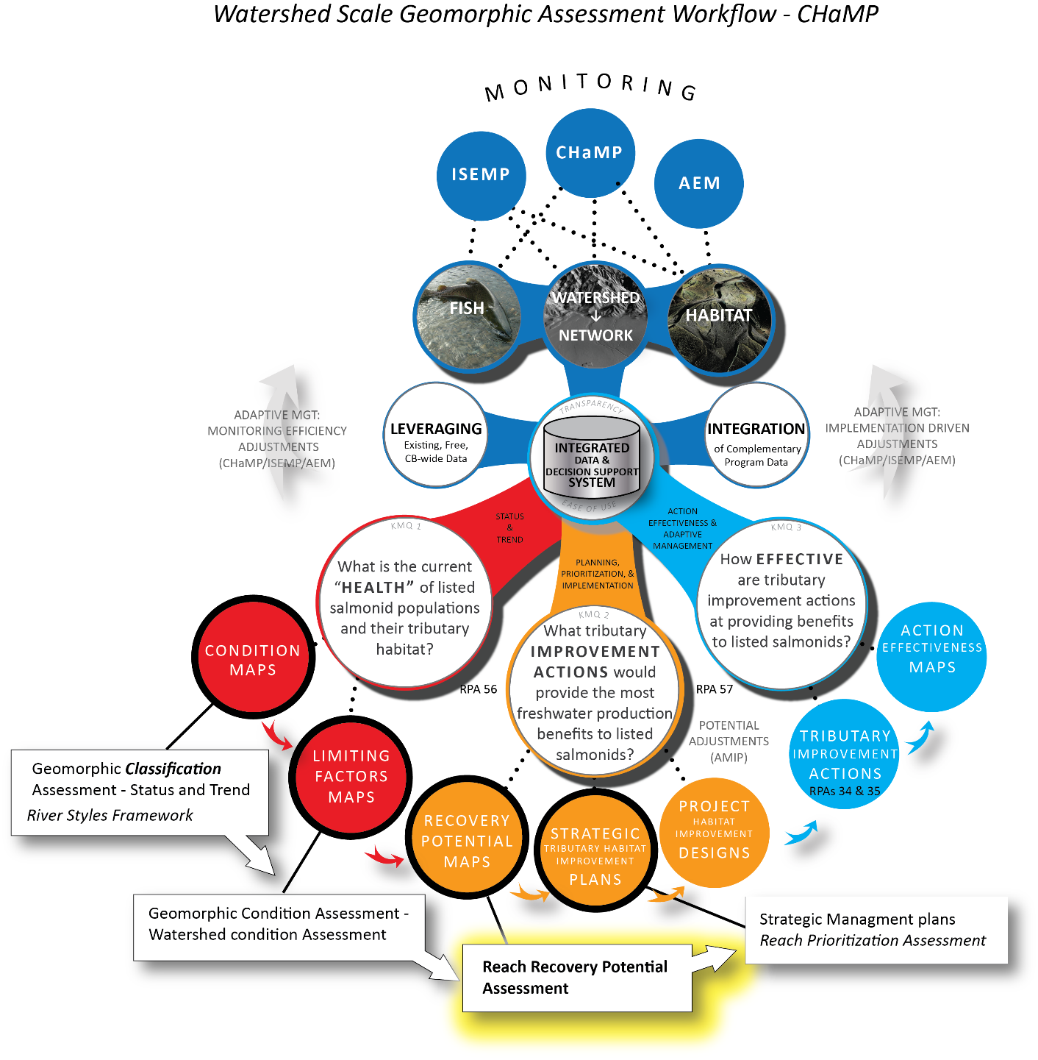
Geomorphic Recovery potential informs Tributary Improvement Actions, leads to strategic Management planning

Slide 18
Geomorphic Recovery Potential of CHaMP Streams..
…is defined as “Capacity for improvement of the geomorphic condition of a reach in the next 50-100 years”
…is a gauge of healthy function for individual reaches of the same River Style, leveraging the Geomorphic classification and Geomorphic Condition assessments for the watershed.
…is a key input for the development of Strategic Tributary Habitat Improvement Plans
…is determined for every reach of every River Style in the watershed.

Slide 19
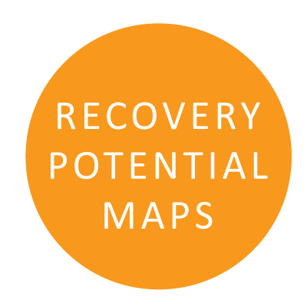
Steps for creating Geomorphic Recovery Potential Maps using River Styles
Determine the trajectory of river change
  Place each reach on the appropriate “timeslice” of its Evolutionary Diagram
  Use this to determine the trajectory of change of each reach in the catchment – either Intact, restoration, degradation or creation.
  2. Assess River Recovery Potential
  Place reaches in their catchment context
  Assess the limiting factors to recovery

Slide 20
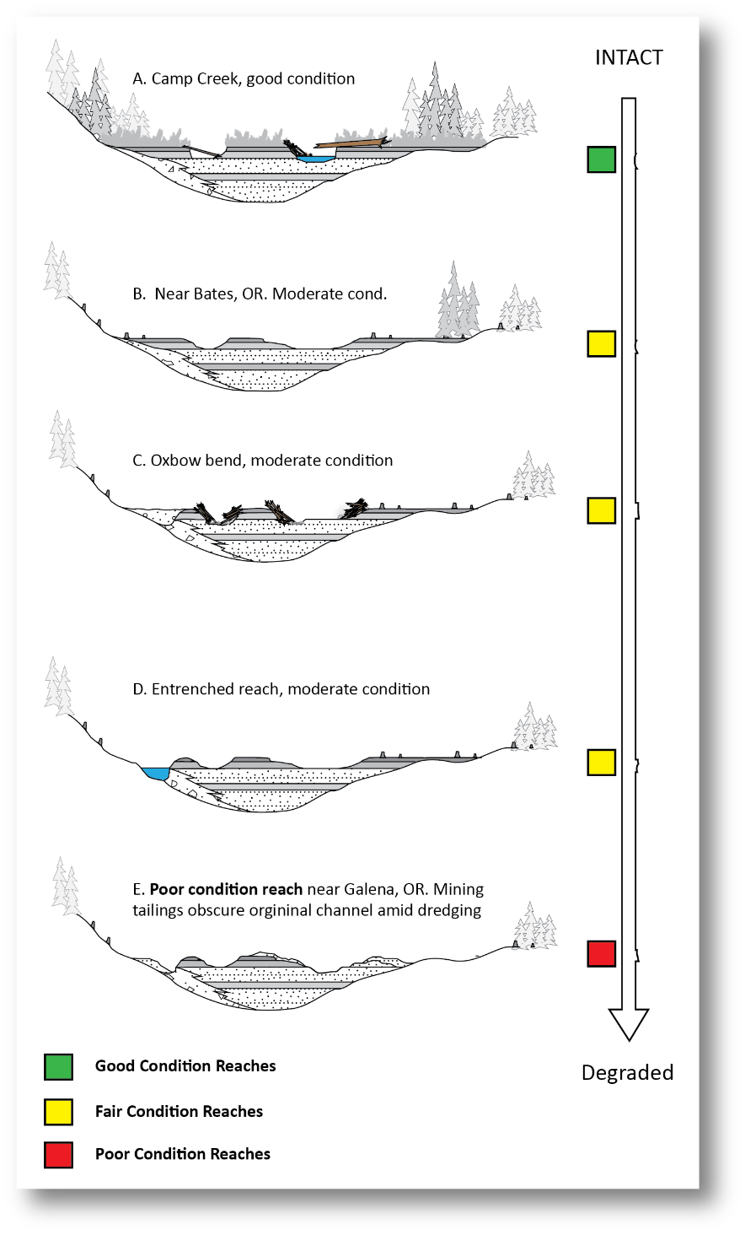
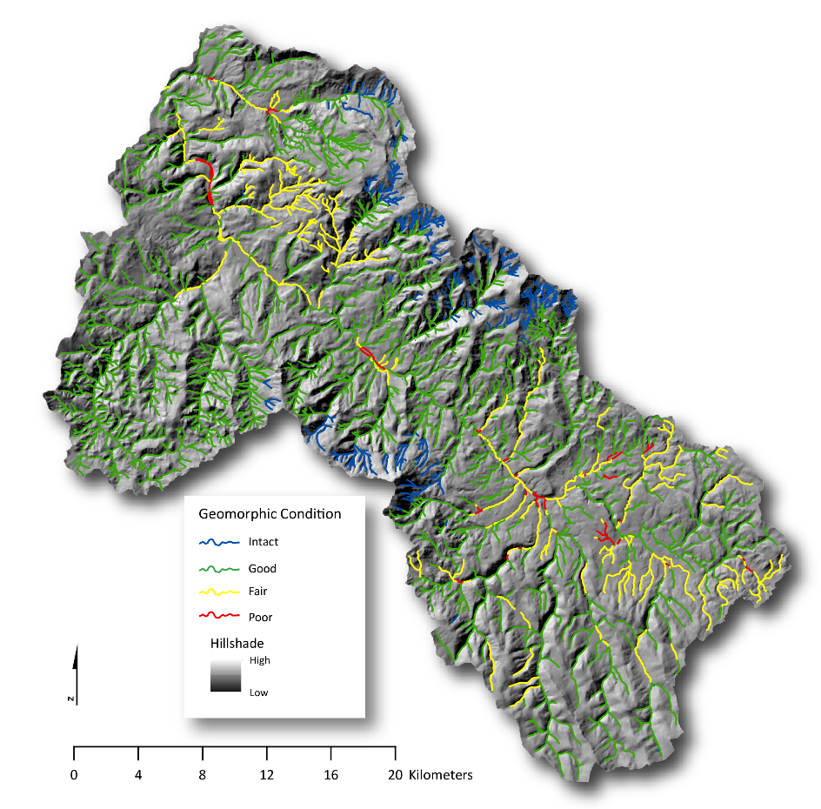
1a. Trajectory of river change…(step one)
Each reach of a river style is referenced from the Geomorphic Condition Map, then plotted on the evolutionary diagram created during the condition assessment
1
2
3
2
3
1
Notes:
Using the evolutionary diagram created as a step for the Geomorphic Condition Map, the different reaches are placed where they fall in the sequence. The stoplight colors are their geomorphic conditions. The trajectory of Change is determined in the next slide.

Slide 21
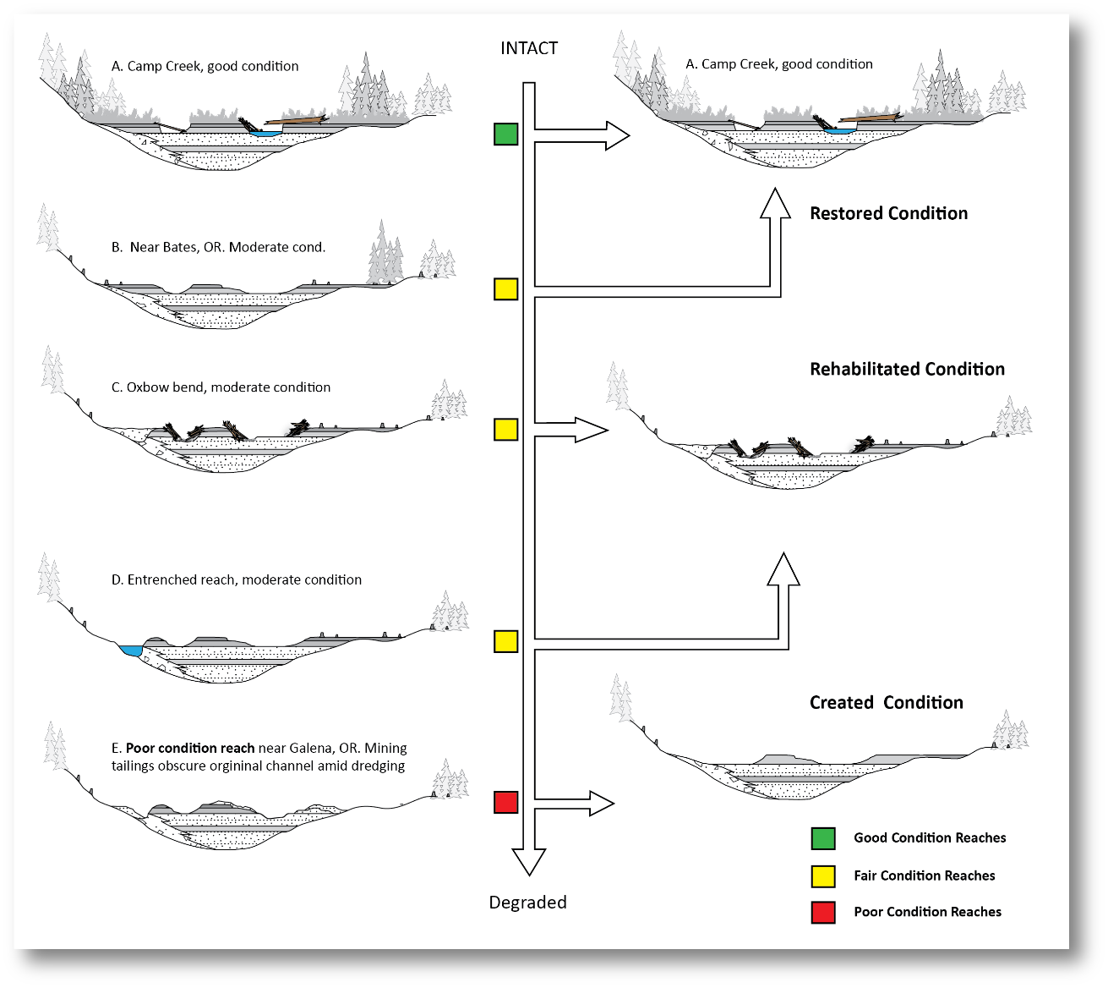
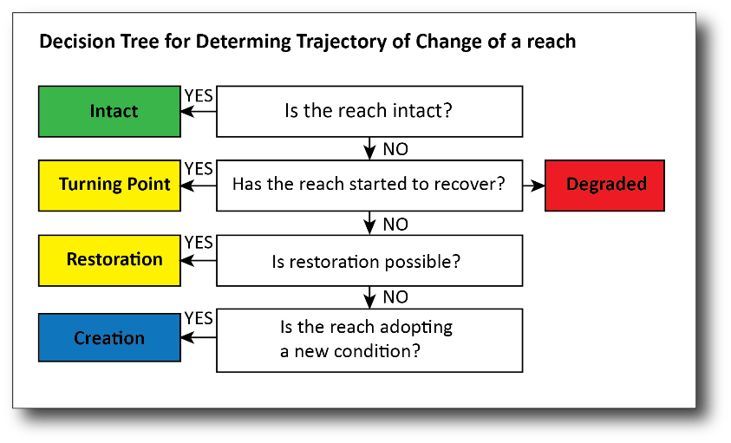
1b. Trajectory of river change…(step two)
Based on their conditions and
run through the decision tree shown below, the trajectory of change for each reach of the River Style is determined.
Notes:
Using the Evolutionary diagram and

Slide 22
2. Assess Recovery Potential
A “recovery trajectory” may not equal “recovery potential”
Geomorphic Recovery Potential is “…the capacity for improvement of the geomorphic condition of a reach in the next 50-100 years”
Multiple factors may influence the actual trajectory and pathway of adjustment…
Such as…

Slide 23
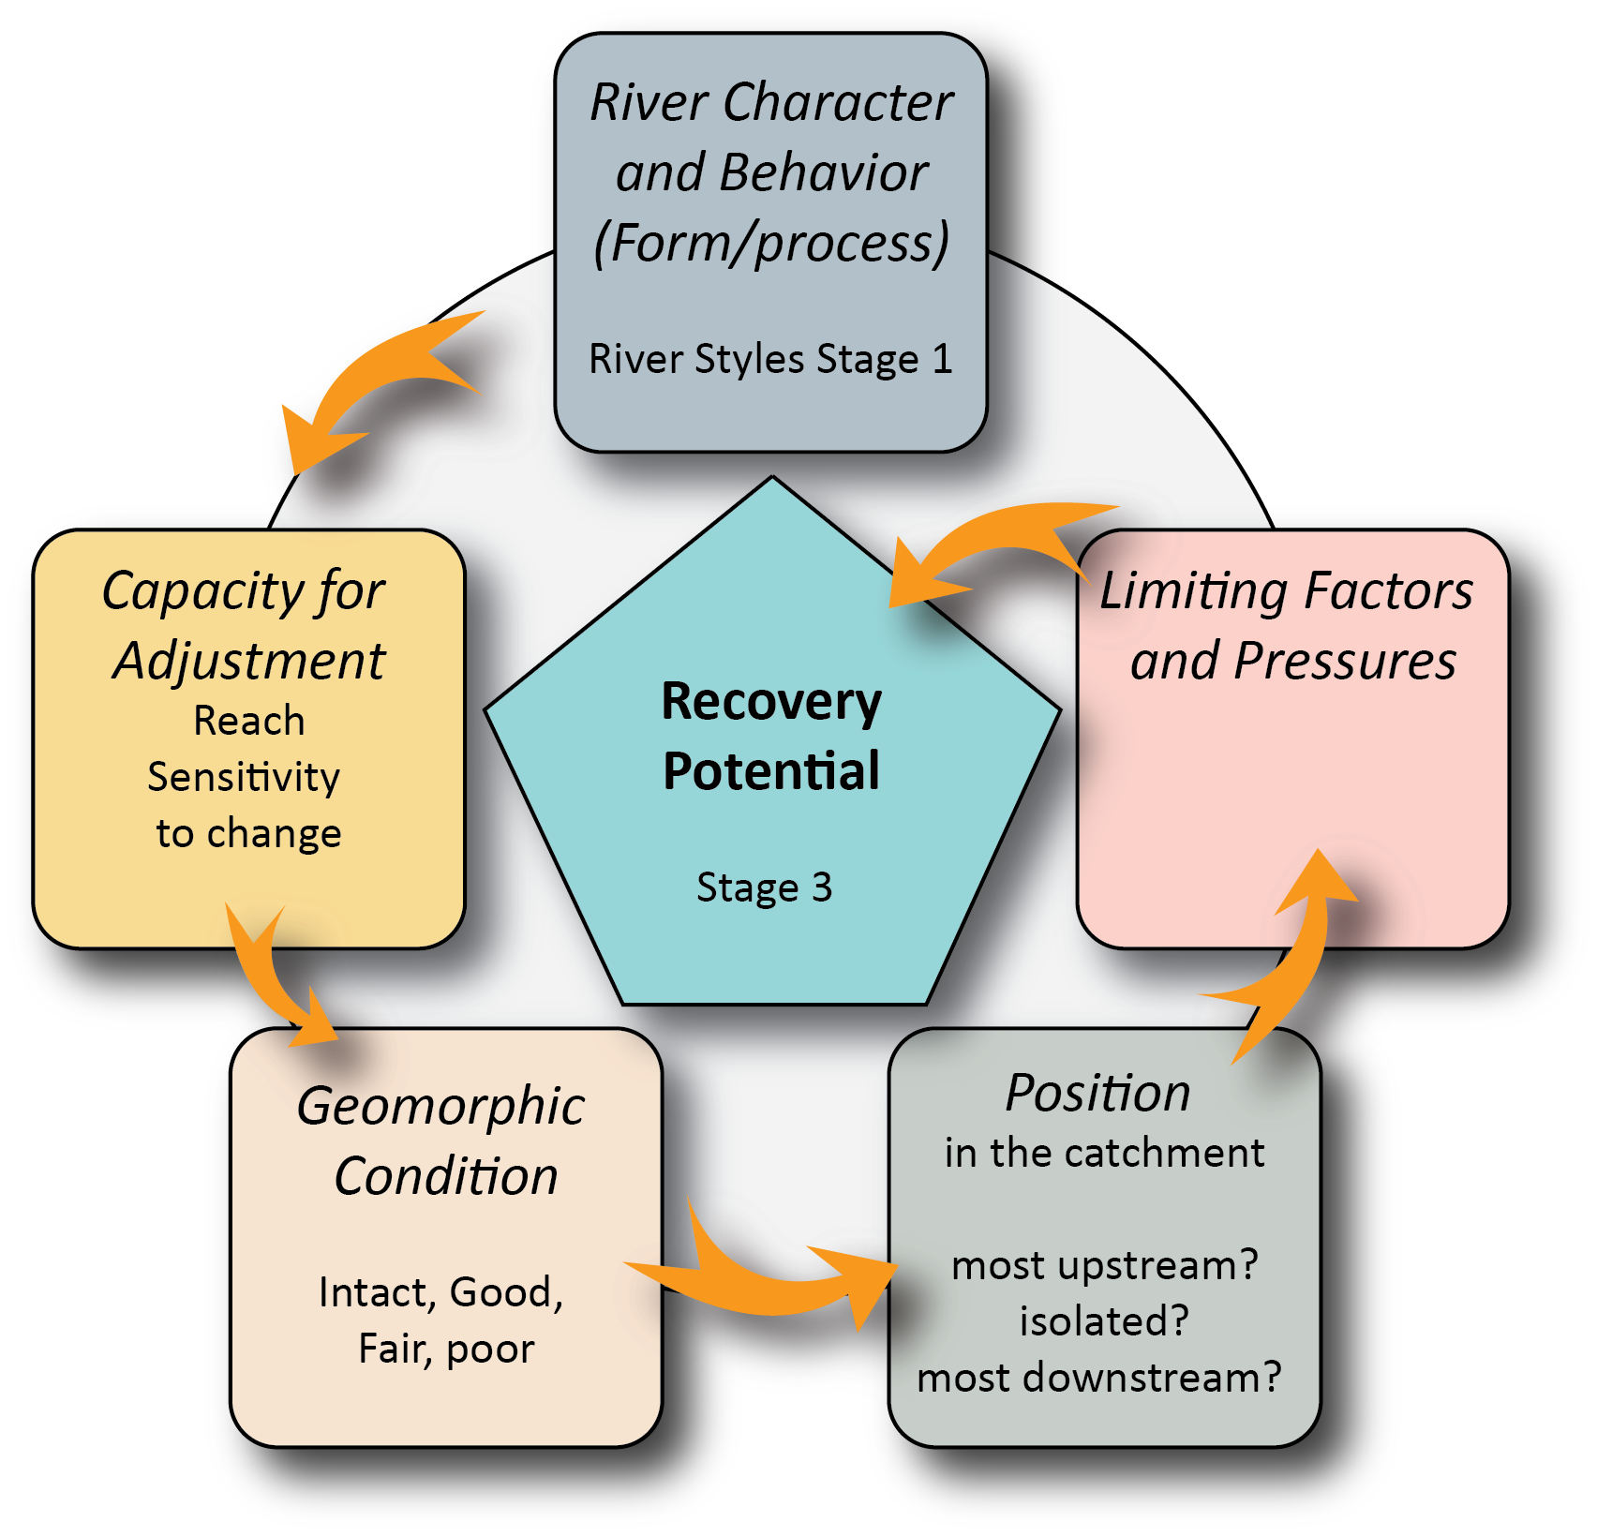
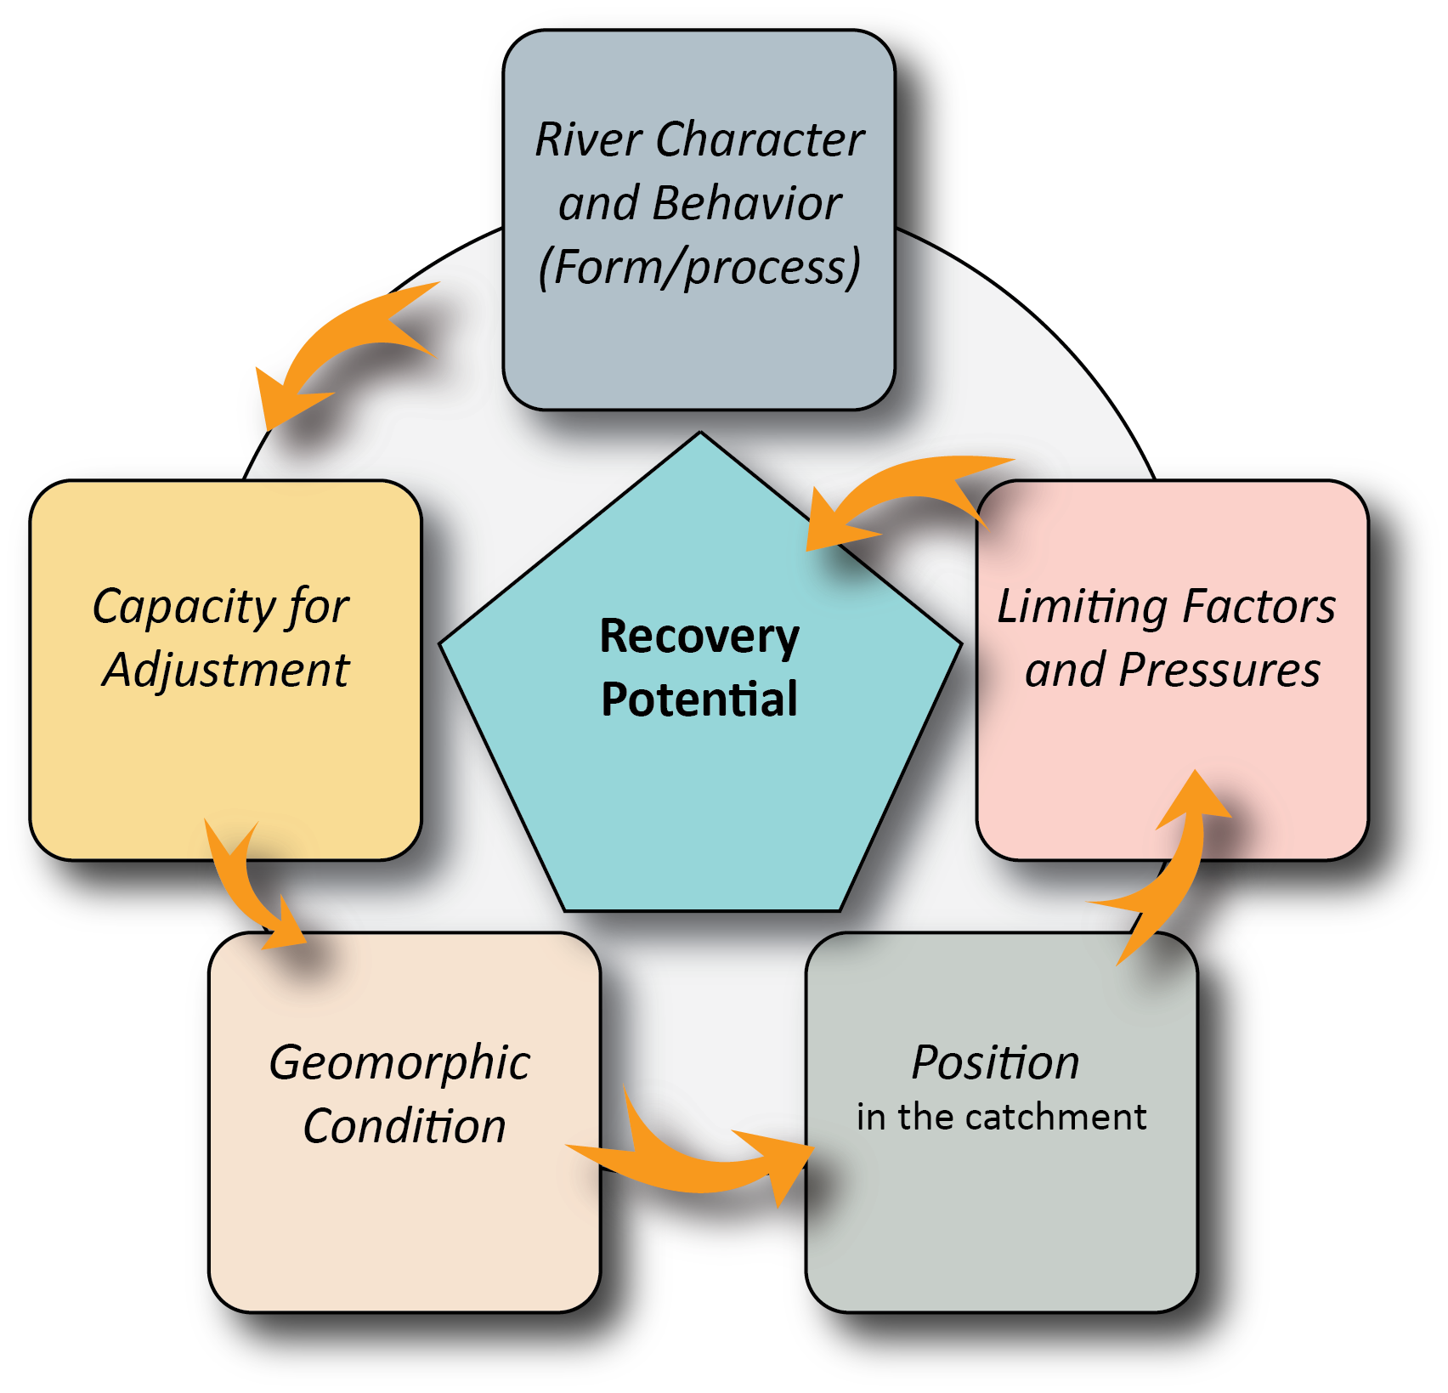
Factors influencing Recovery Potential…
Form-process associations
within boundary conditions
(valley setting, sediment flux, etc.)
Limiting Factors
Include Land
management
(deforestation,
grazing), removal of
woody debris;
Water mismanagement
And other pressures
within the watershed
that threaten the
conservation of
intact reaches
Sensitivity to
Changes in
channel, planform,
and bed material
Characteristics.
Sensitive reaches
may show Increased
susceptibility to
Disturbance effects
Disturbance responses may
Be propagated to
downstream reaches..
--important to consider if
good condition reaches lie
downstream of degraded ones.
Intact, good, fair and poor-condition
reaches of a single River Style…
Notes:
There are multiple caveats to

Slide 24
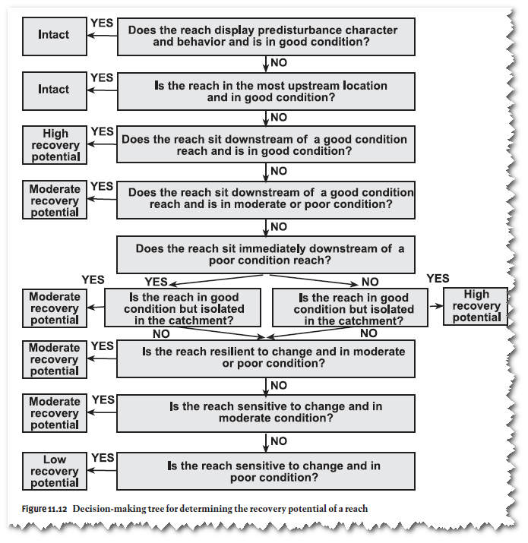
A decision tree for Recovery Potential..
Tailored to individual watersheds
as variations of influential factors
apply
Leverages the five factors that
influence Recovery Potential:
Form/process, geomorphic
condition, reach sensitivity,
position in the watershed,
and limiting factors & pressures
Applied to each reach of every
River Style;

Slide 25
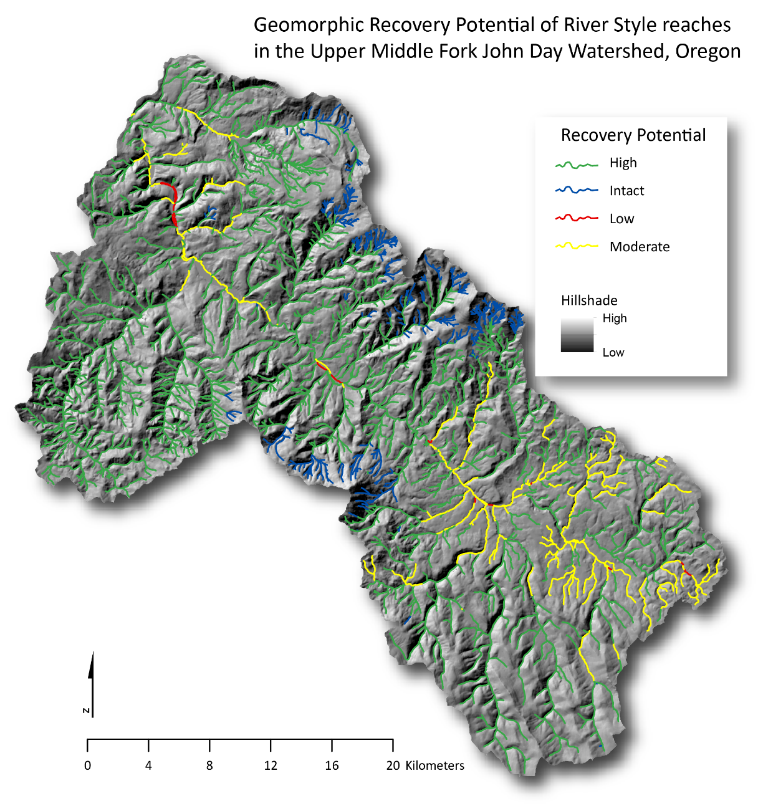
Recovery Potential of streams, by reach, Middle Fork John Day Watershed
Reaches of middle watershed
With Moderate and Low
Recovery Potential
Reaches that incurred intense
Placer mining and wholesale
channel diversion in the early
century (and heavy grazing)
will require restoration efforts to
improve their condition
and recovery potential.
High Recovery Potential
1st- 4th order tributaries in
uppermost watershed in good
or intact condition were
found to have high Recovery
Potential, regardless of history
of logging, grazing, and
In lower watersheds, some
mining.
Disclaimer: this map is based
on field data and full
analyses conducted in 2012-
2013, yet the results are
Intended as Proof of Concept
exercises and are hypothetical in
nature.
Upper watershed areas with good to moderate
Recovery Potential
The low-relief, accessible landscape of the upper watershed
has absorbed multiple land uses including mining, logging and milling,
grazing, current and past ranching operations, and
widespread canal diversions. With intermittent streams throughout and ubiquitous impacts in the uppermost watersheds, many of these streams have only moderate recovery potential.

Slide 26
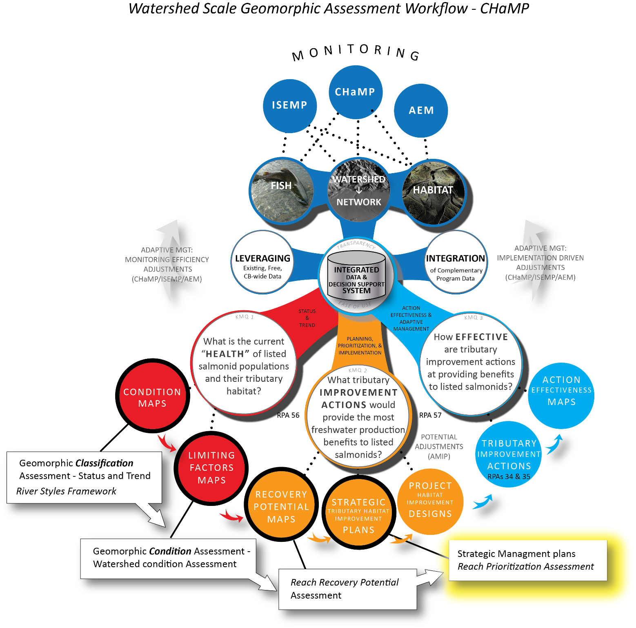
Strategic Management Plans draw on Geomorphic Assessment phases, informs Project Designs…

Slide 27
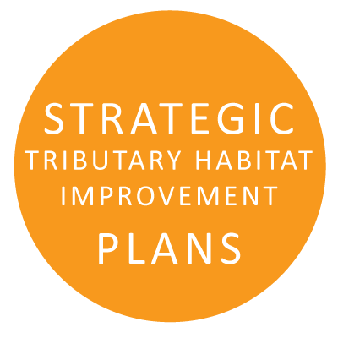
Steps for creating a Tributary Habitat Improvement Plans using the River Styles Framework
Create a Catchment-Framed Physical Vision
Identify Target Conditions for River Rehabilitation
Prioritize efforts based on Geomorphic Condition and Recovery Potential
Monitor and audit Improvement…we’re good at this….

Slide 28
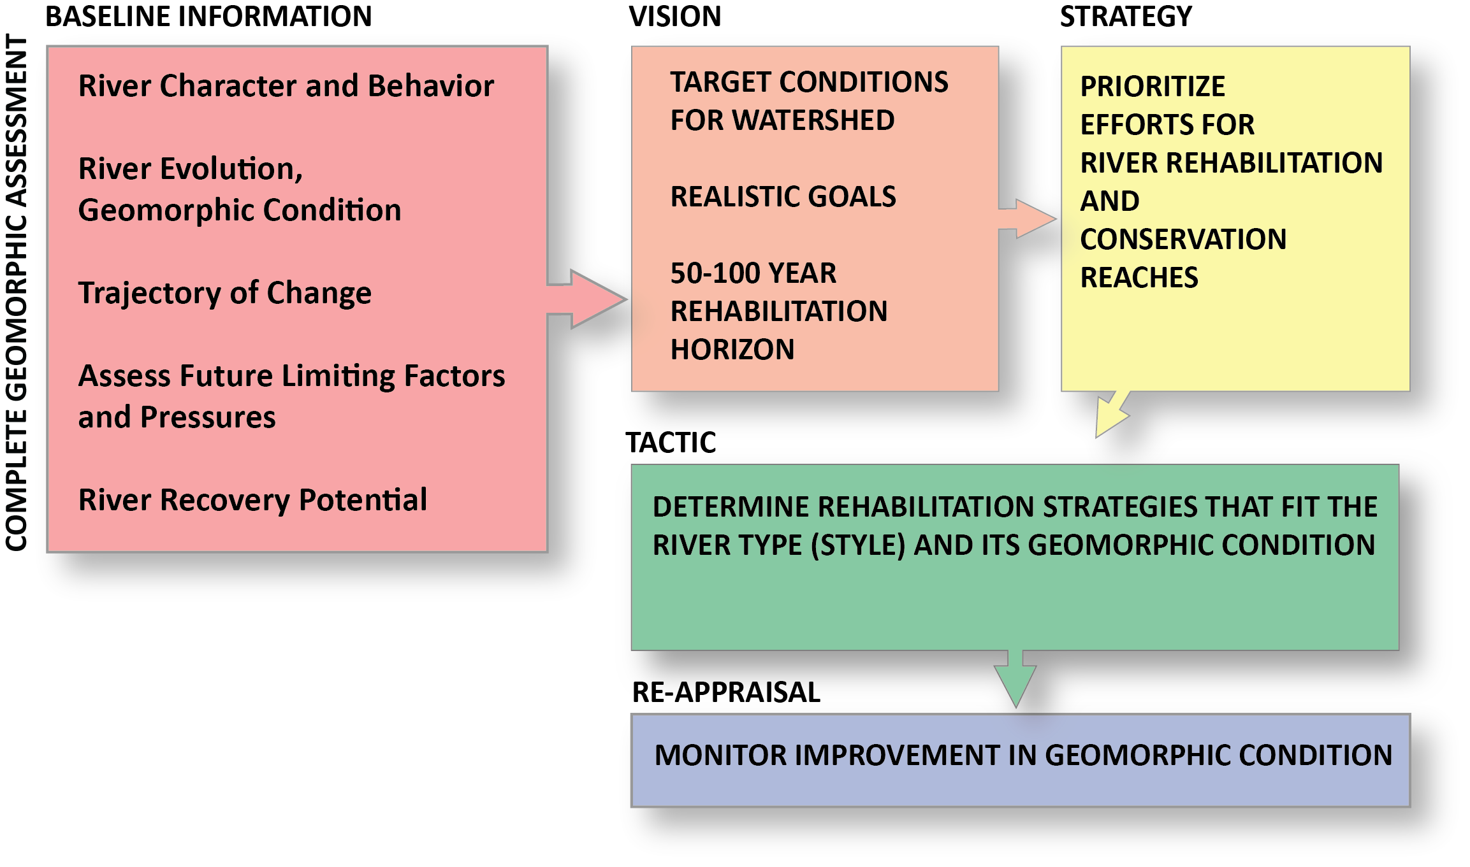
1. A Catchment-Framed Physical Vision
Long-term, realistic goals for the watershed: Target conditions identified,
Prioritization undertaken, monitoring strategies put in place

Slide 29
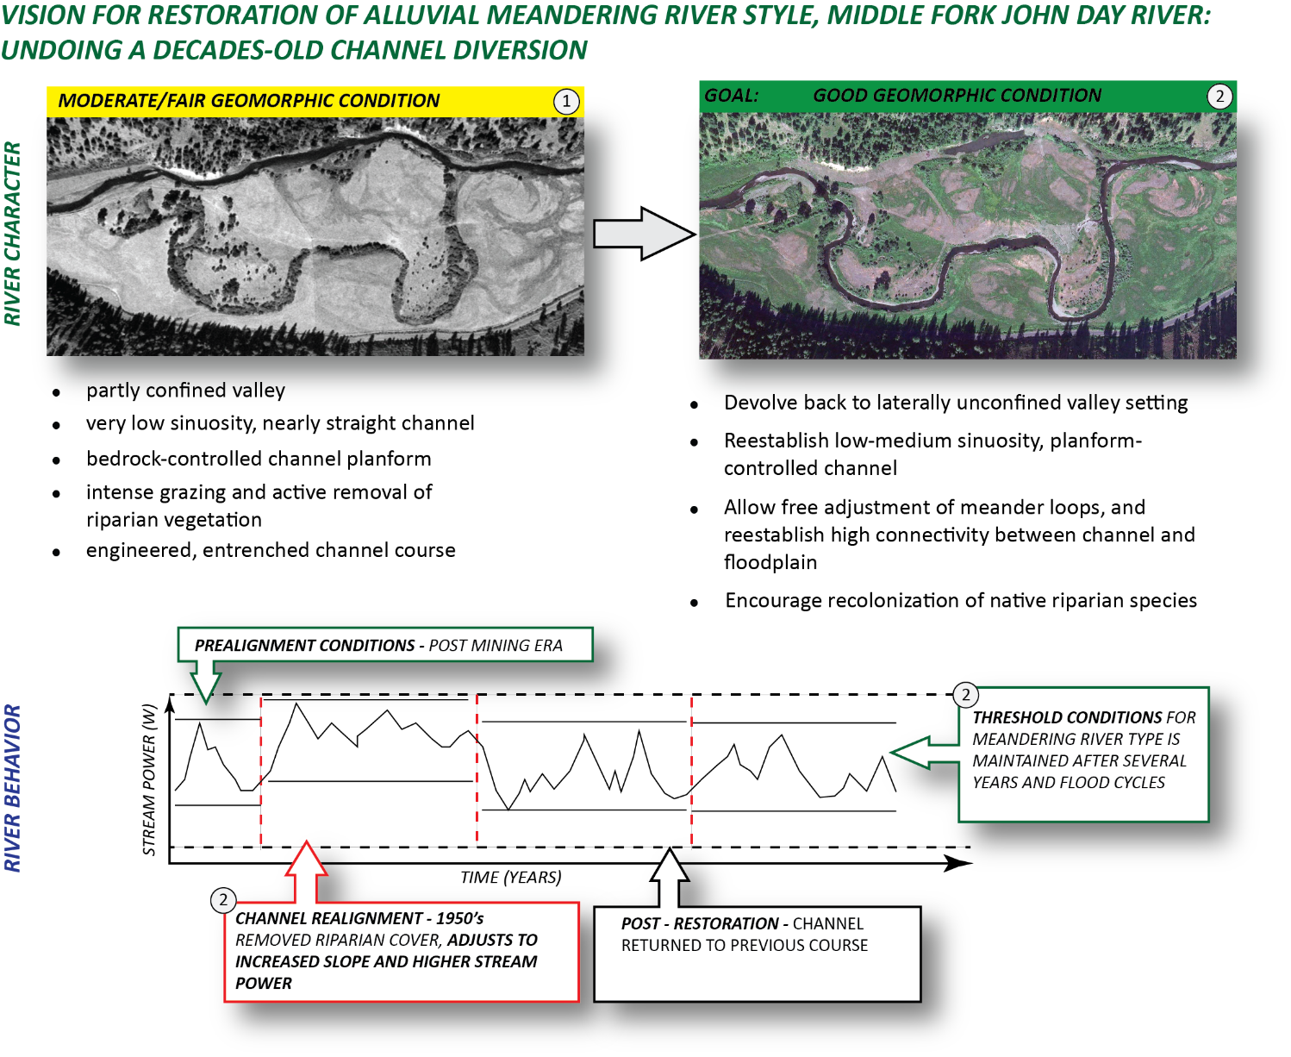
2. Identify Target Conditions for River Rehabilitation and determine the Required Intervention
This hypothetical example (using an actual restoration) shows target conditions for both river form (character) and process (behavior)

Slide 30
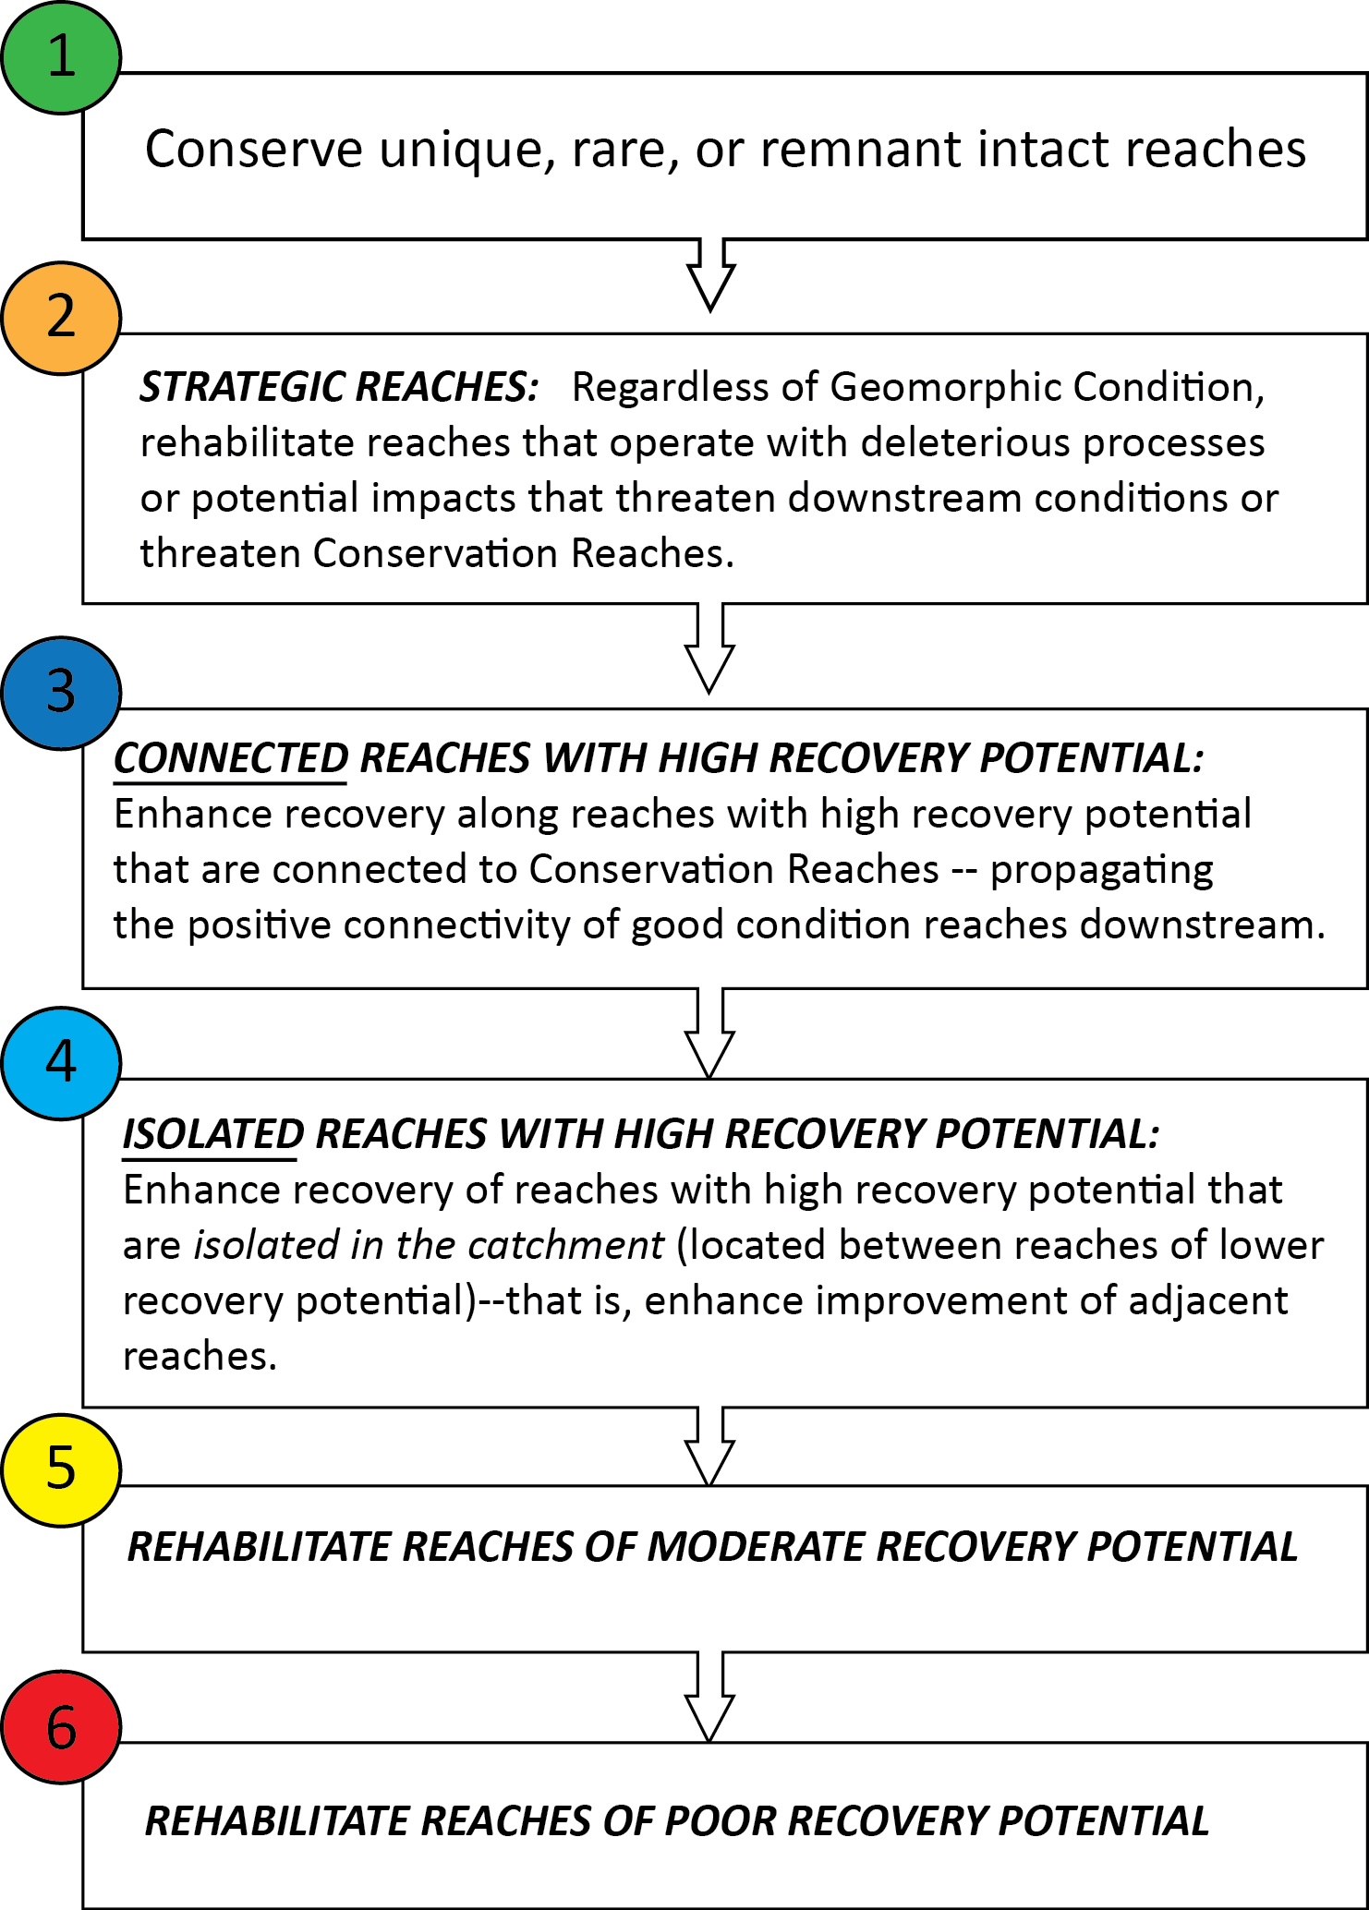
3a. Prioritization of action for river reaches based on Geomorphic Condition and Recovery Potential
First priority to preserve remaining habitat and refugia in good and intact reaches
High priority to mitigate problem areas that
will directly or indirectly propagate to down-
stream and special/high quality reaches
Maximize positive effects of most extensive
networks of intact and good condition
reaches—particularly those connected to
conservation areas or high quality habitat
Preserve pockets of reaches and habitat
where existing quality may be of future
benefit, and even spread downstream
Finally, we do what we can with reaches
that show little recovery potential--or where
The vision plan envisions a role in overall watershed recovery

Slide 31
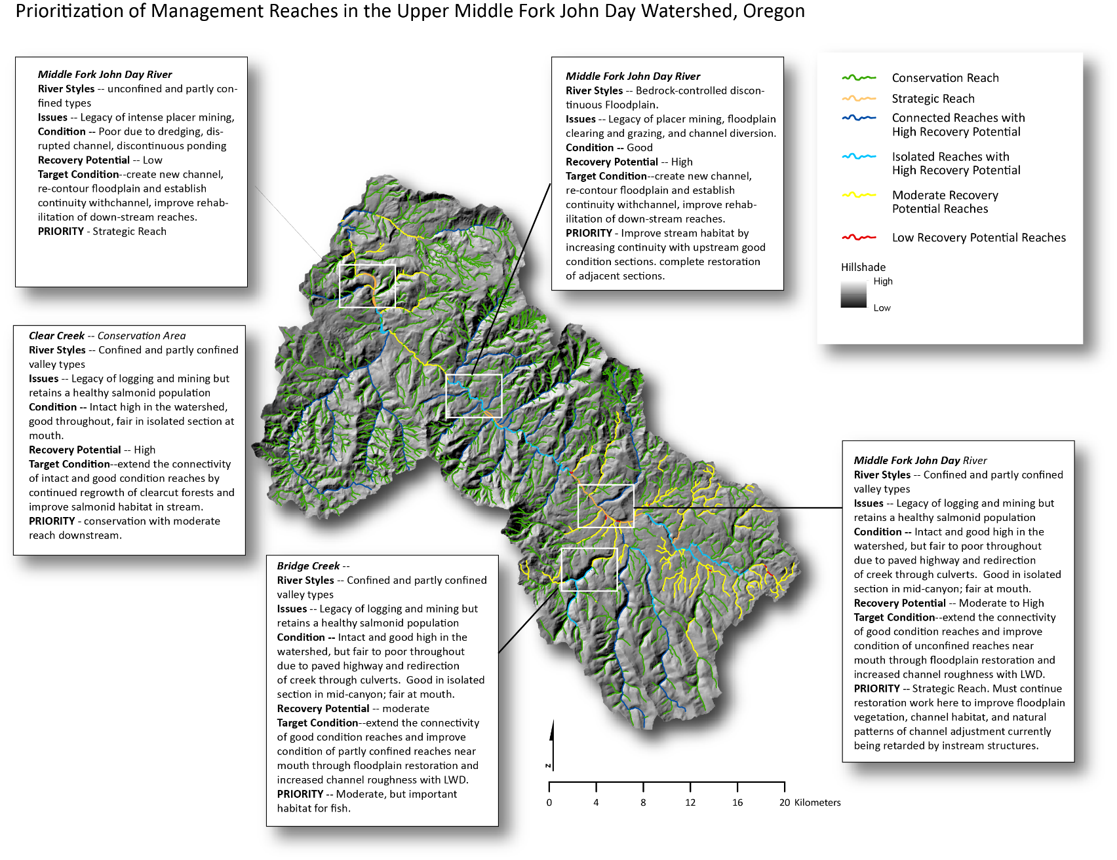
3b. Prioritization of Management Reaches in the upper Middle Fork John Day River

Slide 32
Take Homes
River Styles gives us a framework for:
  Reach typing to help in sample design and stratification of sampling
  Providing geomorphic context (character & behavior)
  Assessing geomorphic condition, which informs habitat condition
  Interpreting recovery potential
  Building informing strategic improvement plans

