Slide 1

A Review of CHaMP’s interoperability, study design and metrics
CHaMP and ISEMP Analysis and Synthesis Workshop
Portland, Oregon – February 25th and 26th, 2014
Presenter:
Boyd Bouwes, Phil Larsen,
and Matt Nahorniak

Slide 2
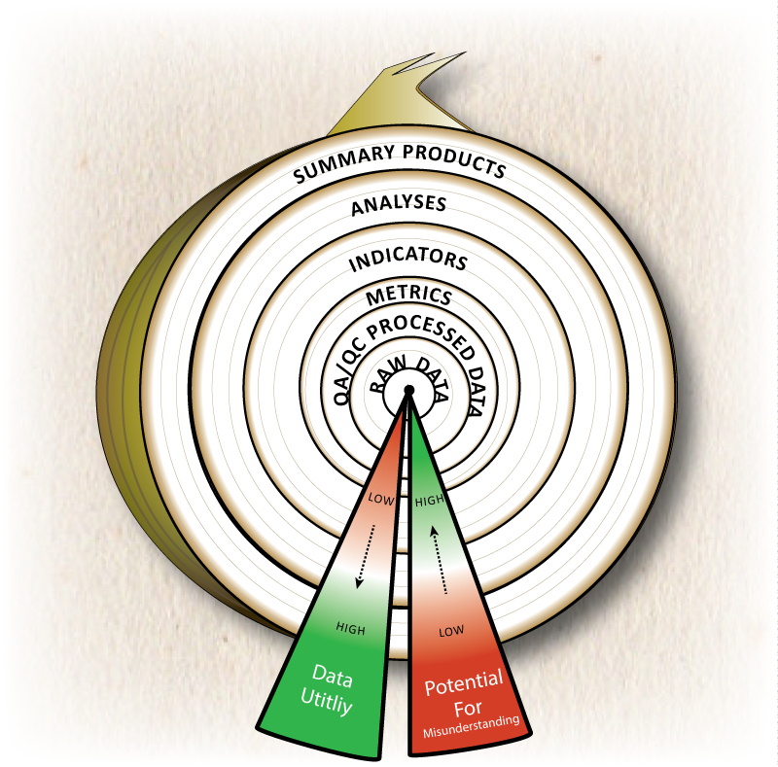
Hello “Stinky Stuff In The Middle”

Slide 3
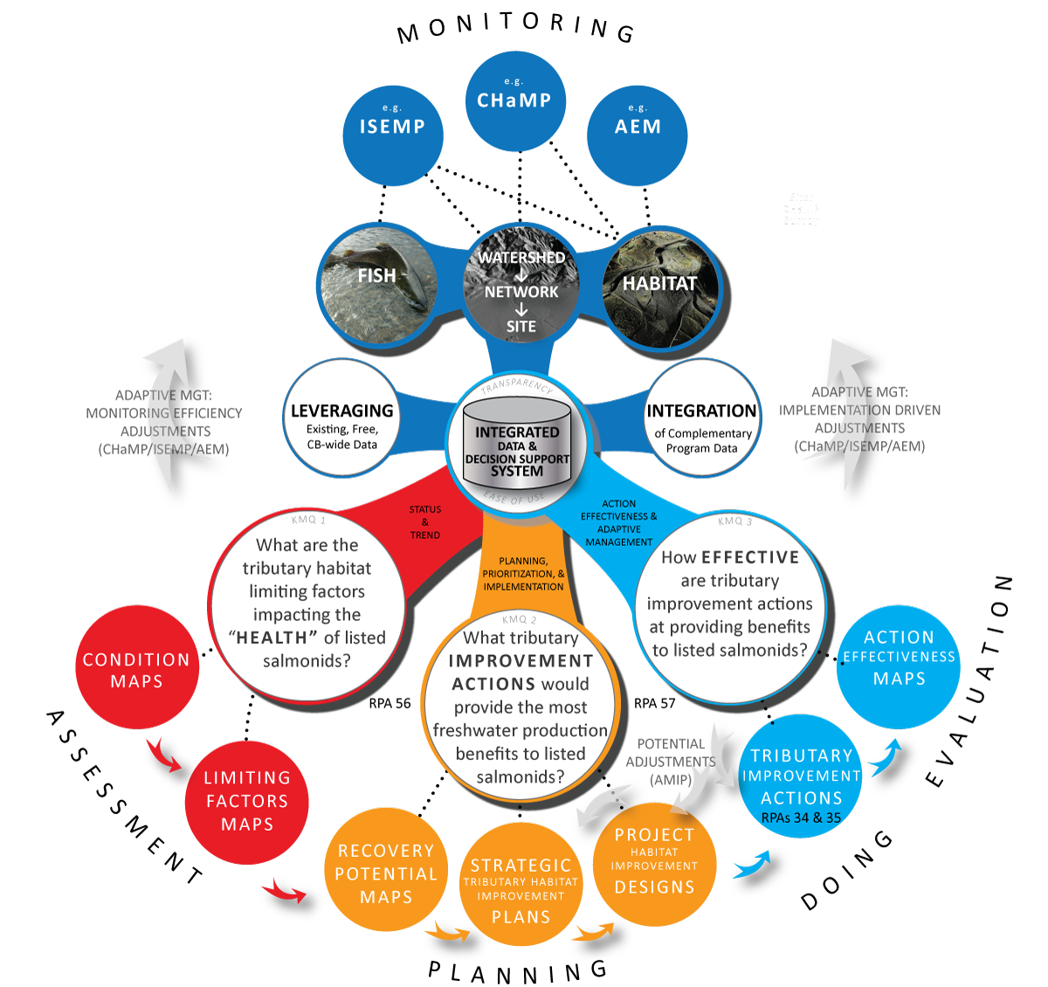

Slide 4
Reasons for Programs to be Interoperable
Maximize efficiencies
Leverage existing data
Scope and scale of current habitat monitoring efforts is not adequate to answer scope and scale of management questions
Sharing of information between monitoring groups is poor we need to do better.

Slide 5

How do we speak the same language?
What are the objectives?
Need Coordination
Need a road map/ framework for each step
Identify the players
Micro adjustments to each of the pieces
Set realistic expectations for each step

Slide 6
Protocol Interoperability Assessment Pieces
Notes:
Is this editable? The boxes aren’t easy to read (black on orange will be tough), and the long text boxes are hard on the eyes (I prefer short and squatty ones). Content is ok, but the questions could be shortened. I’d carry an ‘oval’ to each one of your slides after this (e.g. yellow oval to the study design nslide, green oval to the protocol slide, etc). It will help link all the slides together.

Slide 7
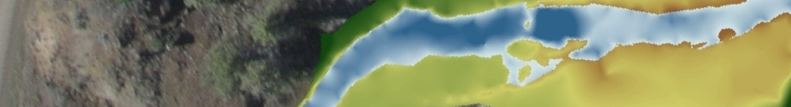
CHaMP Protocol
Methods and Metrics based on 3 criteria
Information Content- info related to salmonid productivity including survival and growth
Data Form- provide robust statistical information and data quality (detect heterogeneity, repeatable)
Feasibility- metrics generated by field tools and software currently available. Field work done by a 3 person crew/day at 80% of sites.

Slide 8
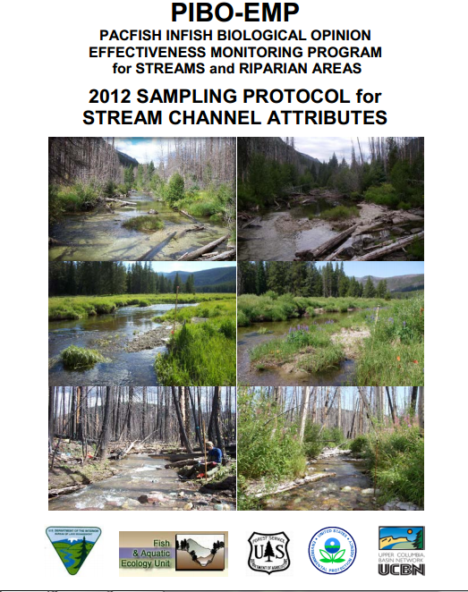
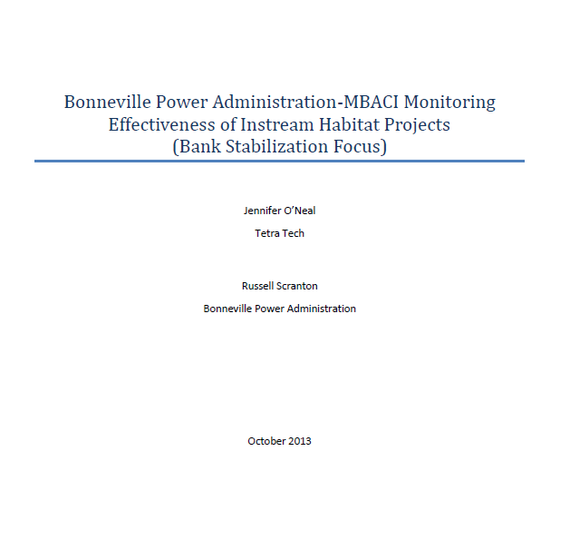
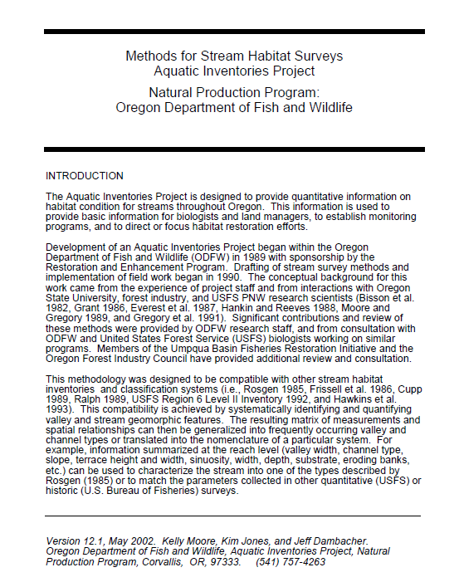

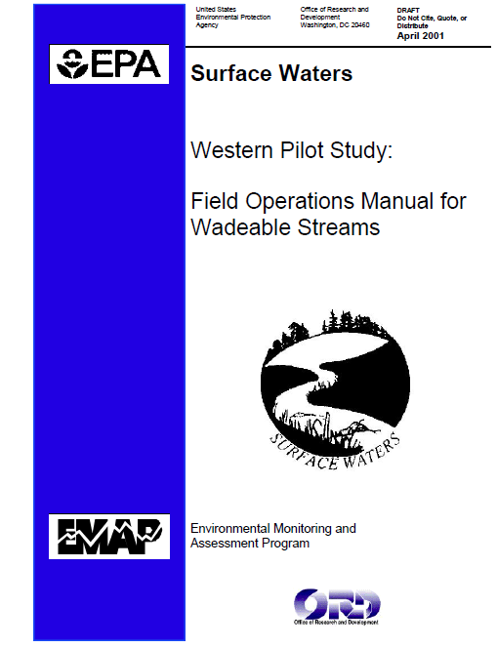
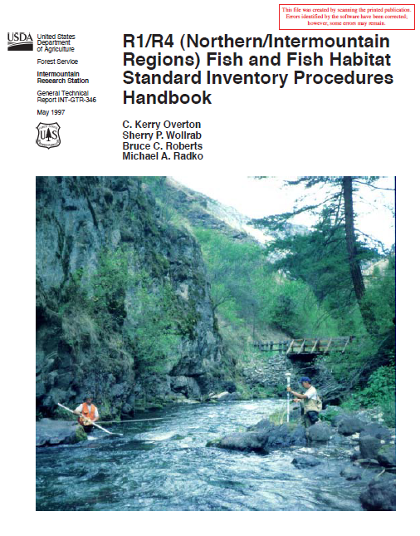
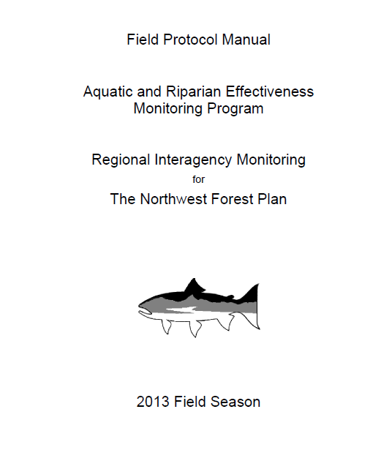
Crosswalk with other protocols
CHaMP Protocol Foundations
AEM
ODF&W
Crosswalk with remote sensing
AREMP
R1/R4
Notes:
Add text boxes of program names to the items you can’t read (e.g. ODFW/AREMP paper, CHaMP). I’d add the ‘green’ protocol circle from the previous slide as a reminder that you’re going thru an example from each of the 4 boxes on the first slide.
Maybe add a slide after this that drills down to methods?

Slide 9
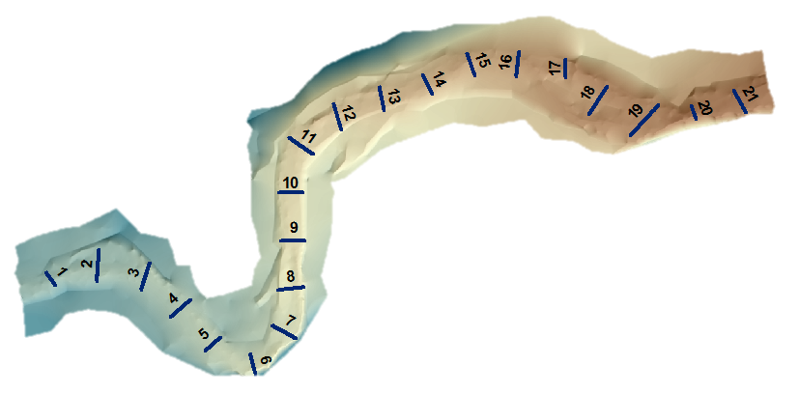
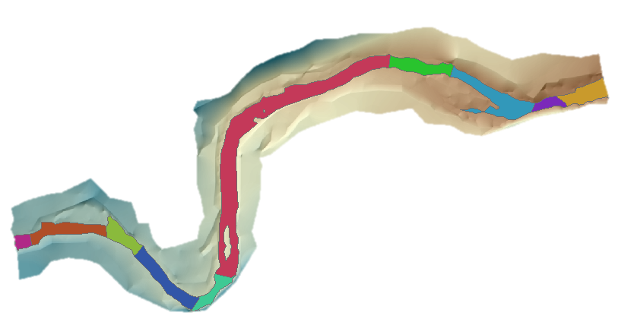
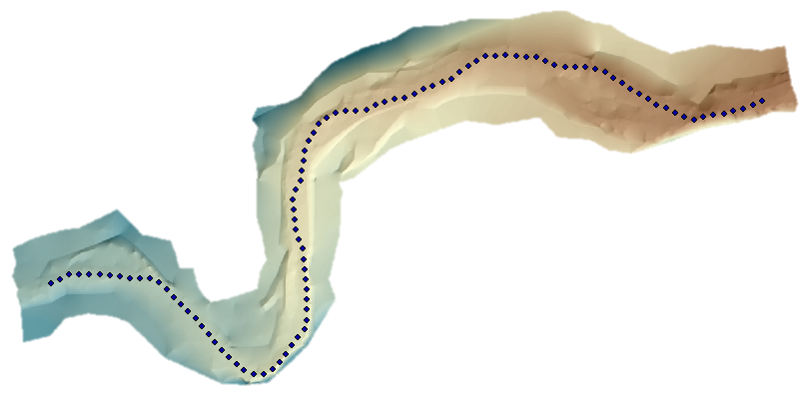
DEM based protocol
Crosswalk with other protocols
Cross-sections
(PIBO)
Channel Units
(ODFW)
Long-profiles
(EMAP)

Slide 10
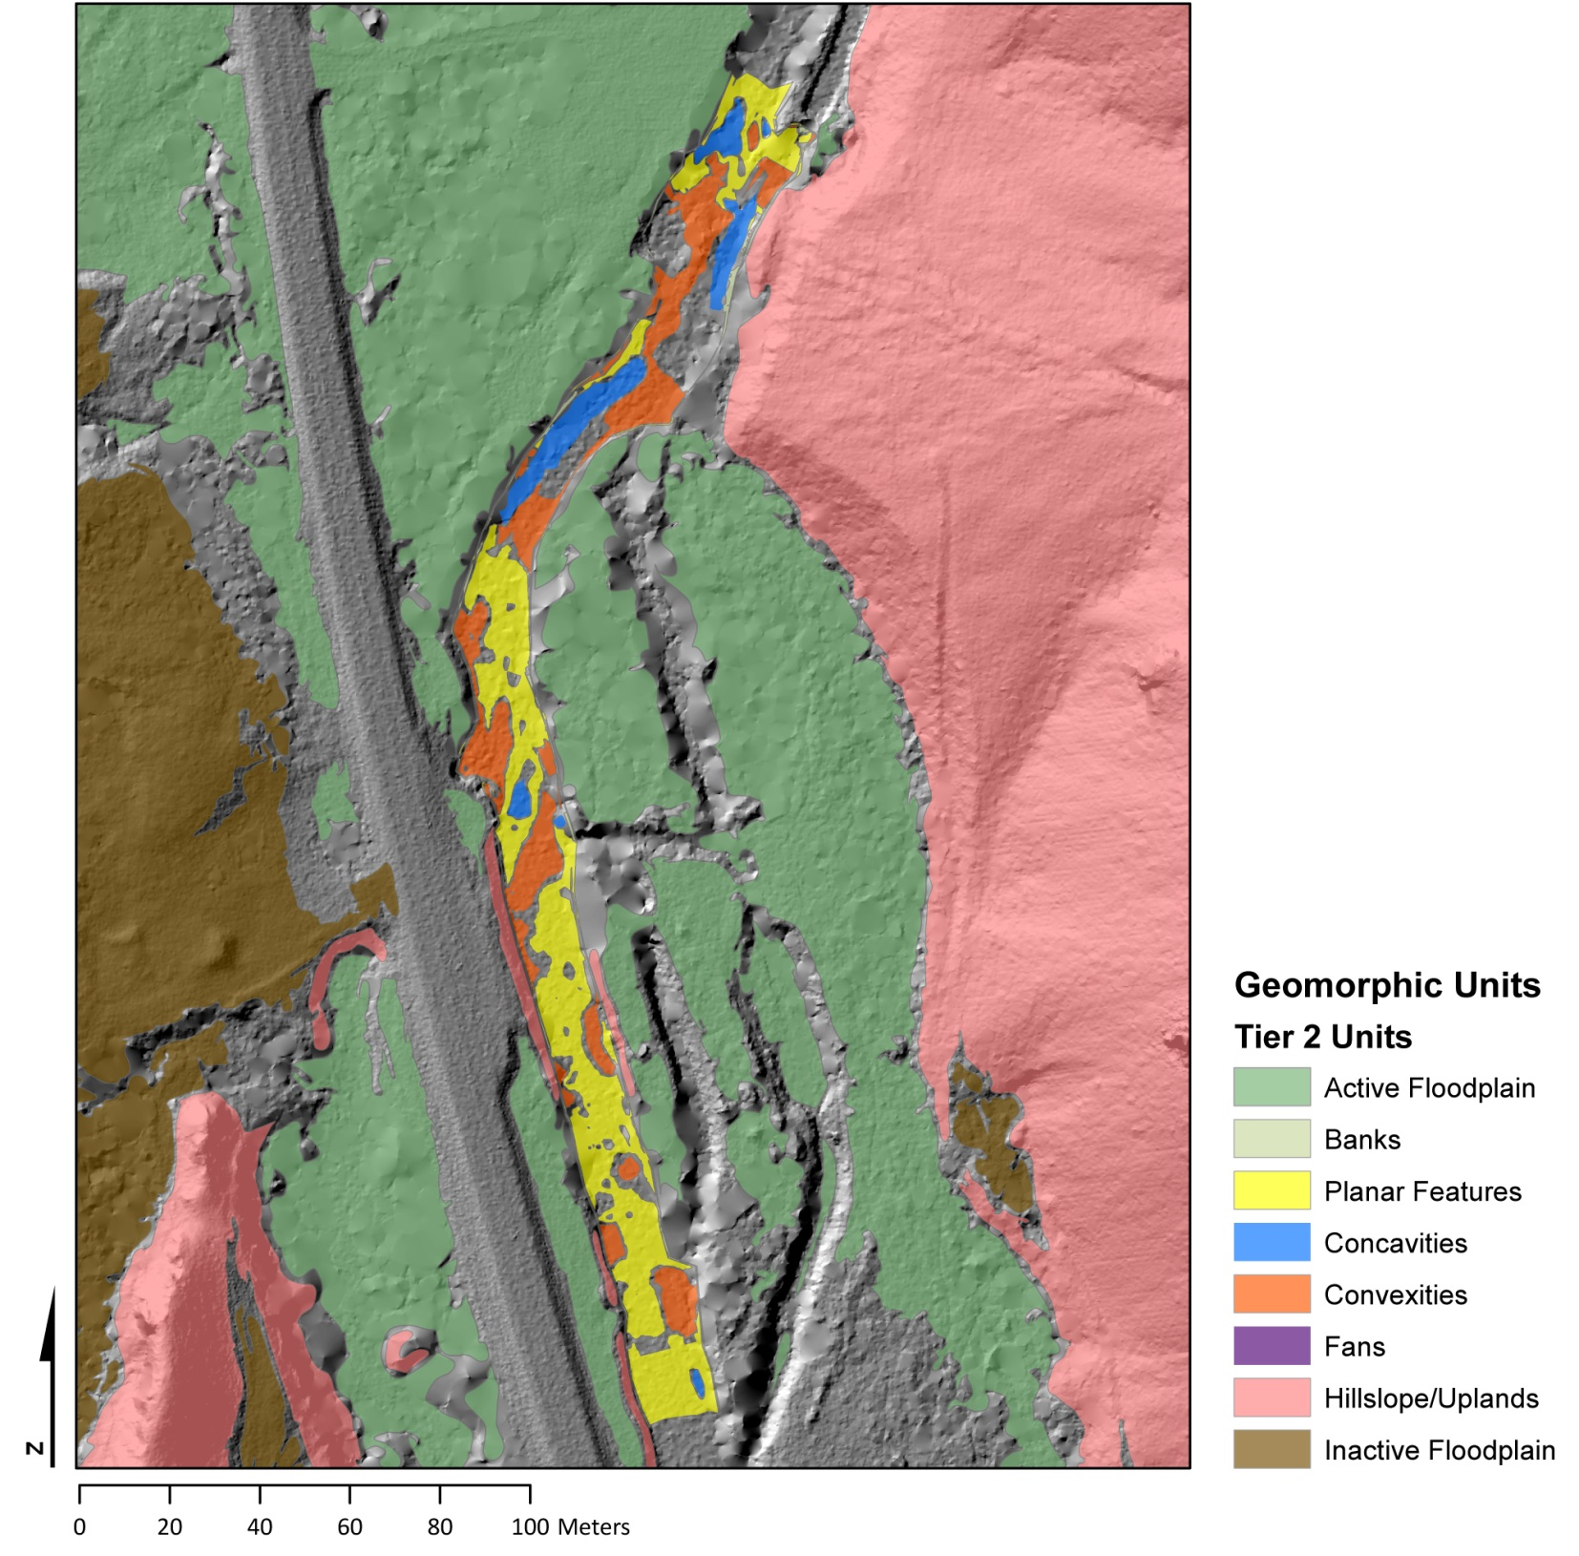
DEM based protocol
Crosswalk with remote sensing

Slide 11
RBT and GCD Measurements
Site Length (centerline)
Site Length (Thalweg)
Sinuosity
Wetted width
Bankfull width
Bankfull Channel Capacity
Area Sum
RP100
Pool tail crest depth average
Pool max depth average
Average Bankfull elevation
Average channel capacity
Average cross section area
Average rectangular cross section area
Site topographic gradient
Site water surface gradient
Site area wetted
Site area bankfull
Wetted volume
Bankfull volume
Detrended DEM standard deviation
Water depth standard deviation
For Each Channel Unit
  Area
  Volume
  Count
  Frequency
  Spacing
  Percent of site
  Average Max Depth
  Average Depth at Thalweg Exit
  Average Residual Depth
For Each Tier 1 and Tier 2 Channel Unit Type
  Area
  Volume
  Count
  Frequency
  Spacing
  Percent of site
  Average Max Depth
  Average Depth at Thalweg Exit
  Average Residual Depth
GCD results for the entire site, for each tier 1 and 2 channel unit type, and also for the common bankfull area between two visits:
  Raw area of erosion
  Thresholded area of erosion
  Percent of area of interest with detectable change
  Total net volume of difference
  Total net volume of difference +/- error
  Average net thickness of difference
  Average net thickeness of difference +/- error
  Average net thickness of difference with detectable change
  Average net thickness of difference with detectable change +/- error

Slide 12
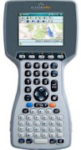
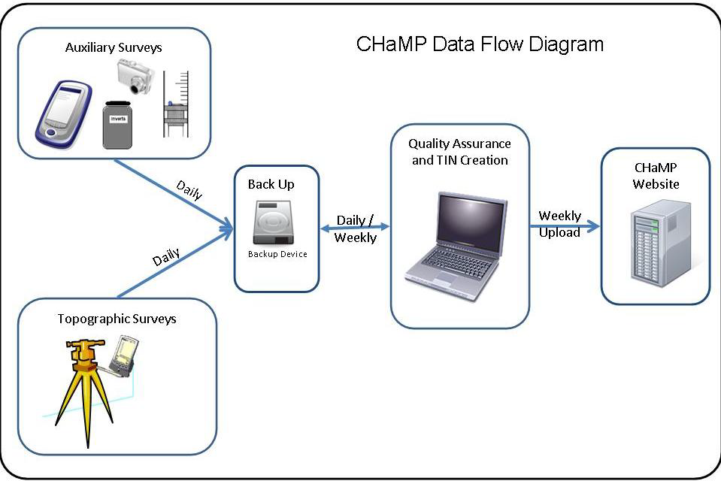

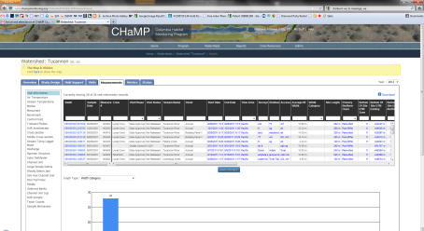
Auxiliary Data Workflow
Data Logger
Data Broker/QC
Website Upload/QC
Logger Data Transferred Through Broker
Channel Units
Side Channels
Fish Cover
Ocular Substrate
Pool Tail Fines
LWD
Pebbles
Embeddedness
Riparian
Discharge
Water Chemistry
Drift
Air Temperature
Stream Temperature
QA/QC

Slide 13
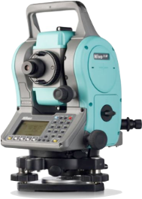
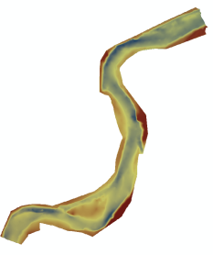
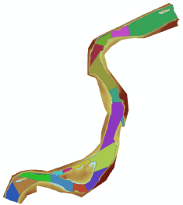

Topographic Data Workflow
Flexible Output
Total Station
Foresight
ArcGIS
RBT
Website Upload

Slide 14
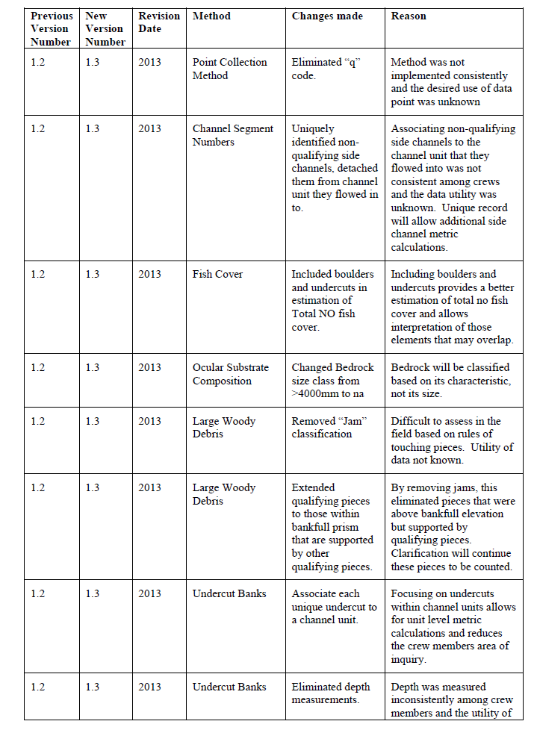

Slide 15
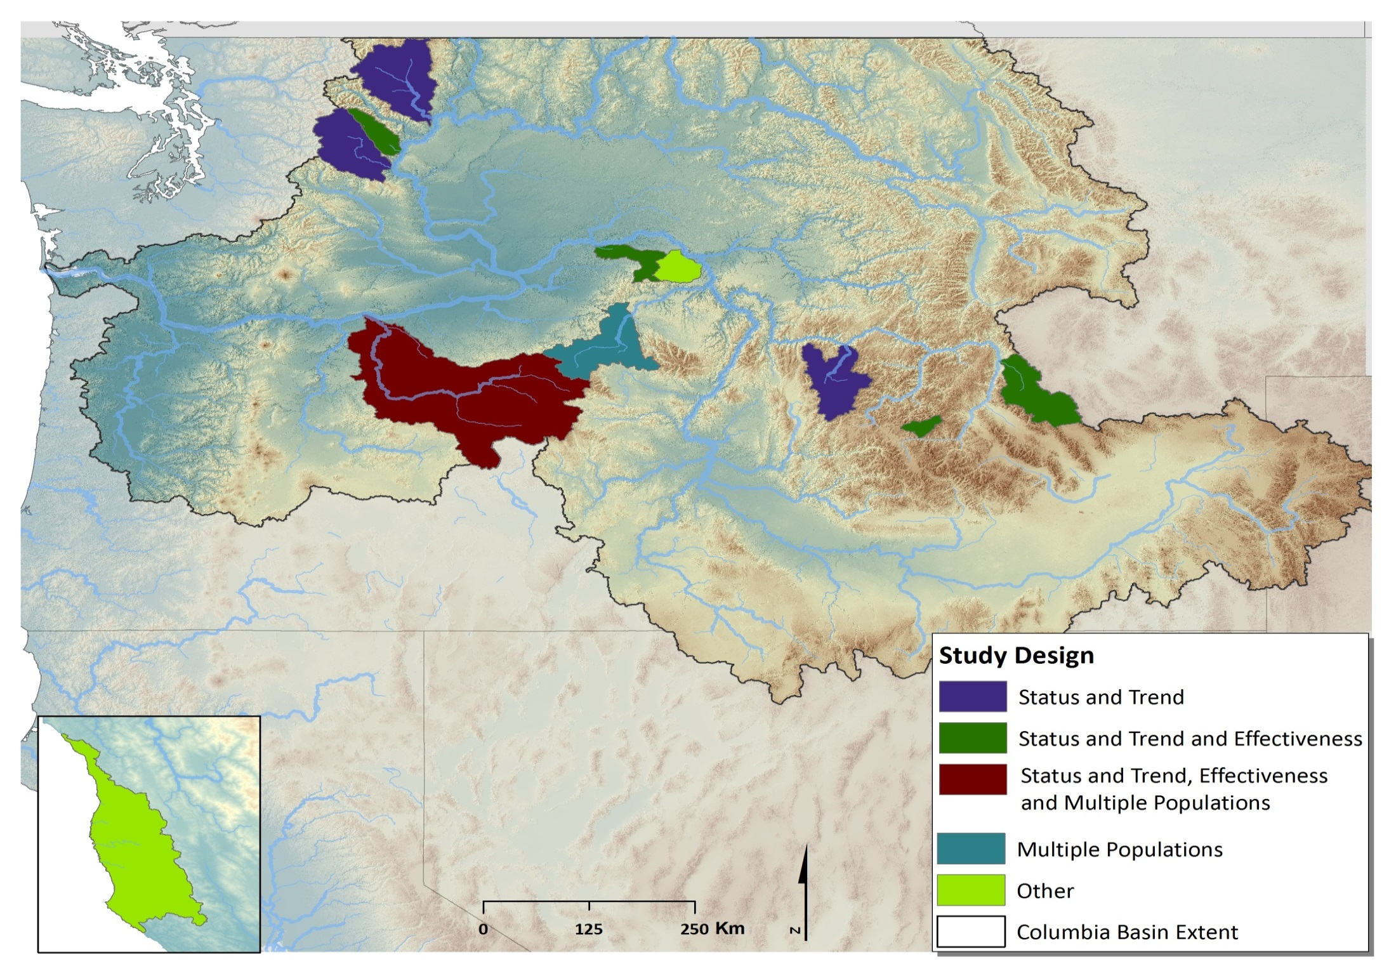
CHaMP Study Design(s) Differences
Big Navarrow Garcia (CA)
Notes:
What are you pointing out on this slide? The image I attached in the email may be better for this.

Slide 16
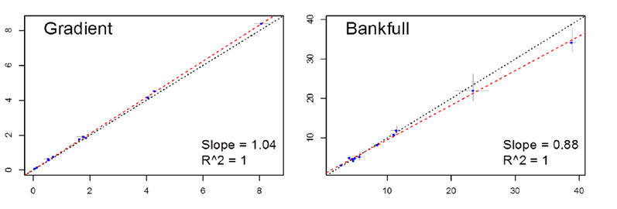
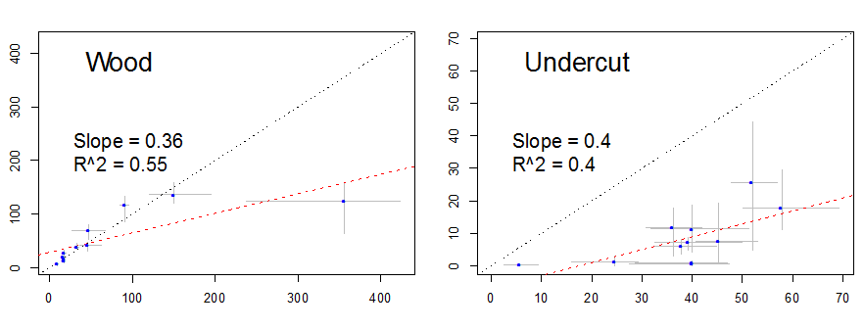
Need to Conduct Metric Comparisons
Notes:
I’d add the list of metrics, too…? Not clear what you’re covering here. ☺

Slide 17
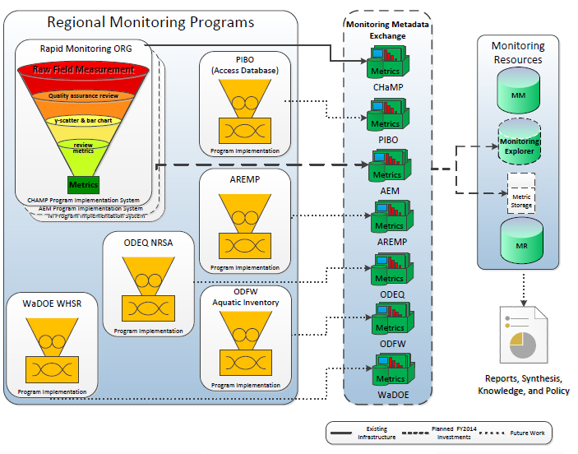
Notes:
You need a summary slide after this one---what are the take home messages? Maybe add your first slide in again as your last slide?

Slide 18

CHaMP’s design
CHaMP and ISEMP State of the Science Workshop
Portland, Oregon – February 25th and 26th, 2014
Presenter:
Phil Larsen
Pacific States Marine Fisheries Commission
Collaborators:
CHaMP and ISEMP staff

Slide 19
CHaMP’s spatial-temporal design: the basics
CHaMP’s objectives and design
Role of randomization in site selection
The conundrum of multiple objectives

Slide 20
CHaMP’s Design Objectives
Fish Habitat Status and Trend in each CHaMP watershed and key subpopulations within each watershed (e.g. geomorphic classes)
CHaMP’s temporal ‘domain’= 9 years
Status implies describing variation across the stream network and summaries of that variation
Trend implies describing how that variation is changing over time
Watershed-specific objectives
Notes:
Should matt cover this at the beginning of his talk?

Slide 21
D84 Status: Lemhi 2011-2013

Slide 22
Organizing Variation
Spatial variation
  Site to site differences
  Not spatially explicit within a watershed
Year to year temporal variation
  Coherent or synchronous across all sites: ‘year’
  Independent from site to site: ‘interaction’
Noise (or residual)
  Within year temporal variation
  Crew to crew variability
  Protocol variability

Slide 23

Design Conundrum:
Balancing sites
Objectives compete for samples
For CHaMP, samples = sites selected on the streams
Status = more unique sites
Trend=revisit same sites annually
SITES
Status
Trend

Slide 24
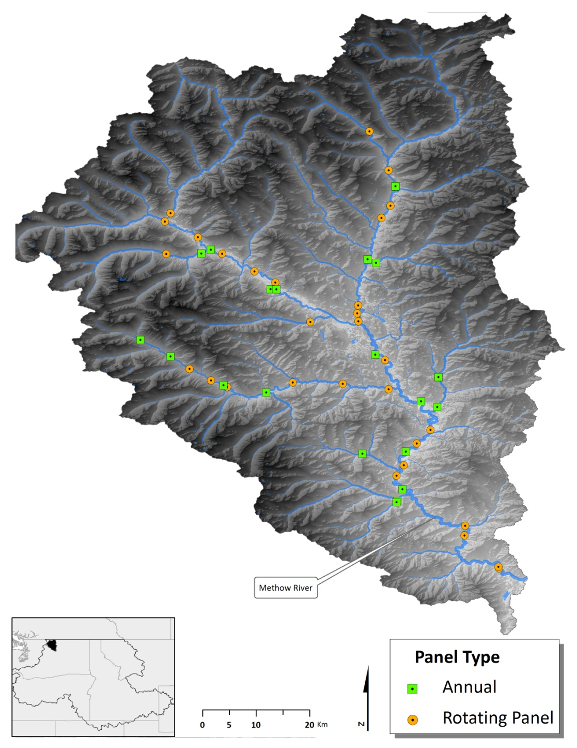
CHaMP’s design balance
4 panels: 45 unique sites in 3 years
  An annual panel: 15 sites
  3 rotating panels each on a
  3 year cycle: 10 sites/year
  Each site field sampled once in
  its designated year
  Some sites revisited within the year to estimate ‘noise’
  Stratified by geomorphic class

Slide 25
Role of annual sites
Separates ‘year’ variation from ‘interaction’ and ‘noise’
  Provides insight into trend detection sensitivity
Provides continuity in describing temporal patterns
  Fills in the gaps between the once every three years sites
  Picks up early trends
Can be used to increase precision of trend detection from the 3 yr panel sites.

Slide 26
Role of 3 yr panel sites
Along with annual sites, allows 3 yr running average for status estimates
Allows site specific trend estimates after three visits
Sample size of 45 for trend estimate after 9 years
Higher number unique sites than if all annual sites

Slide 27
CHaMP site stratification:
Valley Class
Watershed | Source | Transport | Depositional | Total | Site density
Entiat | 15 | 1 | 16 | 32 | 0.26
John Day | 54 | 48 | 40 | 142 | 0.18
Lemhi | 38 | 25 | 39 | 102 | 0.33
Methow | 4 | 0 | 41 | 45 | 0.13
South Fork Salmon | 16 | 16 | 23 | 55 | 0.30
Grande Ronde | 27 | 29 | 60 | 116 | 0.12
Wenatchee | 15 | 14 | 14 | 43 | 0.09

Slide 28
CHaMP’s spatial-temporal design: the basics
CHaMP’s objectives and design
Role of randomization in site selection
The conundrum of multiple objectives

Slide 29
Randomization
Why can’t I add my sites?
Spatially balanced sampling:
Randomization selects unbiased samples
Each site is chosen with a known ‘probability of selection’ or weight.
  Simple random sampling = each site has same weight
  Stratification = different weights for different sets of sites
What weights should be assigned to ‘opportunistic’ sites?
Notes:
Suggest slimming text (as edited) b/c matt will cover…? “You can add your sites if justifiable weights can be assigned” is unclear. Suggest removing this.

Slide 30
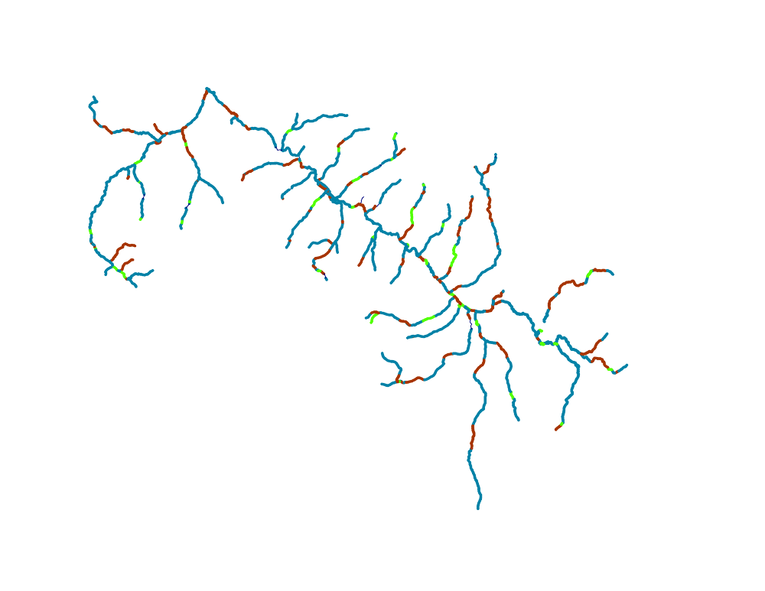
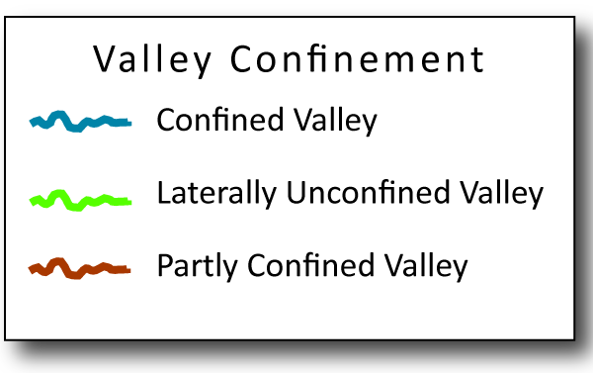
A CHaMP design
Each color has a different
Geomorphic Valley Class

Slide 31
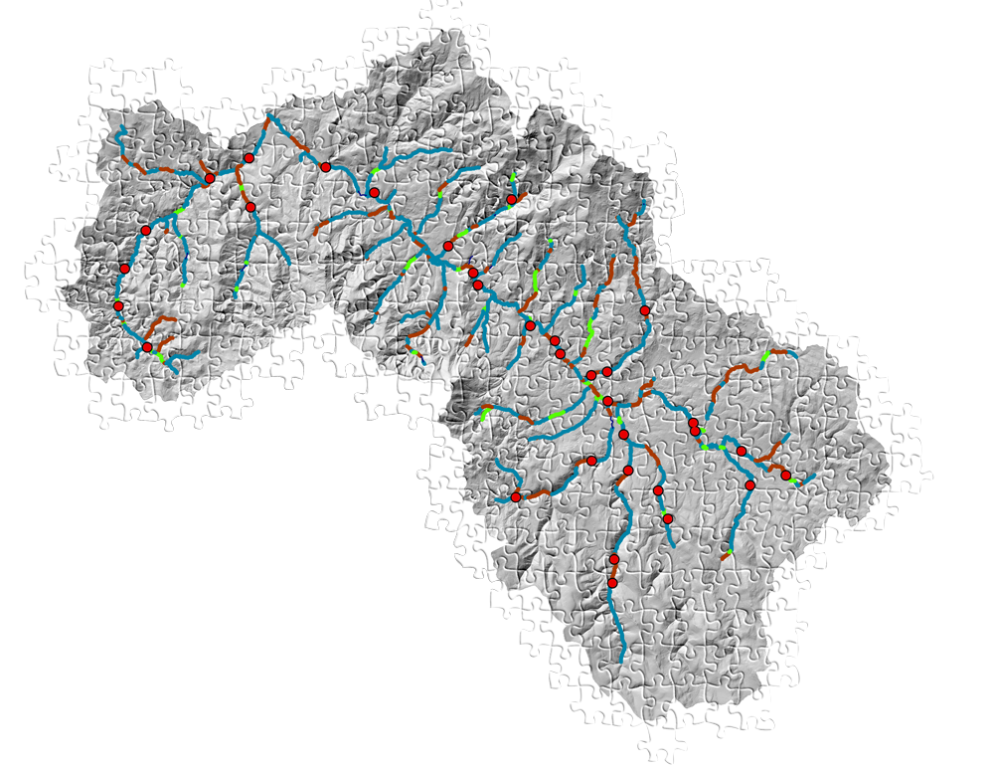
Distributing sites along the network

Slide 32
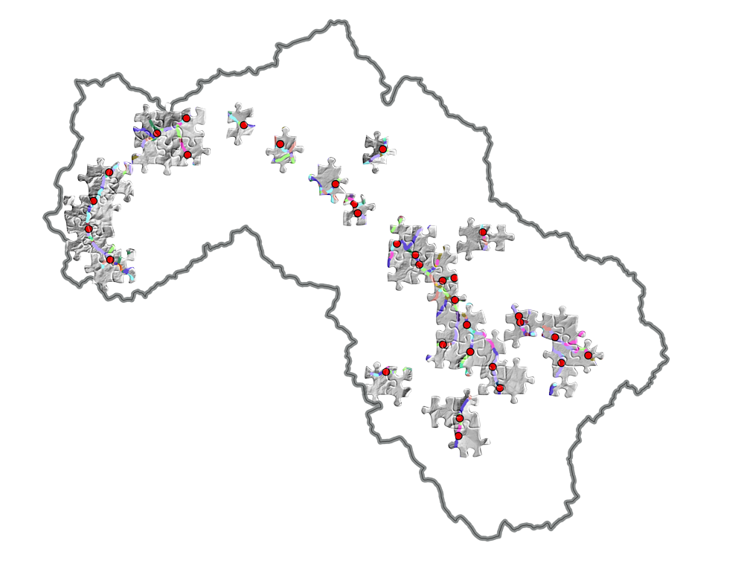
We sample sites
When a site is sampled,
these are the only sites
explicitly measured
on network

Slide 33
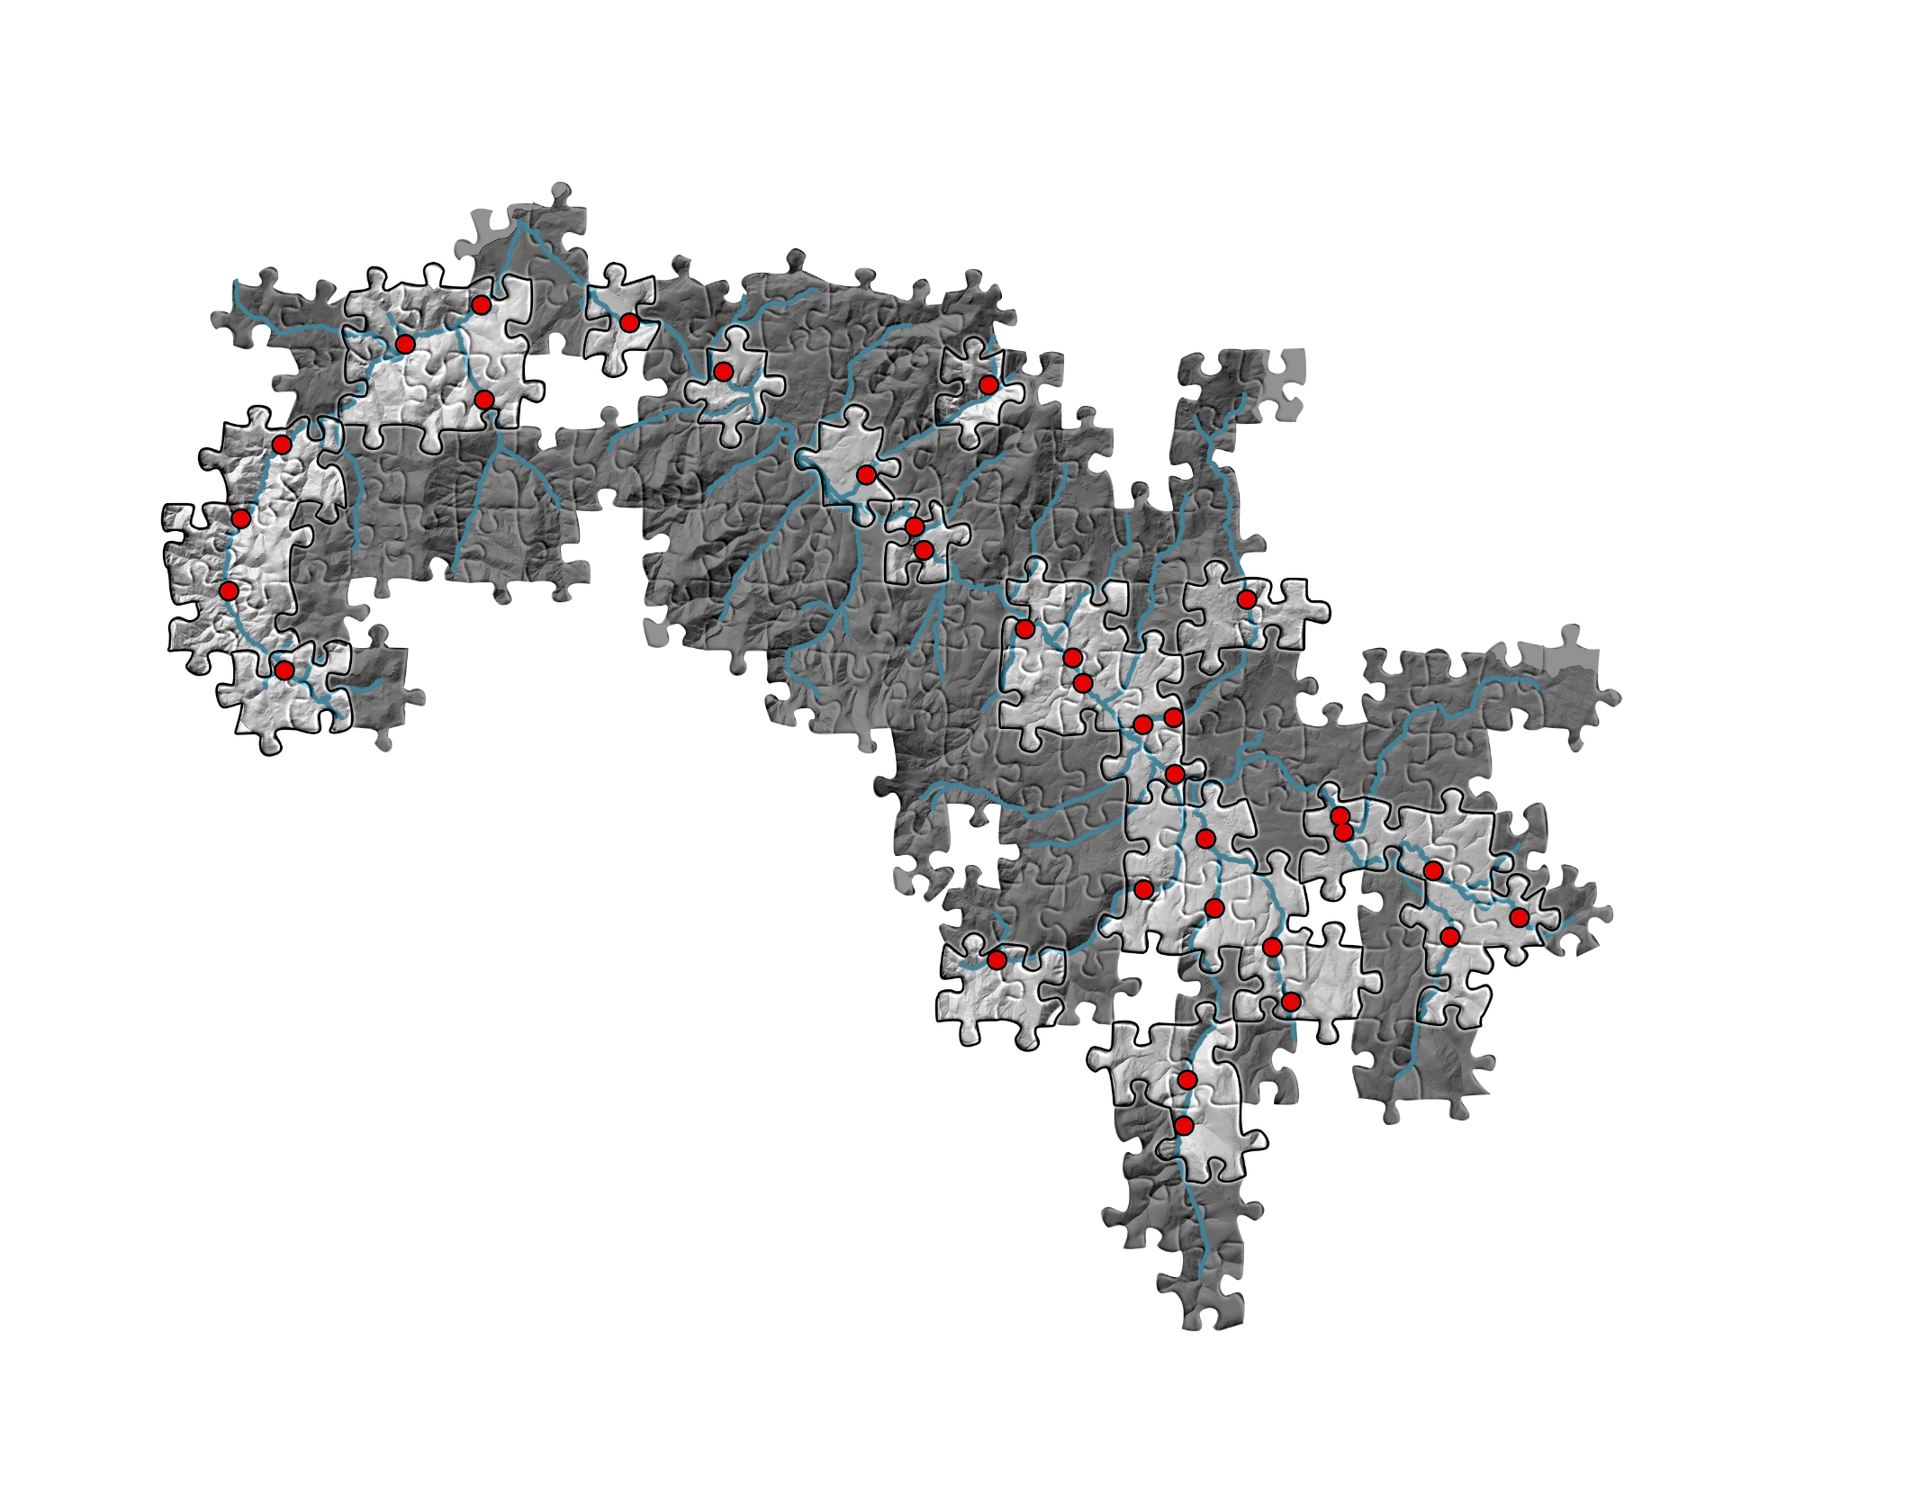
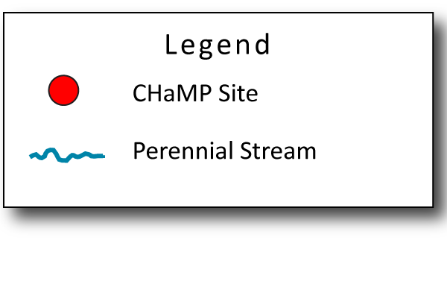
Then, extrapolate from sampled sites out
to the rest of the network

Slide 34
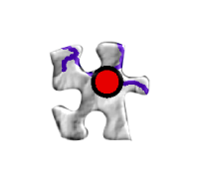
What if one of those sites was ‘opportunistic’ and not part of the random sample?

Slide 35
What if one of those sites was ‘opportunistic’ and not part of the random sample?
Site will likely only represent the
reach where it was sampled
Notes:
Indicate that if randomizationused in site selection, can develop weights for a combined sample

Slide 36
D84 Status: Lemhi 2011-2013

Slide 37
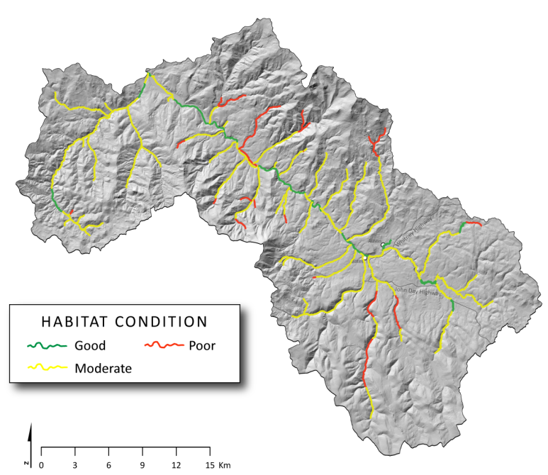
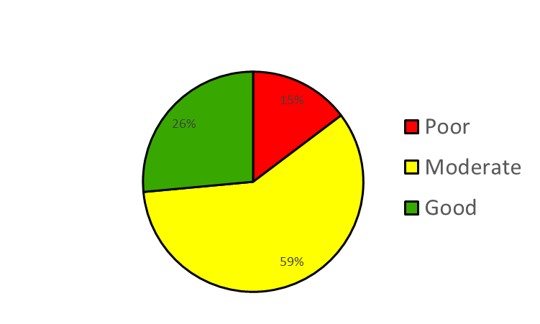
Summary Products
Design-based
Model-based

Slide 38
CHaMP’s spatial-temporal design: the basics
CHaMP’s objectives and design
Role of randomization in site selection
The conundrum of multiple objectives

Slide 39
Competing Objectives/
Design Alteration Implications
Characterize assessment units within watersheds (e.g., 5th field HUCs
  Implies increasing sample size within a watershed
Characterize watersheds outside CHaMP domains
  Implies decreasing sample size within a watershed
Reduce or eliminate annual sites
  Reduces linkage across years
  Reduces ability to increase precision of 3 yr panel sites for trend
  Reduces ability to estimate ‘year’ variation and its implications
Increase panel structure to, for example, 5 year panels
  Extend temporal domain to 15 years
Incorporate sites from other monitoring programs
  Estimate site weights?

Slide 40
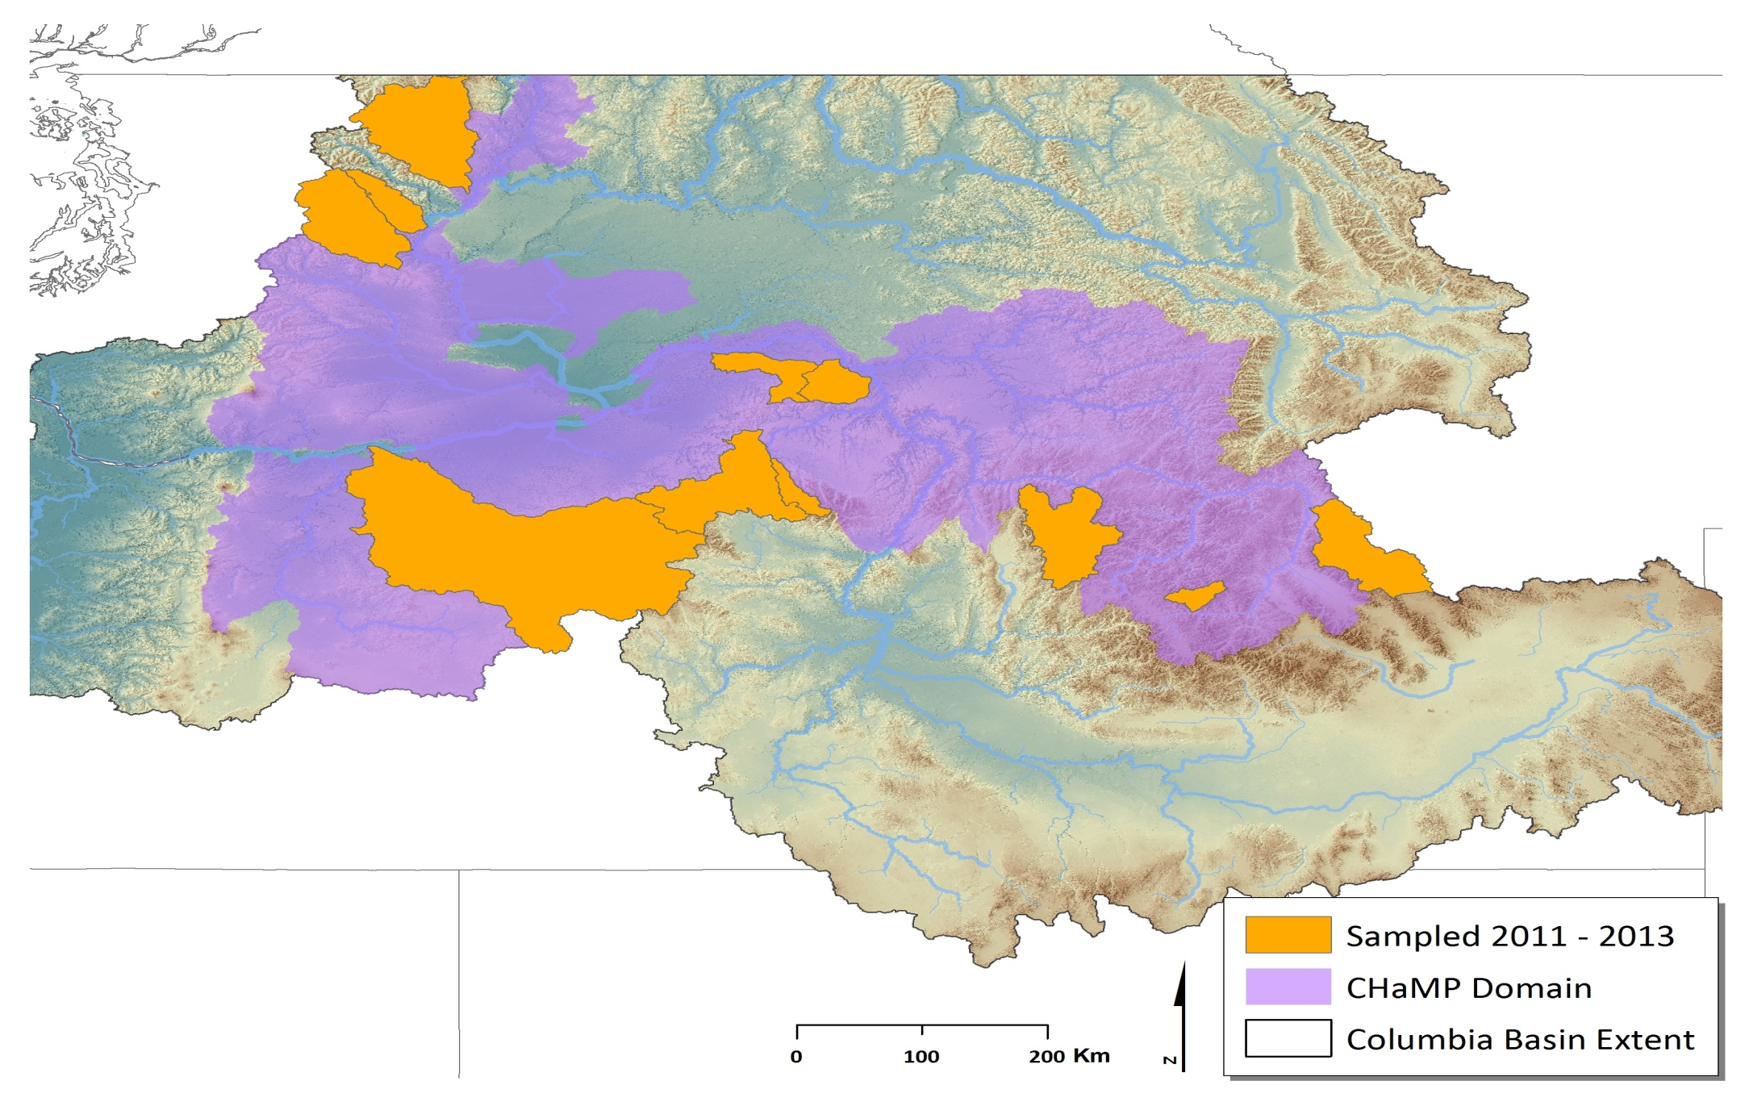
Notes:
Placeholder map

Slide 41
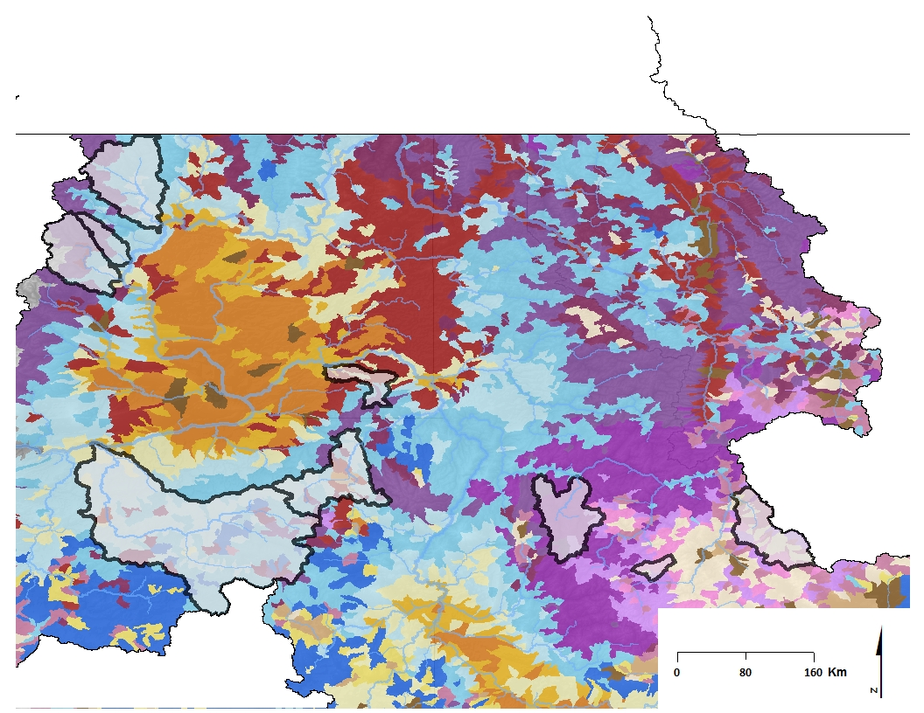
Natural landscape classes
within CHaMP domain
Notes:
Annual precipitation
Growing degree day
Annual temperature range
Elevation
Watershed slope
% watershed with highly erodible geology
Low gradient stream density

Slide 42
Natural landscape classes within CHaMP domain
47%
Warm, low, steep
3%
Dry, mid-elevation,
moderate slope
[
7%
Cool, wet, mid-elevation,
Moderate erodibility
1-4%
Other
7%
Hot, dry,
low erodibility
25%
Cool, wet, high,
moderate erodibility

Slide 43
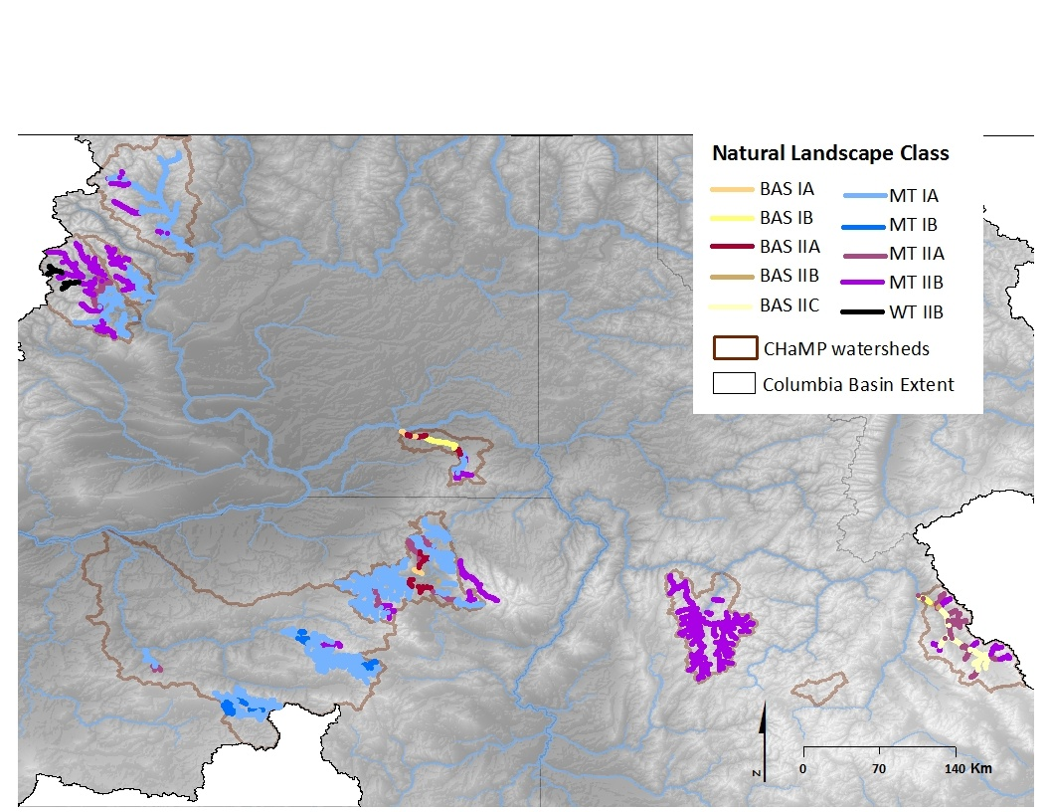

Slide 44
CHaMP km within TRT domain
Percent landscape classes
7 4 4 1 2 47 3 7 24 1
% CHaMP covered

Slide 45
CHaMP’s spatial-temporal design: the basics
CHaMP’s objectives and design
Role of randomization in site selection
The conundrum of multiple objectives

Slide 46
CHaMP Metric Assessment
CHaMP and ISEMP State of the Science Workshop
Portland, Oregon – February 25th and 26th, 2014
Presenter:
Matt Nahorniak
Collaborators:
Phil Larsen, Boyd Bouwes, Carol Volk, Kevin See

Slide 47
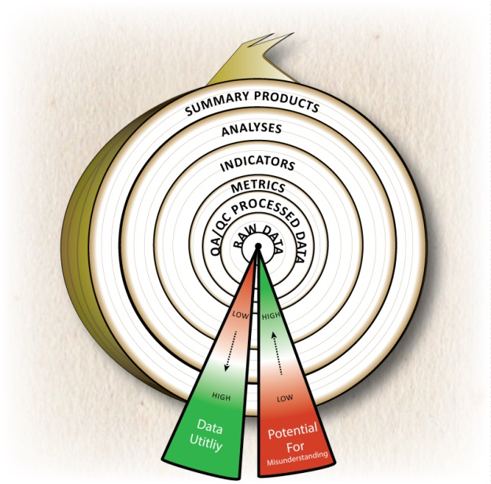
CHaMP Metric Assessment
Metric Assessment Objectives:
Ensure CHaMP Metrics are Capable of Supporting the Indicators, Analyses, and Summary Products Depending on them
  Feed Back into Measurement Protocols
  Feed Back into Sampling Designs
  Feed Forward into development of indicators, analyses, and summary products
  Enable Program Interoperability,
    At the metric level and in support of summary products
    A the summary products level
  Ensure a Healthy Core!

Slide 48
CHaMP Metric Assessment
Ensure CHaMP Metrics are Capable:
Metric Capability is a Function of:
  Measurement Accuracy and Precision (“Bias” and “Noise”)
  Spatial and Temporal Variance Patterns
  Sampling Design
  Models from which Indicators, Analyses, and Summary Products are Built
Steps to Assessing Metric Capability:
  Make Status and Trend Estimates at Spatial and Temporal Scales of Interest
  Create Graphical Tools to Visualize Elements of Metric Capability
    Patterns of Measurement Noise and Spatial/Temporal Variance
    Identify Problems, Outliers, Data Transformation Needs, etc.
  Statistically Model Components of Variance
  Compare Metric Performance with Requirement of Summary Products

Slide 49
CHaMP Metric Assessment
Estimating Status and Trend
Calculate GRTS adjusted sample weights to ensure accurate, properly weighted Status and Trend Estimates.
  R-Code Generate to Automate Process.
Generate Estimates:
  CHaMP Metric Means and CDFs
  Standard Errors
  By Watershed and Valley Class
  By Year, and Aggregate over All Years
Make Estimates Available As
  Data files
  Graphical Outputs

Slide 50
Graphical Assessment of CHaMP Metric D84
Metric Performance Summary Particle Size Distribution: D84
Notes:
Between 2011 and 2012, an study found that sampling 210 particles per sites was excessive with respect to required precision. A reduction to 105 particles per sites was implemented, enabling more efficient measurements.
2012 and 2013 data, show only small (if any) decreases in precision in D84 and related metrics. As expected, there is no apparent reduction in precision of valley class and watershed level estimates.

Slide 51
CHaMP Metric Assessment: Components of Variance
Understanding components of variance is key to optimizing sampling designs across time and space.
Total variance is broken down into:
  Temporal Variance
  σ²_{year-year}
  Spatial Variance:
  σ ²_{watershed(year)}
  σ²_{Strata(watershed,year)}
  σ²_{site (stratum,watershed,year}
  Measurement Noise
  σ²_{e}
This information can be used to:
Identify problem metrics
Feedback into current / future Sampling Designs

Slide 52
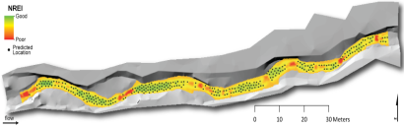
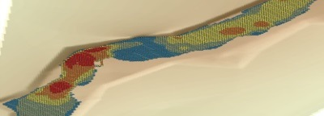
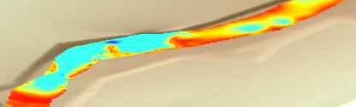
CHaMP Metric Assessment
Is Metric Capable of Supporting Indicators, Analyses, and Summary Products?
Example: D84 ➔ Hydraulic Modeling ➔ NREI and HSI
Discharge
Add’l CHaMP Inputs
NREI
D84
Hydraulic Models
Life Cycle Models
DEM
HSI
Validation and Sensitivity Studies show Modeled Depth and Velocity α ln(D84), for shallow streams
Measurement Noise for ln(D84) is very small w/r/t site-site, strata-strata variance. Therefore, D84 does not limit Hydraulic Modeling’s ability to differentiate between sites or groups of sites.
D84 is Capable for Supporting Hydraulic Modeling!

Slide 53
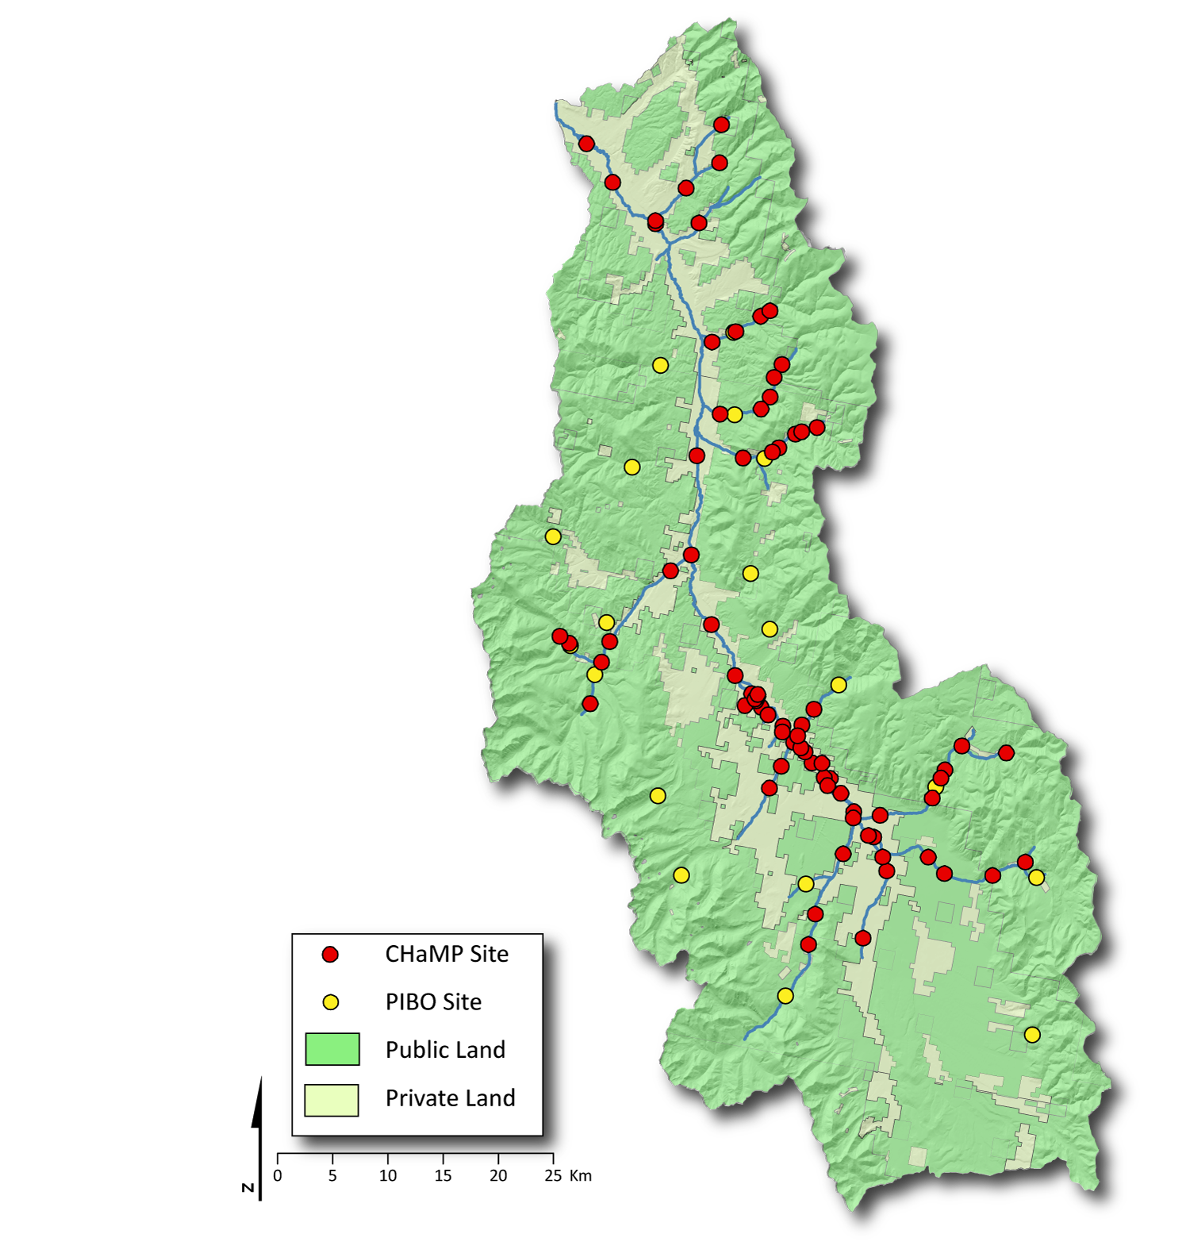
Interoperability: Leveraging from PIBO and Other Programs
Use PIBO data directly
  Increased Sample Size for GRTS roll-ups, creating limiting factor maps, etc.
  Crosswalk to make comparable
    Quantify errors or bias induced from program-program differences
Use Higher Level Summaries as watershed level covariates in CHaMP / ISEMP models
  Watershed level PIBO comparisons to reference condition
  Use in hierarchical models
Lemhi

Slide 54
Backup Slides
CHaMP Metric Assessment

Slide 55
Length, Width, and Volume Metrics
Notes:
As expect, most of the variance in length, width, and volume metrics is site to site and across strata, while changes across time are small in comparison.
Measurements of these parameters are highly repeatable.

Slide 56
Boulders, Cobbles, Gravel, etc.
Notes:
Between 2011 and 2012, an study found that sampling 210 particles per sites was excessive with respect to required precision. A reduction to 105 particles per sites was implemented, enabling more efficient measurements.
2012 and 2013 data, show only small (if any) decreases in precision in D84 and related metrics. As expected, there is no apparent reduction in precision of valley class and watershed level estimates.

Slide 57
Volume and Area by Pools, Turbulent, and Non-Turbulent Zones
Notes:
Measurement noise is generally higher for these metrics than others. However, measurement noise is still reasonable when estimating status and trend over spatial regions for which a reasonable sample size is present.

Slide 58
Depth Profile, Gradient, and Sinuosity
Notes:
Much like length, width, and volume metrics, most of the variance in depth profile, water surface gradient, and sinuosity occurs site to site and across strata, while changes across time are small in comparison.
Measurement noise is generally small for these metrics, relative to site-site or other signals.

Slide 59
