Slide 1
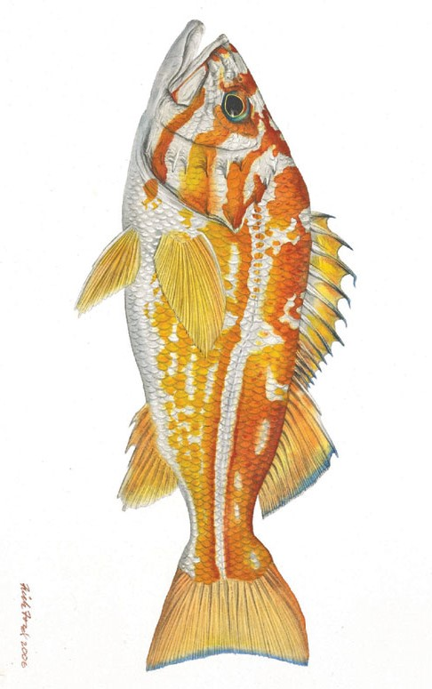


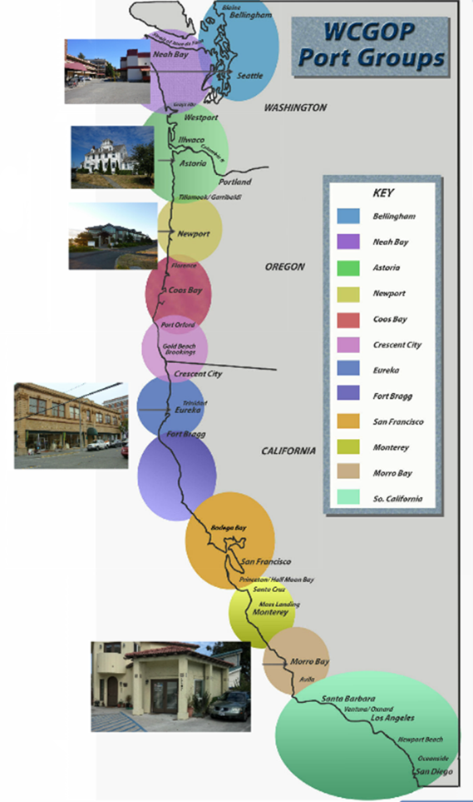
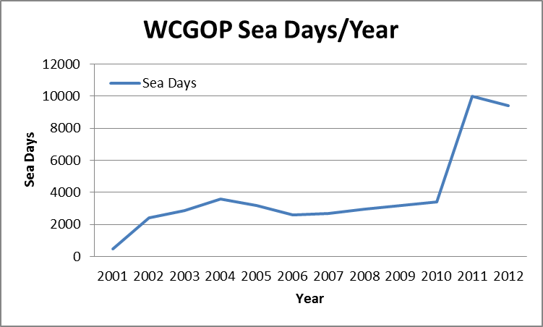
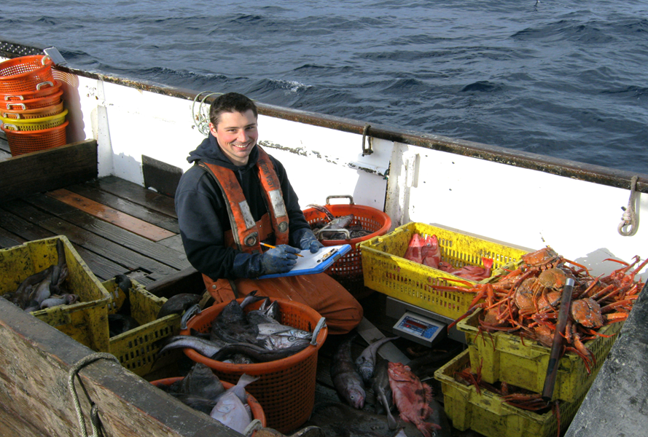
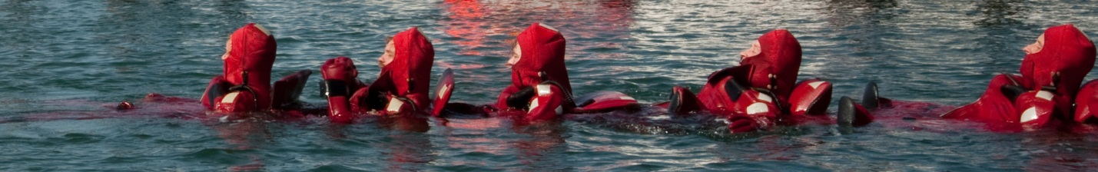
Rationalizing the Irrational. Observer Program considerations for a fishery transitioning to a multi-species individual fishing quota system.
Jim Benante¹ and Jon McVeigh²
¹ Pacific States Marine Fisheries Commission, Seattle, WA
² NOAA Fisheries, Northwest Fisheries Science Center, Seattle, WA
Introduction
The West Coast Groundfish Observer Program(WCGOP) was initiated to address issues with catch accounting in the groundfish fisheries off the west coast, which were declared an economic disaster in 2000. The WCGOP began in 2001, with four staff members administering the program. Over the last 12 years, the WCGOP has grown to 26 staff members and evolved to adapt to changes in the management of the groundfish fishery. The groundfish fishery operates from Blaine, WA to San Diego, CA, encompassing over 7,800 miles of coastline. Staff are located in five offices spread along the coast. The WCGOP faces many challenges with a large number of species to monitor, a large coastline, overfished species concerns, ESA listed species interactions, etc. A new monitoring requirement in 2011 added a new and unique challenge for the WCGOP.
Gear
Observer Training
From November 2010 through April 2012 (18 month time period) the WCGOP had its most intensive training period, by administering eight trainings that prepared 172 observers for deployment. Prior to catch shares the program was accustomed to one training per year with 20 observers.
Data Quality
Safety
Training
Regulations
Type of Training | Dates | Number of Observer
CS 3 Week Training | 11/29/2010- 12/15/2010 | 35
CS 3 Week Training | 1/10/2011- 1/26/2011 | 29
CS 3 Week Training | 1/30/2011- 02/15/2012 | 22
CS 3 Week Training | 2/7/2011- 2/23/2011 | 20
NCS 3 Week Training | 03/14/2011- 03/30/2011 | 9
CS 3 Week Training | 05/09/2011- 05/25/2011 | 26
CS 3 Week Training | 01/30/2012- 02/15/2012 | 22
NCS 3 Week Training | 03/12/2012- 03/28/2012 | 9
Debriefing
Reporting Timelines
Science
Staffing
Timeline of Events Leading up to the Catch Share Fishery Implementation:
Compliance
Catch Share Fishery
In January 2011 the limited entry groundfish trawl fisheries were rationalized and the Catch Share (CS) Program began. Under the catch share program, the total allowable catch of 62 groundfish species were divided into shares and allocated to individual permit owners. Full accountability of catch is required under this quota share program and therefore retained and discarded catch counts towards a vessel’s quota. To accomplish this; fishery managers required 100% monitoring using at-sea observers and shore side monitors. As a result, the number of observers required to monitor the fishery dramatically increased. The implementation of the new catch shares program had a large impact on the WCGOP. In 2010, the WCGOP began to
prepare for the catch shares program by adapting sampling strategies, training curriculum, manuals, forms, the database, gear, etc. Once catch shares was implemented, the WCGOP program adapted to the increased number of training and briefing classes, data, debriefings, gear management, etc.
Catch Share Fishery began (66% increase from 2010)
Safety
There were 4,000 more sea days in 2011 vs. 2010. With over 19,000 days at sea in 2011-2012, the potential for accidents and injuries is real and needs to be addressed on a daily basis. Maintaining a high level of safety standards during a time period when the breadth and scope of a program changes dramatically can be a challenge.
The WCGOP continues to put safety at the forefront of observer training and there has been no change in training curriculum with regards to safety training since CS implementation. In addition, high quality safety equipment is provided and the WCGOP works closely with the USCG and NMFS enforcement to ensure observer safety standards are maintained during deployments.
Observer Program Considerations
When an observer program more than doubles in size there are many pitfalls to avoid during the first two years. Lessons learned from the WCGOP’s experience point to these areas of particular importance:
Database – Will the current database meet the increase or change in in data? Is an at-sea data collection system necessary?
Reporting requirements – Are “real-time” data reporting systems needed? Do existing databases need changes or the ability to communicate with new or existing databases/entities to meet reporting requirements?
Electronic Monitoring – Is there a role EM can play in monitoring the fishery? What are the costs? Will science needs still be met?
Staffing – Are staffing levels adequate to handle the increase in observers and their data as well as training and other increased workloads?
Year | Number of observers | % increase from 2010
2001-2010 | 20-40
2011 | 140 | 71%
2012 | 115 | 65%

