Slide 1


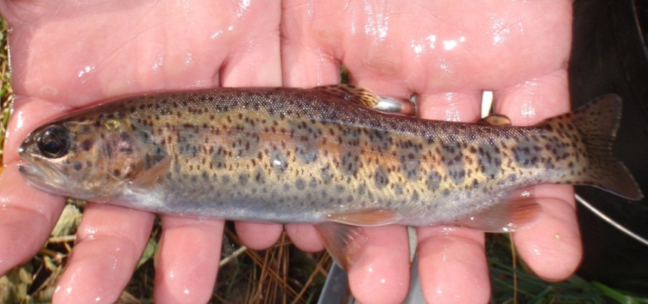
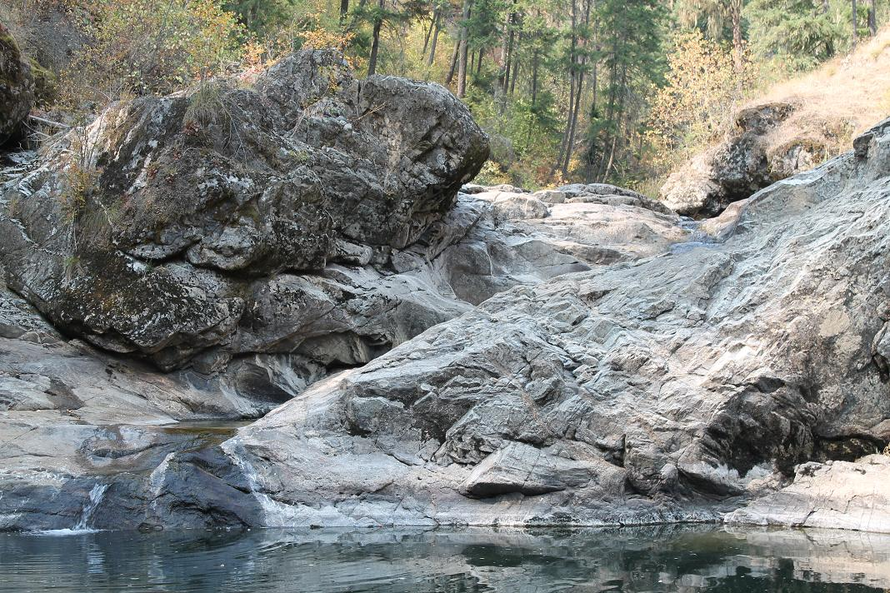
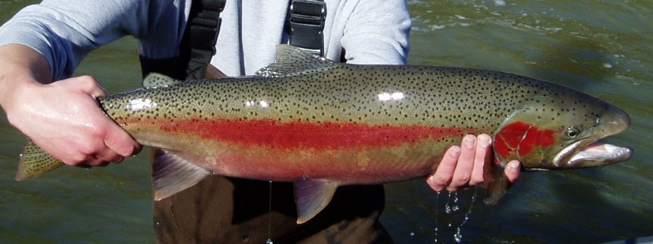
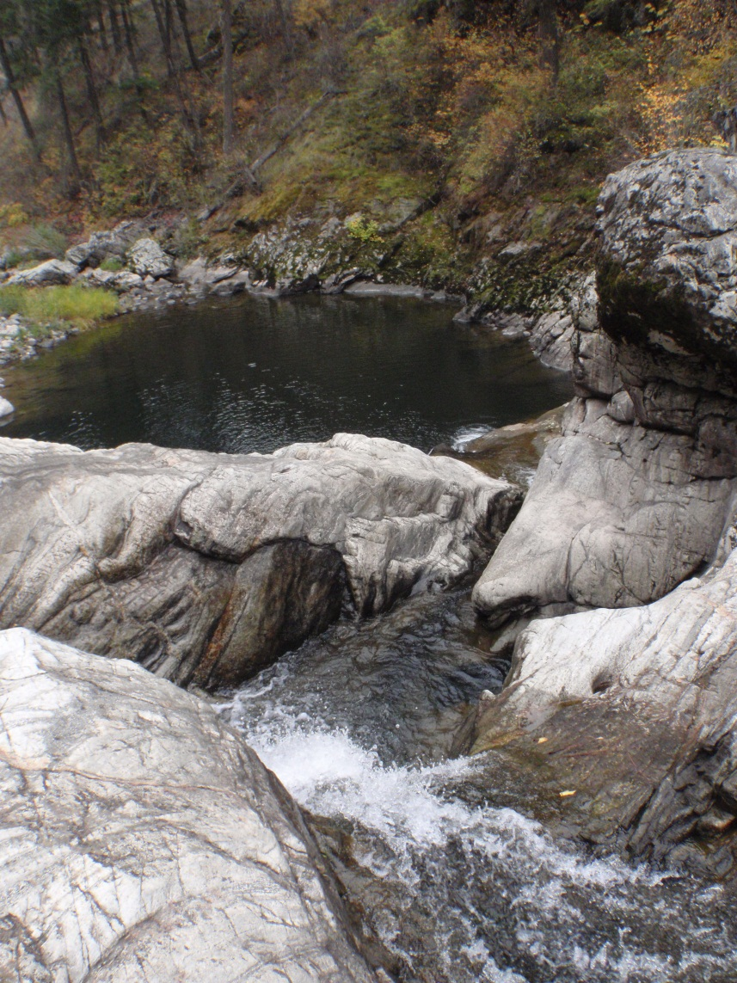
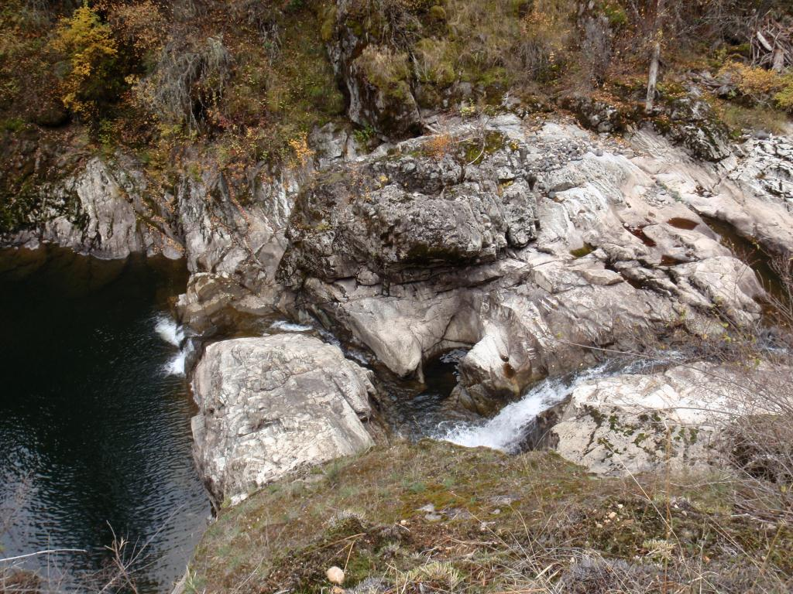
Jumping the Falls? Interactions Between Resident and Anadromous O. mykiss Populations at a Putative Natural Barrier, Big Bear Falls, Potlatch River, Idaho
T. Vanderwey, L. Redfield, B. Bowersox, M.W. Ackerman
Introduction
Methods
Discussion
Rainbow trout, Onchorhynchus mykiss, have varied life histories, including resident and anadromous forms. Reproductive contribution of resident trout may be critical for maintenance of genetic diversity in anadromous populations.
Tissue samples were taken from 418 fish, representing six collection locations. The six collections formed three groups (2 collections per group): 1) putative residents collected at the headwaters, 2) adult steelhead in lower Big Bear Creek, and 3) juveniles of unknown life history collected both above and below Big Bear Falls (Figure 1, Table 1). All samples were genotyped at 191 single nucleotide polymorphisms (SNPs). Multi-locus SNP data was used to evaluate genetic diversity among collections and to estimate the origin of unknown juveniles collected at the waterfall. Analyses include:
  Tests for deviation from Hardy-Weinberg equilibrium (HWE) were performed across all SNPs for each collection using GENEPOP v4.0 (Raymond and Rousset 1995).
  Percentage of polymorphic SNPs and average expected heterozygosity (H_{E}) for each collection were estimated using GENALEX v6.3 (Peakall and Smouse 2006).
  Sibship, both within and among collections, was evaluated using COLONY v2.0 (Jones and Wang 2010). We also used COLONY to estimate effective population size (N_{E}) of the unknown collection taken above the falls.
  We used STRUCTURE v2.3.4 (Pritchards et al. 2000) to determine the proportional membership of each individual in the study to the ‘resident’ or ‘steelhead’ life histories. We only used SNPs with >10% minor allele frequency variation (l = 81) between the reference resident and steelhead populations.
Our results indicate Big Bear Falls is not a complete migration barrier. When water levels allow, migration past the falls is achievable.
Of the 33 individuals from the unknown juvenile above falls
collection, 22 were from only two family groups. This indicates a very limited parent group passed the falls. We estimated the N_{E} of this collection to be 5 (2-20;
Table 1. Oncorhynchus mykiss collections screened with 191 SNP assays from Big Bear Creek, Potlatch River, Idaho. Collections are color-coded to represent 3 populations: 1) reference resident, 2) reference anadromous (steelhead), and 3) unknown juvenile collections. Colors correspond to Figure 1. The percentage of SNPs deviating from HWE, percentage of polymorphic SNPs, and average expected heterozygosity of each collection is shown.
95% Cl). We found that all but one of the unknown juvenile
O. mykiss assigned to the steelhead reference group.
We identified evidence of resident contribution to the steelhead adult collections in lower Big Bear Creek. Approximately 2% of adult steelhead assigned to the resident reference group. This confirms that cross-life-history form production may be critical to persistence of anadromous life-histories within partially anadromous salmonoid populations, particularly in areas where anadromous fish abundance is low due to natural or anthropogenic influences (Courter et al 2012) and that life history diversity, represented by these mechanisms, is believed to buffer against extinction (Hilborn et al. 2003).
Collection Name | Collection Sample Size | Life History | Percent of SNPs out of HWE | Allelic Richness (Fstat) | Percent Polymorphic Loci | Expected Heterozygosity
EF Big Bear Creek | 48 | Putative Resident | 5% | 1.86 | 88% | 28%
Schwartz Creek | 52 | Putative Resident | 3% | 1.83 | 88% | 27%
Big Bear Creek Weir | 102 | Anadromous | 4% | 1.95 | 99% | 31%
Little Bear Creek Weir | 341 | Anadromous | 6% | 1.94 | 99% | 30%
Big Bear Cr. - Below Waterfall | 36 | Unknown | 5% | 1.93 | 97% | 30%
Big Bear Cr. - Above Waterfall | 33 | Unknown | 11% | 1.69 | 74% | 20%
Figure 1. Map of study area showing location of resident, anadromous, and unknown juvenile collections. Location of Big Bear Falls is shown.
Big Bear Creek in Potlatch River, Idaho contains both resident and anadromous (hereafter steelhead) forms of native redband trout O. mykiss gairdneri. Putative resident populations occur in headwater tributaries, whereas steelhead spawn in lower Big Bear Creek (Figure 1). Big Bear Falls, a chute waterfall, is presumed to be an upstream migration barrier between these two populations. The degree of genetic isolation and relationship between these populations was previously unexplored.
Steelhead in the Snake River Distinct Population Segment (DPS) are considered threatened under the ESA. Big Bear Creek, within the Snake River DPS, is a candidate for habitat improvement with the goal of potentially increasing natural production of steelhead. However, before an effective restoration strategy can be established, a better understanding of the relationship between resident O. mykiss and steelhead is required. Our objectives are three-fold:
Results
Acknowledgements
Five of the six collections deviated from HWE at less than 7% of SNPs. The collection of juveniles taken from above the falls deviated from HWE at 11% of SNPs. Deviations from HWE were largely due to excess heterozygotes, indicative of kinship bias. Due to the kinship bias, we focused on the unknown collection in sibship analyses. Using COLONY, we established that among the 33 above falls individuals, 22 belonged to just two families.
The resident collections exhibited reduced genetic diversity relative to steelhead collections. Resident collections were polymorphic at only 88% of SNPs screened; steelhead collections were polymorphic at 99% of SNPs. Interestingly, the collection of juveniles taken from above the waterfall was only polymorphic at 74% of SNPs. The unknown above falls juvenile collection demonstrated a reduced H_{E} of 20%. The adult steelhead population from lower Big Bear Creek exhibited 30-31% and the resident population 27-28% H_{E}.
Using STRUCTURE we found high levels of differentiation between the resident and steelhead collections (Figure 2). We established that 68 of the 69 unknown juveniles show strong membership to the steelhead reference population. Further, we identified evidence of resident contribution to the steelhead gene pool. However, there is little evidence of steelhead contribution to the resident gene pool.
Funding for this research was provided by Bonneville Power Administration. We thank Ryan Banks, Nick Davids, Michael Lovejoy, and Tom Chance for their field data and sampling contributions.
References
Bowersox, B., R. Banks and N. Davids, 2011. Potlatch River Steelhead Monitoring and Evaluation – Annual Report 2011. Idaho Department of Fish and Game, Report # 12-108.
Courter I.I., Child, D.B., Hobbs, J.A., Garrison, T.M., Glessner, J.J.G., Duery, S. 2012. Resident rainbow trout produce anadromous offspring in a large interior watershed. 3-22.
Hilborn, R., Quinn, T.P., Schindler, D.E., and Rogers, D.E. 2003. Biocomplexity and fisheries sustainability, Proce. Natl. Acad. Sci. 100:6564-6568.
Jones, O. and Wang, J. (2009) COLONY: a program for parentage and sibship inference from multilocus genotype data. Molecular Ecology Resources 10: 551–555.
Peakall, R. and Smouse P.E. (2006) GENALEX 6: genetic analysis in Excel. Population genetic
Establish whether Big Bear Falls is a complete barrier to upstream migration of steelhead.
Determine the origin (resident, steelhead, or mixed) of juveniles captured below and above Big Bear Falls.
Evaluate resident contribution (if any) to steelhead production below the waterfall.
software for teaching and research. Molecular Ecology Notes 6, 288-295.
Pritchard, J. K., Stephens, M. & Donnelly, P. (2000) Inference of population structure using multilocus genotype data. Genetics 155, 945– 959.
Raymond M. & Rousset F, 1995. GENEPOP (version 1.2): population genetics software for exact tests and ecumenicism. J. Heredity, 86:248-249.
Steelhead
Resident
Unknown
Figure 2. Proportional membership plot from STRUCTURE generated using most informative SNPs. Histogram shows proportional membership of each fish to k = 2 (resident versus anadromous) clusters; each bar represents a fish. Resident reference, steelhead reference, and unknown juvenile collections are bracketed to aid interpretation.

