Slide 1


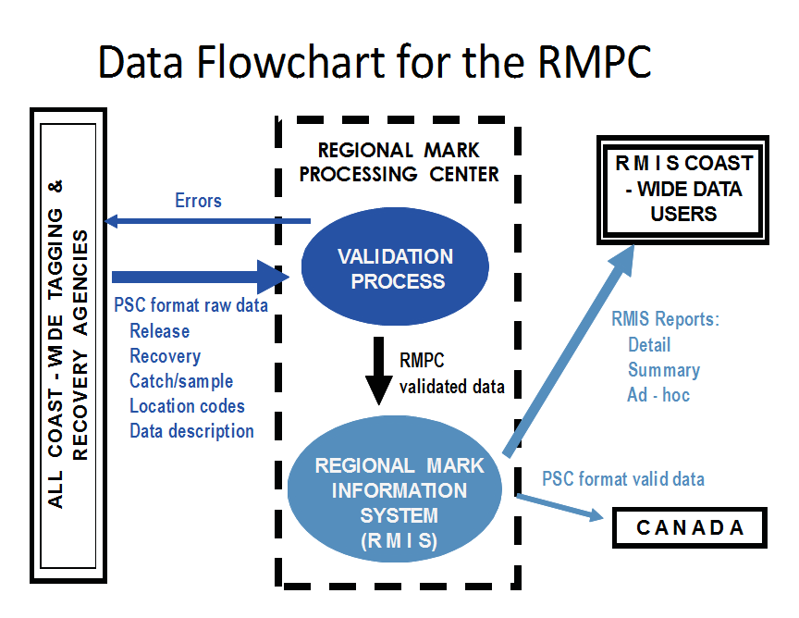
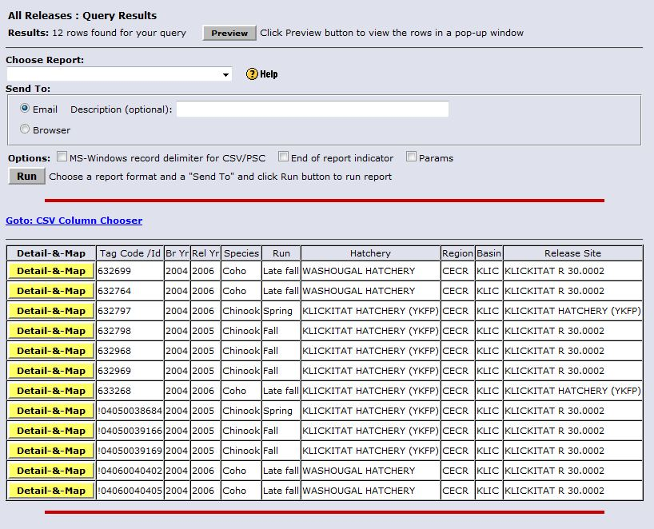
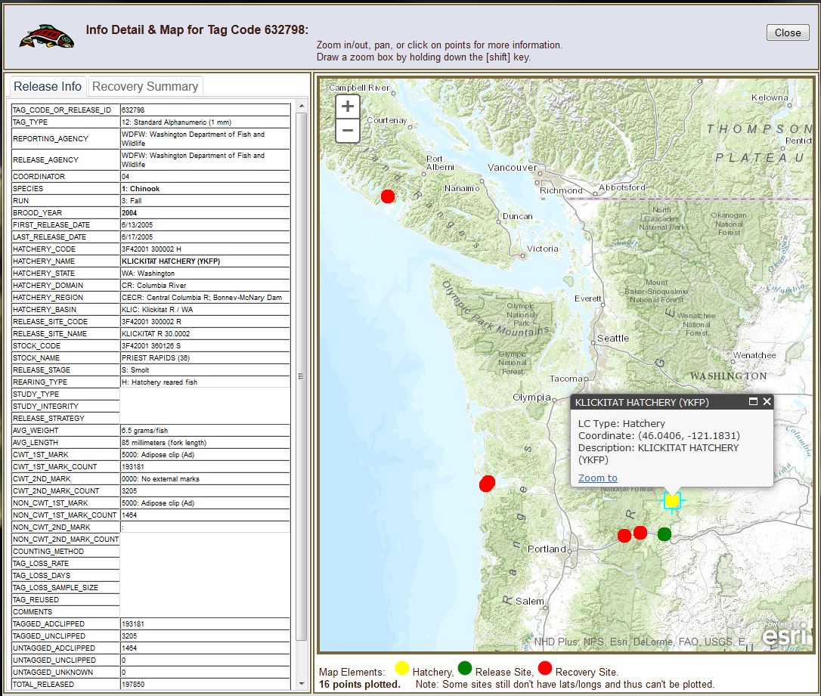
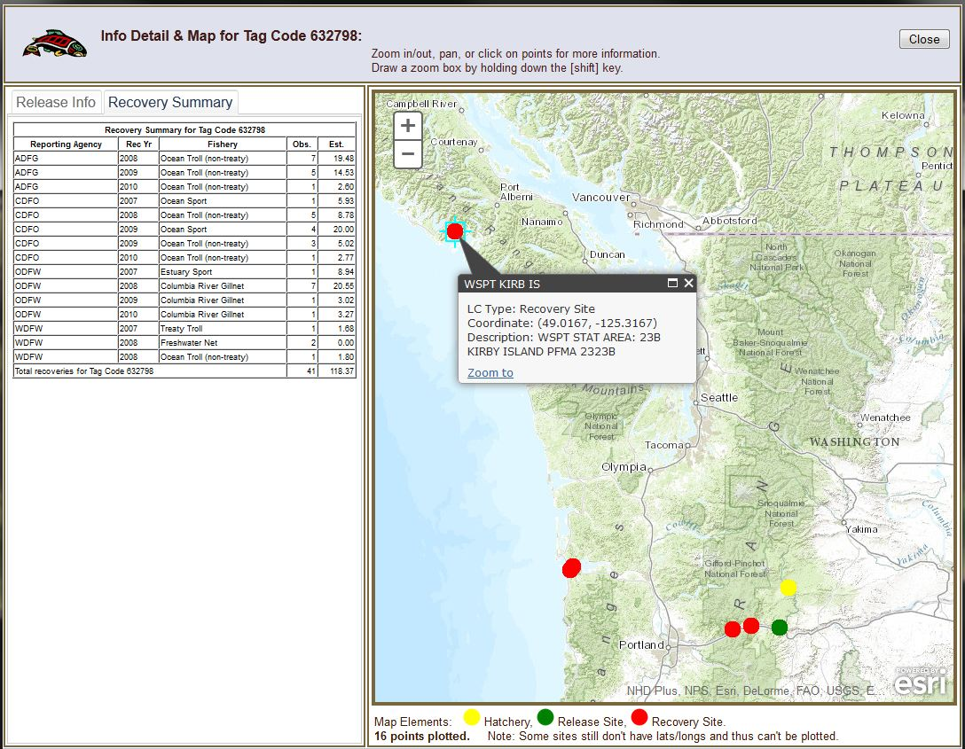
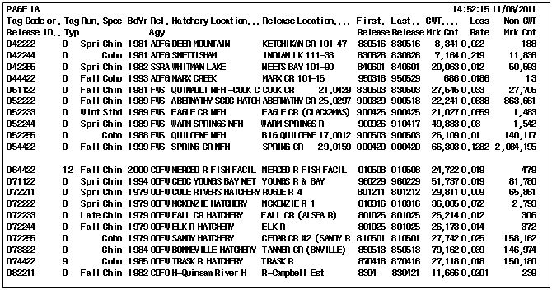
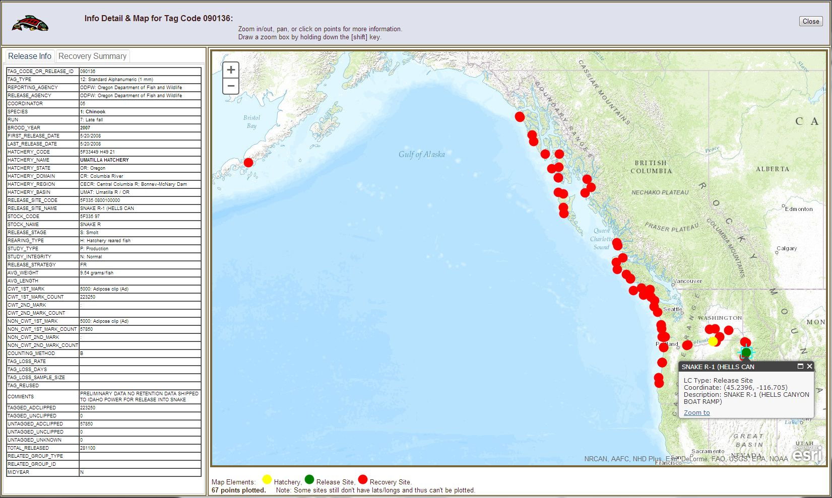
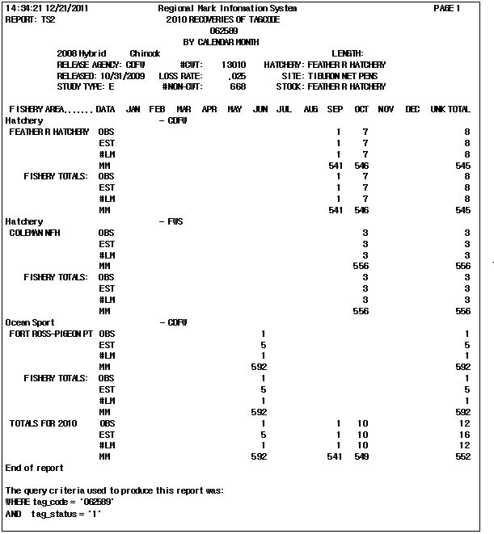
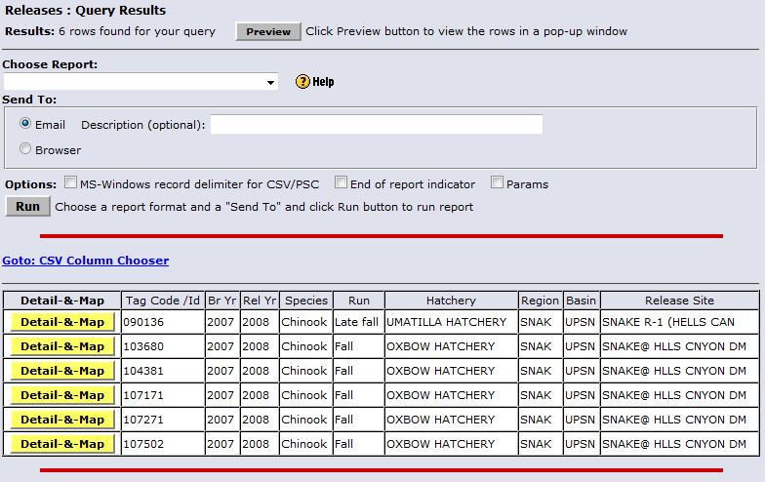
RMIS Overview & Infomap Service
PSMFC Regional Mark Processing Center (RMPC)
Overview of RMPC & CWT Database
RMIS Reporting - Infomap Service
Since 1977 the RMPC has provided essential services to international, state, federal, tribal and other fisheries organizations. One principal service involves the development and maintenance of the Regional Mark Information System (RMIS) – online & available for querying and reporting from the Coded-wire Tag (CWT) database. In addition to serving a diverse set of fisheries researchers & managers through RMIS, the RMPC serves two principal bi-lateral (U.S. & Canada) committees coast-wide: 1) Regional Committee on Marking & Tagging (RCMT); 2) Pacific Salmon Commission (PSC).
Many State, Federal, Tribal and private reporting agencies in the United States and Canada participate in a massive coastwide coded-wire tagging effort to provide essential data for effective conservation and management of Pacific salmonid stocks.
Agency CWT datasets are forwarded to the RMPC where they are loaded and validated against an extensive set of checks. Once validated, the data are moved into the CWT database accessible via RMIS. Some Reporting Agencies which send CWT Release & Recovery datasets to the RMPC include:
NMFS - National Marine Fisheries Service
NWIFC - Northwest Indian Fisheries Commission
USFWS - U.S. Fish and Wildlife Service
IDFG - Idaho Department of Fish and Game
ODFW - Oregon Department of Fish and Wildlife
WDFW - Washington Department of Fish and Wildlife
CDFO - Canada Department of Fisheries and Oceans
CDFW - California Department of Fish and Wildlife
CRITFC - Columbia River Inter-Tribal Fish Commission
ADFG - Alaska Department of Fish and Game
Using RMIS:
CWT data in RMIS can be queried by anyone by going to the website: http://www.rmpc.org. To use RMIS, simply enter your email address and click on the Login button. The first time you login you'll be asked to verify that you want to create a new account. At this point, enter in the following information:
1. Email Address (re-type)
2. Name
3. Organization
4. Phone Number
On subsequent logins your email address will be recognized as a returning user.
RMIS Infomap Service
Recently RMIS has added an exciting new feature to the RMIS Releases query forms. The new feature is called the RMIS Infomap Service option. It presents the following:
A detail of Release data for a given Tag Code or Release Id (untagged group) -- in the left tab;
A summary of Recovery data by Reporting Agency, Recovery Year, & Fishery for the Tag Code (if applicable) -- in the right tab;
A map which plots any available lat/long points relevant to the release event. The map-able points may include hatchery, release site, and/or recovery sites (for tag-coded groups).
Infomap Example Illustrations
Here is a result Info-list for the following query:
Chinook & coho salmon released in RMIS Basin KLIC (Klickitat R / Washington)
Brood Year 2004
RMIS – Decision Support for Management & Research
Salmon and steelhead feed in the ocean from one to five years, depending on the species, before returning to spawn in their natural streams. Consequently, many millions of tagged fish from a number of brood years are present in the Pacific Ocean at any given time. As such, the multiplicity of tagging studies today represent a long term, multi-million dollar investment by State, Federal, Tribal, and private sector entities.
Some benefits of the CWT program:
One of the best ways to evaluate wild/natural stocks and their interactions;
Reliable method to evaluate harvest contribution rates, distribution, survival trends;
Management decisions based on CWT data are acquired in real time activities can be evaluated with immediate results;
Changes in environment, hatchery practices, and harvest practices can be effectively tracked and factored into management decisions;
Contributes to resolution of tribal and international harvest allocation issues;
ESA concerns can be more effectively addressed;
CWT is currently the only stock identification tool which is Pacific coast-wide in scope and provides information for the entire life cycle of fish.
RMIS – Key Data Elements
RMIS - Example Tabular Reports
Release Data
When a group of fish is released from a hatchery or other release site containing any number of coded wire tagged fish, the group is associated with a unique tag code. Any pertinent information from releasing agencies regarding the release group is submitted to the RMPC by the responsible state, provincial, or federal agencies. There are approximately 50,000 tagged release groups in the database dating back to 1968.
When a group of fish is released without coded wire tagged fish present, the release group is called an untagged/unassociated group. The release group is assigned a 12 character alpha-numeric identifier. This information is likewise housed at the RMPC. There are approximately 100,000 untagged release groups in the database dating back to 1952.
Recovery Data
When tags are removed from fish and decoded, the tag is linked to the specific location of catch, date of catch, fishery, and other related biological data. Where possible, the ratio of the number of fish sampled to the total catch is multiplied by the total number of tags extracted to form the Estimated Number of fish.
In addition to passing rigorous validation tests, the recovery data records must match by tag code with a tagged release record. There are currently about 7 million reportable recovery records in the database.
Release Listing Report:
This report lists some commonly used columns from the Releases data file (including numbers of fish released). It is sorted by Tag Code.
Here is a result Info-list for the following query:
Fall & Late fall Chinook salmon released in RMIS Basin UPSN (Upper Snake R, above Lewiston, Idaho);
Brood Year 2007
Recovery Summary Report:
This report is a summary of recoveries of a tag-coded group & shows month recovered. It is aggregated by columns: Tag Code, Recovery Year, Reporting Agency, Recovery Site Name.

