Slide 1
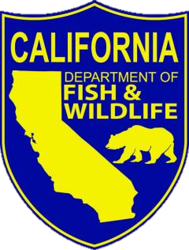

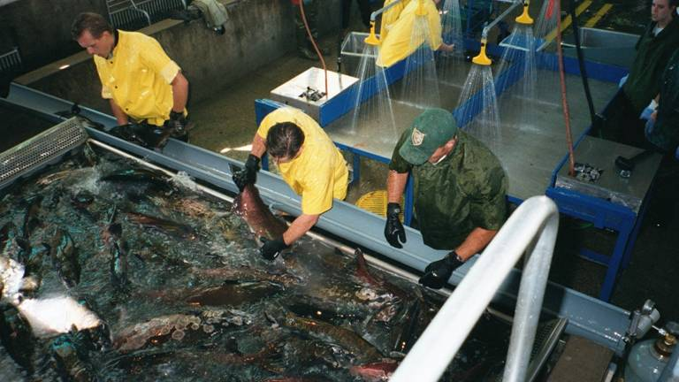
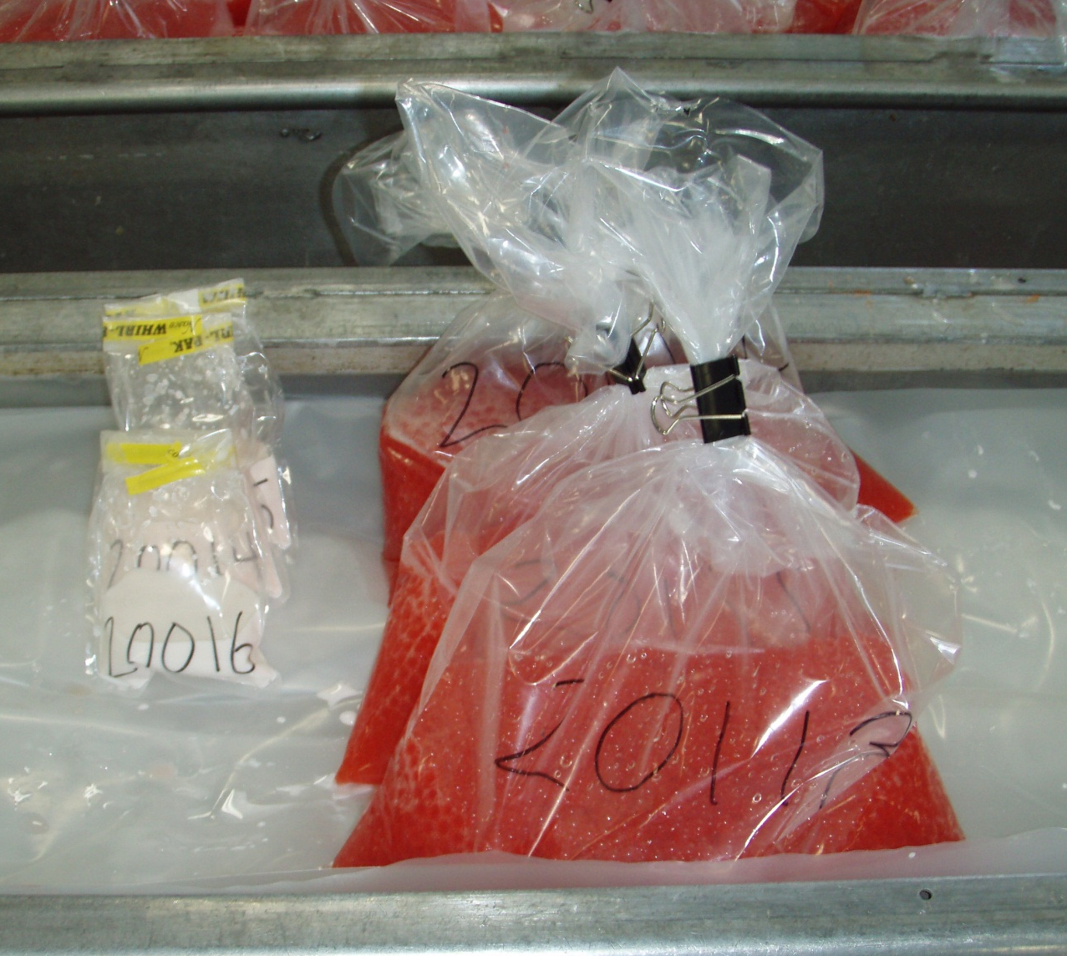

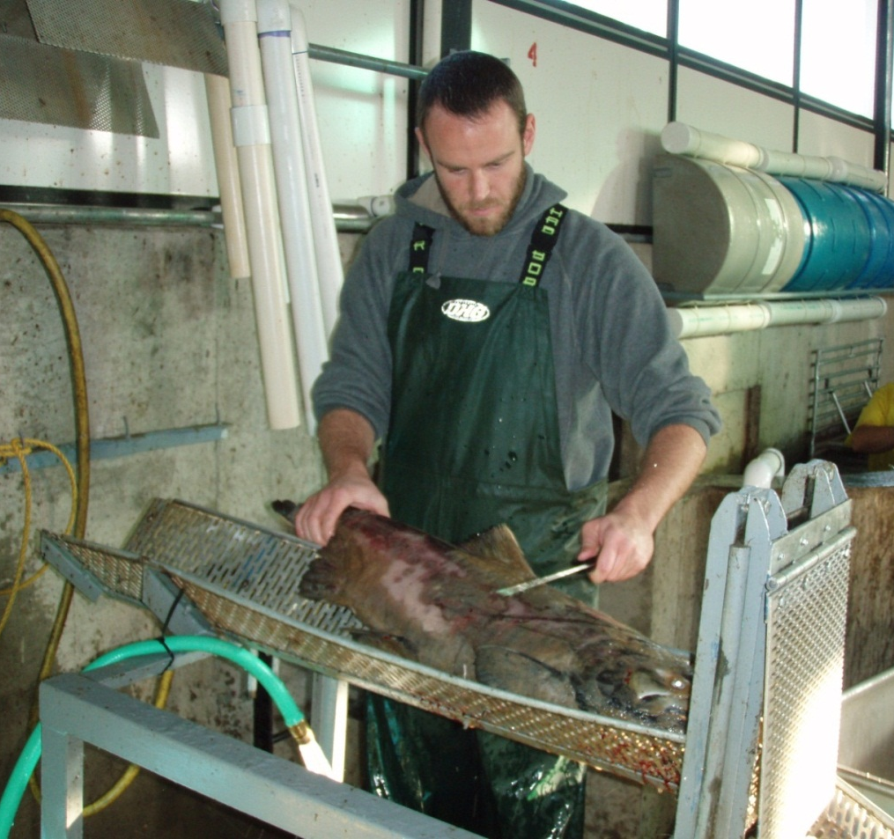
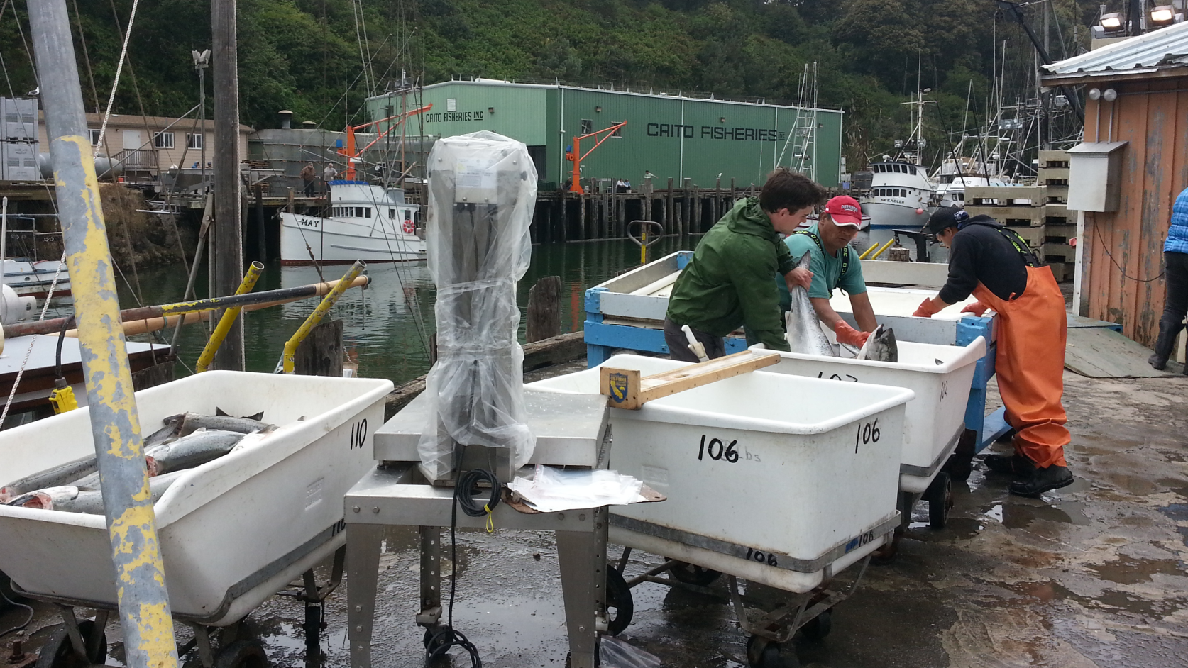

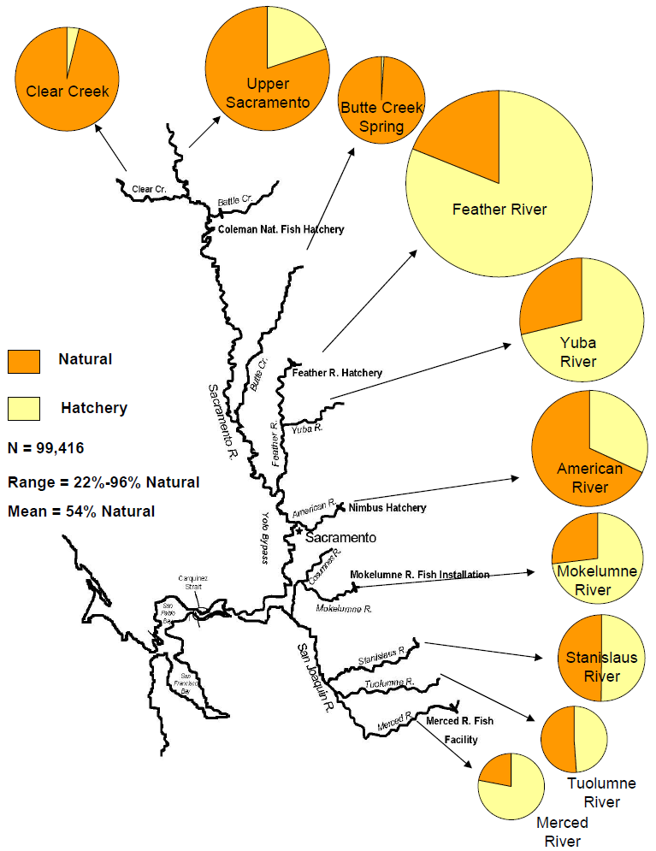
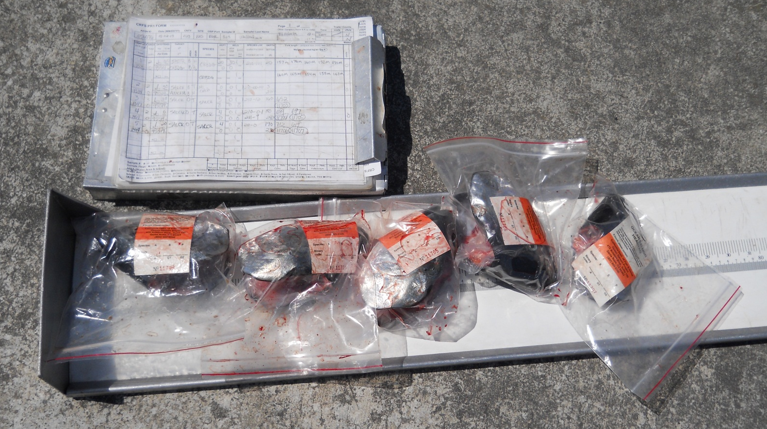
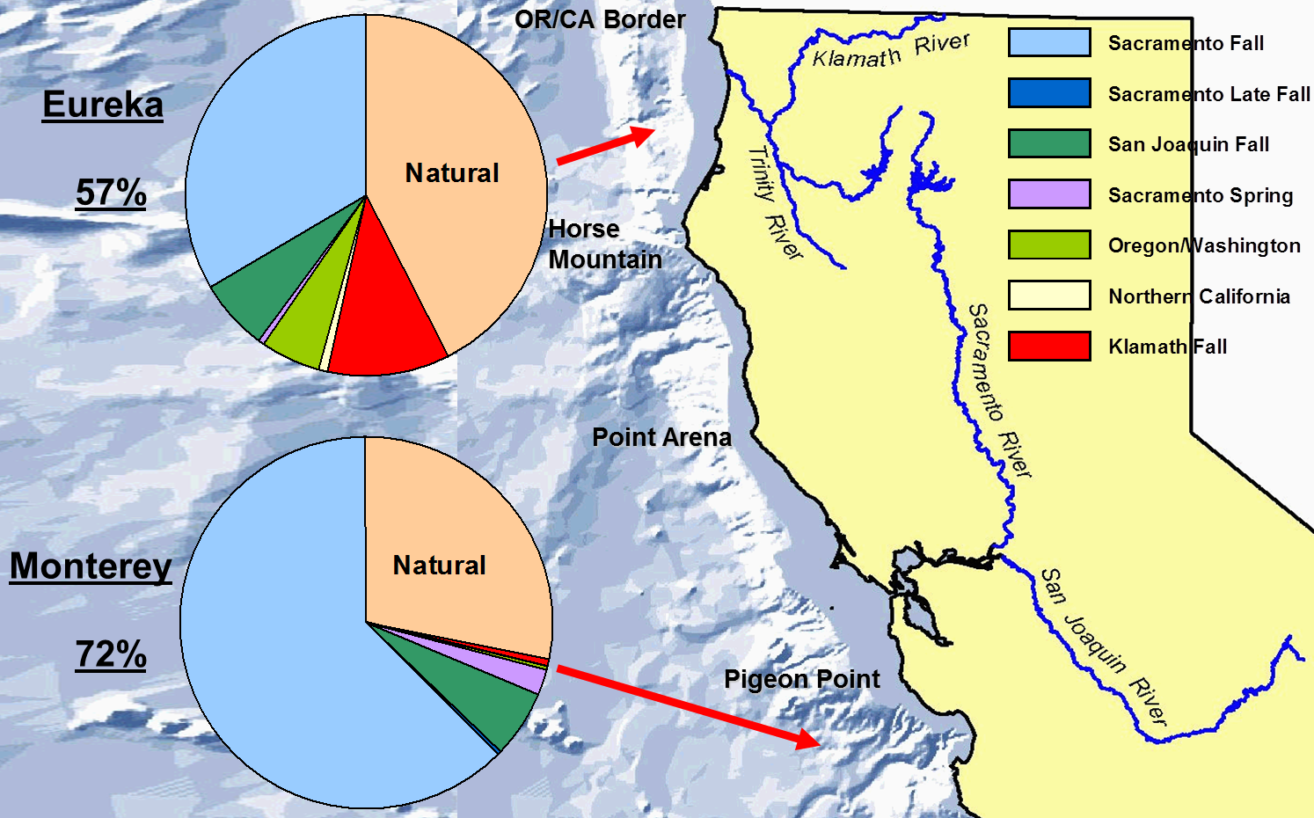
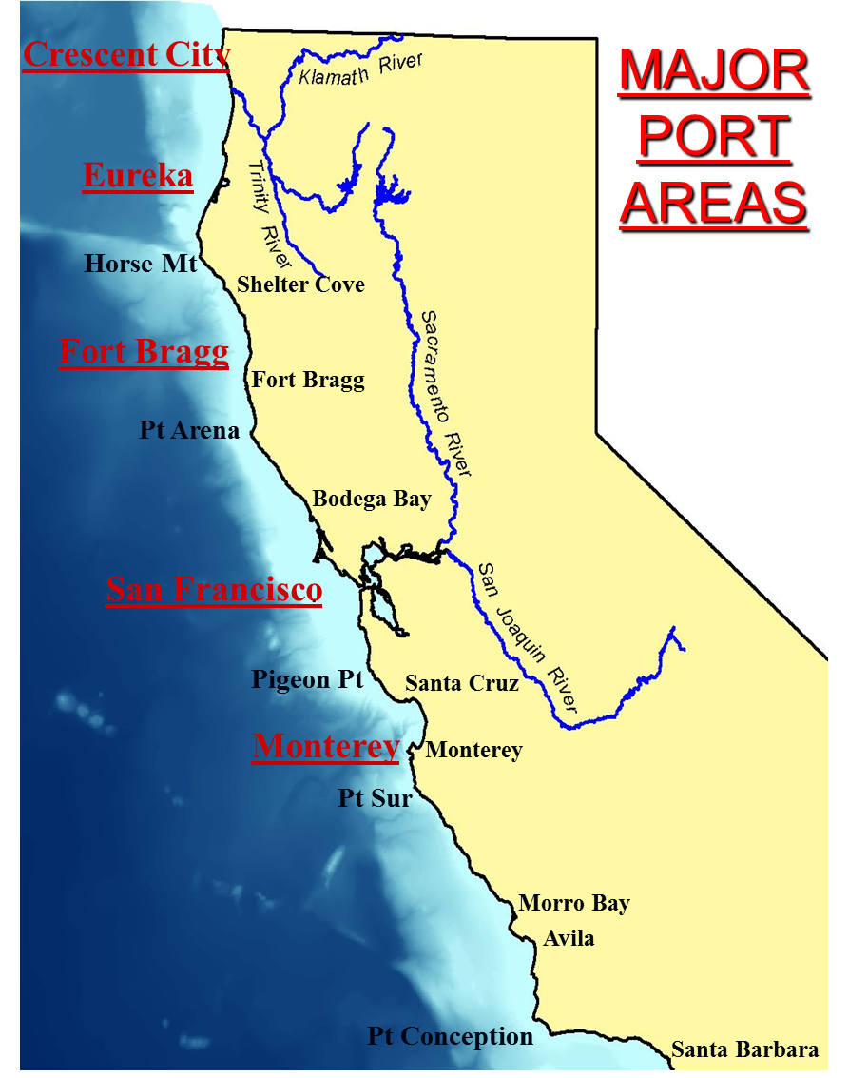
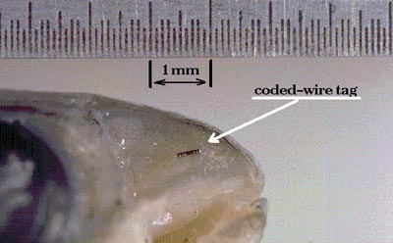

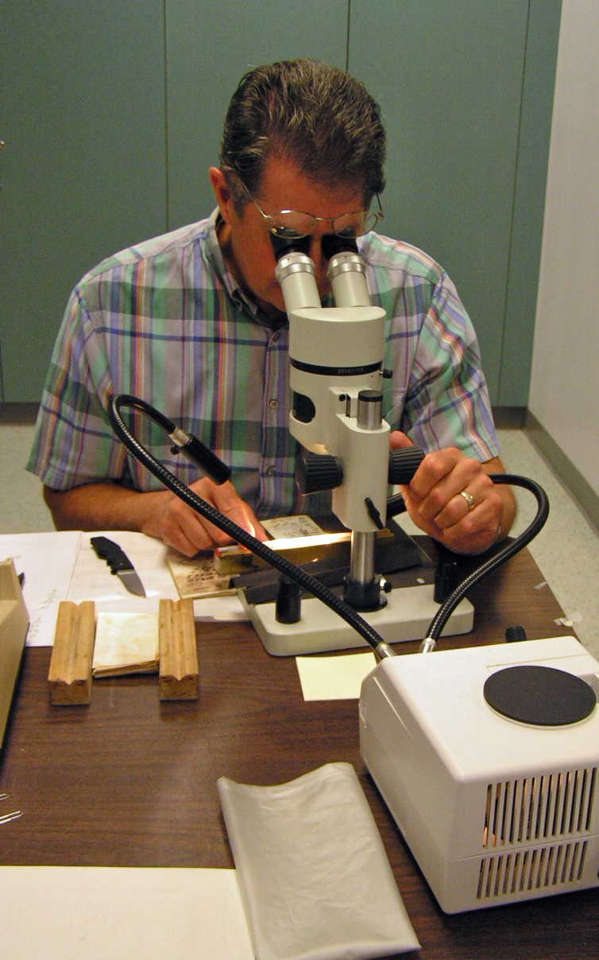
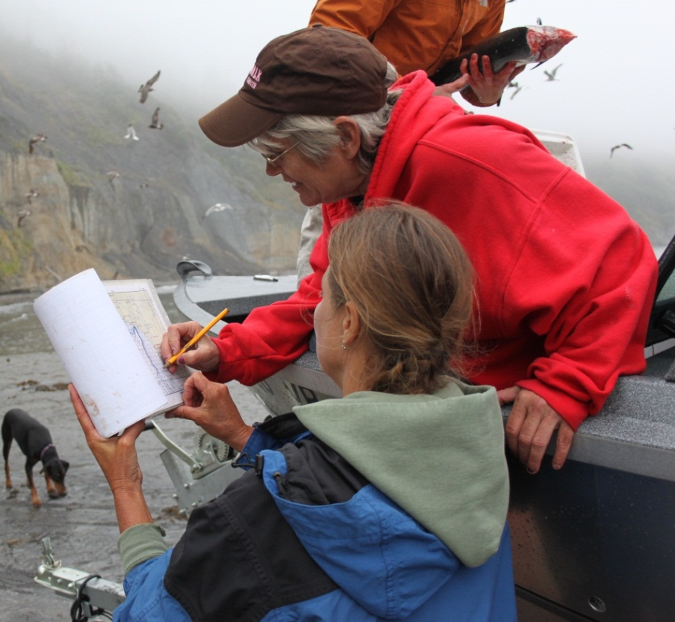
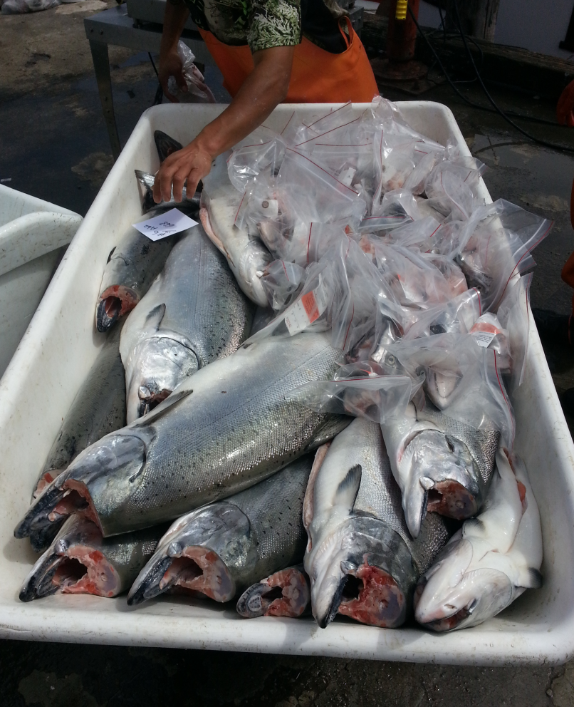
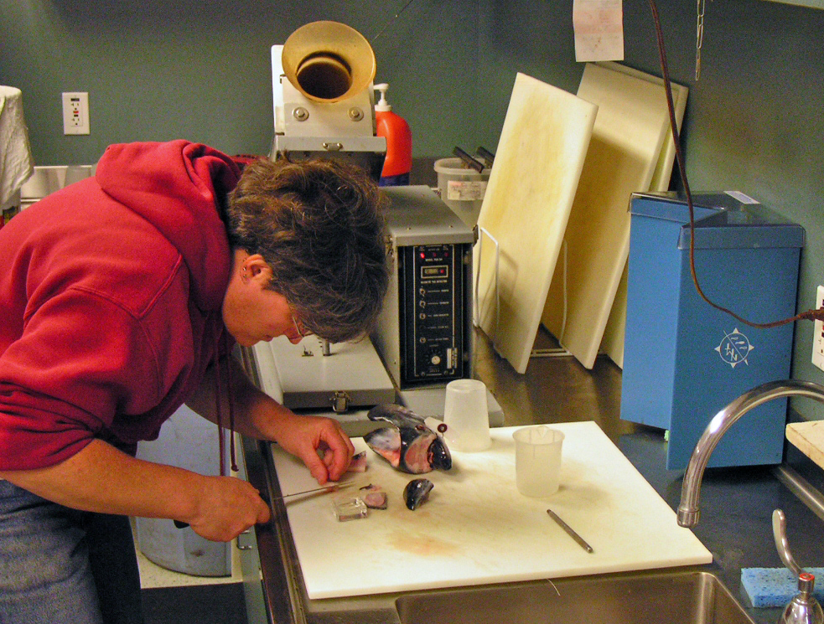
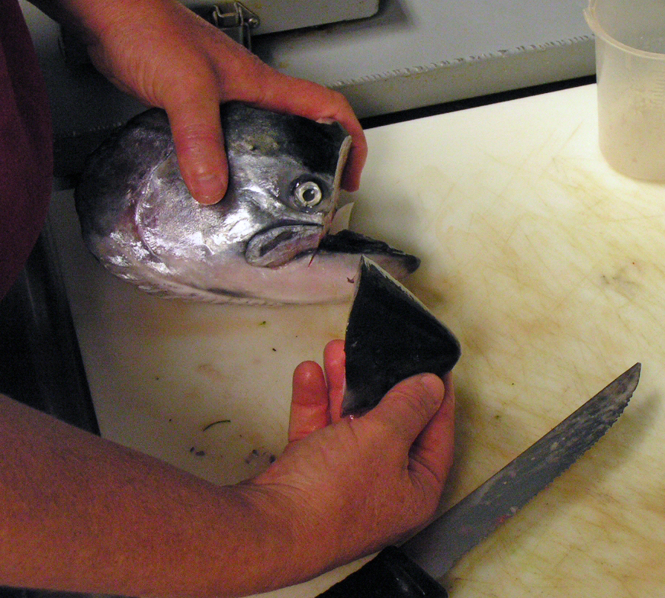
Ocean Salmon Monitoring and Management Project
California Department of Fish & Wildlife, Marine Region
Project Overview
The Ocean Salmon Project (Project) provides fishery-dependent and fishery-independent data needed for the management of ocean, river, and tribal salmon fisheries. The Project produces annual estimates of ocean salmon harvest, fishery effort, ocean abundances, and fishery impacts on salmon stocks of special concern (ESA-listed stocks) and those managed by the Pacific Fishery Management Council and the California Fish and Game Commission. These stocks include fall Chinook (Oncorhynchus tshawytscha) from the Klamath-Trinity basin, Central Valley, and coastal rivers; spring and winter Chinook from the Central Valley; and coho (O. kisutch) statewide. Project biologists collaborate with other department, state, federal, and tribal salmon projects and provide technical assistance to the Pacific States Marine Fisheries Commission, the Pacific Fishery Management Council, the California Fish and Game Commission, non-governmental organizations, academia, and California constituents.
Ocean Fisheries Monitoring
The Project has two primary objectives: 1) estimate total salmon harvest and fishing effort by management area and half month period for commercial and recreational ocean salmon fisheries, and 2) assess the contributions of important salmon stocks to these fisheries by time and management area
A minimum of 20% of all ocean salmon fisheries are dockside sampled
  Commercial: ≥20% of all salmon pounds by time and management area
  Recreational: ≥20% of all salmon-targeting trips (charter and party boats) or available fishing days (private skiffs) by time and management area
Field staff measure and collect the heads from all adipose fin-clipped salmon (indicating the presence of a coded-wire tag) observed during sampling, and also collect other biological data, including fin clips for genetic analysis and scales for untagged-stock age structure, as needed
Central Valley Support
Project staff assist sampling returning spawners at several Central Valley hatcheries
Project staff collect scale samples from returning Chinook for age structure analyses and heads are collected from all adipose fin-clipped salmon for coded-wire tag recovery and scale-age validation
During years of low Chinook abundance, Project staff conduct real-time coded-wire tag analyses of returning spawners for broodstock selection in order to preserve the genetic integrity of different stocks and increase the available broodstock
Coded-Wire Tag Processing and Analysis
In 2006, a Constant Fractional Marking program was initiated to increase the coded-wire tag rate of hatchery produced fall Chinook and tag each release group representatively; at least 25% of all fall Chinook produced in California’s hatcheries are adipose fin-clipped and implanted with a microscopic (≤1 mm) coded-wire tag which includes a unique code that provides release information
The Project’s laboratory now manually extracts, reads under a microscope, and validates coded-wire tags from over 30,000 ocean-caught adipose fin-clipped salmon and nearly 20,000 Central Valley Chinook annually
An additional 20,000 Central Valley coded-wire tags are processed annually at a separate state lab with Project staff providing data validation, management, and analysis
Coded-wire tag recovery information, combined with harvest and effort estimates by time, management area, and fishery, provide biologists and fishery managers with the information needed to design fishing seasons that allow harvest of abundant stocks while protecting weaker stocks
Project biologists determine the contribution and stray rates of hatchery and natural-origin Chinook returning to spawn in the Central Valley and Klamath-Trinity basins, and evaluate hatchery release strategies
Each year, Project staff upload statewide ocean and inland coded-wire tag recovery and associated catch-sample data to the Regional Mark Processing Center, a coast-wide centralized public data warehouse maintained by the Pacific States Marine Fisheries Commission
Central Valley Scale Aging
Age-specific escapement data allow for cohort reconstruction which may result in more reliable forecasts of ocean abundance, fishery harvest, and expected spawning escapement
Age-specific data for Klamath-Trinity fall Chinook have been available for decades, but lacking for Central Valley Chinook, limiting scientific understanding of these stocks
An annual standardized Central Valley scale collection program was initiated in 2006 to allow for age-specific spawning escapement estimates by stock
Central Valley scale samples are aged and validated with coded-wire tag information using state of the art digital imaging techniques along with computer aided data storage and retrieval methods
Fisheries Management
Total and age-specific ocean and river harvest, fishery effort, spawning escapement, and associated coded-wire tag data collected and maintained by Project staff provide the scientific basis for fishery management decisions
Project staff use data to evaluate salmon cohort reconstructions, forecast Klamath River and Sacramento River fall Chinook ocean abundances, and update multi-year ocean harvest models which are used to analyze fishing season alternatives proposed by the fishing industry
Project staff participate on Klamath-Trinity and Central Valley technical teams and the Pacific Fishery Management Council’s Salmon Technical Team, which are responsible for ensuring the best available science is used for management decisions and that conservation objectives for all California salmon stocks are met
Project staff host and actively participate in at least four annual public hearings to assist in the development of salmon fishing season alternatives and allow for constituent comment
Data and analyses conducted by Project staff are publicly available through the Pacific Fishery Management Council and the Regional Mark Processing Center
Ocean Salmon Management Areas
Harvest & Spawning Review
Seasons Adopted
Ocean Harvest
Fall Run Spawning
Coded-Wire Tag Analyses
Season Alternatives
Stock Assessment
April
Sep
Nov
Dec
Jan
Feb
March
April

