Slide 1


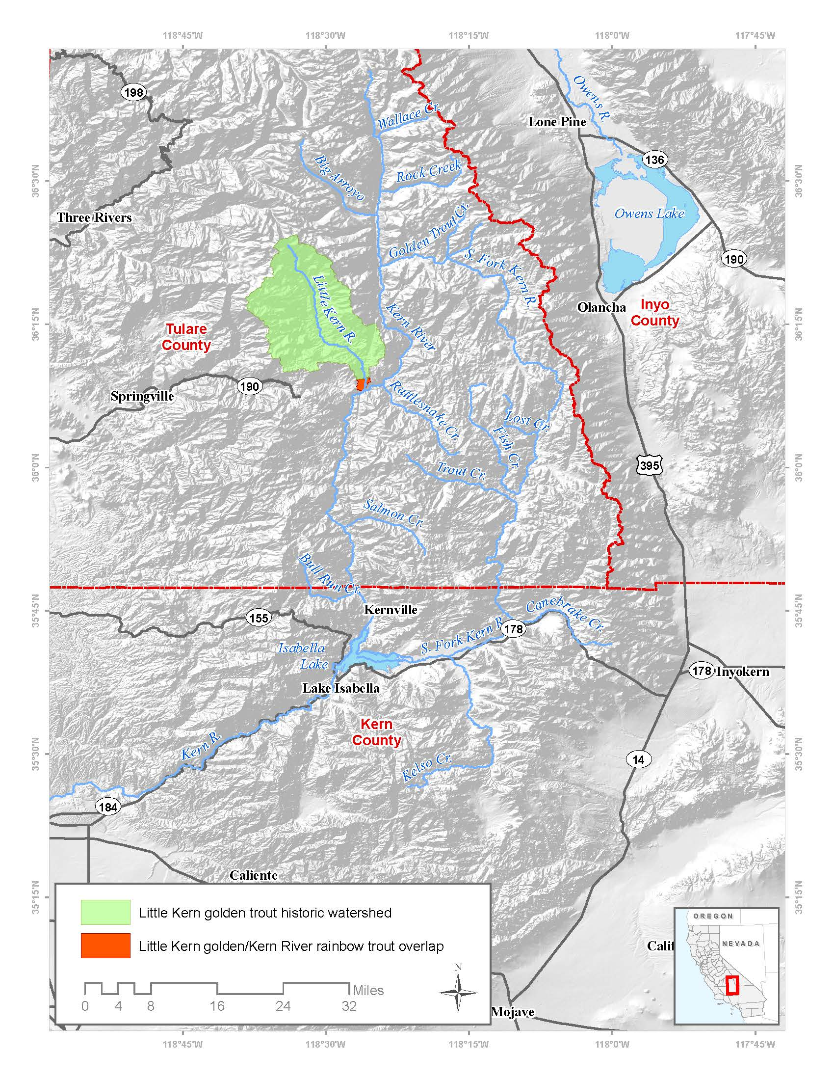
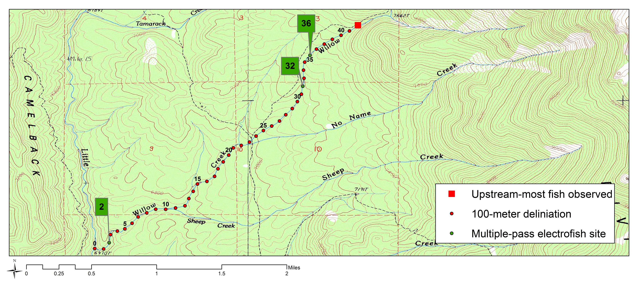
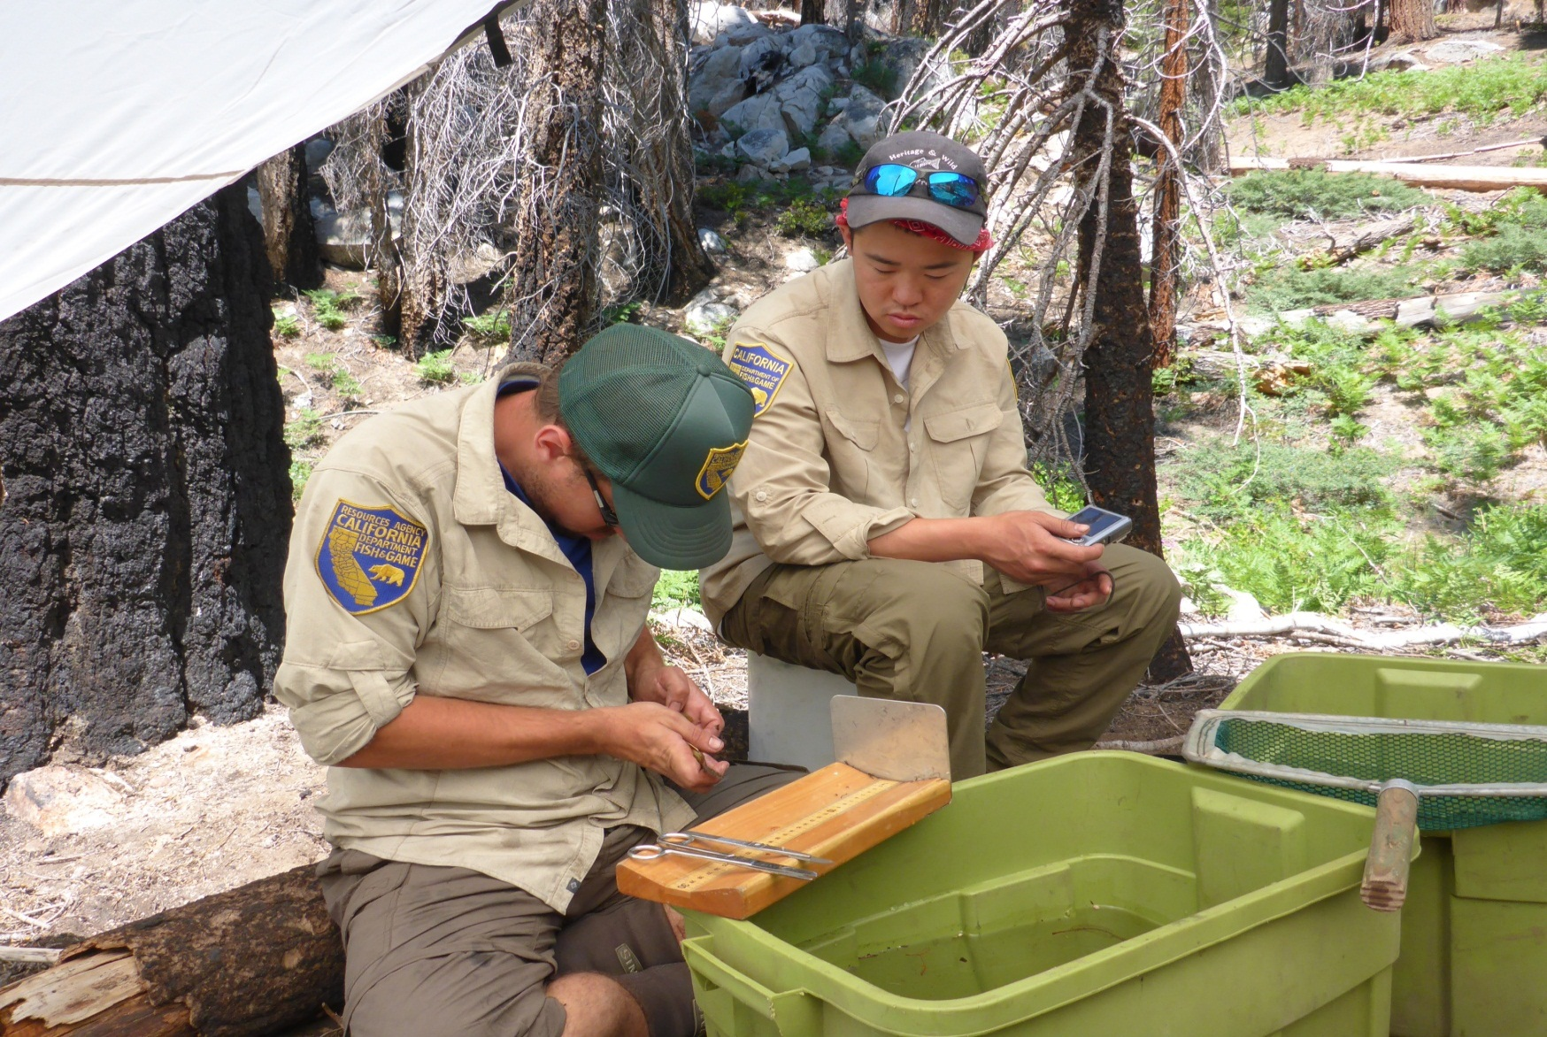
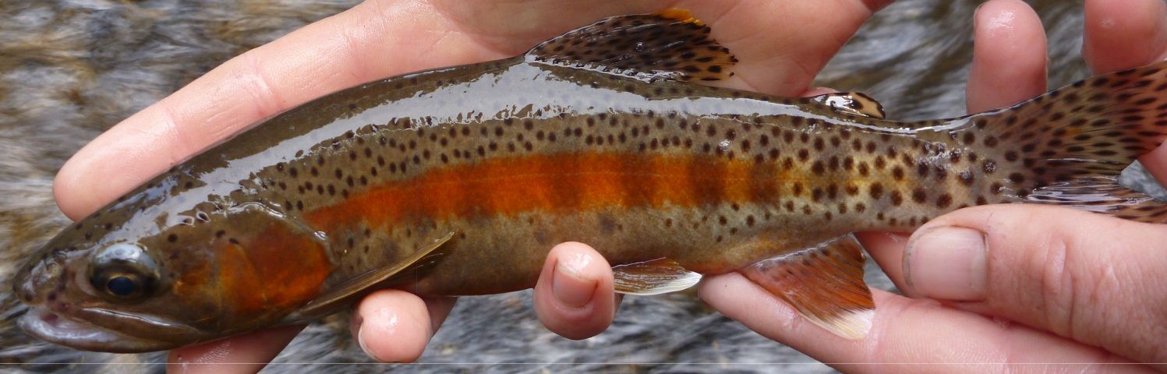
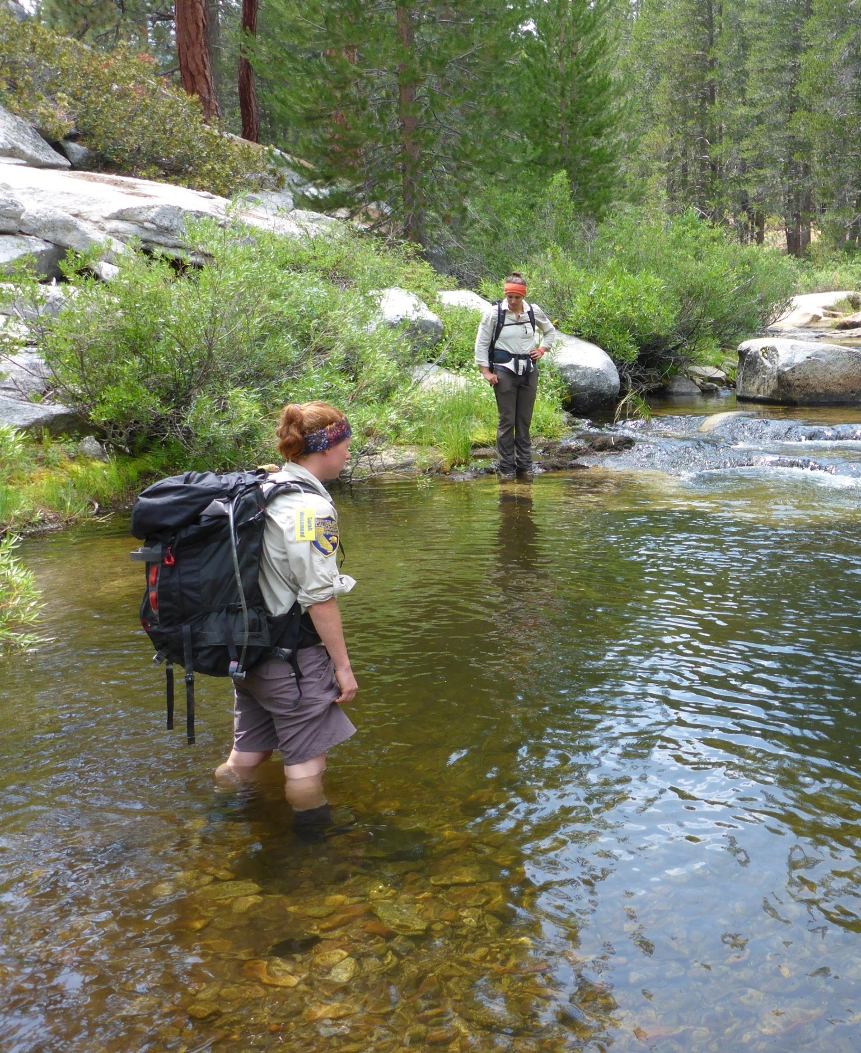
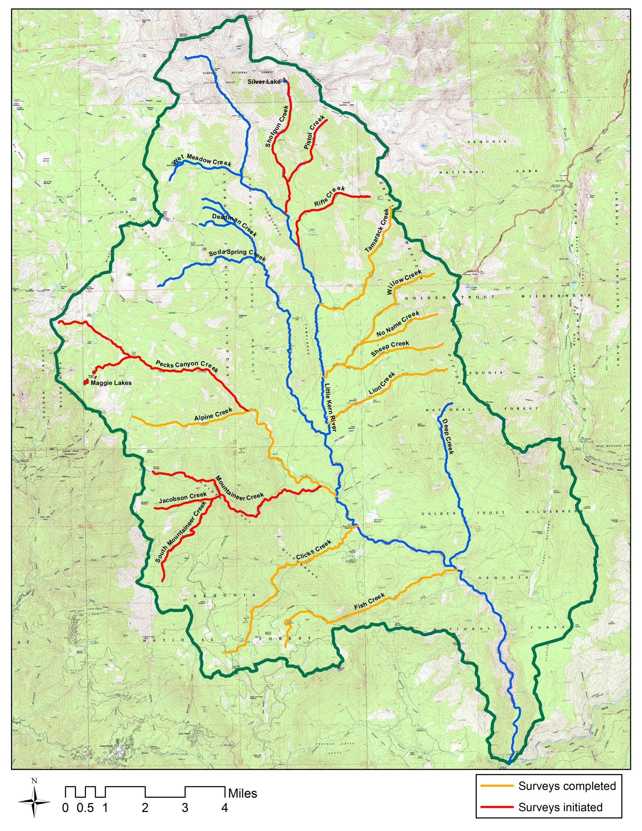
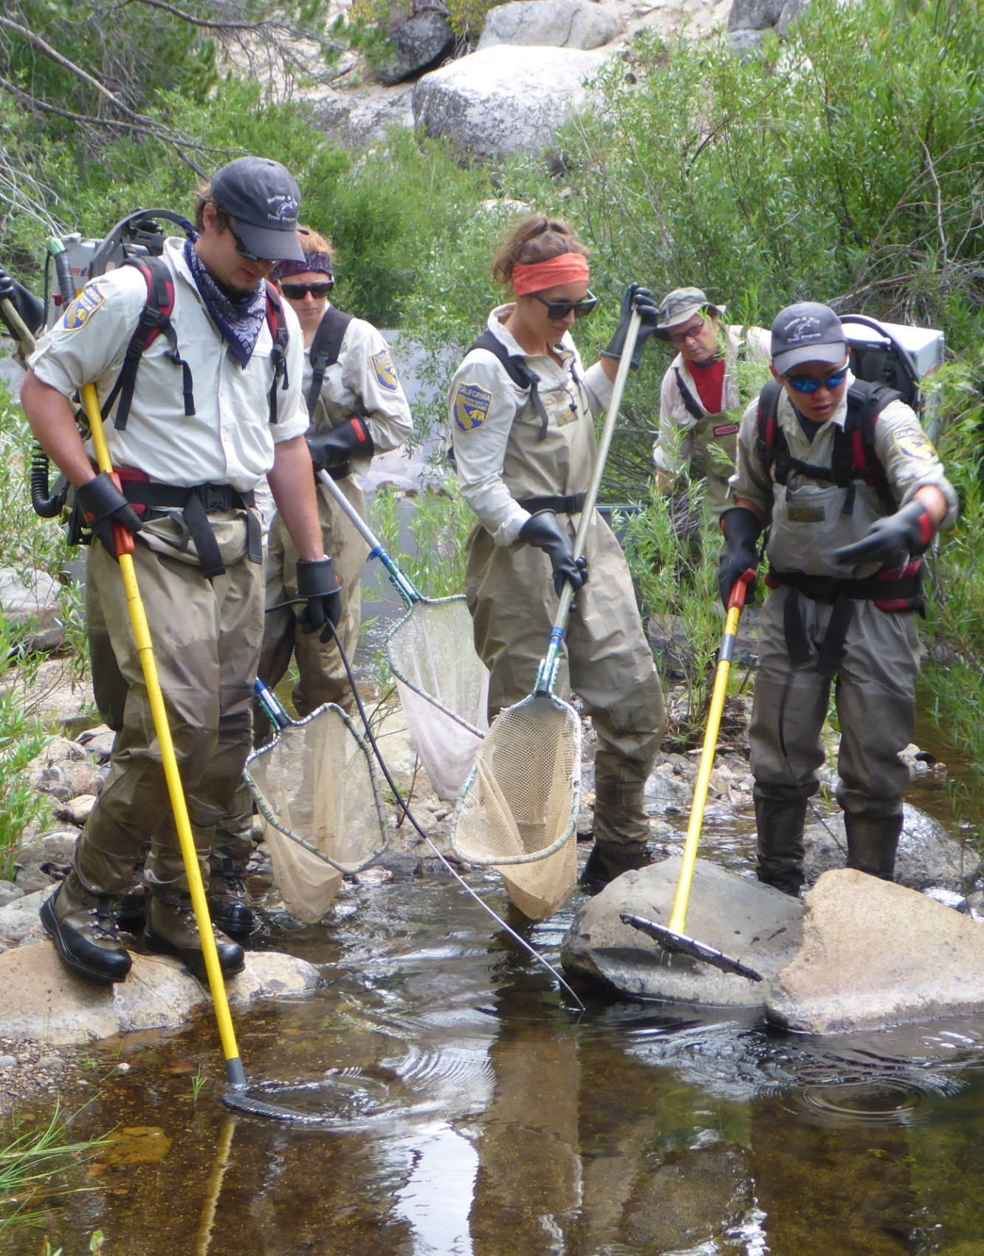
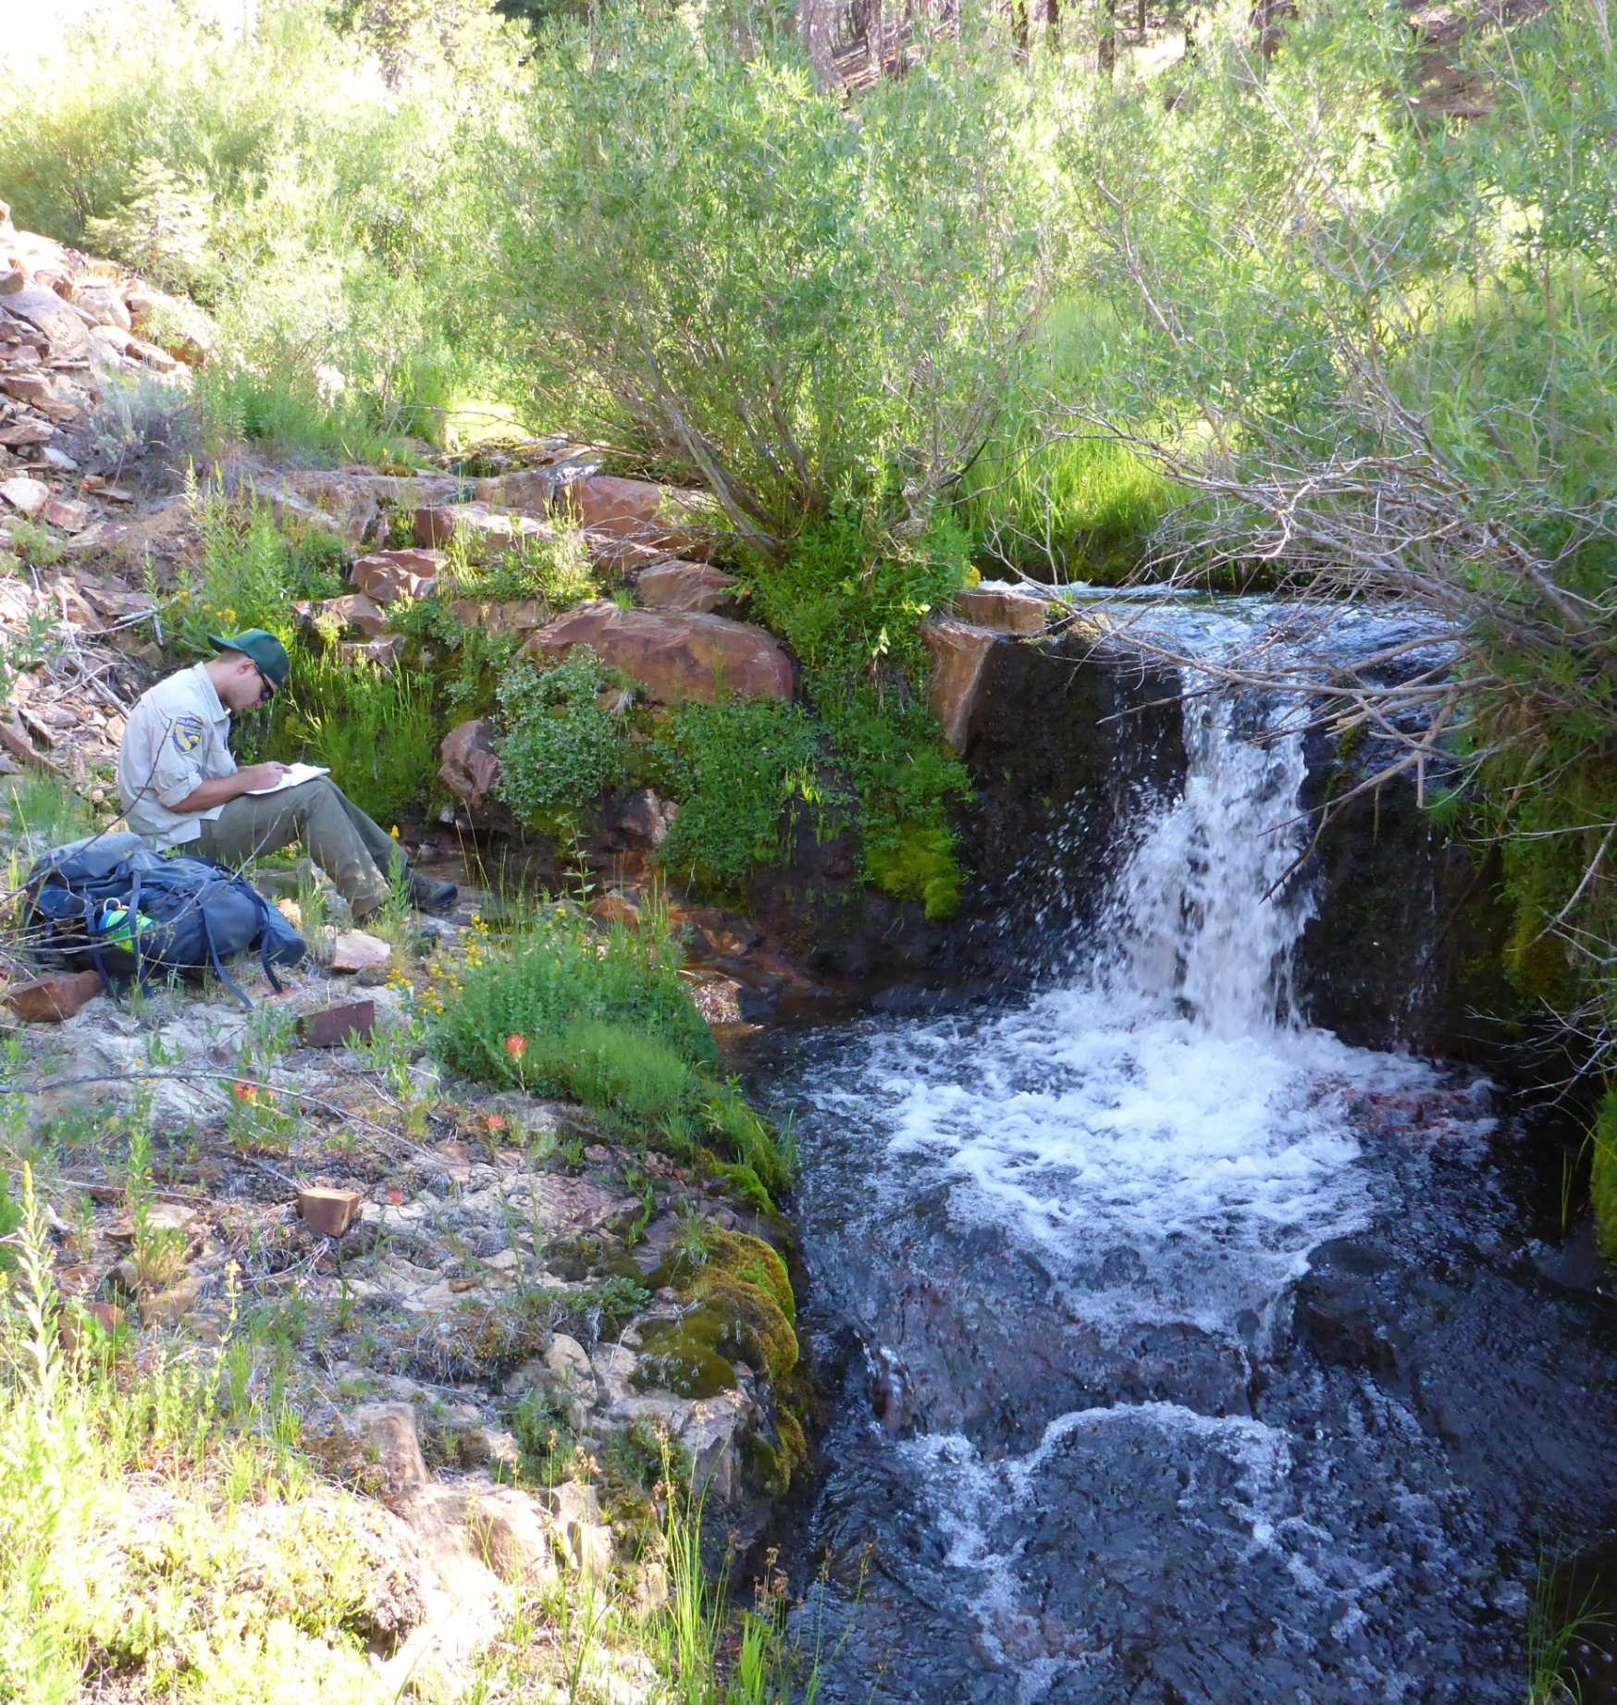
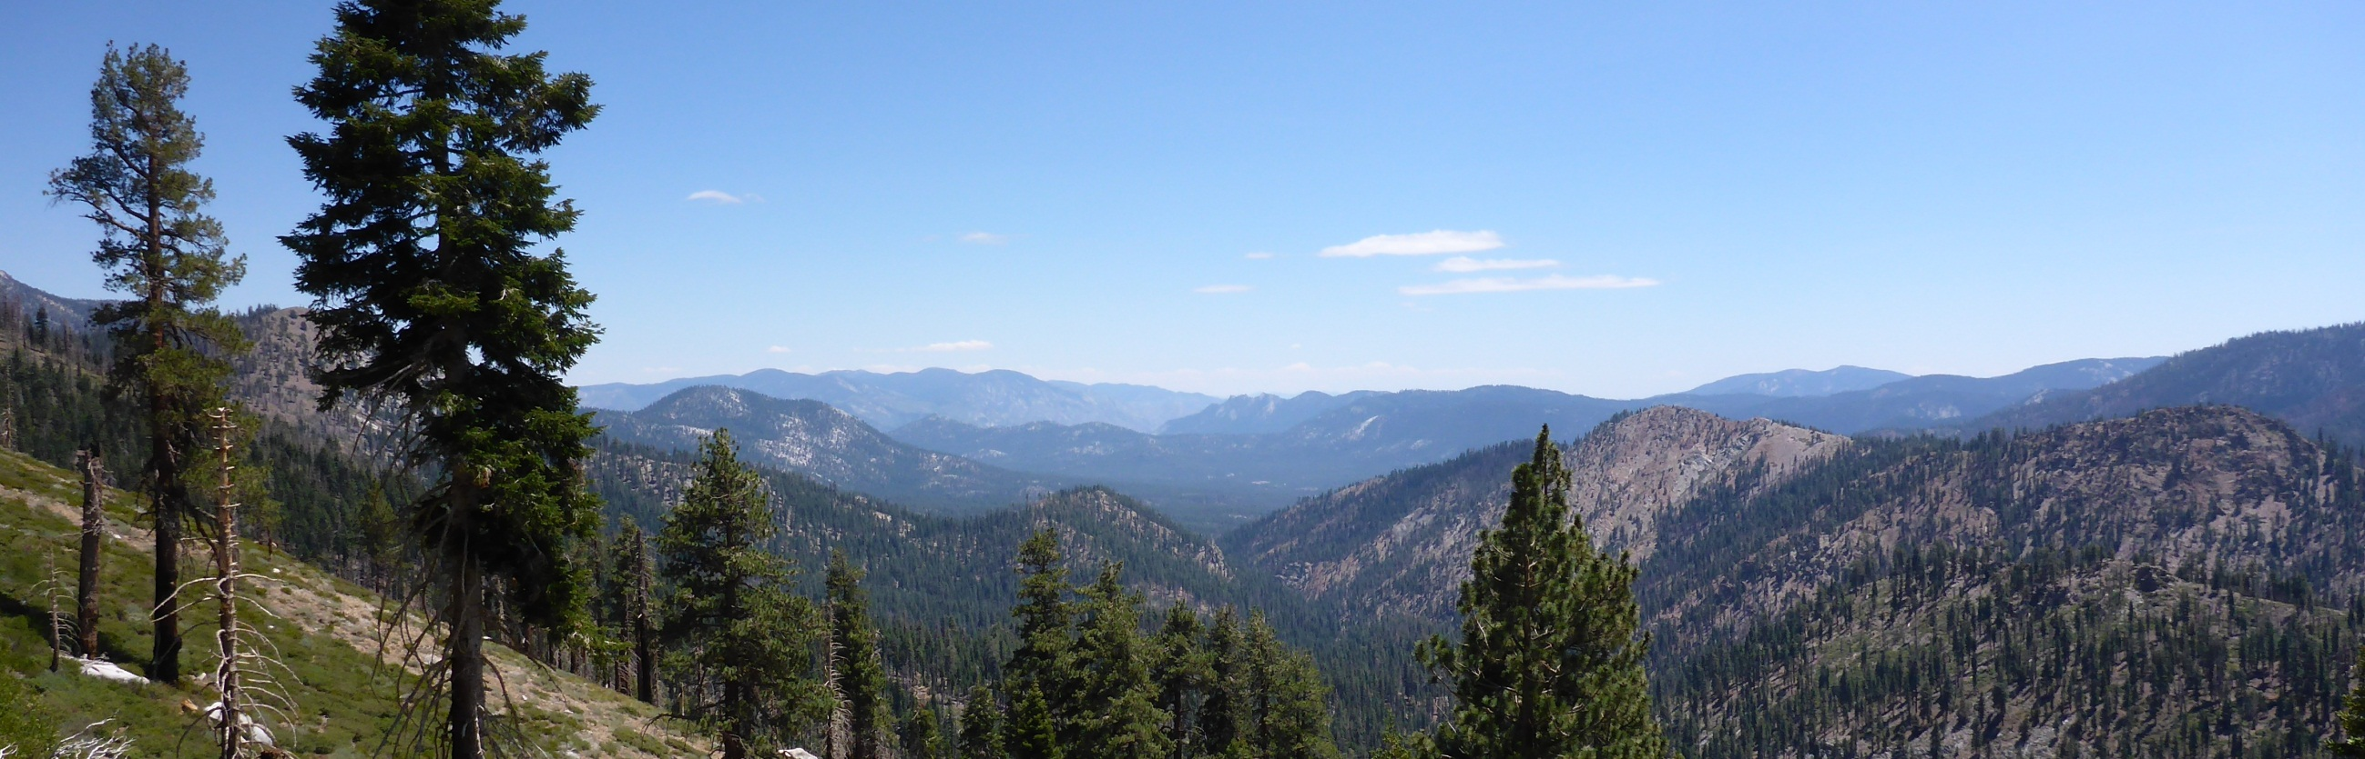





Watershed assessment, management and restoration of Little Kern golden trout in the Little Kern River, California
Heritage and Wild Trout Program
Zuber, C., R. Bloom, S. Mehalick, and J. Weaver
Introduction
Goals and Objectives
Discussion
Little Kern golden trout (Oncorhynchus mykiss whitei) are endemic to the Little Kern River watershed and are listed as Threatened under the federal Endangered Species Act. The Little Kern River is tributary to the Kern River and is located approximately 65 miles northeast of Bakersfield, CA (Figure 1).
Assess the current status of Little Kern golden trout and associated threats.
Survey ten percent of the watershed using stratified random sample design and depletion electrofish methodology (Figure 3).
Gather baseline fisheries data including species distribution, size-class structure and abundance.
Conduct habitat assessments to document resource condition.
Since 2010, the HWTP has gathered baseline fisheries and habitat data throughout the native range of Little Kern golden trout in an effort to help restore and manage this threatened species. As of August 2013, 38 percent of the Little Kern River and tributaries have been surveyed via electrofishing (Figure 4). A
comprehensive assessment of the entire watershed should be completed by 2014.
These data will provide up-to-date information to aid in the development of recovery plans, provide information on the current
Little Kern golden trout
Figure 1. Map of Little Kern golden trout historic watershed (left) and photograph of Little Kern golden trout (above).
Figure 6. HWTP staff taking fish measurements.
status of fish in the watershed and give insight into any associated threats posed to Little Kern golden trout such as genetic introgression and/or impacts from recent fire.
Figure 3. Map of stratified random sample design using 100-meter delineations in Willow Creek a tributary to Little Kern River.
Throughout this process, the HWTP is evaluating the Little Kern River and tributaries for designation as a Heritage and Wild
Trout Water. Wild Trout Waters are those that support self-sustaining (wild) trout populations, are aesthetically pleasing and environmentally productive, provide adequate catch rates in terms of numbers or size of trout, and are open to public angling. Heritage Trout Waters
Collect angler data including catch rates, catch sizes, and species composition.
Document barriers to fish migration to ensure putative populations remain isolated from hybridized fish (Figure 5).
The Little Kern River watershed encompasses a total of 137 miles of perennial stream habitat, the majority of which is located on public land administered by the U.S. Forest Service (USFS)
Document life history information such as age and growth rates, size at maturity, spawning and fry emergence timing, and other factors.
Collect tissue samples to determine genetic relationships of trout throughout the watershed and to aid in the development of a basin-wide genetics management plan.
Determine presence, absence and severity of fin abnormalities and potential causation.
Identify restoration and recovery actions to protect and conserve Little Kern golden trout and their habitat.
within the Sequoia National Forest. Concern about the current status of Little Kern golden trout populations prompted the California Department of Fish and Wildlife (CDFW) Heritage and Wild Trout Program (HWTP), with assistance from the Sequoia and Inyo National forests, to initiate fisheries and habitat assessments throughout the watershed (Figure 2).
Throughout this multi-year survey effort, baseline data will be gathered to help
Figure 7. HWTP staff assessing habitat conditions.
are a sub-set of Wild Trout Waters and highlight populations of California’s native trout that are found within their historic drainages.
develop recovery plans to restore Little Kern golden trout to a level in which the sub-species can be de-listed from Threatened status.
Acknowledgements
Figure 4. Map of Little Kern River watershed.
This project is a collaborative effort with the USFS; U.S. Fish and Wildlife Service; University of California at Davis; California Trout; Trout Unlimited; and private landowners. In addition, data collection has been accomplished through the hard work and dedication of Pacific States Marine Fisheries Commission employees, CDFW personnel, and numerous volunteers.
Acknowledgements
Figure 2. Photograph of Little Kern River watershed.
Figure 5. Photograph of HWTP staff documenting a fish barrier.

