Slide 1

StreamNet Executive Committee Meeting
Wednesday, September 21, 2022
ExCom only: 9:30 AM – 11:30 (PDT)
Joint session: 1:00 – 3:30 (PDT)
9:00 to 11:30 (PT) StreamNet ExCom only Click here to join the meeting Or call in (audio only) +1 207-387-0436,,81473875# | 1:00 - 3:30 (PT) StreamNet ExCom & PNAMP SC Click here to join the meeting Or call in (audio only) (202) 640-1187,,138908893#

Slide 2

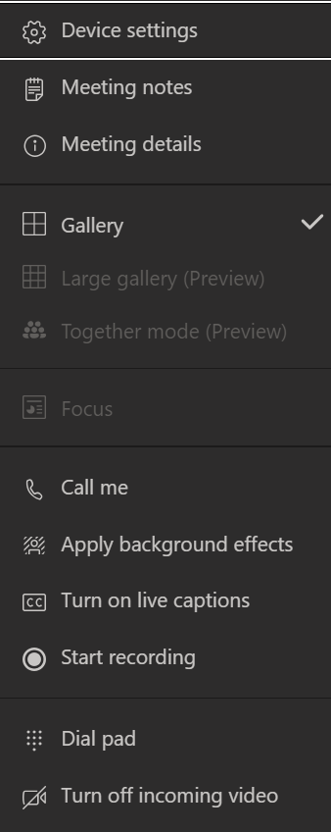

Welcome and Introductions
Please leave web cameras on to facilitate discussion
Please mute yourself when not speaking.
  Use *6 to mute phone audio.
  Use the microphone icon on the control bar to mute computer audio.
All participants,
please use the chat to introduce yourself
(name and affiliation)
Check device settings
if you are having problems with audio/video

Slide 3
Agenda
(times are approximate, Pacific time zone)
9:00 | Welcome and introductions
9:05 | Next StreamNet Executive Committee proposed for Oct 2023
9:15 | SN ExCom members’ verbal updates and announcements (~2-5 min each)
10:20 | Discussion of proposed updates to Coordinated Assessments Partnership (CAP) 5-year plan
10:45 | Break
11:00 | Discussion of proposed changes to the CAP Fish HLIs user interface
11:30 | Lunch Break
1:00-3:30 | Joint SN ExCom & PNAMP SC session Brief Progress Updates: Hatchery Coordinated Assessments Exchange (HCAX) StreamNet-MonitoringResources.org progress Coordinated Assessments Partnership (CAP) Workshop Planning Fish Monitoring Work Group Update on Current Tasks (FMWG) Partner needs that StreamNet & PNAMP can support Partner Presentation: Columbia Basin Collaborative Information Needs

Slide 4
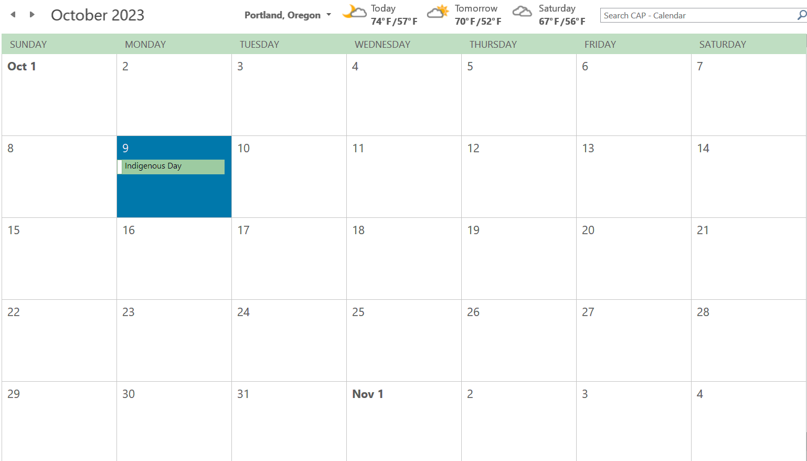
Next StreamNet Executive Committee
October 2023
  Push to October and leave StreamNet Steering Committee to September
  Alternatives?
  Days to avoid
Survey post of meeting
  Continue joint session PNAMP SC?
Doodle
  Post survey outcome

Slide 5
Updates and Announcements
SN ExCom members’ verbal updates and announcements (~2-5 min each)
Colville Tribes: John Arterburn
CRITFC: Sheryn Olson
IDFG: John Cassinelli
ODFW: Tom Stahl / Art Martin
MFWP: David Schmetterling
WDFW: Dan Rawding
USFWS: John Netto
BPA: Jody Lando / Rodrigo George
NPCC: Patty O'Toole
NOAA: Greg Sieglitz
PNAMP: Jen Bayer
StreamNet: Nancy

Slide 6
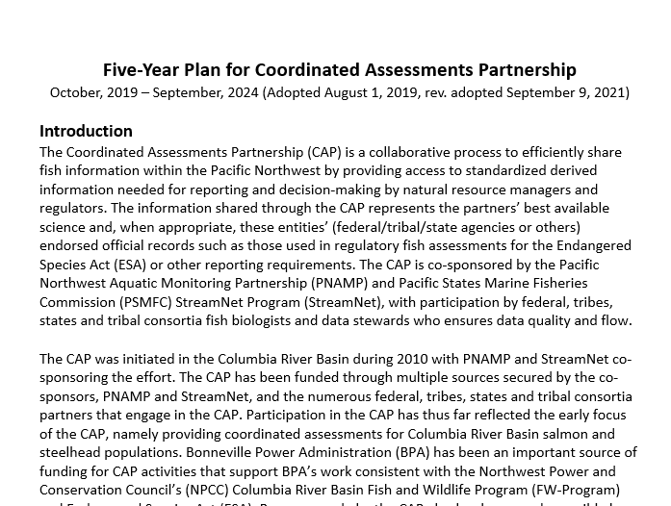
CAP 5-year plan - propose and discuss CY23

Slide 7
Proposed Changes for CAP 5-Year Plan
Summary of proposed changes thus far:
Correct old URLs, typos, remove obsolete info (e.g. priority populations, StreamNet trends)
Clarify and update CAP/StreamNet specific target text (e.g., Fish Monitoring Data etc.)
Add Bull Trout DES development steps in anticipation of regional support for development
Clarify white sturgeon DES text and steps
Update HCAX hatchery indicator content
  Completed 2021, 2022 tasks; and postponed harvest indicator task
Meeting document:
Five-Year-Plan-for-Coordinated-Assessments-20190731 (proposed revisions Sept2022)

Slide 8
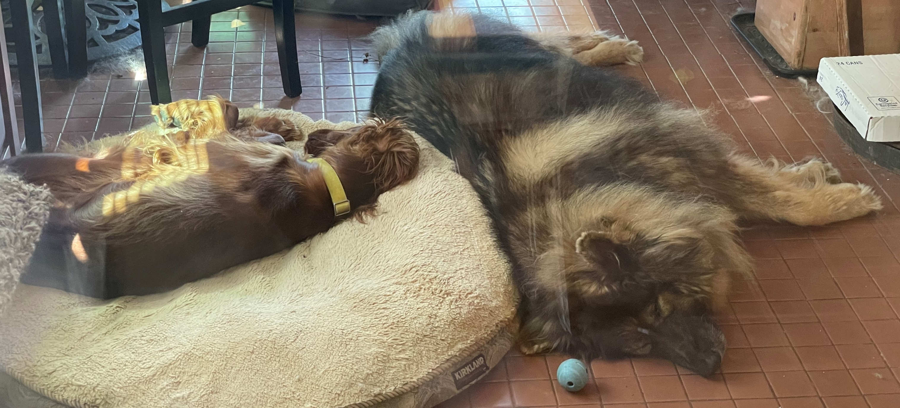
Break back at 10:45 (PT)

Slide 9
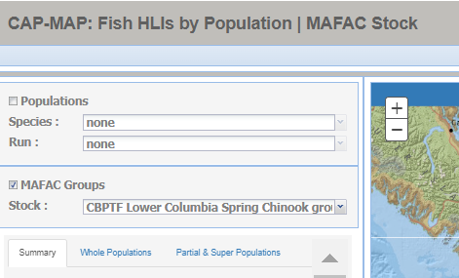
Discuss draft changes to the CAP Fish HLIs user interface

Slide 10
Review status of SN ExCom Sept 2022 decisions on CAP Fish HLIs
Task | CAP Fish HLIs map query | Draft CAP Fish HLIs tabular query
Provide additional filters (e.g. population name, HLI, pop fit, methods, compiled by) | ---- | Done
Remove ‘non-trt’ from pop names | Done | Done
Display partial population estimates (subpop) with whole population estimates; place whole estimate at top and differentiate clearly from partial | Pending changes to MAFAC/Superpop | Done displayed on separate rows
Provide info on data availability for all populations without CAP Fish HLIs/related trend | FMWG Data Display reviewed data and provided input on display Mock up display for map query ready for input Next step: SN SC input and SN ExCom review then finalize
Separate out HLIs for different groupings (e.g. Multiple pop; MAFAC-NPCC groups) | Same as previous row | Done via filter Whole, Multiple, Partial. New groupings will be added

Slide 11
View proposed changes to the CAP Fish HLIs user interface
Go to online map demo

Slide 12
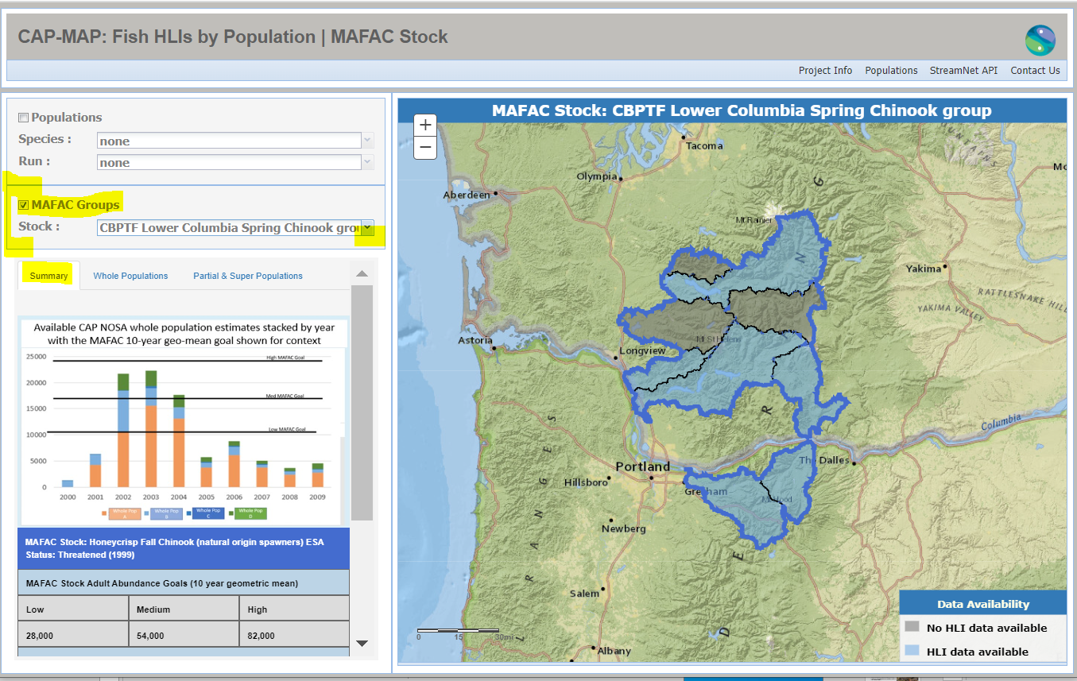
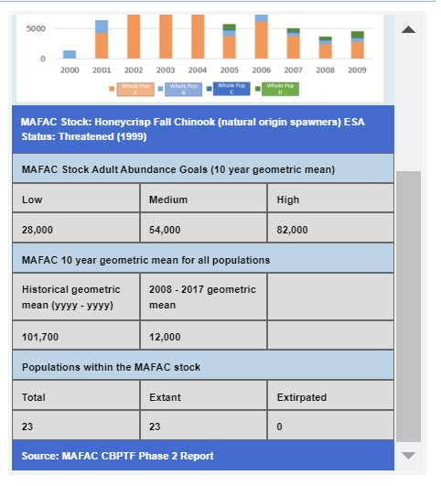

Slide 13
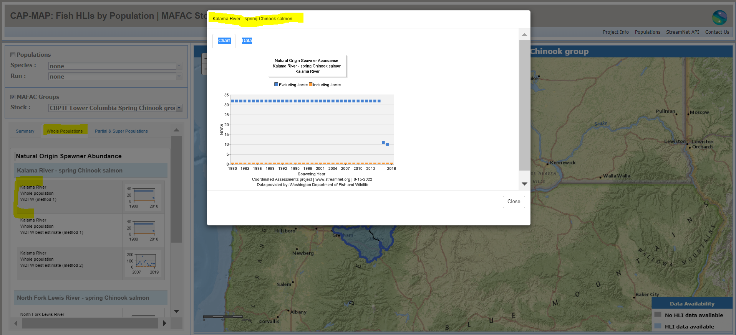

Slide 14
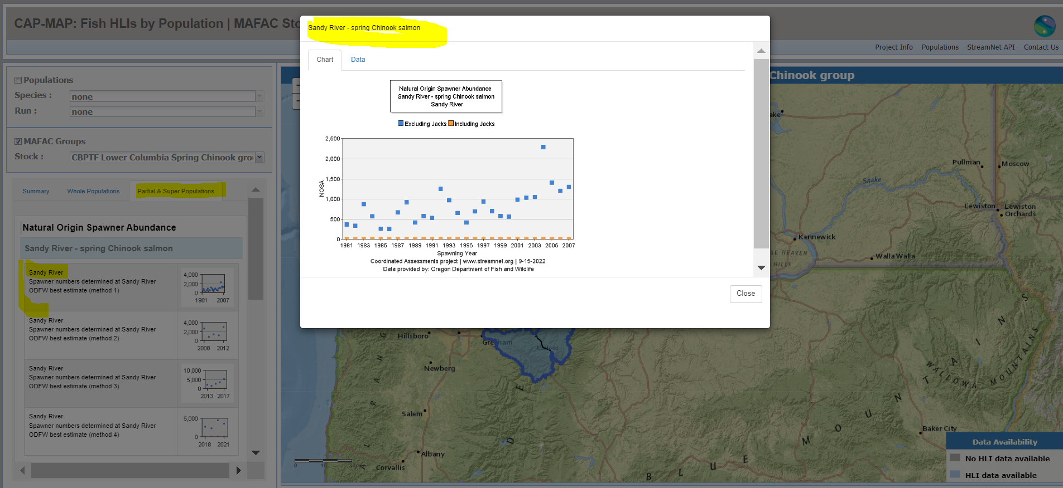

Slide 15
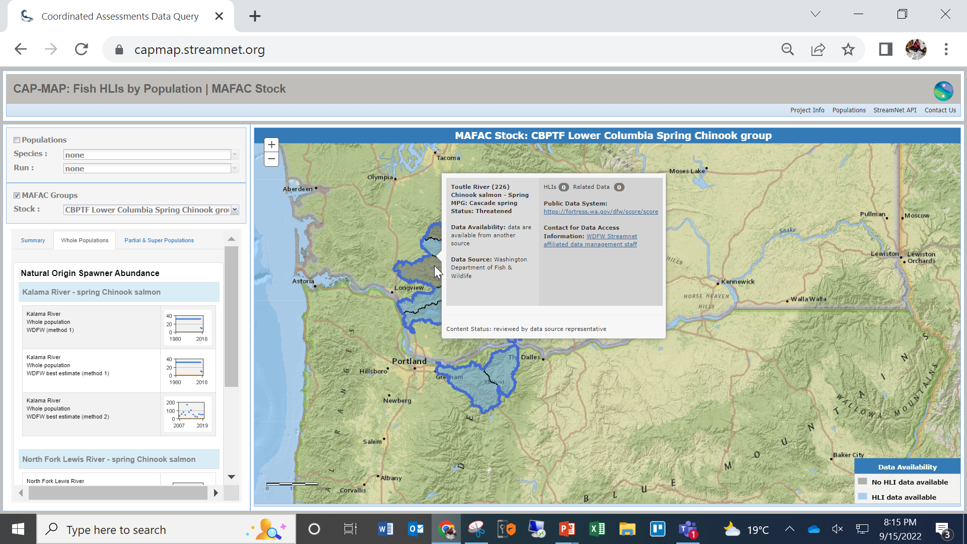

Slide 16
Lunch Break – Back at 1pm
Return and use afternoon link
1:00 - 3:30 (PT) StreamNet ExCom & PNAMP SC
Click here to join the meeting
Or call in (audio only)
(202) 640-1187,,138908893#

Slide 17


Use the meeting chat if you need assistance.
  Chats can be seen by all participants.
Please mute yourself when not speaking.
  Use *6 to mute phone audio.
  Use the microphone icon on the control bar to mute computer audio.
If you are having problems with audio/video, check your device settings.
StreamNet Executive Committee & PNAMP Steering Committee Joint Session
Welcome! We’ll be starting shortly.

Slide 18

StreamNet Executive Committee & PNAMP Steering Committee Joint Session
September 21, 2022
Please mute yourself when not speaking
*6 for phone audio
Microphone icon on the control bar for computer audio
Notes:
18
18

Slide 19

Tips
Please mute yourself when not speaking.
  Use *6 to mute phone audio.
  Use the microphone icon on the control bar to mute computer audio.

Slide 20

Questions or Feedback?
Put it in the chat or raise your hand

Slide 21

AGENDA
1:00 | Welcome & Introductions
1:10 | Brief Progress Updates: Hatchery Coordinated Assessments Exchange (HCAX) StreamNet-MonitoringResources.org progress Coordinated Assessments Partnership (CAP) Workshop Planning Fish Monitoring Work Group Update on Current Tasks (FMWG)
1:55 | Introduce idea of partner needs that StreamNet & PNAMP could support together
2:00 | Partner Presentation: Columbia Basin Collaborative Information Needs -- Mike Edmondson, Idaho Governor’s Office of Species Conservation Administrator
2:20 | Break
2:30 | What's next? Group discussion of tasks to meet partner needs
3:30 | Adjourn

Slide 22
Brief Progress Updates
Hatchery Coordinated Assessments Exchange (HCAX)
StreamNet-MonitoringResources.org Progress
Coordinated Assessments Partnership (CAP) Workshop Planning
Fish Monitoring Work Group Update on Current Tasks (FMWG)

Slide 23
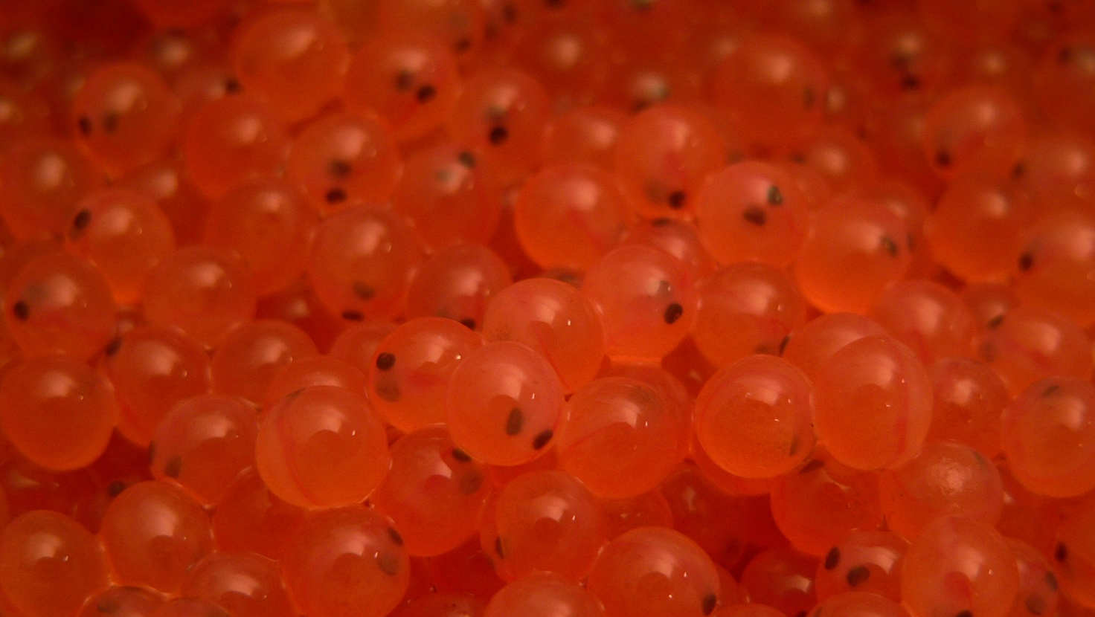
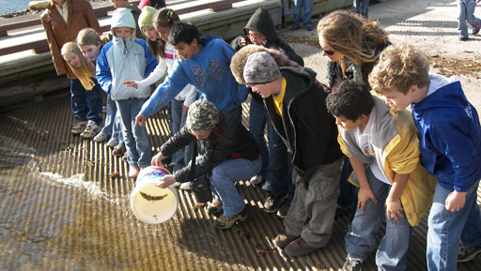
Hatchery Coordinated Assessments Exchange (HCAX)
Schedule & Progress
2021
Workshop 1: confirm metrics/indicators
Biologist Work Group Meetings: identify and agree on field-names, definitions, and develop standardized pick-lists
2022
Data Managers Work Group Meetings: develop data sharing rules and procedures (Data Exchange Standard)
2023
Testing and implementation
Photo credit: NOAA
Photo credit: NOAA
Photo credit: USFWS

Slide 24
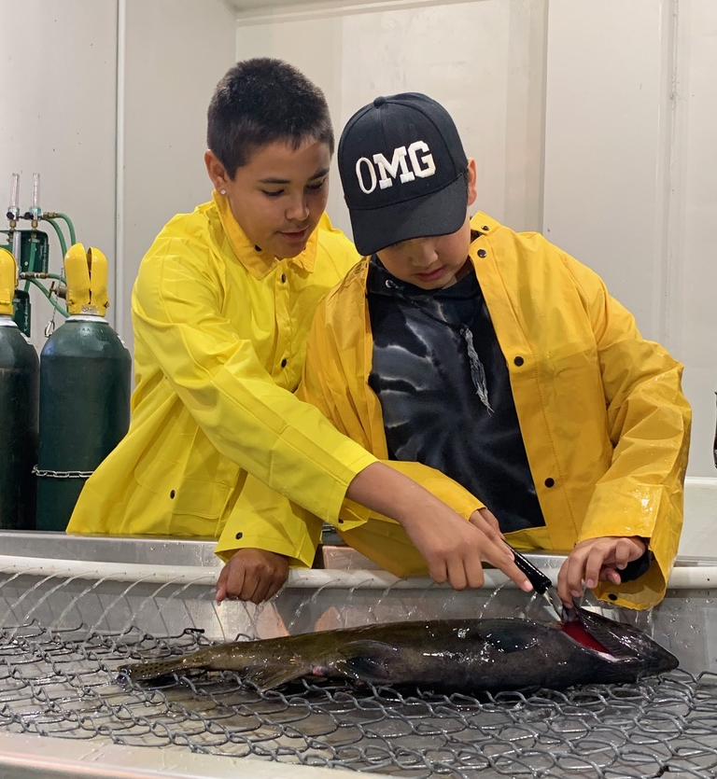
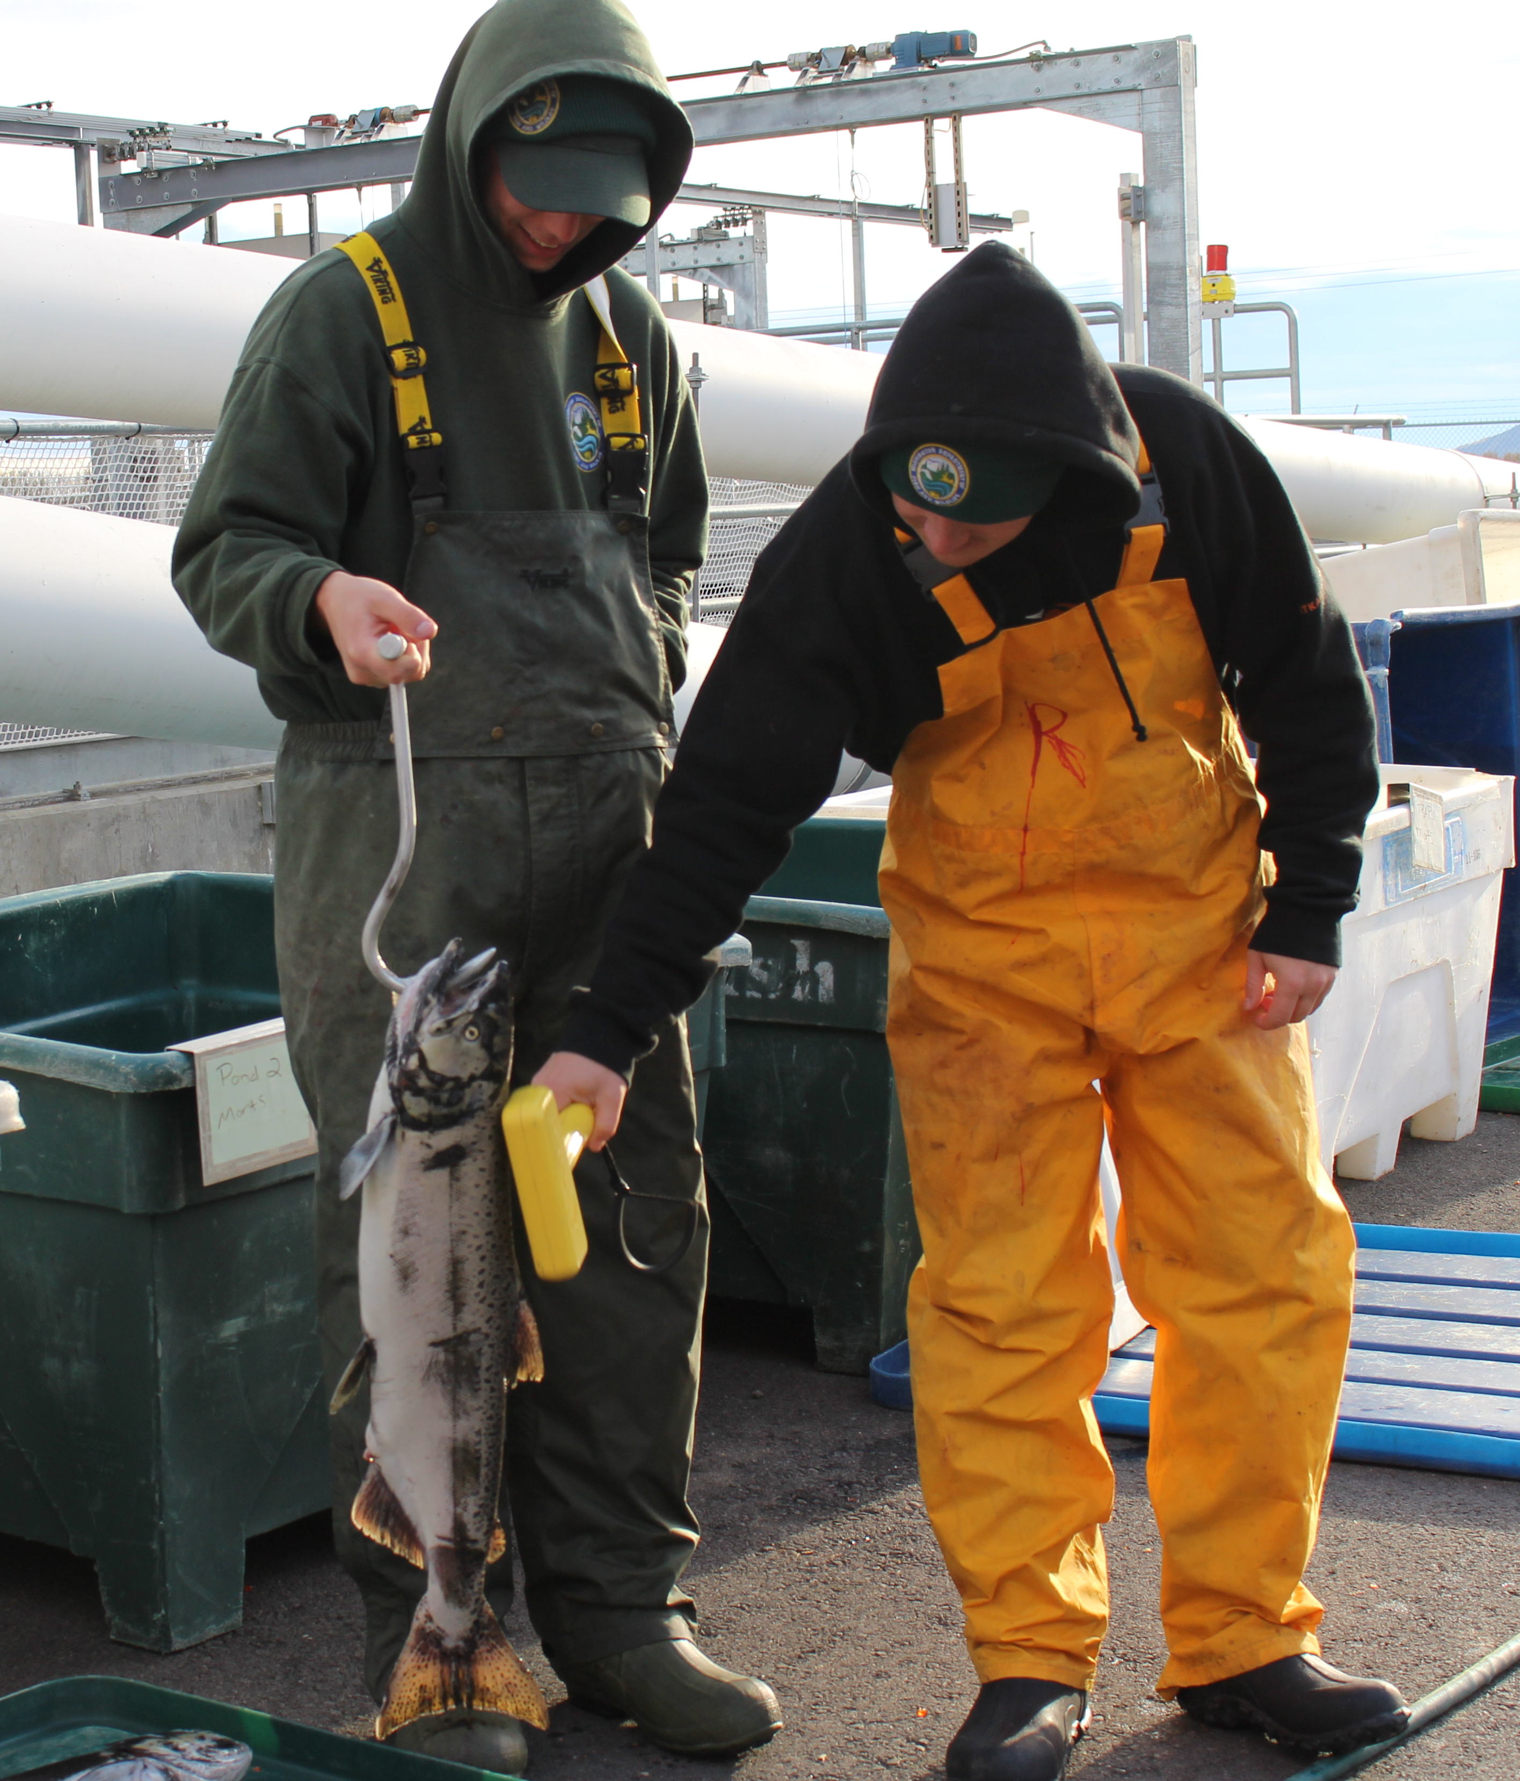
HCAX Project Participants
BPA
Chelan PUD
Confederated Tribes of the Colville Reservation*
Confederated Tribes of the Umatilla Indian Reservation
CRITFC
Idaho Power
IDFG
NOAA
NPCC
ODFW
PSMFC/RMIS
PSMFC/StreamNet*
Shoshone-Bannock Tribes
USFWS
USGS/PNAMP*
WA Governors Salmon Recovery Office*
WDFW*
Yakama Nation Fisheries
* indicates EPA EN grant partners
Photo credit: CRITFC
Photo credit: WFDW

Slide 25
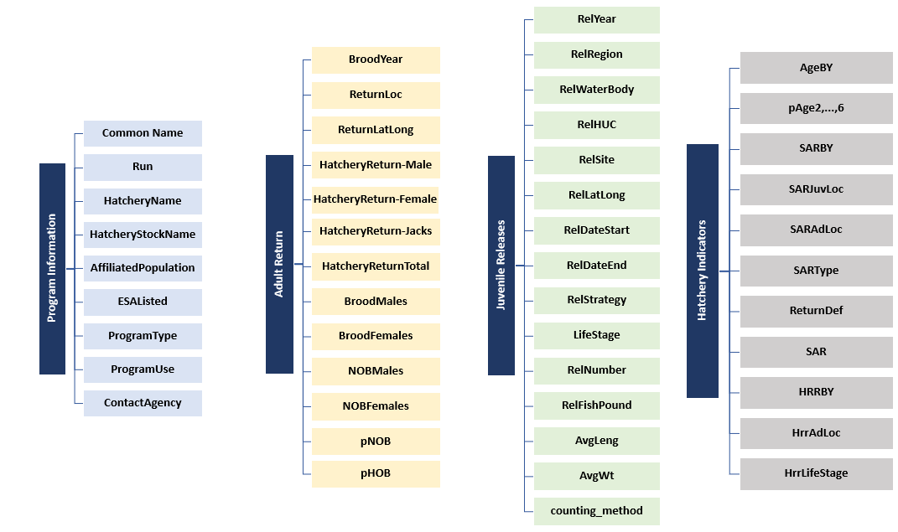

HCAX Data Categories (current)
Details: HCAX Controlled Vocabulary_v1.0
Access HCAX docs: https://www.pnamp.org/project/hatchery-data-sharing-hcax

Slide 26
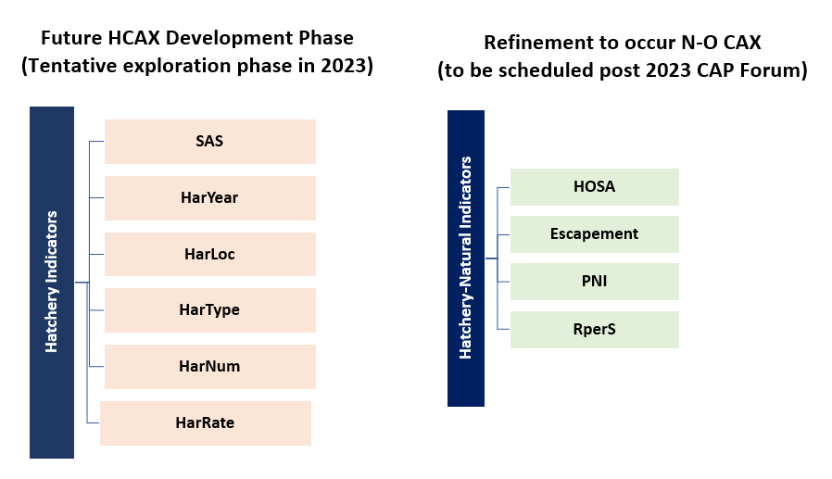
HCAX Data Categories for Future Development

Slide 27





StreamNet-MonitoringResources.org Progress
GOAL: Improve connections between existing data systems
"enter once and reuse multiple times"
Preliminary Work Completed
CBFish.org
proposals
contracts/SOW
annual reports
StreamNet
local trends
CAX
archived data
Implementation in progress
MonitoringResources.org
study plans
sample designs
protocols
methods
CBF&W Library
reports
gray literature
books
access to peer journals

Slide 28
StreamNet-MonitoringResources.org Progress
Progress
February 2022: SN Technical Team Meeting to introduce agency data compilers to MR’s concepts for connecting MR Study Plans to SN Fish Monitoring Data (FMD; aka “Trends”) and CAP HLIs. General agreement on moving forward with a more detailed plan.
April 2022: Agreement on data connections to pursue in 2022-2023 -> FMD, not HLIs due to time/resource limitations. Also identified necessary StreamNet DES modifications.
July 2022: MR developed a plan & resources to facilitate connecting BPA Project & study plan to FMD data trends. StreamNet implemented DES modifications.
Next Steps
Sept 27th: Kick-off meeting to begin collecting data starting with IDFG & ODFW data compilers

Slide 29
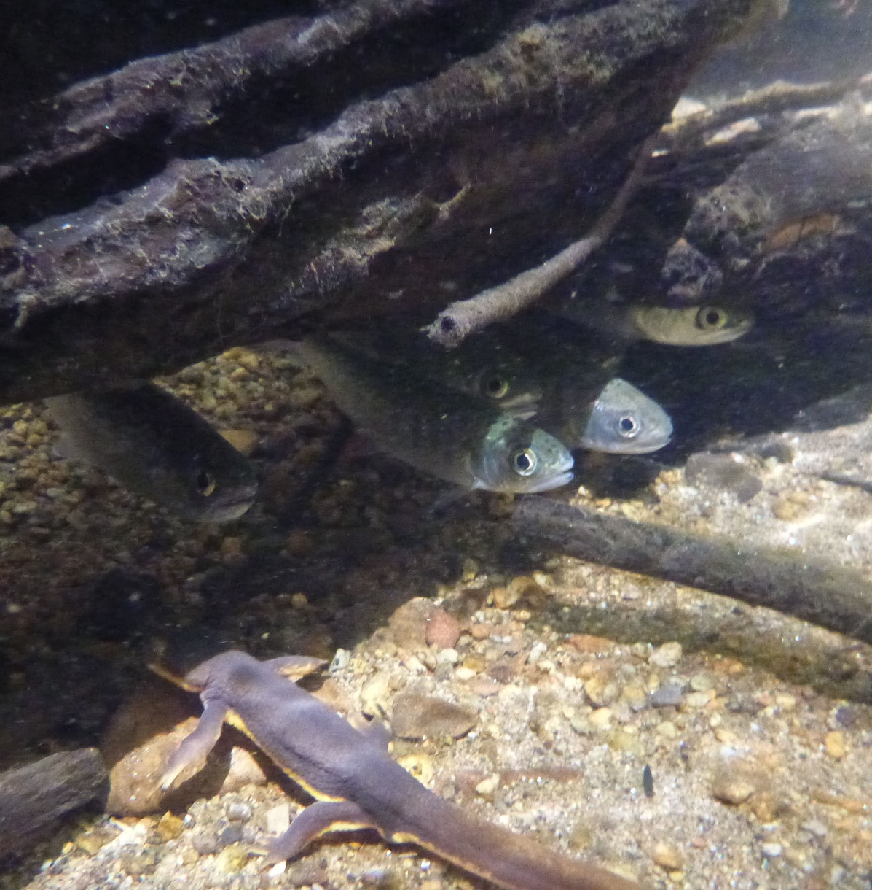
Coordinated Assessments Partnership (CAP)
2023 Workshop
Why: support CAP community of practice to collaboratively agree on important metrics and indicators benefiting from a standardized and efficient exchange process to inform regional assessments and reporting
Expected outcomes:
  Identify current and future data access challenges (provider/user perspectives) and propose solutions
  Confirm data that inform regional assessments (research, management) that would benefit from inclusion
  Strategies for collaborative approaches and funding to address needs and challenges
When: April 2023; 1 or 1 1/2 days; dependent on final agenda
Who: All CAP Data Providers and Data Users, and including:
  StreamNet Steering Committee, DDT, Tech Team
  StreamNet Executive Committee
  PNAMP FMWG members active in relevant tasks
  PNAMP Steering Committee
Photo credit: NOAA

Slide 30
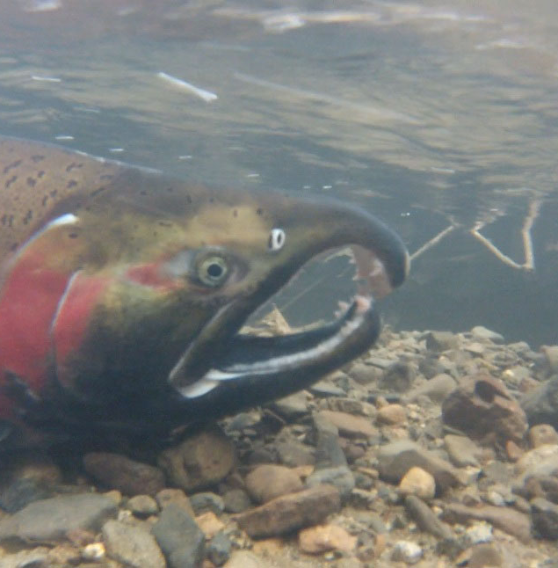
Workshop Agenda Will Focus on Problem Solving
Data Submittal Issues
  Issue 1: Connecting quality metadata to datasets
  Issue 2: Expected Content is not being submitted in existing DES for natural origin salmon and steelhead
Data Retrieval/Data User Issues
  Issue 1: Data Consumers accessing CAP CAX and other salmonid related regional data systems can’t easily map stocks, species, populations between these systems e.g., FishGen, RMIS, PTAGIS, CAP CAX, FINS, etc. How can we streamline access for data consumers?
  Issue 2: Mismatch between field names shown in CAP queries and the data providers’ public website. How can we alleviate confusion or concerns about the data in CAP CAX?
  Issue 3: Other ways we can improve data for the same stock/population that resides in multiple systems more easily accessible?
  Issue 4: Discuss whether updated data queries for accessing data for groups/stocks is adequate to support Columba Basin Collaborative data needs, another target user, or are other improvements needed?
Photo credit: NOAA

Slide 31
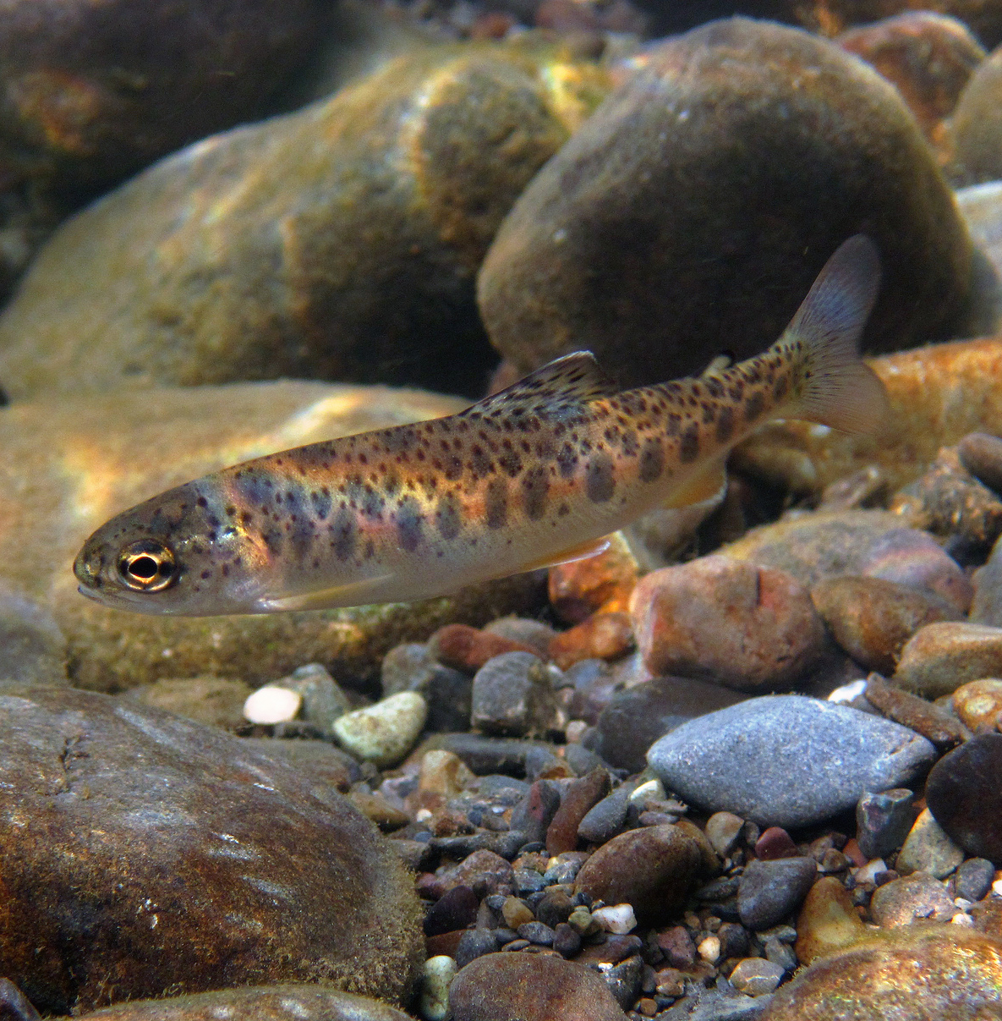
Also…Review Accomplishments and Plan for the Future
Refresher on the CAP structure and processes
Results from the past 6 years (what has changed since the last CAP Workshop in 2017)
CAP’s Next Data Categories
  Review the data categories/species identified in the CAP 5-year Plan
  Discuss intent to explore development for next HLI data category DES (perhaps Bull Trout) in FY24-25 and possible grant funding
  Discuss other data category/species to be tackled next – what and when? Habitat? Sturgeon?
Preparing for the future of efficient data exchanges
  Funding opportunities
  Future of data mobilization
Photo credit: NOAA

Slide 32
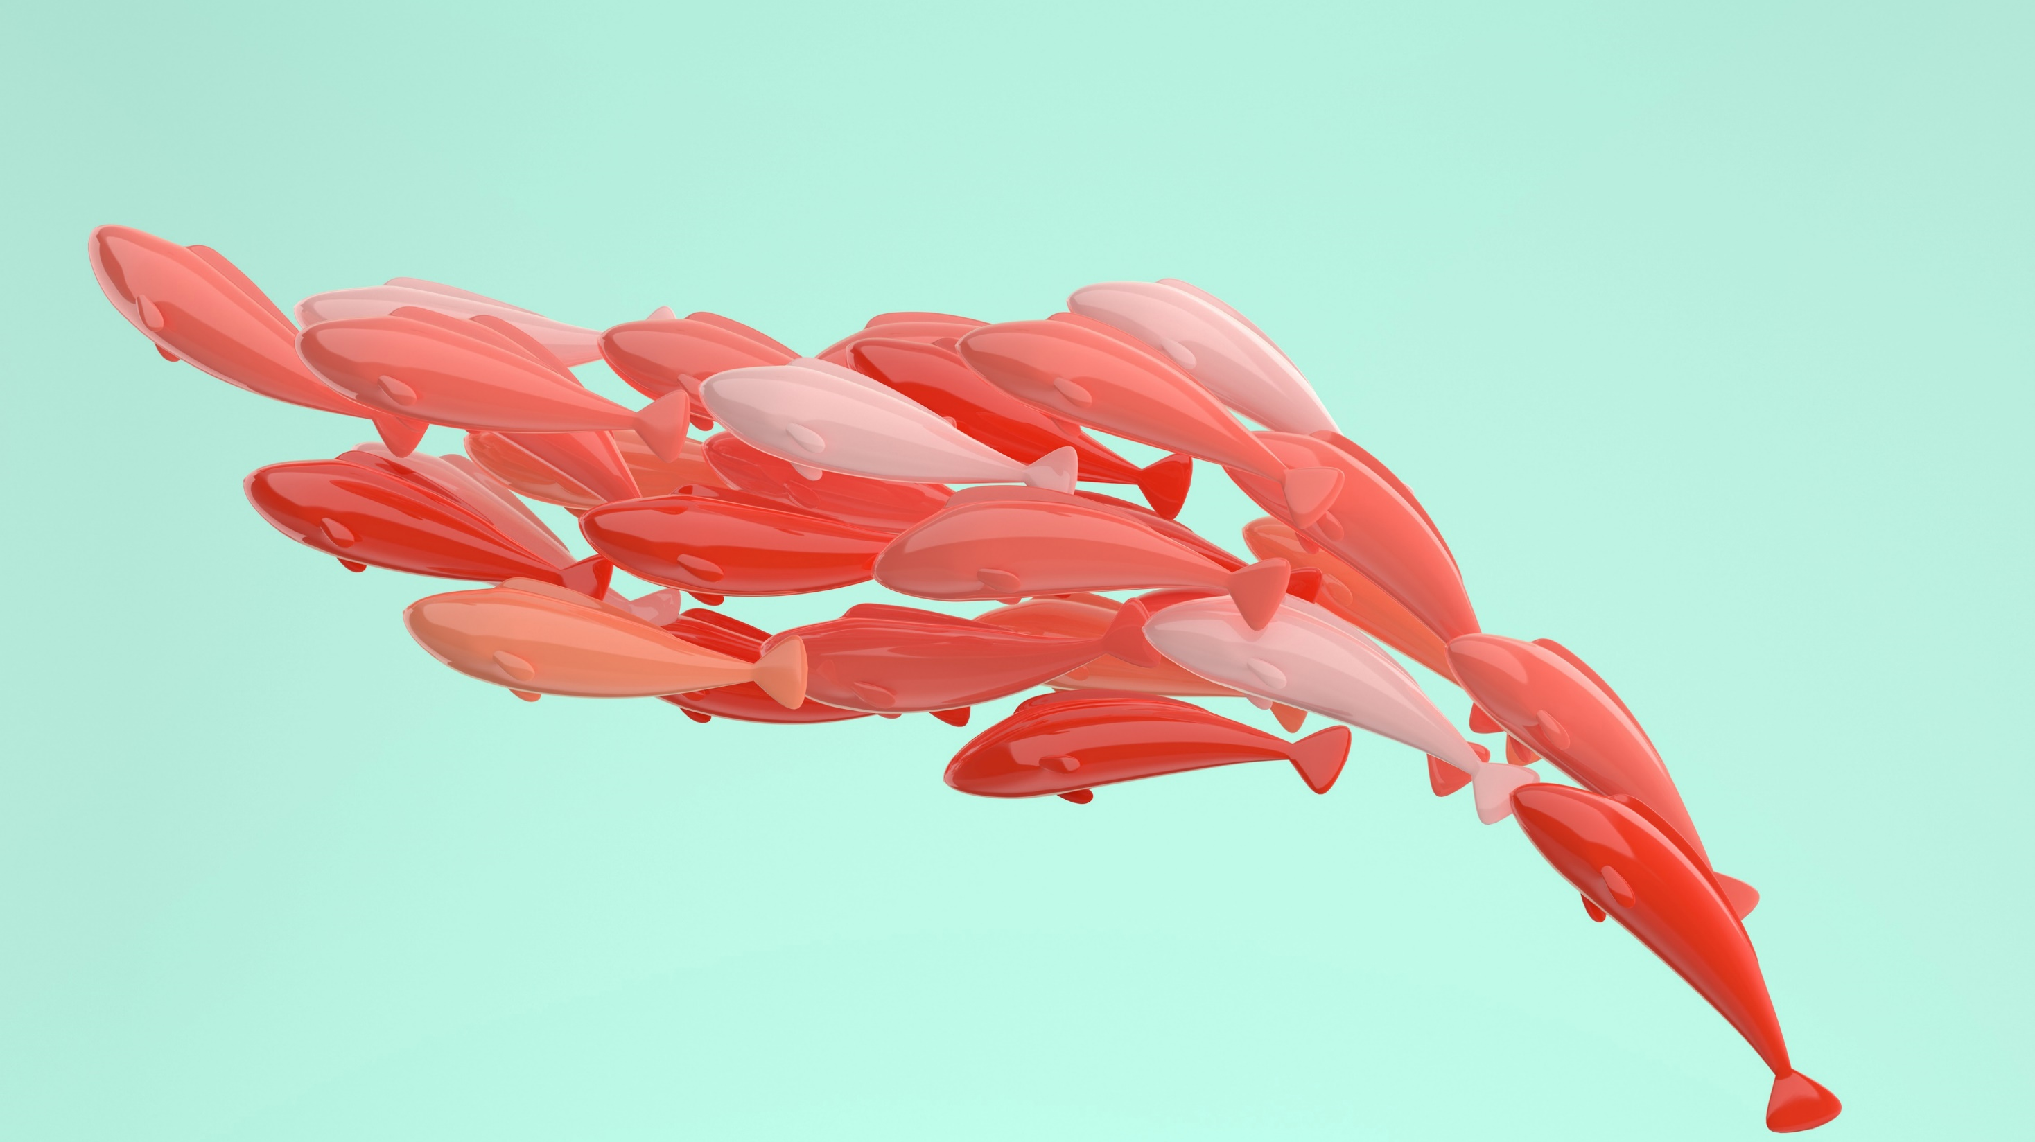
Fish Monitoring Work Group (FMWG) - Update on Current Tasks

Slide 33

FMWG description, initial task list, completed, and current
Introduce what this is-when we rebooted it we deliberately made a plan with streamnet to work together across these projects
Goal is efficiency
Sequencing appropriately
Acknowledge core team – include jen and Nancy-OR, ID, and BPA for support
Initial task list came from input from a survey that was broadcast widely to everyone that had participated in a fish-related PNAMP activity in the past few years
We whittled it down by setting criteria /roadmap using charter-we will not take on a task without a lead or clear outcome in mind – in kind time of leaders – interested in more than one task than we are presenting
Today, we’ll share current active tasks, we have finished some things – see website

Slide 34
Data Display: Implementation
Task Team Leads:
Nancy Leonard nleonard@psmfc.org
Lara Erikson lerikson@psmfc.org
Purpose: Inform implementation of Data Display recommendations approved by StreamNet Executive Committee in 2021 related to (1) display data availability for populations without CAP Fish HLIs; and (2) display groups (superpop, MAFAC) separately on the CAP Fish HLI.
Products:
  For populations within CAP Fish HLIs (a) revise/confirm draft document summarizing data availability, (b) provide input on how content will be displayed.
  For displaying groups and their HLIs provide input on how available data in the CAP Fish HLIs will be shown for superpops and MAFAC groups.
Next Steps:
  Sept 19: SN Steering Committee reviewed proposed changes and provided input
  Sept 21: SN Executive Committee reviewed proposed changes supported by SN Steering Committee and discussed what to implement
  SN staff to implement per SN Executive Committee guidance

Slide 35
Fish Population Names and GIS Boundaries
Task Team Leads:
Van Hare vhare@psmfc.org
Evan Brown evan.brown@idfg.idaho.govg.idaho.gov
Purpose: Defining Fish Population Names and Boundaries for StreamNet tools. This includes the focal fish species informing the NPCC Addendum goals, objectives and indicators (e.g., bull trout, white sturgeon, cutthroat trout, redband trout, kokanee) Note, this task supports ideas identified during 2019 Smolt Analytics workshop (create Standard GIS layers and fields).
Products: List of recommended population names and boundaries (polygons layer) to be used by StreamNet tools;
Use the USGS National Hydrography Dataset (NHD) Watershed Boundary Dataset (WBD)
Next Steps: a finalized agenda and any additional materials with the meeting reminder as the date approaches
Meeting: Wednesday, April 27, 2022 9:30-11:30 am (PDT) link

Slide 36

MAFAC and NPCC SPI
Task Team Leads:
Kris Homel khomel@nwcouncil.org
Lara Erikson lerikson@psmfc.org
Purpose: Using existing CAP Fish HLIs to inform adult abundance estimates for the groups identified by MAFAC and incorporated in NPCC’s 2020 Addendum.
Task 1: Provided the following information about the population estimates that may be included in each rolled up MAFAC stock NOSA value:
  Number of populations included within a stock that contain a whole population NOSA estimate.
  For each population, specified whether jacks were included/not included in the estimate.
  If lacking spawner abundance, does it have escapement abundance?
Number of populations included within a stock with a partial population NOSA estimate:
  Specified whether jacks were included/not included in the estimate.
Next Steps: Produce report by task team leads summarizing available data from StreamNet and other sources.
  Report to be shared with StreamNet.
  NPCC pausing inclusion at this point pending potential development by Columbia Basin Collaborative Topic Specific Work Groups.

Slide 37

Carrying Capacity Standards
Task Team Leads:
Morgan Bond morgan.bond@noaa.gov
Tim Copeland tim.copeland@idfg.idaho.gov
Russell Scranton rwscranton@bpa.gov
Progress
- First meeting was held November 29, 2021 (event page)
- Confirmation of general approach and scope
Next Meeting
Presentations on limitations, QA processes and information needs for carrying capacity product development
  May or June Date TBD
Review Paper
Further discuss proposed Data Exchange Standard concepts

Slide 38
Juvenile Density (Snorkel & Electrofishing)
Task Team Leads:
Kasey Bliesner (ODFW) kasey.bliesner@odfw.oregon.gov
Russell Scranton (BPA) rwscranton@bpa.gov
Marika Dobos (IDFG) marika.dobos@idfg.idaho.gov
Progress
- First meeting was held February 2022 (link)
-
- Use Cases in development
Next Meeting
Beginning of October

Slide 39
Rotary Screw Trap (RST) Operation
Task Team Leads:
Kasey Bliesner (ODFW) kasey.bliesner@odfw.oregon.gov
Russell Scranton (BPA) rwscranton@bpa.gov
Marika Dobos (IDFG) marika.dobos@idfg.idaho.gov
Polly Gibson (ODFW)* polly.p.gibson@odfw.oregon.gov
Progress
- First meeting was held February 2022 (link)
-
Acknowledge that Polly particpants

Slide 40

Introduce idea of partner needs that
StreamNet & PNAMP could support together

Slide 41

Partner Presentation:
Columbia Basin Collaborative Information Needs --
Mike Edmondson, Idaho Governor’s Office of Species Conservation Administrator

Slide 42
Columbia Basin Collaborative
September 21, 2022

Slide 43
A regional approach to achieving the Columbia Basin Partnership goals
Consideration/Implementation by regional forums and processes: state, federal, tribal, international
Implementation by regional sovereigns: federal, state, tribal
Proposals to Congress
Sovereigns and other Regional Entities
Role: Review recommendations and make independent decisions to implement/support actions
Project Team
Leads: WA, ID, MT, OR
Role: scope assignments, develop agendas, process coordination
Recommendations and feasibility assessments
Regional and Sector Caucuses
Members in the I/RG will coordinate with respective caucuses for input and alignment
Integration/Recommendations Group (I/RG)
Role: Assess feasibility and develop recommendations for implementation; strives for consensus
Prioritized information requests
Proposed biological-based priority actions
Draft feasibility assessments and recommendations on implementation paths
Subject Specific Input from Regional Forums
Topic Specific Work Groups
Role: provides scientific, technical and other analysis per assignment from Integration/Recommendations Group
Columbia Basin Collaborative
43

Slide 44
The Integration/Recommendations Group

Slide 45
I/RG Role
Monitor the overall progress of the CBC to achieve the CBPTF goals
Review recommendations for projects and actions in the region
Seek consensus and promote recommendations to decision-makers
Provide a clearing-house forum for understanding, promoting and acting on short and long-term opportunities
Mobilize and motivate people across the basin to support salmon rebuilding and achieve the CBP goals
Engage decision-makers to monitor and follow-up on implementation of recommendations

Slide 46
I/RG Membership
Tribe​
Burns Paiute Tribe​
Coeur d’Alene Tribe​
Confederated Tribes of the Colville Reservation​
Confederated Tribes of the Grand Ronde​
Confederated Tribes of the Umatilla Indian Reservation​
Confederated Tribes of Warm Springs​
Cowlitz Indian Tribe​
Fort McDermitt Paiute and Shoshone Tribe​
Nez Perce Tribe​
Shoshone-Paiute Tribes​
Spokane Tribe of Indians​
Yakama Nation​
*Invited but not confirmed
Federal entity
NOAA National Marine Fisheries​
Federal action agencies: BPA, Army Corps, and/or Bureau of Reclamation​
Columbia Basin Federal Caucus​
State​s
State of Idaho​
State of Montana​
State of Oregon​
State of Washington​
Sector | Primary Representative | Alternate Representative
Utilities | Seattle City Light | Western Montana G&T
Utilities | Benton PUD | Idaho Consumer-Owned Utilities Association
Non-tribal fisheries | Coastal Trollers Association | Commercial Salmon Fisherman
Non-tribal fisheries | Northwest Sportfishing Industry Association | Idaho Wildlife Federation
River Economies | Idaho Water Users | Kittitas Reclamation District
River Economies | Port of Lewiston | Wheat Farmer
Conservation | Salmon Safe | American Rivers
Conservation | Trout Unlimited | Northwest Energy Coalition
46

Slide 47
Topic Specific and Science Integration Work Groups

Slide 48
Purpose of Work Groups
Develop draft recommendations for actions, and assist the I/RG in feasibility assessments of those actions
Work collaboratively to clarify and assess subject-specific issues and potential actions and solutions
Leverage existing data and studies to support their assessments
Coordinate and collaborate across other Work Groups for complementary analyses and solutions
48

Slide 49
Structure of Work Groups
Made up of regional experts, sector leaders, and advisors
The I/RG will agree on the membership
The duration of the WG will vary and depends on the topic and assignment from the I/RG
I/RG members can also participate
49

Slide 50
Work Groups
Estuary/Tributary Habitat
Hatcheries/Harvest
Hydrosystem (mainstem and blocked areas)
Predation
Science Integration Work Group
*Listed alphabetically, order does not represent priority.
50

Slide 51

BREAK
Return at 2:30

Slide 52
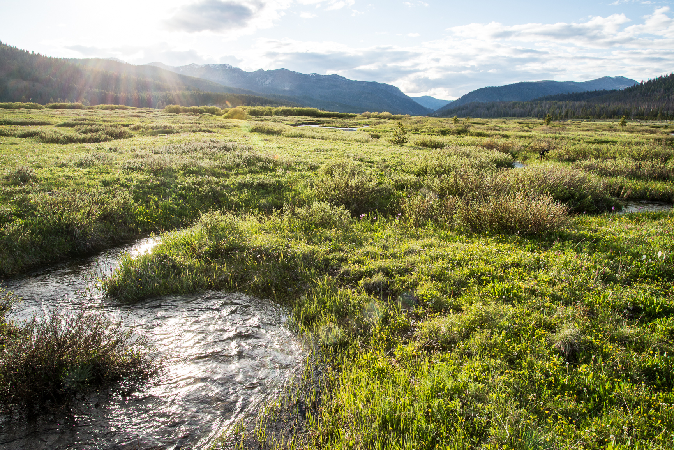
What's next?
Group discussion of tasks to meet partner needs
Photo credit: NOAA

Slide 53
Quick Reminder of Current StreamNet CAP Tasks
StreamNet Fish Monitoring Data (related data)
Maintain Natural Origin Indicators
HCAX Hatchery Indicators
Scoping HCAX Harvest Indicators (start FY23)
CAP 2023 Workshop
Pilot Rotary Screw Trap Sites, Data, & Metadata Dashboard
Update StreamNet and CAP DES' as needed
Improving metadata
Current CAP HLIs
Spawner abundance and/or escapement
Smolt to adult ratio
Recruits per spawner
Presmolt abundance
Number of outmigrants
Proportionate natural influence (PNI)

Slide 54
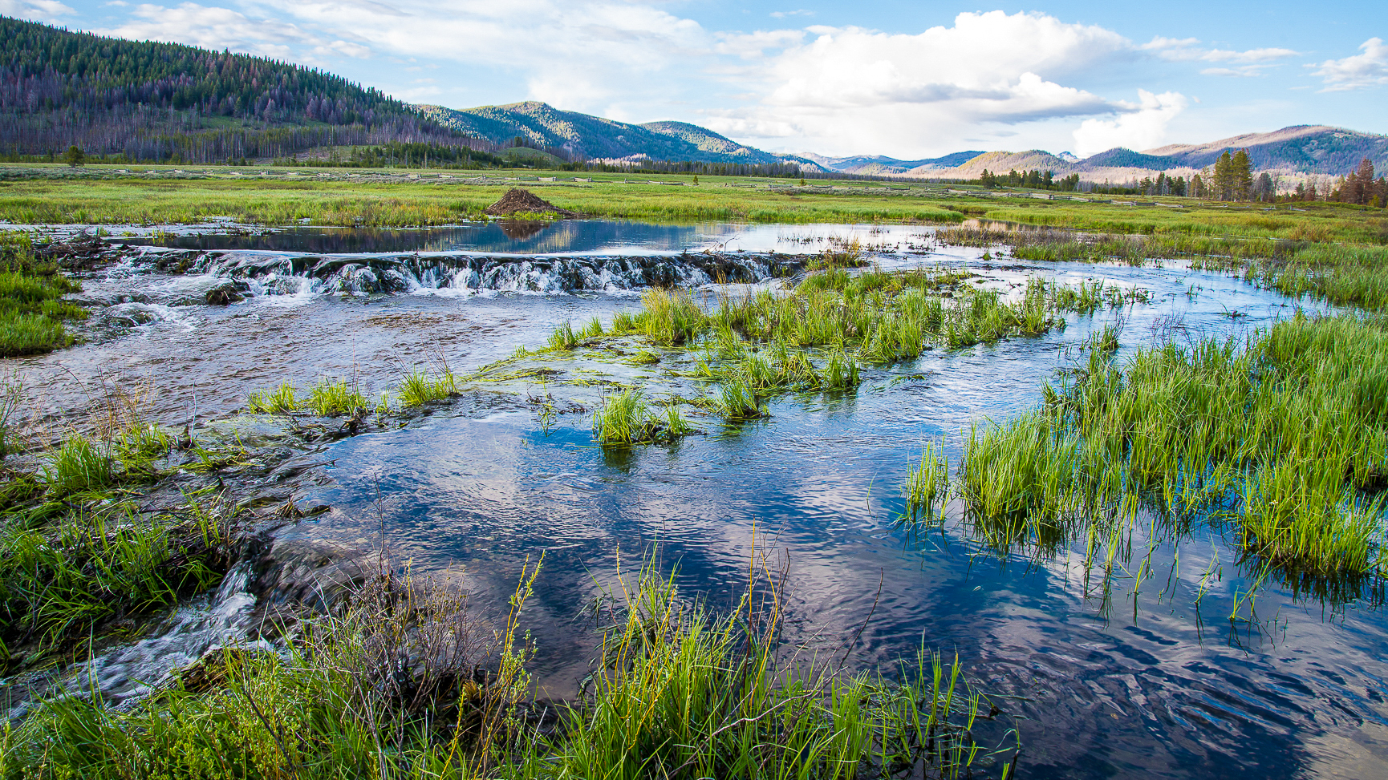
Interactive Polling

Slide 55

Discussion

Slide 56


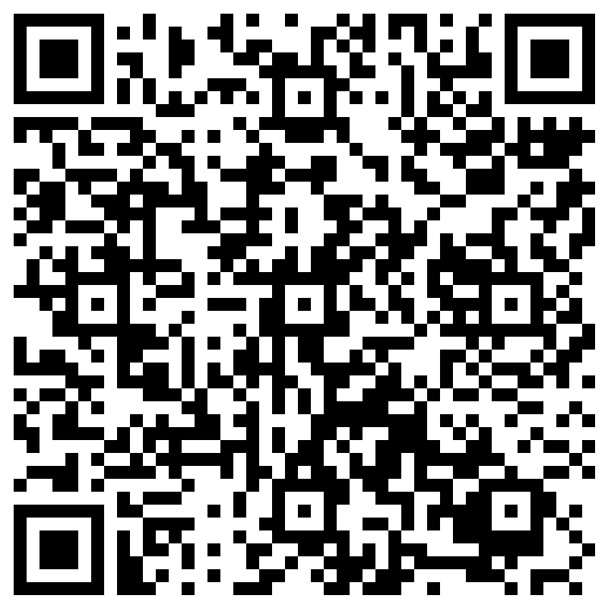
SURVEY
https://forms.office.com/g/8zDqPR4JpQ

Slide 57
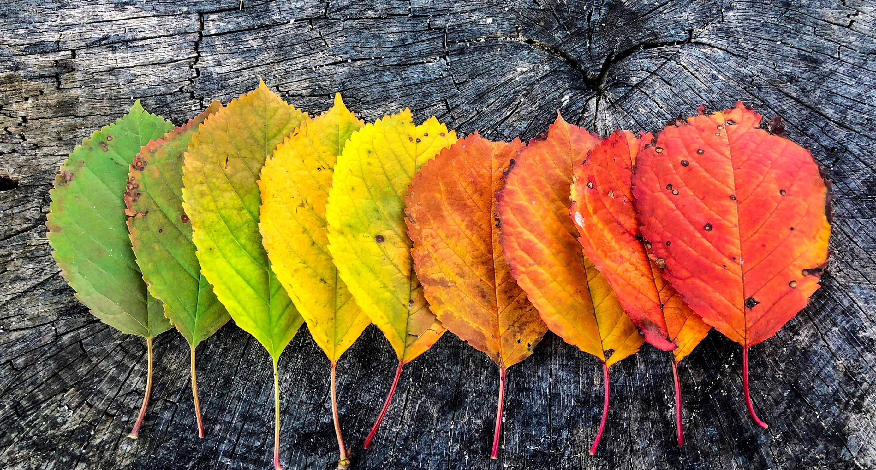
ADJOURN
Thanks for joining us!

