Slide 1
Documentation of
CAX Methods and Protocols
Jen Bayer USGS/PNAMP
March 16, 2015
Notes:
1
1

Slide 2
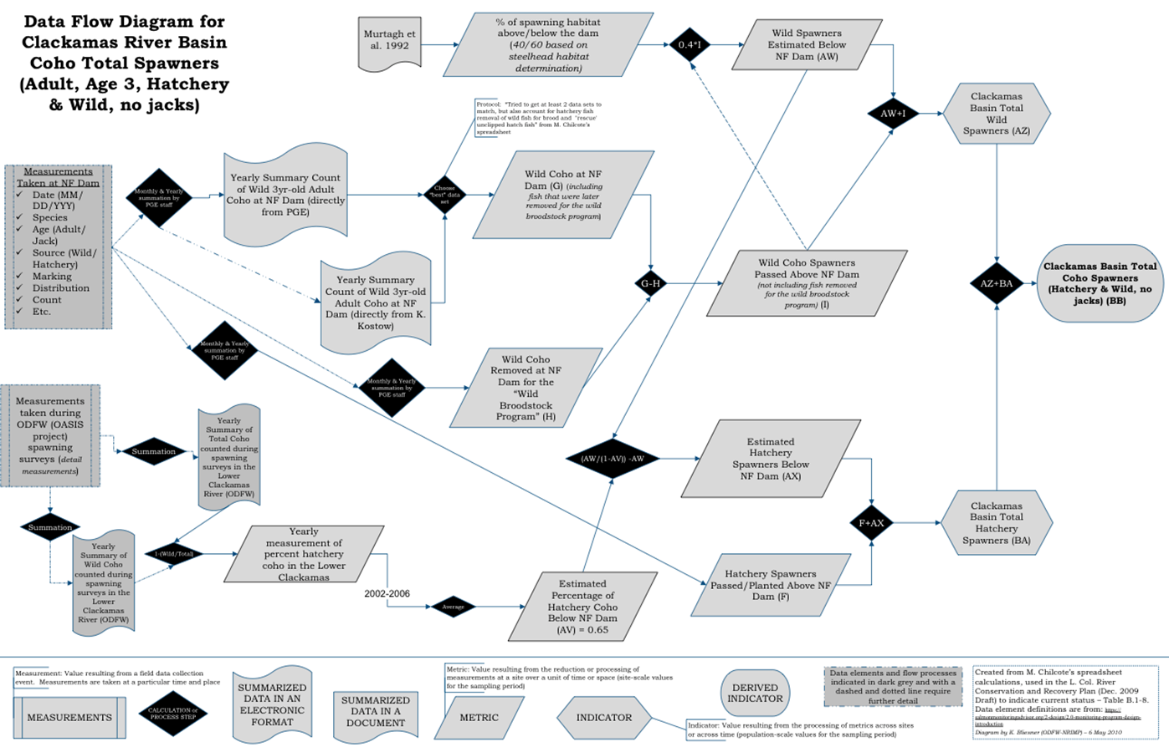
Coordinated Assessments Project
Documentation Support for Agencies and Tribes

Slide 3
CAX Data Exchange Standard
Section A: Indicators for Populations of Natural Origin Fishes.
A1. NOSA Table.
A2. SAR Table.
A3. RperS Table.
Section B: Indicators for Hatchery Programs and Populations of Hatchery Origin Fishes
B1. HatcherySpawning Table.
B2. PNI Table.
B3. EggToRelease Table.
B4. SAR_Hatchery Table.
B5. RperS_Hatchery Table

Slide 4
CAX Standard Requires Metadata
Protocol and method documentation
ProtMethName | The name(s) of all protocols and associated data collection and data analysis methods used to calculate the indicator estimate. | Memo | Provide title of protocol and name(s) of relevant methods used. Documentation should include the study design (including spatial, temporal, response and inference designs), annual implementation notes on variations from routine step by step procedures or design criteria, also known as survey design, description of field methodology and analytical approach.
ProtMethURL | URL(s) for published protocols and methods describing the methodology and documenting the derivation of the indicator. If published in MonitoringMethods.org, this link will provide access to study design information and all methods associated with the protocol. | Memo | Provide URL(s) to source documentation of methodology. For MonitoringMethods.org provide link to the protocol. Methods documentation should include survey design, description of field methodology and analytical approach. URL links may be to online methods documentation resources like MonitoringMethods.org, other online resources, or online literature. If methodology is unchanged from a previous year, use the previous link references. If methodology changed for this estimate, provide a new link.
Notes:
4

Slide 5
CAX Standard Requires Metadata and Monitoring Methods Makes it Easy
Protocol and method documentation
ProtMethName | The name(s) of all protocols and associated data collection and data analysis methods used to calculate the indicator estimate. | Memo | Provide title of protocol and name(s) of relevant methods used. Documentation should include the study design (including spatial, temporal, response and inference designs), annual implementation notes on variations from routine step by step procedures or design criteria, also known as survey design, description of field methodology and analytical approach.
ProtMethURL | URL(s) for published protocols and methods describing the methodology and documenting the derivation of the indicator. If published in MonitoringMethods.org, this link will provide access to study design information and all methods associated with the protocol. | Memo | Provide URL(s) to source documentation of methodology. For MonitoringMethods.org provide link to the protocol. Methods documentation should include survey design, description of field methodology and analytical approach. URL links may be to online methods documentation resources like MonitoringMethods.org, other online resources, or online literature. If methodology is unchanged from a previous year, use the previous link references. If methodology changed for this estimate, provide a new link.
Notes:
5

Slide 6
Coordinate Assessments Requirements Metadata
Protocol and method documentation
ProtMethDocumentation | Citation or documentation that describes the protocol and/or method(s) listed in the ProtMethName field. Include references not documented in MonitoringMethods.org, such as reports, journal articles or other publications that describe the survey design, field methodology and analytical approach used to derive the indicator estimate. | Memo | Provide a citation(s) to documentation of the methodology used. This may be in the form of reports, journal articles, or other publications that describe the study design (including spatial, temporal, response and inference designs), variations from routine step by step procedures or design criteria, description of field methodology and analytical approach. If the methodology is not yet published, either insert here, or describe in a separate document and make it available online (provide the URL). Leave this field blank if methodology is described in MonitoringMethods.org. Note: If there is no link to a cited document online, provide a copy of the document to the StreamNet Library (streamnetlibrary.org). The library will scan the document and provide a URL. Post the URL in the ProtMethURL field. If methodology is unchanged from a previous year, use the previous link or reference citation. If methodology changed, provide a new link or reference citation.
MethodAdjustments | Minor adjustments to a method in a given year that are not described in the method citations above but are important. | Memo | Give a brief description of changes or adjustments to a standard method if they are NOT described in the methods documentation already provided. If multiple documentation sources are cited, be sure to indicate which method from which document was adjusted. In MonitoringMethods.org, documentation of changes or adjustments to methods or protocols can be described in the Implementation Notes section of each published method or protocol.
Notes:
6

Slide 7
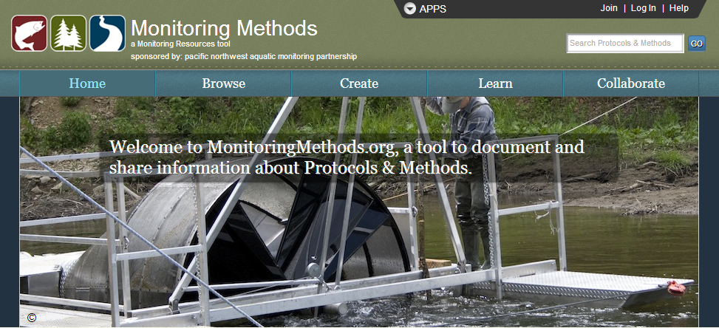
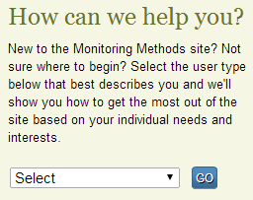
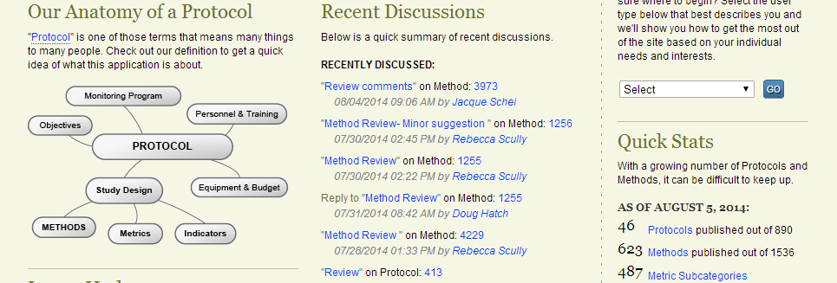
Promote consistent documentation
Improve access to information
Promote community discussions
Identify best practices
Streamline creation of metadata
Notes:
7

Slide 8
Benefits of Using Monitoring Methods
Structured, consistent information
allows comparisons of Protocols & Methods
Precise documentation allows methods to be repeated
Documents all categories in the CAX Standard
Library of methods that can be reused and customized to reflect project specific alterations
732 published methods; over 50 are from the published AFS Salmonid Field Protocols, Fisheries Techniques or Standard Methods for N. American Freshwater Fishes books
Easy to document and track yearly changes to Protocols and Methods

Slide 9
PNAMP is Working to Streamline Documentation in Monitoring Methods
Work with CA partners to understand their needs
Provide templates for analysis methods
Development changes will improve support of indicator documentation

Slide 10
CA and Monitoring Methods Next Steps
Present Monitoring Resources tools, templates, and examples of documentation at the CA workshop April 2, 2015
Work with users to document their Protocols and Methods

Slide 11
Discussion
BPA project sponsors: By documenting in Monitoring Methods you are killing two birds with one stone: fulfilling your contract and CA requirements
PNAMP is committed to working with CA to streamline and support the documentation process
Focus on documenting analytical methods for calculating the indicators
If not Monitoring Methods, how does the Executive Committee think documentation should occur?

Slide 12
www.monitoringresources.org www.pnamp.org
If you’d like additional information about any of the tools,
please contact Jen Bayer (jbayer@usgs.gov), Rebecca Scully (rscully@usgs.gov) or Katie Pierson (kpierson@usgs.gov).

Slide 13
Better Documentation Has Many Benefits
Help each other gain a better understanding of who’s collecting what information, why and how
Scientific integrity
Promote collaboration and coordination
Better use of limited funds
Institutional memory
Accountability, reporting
Minimize uncertainty about utility of others’ data
We need to have more thorough, consistent documentation available about our monitoring programs and projects to support multiple needs.
Notes:
13

