Slide 1
Flume Demonstration
What did we see?
CHaMP and ISEMP State of the Science Workshop
Portland, Oregon – February 25th and 26th, 2014
Presenter:
Joe Wheaton
Collaborators:
Kenny DeMeurichy, James Hensleigh, Phillip Bailey, Wally MacFarlane & Sara Bangen

Slide 2
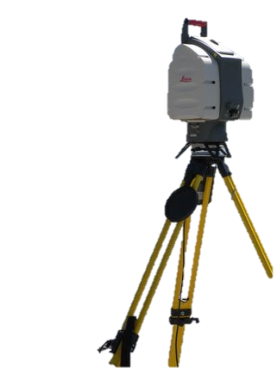
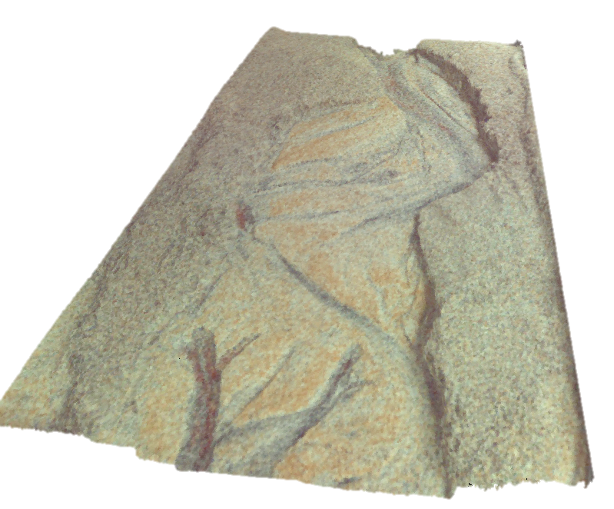
The Toys Were For More Then Just Playing in the Sandbox
Ground-Based LiDaR
FLOW
Raw Point Cloud

Slide 3
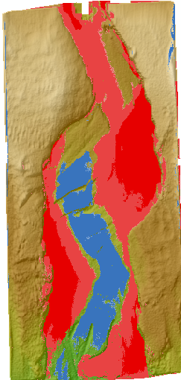
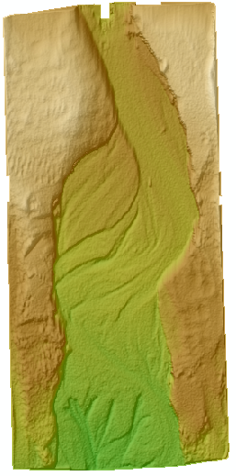
Also to Show Off the Capacity We Have Built Within CHaMP to Quickly Collect Data and Produce Metrics
DoD…
FLOW
OLD DEM
NEW DEM

Slide 4
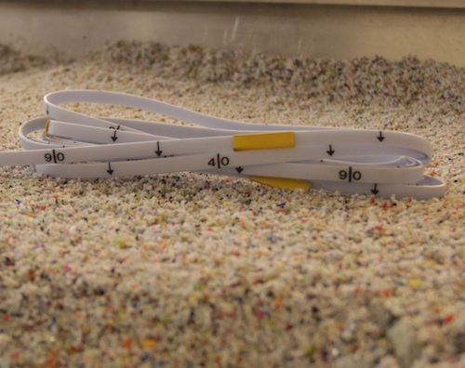
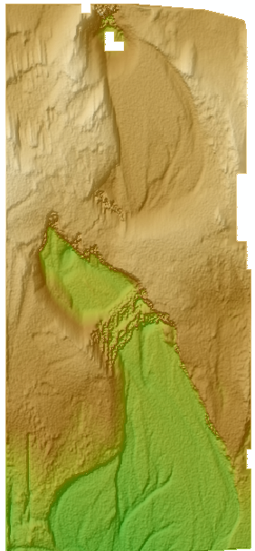
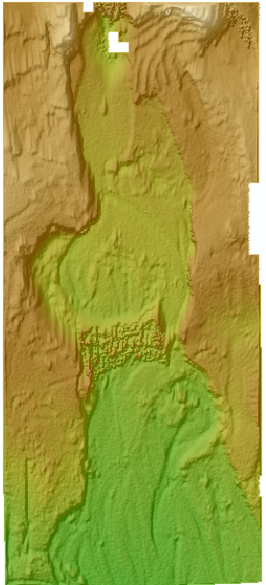
PRE-TREATMENT DEM
POST TREATMENT DEM
Culvert
Removed
Culvert
Bridge
Avulsion
Around
Bridge
DEM post processed using CHaMP Topo Processing Tools, While we were talking…

Slide 5
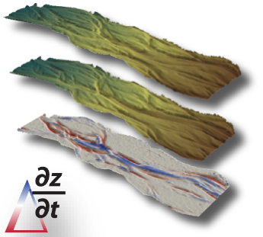
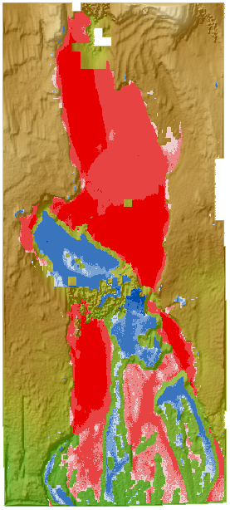
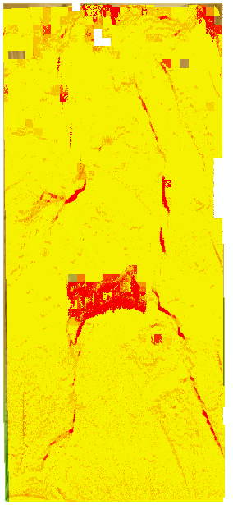
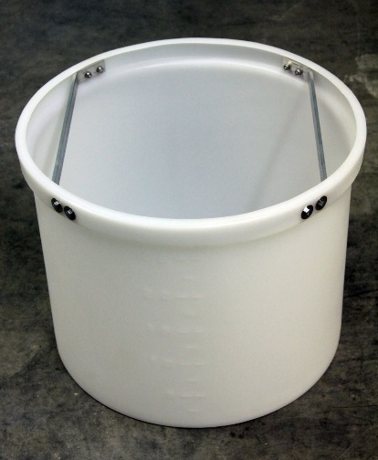
We Used GCD to Quantify These Changes (i.e. CHaMP Action Effectiveness Monitoring)
Massive widening
Spatially Variable
Error Model
Deposition: 910.8 cm³
Erosion: - 8750.9 cm³
NET: - 7840.8 cm³
(- 32.93 cups)
Head
Cut & Widening

